Slide 1
Internal Communications Overview:
Affiliation Models and Considerations
A tool from HFMA’s Value Project Toolkit: hfma.org/valueproject

Slide 2
Contents
Marketplace Characteristics/Drivers and Impacts
Organizational Strategic Goals
Organizational Strategic Initiatives
Affiliation/Acquisition Models
Process
Market, Community, and Organizational Considerations
Partner Evaluation Considerations
As Options Are Narrowed

Slide 3
Marketplace Characteristics/Drivers and Impacts (Examples)
Key national/regional trends (cost of care, revenue trends, patient mix trends and forecasts, etc.)
Major competitor actions/regional market dynamics
Organizational Impacts
  Need for significantly improved cost structure through
    Supply chain and revenue cycle improvements
    Investment in population health management infrastructure
    Streamlined clinical care delivery
    Patient and caregiver engagement
  Need for excellent patient satisfaction scores
    Given increased marketplace transparency and increased cost-sharing
  Need for improved market share
    Regional hospital consolidations represent more formidable competitors

Slide 4
Organizational Strategic Goals (Examples)
Improve operating cost by $XX annually
Increase market share 3% annually
Improve select clinical quality metrics
Improve patient satisfaction scores
Improve employee engagement survey results
Etc

Slide 5
Organizational Strategic Initiatives (Examples)
Investment in revenue cycle improvement initiatives
Investment in electronic health record
Investment in other elements of population health infrastructure
  Care delivery networks
  Care coordinators
  Disease registries
  Etc.
Investment in geographic expansion
Care delivery process improvement initiatives
Etc.

Slide 6
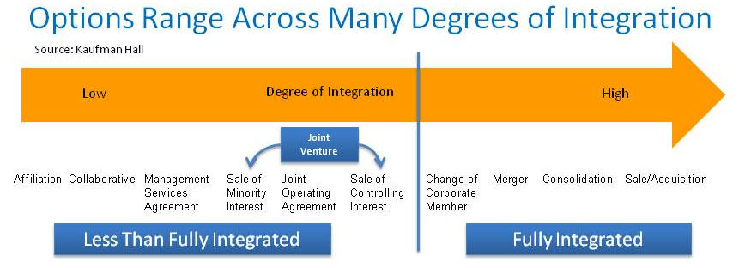
Affiliation Models
A wide and growing range of options and sub-options
Structure follows function (where do we need to go)
  Models to the right are necessary for favorable access to capital
  Less integrated models (to the left) retain more control at the community level and are more reversible
  Either end of the continuum can be effective in gaining efficiencies and in accessing large enough populations to manage care effectively and assume risk

Slide 7
Affiliation Models
How do the potential affiliation models match up with our strategic objectives? For example:
  Expand geographic footprint
  Diversify operations
  Invest in electronic health record and other elements of population health management infrastructure
  Gain system-wide economies (such as supply chain or revenue cycle savings)
  Gain regional economies (such as ensuring a logical mix of primary care physicians, specialists, other facilities and programs, etc.)

Slide 8
Market, Community and Organizational Considerations
What are our biggest needs or goals from consolidation/affiliation?
What do we expect our competitors to do next?
What are our options for consolidation/affiliation?
  … in our region?
  … outside of our region?

Slide 9
Market, Community and Organizational Considerations (continued)
What are the implications of our affiliation options for
  Our patients?
  Our providers?
  Our employees/staff? (Discuss potential employee benefits, job security concerns.)
  Our employers and other key stakeholders?

Slide 10
Process
Describe what process has been utilized to examine affiliation options
  Whether a consultant involved or not; how information is being gathered (including how internal impacts are being assessed)
  Criteria to identify options, and winnow them down (e.g., type of model proposed; regulatory and image issues; internal impacts; financial impacts; relationship issues)
  Timeline (and where the organization is currently in this process)

Slide 11
As Options Are Narrowed …
Perform Due Diligence (legal, financial, regulatory and compliance)
Conduct Business Planning
  Vision
  Approach/Organizational Structure
  Capitalization
  Governance (powers, roles and responsibilities, etc.)
  Management Structure and Initial Management
  Early Initiatives and Priorities
  Financial Projections
Execute Definitive Agreement (standard and negotiated terms)

