Slide 1
How to Identify and Eliminate the Hidden Costs of Poor Quality
An HFMA Forum Networking Event
Sept. 8,2016
10:00 – 11:00 a.m. Central (8:00 – 9:00 a.m. Pacific/9:00 – 10:00 a.m. Mountain/11:00 a.m. – 12:00 p.m. Eastern)
Kim Hollon, FACHE
CEO
Signature Healthcare
khollon@signature-healthcare.org
David Kashmer, MD
Chair of Surgery
Signature Healthcare
dmkashmer@thesurgicallab.com

Slide 2
In The Next 35 Minutes…
Why bother with the cost of poor quality (COPQ)?
COPQ is a tool to highlight what poor quality costs your organization; it is not GAAP or Sarbanes-Oxley (SOX)
COPQ can be $250,000 per project
The tale of four buckets
One very special bucket has a positive ROI
How to avoid “We didn’t see the cost savings we expected.”
Call to action & questions

Slide 3
Why Bother With The COPQ
COPQ can account for10-15 percent of operating costs in a thriving company (ASQ)
Poor quality becomes visible (fee for service can mask poor quality)
CEOs vary on their approaches: “Anyone who does a quality project for cost savings will be fired.”
The cost is surprisingly high with each project (250k)
HHS plans to tie 50 percent of payments to quality by 2018

Slide 4
Polling Question 1
What is your organization’s level of experience with implementing quality programs?
Have strong quality improvement initiatives
In the process of developing a quality improvement framework
In the early stages of developing a quality improvement framework
Have not started any quality improvement initiatives or planning

Slide 5
A Tale Of Four Buckets…

Slide 6
One Very Special Bucket
Prevention!!!

Slide 7
Polling Question 2
Is your organization measuring the cost of poor quality?
Yes, in all areas.
Yes, but only for a few select quality improvement projects.
We are just starting to measure the cost of poor quality.
We do not measure the cost of poor quality at this time.

Slide 8
How To Avoid “We Didn’t See The Savings”
Assign a project champion
Give early input
Focus on the P&L and “hard savings”
Don’t let them count the halo effect
Realign the COPQ as project progresses
Decide on a time period? COPQ in one year?

Slide 9
Polling Question 3
What is your greatest challenge with measuring the cost of poor quality?
Gathering data
Gaining staff buy in for the measurement process
Accessing the right financial tools to measure poor quality
Having enough staff to measure and track the cost of poor quality

Slide 10
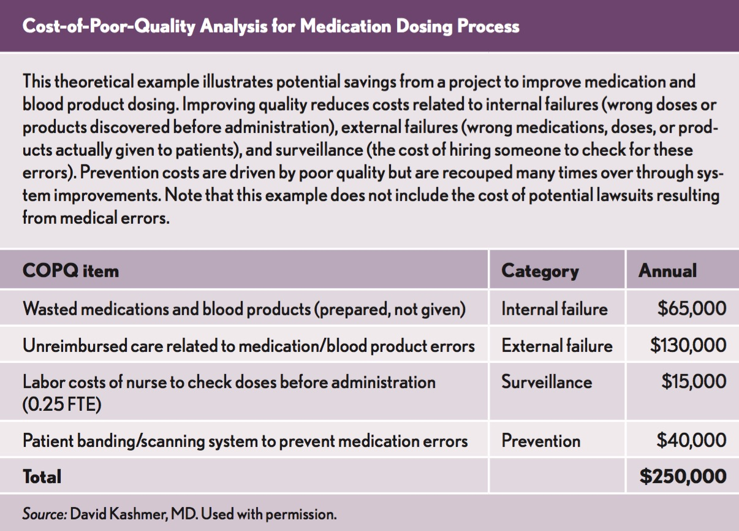

Slide 11
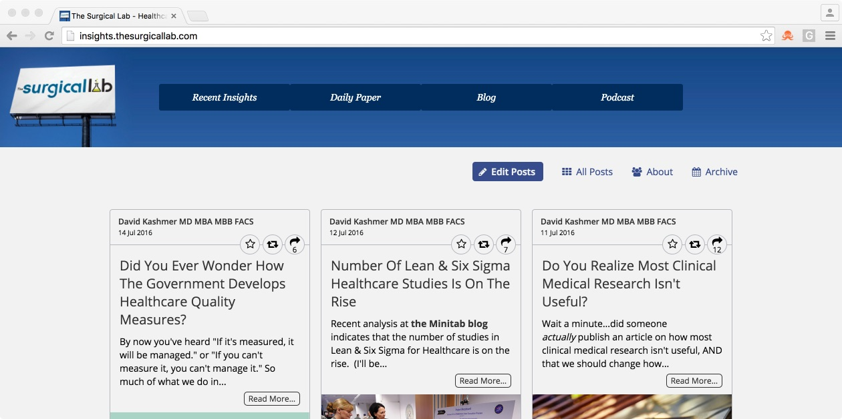
For More Information
Insights.TheSurgicalLab.com
TheHealthcareQualityBlog.com

Slide 12
Questions & Answers
Ask the speakers a question or share your
experiences. Just type your question or comment into the Q&A box on your computer screen.

Slide 13
Contact Information
Kim Hollon, FACHE
CEO
Signature Healthcare
David Kashmer, MD
Chair of Surgery
Signature Healthcare
DKashmer@Signature-Healthcare.org
khollon@signature-healthcare.org

Slide 14
To Complete the Program Evaluation
The URL below will take you to HFMA on-line evaluation form. You will need to enter your member I.D. # (can be found in your confirmation email when you registered)
Enter this Meeting Code: 16AT45
URL: http://www.hfma.org/awc/evaluation.htm
Your comments are very important and enables us to bring you the highest quality programs!

