Slide 1
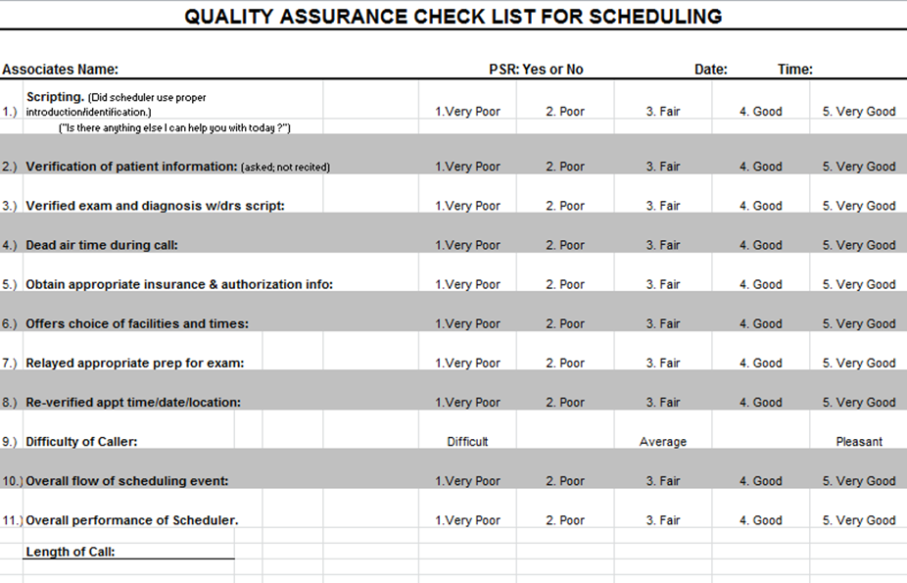
Scheduler Scorecard
An HFMA Forums Tool (hfma.org/forums)
Source: Health First. Used with permission.

