Slide 1
Certified Healthcare Financial Professional
Module I The Business of Healthcare
Course 6: Looking to the Future

Slide 2
Learning Objectives
YOU will be able to
Describe some of the new healthcare reimbursement models;
Define the use of business intelligence in the context of health care;
Describe how finance professionals, physicians and payers will need to work together;
Notes:
Next to national defense, the health care industry in the United States is one of the largest sectors of the economy. Currently making up almost 20 percent of the nation's gross domestic product, health care in the US will be a significant factor in the national economy for the foreseeable future. Upon completing this course, you should be able to:
Describe the general characteristics of the healthcare industry in the US;
Describe the impact of health reform on the industry;
Describe the payment system for healthcare services;
Define the role of financial management in health care organizations; and
Describe some of the new challenges facing healthcare finance in the US.

Slide 3
Learning Objectives
YOU will be able to
Define the trend of population health in future healthcare delivery models; and
Apply the lessons learned in this course to your future work in the healthcare industry.

Slide 4
Purpose of this Chapter Learning Program
Highlight key knowledge for strong job performance
Provide an overview of important concepts. The in-depth presentation is in the online course.

Slide 5
Evolving Models of Reimbursement
Fee-For-Service reimbursement =
Incentive to providers to provide more services (?!)
Notes:
Much has been made about the inefficiency of the US healthcare system and how fee-for service reimbursement has created an incentive to provide more services to patients
Also there is little financial incentive in the current fee-for-service system for providers to coordinate the care they provide with other healthcare providers by taking time to
coordinate patient care information and verify that the services provided are working together to help the patient.
Capitation has had some success in reducing the incentives for fee-for-service reimbursement and encourages providers to maximize efficiency in healthcare service delivery, but it does not provide incentives for providers to work cooperatively to coordinate care decisions with other caregivers

Slide 6
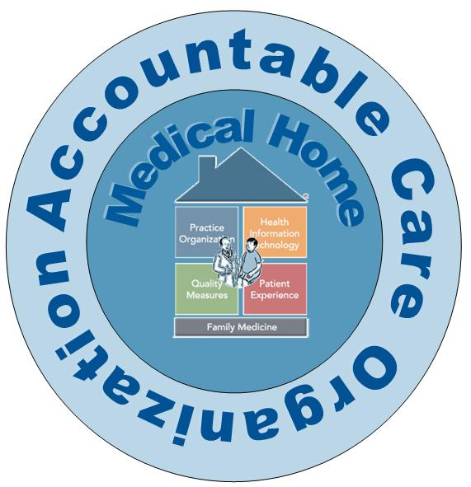
Evolving Models
Notes:
The Patient Centered Medical Home, usually referred to as the Medical Home, is a primary care delivery model intended to organize providers into a coordinated team to meet the majority of a patient’s health care needs. The Medical Home may include not only primary care physicians, but also nurse practitioners, physician assistants, pharmacists, nutritionists, health educators, and social workers to directly provide care and also to coordinate care from multiple sources.
The Patient Protection and Affordable Care Act (PPACA) includes provisions for a new approach to reimbursing hospitals and physicians for their services. Since current payment methods do not encourage providers to work together to keep patients healthy, PPACA has attempted to change that paradigm with its call for providers to organize together in entities called Accountable Care Organizations (ACO).

Slide 7

Network of providers
Share financial and clinical responsibilities
Serve a defined group of patients
Key feature: Primary Care physicians in a lead role
Notes:
An ACO is a network of healthcare providers that can include physicians, hospitals, and other providers (such as nursing homes or retail pharmacies) organized together to share the financial and clinical responsibility for the care of a designated group of patients.
The key feature needed to implement an ACO is a group of primary care physicians that serve in lead role in managing the care of a population of patients, often in patient centered medical homes
An ACO makes the provider group accountable for the health of the patients under their care and creates financial incentives for cooperation among providers to share data and avoid unnecessary tests or procedures. In addition, the ACO must meet quality targets that include providing preventive health services to patients and monitoring their health.
under the ACO model, the total costs incurred for patients covered by the ACO are tallied at the end of a year and incentives can be paid to providers for keeping the overall costs of care to a patient population below targeted levels

Slide 8

ACO Challenges
Patient Loyalty
Managing costs and quality of care of non-ACO providers
Bundled payments
Notes:
A challenge with the ACO model arises from the fact that unlike a capitation arrangement or an HMO, the patient is free to seek care from providers not in the ACO
a bundled payment is one where the health plan pays a single prospective rate to all providers involved in a patient’s care and the provider entities then equitably divide the payment amongst themselves.

Slide 9

Bundled Payment
Essentially, “Fee-for-Service”
Collaborative care delivery meets funding autonomy
Collaborate on rewards … and risks
Notes:
Because a bundled payment is essentially a fee-for-service mechanism, there is an incentive for providers working together to limit the services provided to a patient to only those related to the bundled payment This also can mediate some of the inherent conflict between a hospital that is paid a DRG or case rate and physicians who may have the incentive to order additional services that could financially penalize the hospital.
The bundled payment can give hospitals and physicians that are otherwise working in a collaborative manner some greater autonomy over how they organize the financing of health care in their local community. it can be an incentive for providers in the community to work together more closely than they have in the past. Since multiple providers are involved with the care of a patient and are sharing the risk of expenses for treating a patient,

Slide 10
The Point of Medical Homes, ACOs and Bundled Payments
Providers working together to generate positive patient outcomes
Decrease incentive for providers to strive to provide an increasing volume of services
Increase incentive to focus on quality of outcomes and value for the prices paid
Notes:
Overall, the medical home, ACO, and bundled payment models all create a situation where providers must work together to generate positive patient outcomes
Also, such payment mechanisms reduce the incentive for providers to increase the volume of services and instead also take into account the quality of services and the overall value delivered for the price paid

Slide 11

BA and BI in Health Care
Notes:
The new business models described in this course call for organizations to have a solid understanding of costs and utilization of healthcare resources. Since the new payment methods include penalties for adverse patient care events such as unplanned readmissions or wasteful use of diagnostic testing, organizations cannot manage to these new performance measures unless they have an understanding of their frequency and underlying causes.
Business intelligence (BI) is a process by which data available in the organization is analyzed and converted into information usable by decision-makers
Business analytics (BA) are the software tools used to capture, store and sort data
There is a very fine line of difference between BA & BI and this is just same as the difference between Data and Information
In today's healthcare industry, finance and clinical professionals must collaborate to understand information produced by the business intelligence function and guide management on the best course of action

Slide 12
Business Intelligence Implementation
Key Factors:
Data Strategy
Determine metrics to monitor: Business and strategic plans
Access (and timeliness) to data for decision makers
Maintaining data integrity
Notes:
A critical first step in implementing a business intelligence function is to have a basic data strategy that includes agreement on what data is gathered, what is measured, and a process to protect the accuracy of such data
Once the foundation of data gathering is established, management must decide on what metrics will be monitored. In
In order for information from business intelligence to be useful, it must be available to decision-makers in time for them to take action on it A final critical element in business intelligence, particularly in health care, is a process by which the integrity of data is maintained. Not only is this important in the accurate reporting of clinical data which could influence patient care, but it is essential when evaluating the costs of care under fixed or prospective payment methodologies

Slide 13
Aligning to Drive Value
value : “quality in relation to the
total payment for care”
Notes:
value as “quality in relation to the total payment for care”. Quality in this context is defined as a composite of patient outcomes, safety and experiences with caregivers. On the other hand, cost in this definition of value is the amount paid by all purchasers of health care including the insurer and patient. In this sense, the partnership between clinicians and finance is essential, since clinical professionals have greater insight on the quality elements of value while finance has understanding of payments and access to analytical tools and data.
Essential elements of this cooperative relationship between clinical and financial staff include: a common set of objectives, agreement on communication strategies, and a sense of trust and transparency between the two disciplines

Slide 14

Financial and Clinical Alignment
Notes:
Since the strategic plan for a healthcare business usually has input from multiple stakeholders including finance and clinical staff, there is at least a basic underlying understanding of organization goals between finance and clinical staff. The greater difficulty in adopting that common set of objectives is in the perception of finance and clinical staff.
The linkage between strategic objectives and their achievement may look different from the finance or clinical perspectives. Clinicians may view organizational success very differently then finance and not consider the financial implications of clinical decisions.
finance may adopt a very focused view on cost and revenue and not consider the impact of such decisions on clinical outcomes. Applying some financial context to such a decision would assist clinicians in further defining patient care needs while addressing the limitations on resources available to the business.
The growing linkage between quality and payment creates the necessity of opening lines of communication between these previously disparate interest groups. Finance can lead this effort through provision of credible data from the business intelligence function that documents efficiency and outcomes. It is essential that any such data sharing be done in an objective and constructive fashion
The most important thing to keep in mind while fostering collaboration between finance and clinicians is an understanding of “what's in it for me?” from both perspectives
Collaboration between clinical staff and finance is not the only opportunity for partnerships. Payers and providers are also finding value in aligning with each other to improve financial results and patient care. These partnerships can be in the form of an integrated health system where the health plan and providers operate under common ownership – or can be as simple as a contractual affiliation.

Slide 15
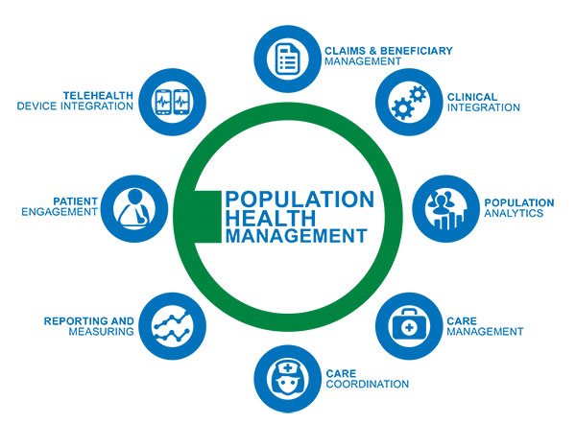
Population Health Management
Notes:
An area of future healthcare management that will truly rely on the collaboration between finance and clinical disciplines is that of population health. Managing population health entails a group of providers and a health plan collaborating to improve performance on measures of overall health (such as hypertension or diabetes or cancer screenings) for a specific group of patients
In the past, health plans have had the overall goal of improving population health. However, those goals - which include reducing payments for diagnostic and treatment services that make up the income for physicians and hospitals - are in conflict. A population health initiative can help better align the interests of physicians, hospitals, and health plans
Most of the challenges in population health management arise from the management of chronic conditions and in the coordination of care between different providers taking care of the same patient. This can result in a fairly complicated relationship among physicians, hospitals, and health plans.
Population health management requires more than just collaboration between finance and clinical professionals in the analysis of data. Their cooperation should also extend into decisions on how and what data gets reported to front-line caregivers and to executives (these reporting needs will of necessity be different), but also in determining the makeup of a network of caregivers (therapists, pharmacies, clinics, and specialty providers) needed to meet the health care needs of an assigned population

Slide 16
Implications
Rapid change in business model: From volume to value
New skill sets required:
Collaborative team skills
Multidisciplinary approaches
“Optimizing costs”
Big picture: less about numbers alone and more about viewing the context o fhtenumbers
Notes:
The healthcare industry is undergoing a rapid change in its basic business model, moving from a volume-based emphasis to one of demonstrated value.
The past skills for success for a healthcare manager that included identifying ways to increase volumes of services and prices for such services are now of lesser value.
Instead success skills in today’s healthcare industry now include skills in working cooperatively with multiple disciplines in the field and in understanding that business success is less related to cost cutting and more to optimizing costs that are incurred
less about numbers alone and more about the context in which those numbers are viewed. The successful healthcare manager must think not only about numbers but also about causes and solutions.

Slide 17
Implications
New Skills (cont)
Insight into clinical sciences i.e. professional practice models
Clinical professional must help inform business decisions
Focus: benefit the business and the Patient
Notes:
The new “big picture” paradigm in health care now requires insight to the clinical sciences that is not normally a part of the background and training of healthcare finance professionals
we must place reliance on clinical professionals to inform business decisions. Finance professionals do not necessarily need clinical expertise but instead have a broad enough view of a business opportunity to call in experts to assist in framing strategy and decisions in a way that benefits the business – and the patient.

