Slide 1
Revenue Cycle Operations Research Summary report
A survey conducted by HFMA, sponsored by Currance
June 2022

Slide 2
Overview
26 closed-ended questions
1,503 HFMA member invitees
110 respondents
100% Revenue Cycle, Finance, and Accounting
Job level is shown on the following slide.
Hospitals and Hospital Systems
Fielded May 24 – June 5, 2022
Job Level | %
CFO | 41
Director | 20
Manager/Supervisor | 19
Vice President | 8
Staff Specialist or Professional (Analyst/Accountant) | 4
Executive Director | 3
Other Professionals | 2
Assistant/Associate Vice President Excluding CFO | 1
President/CEO | 1
Partner, Principal, Owner | 1
Other Chief Officer Excluding CFO | 1

Slide 3
What is your organization’s net patient service revenue (NPR)?
Health System Headquarters/Corporate Offices
Hospital or Medical Center

Slide 4
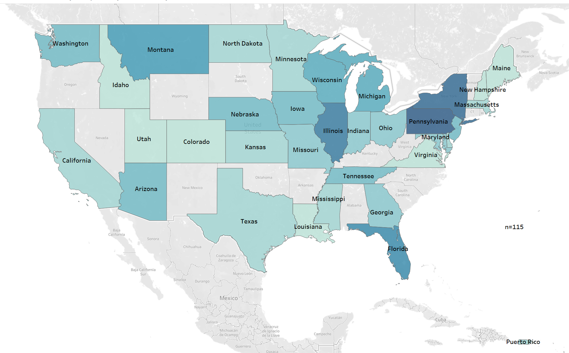
In what state are your primary revenue cycle functions located?
State | %
Arizona | 3.5
California | 1.7
Colorado | 0.9
Delaware | 1.7
Florida | 6.1
Georgia | 2.6
Idaho | 0.9
Illinois | 7.0
Indiana | 2.6
Iowa | 3.5
Kansas | 1.7
Louisiana | 0.9
Maine | 0.9
Maryland | 2.6
Massachusetts | 1.7
Michigan | 4.3
Minnesota | 1.7
Mississippi | 1.7
State | %
Missouri | 2.6
Montana | 5.2
Nebraska | 3.5
New Hampshire | 0.9
New Jersey | 3.5
New York | 7.8
North Dakota | 1.7
Not in the USA | 0.9
Ohio | 2.6
Pennsylvania | 8.7
Puerto Rico | 1.7
Tennessee | 3.5
Texas | 1.7
Utah | 0.9
Virginia | 0.9
Washington | 3.5
Wisconsin | 4.3

Slide 5
What EHR do you use?
Health System Headquarters/Corporate Offices
Hospital or Medical Center

Slide 6
How long have you had your EHR fully implemented?
Average length of implementation (in years) for each EHR.
“12.0” = “More than 10 years”

Slide 7
Average length of implementation (in Years) for Each EHR.
Health System Headquarters/Corporate Offices
Hospital or Medical Center

Slide 8
Please rate your satisfaction with the following: Averages based upon a 1-4 scale. 1=“Not at all satisfied” 4=“Very Satisfied”

Slide 9
Please rate your satisfaction with the following:
EHR Functionality for Revenue Cycle
Revenue Cycle Bolt-Ons & Tools Beyond EHR

Slide 10
Please rate your satisfaction with the following:
Revenue Cycle Outsourcers
Revenue Cycle Reporting

Slide 11
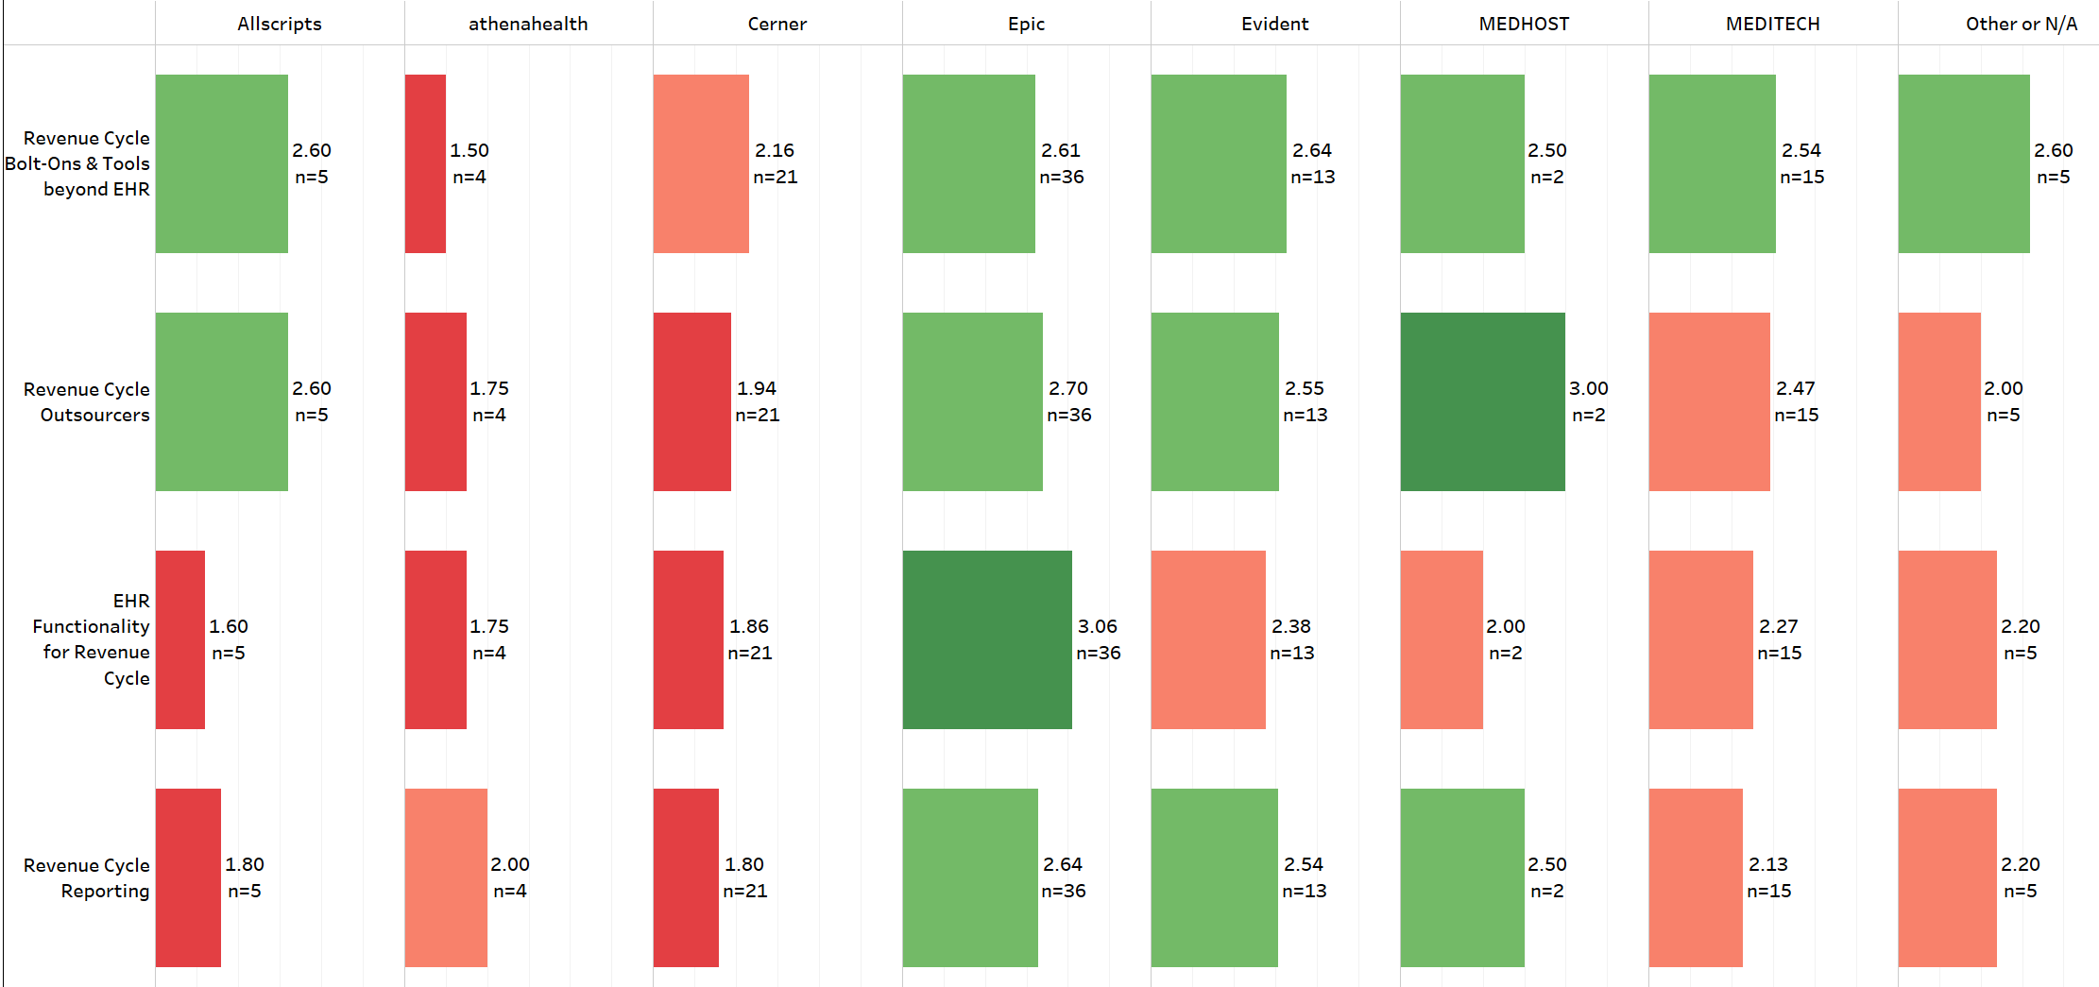
Satisfaction by EHR. Please Rate your satisfaction with the following
<2.5
>2.5

Slide 12
To what degree do each of the following represent a challenge to your revenue cycle, and how important are each of them to your revenue cycle?
1 = No Challenge, or Not Important; 4 = Very Challenging or Very Important

Slide 13
To what degree do each of the following represent a challenge to your revenue cycle, and how important are each of them to your revenue cycle?
1 = No Challenge, or Not Important; 4 = Very Challenging or Very Important
Health System

Slide 14
To what degree do each of the following represent a challenge to your revenue cycle, and how important are each of them to your revenue cycle?
1 = No Challenge, or Not Important; 4 = Very Challenging or Very Important
Hospital or Medical Center

Slide 15
How confident is your team in yield performance measurement (cash collected from earned revenue) for each of the following?
1 = Not At All Confident; 4 = Very Confident

Slide 16
How confident is your team in yield performance measurement (cash collected from earned revenue) for each of the following?
Ability to Measure Yield Performance in Near Real-Time
Accuracy and Precision of Yield Performance Measurement

Slide 17
Are you looking to augment your current EHR workflows with new tools and reporting?
Health System Headquarters/Corporate Offices
Hospital or Medical Center

Slide 18
Are you waiting for EHR road map for workflow tools and reporting innovations?
Health System Headquarters/Corporate Offices
Hospital or Medical Center

Slide 19
What percentage of each of these aspects of your revenue cycle is outsourced today? (All Responses)

Slide 20
What percentage of each of these aspects of your revenue cycle is outsourced today?
HIM
Patient Access
Patient Financial Services

Slide 21
How valuable would you find an approach to revenue cycle outsourcing that allows you to engage as needed with more flexible contracts and scope?
Health System Headquarters/Corporate Offices
Hospital or Medical Center

Slide 22
In your opinion, how valuable are each of these benefits of outsourcing?

Slide 23
In your opinion, how valuable are each of these benefits of outsourcing?
Access to Innovative Tools
Access to Skills/Industry Experience
Fills a Resourcing Gap

Slide 24
In your opinion, how valuable are each of these benefits of outsourcing?
Permanent Improvement
Reduction in Cost

