Slide 1

The changing environment of Healthcare
Payment & Delivery
An Employers Perspective

Slide 2

Objectives
Our aim is to show ways to build direct partnership between providers and employers
Participants will learn how employers purchase and manage health benefits for their employees and their families
Participants will learn trends in proven employer approaches to managing health-related costs and improve their value of investment (VOI)
Participants will learn examples of successful employer-provider relationships along with a view on future collaboration.

Slide 3
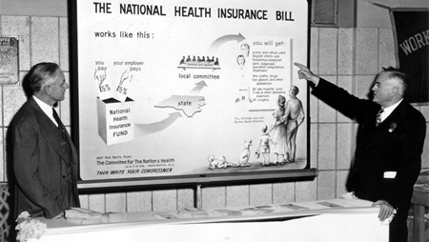

Slide 4
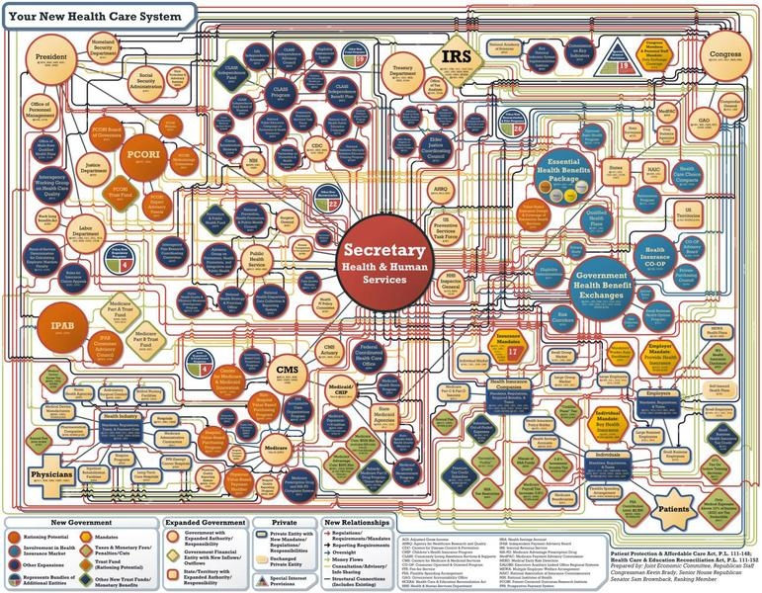

Slide 5
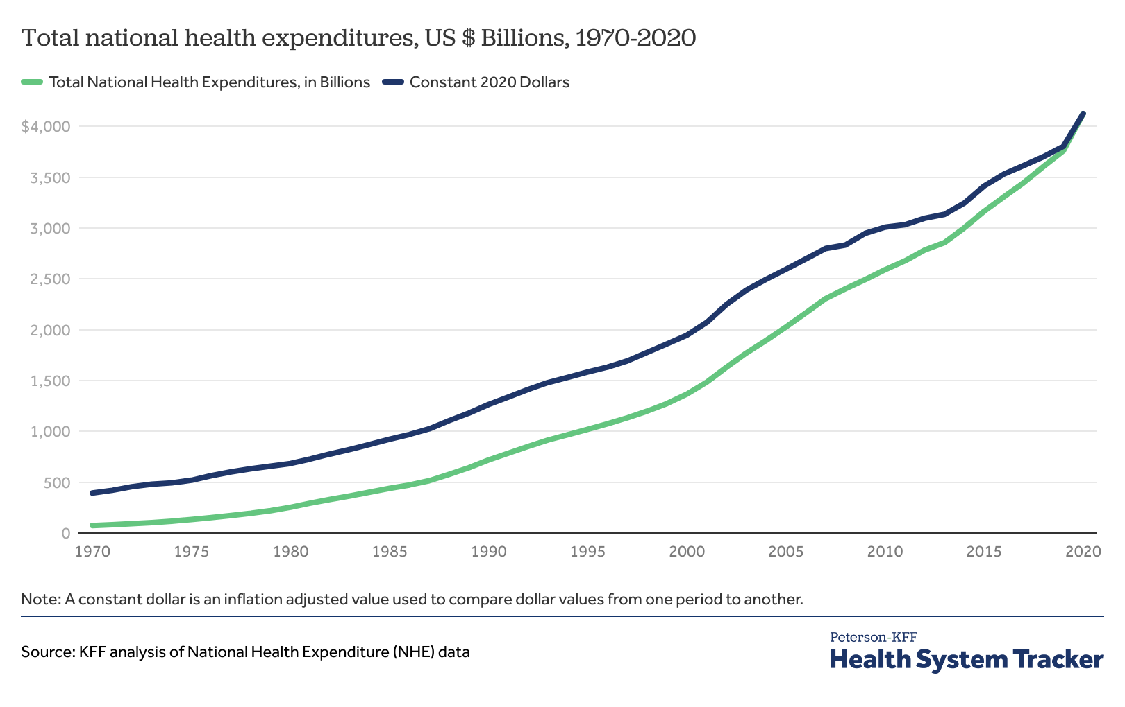

Slide 6
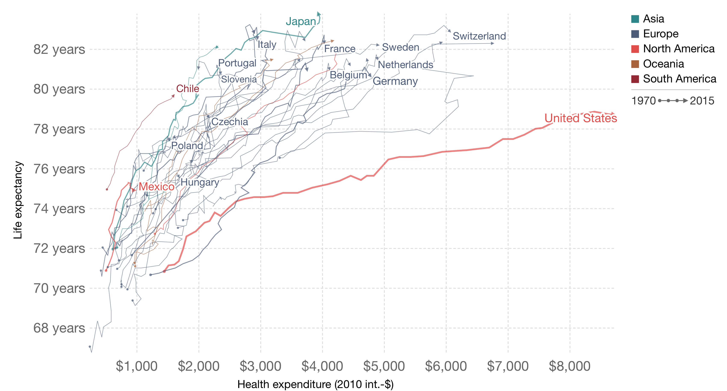
Life Expectancy & Health expenditures

Slide 7
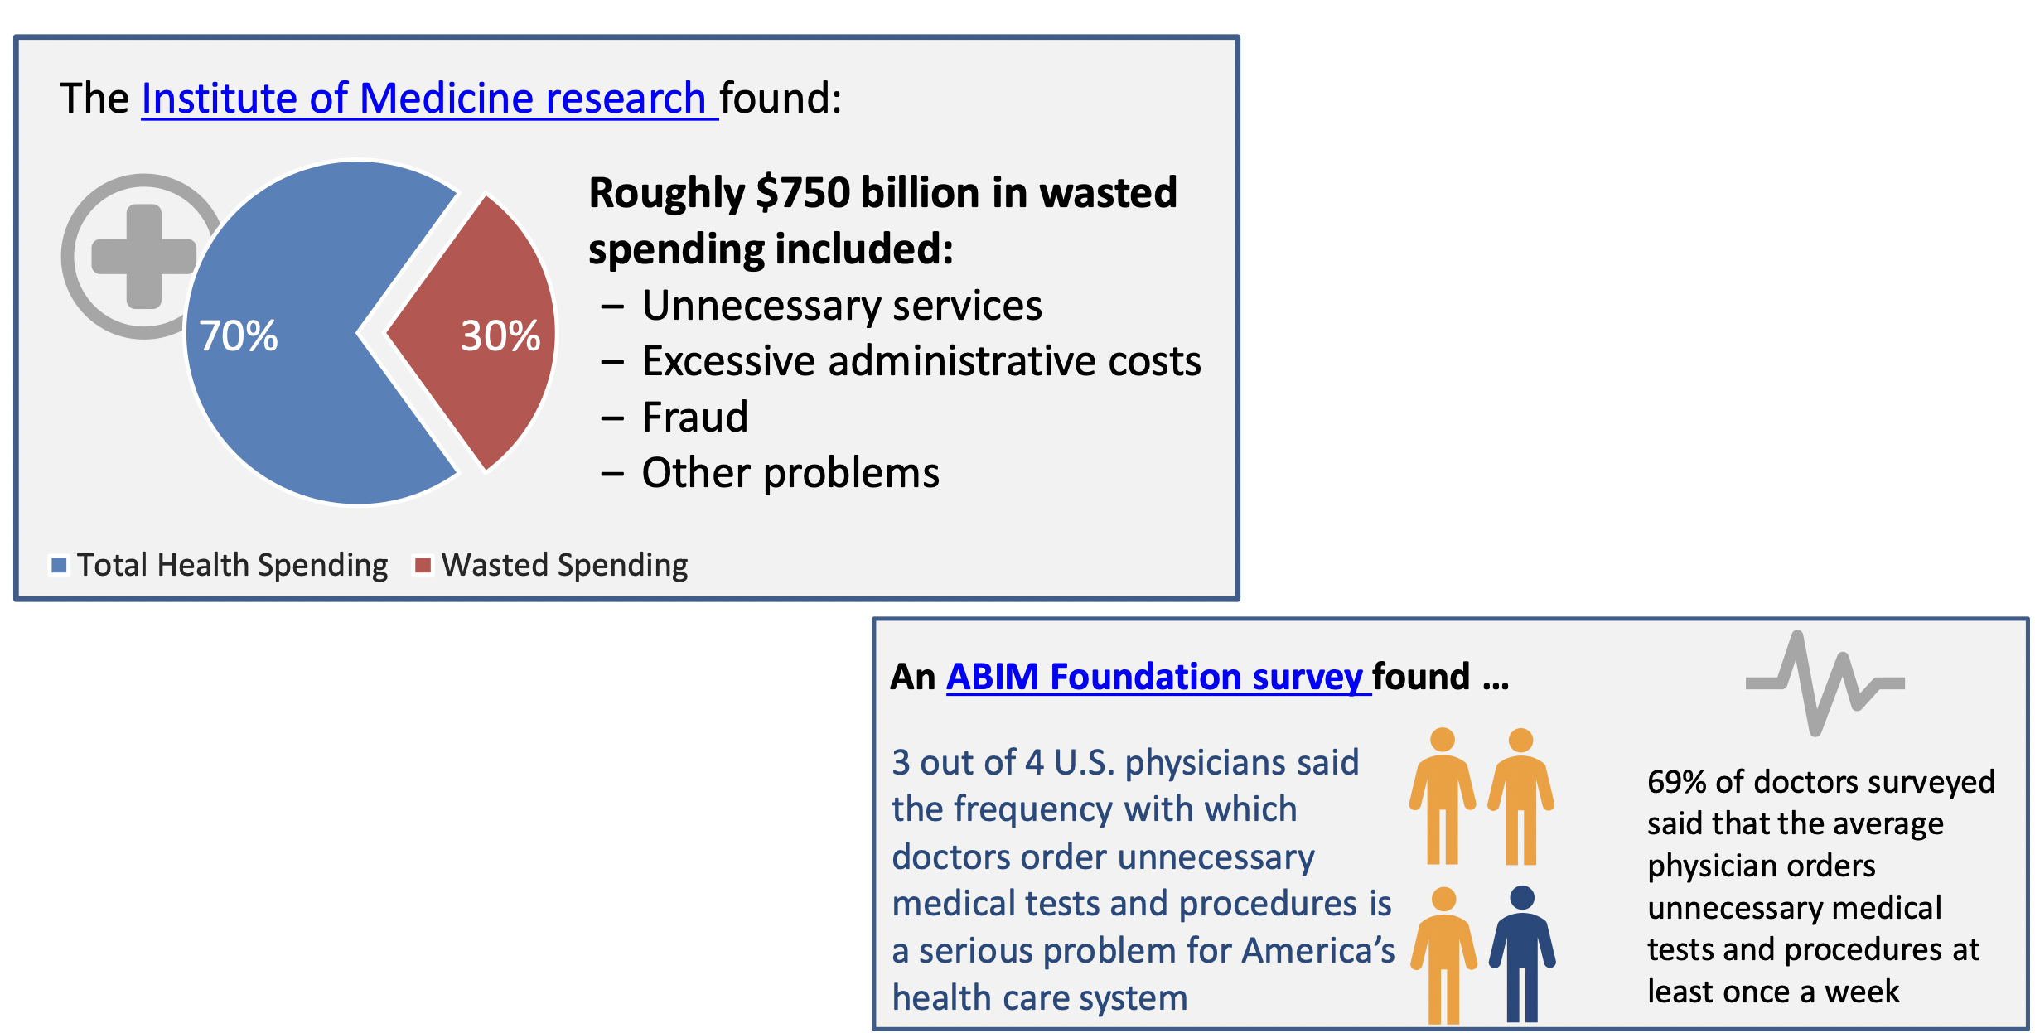

Slide 8
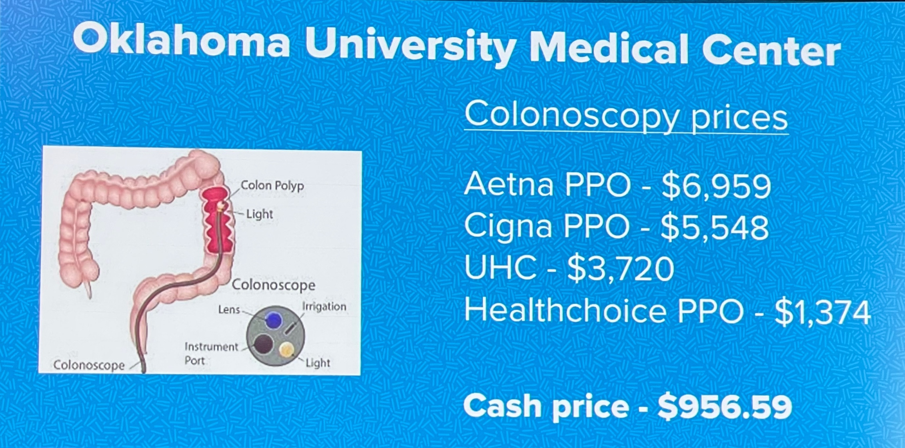

Slide 9
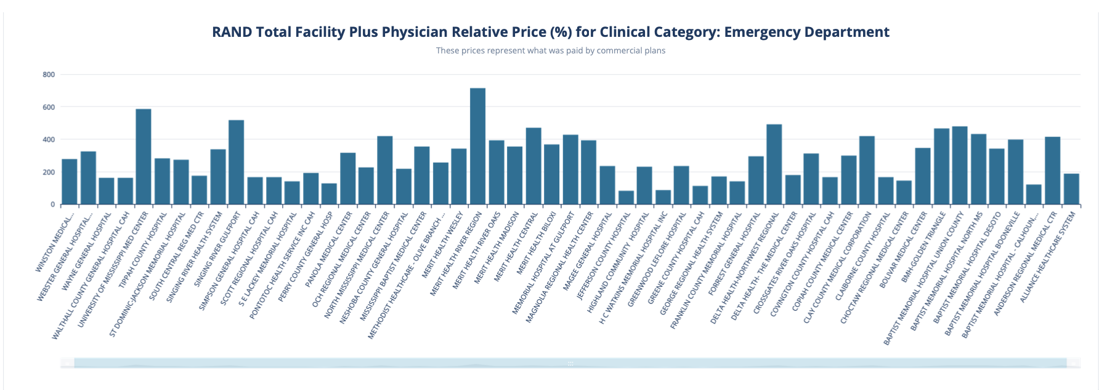

Slide 10
EMPLOYERS

Slide 11
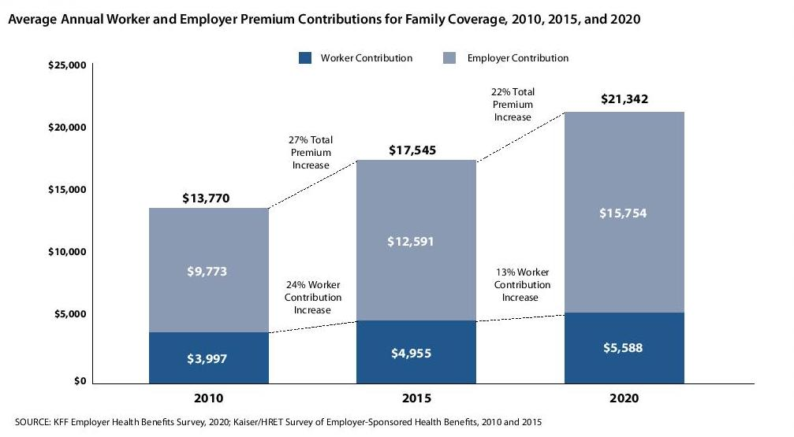

Slide 12
How Employer’s Purchase Benefits
Health Benefits
Medical Insurance
Dental Insurance
Vision Insurance
Pharmacy Insurance
Worker’s Compensation
Disability – STD/LTD
EAP
Mental Health Insurance
An Old Inefficient System which purchas4s in silos with Perverse Incentives

Slide 13
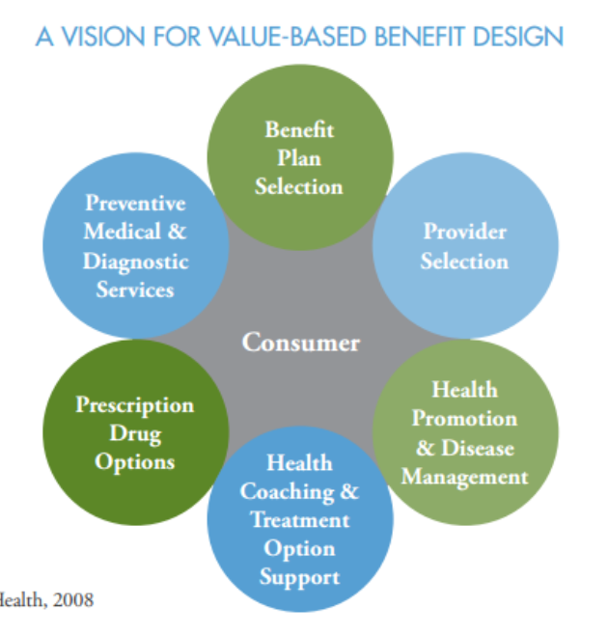

VALUE-BASED DESIGN

Slide 14
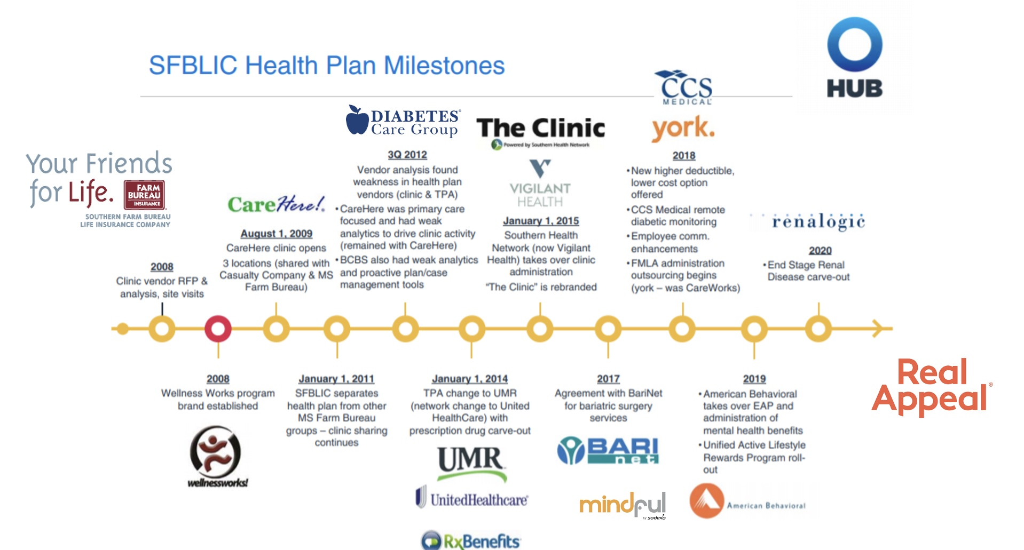

Slide 15


Slide 16




Slide 17

Thank you
Mirjam Nilsson
SERVICE REPRESENTATIVE
nilsson@example.com
678-555-0100

