Slide 1
Bolder. Brighter. Better.
Tammie Jackson, FHFMA, MHA, CHFP
Chief Growth Officer, nThrive
2021-22 National Chair, HFMA

Slide 2

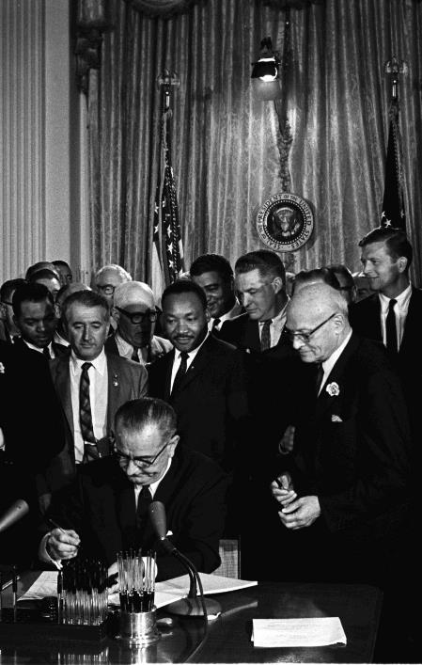


Slide 3

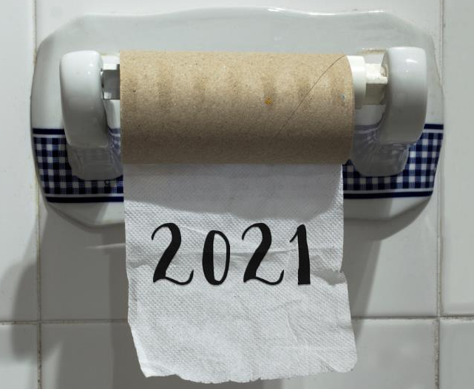

Slide 4


Slide 5
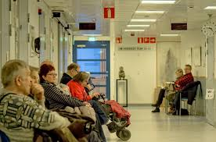

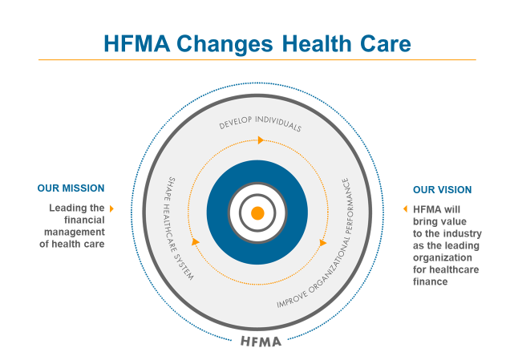


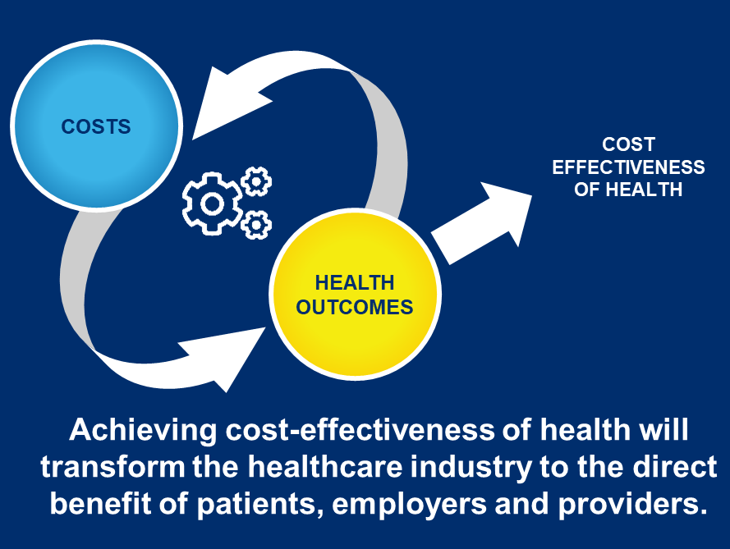
Objectives

Slide 6
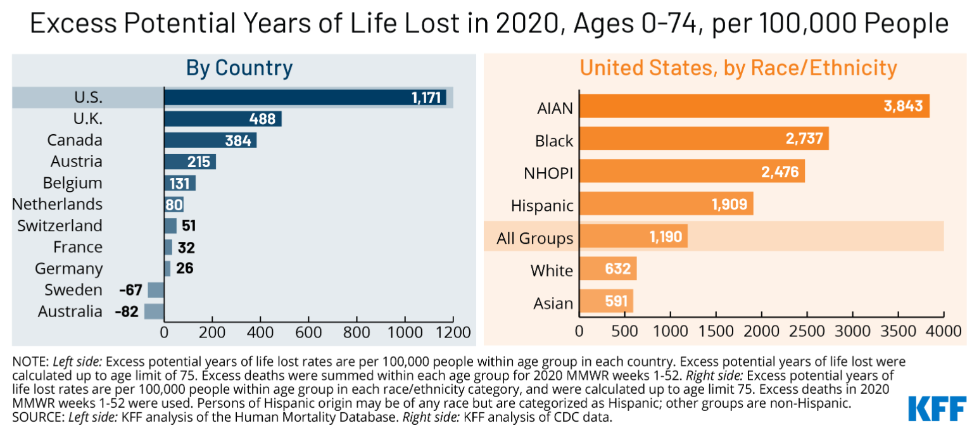
Higher excess deaths during the pandemic in the U.S were partly driven by racial disparities
https://www.kff.org/wp-content/uploads/2021/04/WEB2-Excess-Deaths-Racial-Disparities_1.png
Notes:
https://www.kff.org/wp-content/uploads/2021/04/WEB2-Excess-Deaths-Racial-Disparities_1.png

Slide 7
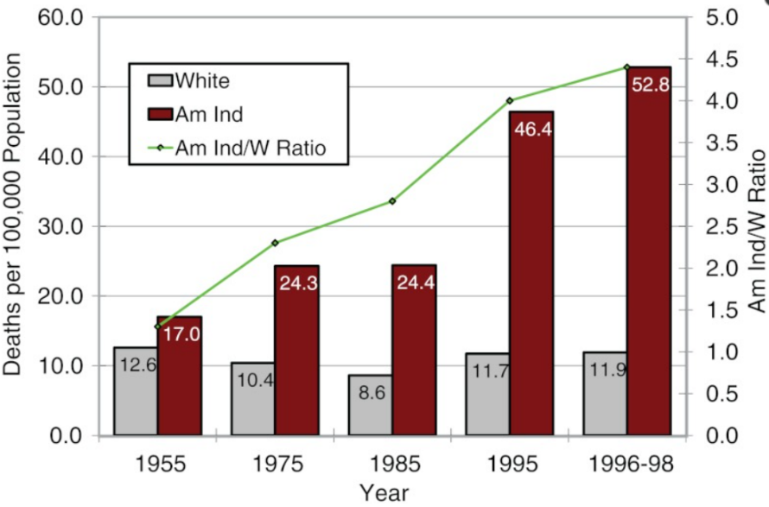
Rates of disparity in mortality from diabetes among American Indians and whites, 1955-1998
Source: Indian Health Service (2001)

Slide 8
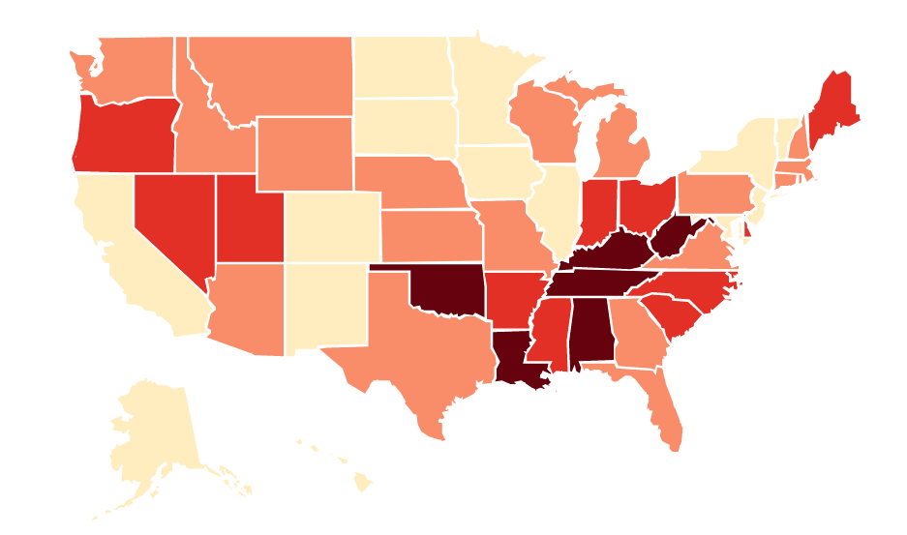
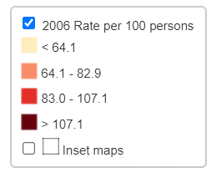
U.S. State Opioid Dispensing Rates, 2006
https://www.cdc.gov/drugoverdose/rxrate-maps/state2006.html
Notes:
https://www.cdc.gov/drugoverdose/rxrate-maps/state2006.html

Slide 9
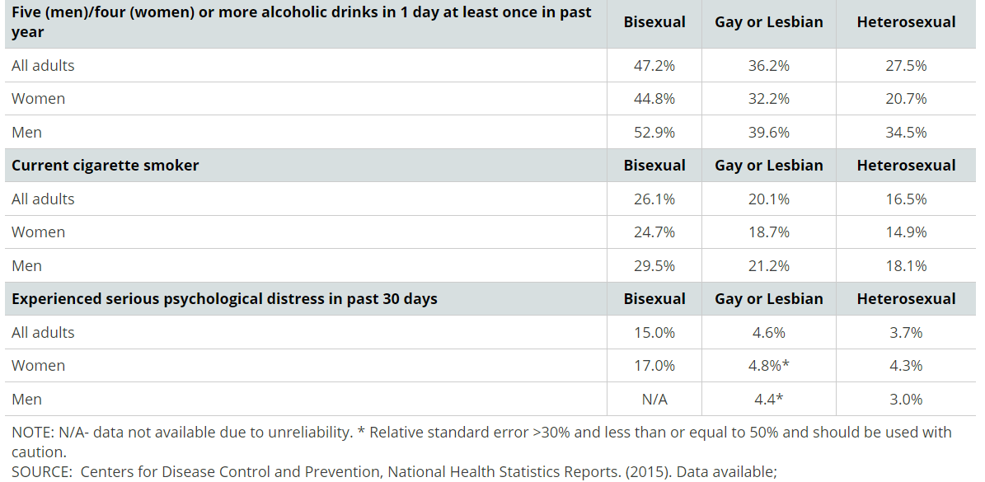
Alcohol Use, Cigarette Use and Serious Psychological Distress Among Bisexual, Gay or Lesbian, and Heterosexual Adults ages 18-64, 2015
Notes:
https://www.cdc.gov/nchs/data/nhis/sexual_orientation/asi_2015_stwebsite_tables.pdf

Slide 10
Population Differences Between People With and Without Disabilities on Health Indicators of Health Care Access, Health Behaviors, Health Status, and Social Determinants of Health: United States
Health Indicator | People With Disabilities % | People Without Disabilities %
Children and adolescents considered obese (aged 2–17 y) | 21.1 | 15.2
Adults who are obese | 44.6 | 34.2
Adults who smoke (100 cigarettes in lifetime and currently smoke) | 28.8 | 18.0
Annual no. of new cases of diagnosed diabetes (per 1000 persons) | 19.1 | 6.8
Adults with cardiovascular disease (18–44 y) | 12.4 | 3.4
Adults with cardiovascular disease (45-64 y) | 27.7 | 9.7
Victim of violent crime (per 1000 persons) | 32.4 | 21.3
Adults (> 16 y) unemployment | 15.0 | 8.7
Adults with < high school education | 13.0 | 9.5
Internet access | 54 | 85
Inadequate transportation | 34 | 16
https://www.ncbi.nlm.nih.gov/pmc/articles/PMC4355692/table/tbl1/?report=objectonly
Notes:
https://www.ncbi.nlm.nih.gov/pmc/articles/PMC4355692/table/tbl1/?report=objectonly

Slide 11
“If we are serious about eliminating unfair, preventable differences in health outcomes, we must eliminate the unfair social conditions that give rise to them. This will require meaningful changes not only in programs and individuals’ attitudes and practices, but in policies, laws, systems, and institutional practices that keep social inequities in place, leading to health inequities.” ~ Robert Wood Johnson Foundation

Slide 12
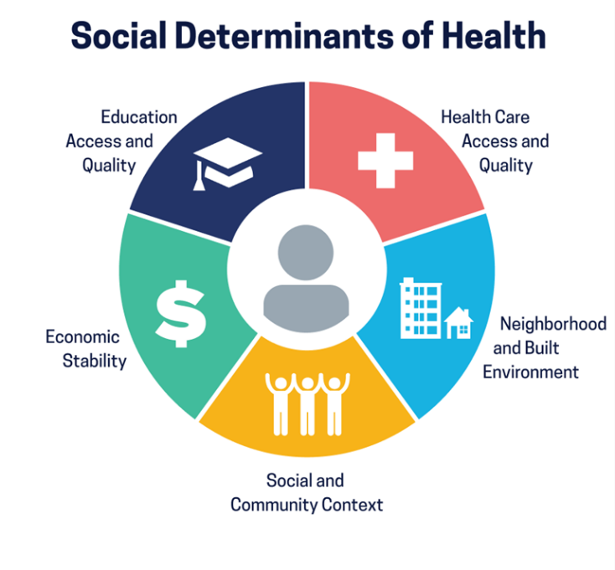
Healthy People 2030, U.S. Department of Health and Human Services, Office of Disease Prevention and Health Promotion. Retrieved 8-9-21, from https://health.gov/healthypeople/objectives-and-data/social-determinants-health

Slide 13
“Health equity is defined as the absence of unfair and avoidable or remediable differences in health among population groups defined socially, economically, demographically or geographically.” ~ World Health Organization

Slide 14

Disparities adversely affect groups who have systematically experienced greater obstacles to health based on their:
Race or
Ethnicity
Religion
Socioeconomic Status
Language, Citizenship
Age, Gender
Mental Health
Cognitive, Sensory
or Physical Disability
Sexual Orientation or Gender Identity
Geographic Location
Other

Slide 15
How to design an equitable revenue cycle strategy
Communicate to your teams how revenue cycle practices can exacerbate the social determinants of health.
Track data to ensure you execute revenue cycle practices equitably.
Expand and standardize charity care coverage to reduce the economic burden of high-cost care.

Slide 16
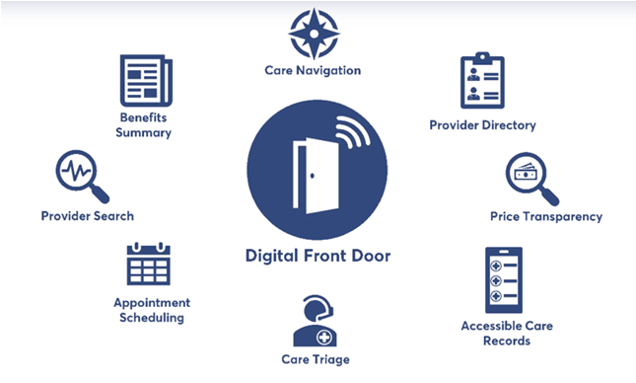
Digital Front Door Strategies

Slide 17

Keys to an inclusive, accessible telehealth practice
Flexible workflow
Additional time for training
Inclusive patient intake process
Dedicated telehealth support
Extra time scheduled before appointment for patient questions
Additional support available during actual appointment

Slide 18
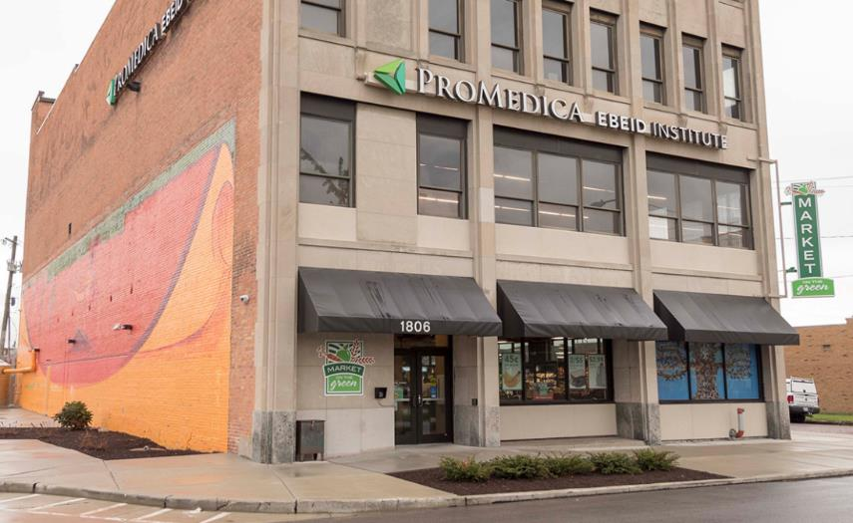
The ProMedica National Social Determinants of Health Institute creates healthier people and communities by establishing local, regional and national opportunities to integrate social determinant factors with clinical care and provide a more holistic approach to health and well-being.

Slide 19
The ProMedica-Socially Determined Food Clinic produced dramatic, meaningful outcomes
Emergency department usage
Readmission rates
Per member per year medical cost
18%
5%
6%

Slide 20
Impact of ProMedica-Socially Determined Financial Opportunity Center
Financial Security:
Average monthly income increase: $210
Average credit score increase: 122 points
Healthcare Utilization and Cost:
24% reduction in ED visits = $36,000 cost savings
18% reduction in inpatient visits = $134,000 cost savings

Slide 21
What can you do?
You become the 1st filter…
Advocate for a revenue cycle strategy that can be administered in equitable ways
Foster a Digital Front Door strategy that makes healthcare more financially attainable
Facilitate an inclusive telehealth strategy that provides equitable access, regardless of socioeconomic status
Learn about large-scale interventions that address SDoH in meaningful ways
Stay informed and get educated
Socialize these topics to increase awareness

Slide 22


Slide 23


Slide 24
HFMA Member Career Stage
Two-thirds of HFMA’s 86k members are professionals, managers and executives.
33%
29%
13%
25%
EXECUTIVE LEVEL
PROFESSIONAL LEVEL
DIRECTOR/MID LEVEL
OTHER
As of November 2021

Slide 25
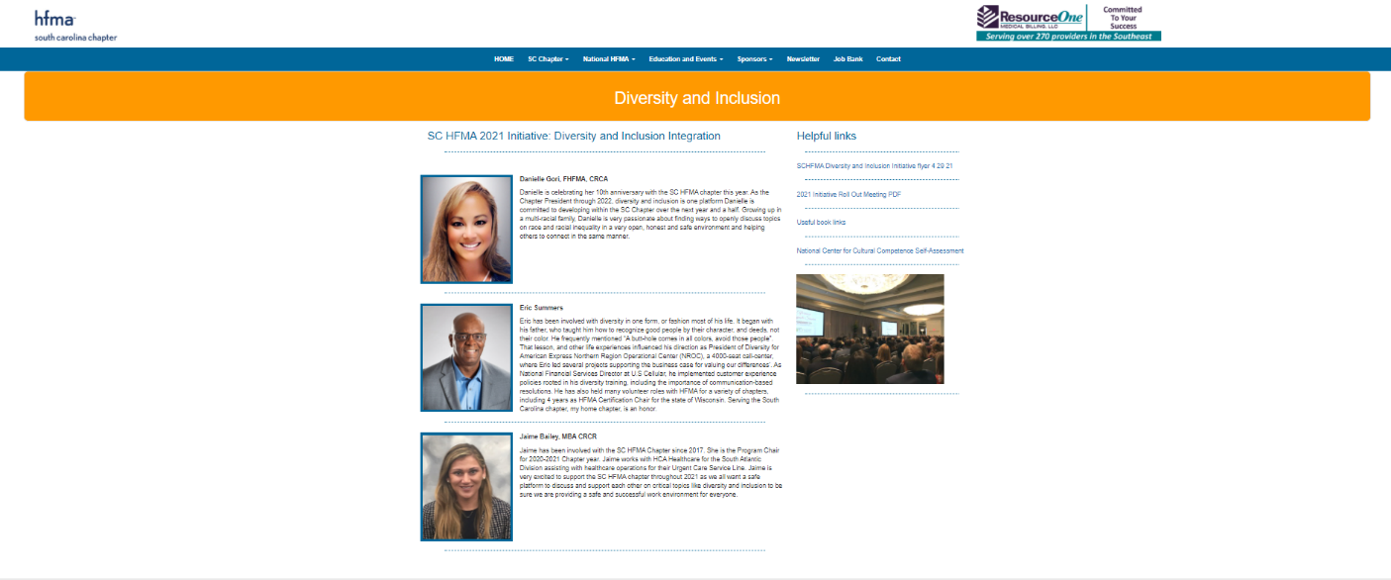
South Carolina’s Diversity & Inclusion Initiative

Slide 26


Slide 27


Slide 28

Healthcare 2030 Series
https://www.hfma.org/industry-initiatives/healthcare-2030.html

Slide 29

Key Performance Indicators for Claim Integrity
Initial Denial Rate
Primary Denial Rate
Denial Write-Offs as a Percentage of Net Patient Service Revenue
Time from Initial Denial to Appeal
Time from Initial Denial to Claim Resolution
Percentage of Initial Denials Overturned
https://www.hfma.org/industry-initiatives/standardizing-denial-metrics-revenue-cycle-benchmarking-process-improvement.html

Slide 30

New, first-of-its-kind master’s degree program
Developed jointly by HFMA and Boise State University
Taught by faculty from both organizations
Remote classes, with live evening sessions
Includes four HFMA certifications
First classes began January 2022
For more info: https://www.boisestate.edu/phsm

Slide 31
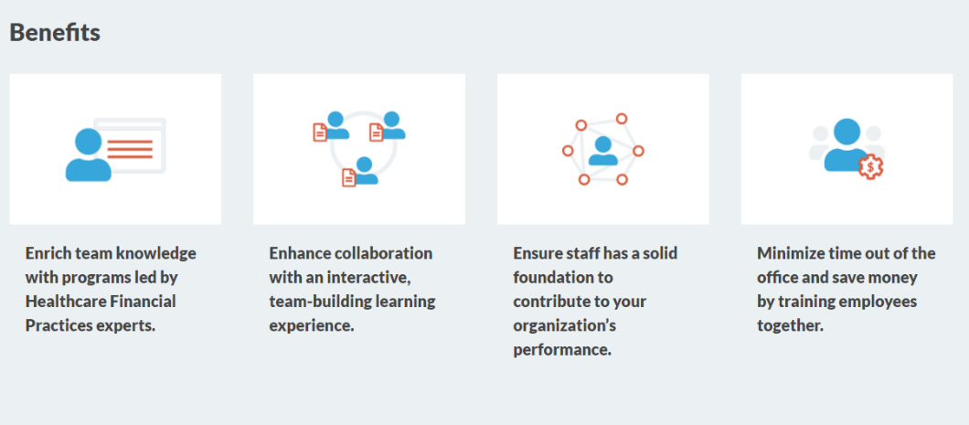
HFMA Organizational Learning Opportunities
Healthcare Finance Essentials
Revenue Cycle Essentials
Medicare Cost Report Strategies
Big Data and Analytics in Healthcare
Trends, Future Outlook and Navigating a Disruptive Environment
Finance and Business Skills for Nurse Leaders
Finance for Clinical Executives

Slide 32


