Slide 1
Preparing for the Medicaid DSH Examination
We Make Healthcare Reimbursement Easy
Brooke Yowell
Michigan Great Lakes HFMA Spring Reimbursement Meeting
March 22, 2022
Notes:
Thank everyone for attending
Today’s webinar is not state specific. If you have any state specific questions, feel free to leave questions in the chat or you can email me directly.

Slide 2
Agenda
Overview of Medicaid
Medicaid Reimbursement
Medicaid Supplemental Payments
Disproportionate Share Hospital (DSH) Program
DSH Examination Overview
Exhibits A-C
Eligible Patient Accounts
Preparing for the DSH Examination
Reinstatement of CMS FAQs 33 & 34
Consolidated Appropriation Act, 2021
Questions?

Slide 3
What is Medicaid?
Medicaid is a federal program through which states partner with the federal government to provide health care coverage to low-income children, families, elders, and people with disabilities.
States develop their unique Medicaid programs based on federal rules – each program must be approved by the Federal Centers for Medicare and Medicaid Services (CMS).
The federal government establishes basic mandatory program requirements
States choose whether to participate
Jointly financed: Federal and State governments pay a share
States choose whether to participate
Jointly financed: Federal and State governments pay a share

Slide 4
Children’s Health Insurance Program (CHIP)
Provides health coverage to eligible children through Medicaid and separate CHIP programs.
CHIP is administered by states, according to federal requirements.
Jointly funded by states and federal government.
Notes:
CHIP is an extension of Medicaid.

Slide 5
Enrollment
76.3 Million People Covered
6.9 Million enrolled in CHIP
39.2 children enrolled in CHIP or Medicaid program (48.6% of total Medicaid Enrollment)
As of June 2021
Enrollment has increased 17.7% since February 2020 as a result of the Public Health Emergency
Notes:
June 2021 Enrollment Report
Prior to the pandemic, enrollment has been steady and even declining in some States.

Slide 6
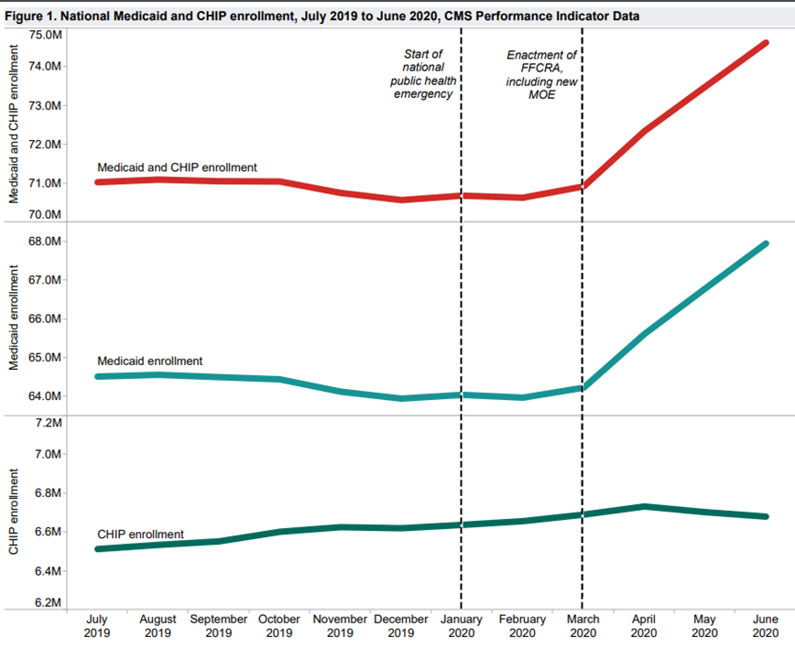
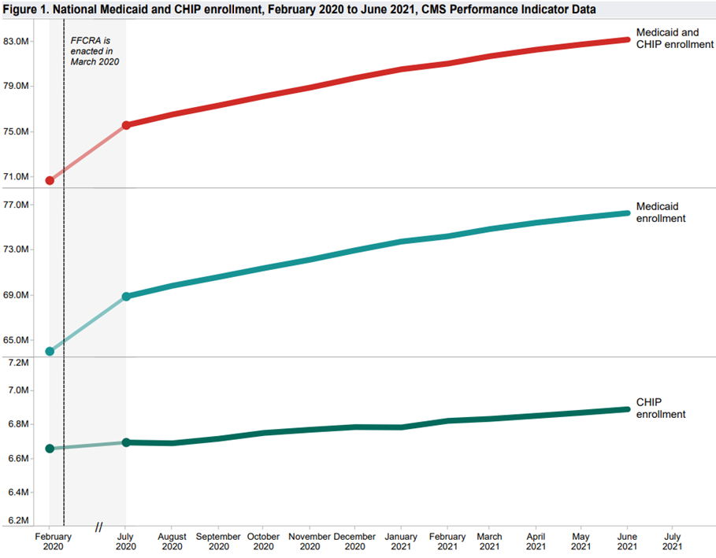
Enrollment

Slide 7
Eligibility
Mandatory Eligibility Groups
Low-income families
Qualified pregnant women and children
Individuals receiving SSI
Optional Eligibility Groups
Individuals receiving home and community-based services
Children in foster care
Medically Needy Programs
209(b)
Notes:
Federal government requires states to provide coverage for the Mandatory eligibility groups.
States can choose to provide coverage for the optional groups.
In Florida, Medicaid covers approximately 60% of all births.

Slide 8
Affordable Cares Act of 2010
Under the Act, states have the opportunity to expand coverage to nearly all low-income Americans under the age of 65.
FPL extended to at least 133% for children in every state
Option to expand eligibility to adults with income at or below 133% of FPL
37 States have expanded
States can choose to expand at anytime
Build Back Better – How does this effect states who have not expanded Medicaid?
Notes:
Most states cover children at a higher income level
Build back better – 12.5% reduction in DSH payments and Reduce uncompensated care pools for states that have not expanded
Ensure all pregnant people enrolled in Medicaid and CHIP can maintain coverage for 12 months after the end of their pregnancy and create a new state option to better coordinate their care;

Slide 9
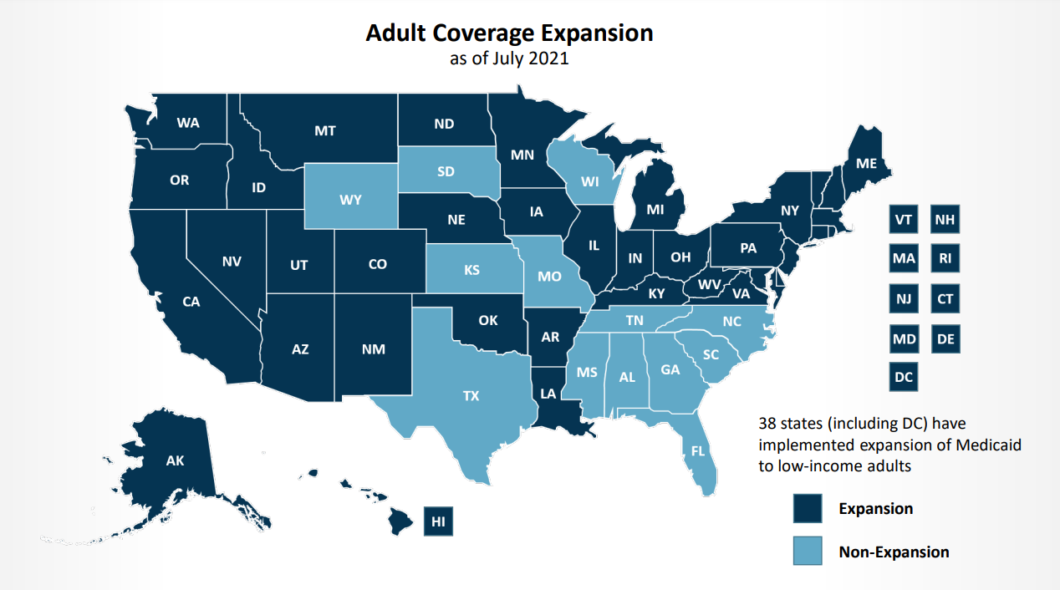
Notes:
First poll question after this slide

Slide 10
Reimbursement
Medicaid reimbursement varies by state
Fee-for-service Delivery System
Cost Based vs Prospective Payment System (PPS)
Managed Care Delivery System
Combination of both
Medicaid payments have historically been below costs, resulting in shortfalls
Supplemental Payments
Notes:
Supplemental payments help providers get to their cost of providing care
In general terms: Providers cannot be paid more than their cost

Slide 11
Fee-For-Service
Reimbursement to providers comes directly from Medicaid.
Each service receives a specific reimbursement in exchange for services provided.
Uses a fee schedule or base rate
Cost based reimbursement – Medicaid cost reports
Prospective Payment System
Diagnostic Related Groups (DRGs) - Inpatient
Enhanced Ambulatory Patient Grouping (EAPG) – Outpatient

Slide 12
Managed Care
Health care delivery system organized to manage cost, utilization, and quality.
Provides for the delivery of Medicaid health benefits and additional services through contracted arrangements between state Medicaid agencies and MCOs
States pay a per-member per-month (capitation) rate to MCOs
Actuarially sound
Approximately 70% of Medicaid recipients are currently enrolled in managed care

Slide 13
Benefits of Managed Care
Reduce program costs
Better manage utilization of health services
Improve health plan performance
Improve health care quality
Improve outcomes
Providers negotiate contract with each MCO

Slide 14
What is FMAP?
The Federal Medical Assistance Percentage (FMAP) is used to calculate the amount of federal share of state Medicaid program expenditures.
Varies from state-to-state
Updated annually
The FMAP formula is based on the ratio of the state per capita income to the national per capita income.
Uses three most recent calendar years for which satisfactory data are available from the Department of Commerce, Bureau of Economic Analysis.
The lower the state’s average per capita income, the more FMAP and vice versa.
All states receive at least 50% FMAP.

Slide 15
Enhanced FMAP
January 31, 2020: Federal Department of Health and Human Services declared a Public Health Emergency (PHE).
The CARES Act provides a 6.2 percentage point increase in federal Medicaid matching funds to help states respond to the COVID-19 pandemic.
Enhanced FMAP is effective January 1, 2020 through the end of the quarter in which the PHE ends.
State accepting the enhanced FMAP must provide continuous Medicaid eligibility through the end of the month in which the PHE ends.
Applies to people enrolled as of March 18, 2020, or who enroll at any time thereafter during the PHE
States may request to stop receiving the enhanced FMAP at any time without losing what they claimed previously.
Notes:
The enhanced FMAP reduces the state share required to pull down federal funds.

Slide 16
State Share Funding
General Revenue
Intergovernmental Transfers (IGTs)
Transfer of funds from a governmental entity (other than Medicaid)
Counties, Healthcare taxing districts, providers operated by state or local governments
Bona fide donation
Certified Public Expenditures (CPEs)
CMS requires cost reimbursement methodologies for providers using CPEs to document actual cost of providing services
Statistical time studies, periodic cost reporting, and reconciliation of any interim payments
Provider Fees/Tax/Assessment
Must be uniform and broad based to be allowable by CMS
6% max of net patient revenue
Inpatient and Outpatient Assessment
Notes:
Health care related taxes must be broad-based and uniform. That is, they must be levied against all non-governmental providers in a particular class, not only those that accept Medicaid payments, and the tax rate must be uniform across all providers in the class.
Providers cannot be held harmless through a direct or indirect guarantee that they will be repaid for the amount of taxes that they contribute. However, the indirect guarantee test does not apply if the tax rate falls within a safe harbor established under regulation. The safe harbor is currently 6 percent of net patient revenue.

Slide 17
Supplemental Payments
Payments made to Medicaid providers in addition to the Medicaid reimbursement they received for services provided.
The state share funding source is generally funded through non-General Revenue funds.
Authorized by the Legislature either through statute or the General Appropriations Act and approved by the federal Centers for Medicare and Medicaid Services.
Typically approved by CMS through 1115 Waivers or State Plans

Slide 18
Supplemental Payment Programs
Disproportionate Share Hospital (DSH) Program
Uncompensated Care Pools/Low Income Pool Program
Upper Payment Limits
Directed Payments Programs (Pass-through Payments)
Graduate Medical Education
Medicaid Enhanced Payments
Emergency Medical Transportation Programs
School Based Programs
Notes:
Poll Question #2 After this slide

Slide 19
Disproportionate Share Hospital (DSH) Program
DSH was created under federal law to compensate hospitals that have provided a disproportionate share of Medicaid or charity care services.
Federal law establishes an annual DSH allotment for each state that limits Federal Financial Participation (FFP) for payments made to hospitals.
FFP is not available for state DSH payments that are more than the hospital’s eligible uncompensated care cost.
Uncompensated care cost – cost of providing inpatient and outpatient hospital services to Medicaid patients and the uninsured, minus payments received.
$12.8 Billion total allotment for FY 2020
Notes:
CMS releases allotment around October of each year

Slide 20
DSH Audit and Reporting Requirements
States are required to submit an independent certified audit describing DSH payments made to each DSH hospital.
Any payments in excess of uncompensated care must be returned to the state.
States have option to redistribute or return to CMS.
Myers & Stauffer conducts most audits in the country

Slide 21
DSH Examination Overview
Today’s focus will be on Myers & Stauffer’s DSH Examination
The State/Myers & Stauffer will send out examination letters to each provider required to submit examination surveys.
Surveys due 30-45 days after letters are sent out.

Slide 22
DSH Examination Surveys
Hospitals will need to complete 2 surveys
Completed using Medicare cost report and internal hospital data
Survey part I
Survey part II

Slide 23
Survey Part I
Basic hospital information
Cost Report Year
OB Qualifying Questions
Other Medicaid Payments Received
Certification/Signature Page
Checklist of required submission documents

Slide 24
Survey Part II
Sections D-L
MIUR/LIUR Calculation
Myers & Stauffer will prepopulate the data for schedule G using your most recently filed Medicare Cost Report.
Uses HCRIS data
Did you have an amended cost report?
Review data to ensure they are using the correct data
Data from Exhibits A-C will be used to complete portion of the survey
Data from Exhibits A-C will be used to complete sections H-K
Notes:
Section J&K are Organ Acq
MIUR – Medicaid Inpatient Utilization Ratio
LIUR – Low Income Utilization Ratio
Schedule D calculated the Medicaid Per Diem Cost for Routine Cost Centers and the Cost to Charge ratios for ancillary cost centers.

Slide 25
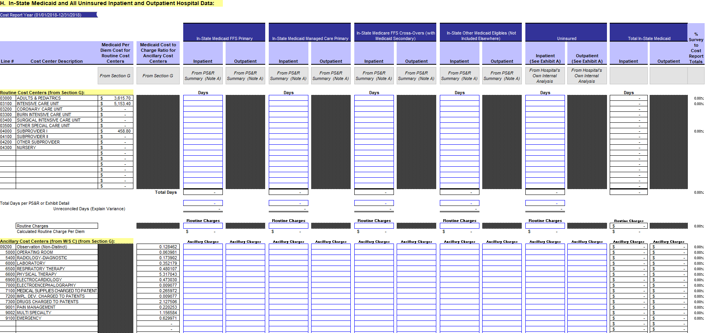
Survey Part II – Schedule H & I
Template Example
Notes:
Schedule H – In State
Schedule I – Out of State

Slide 26
Survey Part II – Schedule H & I

Slide 27
DSH Exhibits
The Exhibits will include patient level detail
Some of this data will come from the State, and some will need to be pulled from internal hospital records
Exhibit A – Uninsured
Exhibit B – Cash Payments
Exhibit C – Medicaid FFS, Medicaid MCO, Medicaid Other Eligible, Crossover, Out of State

Slide 28
Exhibit A – Uninsured Patients
Listing of all uninsured patients during cost report year
Include charges/days by revenue code
Need to include any patient or third-party payments received
Must follow Myers & Stauffer template and have minimum data field requirements
Depending on hospital accounting system, might need additional fields such as GL/Department codes to properly categorize charges by cost report line
Notes:
Claims with no third party coverage for a specific service or exhausted benefits before services are rendered.
Are you including all eligible uninsured accounts?
Review your states definitions for uninsured

Slide 29
Exhibit A – Required Data Fields
a. | Claim Type
b. | Primary Payor Plan
c. | Secondary Payor Plan
d. | Hospital's Medicaid Number
e. | Patient Identification Number (PCN)
f. | Patient's Birth Date
g. | Patient's Social Security Number
h. | Patient's Gender
i. | Patient Name
j. | Admit Date (see below for acceptable date formats)
k. | Discharge Date (see below for acceptable date formats)
l. | Service Indicator (inpatient/outpatient)
m. | Revenue Code
n. | Revenue Code Charges
o. | Routine Days of Care
p. | All patient payments (including payments received from collection agencies) received on the claim for services provided from the admit date through the present
q. | All private insurance (primary or third party liability) payments received on the claim for services provided from the admit date through the present
r. | If the uninsured claim is being claimed as uninsured due to exhausted benefits or meeting lifetime/annual maximums, please enter "Exhausted" in this column. If it is being claimed because it is not a covered service under the insurance package enter "Non-Covered Service" (it must be a covered service under the Medicaid state plan). If neither apply, leave this field blank.

Slide 30
Exhibit A

Slide 31
Exhibit B – Cash Payments
Listing of patient payments received during cost report year, regardless of when services were provided.
Will need to determine if each patient is insured or uninsured
Only uninsured patient payments will be used to calculate uncompensated care costs
Notes:
The uninsured payments will offset Exhibit A – uninsured costs

Slide 32
Exhibit B – Required Data Fields
a. | Claim Type
b. | Primary Payor Plan
c. | Secondary Payor Plan
d. | Transaction Code
e. | Hospital's Medicaid Number
f. | Patient Identification Number (PCN)
g. | Patient's Birth Date
h. | Patient's Social Security Number
i. | Patient's Gender
j. | Patient Name
k. | Admit Date (see below for acceptable date formats)
l. | Discharge Date (see below for acceptable date formats)
m. | Date of Cash Collection
n. | Amount of Cash Collections
o. | Indicate if Collection is a 1011 Payment
p. | Service Indicator (inpatient/outpatient)
q. | Total Hospital Charges for Services Provided
r. | Total Physician Charges for Services Provided
s. | Total Other Non-Hospital Charges for Services Provided
t. | Insurance Status at Time of Service (Must Enter "Insured" or "Uninsured")
u. | If the uninsured claim is being claimed as uninsured due to exhausted benefits or meeting lifetime/annual maximums, please enter "Exhausted" in this column. If it is being claimed because it is not a covered service under the insurance package enter "Non-Covered Service" (it must be a covered service under the Medicaid state plan). If neither apply, leave this field blank.
v. | Calculated Hospital Collections IF(O) = "Uninsured" or (P)="Exhausted" or (P)="Non-Covered Service", (L)/((L)+(M)+(N))*(I), 0)

Slide 33
Exhibit B

Slide 34
Exhibit C – All other patient types
Similar to the Exhibit A, patient level detail by revenue code
Required for all payer types that require internal hospital data
Need to include all payments received for patient
This needs to be broken down by payer type
Medicaid FFS, Medicaid MCO/HMO, Medicare FFS, Medicare HMO, other third party payment, patient payments
Depending on hospital accounting system, might need additional fields such as GL/Department codes to properly categorize charges by cost report line
Payer Types – Separate Exhibit for each
Medicaid FFS
Medicaid MCO/HMO
Medicaid Other Eligible
Crossover

Slide 35
Exhibit C – Requires Data Fields
a. | Claim Type
b. | Primary Payor Plan
c. | Secondary Payor Plan
d. | Hospital Medicaid Number
e. | Patient Identification Number (PCN)
f. | Patient's Medicaid Recipient Number
g. | Patient's Birth Date*
h. | Patient's Social Security Number*
i. | Patient's Gender*
j. | Patient Name
k. | Admit Date (see below for acceptable date formats)
l. | Discharge Date (see below for acceptable date formats)
m. | Service Indicator (inpatient/outpatient)
n. | Revenue Code
o. | Revenue Code Charges
p. | Routine Days of Care
q. | Medicare Traditional Payments (all payments received for the services provided from the admit date through the present)
r. | Medicare HMO Payments (all payments received for the services provided from the admit date through the present)
s. | Medicaid Payments (all payments received for the services provided from the admit date through the present)
t. | Medicaid MCO Payments (all payments received for the services provided from the admit date through the present)
u. | Private Insurance (primary or third party liability) Payments (all payments received for the services provided from the admit date through the present)
v. | Self-Pay payments (all payments received from patients for the services provided from the admit date through the present)
w. | Total Payments received on the claim (sum of all payments listed above)
Notes:
Pull up Exhibit A-C template after this slide for reference

Slide 36
Exhibit C

Slide 37
Preparing for the DSH Examination
There are some things that you can do now
Start gathering all financial documents that will be used to complete the surveys. These will also need to be submitted with the surveys.
Financial Statements
Listing of other Medicaid Supplemental Payments
Working Trial Balance
Medicare Cost Report
Logical statements
Review prior year results
Are you including all eligible accounts?
Were any adjustments made in prior years?

Slide 38
Preparing for the DSH Examination
Look at your hospitals staffing capabilities and any upcoming PTO/Vacation Requests
Schedule a meeting with your IT department
Determine if prior year search queries captured all eligible accounts
Do they have the staffing capabilities to complete the request timely?
Request the data as soon as possible
This can be done before you receive the letter from Myers & Stauffer
Notes:
Poll question #3 after this slide

Slide 39
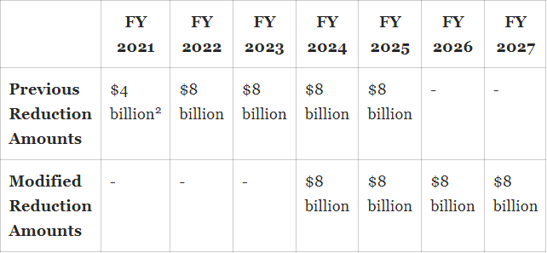
Consolidated Appropriations Act, 2021
Creates new supplemental payment reporting requirements for States
Changes the calculation of hospital specific DSH limits, effective October 1, 2021
Eliminates reduction in FY 2021
Also delays remaining 4 years of cuts until FY 2024
Notes:
The act also requires new supplemental payment reporting requirements for States –

Slide 40
DSH Rule – Reinstatement of CMS FAQs 33 & 34
On April 30, 2017 CMS issued final rule On April 30, 2017 CMS issued final rule, withdrawing FAQs 33 & 34 from the Medicaid DSH guidance that was issued in January 2010 titled “Additional Information on the DSH Reporting and Audit Requirements”
Uncompensated costs include only those costs for Medicaid eligible individuals that remain after accounting for all payments received, including Medicare and other third party payments.
As of December 30, 2018 FAQs 33 and 34 are no longer operative
States had option to revise DSH audits to remove third party payments for services provided before June 2, 2017
August 13, 2019 final rule reinstated for services provided on or after June 2, 2017
Third party payments will now be included in the calculation of uncompensated care (UC) costs.
This will reduce UC costs
How will this effect your hospitals DSH limits?
Notes:
This has a huge impact for hospitals who are overpaid or close to being overpaid.

Slide 41
Medicaid Services Provided by TRG
DSH/Uncompensated Care Pool Audits
Supplemental / Enhanced / Pool Payment Optimization
Settlement and Upper Payment Limit Issues
Prospective Payment Rates
Special Designation Requests
Medicaid Appeals
Charity Care/Financial Assistance Optimization

Slide 42
Questions?

