Slide 1
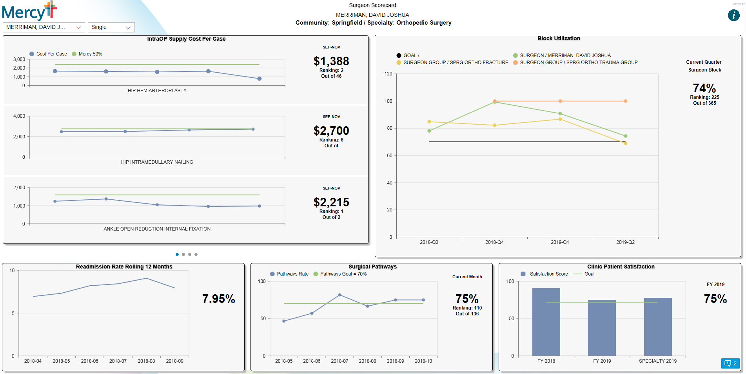
An HFMA Tool (hfma.org)
Read the related article: “Mercy Saves Millions in the OR Through Standardization and Automation”
Surgeon Scorecard
Choose Surgeon…
Single
Community: Northwest / Specialty Orthopedic Surgery
Source: Mercy, Chesterfield, Mo. Used with permission.

Slide 2
An HFMA Tool (hfma.org)
Read the related article: “Mercy Saves Millions in the OR Through Standardization and Automation”
Surgeon Scorecard
Community: Northwest / Specialty Orthopedic Surgery
Source: Mercy, Chesterfield, Mo. Used with permission.

