Slide 1

“Thank You” to all our sponsors who continue to support Iowa HFMA.
(updated March 2022)

Slide 2





Platinum Sponsors

Slide 3




Platinum Sponsors

Slide 4




Platinum Sponsors

Slide 5


Platinum Sponsors

Slide 6





Gold Sponsors

Slide 7




Gold Sponsors

Slide 8





Gold Sponsors

Slide 9





Silver Sponsors

Slide 10






Bronze Sponsors

Slide 11
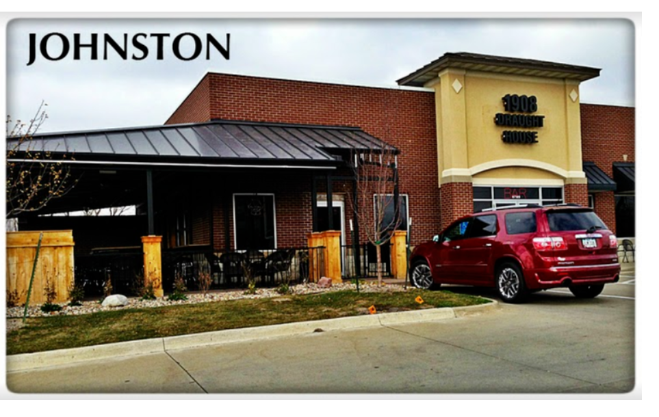

Networking Event- 5pm tonight – 1908 Draught House
Event Sponsors:

Slide 12

Upcoming Events:
--Summer Meeting
--Thursday, July 14th
--Hilton Garden Inn

Slide 13


Women’s Conference Sponsors

