Slide 1

Transitional Care
The Underutilized Value Proposition
Iowa HFMA
July 2022

Slide 2


Mark Lindsay MD is an Assistant Professor of Medicine at Mayo Clinic College of Medicine. He has practiced at Mayo Clinic Health System Eau Claire since 1997. He served as Quality Officer for Mayo Clinic Health System from 2006-2010 supporting Quality, Patient Safety and Service Excellence for 19 hospitals and 70 clinics in Minnesota, Wisconsin, and Iowa. His Master’s project from the USC School of Business was the development of 11 Transitional Care programs in Minnesota, Wisconsin and Iowa. He presently serves as Medical Director for Allevant supporting rural healthcare post-acute pathways.
Jordan Tenenbaum MHA serves as President of Allevant Solutions. Jordan served as CEO for Select Specialty Hospital - St. Louis, part of Select Medical's 109 long-term acute care (LTAC) hospitals and 18 rehabilitation hospitals. As an executive with extensive health care experience in the for-profit, non-profit and academic-based sectors, Jordan received a bachelor's degree in Kinesiology at the University of Wisconsin - Madison, a master's in Hospital Administration from Washington University in St. Louis, and a Fellowship in Hospital Administration from Thomas Jefferson University Hospital. Jordan served as an NRHA 2020 Rural Health Fellow.

Slide 3

Agenda
New Model of Care
Healthcare journey, a few observations
Transitional Care, one of the highest value equations in healthcare
Overcoming barriers
Getting started
Financial and Market Opportunity
MENDS: new model for prevention, chronic disease, health, and cost containment
Notes:
In this presentation I’m going to go over why Transitional Care is a Win/Win/Win for CAHs, IPPS Hospitals and most importantly patients. We’ll talk about the benefits of Transitional Care and more about how this opportunity can positively impact your organization and community. We’ll also talk about a new model for helping address chronic disease management, wellness, and population health is a golden moment and a natural transitional for patients who require post-acute care.

Slide 4
Transitional Care
A comprehensive post-acute care program maximizing the use of Swing Beds. High quality value proposition for patients who no longer need Acute Care but are not ready to go home
H
Acute Care
Critical Access
H
Earlier discharge & improved patient flow
Lower readmission rate
Positive quality & financial impact
Expand scope of services
Care for more patients locally
Increase revenues
Patient
Care closer to home
Shorter length of stay
Higher likelihood of home discharge
Reduced harm

Slide 5
Eau Claire Transitional Case Study

Slide 6

Bloomer: Transitional Care Pilot
Perfect storm
Overcoming physician and nurse resistance
Maximizing existing capacity and resources
Financial

Slide 7
Transitional Care: “Right care, right place, right time”
Benefits:
After TCU: 9 of next 10 quarters positive NOI, doubled bed days
Eau Claire Acute Hospital $3.0 Million in one of first years
Physician engagement
Bloomer: High employee satisfaction

Slide 8
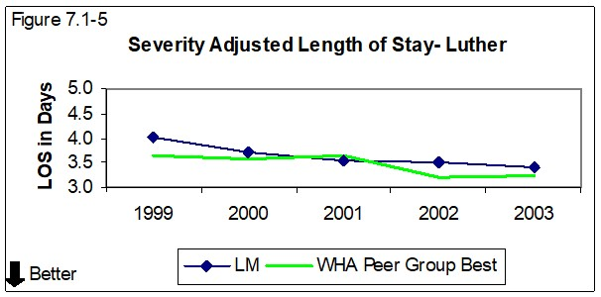
Positive Impact on PPS Length of Stay
Opportunity for Collaboration

Slide 9

Expansion to Osseo
Challenges:
Low census and financially challenged
Initially no respiratory therapists
Smaller population

Slide 10

Cardiac Surgery and Post-Acute Care at Osseo CAH Transitional Care
Why engage cardiac surgeons?

Slide 11
Rapid and Sustained Growth
Osseo Transitional Care – a new trajectory
Destination post-acute center – not just for local community

Slide 12
Expansion to Mayo Critical Access Hospitals

Slide 13
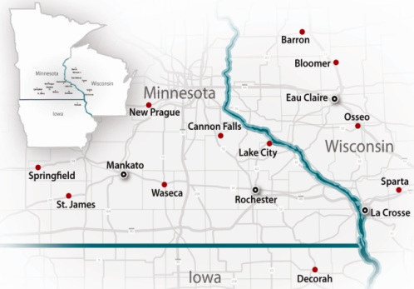
Transitional Care Expanded to 11 Mayo Clinic Health System Critical Access Hospitals
Win for acute care hospitals, critical access hospitals, and most importantly – patients!
Mayo Transitional Care, a preferred destination for complex medical and surgical cases

Slide 14
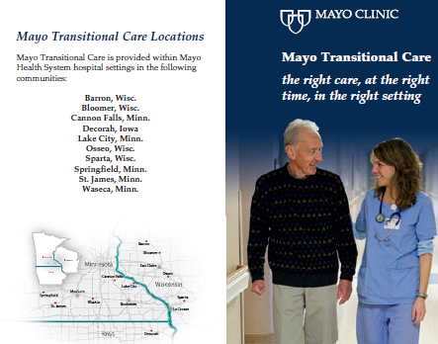
Referral Education Strategies
Brochure highlighting program strengths
  Higher nurse ratio / more nurse hours per patient day
  Available hospital resources (on-site radiology, lab, physician to address acute change in condition)
Program web page
  Benefits
  Outcomes
  Spotlight the team
  Success stories

Slide 15
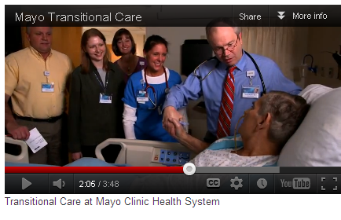
Transitional Care at Mayo Clinic Health System
It’s all about the team!

Slide 16

Creating a Positive Culture

Slide 17
Mayo Transitional Care Program
Growth from Mayo Clinic
Referrals from Mayo Clinic to Mayo CAH Transitional Care increased by over 500%
Transitional Care and respiratory patient days increased by 200% and 800% respectively from 2009 to 2011
Net Revenue + Cost Avoidance/ Centralized Resources Approximately 20/1 return
Reduced excessive acute care hospitals stays, hospital readmissions, Medicare bed days beyond mean geometric length of stay
Improved patient flow at system level

Slide 18
Growth, Quality, and Staffing Advantage
95.3% rated Excellent Care
Less than 4% readmission back to Acute Care
One of the greatest benefits, “not having to call off nurses because census is low”
“GRHS adapting well to changing healthcare”
The McLeod County Chronicle
by Lori Copler 10/14/15

Slide 19
Reporting, Measuring, and Improving Quality
SNFs have public measures on www.carecompare.gov , no current CMS CAH Swing Bed data requirement
Internal measurement
  Swing Bed days
  Types of patients referred and admitted (complex medical, complex surgical, ortho, neuro, cardiac, respiratory, wound, etc.)
  Number of referrals, admissions, denials (and reasons)
  Discharge disposition (home, assisted living, skilled or residential nursing home, acute care hospital, hospice, deceased)
  Length of stay
  Transitional Care Bundle

Slide 20
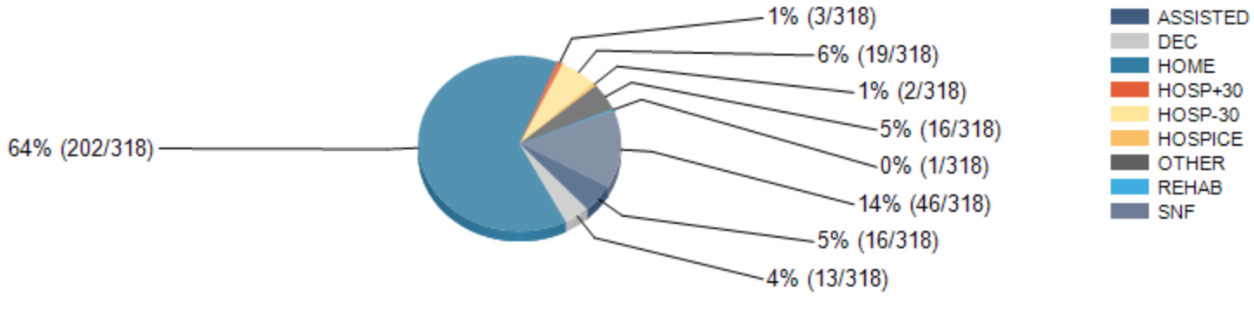
System Collaborative (6 CAHs)
Swing Bed Growth With Focus on Quality and Outcomes
Multiple CAH Collaborative
Win for Acute Care Hospital
Win for CAHs
Most importantly, win for patients!
Transitional Bundle: all or none measure (4 elements) 93%
Patient identified goal
Team based plan of care
Greatest risk of harm identified
Communication board

Slide 21
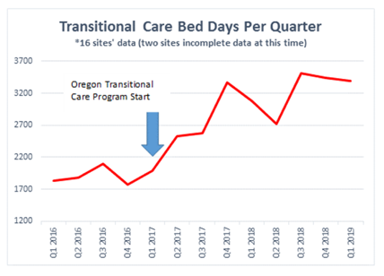
Oregon Statewide Program
3 year program, 18 CAHs
Only 4.8% of 2,277 Program Discharges readmitted back to an Acute Care Bed
Total Referrals Increased 98%
External Referrals Increased 178%
Swing Bed Days increased 84%
594 patients rated, “Would Recommend” 4.9/5

Slide 22
Experience with Over 70 CAHs
Key Metrics
49% average increase by Year 2 in post-acute swing bed days
Over 145,000 swing bed days
Average length of stay 10-14 days, mean 13.4
More than 60% of cases are complex medical or surgical, ortho cases account for 22% of cases
68.4% of patients are discharged home, 7.2% to assisted living
78% of patients return to independence
6.6% of patients return to acute hospital within 30 days

Slide 23
Financial Approach
CAH Cost Reports
Financial Template Modeling
Transitional Care Program Impact on Swing Bed Revenues
Cost Avoidance Opportunity for Partnering Acute Care Hospitals

Slide 24
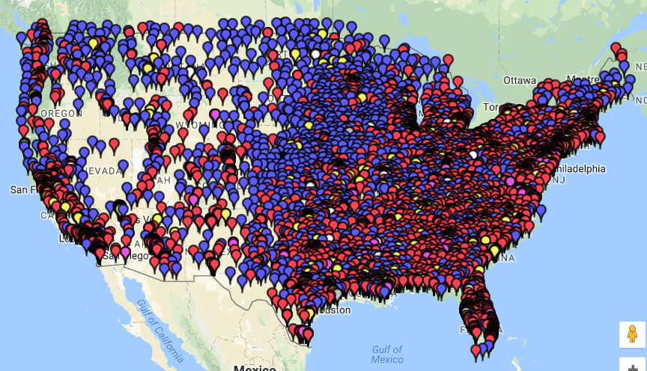
Opportunity for Collaboration
Collaborative cross referral and care coordination to improve access, quality, and financial success
Notes:
This map shows CAHs in blue pins and IPPS (or urban) Hospitals in red pins. Across the country there are strong opportunities to continue to enhance the relationship between CAHs and IPPS Hospitals and expand access to high quality post-acute care for your community – that is the goal of the Transitional Care program. Transitional Care should be thought of as a foundational service line that allows CAHs to grow and maximize the current volume-based reimbursement environment in order to plan for the future value-based environment. It allows CAHs to collaborate with IPPS Hospitals for the benefit of the patient rather than compete.

Slide 25
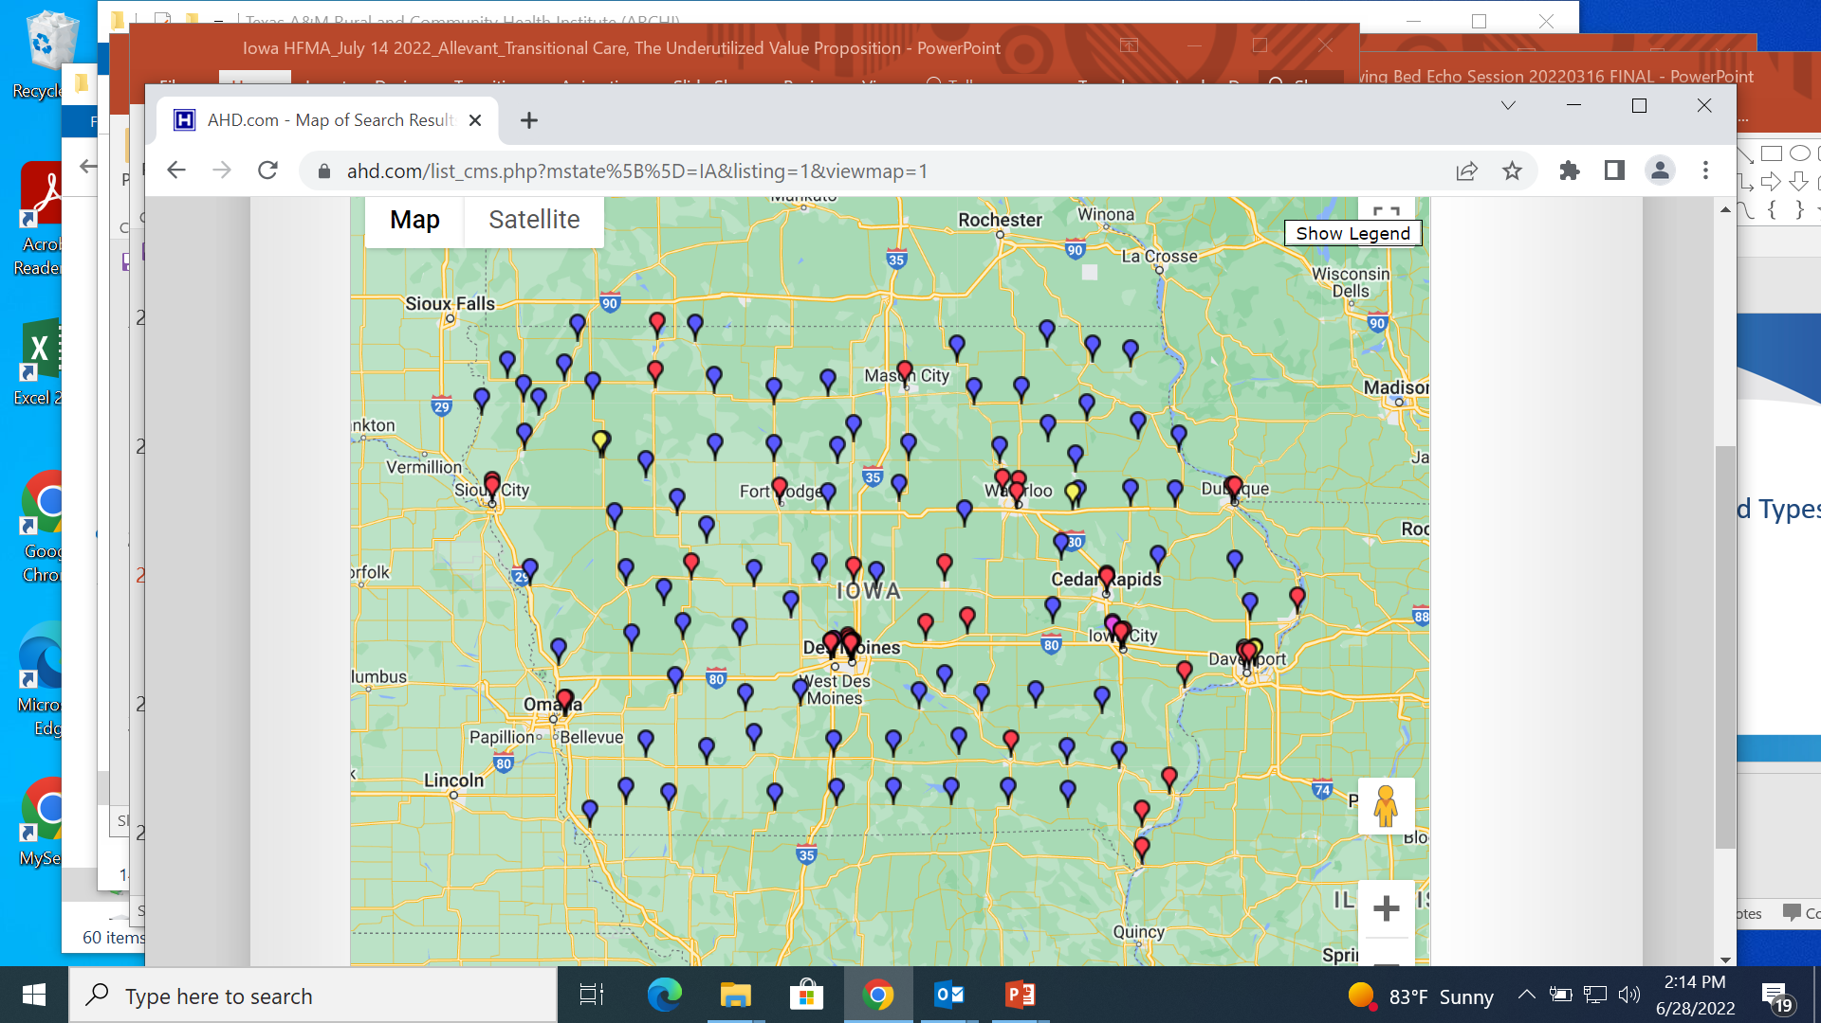
Available Post-Acute Care Capacity IA Statewide
Data based on 83 Critical Access Hospital (blue pins)
  22% Average Bed Utilization Rate*
  6,343 beds per Critical Access Hospital of Available Capacity*
AHD.com.
. *Based on 2020 Cost Report Data
Opportunities for collaboration between PPS and CAHs to improve access to quality post-acute care

Slide 26
CAH Financial Opportunity
Somewhere Hospital (1,555, 275 , 6, 111)
Net Income Impact +$1,070,000

Slide 27
County Utilization of PAC Example
13.85% or 6,171 Medicare Beneficiaries utilizing PAC
Opportunity to improve outcomes, reduce cost, increase access
Notes:
So we know that by growing the swing bed volume there is a positive financial impact. But how do we know if the demand is there? We look at the Post-Acute Care (PAC) utilization of your county and contiguous counties with the idea that as you become an “expert” in post-acute care and are able to care for more complex patients over time, you will likely draw patients from a wider geography. In this example there are 44,556 Medicare beneficiaries with a PAC utilization rate of 13.85 %. We can help make some estimates of the % of the market you would need to capture to increase your swing bed day volume above a baseline. In this example if this hospital were to capture just 2% of the market, they would see a total annual swing bed day opportunity of 1,234 using an ALOS of 10 days for each swing bed patient. This is somewhat conservative as the ALOS is typically between 10-14 days.

Slide 28
PPS Financial Opportunity (33 Iowa PPS Hospitals)
Average Profit / Loss for cases exceeding Geometric Length Of Stay
Medpar Year | # of PPS Hospitals | Market Name | Average P/L per Long Case | Average P/L per Short Case | Percent of Cases Exceeding GEO LOS
2020 | 33 | Iowa | ($5,480) | $930 | 45%
Total Impact: Number of Long Stay Days and Cost Avoidance dollar opportunity of eliminating those Long Stay Days
Medpar Year | # of PPS Hospitals | Market Name | Total Impact Days | Total Impact Cost
2020 | 33 | Iowa | 143,862 | $285,267,638
The information above shows the cost associated with Medicare days that exceed the STACH DRG GMLOS for patients that are appropriate for Transitional Care in a CAH. The costs are calculated as follows:
  The cost is calculated using the hospitals 2020 Operational CCR multiplied by the STACH’s total charges as reported by 2020 Medicare Provider and Analysis Review (MedPAR)
  This cost per day is then multiplied by the days that exceed the STACH DRG GMLOS.
  Any HCO payments received by the STACH are netted against the cost per day above. This is done because the STACH will not receive the HCO payment if they can clinically move a patient to a proper Post Acute setting earlier in the patient stay.
. *Based on MedPAR data 2020

Slide 29
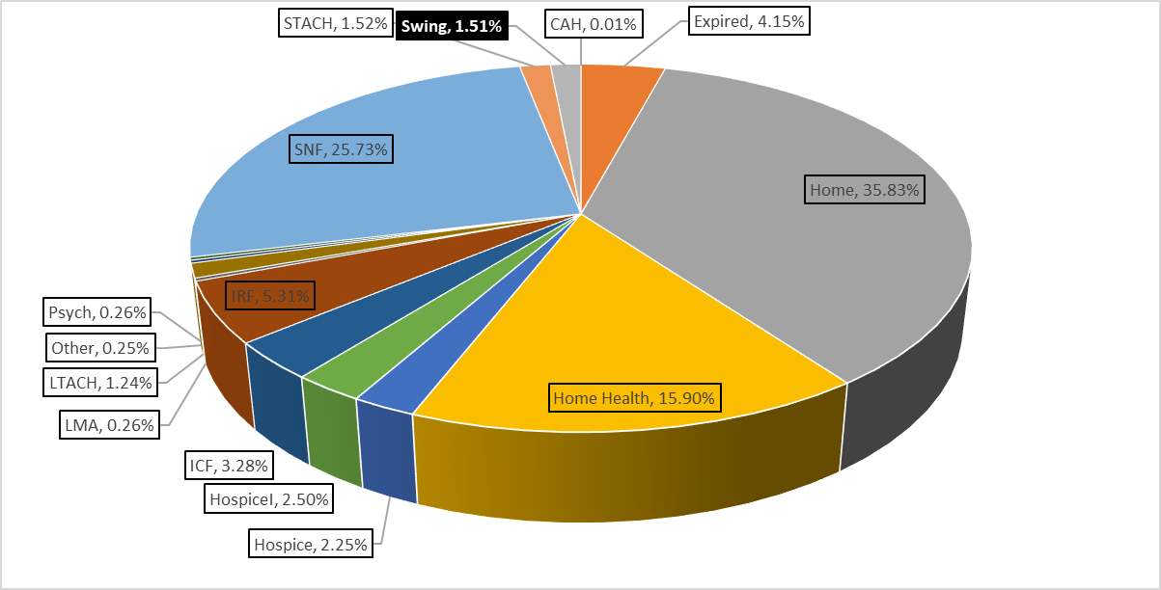
Statewide Discharges by Destination (33 Iowa PPS Hospitals)
1.51% Swing Bed utilization
Based on 78,472 patients from 33 Iowa PPS Hospitals
. *Based on MedPAR data 2020

Slide 30
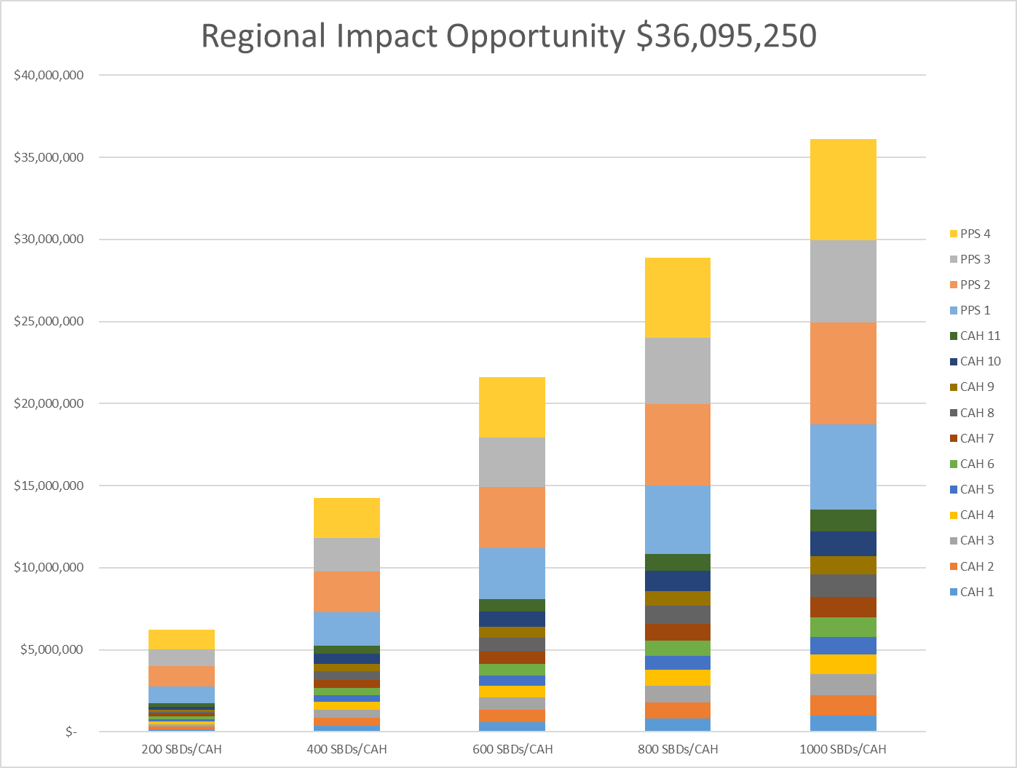
11 CAHs Avg Net Income $1,161,000
4 PPS Hosp Avg Impact Cost $2,050/day
1,000 SB/CAH

Slide 31
Patient Diagnosis and Types of Skilled Needs

Slide 32
DRG Opportunity (33 Iowa PPS Hospitals)
. *Based on MedPAR data 2020
Top 25 DRG’s in 33 IA PPS Hospitals make up 47% of Total (143,862) Ptdays > GEOLOS
The super majority of these DRGs are appropriate for
Transitional Care utilizing the CAH swing bed.

Slide 33
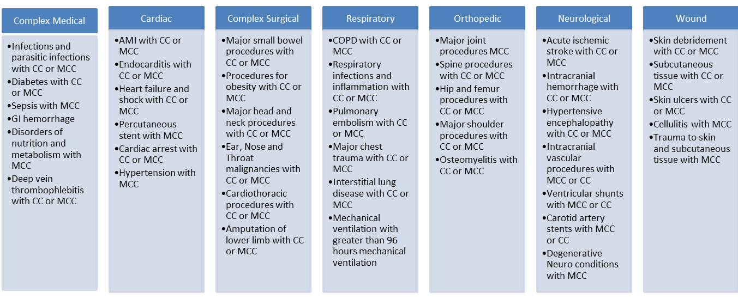
Categories and Diagnoses
That Frequently Require Post-Acute Care
CC- complication or comorbidities
MCC- major complication or comorbidities
Over 750 DRGs
Notes:
You can see here the categories of illness that most frequently require post-acute care. Transitional Care is a swing bed can manage patients with these diagnosis very well with appropriate training, process, and education. We are seeing a movement away from traditional Ortho cases towards more medically complex, which is what our program helps CAHs focus on.

Slide 34
Hospital based post-acute
Inpatient Rehab
Narrow admission criteria: Ability to participate in 3 hours of daily therapy
Daily physician rounds
LTAC
Narrow admission criteria: 96 hours mechanical ventilation
CAH Based Transitional Care
Broad admission criteria: 3 day acute care stay and skilled post acute care need identified
Very small % of patients qualify
ICU
Very small % of patients qualify
Daily physician rounds
On-site physician to address acute change of condition, on-site lab, radiology
High nurse ratio 4-6 hours of daily nursing
Notes:
In looking at the Hospital based post-acute care setting, specialized post-acute care providers like inpatient rehab and LTAC have very narrow patient criteria and only a small % of patients can qualify. CAH Based Transitional Care programs have broad admission criteria as well as the resources and training to care for more complex patients.
When looking at Skilled Nursing Facilities in comparison to CAH Based Transitional Care Programs, both have broad criteria however, CAHs have much higher nursing ratios with 1/3 the typical average length of stay. The RN hours per resident day at a nursing facility are much lower (Typically less than 50 minutes) . It is very challenging for these providers to care for more complex patients. CAH Transitional Care programs are typically 4-6 hours of nursing per day. CAHs also typically have on-site physicians to address an acute change in condition and onsite lab and radiology. With the appropriate training and education, the CAH based Transitional Care program has all the resources to care for more complex patients very effectively.

Slide 35
Types of Skilled Needs
Services safely and effectively performed only by, or under the supervision of an RN, LPN/LVN (if allowed by regulation), or a qualified therapist
Individualized patient assessment demonstrates necessity of the specialized judgment, knowledge, and skills of an RN, LPN/LVN (if allowed by regulation), or a qualified therapist
Direct skilled nursing
Direct skilled therapy
Teaching and training
Management and evaluation of a care plan
Observation and assessment of patient’s condition

Slide 36
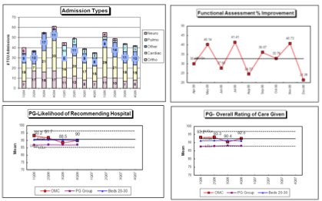



Allevant Services
Clinical Staff Training & Education
Real Time Data Base
Experienced Implementation Team
Evidenced Based
Best Practices
Branding / Referral Education & Marketing
Notes:
You are likely caring for patients in swing beds today. Our goal is to maximize the opportunity to help you grow your Transitional Care Programs using a multipronged project management approach. You can look at the project in 3 major parts 1) Planning 2) Execution 3) Growth. We will help your teams become “experts” in post-acute care so that they are more confident and comfortable caring for more complex patients over time and expand access for your patients. Allevant provides team-based, process, and discipline specific Training and Education both onsite and remotely. We have a quality and development database that allows you to help track outcomes and educate potential referral and payor partners on those outcomes. We will collaborate with your team with referral hospitals to help provide education, using outcome and MedPAR data, to their administrators, physicians, case managers, and nurses to tell the story about why it is in their best interest and their patient’s best interest to utilize your Transitional Care program. You also have the ability to utilize the brand associated with Allevant developed by Mayo Clinic and Select Medical. Dr. Lindsay leads all of our implementations and you always have access to our team of experts.

Slide 37
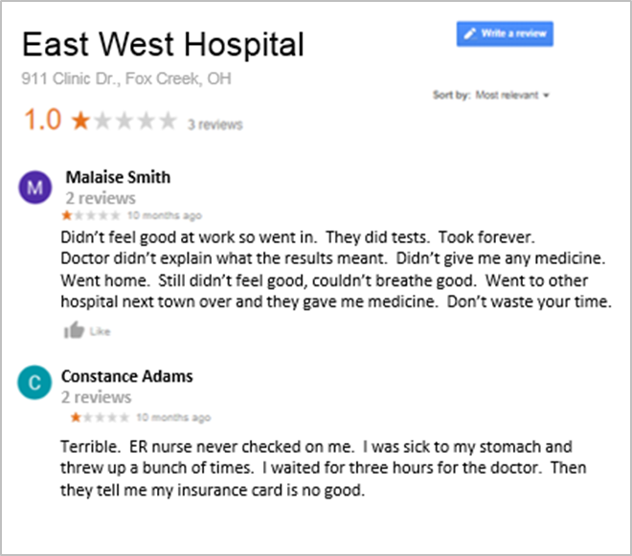

Social Media Strategy
You need to know your audience, be familiar with the tools, and have a good strategy!
Notes:
How you educate your internal staff and physicians, community, and referral partners on your Transitional Care swing bed program is critical. Many rural hospitals do not have a comprehensive strategy, resources and familiarity of available tools to positively impact their online reputation and educate key stakeholders regarding the significant benefits your hospital can provide.
Allevant’s program offers Templates and resources for promoting your Transitional Care Program, Social media training and guide, Website template, Press releases, open house materials, and Brochures

Slide 38

Allevant Education
  Accredited CNEs for RN’s and other providers
  Can be lower cost for nurse and hospital to maintain credentialing and sometimes licensure
  Quality education that meets or exceeds the education standards of ANCC
2,800 accredited Continuing Nurse Education eligible online learners
47,900 online education modules completed
38,000 hours of education completed
Notes:
Allevant has over 60 multidisciplinary courses available for your team with many more modules in the works to help your staff feel confident and comfortable caring for Transitional Care patients. Our modules provide your staff with CNEs for RN’s and other providers. As of 2019, we had approximately 5,000 users benefiting from this education.

Slide 39
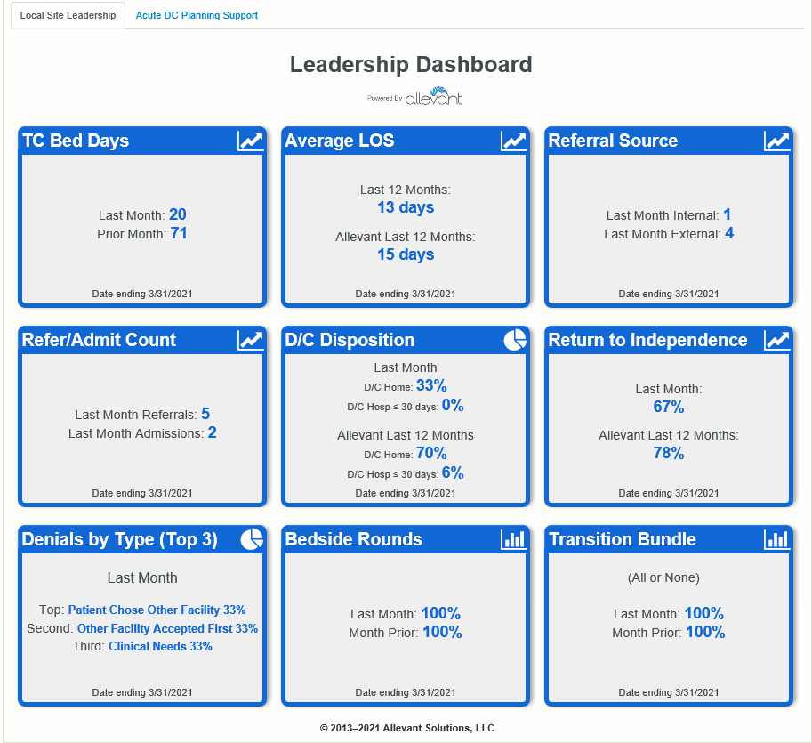
Leadership Data Dashboard
Quickly measure/report quality and growth outcomes
Easy access to detailed graphs
Benchmark performance with other sites
Notes:
You are likely caring for patients in swing beds today. Our goal is to maximize the opportunity to help you grow your Transitional Care Programs using a multipronged project management approach. You can look at the project in 3 major parts 1) Planning 2) Execution 3) Growth. We will help your teams become “experts” in post-acute care so that they are more confident and comfortable caring for more complex patients over time and expand access for your patients. Allevant provides team-based, process, and discipline specific Training and Education both onsite and remotely. We have a quality and development database that allows you to help track outcomes and educate potential referral and payor partners on those outcomes. We will collaborate with your team with referral hospitals to help provide education, using outcome and MedPAR data, to their administrators, physicians, case managers, and nurses to tell the story about why it is in their best interest and their patient’s best interest to utilize your Transitional Care program. You also have the ability to utilize the brand associated with Allevant developed by Mayo Clinic and Select Medical. Dr. Lindsay leads all of our implementations and you always have access to our team of experts.

Slide 40
Reality of Transitional Care
Highly rewarding for staff
Culture shift
Care for more patients locally
Positively impact revenues
“Golden Moment”
Notes:
You will likely experience some negative perceptions of post-acute care from some staff and physicians which is completely normal whenever embarking on a new program. The reality of Transitional Care is that it creates a positive culture shift towards strengthening teamwork and a focus on outcomes and benefits to staff and your community.

Slide 41
Healthcare disparities in rural communities are tremendous and Life expectancy is going in the wrong direction, cancers related to obesity are going to surpass cancers related to tobacco

Slide 42
MENDS® Treatment: More energy, live longer, weight loss, cholesterol reduction, improved blood flow, blood pressure reduction and a lot more
®
Notes:
Transitional Care also presents a golden moment for you to help address chronic disease, wellness, and population health opportunities for your patients, staff, and community.
The current practice of medicine for treating chronic disease is very expensive and not very effective. For example, we spend Billions of dollars on the use of statins to lower blood pressure and it only increases life expectancy by a small number of days.
If I told you there was a pill that could help increase your life expectancy by 10 to 15 years, help you lose weight, lower your cholesterol, improve your blood flow, improve your blood pressure, and have more energy what would you be willing to pay for it? The reality is that the data and science exists and it only requires behavioral changes in every day lifestyles.

Slide 43
My Framingham Experiment
BMI 28 to 23
Weight 178 to 150
LDL Cholesterol 154 to 80
Total Cholesterol 230 to 148
Systolic blood pressure 150 to 120
HDL Cholesterol unchanged
Framingham Calc: 30 year risk from 52% to 24%
Notes:
Be utilizing the existing science and making these lifestyle changes, Dr. Lindsay made significant changes to many of his key health indicators and decreased his 30 year risk from having a negative health event from 52% to 24% based on the Framingham Health Risk Calculator.

Slide 44
MENDS® Opportunities
All present Transitional Care clients,
Grants to include:
  CAH transitional care patients
  Ambulatory care clinics
  Skilled nursing facilities
  Hospital and clinic healthcare workers
  Rural communities

Slide 45

Questions?
Contact us!
Mark Lindsay, MD MMM, Allevant Medical Director, Assistant Professor of Medicine at Mayo Clinic College of Medicine
Lindsay.Mark@mayo.edu
(m) 717-577-8689
Jordan Tenenbaum, MHA
President for Allevant
jtenenbaum@allevant.com
(m) 314-302-5373

Slide 46
References
AHRQ database 2012. http://www.ahrq.gov/professionals/quality-patient-safety/patientsafetyculture/hospital/2012/hosp12taba1.html
American Hospital Association section for small or rural hospitals: Annual report 2012. http://www.aha.org
Ankrom, M.A. and Barofsky, I. (1998). What happens to patients in a Nursing Home Based Chronic Ventilator Unit: A Five-Year Retrospective Review of Patients and Outcomes. Annals of Long-Term Care. 6(10):309–314.
Bahloul H.J. , Mani N. International telepsychiatry: a review of what has been published. J Telemed Telecare. 2013 Jul; 19(5):293-4.
Bonner AF, et al. Patient safety culture: A review of the nursing home literature
and recommendations for practice. Ann Longterm Care. 2008;16(3):
18–22.
Casey M., Moscovice I. The Use of Hospitalists in Small Rural Hospitals. Rural Health Research Center Policy Brief. 2012.
http://rhrc.umn.edu/wp-content/files_mf/hospitalist_policy_brief.pdf
CDC website. 2013 http://www.cdc.gov/chronicdisease/overview/index.htm
CMS Initiative to Reduce Avoidable Hospitalizations Among Nursing Facility Residents.
2012.
https://www.cms.gov/Medicare-Medicaid-Coordination/Medicare-and-Medicaid
Coordination/Medicare-Medicaid-Coordination
Office/Downloads/NFSlideOverviewPresentation.pdf
Commonwealth report: Rehospitalization of Skilled Nursing Facility Medicare Patients. http://www.commonwealthfund.org/Performance-Snapshots/Nursing-Home-and-Home-Health-Care/Rehospitalization-of--Skilled-Nursing-Facility-Medicare-Patients.aspx
Cook, C.H. and Martin, L.C. (1999). Survival of critically ill surgical patients discharged to extended care facilities. J Am Coll Surg. Nov; 189(5): 437–41.
Eberhardt MS, Pamuk ER. The importance of place of residence: examining health in rural and nonrural areas. Am J Public Health 2004;94(10):1682–6.
Grant, M. J., Donaldson, A. E., & Larson, G. Y. (2006). The safety culture in a children's
hospital. Journal of Nursing Care Quality, 21(3), 223-229.
Gorski M. Advancing Health in Rural America: Maximizing Nursing’s Impact. AARP Public Policy Institute. June 2011. www.aarp.org/ppi
Hartley D. Rural health disparities, population health, and rural culture. Am J Public Health 2004;94(10):1675–8.
Ivantage Report: Rural Relevance under healthcare reform. 2012
http://www.ivantagehealth.com

Slide 47
References
Kentucky Hospital Association: The value of critical access hospitals. 2013
http://www.kyha.com
Kramer, A.M., S. Elder, G. Goodrich, R. Fish, N. Donelan-McCall.
“Relationship Between Staffing Measures and Community
Discharge, Rehospitalization, and Post-Acute Care Quality
Measures for Short-Stay Residents.” Colorado Foundation For
Medical Care. January 2008.
Lindsay M.E., “Continuum of Care Program.” Patient Flow: Reducing Delay in Healthcare Delivery. International Series in Operations Research and Management Science, Vol. 91. 2006. Hall, Randolph W. (Ed)
Lindsay M.E., “Mayo Post Acute Program and Care Continuum.” Patient Flow: Reducing Delay in Healthcare Delivery. International Series in Operations Research and Management Science, Vol. 206. 2013 Hall, Randolph W. (Ed)
Lindsay, M.E., Bijwadia, J.S. Schauer, W.W., Rozich, J.D. “Shifting Care of Chronic Ventilator – Dependent Patients from the Intensive Care Unit to the Nursing Home.” Joint Commission Journal on Quality and Safety, 30:5 (May 2004) 257-65.
Lindsay, M.E, Schauer W, Johnson A, Lee R, Thelen M,
Ventilation Today: “Standardized Protocols, Empowered Staff and NPPV Improve Hospital Flow.” Advance, Volume 14, Number 9, November 2005, 19-20.
National Rural Health Association. 2013. www.ruralhealthweb.org
Needleman J., et al. Nurse staffing and inpatient mortality. N Engl J Med. 2011 Mar 17:3364(11):1037-45
National Healthcare Expenditures:
http://www.census.gov/compendia/statab/2012/tables/12s0134.pdf
Ouslander et al. “Potentially Avoidable Hospitalizations of
Nursing Home Residents: Frequency, Causes, and Costs.” 2010
Rural Assistance Center. 2013: www.raconline.org
Saxton, R., Hines, T., & Enriquez, M. (2009). The negative impact of nurse-physician disruptive behavior on patient safety: A review of the literature. Journal of Patient Safety, 5(3), 180-183.
Society of Hospital Medicine (2013). http://www.hospitalmedicine.org/AM/Template.cfm?Section=Issues_in_the_Spotlight1&Template=/CM/ContentDisplay.cfm&ContentID=13117
Zimmerman, S., Gruber-Baldini, A. L., Hebel, J. R., Sloane, P. D. and Magaziner, J. (2002), Nursing Home Facility Risk Factors for Infection and Hospitalization: Importance of Registered Nurse Turnover, Administration, and Social Factors. Journal of the American Geriatrics Society, 50: 1987–1995.

