Slide 1

Mastering the Three R’s of Successful Physician Staffing: Recruitment, Retention and Retirement
1

Slide 2

Tim Sheley
Executive Vice President
770.643.5554
sheley@jpsearch.com
Carly Clem
Sr. Director of Recruitment
770.643.5520
cclem@jpsearch.com

Slide 3
LEARNING OBJECTIVES
Outline tactics and best practices to optimize
your digital recruitment process to achieve desired placement results and improved ROI.
Articulate the benefits and address the challenges of your culture during the interview process to accelerate recruitment and foster retention.
Explore physician retirement planning from the perspectives of the administrator and physician to aid in the staff planning process.

Slide 4
STATE OF THE INDUSTRY
Demographic trends continue to be the primary drivers of increasing demand from 2015 to 2030.
Projected physician shortfall between
37,800 and 124,000 by 2034.
If underserved populations had standard care utilization patterns, demand for physicians would rise substantially.
25% of Physicians are approaching retirement age.
Medical School Graduates
Outnumber Residency Slots
Visa Processing Backlog and Foreign Travel Restrictions
Limits on Treatment Activity by
Advanced Practice Providers
Source: “The Complexities of Physician Supply and Demand 2017 Update.” IHS Markit for Association of American Medical Colleges. February 2017

Slide 5
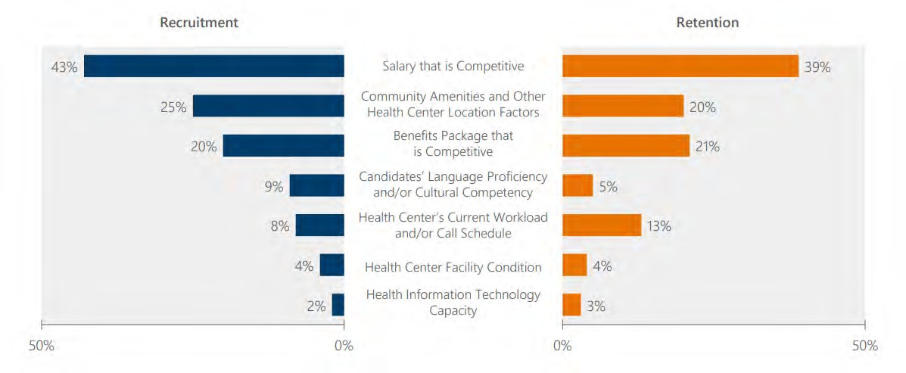
HEALTH CENTERS HAVE UNIQUE CHALLENGES RECRUITING AND RETAINING STAFF
Percent of Health Centers Reporting Specific Challenges for Recruitment and Retention
Source: NACHC Staffing the Safety Net: Building the Primary Care Workforce at America’s Health Centers. 2016

Slide 6
PRIMARY CARE CANDIDATE POOL IN KENTUCKY
Active Primary Care Physicians
3,453
KY Medical School Graduates Who Match to Primary Care 885 (over 5 years)
Active PCPs under 60
2,417
Estimated Number that will practice primary care
446 (89/year)
Available due to 7% turnover
169
Residents who will practice in Kentucky each year
40
Total PCP Annual Candidate Pool in Kentucky 209
Kentucky ranks #25 in the nation in retaining medical school graduates (45%) regardless of where they go for residency
Sources: 2019 AAMC State Physician Workforce Data Book, Kentucky’s Primary Care Workforce: Current Status and Output of New Trainees January 2020 Update

Slide 7
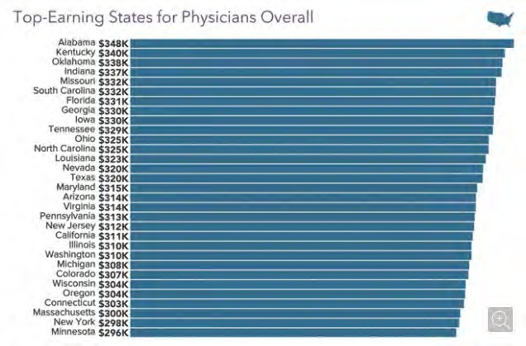
2021 TOP-EARNING STATES FOR PHYSICIANS OVERALL
Source: Medscape Physician Compensation Report 2021: The Recovery Begins

Slide 8
PHYSICIAN RECRUITMENT: BY THE NUMBERS
6-7% or 50,000 physicians will accept new positions in 2022.
Takes 6 – 9+ months to recruit most specialties.
Up to $250K invested in a candidate, including marketing, interview expenses, sign-on bonus and relocation stipend.
Lost revenue can easily reach $1 million during a single vacancy.

Slide 9

Physician Recruitment
Digital sourcing is the smart way to quickly and cost effectively engage the right candidates and score better hires

Slide 10
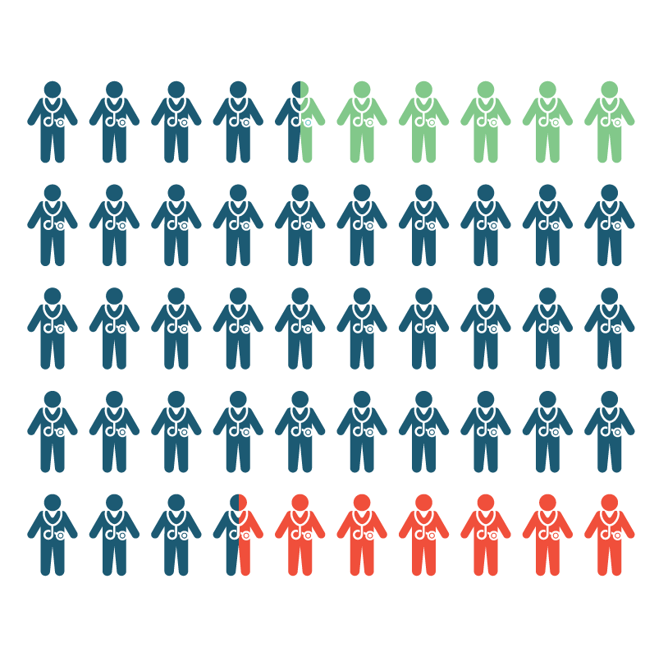
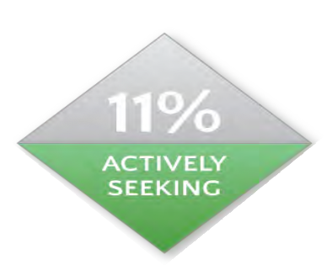
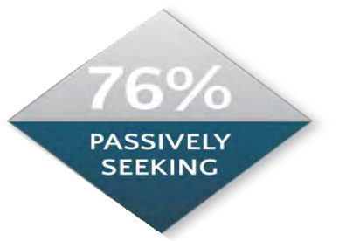

LOW SUPPLY & HIGH DEMAND: REACHING ACTIVE & PASSIVE CANDIDATES
SEARCHING FOR JOBS
INTERESTED, BUT NOT PROACTIVE
HAPPY IN CURRENT POSITION

Slide 11
HOW TO RISE ABOVE THE NOISE
97% of physicians prefer to receive job opportunities by email and 75% want them sent to their personal email
86% of physicians check their email 2-3 times per day
60% of physicians have used job boards for their own job search
16% of physicians say they read direct mail

Slide 12


BE EFFICIENT AND STRATEGIC
Email Blasts
48-HOUR LAUNCH
Social Networks
Job Boards
Proprietary CRM

Slide 13

CRAFTING AN AGILE AND STRATEGIC DIGITAL RECRUITING FOOTPRINT
BUILD
Effective Job Ads Physician Database Social Media Network
BUY
Mobile Compliant Website
Email Marketing System
Job Board Subscriptions
TEACH
Digital Networking
Effective Communication and Best Practices
Candidate Vetting Process

Slide 14
49%
BEWARE...YOU MUST BE RELEVANT
16%
are contacted
once per week
of physicians get
weekly
job opportunities
Less than
10%
of recruiter communications are
relevant
39%
receive multiple
contacts
per week
Source: Doximity Physician Survey

Slide 15
CRAFTING AN AGILE AND STRATEGIC DIGITAL RECRUITING PROCESS
Post (and Advertise) Jobs
Create Brand Awareness
Source Candidates
Share Content
Build Network

Slide 16





DIGITAL CANDIDATE SOURCING
JOB BOARDS
Resume Search
Job Posting
EMAIL
Targeted and Specific
Engaged Database
Test and Optimize
SOCIAL MEDIA
Follow Industry Leaders
Join Discussion Groups
Use Targeting Tools
DOXIMITY
Talent Finder Tool
Ultra Targeted DocMails

Slide 17
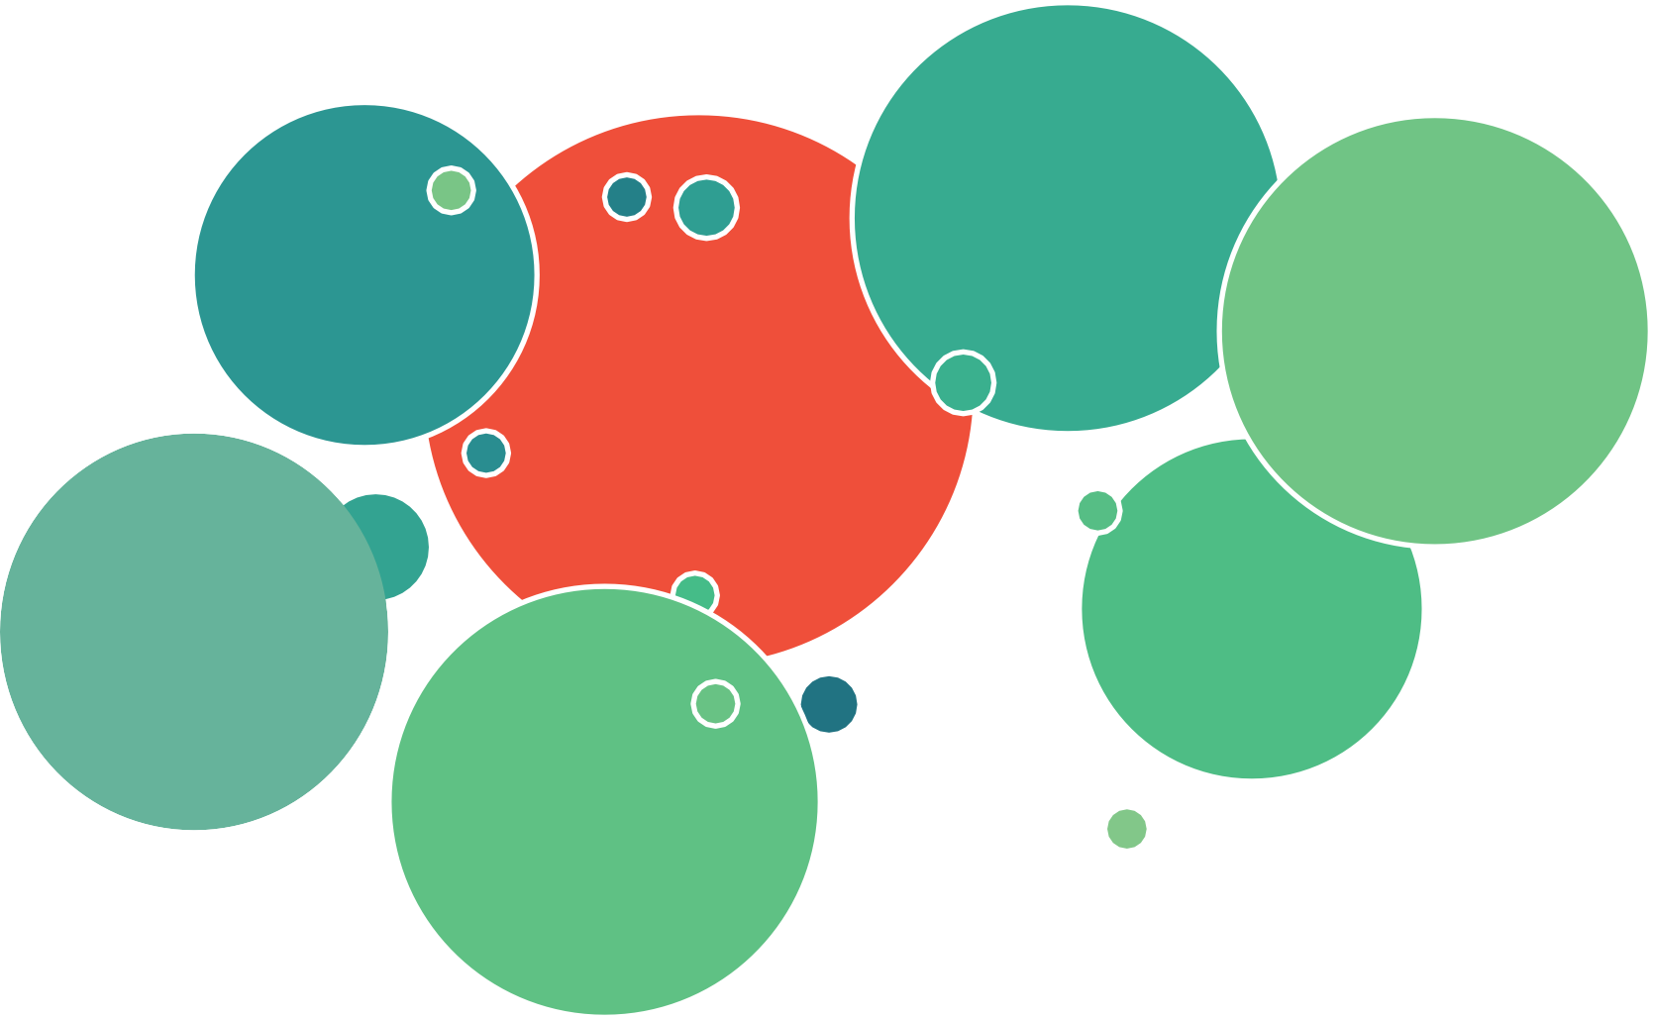
SHARING VALUABLE CONTENT AND BUILDING A NETWORK
Target Your Audience on Social Media
Identify Physician Champions & Influencers
Boost Posts to Targeted Audiences
Network Online & Offline
Attend Virtual Job Fairs
Publish Relevant Content
Join Social Media Groups

Slide 18


POSTING AND ADVERTISING JOBS
₁ Make it Appealing to
Both Search Algorithms
and Humans.
2
3
Partner with Marketing or a Creative Colleague to Create Engaging Images.
Put Money Towards Boosting and Advertising.

Slide 19
Physician Retention
Focus on clinical and cultural fit

Slide 20

A CULTURAL BLUEPRINT FOR PHYSICIAN RERUITMENT AND RETENTION

Slide 21
THE BUILDING BLOCKS OF CULTURE
What Culture is
Why You Benefit
Shared mission
Behaviors that align with values
Top reason for turnover
How to Build
Competitive advantage Improved performance
Successful recruitment and retention
Assess your baseline through surveys
Follow a plan to close the gaps
Continuously measure and improve
Provide strong leadership and clear communication

Slide 22
PHYSICIAN SATISFACTION FACTORS
MGMA Surveyed Physicians and
Administrators Summer 2021
Average Physician Rating – 5.5
25%
Why Physicians Stay
Stability of base salary
Non-compete clauses
Having to move the family
Sense of duty/calling
Devotion to patients/Love the work
20%
15%
10%
What Drives Satisfaction?
Two-way communication
Additional compensation
Reduced administrative burden
Additional time off
Equity in workload
5%
0%
0
1
2
3
4
5
6
7
8
9
10
0 1 2 3 4 5 6 7 8 9 10
MGMA, Recruitment and Engagement Survey, 2021
- 22 -

Slide 23
LINK BETWEEN CULTURE AND BUSINESS HEALTH
Favorable Workplace Culture Results in:
33% improvement in quality
41% reduction in absenteeism
50% drop in patient safety incidents
Source: “Gallup’s Approach to Culture | Building a Culture That Drives Performance”
23

Slide 24
CULTURE & ENGAGEMENT: MORE IMPORTANT THAN MONEY FOR LONG-TERM RETENTION
Trust in the healthcare organization’s leadership team
Quality of communication across the healthcare organization
The two elements that have the strongest connection to satisfaction
Source: “The Engagement Gap,” Jackson Healthcare, 2016

Slide 25
Physician Retirements
More than 2 of 5 physicians will reach retirement age in the next 10 years per AAMC

Slide 26
THE REALITIES OF PHYSICIAN RETIREMENTS
Key survey findings:
Physicians feel it’s their responsibility to initiate the retirement conversation, but they are less comfortable doing so than administrators.
Physicians and administrators have vastly different opinions on what the ideal notice period is for retirement.
Administrators assume many physicians will fully retire but a number plan to work elsewhere.

Slide 27
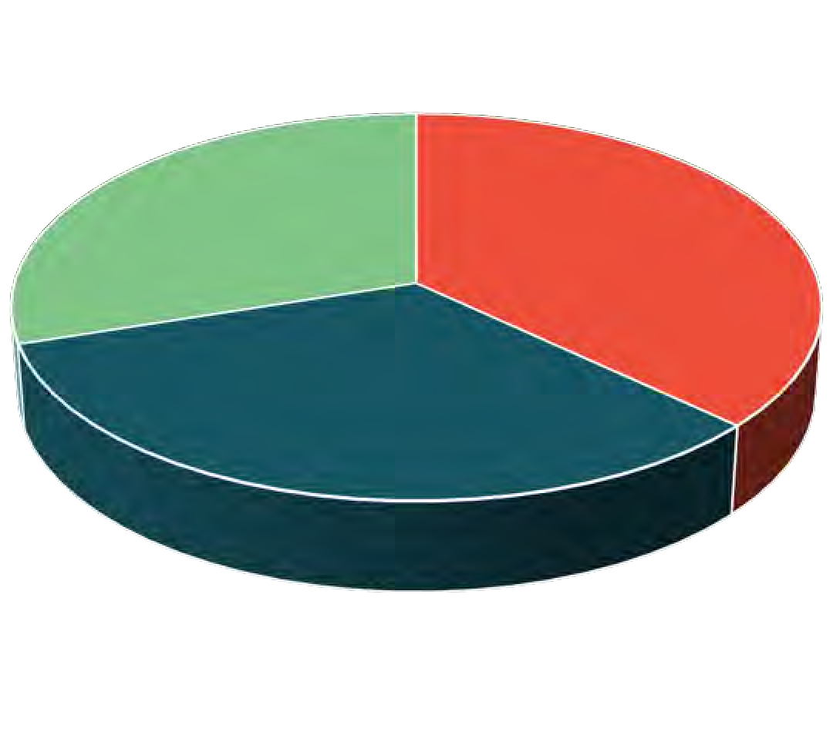
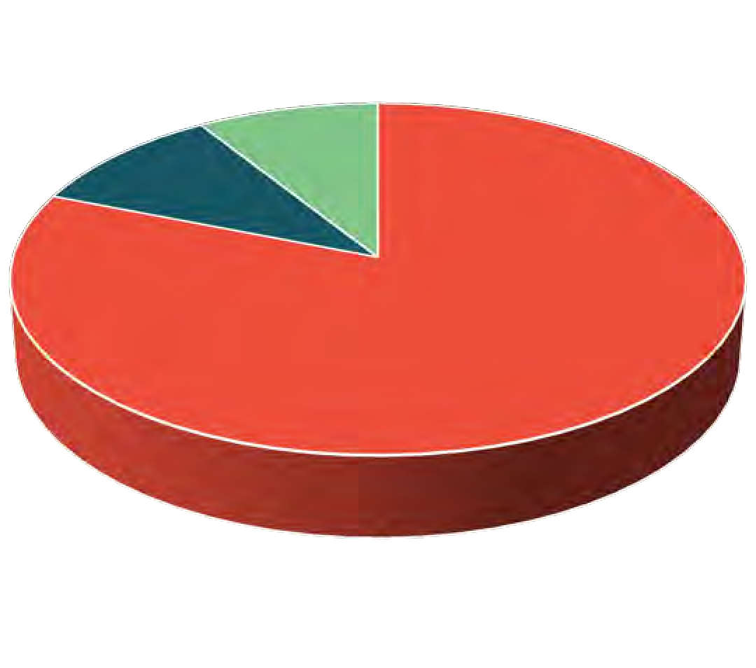
WHOSE RESPONSIBILITY IS IT TO INITIATE THE RETIREMENT CONVERSATION?
Administrators Physicians
Other 9%
Other 30%
Employer 10%
Physicians 37%
Physicians 81%
Employer 33%

Slide 28

HOW COMFORTABLE ARE YOU HAVING THE RETIREMENT DISCUSSION?
52% of Physicians are comfortable or extremely comfortable.
74% of Administrators are comfortable or extremely comfortable.
28

Slide 29
CHALLENGE: INITIATING THE RETIREMENT DISCUSSION
Physicians feel strongly about driving the retirement conversation, yet only half are comfortable or extremely comfortable having it.
Administrators are concerned about having the conversation for a variety of reasons, i.e. age discrimination.
There’s no established process for initiating the conversation on either side, including who is responsible.
28

Slide 30
WHEN IS THE IDEAL TIME TO PROVIDE NOTICE OF RETIREMENT?
Administrators
Physicians
<3 Months
<3 Months
3-6 Months
3-6 Months
6-9 Months
6-9 Months
9-12 Months
9-12 Months
1-3 Years
1-3 Years
>3 Years
>3 Years
Other
Other
0% 10% 20% 30% 40% 50% 60%
0% 5% 10% 15% 20% 25% 30%
30

Slide 31
HOW LONG WILL IT TAKE TO FILL A VACANCY?
Average Days to Fill
Primary Care
Specialty Care
Surgery
All
190
200
210
220
230
240
250
260
31

Slide 32
CHALLENGE: HOW MUCH NOTICE IS NEEDED TO FILL A VACANCY?
It’s important to know your time-to-fill benchmarks.
Establish appropriate standards for retirement notice and communicate it to physicians.
Build in a contingency plan for recruitment because it may take longer than expected, i.e. consider locums, part-time, etc.
31

Slide 33
HOW DO PHYSICIANS TRANSITION TO RETIREMENT?
Administrators
Physicians
Reduce Hours Over 1-3 Years
Reduce Hours Over 3-5 Years
Retire Fully
0% 10% 20% 30% 40% 50% 60%
Retire and Work Elsewhere
Reduce Hours Over 1-3 Years
Reduce Hours Over 3-5 Years
Retire Fully
0% 5% 10% 15% 20% 25% 30%
31

Slide 34
KEY TAKEAWAY: IMPROVE RECRUITMENT ROI AND MAXIMIZE REVENUE
Interview-to-Hire Ratio
Acceptance Rate
Reduce Interview-to- Hire Ratio from 5:1 to 3:1 for a Cost Savings of $18,000
* Estimating $6,000 per Interview in travel and team hours
Shorten Vacancy
Improve Acceptance Rate by 20% for a Cost Savings of
$24,000
Shorten Vacancy Time by 60 days for Revenue Gain of
$138,000
* Given $828,000 average revenue per primary care physician per year (specialists will be more)
* Estimating $24,000 to restart search and resume interviews for declined offer

Slide 35
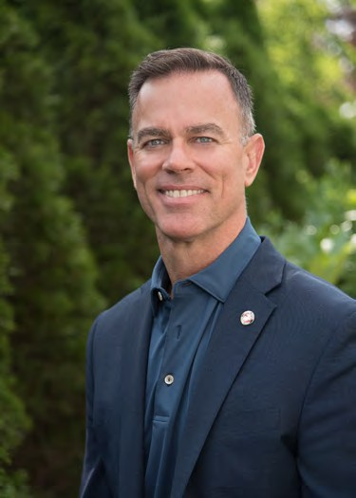

QUESTIONS?
Tim Sheley
Executive Vice President
770.643.5554
sheley@jpsearch.com
Carly Clem
Sr. Director of Recruitment
770.643.5520
cclem@jpsearch.com

