Slide 1
Helping Health Care Professionals & Their Organizations Succeed
Healthcare Financial Management Association: An Introduction

Slide 2
Today’s Presentation
Industry overview
HFMA initiatives
Organizational overview
Benefits and resources
Get involved

Slide 3
Industry Overview

Slide 4
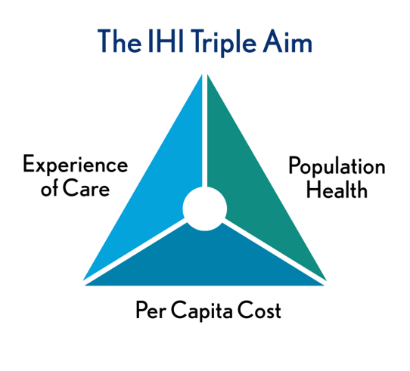
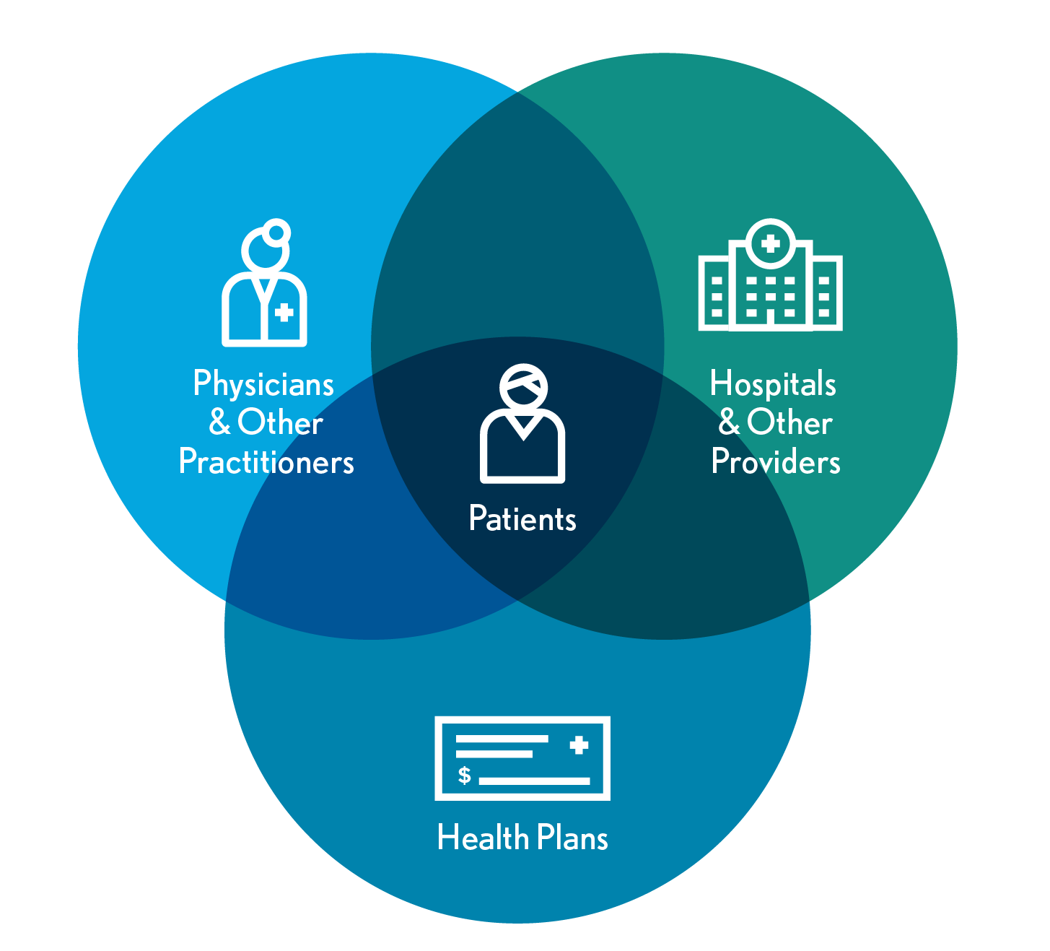
Realignment Is Erasing Traditional Healthcare Boundaries
Driven by demands for care transformation, the healthcare industry is realigning at an unprecedented pace.

Slide 5
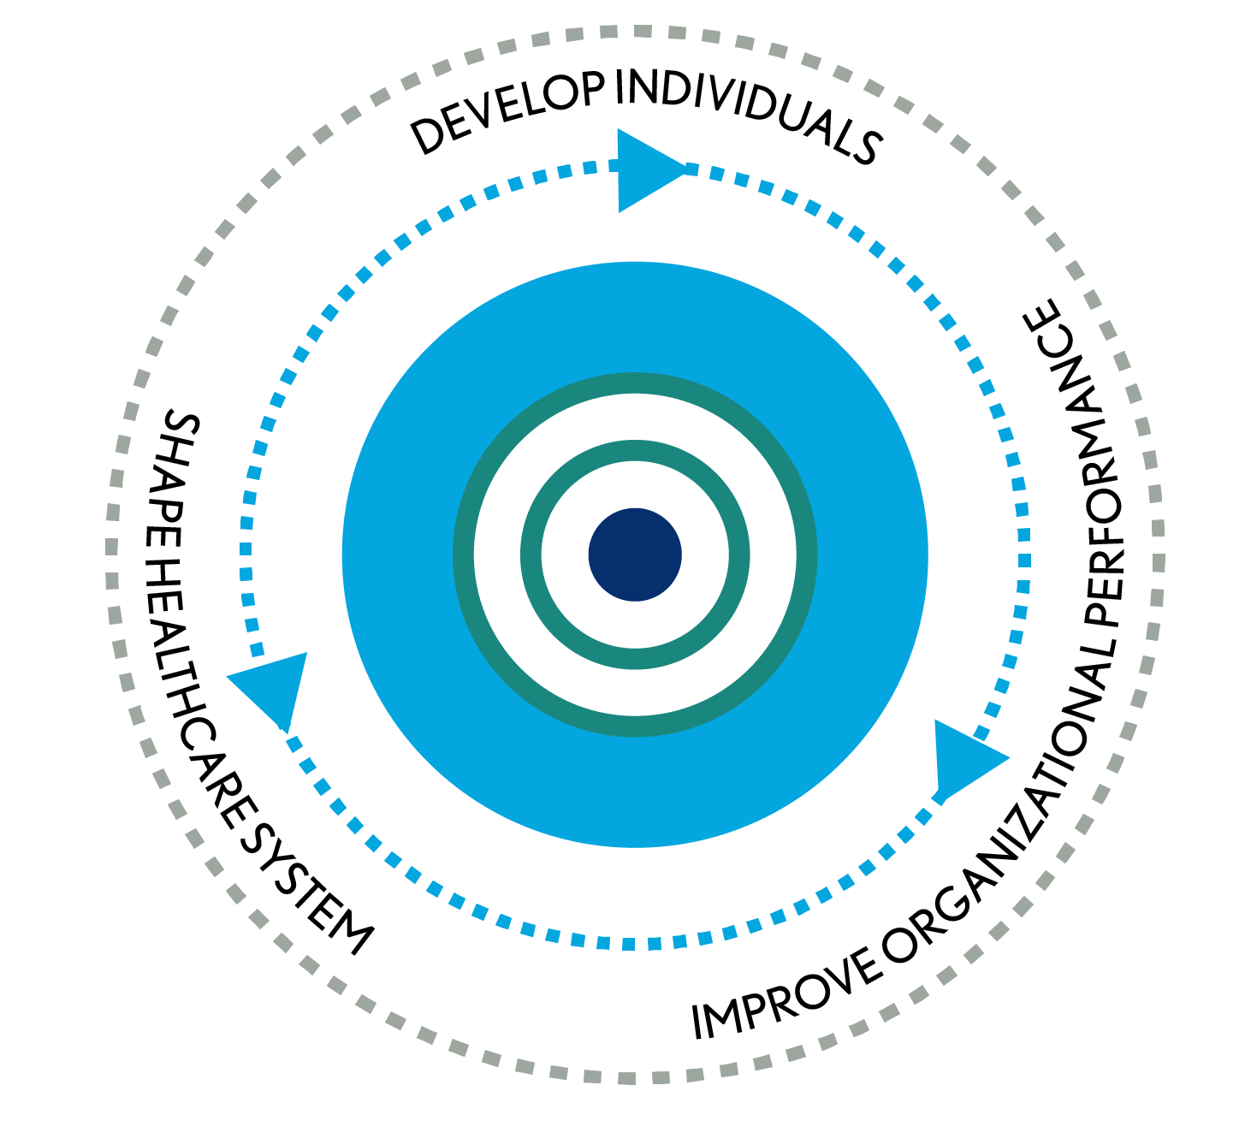
We Help Stakeholders Achieve Optimal Results
OUR MISSION
Leading the financial management of health care
OUR VISION
HFMA will bring value to the industry as the leading organization for healthcare finance

Slide 6




Thought Leadership Shapes the Future of Health Care
WHAT WE DO
Share finance perspectives to drive improvement
Convene healthcare groups to build consensus
Develop strategic frameworks to guide action
Establish principles and guidance to advance capabilities
Foster measurement and accountability for outcomes
CHANNELS
Official Comments and Testimony
Media
Other Associations and Industry Groups
Chapters
Notes:
In notes please address following: showing people that we "don't lobby" but we are the "technical experts"?

Slide 7
HFMA Helps Turn Knowledge into Action
Continuing education and training
Career development and certification
Small group-focused interactions
Information analysis and perspective
Standard setting
Organizational performance management
Problem-solving Community: online and face-to-face networking
Your Challenge. Our Mission.
Notes:
Verify "standard setting"

Slide 8
HFMA Initiatives

Slide 9

Regulatory Resources: Perspective on the Policymaking Process
hfma.org/policy

Slide 10

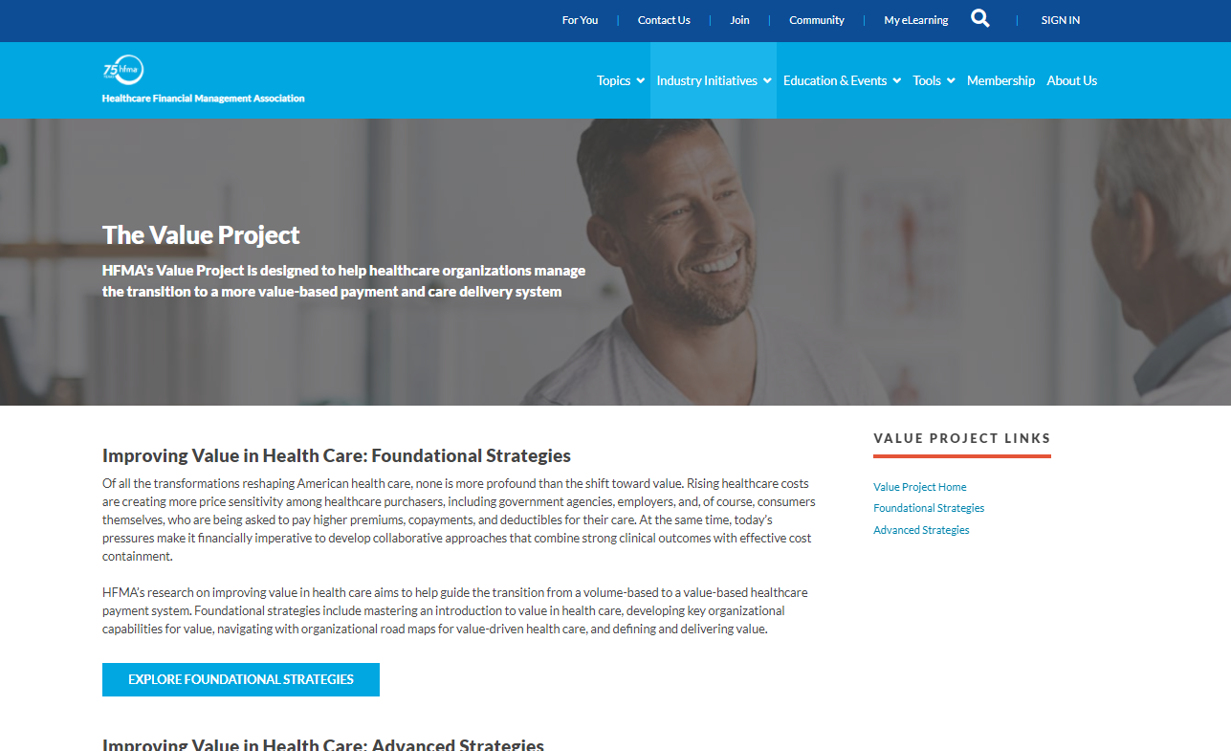
The Value Project: Discover Strategies for High-Value Health Care
hfma.org/valueproject

Slide 11

Total Cost of Care
Includes three studies:
Growth of population-based payments is not associated with a decrease in market-level cost growth, yet.
Market factors associated with Medicare costs and cost growth.
What is driving total cost of care? Analysis of factors influencing total cost of care in U.S. healthcare markets.
hfma.org/tcoc

Slide 12
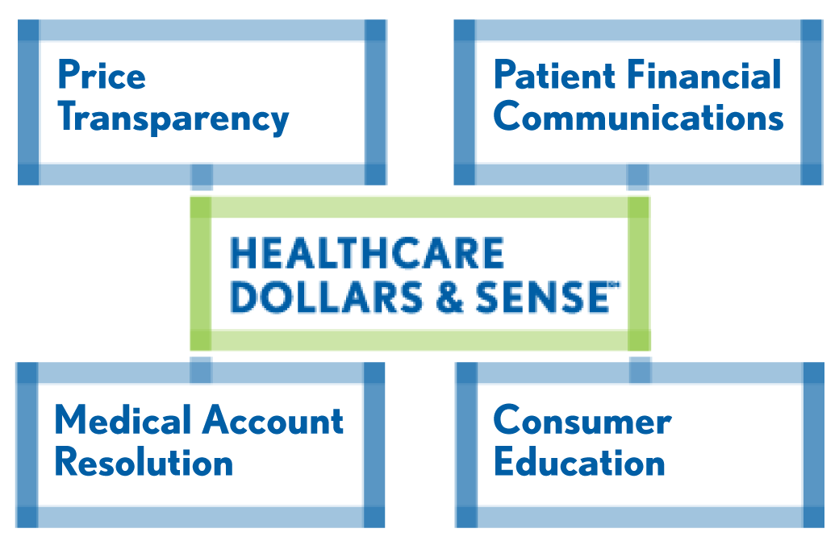
Healthcare Dollars & Sense®: Improve the Financial Experience for Patients
Achieve Adopter Recognition!
Join more than 300 healthcare organizations that have adopted HFMA’s best practices for patient financial communications.
Ensure that your organization’s policies reflect consumer needs in the high-deductible health plan era.
Learn from the revenue cycle self-assessment that’s part of the application process.
hfma.org/dollars

Slide 13


Educate Consumers, Improve Transparency
hfma.org/dollars

Slide 14
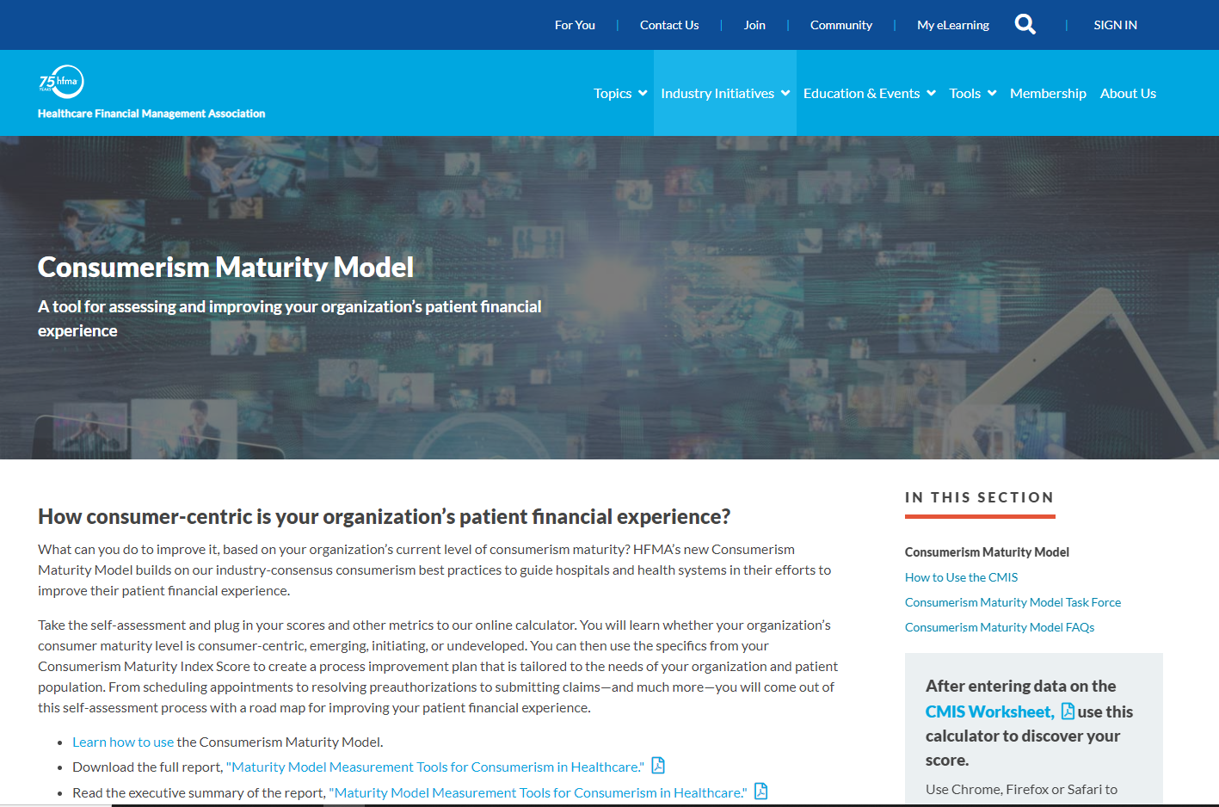
Equip Staff for Success in the Consumerism Era
Agenda for live onsite training for your patient access staff
Slide deck that can be customized
Sample financial policies
Coaching guidelines
Consumerism Maturity Model

Slide 15
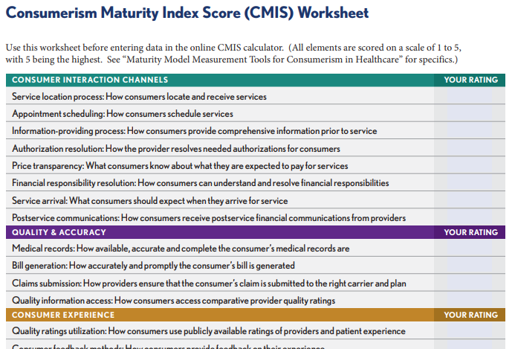
Consumerism Maturity Model
Self-assessment tool, online
Appropriate for all providers: hospitals, systems and physician groups
Takes a consumer-first viewpoint
Identify gaps and areas for improvement
Build your roadmap for success
Designed by industry-wide task force

Slide 16

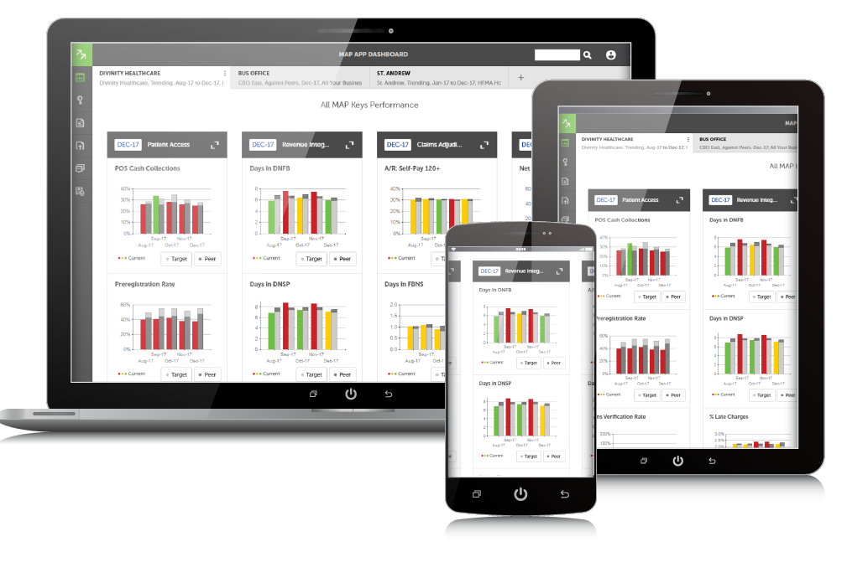
MAP: Hit Your Revenue Cycle Performance Targets
MAP Keys – industry standard KPIs
MAP Award – recognizes revenue cycle excellence
MAP App – online benchmarking tool
hfma.org/map

Slide 17
Organizational Overview

Slide 18
Professional Membership Association – serving both individuals and organizations
97%
28%
96,000+
MEMBER COUNT AS OF OCTOBER 2022
ENTERPRISE MEMBERSHIP RETENTION RATE AS OF NOVEMBER 2021
MEMBERSHIP GROWTH SINCE JUNE 1, 2020
Notes:
HFMA provides two ways to join: individual memberships and our group or organizational memberships, known as Enterprise.

Slide 19

Organizational Membership
Organizations can offer HFMA benefits and resources to all employees - administrative and clinical.
Cost effective means for providing teams with relevant healthcare finance training and tools.
Build staff competencies, knowledge and engagement.
Drive organizational performance.
Options for all sizes of provider and business partner organizations.
hfma.org/enterprise
Notes:
What Enterprise Means for Current HFMA Members
- Individual membership and benefits will not change. These members simply roll over into the Enterprise account.
- Common ground and shared experiences with a wider range of people.
Ability for providers to leverage performance benchmarking with preferred MAP App access pricing.

Slide 20
Member Career Stage
33%
29%
13%
25%
EXECUTIVE LEVEL
PROFESSIONAL LEVEL
DIRECTOR/MID LEVEL
OTHER
As of November 2021

Slide 21
Primary Member Job Functions
As of November 2021

Slide 22
Member Profiles Vary by Membership Category
17%
14%
34%
7%
33%
INDIVIDUAL MEMBERS
ENTERPRISE MEMBERS
58%
21%
33%
EXECUTIVE LEVEL
PROFESSIONAL LEVEL
DIRECTOR/MID LEVEL
OTHER
As of November 2021

Slide 23
Provider Organizations (Hospitals/Systems) Make Up Majority of Membership Base
28%
11%
3%
21%
50%
6%
30%
79%
72%
Individual Members
Enterprise Members
Total Members
HOSPITAL HEALTH SYSTEMS
HEALTH PLANS
INDIVIDUAL
BUSINESS PARTNERS
OTHER
ENTERPRISE
PHYSICIAN GROUPS
As of November 2021

Slide 24
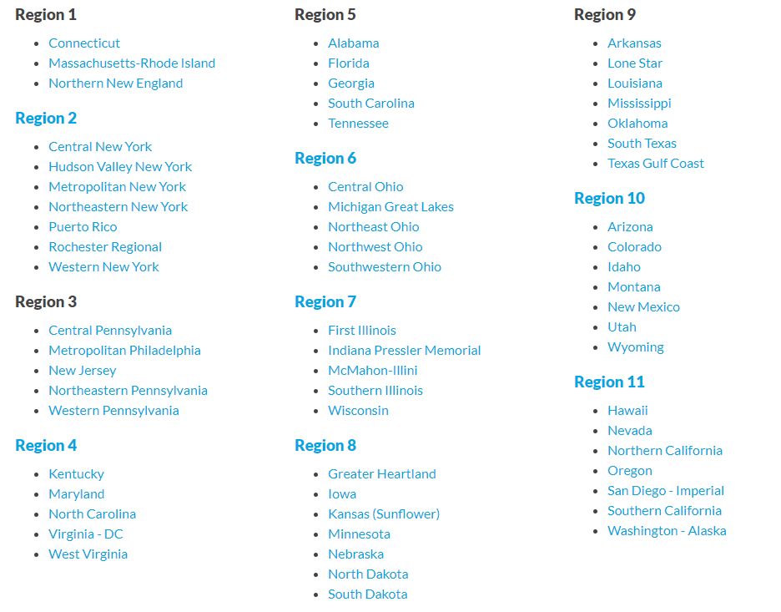
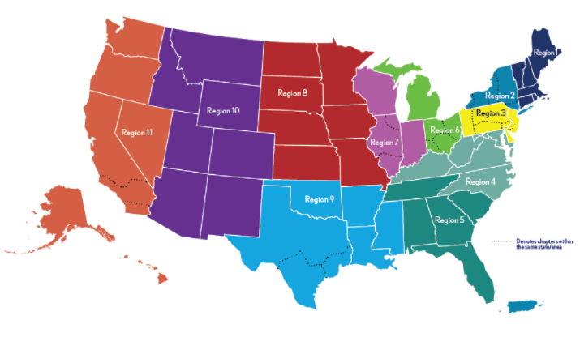
Our Members Belong to 63 Local Chapters
2022-23 Chapters and Regions
Notes:
Every member is provided free membership in one local chapter. In addition, they can get communications from additional chapters, if interested.

Slide 25



Physician & Physician Practice Engagement
For clinical leaders—the opportunity to learn the business side of healthcare.
For physician practice groups—strategies to lead the transition to value-based case.
annual.hfma.org
hfma.org/physician
hfma.org/webinars
Notes:
Invite physician colleagues to attend HFMA’s Annual Conference for a deep dive educational experience in the most pressing challenges facing physicians and practice executives.
Sign up for Physician Business Adviser, a free e-newsletter, & forward it to your physician colleagues so they can subscribe, too.
Suggest that physicians and physician practice executives check out HFMA’s webinars on topics of interest to them, such as the Quality Payment Program.

Slide 26

Heath Plan Engagement
Health plan executives stay up-to-date on the financial management of healthcare organizations.
annual.hfma.org
hfma.org/healthplan
Share HFMA reports focused on industry collaboration to deliver greater value to the patient while ensuring financial sustainability.
Notes:
Invite health plan colleagues to attend HFMA’s Annual Conference to network and hear first-hand about how physicians, providers, and health plans are collaborating in novel ways to improve quality while reducing costs.

Slide 27
When you belong to HFMA

Slide 28
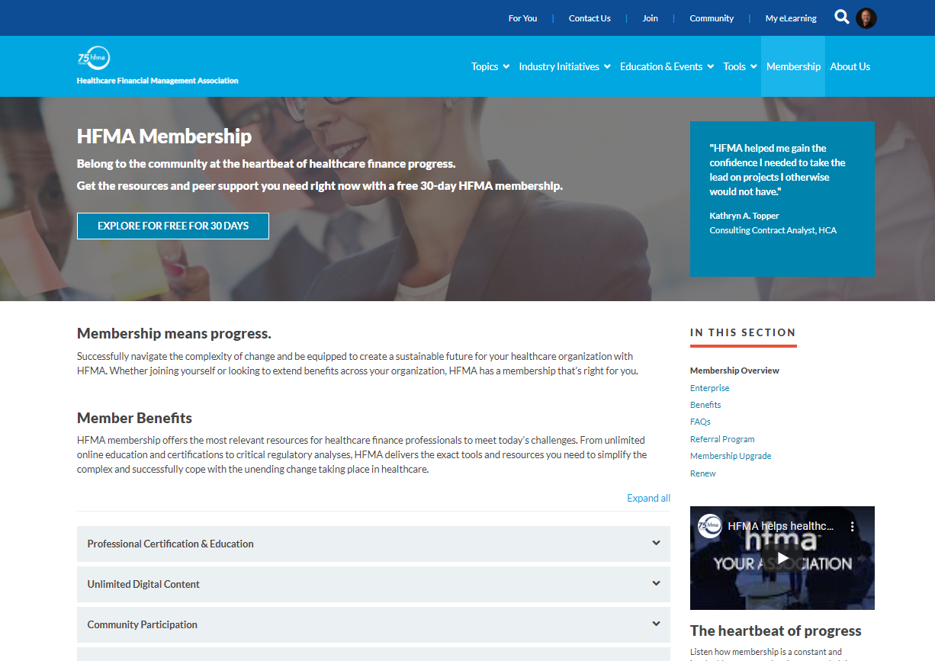
Unlimited online content, e-learning, certifications + more.
hfma.org/membership

Slide 29




Transactions Experiences
Easily find & discover
relevant information
Access what you need when you need it
Navigate the complex healthcare environment
Collaborative opportunities & communities to actively
belong & engage
Notes:
•To summarize, HFMA’s business model is to make it more user-friendly and contemporary for our members…more like what they’ve come to expect from other online entities.
•We have moved away from transactions…and about evolving improved member experiences.

Slide 30





Included with HFMA Membership
Professional Certifications
E-Learning Courseware
Community
E-Newsletters
Exclusive Member-Only Content

Slide 31
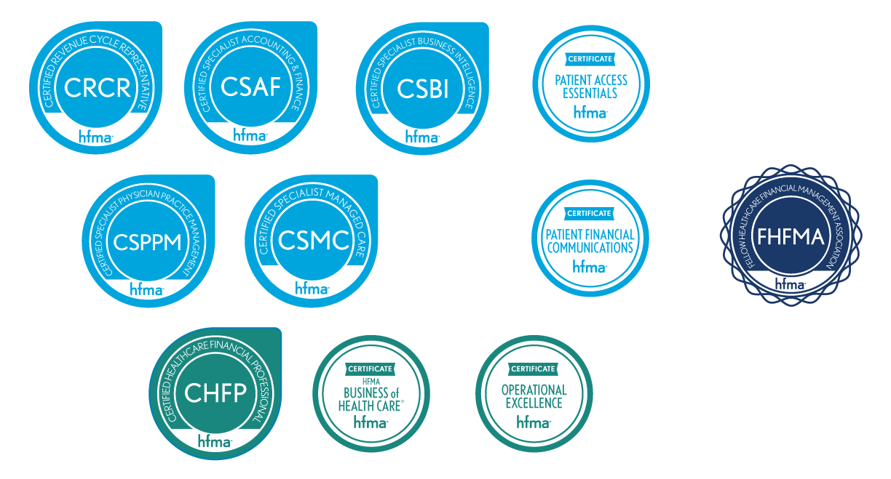

Grow: Distinguish Yourself with Certification
hfma.org/certification

Slide 32



Learn: HFMA Education – In-Person + Digital
Webinars
Notes:
More than 70 hours of webinars on topics that matter most to your success.
Virtual and live (when we can meet live again) healthcare finance education – with specific focus on revenue cycle and financial sustainability

Slide 33



Read: News, Strategies, Insights
hfm magazine
E-Newsletters
Revenue Cycle Insights
Cost Effectiveness of Health Report
Leadership
Healthcare Finance Strategies
Notes:
- Launched new digital version of HFM – now available to read with an online reader, as well as mobile app for all mobile devices, including iPhones, tablets and all Android devices.

Slide 34
Resources: Reports + More
Reports
Fact sheets
Articles
Analyses
Roundtables
Peer Review Short List
Online Knowledge Center Topics
Accounting and financial reporting
Finance and business strategy
Legal and regulatory compliance
Operations management
Payment, reimbursement, and managed care
Revenue cycle
Technology

Slide 35

Listen: HFMA’s Podcast Series
Insights from leading experts on a range of topics in healthcare finance
hfma.org/podcast

Slide 36



Connect: Stay in Touch
Community
HFMA Daily
Social Media
hfma.org
Notes:
HFMA Daily: uses Artificial Intelligence to learn preferences over time and deliver targeted healthcare finance content.
hfma.org: updated regularly with the most news, feature articles and industry blogs.
HFMA Community: your place to network, crowdsource ideas, share expertise and solutions, ask questions of your colleagues and more.
HFMA social help channels keep you connected.

Slide 37
Your HFMA

Slide 38
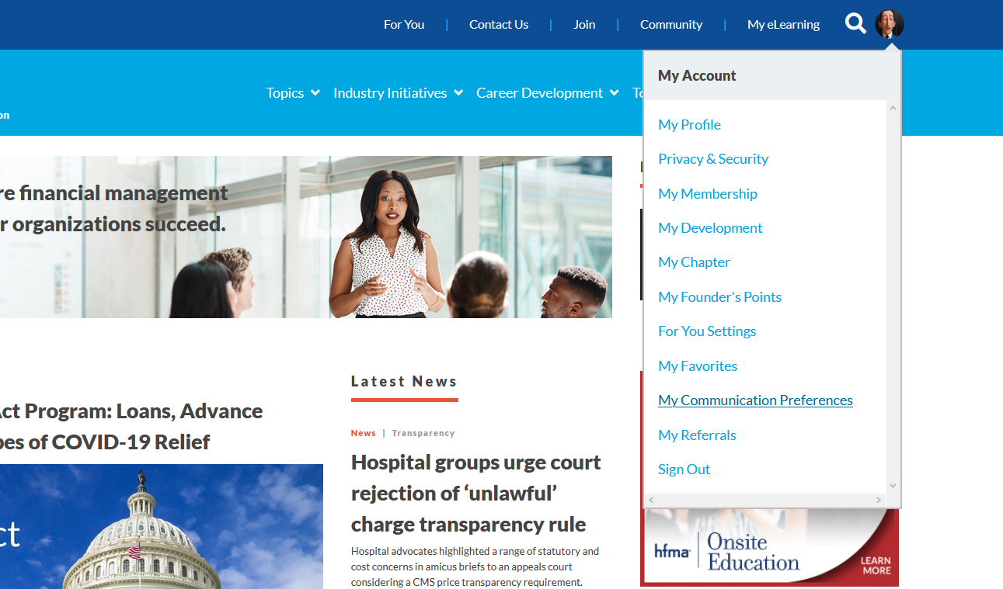
HFMA: It’s all about you.
Notes:
•The membership “button” on the top left is where you have central access to your HFMA account.
Managing your HFMA account is now centralized. From tracking CPE to paying your dues, from setting communication preferences to referring friends and associates to join, all activities are easily managed online.
- Most online content is now member-only access. (Registered Guests only get up to 5 pieces of content per month)

Slide 39
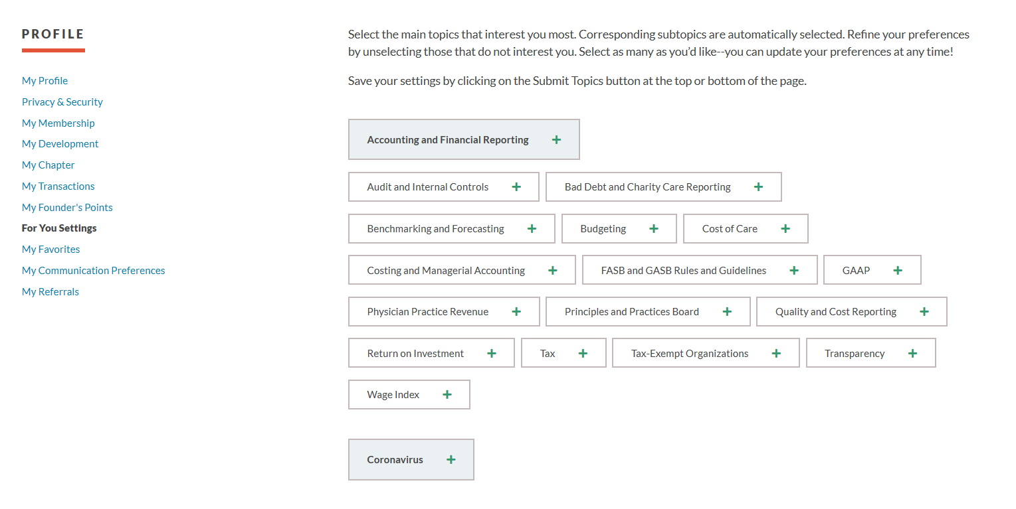
For You: A Personalized Experience
Notes:
Choose the topics that are most relevant to you.
Allows you to build your very own personal FOR YOU page on the HFMA website, which assembles content, meetings, webinars and other information from only those areas you selected.

Slide 40
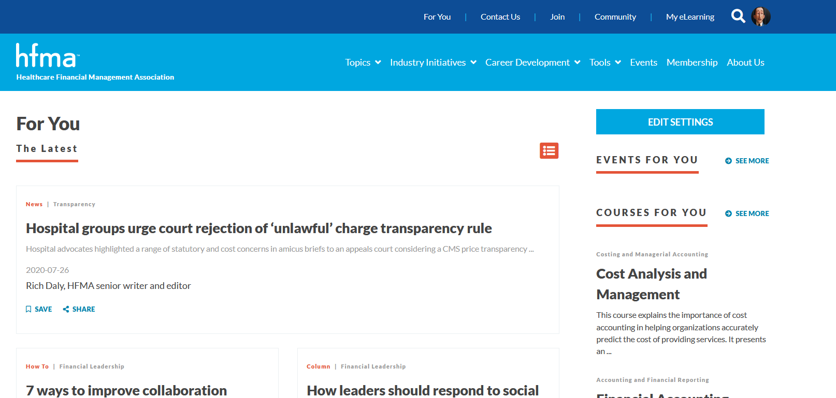
For You: A Personalized Experience
Notes:
HFMA members get a personalized web experience, whereby each member can build a custom home page on hfma.org by choosing those topics on interest that are most relevant.
Making easy edits to these subject matters assembles articles, education events and other digital assets on the member’s For You page within their HFMA online account.
•First, the “For You” section…which you can access from the navigation bar at the top of the home page.
•Here, you will have the ability to “personalize” your online experience by letting us know more about you and your professional interests.
•That way, the content you’re most interested in will be what you see first.

Slide 41
HFMA: Communication Preferences

Slide 42
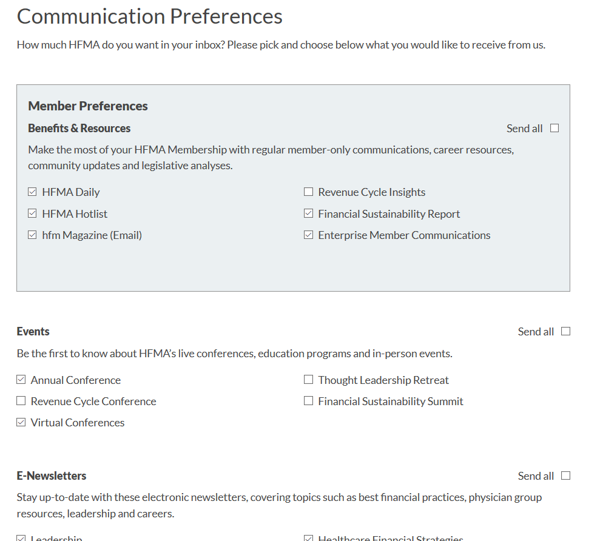
Get the info you want in your inbox.
Notes:
Cut through the clutter when you choose what you communications you want to get from HFMA.

Slide 43
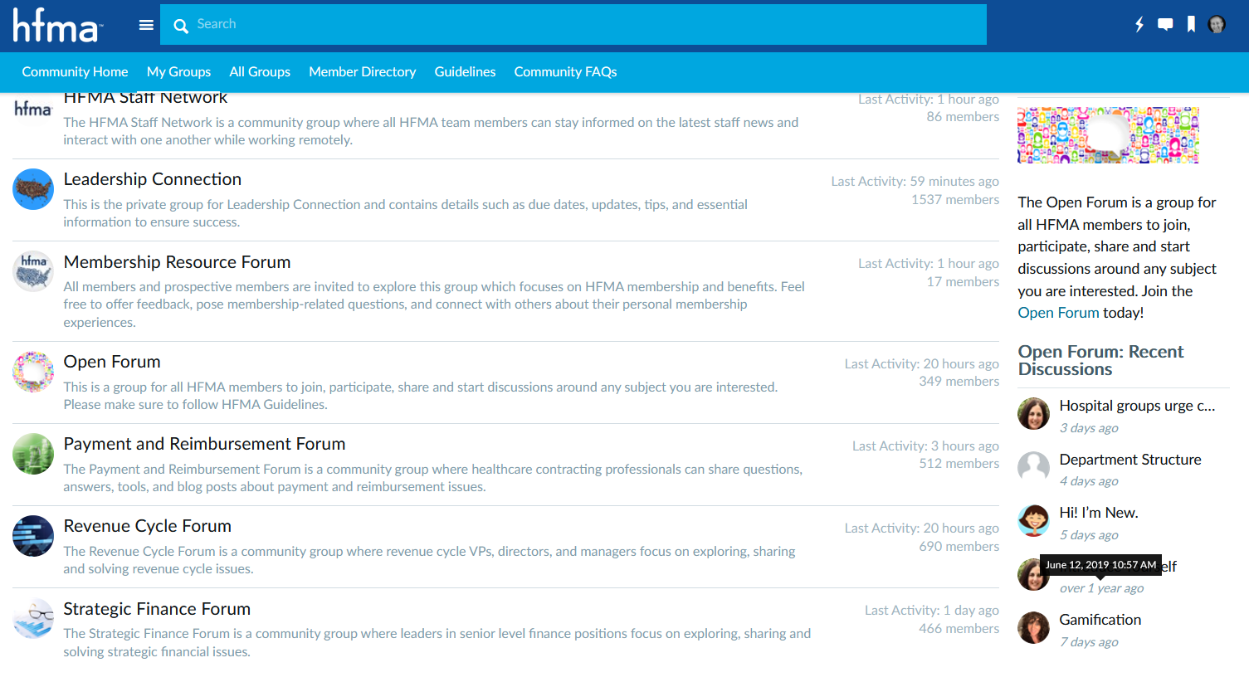
HFMA Community: Connecting & Solving Together
Notes:
Another feature of the new site that we’re especially excited about is the opportunity to become active in HFMA’s online community and conversations.
•Think of it as a professional social media site...similar to LinkedIn
•Included in this area will be access to HFMA’s membership directory…discussion boards…and subgroups of the larger community, such as chapters and topic-related forums.
•Members have the ability to contribute to the community by writing and sharing their expertise with others the HFMA site.
•We are seeing a growing number of HFMA members being active in the community, especially since the surge of the coronavirus.

Slide 44
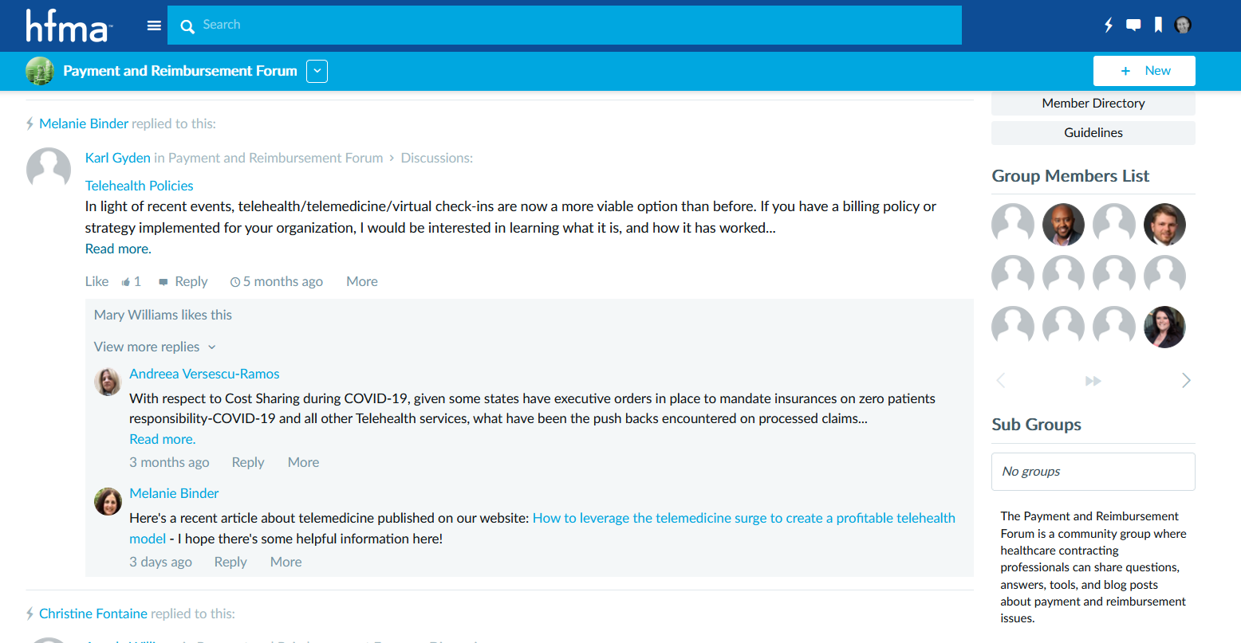
HFMA Community: Members helping members
Notes:
-

Slide 45
Get Involved

Slide 46
Participate: Get Involved
Take your place in one of HFMA’s chapters
Pursue leadership opportunities
Attend education programs
Take advantage of networking opportunities
Notes:
Add networking photos from LTC

Slide 47
Thank you.

Slide 48
Additional audience-specific slides follow.
Use in your presentations as needed.

Slide 49
HFMA for Clinical Leaders
Notes:
Presenter: Feel free to pull these slides into the deck should your audience extend to clinical leaders and/or you would like to highlight HFMA resources for clinical leaders in your presentation.

Slide 50
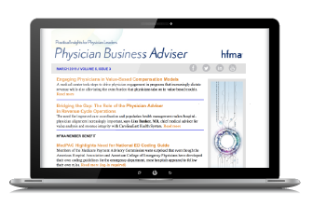

Content Dedicated for Physician Leaders
hfma.org/physician
Notes:
The Physician Business Adviser delivers insightful, real-world, and relevant business and financial advice for more than 45,000 physician leaders
To subscribe, sign-up at: Hfma.org/leadership/physician

Slide 51
HFMA's Business of Health Care
Recommended for clinical leaders
Online course on business fundamentals designed for physicians, nurses and other clinical leaders
13.5 AMA PRA Category 1 Credits; Continuing Education Credit
hfma.org/boh
Notes:
This course is certified for 13.5 AMA PRA Category 1 CreditsTM for physicians as well as continuing education credit for dentists, pharmacists, nurses, and health care executives offering hours toward Fellows of the American College of Healthcare Executives (FACHE) designation

Slide 52
Affinity Groups
Educational and networking opportunities to learn and connect with peers across the industry.
AMC CFO Council
Physician Practice Executive Council
Large System Controller Council
Value Based Healthcare Innovation Council
Financial Analytics Leadership Council
Strategic CFO Council

Slide 53
HFMA for Health Plans
Notes:
Presenter: Feel free to pull these slides into the deck should your audience extend to health plan leaders and/or you would like to highlight HFMA resources for health plan leaders in your presentation.

Slide 54

Content Dedicated to Health Plans
hfma.org/healthplan
Notes:
Check out the specific content dedicated to Health Plans within the Leadership publication
In-depth articles and analysis and blog posts focused on the health plan member
Resources dedicated to lowering total cost of care and improving health care value
Multimedia such as podcasts and webinars all tailored to the health plan member

Slide 55
Executive Councils
Educational and networking opportunities to learn and connect with peers across the industry.
Healthcare Economics Professional /BPCI/APM Council
Financial Analytics Council
Physician Practice Executive Council
Notes:
Curated groups for members interested in the various aspects of the health plan industry.
Groups are facilitated by HFMA staff and members and topics are chosen by the members.
Groups meet at the frequency desired by members both virtually and in-person.

Slide 56
Price Transparency: Role for Health Plans
What you can do:
Familiarize yourself with the guidelines
“Walk the talk”—provide information that health plans need to serve their members
Reference the guidelines in your business conversations
hfma.org/transparency
Notes:
Price Transparency report:
•Clarifies basic definitions that are often misused
•Sets forth guiding principles
•Establishes roles for health plans, providers, others
•Reflects consensus of key stakeholders

Slide 57
Member Resource: Consumer Guide
What you can do:
Read the guide to understand how consumers work with health plans and providers to obtain price estimates
Post the guide on your organization’s website
Share the link with health plan colleagues
hfma.org/consumerguide
Notes:
Consumer Guide to Understanding Healthcare Prices:
•Describes how to request price estimates, step by step
•Clarifies what estimates may or may not include
•Explains in-network and out-of-network care
•Defines key terms
•Provides information on assessing healthcare quality
The guide can be downloaded for free at hfma.org/consumerguide and posted on your organization’s website as a resource for consumers. No permission needed.

Slide 58

White Paper: Data Analytics
What you can do:
Follow the link and read the collaborative report
Share this link with health plan colleagues
hfma.org/analyticswhitepaper
Notes:
The move to value-based care requires a more efficient approach to running the business of health care and providing care at the front lines. Use of data analytics can help reveal new opportunities for increased savings and revenue and improved operations, which can drive efficiency across an organization.
This white paper addresses why data analytics can be a valuable tool and how good data and use of data analytics tools can lead to:
More efficient operations
Bottom-line improvements
Higher-quality, more efficient care
It also highlights how strategic collaborations can make data analytics efforts affordable and more successful and the importance of the leader’s role in championing data analytics

Slide 59
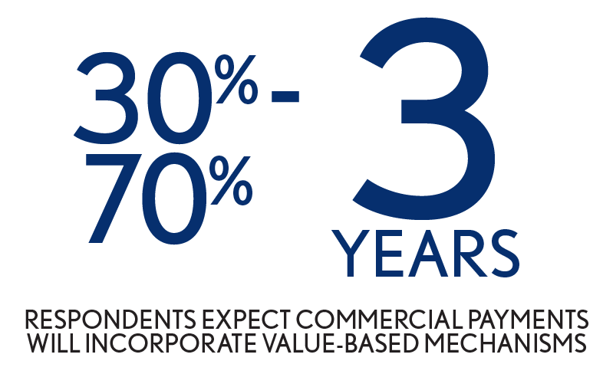
Value-Based Payment Readiness Survey*
What you can do:
Use this health plan-sponsored research as a springboard for discussion with your health plan colleagues
Talk about the obstacles faced by both providers and health plans and how ─ together ─ you can overcome them
hfma.org/surveyreadiness
* Research conducted with support from Humana
Notes:
HFMA, in conjunction with Humana conducted research to determine readiness for Value Based Payment. Key findings were:
Obstacles: Physician buy-in on value proposition, lack of interoperability, ownership of the challenges and consumer engagement in move to value.
Additional Findings: Social determinants account for 60% of factors contributing to health and are not easily addressed alone.
Key Action Step: Traditional stakeholders will need to work closely with community agencies, state agencies, and schools, among others

