Slide 1






Toyon University® Presents
Medicare Cost Report
CMS Proposed Changes
Minnesota Chapter
hfma Regulatory Conference
November 3, 2022
Notes:
Fred

Slide 2
Background
Initial Release Nov 2020
Re-Release June 2022
OMB: 0938-005 https://omb.report/icr/202206-0938-017
Finalized TBD
Many changes impact cost reports beginning on/after October 1, 2022 unless otherwise noted (i.e., stem cell changes effective for cost reports on/after October 1, 2020)
Requirement under the Paperwork Reduction Act (PRA)
CMS requested expedited review due to stem cell transplant acquisition reimbursement (cost reports beginning on or after 10/1/20).
OMB Response to Comments https://omb.report/icr/202206-0938-017/doc/122449600
Current CMS Instructions: https://www.cms.gov/Regulations-and-Guidance/Guidance/Transmittals/Transmittals/r17p240
Comments were due July 22, 2022. Toyon Comments: https://www.toyonassociates.com/2022/07/15/comments-on-proposed-cost-reporting-instructions/
Notes:
Fred

Slide 3
Agenda | Contents
Content | Pages
Worksheet S-10 Uncompensated Care | 4 – 23
Empirical DSH | 23 – 30
Medicare Bad Debt | 31 – 37
Organ Acquisition | 35 – 49
Other Proposed Cost Report Changes | 50
Notes:
Fred

Slide 4

Worksheet S-10 Uncompensated Care
Notes:
Fred

Slide 5
Notable Proposed S-10 Changes
1. Acute Care Only
(S-10 Pt II)
2. Charity and Uninsured Discounts are
“Medically Necessary”
3. Charity Clarifications
- Patient Liabilities
- Inferred Contracts
4. New Exhibits
- 3B Charity
- 3C Bad Debts
“CMS does not mandate the eligibility criteria that a hospital uses under its financial assistance policy.”
Notes:
Fred

Slide 6
Acute Care Only (Worksheet S-10 Pt II)
Worksheet S-10 Pt II
Inpatient and outpatient services billable under the Hospital CMS Certification Number (CCN)
Worksheet S-10 Part I
Inpatient and outpatient services for the entire hospital complex
“Effective for cost reporting periods beginning on or after October 1, 2022, Worksheet S-10, Part II, provides for the collection of uncompensated and indigent care data for inpatient and outpatient services billable under the hospital CCN. The data reported on Part II is a subset of the data reported on Part I.”
“The Worksheet S-10, Part II data will be collected so that CMS may consider the general short-term hospital inpatient and outpatient detailed information, in future years, in determining the scope of the UCC data for purposes of the uncompensated care payment methodology.” (https://omb.report/icr/202206-0938-017/doc/122449600)
Notes:
Fred

Slide 7
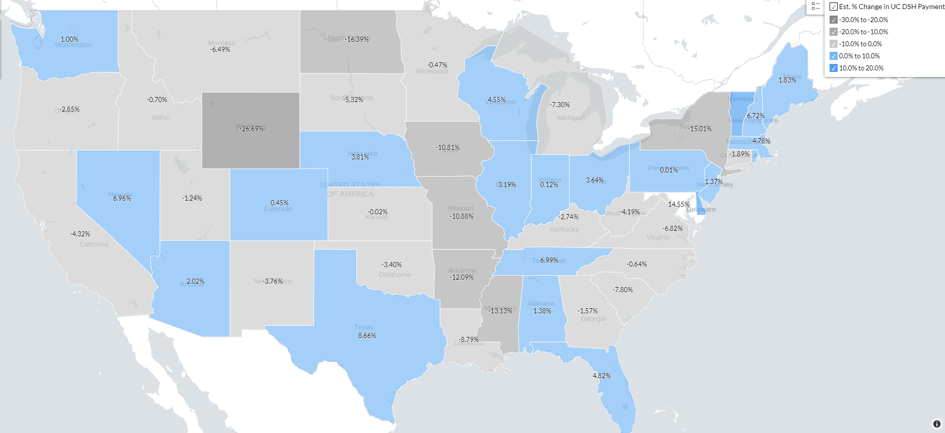
Acute Care Only (Worksheet S-10 Pt. II)
Est. Impact Using FFY 2023 UC DSH Payments
*Est. change applying each DSH hospital’s percentage of non-acute days to UC costs. Days per FFY 2020 Medicare cost report Worksheet S-3 Pt. I.
Notes:
Fred

Slide 8
Medically Necessary Services
CMS Proposed Instruction
Industry Opposition
Reporting Medically Necessary Claims*
Charity care and uninsured discounts result from a hospital's policy to provide all or a portion of medically necessary health care services free of charge to patients who meet the hospital’s charity care policy or FAP
Subjectivity of “Medically Necessary”
Reporting and audit variation concerns
Care provided to low-income patients is medically necessary
Care could have been provided in lower cost setting
Unreasonable E&M
Excessive therapy or diagnosis procedures
Unrelated services, screenings, test, etc. for patient diagnosis
*Items & Services Not Covered Under Medicare:
https://www.cms.gov/outreach-and-education/medicare-learning-network-mln/mlnproducts/downloads/items-and-services-not-covered-under-medicare-booklet-icn906765.pdf
Section 1862(a)(1)(A) of the SSA - No payment may be made under Part A or Part B for any expenses incurred for items or services not reasonable and necessary for the diagnosis or treatment of illness or injury or to improve the functioning of a malformed body member. (https://omb.report/icr/202206-0938-017/doc/122449600)
Notes:
Fred

Slide 9
Charity Clarifications
Current
Categories
Proposed Clarifications
Charity and Self-Pay Discounts
Insured But Uninsured for
Hospital Stay
Insured Charity Discounts
Liability Other Than Coinsurance, Copayments and Deductibles (D&C)
Non-Covered and
Denied Medicaid
Insurance Not Under
Contract with Hospital
Requirements for reporting on Worksheet S-10:
Procedure follows language in Financial Assistance Policy (FAP)
Write-offs occurs during the provider’s cost report year
Excludes Medicare bad debt claims, professional charges, prompt pay, courtesy discounts
Excludes claims from the HRSA CARES Act Uninsured Provider Relief Fund (PRF) ← Included in Proposed Instructions
Services must be medically necessary ← Included in Proposed Instructions
Notes:
Fred

Slide 10
Charity Clarifications
Insured But Uninsured for Hospital Stay
S-10 Line 20, Col. 1
Enter… total charges, or the portion of total charges for insured patients that were determined uninsured for the entire hospital stay.
Charges from Exhausted Benefits
S-10 Line 20, Col. 2 and Line 25.01 Col. 1
Enter… charges, or the portion of charges, other than D&C amounts that represent the insured patient’s liability for medically necessary hospital services…
These charges include a patient’s liability from a contractual or inferred contractual relationship between a public program or private insurer and the provider.
Comments for CMS Clarification
Do these charges include non-covered and denied charges from any payor, if the provider’s FAP considers the patient to be “uninsured” in these circumstances?
Why does the S-10 explicitly and separately discuss the reporting of charges for “non-covered services provided to patients eligible for Medicaid or other indigent care programs”?
Notes:
Fred

Slide 11


Insurance Not Under Contract with Hospital
Inferred Contractual Relationship
“…a contractual relationship between an insurer and a provider will be inferred where a provider accepts an amount from an insurer as payment, or partial payment, on behalf of an insured patient (for example, payments from workman’s compensation funds, payments from an automobile insurer for medical benefits, or payments from an insurer for out-of-network services).”
Insured Charity
WS S-10 Line 20 Col. 2
WS S-10 Line 25.01 Col. 1 (CCR)
Uninsured Charity
WS S-10 Line 20 Col. 1
Charges, or the portion of total charges, for patients with coverage from an entity/insurer that does not have a contractual or inferred contractual relationship with the provider…
Charges, or the portion of charges, other than D&C amounts that represent the insured patient’s liability for medically necessary hospital services…These charges include a patient’s liability from a contractual or inferred contractual relationship between a public program or private insurer and the provider.
Includes patient regardless of whether insurer paid in full*.
  *https://omb.report/icr/202206-0938-017/doc/122449600
Notes:
Fred

Slide 12
Insurance Not Under Contract with Hospital
Example per OMB Response to Initial Comments*
Description | Amount | Worksheet S-10 Line (if specified in FAP)
Total Charges | $20,000
Payment from Insurer | (12,000)
Patient Liability | 8,000 | Line 20, Col 2 & Line 25.01 Col 1
Patient Deductible | 1,000 | Line 20, Col 2
  *https://omb.report/icr/202206-0938-017/doc/122449600
Notes:
Fred

Slide 13
S-10 Uncompensated Care Categories
CMS Proposed Clarification -
Includes Implicit Price Concessions
(ASC Topic 606 Revenue Recognition)
Net of all recoveries received during the cost report Year
Medicare and Non-Medicare
Excludes professional services; amounts reported as charity care; and obligations of insurer
Bad Debt
Notes:
Fred

Slide 14
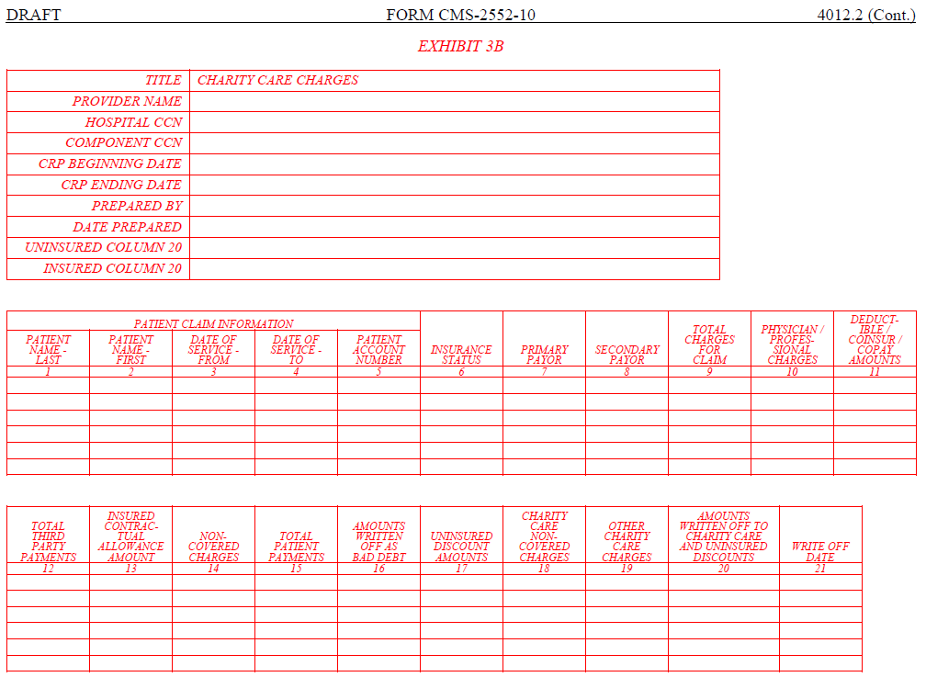
Exhibit 3B – Charity Care Listing
DSH eligible hospitals only
Sole Community Hospitals (SCH) file Exhibit 3B if DRG Payments Exceed Hospital Specific Rate (HSR) Payments
For each CMS Certification Number (CCN) in the hospital complex
Must be submitted with cost reports for cost reporting periods beginning on or after October 1, 2022
A*
B*
C*
D = A+B+C*
*Non-Physician Portion = Col 9/ (Col 9+Col 10) | Not specified in proposed instructions
Notes:
Fred

Slide 15
Exhibits 3B & 3C – Insurance Status
Insurance status at the time services were provided
Charity Care (Exhibit B, Col. 6)
3 – Patient insured
1 – Patient uninsured
2 – Patient insured, but not covered:
No Contractual Relationship
Other Payor Exhausted benefits
Medicaid Not Covered |Exhausted Benefits
Other Payor Not Covered
Bad Debt (Exhibit C, Col. 6)*
1 – Patient uninsured
2 – Patient insured, but not covered:
No Contractual Relationship
All Payors Not Covered
All Payors Exhausted benefits
3 – Patient insured
*Patient responsibility amounts only
Notes:
Fred

Slide 16

Exhibit 3B – Charity Care Listing
Primary and Secondary Payors
(Cols. 7 & 8)
Enter the payor regardless of contractual (or inferred contractual) relationship with insurer
Appears to relate to insurance status on Col. 6, whereby the payor is at the time services were provided
Issue → Payor information may be years old and in different patient accounting system
Notes:
Fred

Slide 17
Exhibit 3B – Charity Care Listing
Noncovered Charges
Non-Covered Not Allowable
(Col. 14)
Services not medically necessary and/or not included in the hospital’s written FAP
Non-Covered per FAP
(Col. 18)
Medicaid and other indigent program non-covered services
Medicaid and other indigent program non-covered charges from days exceeding LOS limit
Portion of charges for patients with exhausted benefits ←Does not stipulate Medicaid
Other Allowable
(Col. 19)
Other allowable charges per FAP
Requested clarification from CMS if other payor non-covered charges can be reported here (if in FAP)
If finalized, would create burdensome process to identify these amounts
Notes:
Fred

Slide 18
Non-Covered Charges – OMB Response to Comments*
Comment
Response
Include amounts written off to charity care for any uninsured portion of an insured patient’s hospital stay, for any insured patient who exhausted benefits, and for any non-covered services.
We appreciate the comment and incorporated this revision in the instructions
  *https://omb.report/icr/202206-0938-017/doc/122449600
Notes:
Fred

Slide 19
Exhibit 3B – Charity Care Listing
Column
Reporting Tips and Insight
Patient Healthcare Information (PHI)
Comment to CMS: Remove PHI
Coinsurance, Copays and Deductibles (D&C)
(Col. 11)
Cleanest when amts tie to Worksheet S-10 Line 20, Column 2
Insured Contractual Allowance (C/A)
(Col. 13)
Include a workpaper note what is included or excluded as the C/A amt (due not report in this column for uninsured patients). Do not use a C/A code to write-off non-covered and denied charges.
Issue → No industry standard in how D&C are determined and reported in patient financial systems
Name, Admission and Discharge Date
Notes:
Fred

Slide 20
Exhibit 3B – Charity Care Listing (cont.)
Column
Reporting Tips and Insight
Uninsured Discount Amount
(Col. 17)
Indicate patients uninsured for part of the stay in detail
Amt Written Off to Charity and Uninsured Discounts
(Col. 20)
Write-Off Date
(Col. 21)
Uninsured and Insured but Not Covered (status types 1 and 2 from Col 6) must reconcile to WS S-10, Line 20 Col. 1 (Uninsured Charity)
Patients may have multiple write-off date*
Insured (status type 3 from Col. 6) must reconcile to WS S-10, Line 20, Col. 2 (Insured Charity Care)
Recommendation to include additional listing with each patient transaction and write-off date (as opposed to per patient account)
*Per OMB -> “We revised the instructions for the “Write Off Date” column to report multiple write-off dates within the cost reporting period of the Worksheet S-10 that the listing supports by entering each date as MM/DD/YYYY separated by a semi-colon” https://omb.report/icr/202206-0938-017/doc/122449600
Notes:
Fred

Slide 21
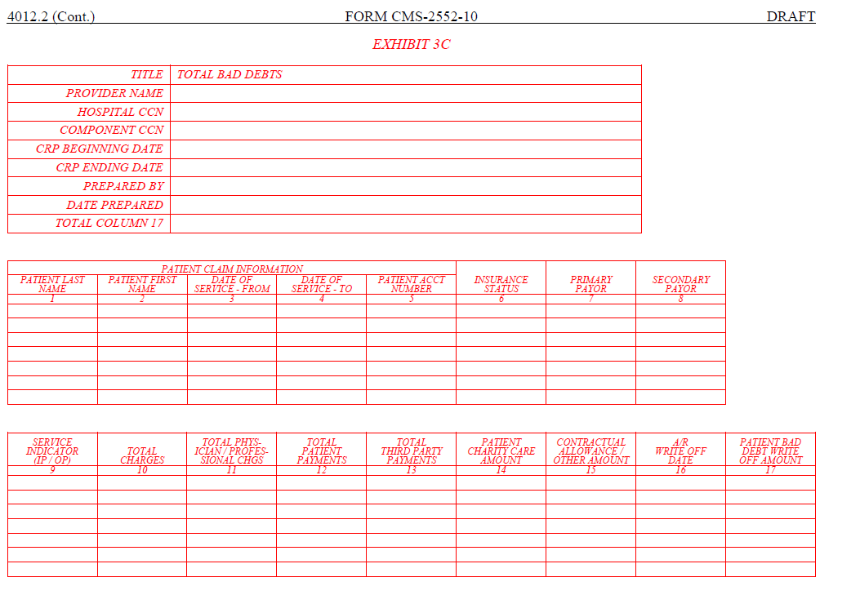
Exhibit 3C – Total Bad Debt Listing
DSH eligible hospitals only
SCHs file listing if DRG Payments Exceed HSR Payments
For each CCN in the hospital complex
Must be submitted with cost reports for cost reporting periods beginning on or after October 1, 2022
Include bad debts for Medicare patients even when an account does not meet the Medicare bad debt criteria
A
B
C
D
E
*F = A – (B+C+D+E)
*Non-Physician Portion = Col 10/ (Col 10+Col 11))
Notes:
Fred

Slide 22
Exhibit 3C – Bad Debt Listing
Column
Reporting Tips and Insight
Patient Healthcare Information (PHI)
Comment to CMS: Remove PHI
C/A | Other Amt
(Col. 15)
Include a workpaper note what is included or excluded as the C/A amt
A/R Write Off Date
(Col. 16)
Patient Bad Debt Write Off Amt
(Col. 17)
Include a workpaper clarifying definition of write-off date (i.e., date removed from active A/R as opposed to end date of collections)
Check CMS calculation for accuracy
Patient Charity Care Amt
(Col. 14)
Report all charity care associated with the account, regardless of the charity care write-off date
Name, Admission and Discharge Date
Patients may have multiple write-off dates → Include additional listing with each patient transaction (as opposed to per patient account)
Include work-paper with any necessary corrections
Must reconcile to WS S-10 Line 26
Will CMS clarify if it is needed to report each date as MM/DD/YYYY separated by a semi-colon?
Notes:
Fred

Slide 23
Polling Question #1
Under CMS’s new proposed Worksheet S-10 instructions and exhibits, preparing this detail will be…
  The same as before
  Easier
  Harder
  Doesn’t matter because its so much fun
Notes:
Scott

Slide 24

Empirical DSH
Notes:
Dylan

Slide 25
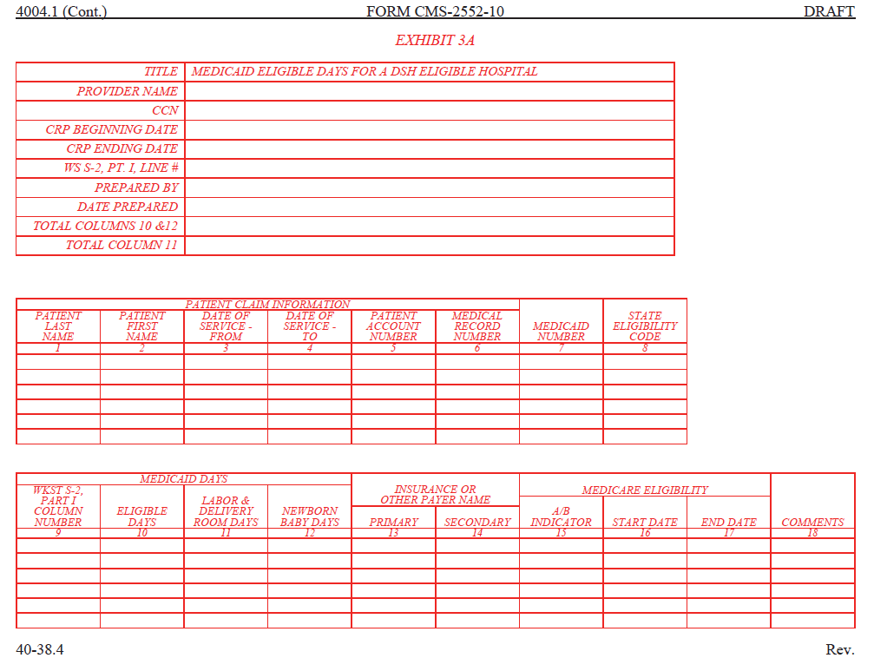
Exhibit 3A – Empirical DSH Medicaid Eligible Days
DSH eligible hospitals only
SCHs file Exhibit 3A if DRG Payments Exceed HSR Payments.
For each CCN with days reported on WS S-2, Part I, line 24 or line 25
Must be submitted with cost reports for cost reporting periods beginning on or after October 1, 2022
Notes:
Dylan

Slide 26
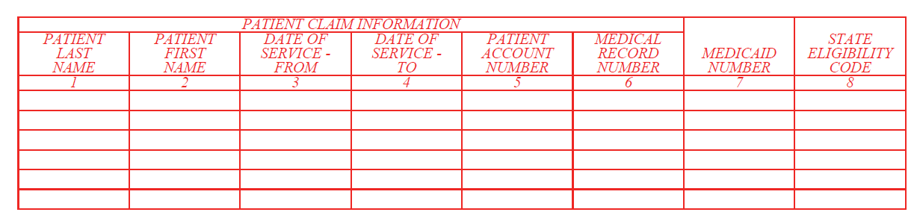
Exhibit 3A – Columns 1 through 8
Medicaid Number (Col. 7)
State Eligibility Code (Col. 8)
Enter the Medicaid Recipient Identification Number
Enter the State plan eligibility code, if available
For a Medicaid eligible newborn baby, enter the Mother’s Medicaid Number
Hospitals should enter the valid code for their state.
Notes:
Dylan

Slide 27
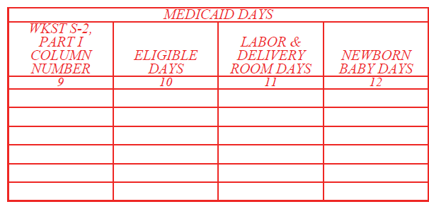
Exhibit 3A – Columns 9 through 12
Eligible Days (Cols. 9 & 10)
Labor and Delivery Days (Col. 11)
Newborn eligible days prior to the Medicaid eligible mother’s date of discharge are to be reported in Column 12
Must correspond with days reported on S-2, lines 24 and 25, columns 1 through 5
Labor and delivery days should be reported in this column and equal the number of days reported on S-2, line 24, column 6
Eligible Days and Newborn Days (Cols. 10 & 12)
If the Medicaid eligible mother was discharged and the newborn baby remained in the hospital, report those days on a separate line in Column 10
Notes:
Dylan

Slide 28
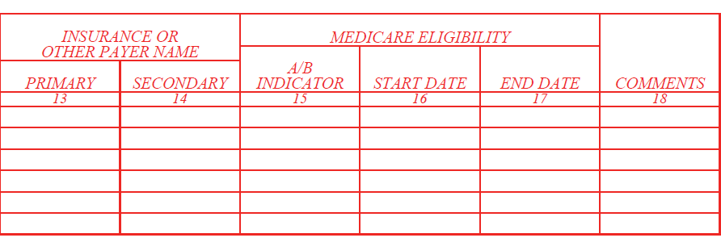
Exhibit 3A – Columns 13 through 18
A/B Indicator (Col 15)
Enter “A” or “B” to indicate the Medicare eligibility for the dates of service
If eligible for only Medicare Part A, enter “A”
If eligible for both Part A and Part B, enter “A”
If eligible for only Medicare Part B, enter “B”
Notes:
Dylan

Slide 29
Worksheet S-2 Days
Industry comment – Remove these columns and create one column for “Total DSH Medicaid eligible days”
Col 3 – Out of State Medicaid Paid Days
Col. 5 – Medicaid HMO Paid and Eligible Days (In State and Out of State)
Col. 2 – In State Medicaid Unpaid Eligible Days
Col. 1 - In State Paid Medicaid Days
Col 4 – Out of State Medicaid Unpaid Eligible Days
Col. 6 – Other Medicaid Days (Labor and Delivery)
Notes:
Dylan

Slide 30
Polling Question #2
The range of detail CMS is requesting for empirical DSH will…
  Have no change to the audit process
  Help expedite and standardize the audit
  Result in more confusion during audit
  Not sure, will wait and see
Notes:
Dylan

Slide 31

Medicare Bad Debt
Notes:
Dylan

Slide 32
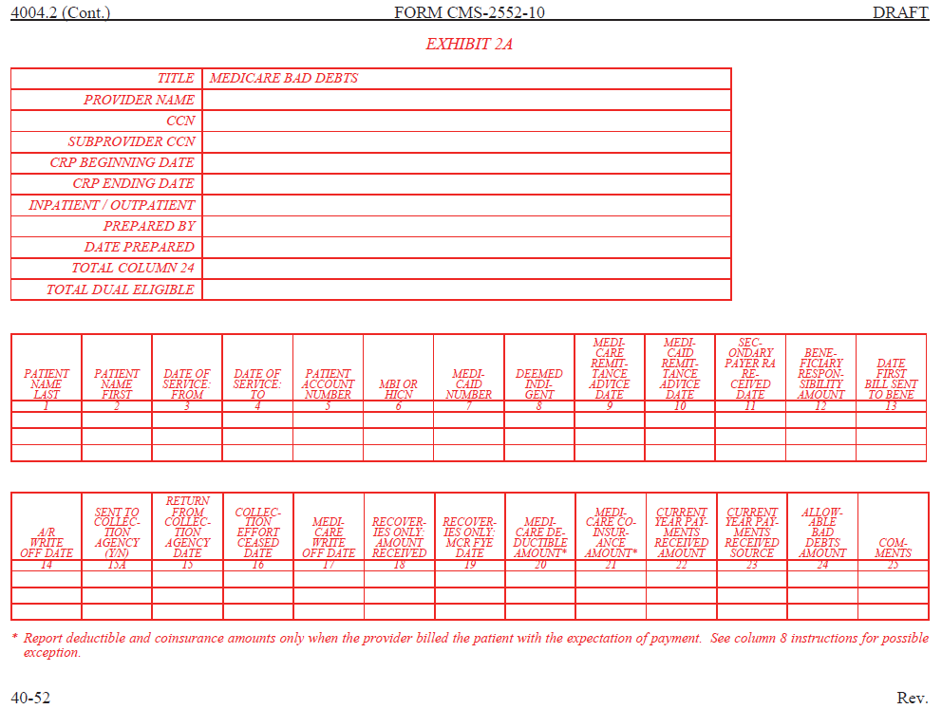
Exhibit 2A – Medicare Bad Debt Form
New (Proposed)
Notes:
Dylan

Slide 33
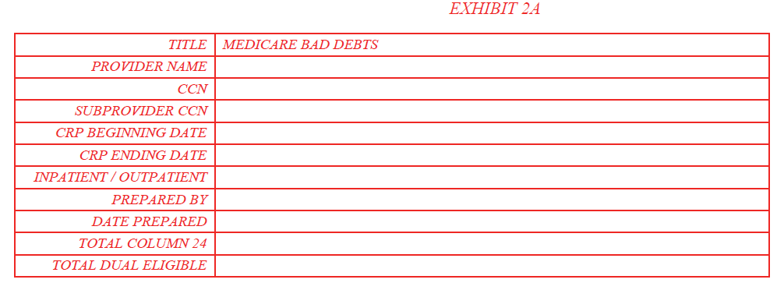
Exhibit 2A – Medicare Bad Debt Header
This requirement is for a cost report beginning on or after October 1, 2022
Complete separate exhibits for inpatient and outpatient bad debt
A separate exhibit needs to be completed for each CCN
Total dual eligible is the sum of amount in column 24 where column 7 has an entry
Notes:
Dylan

Slide 34
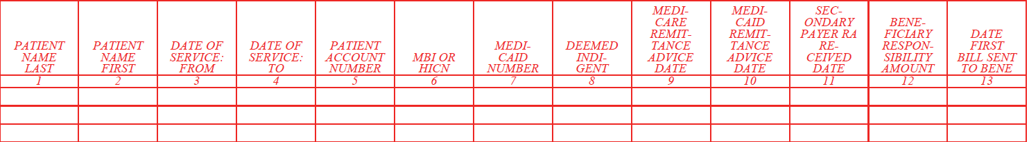
Exhibit 2A – Columns 1 through 13
Col. 8 – Enter “Y” if the Medicare beneficiary was not eligible for Medicaid but deemed to be indigent, otherwise enter “N”
Col.10 – Enter the Medicaid remittance advice date or “AD” (Alternate Documentation) if a Medicaid RA is not used to determine state liability
Col. 11 – Enter the date the remittance advice was received from a secondary payor, if applicable
Col. 12 –Enter the amount of D&C for which the Medicare beneficiary is responsible
- If the beneficiary is a qualified Medicare beneficiary, enter “QMB.”
- For dual eligible patients, enter the share of cost (SOC) amount
- If deemed indigent, enter zero
Col. 13 – Enter the date the first bill was sent to the beneficiary or enter “QMB” (qualified Medicare beneficiary)
Notes:
Dylan

Slide 35
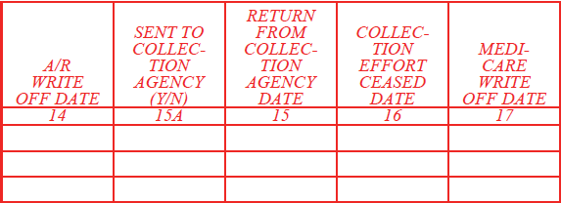
Exhibit 2A – Columns 14 through 17
The dates reported in Columns 14 through 17 may be the same date.
Col. 14 – Enter the date the beneficiary’s liability was written off the accounts receivable (A/R)
The date may be the same as, or earlier than, the date the account was deemed worthless (written off as a Medicare bad debt)
Col. 16 – Enter the date all collection efforts ceased, both internal and external, including efforts to collect from Medicaid and/or from a state for its cost-sharing liability
Col. 17 – Enter the date the D&C amounts were written off as Medicare bad debt
i.e., the amount must have been written off as a bad debt against the A/R in the provider’s accounting system; all collection efforts, internal and external, ceased; and a Medicare RA was received from the state
Notes:
Dylan

Slide 36
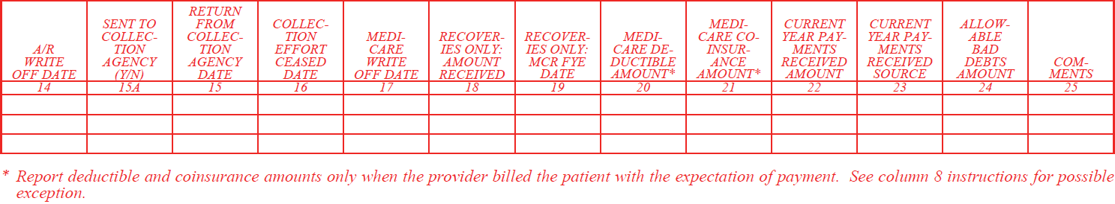
Exhibit 2A – Columns 18 through 25
Col. 18 – Enter amount of recoveries for amounts previously written off as an allowable Medicare bad debt in this or a prior cost reporting period. Include any payments received after the account was written off as bad debt.
Col.19 – Enter the fiscal year end of the cost reporting period in which the Medicare bad debt (to which the recovery applies) was claimed and reimbursed. This column is optional.
Cols. 20 and 21 – Enter the Medicare D&C amounts. (*) Report D&C amounts only when the provider billed the patient with the expectation of payment.
Cols. 22 and 23 – Enter any payment received from the Medicare beneficiary, including their estate or insurance. Enter the patient source, or sources, do not create separate lines to enter each payment source.
Col. 24 – Enter the allowable Medicare bad debt amount. The amount must be less than or equal to the sum of the amounts in columns 20 and 21, less any payments in columns 18 and 22. The sum of the total amount must equal the amount reported on the Medicare cost report.
Notes:
Dylan

Slide 37
Polling Question #3
For preparing CMS’s proposed Medicare bad debt exhibit, my facility
  Has all the required detail electronically available, and is not concerned about the ability to populate the exhibit
  Has all the required detail electronically available, but is concerned about the ability to populate the exhibit
  Does not have all the detail electronically available
  Unsure, to be determined
Notes:
Dylan

Slide 38

Organ Acquisition
Notes:
Robert H

Slide 39
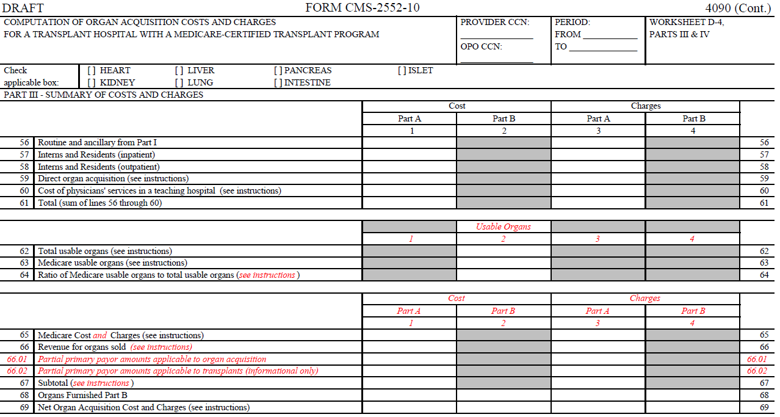
WS D-4, Solid Organ Acquisition Costs
Notes:
Robert H

Slide 40
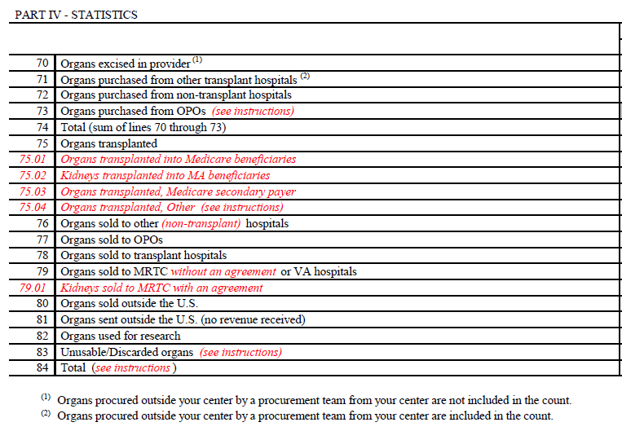
WS D-4, Solid Organ Acquisition Costs
Subscripts for line 75 for transplant statistics
Separate reporting for:
  Medicare
  Medicare Advantage
  Medicare Secondary payor
  All Other
Notes:
Robert H

Slide 41
Allogeneic Bone Marrow Transplant
Inpatient
One week prior and 2-3 weeks after the procedure
High doses of chemotherapy to prepare for transplant
Transplant involves receiving donated cells through an IV catheter or tube
Outpatient
Patients stay at home (or nearby hotel)
Determination on a case-by-case basis
On transplant day, patient undergoes full course of treatment
  Pre-transplant evaluation
  Conditioning
  Infusion of stem cells
  Engraftment and recovery
Notes:
Robert H

Slide 42
IPPS Payment
MS-DRG | Description | FY 2021 | FY 2022 | FY 2023
14 | Allogeneic BMT | 12.7788 | 10.6770 | 11.1930
16 | Autologous BMT W CC/MCC or T-Cell | 6.7262 | 6.7363 | 6.0844
17 | Autologous BMT W/O CC/MCC | 4.8302 | 4.8557 | 4.3701
Allogeneic = Stem cells collected from a donor
Autologous = Uses one’s own stem cells
Notes:
Robert H

Slide 43
OPPS Payment
CPT | Description | APC | FY 2022 *
38240 | Transplant Allo HCT/Donor | 5244 | $41,026.98
38241 | Transplant Autol HCT/Donor | 5242 | $1,393.02
Allogeneic = Stem cells collected from a donor
Autologous = Uses one’s own stem cells
* July 2022 Addendum B
Notes:
Robert H

Slide 44




Allogeneic Bone Marrow Transplant
Local Donors
Unknown Donors
OR
Transplant Recipient
Notes:
Robert H

Slide 45
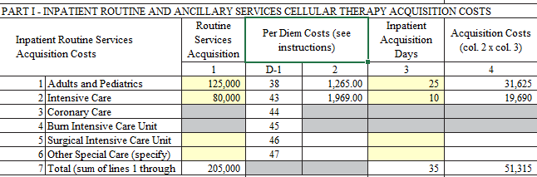
WS D-6, Allogeneic Stem Cell Acquisition Costs
Effective for cost reporting periods beginning on or after October 1, 2020
Enter Live Donor hospital days/charges associated with the collection procedure
Preparation/processing of stem cells derived from:
  Bone marrow
  Peripheral blood stem cells
  Cord blood
  Excludes embryonic stem cells
Notes:
Robert H

Slide 46
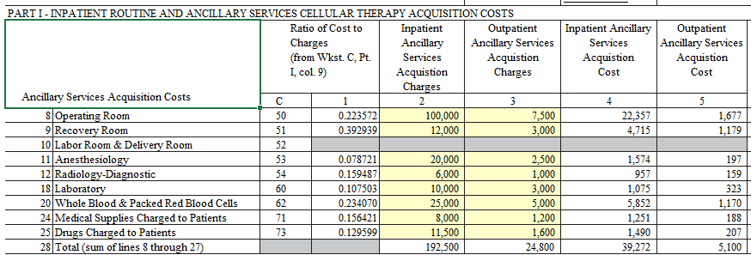
WS D-6, Allogeneic Stem Cell Acquisition Costs
Enter Live Donor hospital charges associated with the collection procedure
  O/R and other ancillary services
  Apheresis services
  Post-operative/ post-procedure evaluation of donor
Notes:
Robert H

Slide 47
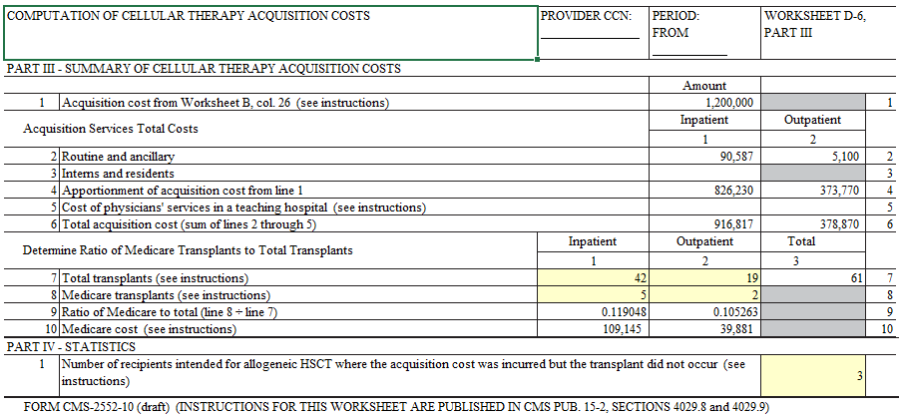
WS D-6, Allogeneic Stem Cell Acquisition Costs
Direct costs are apportioned based on Line 7 total transplants
Notes:
Robert H

Slide 48

WS D-6, New Processes
Hospital Days/Charges
Flag hospital accounts for living donors
All payors (guarantor is recipient’s insurance)
Account for all days/charges related to the donation
Segregate between inpatient and outpatient services
Transplant Counts
Total BMT Allogeneic Transplants by patient
Identify as IP or OP
Identify as Medicare and non-Medicare
Obtain number of aborted BMT Allo Transplants where acquisition costs were incurred
Notes:
Robert H

Slide 49
Polling Question #4
CMS’s changes to organ acquisition reporting and stem cell acquisition reimbursement…
Do not impact my hospital
Require my hospital to materially change data collection and reporting processes
Do not require my hospital to materially change the data collection and reporting processes
Unsure, and still evaluating these instructions
Notes:
Dylan

Slide 50
Other Proposed Cost Report Changes
TEFRA Adj Amts and Date
WS S-2 Lines 88 & 89
WS D-1 Line 55.01
Purch. Admin Services
WS S-2 Line 123
Comment to CMS – If applicable and available, the MAC provide the hospital the TEFRA adjustment date
Comment to CMS – Do not require hospitals to denote if > 50% of prof. expenses are purchased from an unrelated organization outside the main hospital’s market area
COVID-19 Temporary Beds and Days
WS S-3 PT. I Line 34
Outlier Recon. Tentative Settlement
WS E-5
Effective for reporting starting March 1, 2020
COVID-19 temporary bed days available are Excluded from beds on WS E Pt. A, Line 4 – Important for proper Graduate Indirect Medical Education (IME) payments
Cost reporting periods beginning on or after October 1, 2020.
MAC use only
Medicare Opioid Costs
WS A Line 102
Cost reporting periods ending on or after January 1, 2022.
CMS Pub. 100-02, Medicare Benefit Policy Manual, chapter 17
Notes:
Fred

Slide 51
Thank you
Robert Howey
Senior Director
Cost Reporting | Organ Acquisition
robert.howey@toyonassociates.com
Scott Besler
Senior Director
Toyon University and Cost Reporting
scott.besler@toyonassociates.com
toyonassociates.com
888.514.9312

