Slide 1

HFMA Certification: What’s In It For Me?
Courtney Guernsey, FHFMA,CRCR
Vice President, Patient Financial Services, Corewell Health
Certification Director, Michigan Great Lakes Chapter HFMA

Slide 2


Welcome
Certification: What’s in it for Me?
Which HFMA Certification is Right for You?
Getting Started
Passing the Assessment
CHFP: HFMA’s Flagship Certification
Studying Tips & Tricks
HFMA Certification Community Group
What’s next? Get Involved!
Fellow of HFMA
Trivia Time!
Thank You

Slide 3


Competitive edge in the industry.
Stand out among your peers.
Nationally recognized accreditation.
Differentiate yourself in the job market.
Increase your credibility.
Validate your proficiency.
Increase your earning potential.
Position your organization for success.
Earn CPE credits.
Share your designation in your email signature, LinkedIn profile, and more by displaying your digital badge.

Slide 4

which Certification is right for you?
Certified Healthcare Financial Professional (CHFP)
Certified Revenue Cycle Representative (CRCR)
Certified Specialist Accounts & Finance (CSAF)
Certified Specialist Business Intelligence (CSBI)
Certified Specialist Payment & Reimbursement (CSPR)
Certified Specialist Physician Practice Management (CSPPM)

Slide 5
HFMA Certification Programs
Certified Revenue Cycle Representative (CRCR)
Recommended for Revenue Cycle roles including Billing and Claims, Patient Access, and Revenue Integrity.
Increase your knowledge and competency in best practices to positively impact the Revenue Cycle and enhance the patient experience.
Certified Specialist Accounts & Finance (CSAF)
Recommended for Finance roles including Accounting, Business Analysts, Controllers, Financial Planning & Analysis, Internal Auditing, and Financial Reporting.
Strengthen your skills in financial reporting, statements, risk-sharing arrangements, costing methods, and reimbursement.
Certified Specialist Business Intelligence (CSBI)
Recommended for Analysts in Finance, Clinically Integrated Network Business, Systems, Business Intelligence, Actuarial Analysts, Financial Planning & Analysis, and Finance Registration.
Learn methods for looking at data and using tools to ensure the right information is illuminated and used to enable powerful actions and decisions.
Certified Specialist Payment & Reimbursement (CSPR)
Recommended for Case Managers, Claims Specialists, Payor Contracting, Managed Care, Reimbursement, and Pharmacy 340b Analyst/Auditors.
Gain specialist-level knowledge to navigate health care payment and reimbursement models.

Slide 6

HFMA Certification Programs
Certified Specialist Physician Practice Management (CSPPM)
Recommended for Physician Practice Leaders & Executives, Healthcare Administrators, Medical and Health Services Managers, Billing and Claims Specialists, and Program Leaders.
Demonstrate your physician practice finance, cost accounting, revenue cycle, coding, reimbursement, and payer contracting acumen with a special focus on budget preparation, financial projections, cost accounting, managing information systems, and compliance.

Slide 7
Getting Started
Login to your HFMA account and enroll in the certification you are interested in pursuing
Resources are available 24/7, are self-paced/on-demand, and accessible from a computer, tablet, or smartphone
Materials and assessment available for 12-months from the date of enrollment in the certification
Resources
Quizzes/Quiz Builder
Interactive content
Progress Indicators
Bookmark feature
Knowledge checks
Notes tab
Downloadable Key Concepts Guide

Slide 8

Passing the assessment
Average time to complete a CS or CR course is 10-14 hours
Assessment consists of online multiple-choice questions
90 minutes to complete the exam
Passing score is 70%
Recertification is required every 2 years and consists of a 50-question online assessment

Slide 9
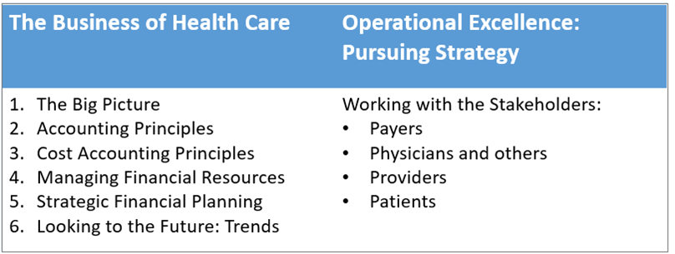
Certified Healthcare Financial Professional (CHFP): HFMA’s Flagship Certification
Module I & II
Demonstrate Expertise Across 4 Essential Pillars
Business Acumen
Collaboration
Financial Strategy
Understanding Future Trends

Slide 10
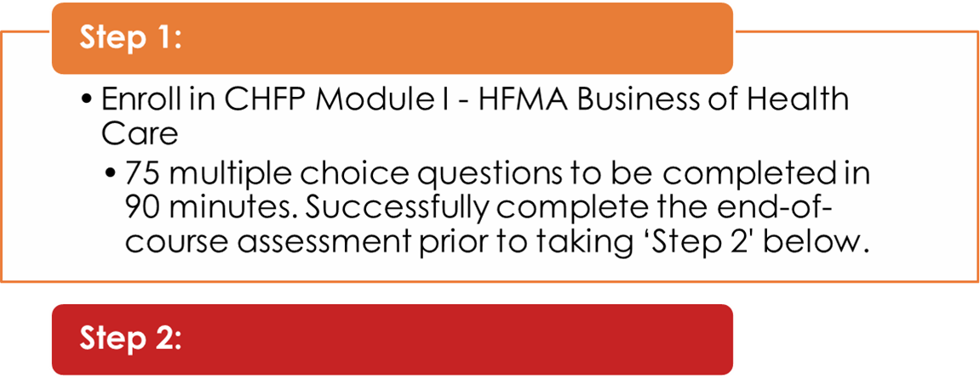
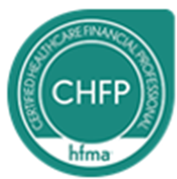
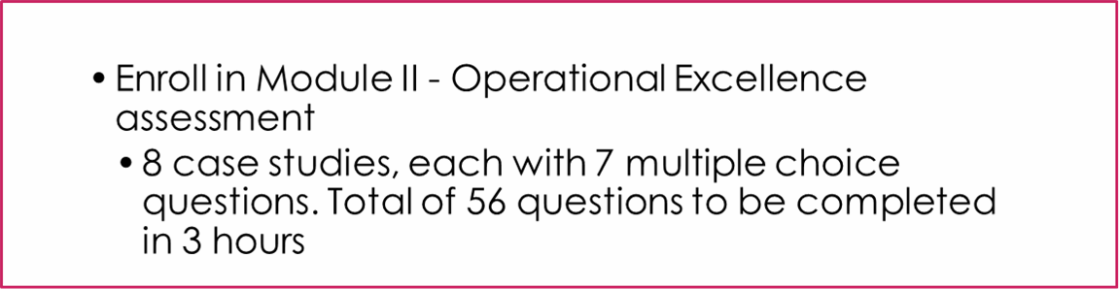
Earning your CHFP

Slide 11
Maintaining your CHFP
Continuing Education Options:
Related Competencies:
Seminars or conferences,
Workshops
Educational offerings sponsored by your employer
Live and on‐demand webinars
E‐learning self‐study courses
Revenue Cycle Functions
Healthcare Environment
Financial Accounting
Financial Management
Quality Monitoring
Leadership

Slide 12
Studying tips and tricks
Download and print the Key Concepts Guide
75% of our exam questions are based on the learning objectives
Complete the checkpoints
Set aside time to study and review
During the test, flag questions you want to revisit
If you didn’t pass, click on the Analysis tab to see your exam summary and review what you missed.

Slide 13
HFMA Certification Community Group
Did you know HFMA has a Certification Community Group??
The community was established so you can ask questions related to HFMA certification programs, network with peers, and share ideas and best practices.
Things you can do:
Introduce yourself and ask a certification question in the discussion platform
Start a discussion around one of HFMAs certification program you are interested in
Connect with others as you prepare for your HFMA certification assessment
Join here today https://community.hfma.org/hfma-certifications/

Slide 14
What’s next? Get involved!!
Volunteer! Your chapter needs you!
Programs Committee
Education Committee
Women In Leadership Committee
Early Careerist Committee
Communications Committee
Membership Committee
Sponsorship Committee
Certification Committee
Networking Committee
For more information and who to contact: https://www.hfma.org/chapters/region-6/michigan-great-lakes/volunteer.html

Slide 15

Fellow of the Healthcare Financial Management Association
Hold the Certified Healthcare Financial Professional (CHFP) designation
Minimum five (5) years professional membership in HFMA (student membership does not count toward this total)
Evidence of bachelor's or master’s degree (or 10+ years of healthcare industry experience)
Letter of recommendation from an FHFMA (active HFMA Fellow), chapter leader or national volunteer, familiar with you/your work on a professional level
Volunteer activity — demonstrate any 1, or combination of the following contributions to HFMA or the industry within the three years prior to applying:
Service as an adjunct instructor at an accredited (post-secondary school) educational institution.
Service in an education, certification, or leadership committee role within the local HFMA chapter or service on one of the HFMA association boards or committees.
Demonstrating a minimum of 10 Hours in the service or preparation of publications, speaking engagements, education, mentorship, etc.

Slide 16




Slide 17
Certification Resources
Overview of Certifications: https://www.hfma.org/education-and-events/certifications.html
Additional Benefits of Getting Certified: https://www.hfma.org/education-and-events/certifications/why-get-certified.html
Maintaining Your Certifications: https://www.hfma.org/education-and-events/certifications/maintaining-your-certifications.html
Maintenance FAQs: https://www.hfma.org/education-and-events/certifications/Maintenance-FAQs.html
Additional questions?
Email careerservices@hfma.org

Slide 18



Thank YOU to our sponsors!

Slide 19
Questions?

Slide 20
Thank YOU!

