Slide 1
2023 Nebraska HFMA
January 2023
Hiring and retaining staff in a highly
competitive market

Slide 2
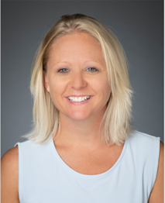
About the speaker
Director of Access Operations and Interpretive Services
Nebraska Medicine
Sheila started at Nebraska Medicine in 2005 within patient financial services.
By 2010, Sheila was promoted to operations manager of PFS. In 2014, Nebraska Medical Center and UNMC Physicians consolidated to form what is now known as Nebraska Medicine. After, Sheila was promoted to director of PFS.
Now as the director of access operations and interpretive services, she helps to support succession planning at Nebraska Medicine.
Sheila Augustine

Slide 3
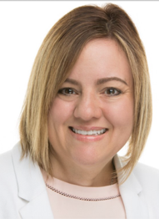
About the speaker
Manager of Revenue Cycle Administrative Services
Nebraska Medicine
Stacie has been with Nebraska Medicine since September 1989.
In her current role as revenue cycle administrative services manager, she is responsible for training, quality and revenue cycle-related systems.
She graduated from Clarkson College with a bachelor’s degree in healthcare business.
She is ARCR-certified through Epic.
Stacie Adcock

Slide 4
Learning objectives
Hiring and retaining staff in a highly competitive market
Define how recent happenings and trends, such as staffing shortages, have altered the course of practices related to staffing, recruiting, training, engagement and retention
Take away realistic strategies that can help to simultaneously improve results in all of these realms
Illustrate team values and culture, including but not limited to a focus on increasing performance achievement

Slide 5

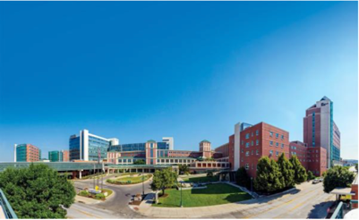
Nebraska Medicine at a glance
$1.8 billion academic health system
Primary clinical partner of University of Nebraska Medical Center
Our two hospitals are anchored by tertiary/quaternary academic medical center
More than 70 specialty and primary care clinics with 50 specialties and subspecialties
Licensed beds are made up of:
      Nebraska Medical Center: 718 licensed beds, Omaha
      Bellevue Medical Center: 91 licensed beds, Bellevue
Organization Facts & Figures |  |  |  | Annual | 2021
Hospitals | 2 |  | Discharges | 40,000 | 39,000
Clinics | 70+ |  | Primary and specialty visits (in-person) | 990,000 | 1,034,000
Licensed beds | 809 |  | ER visits | 80,000 | 91,000
Employees | 9,500 |  | Telehealth visits |  | 82,504
Affiliated physicians | 1,000+
EHR | Epic
The Fred & Pamela Buffet Cancer Center opened in 2017, plus, planning is underway for our NExT project, which includes a state-of-the-art academic medical center facility and a federal all-hazard disaster response military and civilian partnership

Slide 6
Agenda
Where we are today and how we got there
  How COVID, remote work and shortages are continuing change progression
How we approach training: A general overview
  Expanding cross-training, job shadowing and dedicated resources
How training, career progression, and retention intersect
  Check-ins, retention recovery and our career ladder
Promoting engagement and cohesion in performance achievement
  Report cards, quality audits, recognition and staff resources
Reevaluating recruitment and hiring strategies
  Job descriptions, social media and more considerations
Forging and maintaining Culture
  Finding your team values and measuring staff sentiment

Slide 7
Where we are today and how we got there

Slide 8





Accommodating remote structures across the revenue cycle
Remote vs. hybrid vs. onsite
Patient Access
Onsite
Financial Counseling
Hybrid
(Meet with patients in-person or virtually)
HIM
Remote
(Full-time remote except for certain positions)
Patient Financial Services
Hybrid
(Full-time remote except for
certain positions)

Slide 9
COVID-19, Remote work, Shortages all lead traditional roles to shift
Change is leading to more change that is blurring departmental lines
Deployment of Welcome:
patients can now register
themselves on a tablet without
interacting with live staff
Automated wayfinding: patients can show themselves to treatment areas and we’re alerted when they’ve arrived
Live staff are doing less registrations and more documenting, verification or follow-up
Deployment of Automation:
COVID also allowed us to slow
down (in some ways) and
reevaluate processes or automate
Automated Processes: Led to the ability to reduce this team by 2-3 FTEs
Instances like this allowed us to redeploy staff to other functions or teams where there was more need
This is also allowing us to be more patient-facing, grow staff knowledge with work complexity, and flex staff to other functions or areas

Slide 10

We’re not perfect, and we face the same struggles as you…
Limitations exist amid staffing shortages
We now have a taskforce to review potential states that are able to recruit from.
  Which means we may lose staff or prospects to remote work for companies in higher-waged states
Because we still have roles that are not fully remote, we may also lose staff to a local competitor
We’ve had to reevaluate our policies and procedures and how those may attract or detract candidates
We also looked at how our existing vendors might be able to take on more or additional tasks to help ease volumes
  For example: using our statement vendor instead of sending staff onsite to handle certain paper- or print-based tasks

Slide 11
How we approach training:
A general overview

Slide 12
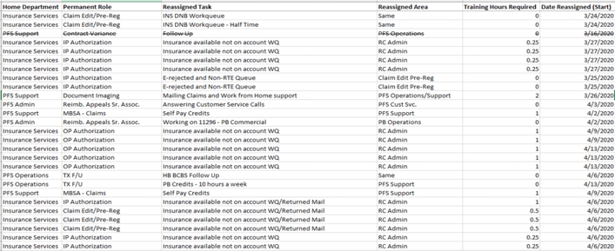


The same trends allowed us to spend more time cross-training staff
Which allowed them to see the connections between their work and other areas
As an example: when volumes decreased, we had multiple staff cross-train on how to handle returned mail, allowing them to see why an accurate address is so important
This also brings to light opportunities for internal promotion and maintains organization-wide retention.

Slide 13

Staff are allowed to job shadow each other as well
For example: A biller could start by shadowing other roles or functions within patient financial services
We schedule one-hour sessions, but some staff will end up shadowing up to four hours
As part of Stay interviews or succession planning, we have the conversations to see if other areas would be of interest

Slide 14
Nebraska Medicine’s Revenue Cycle Training Department Structure
Vice President Revenue Cycle
Revenue Cycle Administrative Manager (Stacie):
Determines quality criteria with each revenue cycle area leader
Assigns criteria a point value (100% total achievable score)
Notifies revenue cycle leaders of retraining needs
Revenue cycle training lead:
Conducts 1 random quality audit per staff member
Revenue cycle trainers:
Conduct 2 random quality audits per staff member (for a total of 3)
Sends audit result summaries to revenue cycle leaders
Lead new-hire training or training for staff transitioning roles
May review audit results with staff members or shadow as needed
Revenue Cycle Administrative Manager (Stacie)
Revenue Cycle Training Lead
Admin Asst (1)
Associate (4)
Analysts (3)
Architects (2)

Slide 15
How training, career progression, and retention intersect

Slide 16







Engraining manager-to-staff check-ins
Weekly
30-Day
60-Day
90-Day
Six-Month
12-Month
18-Month
Quarterly
Each manager creates their own line of questioning or discussion items; staff may fill out ahead of meeting
This approach also helps prepare leaders for succession planning

Slide 17
Example check-in sheet – After two weeks
Discussion guide for first Friday check-in
Date: ________________
Name: _______________
Which team members have you met this week?
What have our team members done to make you feel welcome?
What was the best part of your first week?
What was the most challenging thing you had to deal with this week?
Is there anything that you think we should change to help new staff during their first week at Nebraska Medicine?
Did you have a chance to meet senior leadership for the department?
Did you receive appropriate access to equipment/resources needed for your job?
What questions/ concerns do you have for next week?

Slide 18
Example 30/60/90 Day check-in sheet
Discussion guide for developmental 1x1 (12-18 months)
Date: ________________
Name: _______________
Baseline expectations:
Has this job met your expectations? In what ways?
Where has it fallen short?
Do you have the tools and equipment you need to do your job?
Assimilation:
Which coworkers have been especially helpful to you?
What sources have you been using to learn about news in the department and the organization?
Tell me about some of your successes during your first 30/60/90 days.
Challenges:
Describe any frustrations you’ve experienced so far.
Have you done anything to address these frustrations?
Suggested onboarding improvements:
In what areas would more training be helpful for you and other new hires?
If you could change one aspect of your experience in the department,
what would that be?
On which aspects of your job performance would you like more feedback?
Overall concerns:
11. Do you have any concerns about your job that I could address?

Slide 19
Example quarterly check-in sheet
One-on-one meeting agenda
Date: ________________
Name: _______________
What is at least one new thing you have learned this week?
What do you need from me to be successful?
Any safety concerns to share?
Questions to review:
Items that you will accomplish in the next 5 work days
Items that you would like to keep track of to accomplish in the future
Reminder for iValue nomination:
Database assigned items/questions:
Issue # | Date | Description | Questions
What have you done this week to display helping a friend by teaching
instead of doing?
What have you done this week that might have hindered?
Annual Eval goals: Update on accomplishments:
  ____________________________________
  _____________________________________
  _____________________________________
Items accomplished to report on annual evaluation:

Slide 20
Example 12-18 month check-in sheet
Discussion guide for developmental 1x1 (12-18 months)
Part 1: Professional Goals and Aspirations:
As a first step, it can be helpful to identify where you are in
relation to where you may want to go with your professional career:
Are you new in your role, or new to your organization,
and needing to master essential competencies critical for your success?
Are you thinking about preparing for a different role, which may require
different skills or developing existing skills into significant strengths?
Are you experienced in your role and looking to maintain full
engagement and enthusiasm through taking on additional challenges, building competencies that are needed to meet changing work demands, using strengths more fully or mentoring others?
Part 2: Use the following questions to further refine your professional goals:
What gives you the greatest sense of satisfaction and reward?
What do I want to do that I am not currently doing?
How will these goals/motives help me deliver results at Nebraska Medicine?
What is now, or will be, of greatest need to Nebraska Medicine,
or to my department,
in the future?
Do I see myself changing roles? If so, when, and what does the next role look like?
How might my role change in the future?
What competencies will I need to be ready?
What work experiences do I need to develop professionally and stay engaged?

Slide 21
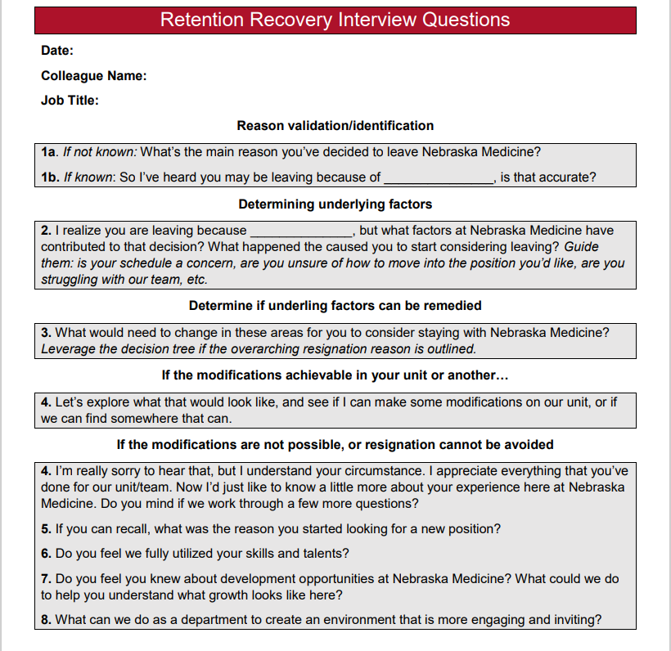
When a staff member does choose to leave…
We conduct a retention/stay interview
to see if we can recover the
team member internally
Audience Question:
Has anyone implemented stay interviews at their organization and, if so, what success have you found with doing these?

Slide 22

Revenue cycle development program
Offering opportunities to grow leadership skills
Recently re-initiated this program
Self-nomination but manager-approved
Up to 3 participants each round
Program runs from July of acceptance year through June the following year
Qualifications:
  2.0 or higher on evaluations
  Meet or exceed productivity and outcome expectations
  Commit to 2-4 hours per week without requiring overtime
  1-hour weekly review/discussion with VP of revenue cycle
What participants do:
Identify a performance improvement opportunity
Complete application for self-nomination
Discuss with manager and obtain approval
Send application to VP of revenue cycle

Slide 23
We offer and regularly update our career ladder
Key:
ACCESS
HIM
PFS
Rev Cycle Admin
Multiple Departments
Bold: Degree/Certificate Required
Application Lead
CDI Lead
Applications Sr Analyst
CDI Sr Analyst
Deaf/HOH Services Associate
Him Coding Lead
Coding/CDI Educator
Revenue Cycle Training/ QA Lead
Denials & Projects Sr. Analyst
Revenue Integrity Sr. Analyst
Language Services Lead
Inpatient Coding Sr Associate
PFS Lead
ED/ Ambulatory Coding Sr Associate
Prof Coding Sr Associate
Revenue Cycle Senior Associate
Rev Cycle Training/ QA Associate
Language Services Associate
Patient Access Lead
Prof. Coding Associate
HIM Lead
Reimbursement Appeals Sr. Associate
Patient Financial Counselor
Insurance Services Sr. Associate
CS Sr. Associate
Collections Sr. Associate
Specialty Billing Sr. Associate
Payment Apps Sr. Associate
Patient Access Sr. Associate
Medical Billing Sr. Associate
Insurance Services Associate
Admin Assistant
Payment Apps Associate
HIM Record Review Sr. Associate
Revenue Cycle Support Associate
Audience Question:
Is any other facility sharing career ladder or growth opportunities throughout the revenue cycle?
Document Imaging Associates
Office Assistant
HIM Records Associate

Slide 24
Promoting engagement and cohesion in performance achievement

Slide 25


Providing individual report cards to drive top-tier performance
Spearheaded by the Vice president of revenue cycle, this initiative started in 2017
Reports issued to each individual staff member monthly
Developed by our database builders
Sent via email from a revenue cycle admin account
These individual report cards contain:
Productivity scores: collaborated with IT to create a file transfer protocol to pull in data daily
Quality scores (rolling year): maintained via distinct database and obtained through the quality audit process.
Departmental KPI achievement: revenue cycle leaders are given access to this database and input data on the 15th of every month.
The latter will even show an individual’s achievement toward a department goal, like POS Collections.

Slide 26
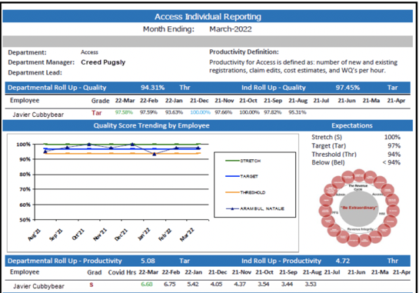
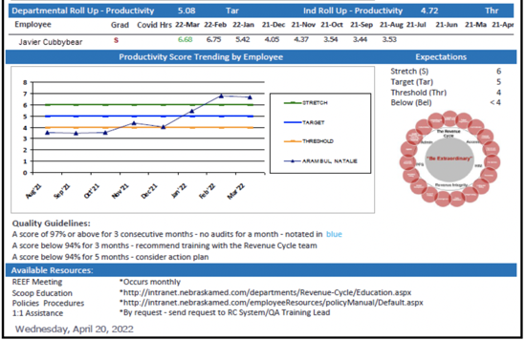
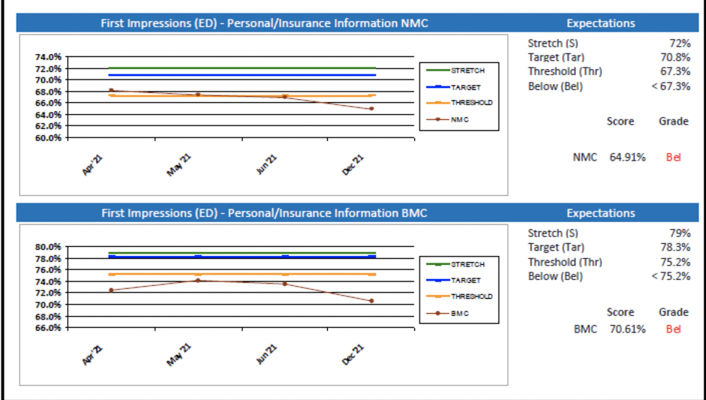
Report Cards –
A Closer Look
Making expectations
and progress clear
while sharing options
for further engagement
(Page 1)

Slide 27
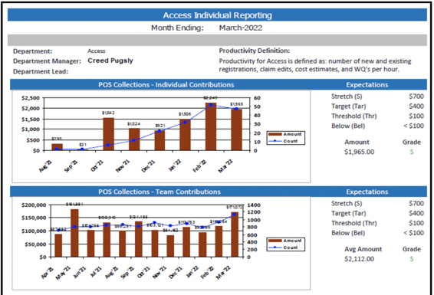
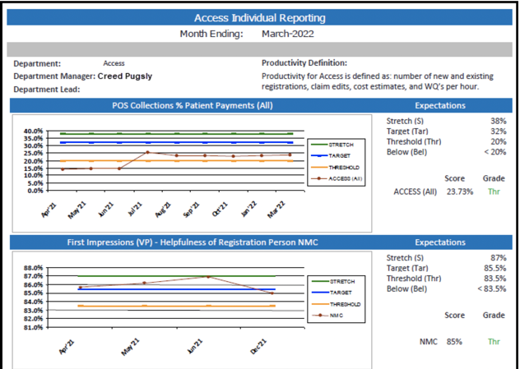
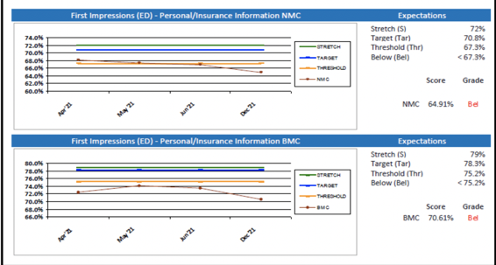
Report Cards – A Closer Look
Departmental specifics (Pages 2 & 3)

Slide 28

Recognizing exemplary performance
How we help to solidify a 97.51% systemwide quality score
For high audit scorers:
97% or higher scores for 3 consecutive months earns a certificate
100% or higher scores for 3 consecutive months earns a lapel pin
Those exhibiting a high degree of teamwork or customer service are given a superstar award
All of these are awarded at monthly team meetings

Slide 29
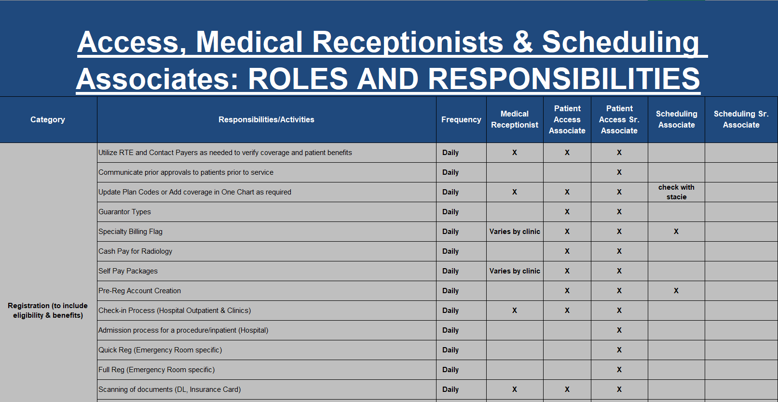
Identifying opportunities for learning and growth
Most importantly, these reports and resulting conversations help staff know exactly what to improve and work toward. It’s less about what is done wrong and more about what to do next.
The “Why didn’t anyone
tell me” phenomenon is real
Helps promote
standardization of processes
and protocol
Brings to light otherwise
unidentified learning
opportunities
  Example: Legal guardian

Slide 30
How monthly quality audits trigger retraining
Action plan
ends
Only 0.017% of team members have had to go through an action plan, signifying the impact of this process
Yes
Did they have a compliance-based error?
Errors = -6 points or an automatic fail
Passed 3 consecutive months?
Yes
No
Trainer will:
Review audit with staff member
Shadow as needed
Provide summary to manager
Did they fail 3 out of 12 rolling months?
Yes
No
Flagged for retraining; manager informed.
Yes
Passed 2 consecutive weeks?
Did they score 94% or higher?
No
Does performance dip another 2 out of 12 months?
Yes
No
Yes
Action plan;
Audit 3x per week
Evaluate
at next review
Pass
As a reward: those who pass 3 months in a row can skip their next audit.

Slide 31
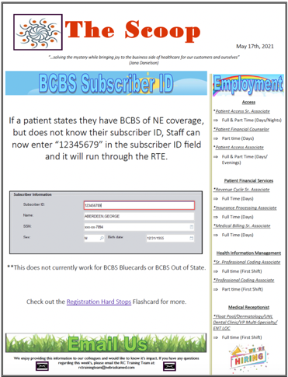

Employee Newsletter
The training team also
sends out a “Weekly Scoop”
newsletter to all
revenue cycle staff
every Monday
Features new team members,
overall performance and
even a food column
Delivers brief education on
updates, policy or process changes
(Pages 1 & 2)

Slide 32

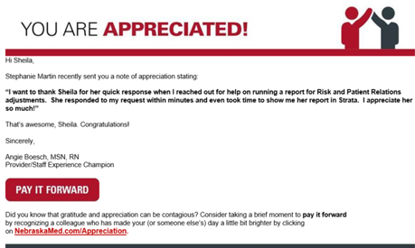
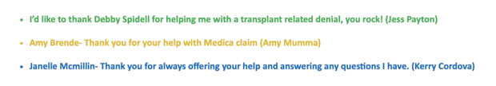
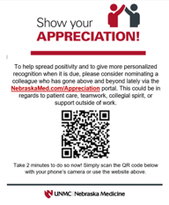
Additional avenues to recognize performance
8:30 AM daily leadership meeting:
Friday M&Ms:
Share performance at a higher level on key metrics
Quickly identify any need for adjustment across teams
Leaders then trickle this down to their respective teams
A way for staff to recognize each other (give “Kudos”)
Sent via email to departments every Friday
Show your appreciation:
Audience Question:
What have others used at their facility(ies) to recognize fellow colleagues?

Slide 33
Reevaluating recruitment and hiring strategies

Slide 34
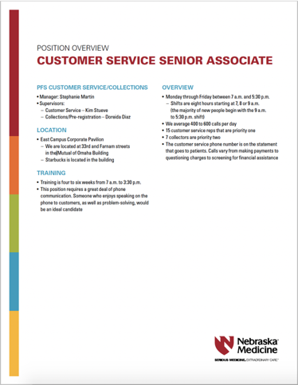
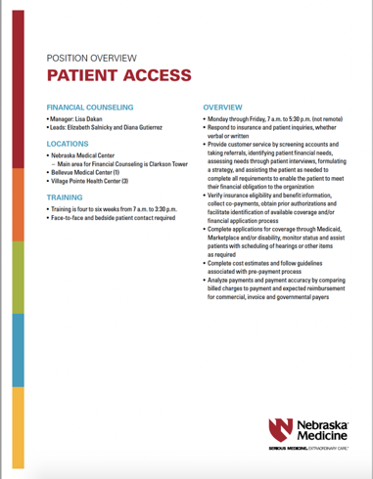
Posted Job Descriptions needed a revamp
From vague to informational
The intention was to provide
a cover sheet to share upfront:
  Whether the position is remote
  (or for a specific location)
  What to expect with training
  Shift details
  Level of workload
  Size of team
  Supervisor names
  And in some cases, indications of
  desired values or provided culture

Slide 35





We’re also trying:
Intern program:
Employee spotlights:
We field interns from community and four-year colleges in the area and will put them through a modified onboarding training program (including access to Epic)
Will spend some time shadowing our staff
Then we can assign certain projects or work
Postings on Facebook or LinkedIn directly from a current employee
Shares when the employee started at Nebraska Medicine, how long they’ve been employed, their career trajectory, and how they ended up in their current role
Strong HR partnerships:
More avenues for posting:
We have dedicated “sourcers” that go out and find candidates
Military communities
College-affiliated programs
More flexibility in how we fill open roles:
We focus less intently on skills assessments
We consider whether to backfill at a lower level, such as a medical biller vs. a specialty biller and grow them or other staff up

Slide 36
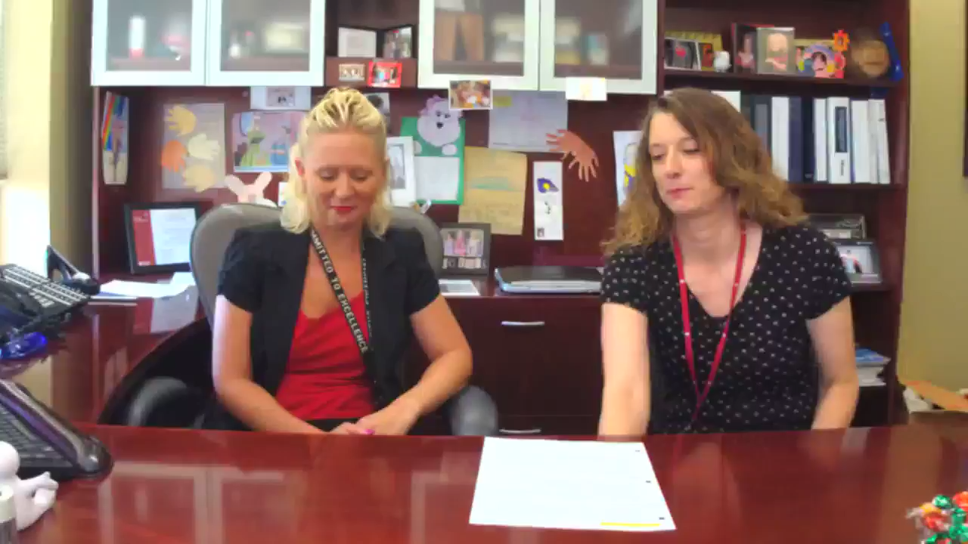

Going live to share open positions
Facebook Live
Career fairs to include local colleges
Utilizing leader networking groups
  Example: Military Wives group
Immediate interviews and hiring on-the-spot

Slide 37
Forging and maintaining Culture

Slide 38
How we achieve extraordinary together
As a result of the efforts outlined, and actively mapping out our cultural values, Nebraska Medicine has been able to foster a systemwide culture of not only quality but accountability.
Nebraska Medicine also partnered with Sean Delaney to focus on employee engagement
Why culture:
A healthy culture creates a better place for us to work
Appreciation:
Offering appreciation is a way to recognize and value others
Mood elevator:
Being aware of our moods helps us with our work and relationships
Be here now:
Being fully present with the people we are with and what we are doing
Accountability:
Taking responsibility for our choices
Curiosity/judgment:
Remaining open to new ideas or ways of doing things
Assume good intent:
A reminder that other people are also trying to get a positive result
Filters:
People and situations look different with the lens we see them
Level of listening:
Listening to understand helps to build stronger relationships
Energy level:
Awareness this helps us understand how we’re prepared to work
Gratitude
The more you practice being grateful, the more you get back
At your best:
An intentional approach to life orients a healthy state of mind
Blue chips:
Things of greater importance are a higher priority in life
Behavioral styles:
A framework for seeing and celebrating different perspectives
Diversity/Inclusion:
Understanding and celebrating differences makes us stronger

Slide 39
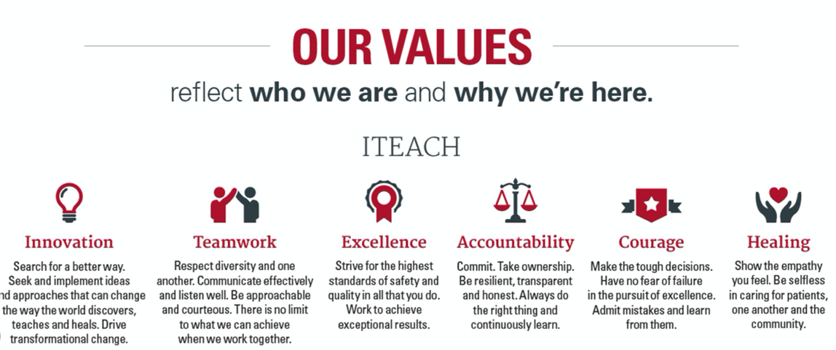
iTEACH values

Slide 40
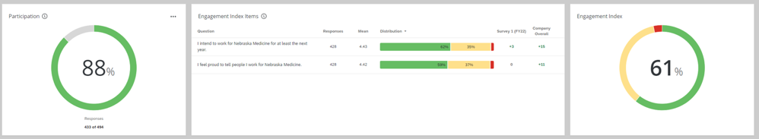
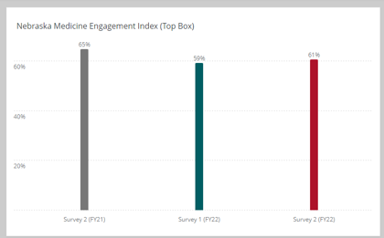
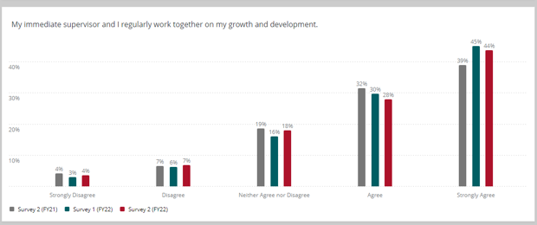
Measuring employee engagement

Slide 41
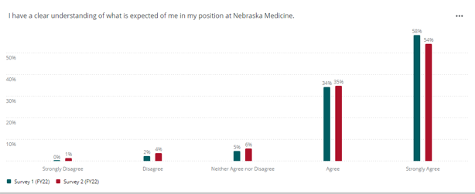
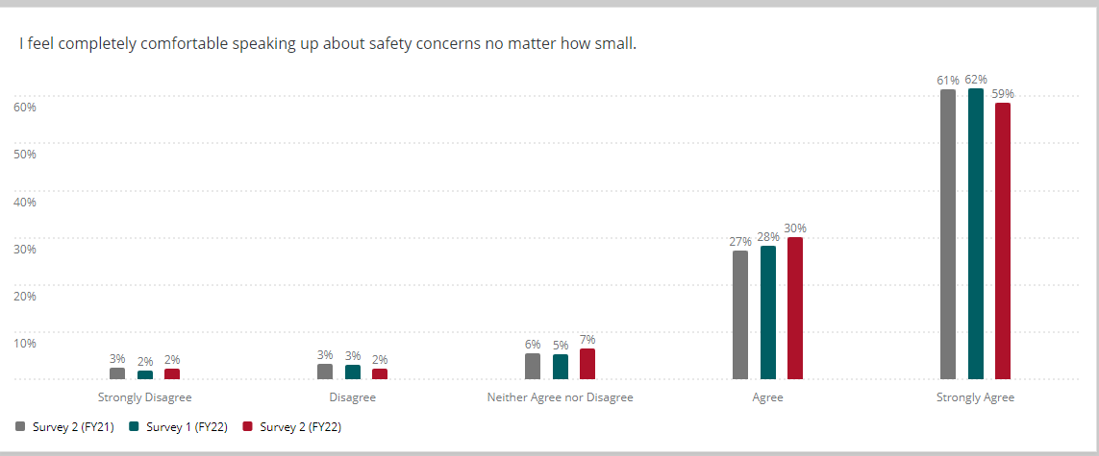
Measuring employee engagement – Cont’d

Slide 42
Thank you
Sheila Augustine
saugustine@nebraskamed.com
Stacie Adcock
SAdcock@nebraskamed.com

