Slide 1
The Bones Are Good
Tom Jalics, CFA
Director of Asset Allocation

Slide 2
“The house don’t fall when the bones are good.” - Maren Morris

Slide 3
Running out of room to grow

Slide 4
The labor lever

Slide 5
Signs of declining labor market slack
Credit: Hokenson Demographics

Slide 6
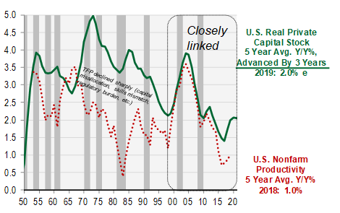
Capex drives productivity…
Credit: Cornerstone Macro

Slide 7
..and confidence drives Capex

Slide 8
CapEx leading up to recessions

Slide 9
What will the election mean for investors?

Slide 10
Presidential election years have been good for stocks
Credit: Strategas Research

Slide 11
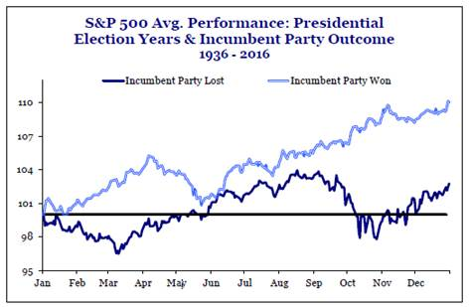
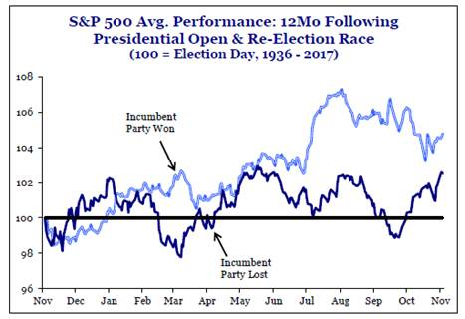
Stocks have performed better when incumbent party retains Presidency—in election year and year following
Credit: Strategas Research

Slide 12
Read polls with caution…

Slide 13
U.S. economy: Structural limitations

Slide 14
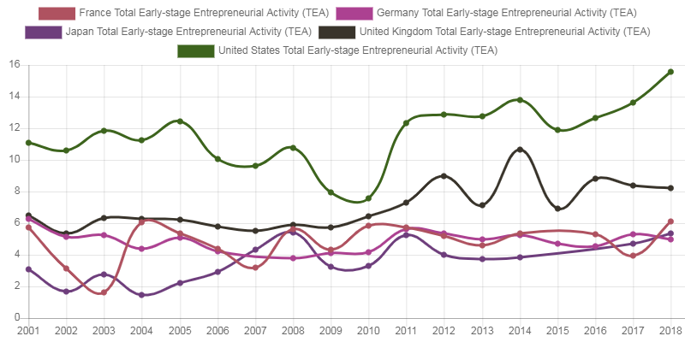
Innovation nation
3D House Printing Projects - Affordable Housing
Stage 4 fission reactors
Cold fusion commercialization
Autonomous driving
Quantum supremacy + Big data + 5G + blockchain = big changes
Second chance employment

Slide 15
More good news

Slide 16
Investment Considerations

Slide 17
Where is the dollar headed?
?

Slide 18
Is Europe poised for a recovery?

Slide 19
Inflation remains muted, but…

Slide 20


Wage gains empower the consumer

Slide 21
PMIs becoming a point of worry

Slide 22
Manufacturing employment preceding recessions

Slide 23
Reading a yield curve inversion right
Normal curve
Inverted curve

Slide 24
Spreads not threatening on a long-term perspective

Slide 25
Deteriorating credit fundamentals

Slide 26
Questions? Thank you

Slide 27
Disclosures & definitions
U-3 Unemployment Rate is the total unemployed as a percentage of the civilian labor force. U-6 Unemployment Rate is the total unemployed, plus all persons marginally attached to the labor force, plus total employed part time for economic reasons, as a percent of the civilian labor force plus all persons marginally attached to the labor force.
The Labor Force Participation Rate refers to the number of people who are either employed or are actively looking for work. The number of people who are no longer actively searching for work would not be included in the participation rate.
CEO Confidence Index measures CEO confidence in the economy, one year from now. This concept tracks the general state of the economy as it relates to businesses.
Capital Goods New Orders Nondefense Ex Aircraft & Parts tracks the value of new orders received during the reference period. It is often used as a proxy for capital expenditures, or CapEx. Capital expenditure are funds used by a company to acquire, upgrade, and maintain physical assets.
Nonfarm Labor Productivity (Output per Hour) tracks the total output the can be produced with a given input of labor. It is measured by dividing total real gross domestic product by total hours worked.
The S&P (Standard & Poor's) 500 Stock Index is a composite of the 500 largest companies in the U.S. and it is often used as a measure of the overall U.S. stock market.
The U.S. Dollar Spot Index indicates the general international level of the USD by averaging the exchange rate between the USD and major world currencies.
Purchasing Managers’ Indexes (PMI) are economic indicators derived from monthly surveys of private sector companies.
The Consumer Price Index (CPI) is a measure of prices paid by consumers for a market basket of consumer goods and services. The yearly (or monthly) growth rates represent the inflation rate
5-Year, 5-Year Forward Inflation Expectation Rate measures expected inflation (on average) over the five-year period that begins five years from today.
The Atlanta Fed Wage Growth Tracker is a measure of the nominal wage growth of individuals. It is constructed using microdata from the Current Population Survey and is the median percent change in the hourly wage of individuals observed 12 months apart.
The Institute for Supply Management (ISM) Manufacturing Purchasing Managers’ Index (PMI) is an indicator of the economic health of the manufacturing sector. The PMI is based on five major indicators: new orders, inventory levels, production, supplier deliveries and the employment environment.
Nonfarm Payrolls measures the number of employees on business payrolls.
The U.S. Treasury Yield is the pre-tax yield to maturity on Generic United States on-the-run government bill/note/bond indices at different maturities. The 10-yr and 2-year maturities are widely quoted and the spread between the two is often referred to as the “yield curve.”
The BarCap U.S. Corporate HY YTW – 10-yr Treasury Spread is calculated by taking the Barclays Capital U.S. Corporate High Yield Yield-to-Worst minus the U.S. Generic Government 10-year Yield.
GDP (Gross Domestic Product) is the total market value of all final goods and services produced in a country in a given year, equal to total consumer, investment and government spending, plus the value of exports, minus the value of imports.
U.S. nonfinancial interest coverage ratio measures the ratio of a U.S. nonfinancial companies’ interest payments over earnings before interest and taxes. It is a debt and profitability ratio to determine how easily a company can pay interest on its outstanding debt.
The U.S. investment grade corporate credit spread measures the Moody’s Baa corporate bond yield spread over the 10-year U.S. treasury yield.
Opinions are provided by Fifth Third Private Bank, National Association. This information is intended for educational purposes only and does not constitute the rendering of investment advice or a specific recommendation on investment activities and trading. The mention of any specific security does not constitute a solicitation or an offer to buy or sell any security. This information is current as of the date of this presentation and is subject to change at any time, based on market and other conditions. Asset Allocation, Diversification, Alternative Investment and Hedging strategies are intended to mitigate the overall risk within your portfolio. Some strategies may be subject to a higher degree of market risk than others. There are no guarantees that any strategy presented will perform as intended. Indexes are unmanaged and do not incur investment management fees. You cannot invest directly in an index. Past performance is no guarantee of future results.
Fifth Third Private Bank is a division of Fifth Third Bank, National Association, which is an indirect subsidiary of Fifth Third Bancorp. Banking, investment and insurance products and services are offered through or made available by one or more of Fifth Third Bancorp’s indirect subsidiaries. Investments, investment services and insurance:
Insurance Products are made available through Fifth Third Insurance Agency, Inc.
Are Not FDIC Insured | Offer Not Bank Guaranteed | May Lose Value
Are Not Insured by Any Federal Government Agency |  | Are Not a Deposit

