Slide 1

Patients:
The New Payers

Slide 2
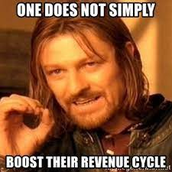

Slide 3
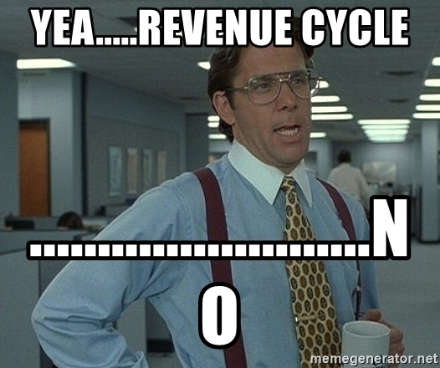

Slide 4



Slide 5
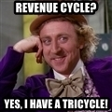


Slide 6
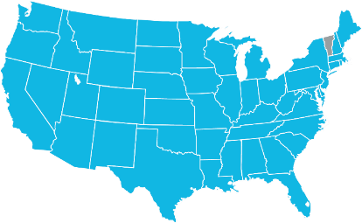



Commerce Bank is CommerceHealthcare®
We don’t just serve the healthcare industry. It’s our specialty.
Partner to 3,000⁺ healthcare providers and 500+ hospitals in 47 states
100+ entities and over 42MM in patient transactions annually
$1B⁺ in loans outstanding and over $2B in healthcare credit commitments
TOP 5
Moody’s national rank with a baseline credit assessment of a1¹
7th
Largest Purchasing
Card Issuer²
$34.5
Billion in Assets
42nd
Largest U.S. Bank³
$8.7
Billion Market Cap
21st
Among U.S. Banks³
$66.8
Billion in Total Trust Assets
18th
Among U.S. Banks³
15.1%
10 Year Annualized
Shareholder Returns⁵
$8.5
Billion Commercial Card volume⁴
$5B⁺
In Investments for Healthcare⁶
As of September 30, 2021, unless otherwise noted.
¹ Moody’s US Bank Ratings, August 19, 2021.
² Amongst top 50 U.S. Banks based on 12/31/2019 assets. Source: Nilson, May 2020.
³ S&P Global Market Intelligence ranking as of June 30, 2021.
⁴ As of December 31, 2020.
⁵ Bloomberg, September 30, 2021
⁶ Total combined among Commerce Trust Company and Capital Markets Group

Slide 7
Consumerism Trivia

Slide 8
Consumerism Trivia
Combined premium contributions and deductibles have grown to reach ___% of median household income?
a
c
11.5%
23.7%
b
d
48.3%
30.1%

Slide 9

Consumerism Trivia
Combined premium contributions and deductibles have grown to reach ___% of median household income?
Answer:
11.5%
Source: Commonwealth Fund, Trends in Employer Health Care Coverage 2008-2018, November 2019.

Slide 10
Consumerism Trivia
What percentage of workers are subjected to a $2,000 or higher deductible?
a
8%
c
29%
b
14%
d
37%

Slide 11
Consumerism Trivia
What percentage of workers are subjected to a $2,000 or higher deductible?
Answer:
c
29%
Source: Kaiser Family Foundation, Employer Health Benefits: Summary of Findings, 2019.

Slide 12
Consumerism Trivia
Prior to the pandemic, what percentage of Americans were just covering basic living expenses?
a
3%
c
23%
b
12%
d
30%

Slide 13
Consumerism Trivia
Prior to the pandemic, what percentage of Americans were just covering basic living expenses?
Answer:
d
30%
Source: Transamerica, Retirement Security Amid COVID-19: The Outlook of Three Generations, May 2020.

Slide 14



AGENDA
Rise of Patient Payers
Providers, Payers and Patients
Improving the Revenue Cycle
Client Study
Measuring Costs & Value

Slide 15



Agenda
01.
PROVIDERS
02.
PAYERS
03.
PATIENTS
Provider Healthcare Trends
Process, Practice, Performance
Payer Healthcare Trends
Maximizing Relationships
Patient Healthcare Trends
Enhancing the Patient Experience

Slide 16
01.
PROVIDERS

Slide 17
Provider Trends
Vertical Integration
94%
Technology
69%
Entry of Non-Traditional Players
63%
Employer Activism
31%
Health System M & A
25%
Emergence of Alternative Models
13%
Other
6%
PERCENT OF HEALTH SYSTEMS

Slide 18
Provider Trends
Lower Reimbursement
Rates
Significant Days
in Cash Flow
Changing where and how
services are provided
Shifting EFT
Mandates and Fees
Changing the Remittance Process

Slide 19
PROVIDERS:
PROCESS, PRACTICE, AND PERFORMANCE

Slide 20
Key Drivers & Catalysts for Change
History of Failed
Collections
Desire to Focus
on Patient Care
Consolidate Groups
Change Processes
Strengthen Relationships
WHY
HOW

Slide 21
02.
PAYERS

Slide 22


Payer Trends
Ever-changing coverage and billing policies
Narrowly designed plans or provider networks
Shifting Risk: Emphasis on value-based contracting
Shifting care outside the hospital setting
Increasing Payer and Provider Partnerships

Slide 23
PATIENTS:
ENHANCING EXPERIENCE

Slide 24




What We Heard | Industry Trends
COVID-19 Impact
Future Planning
Finding Operational Efficiencies
New Technology

Slide 25


Consumerism
in Healthcare
Immediate Access to Care
Digital Healthcare
Cost of Care
Health Data Ownership
Precision Medicine

Slide 26
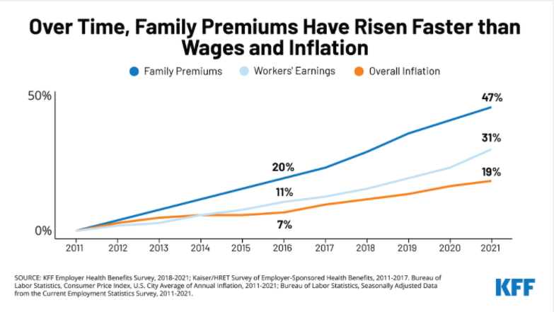

Slide 27
How much medical debt do we owe?
$140,000,000,000
JAMA 7/20/21
https://jamanetwork.com/journals/jama/article-abstract/2782187

Slide 28
More specifically how much do we owe?
$5,000-$10,000
15%
Debt.com survey of 1,186 Americans between 6/17 – 7/6/20 published in USA Today 9/20/20
https://www.usatoday.com/story/money/2020/09/18/unemployment-americans-face-45-b-worth-medical-debt-collections/3480192001/

Slide 29

Patient Healthcare
Trends
Shift in who pays
Price transparency and simplification of statements
New patient payment models
Connection between patient satisfaction and payments
Employer defined benefit plans

Slide 30




Patients Want More Options
New Best Practice: Initiate Discounts, Payment Plans, IVR & Patient Loans at ALL Patient Touchpoints
90%
92%
64%
54%
Providers see up to 90% boosts in payments when offering patients discounts at POS.
92% of patients would return to a healthcare facility that offers a loan program.
64% of patients want flexible payments.
Providers see 54% more electronic payments when patients have the option to pay by phone or text.

Slide 31

Patient Experience:
Collection Conversations
Insurance follow-up
Patient insurance information request
Proactively reaching out to identify potential issues and find solutions
Transparency regarding non-covered charges
Improves patient experience

Slide 32
What Patients are Seeking
Dignity
Equal Access to Credit
Affordability
Convenience

Slide 33

Increasing Focus on Consumerism
COVID-19
Rise in patient out-of-pocket responsibility
New patient payment models
Price transparency and simplification of statements
Connection between patient satisfaction and payments
Patients requesting more options
Staff seeking more options for patients

Slide 34
Consumer’s Hierarchy of Payment Priority
1 | Mortgage / Rent
2 | Auto Loan / Lease
3 | Utility Bills
4 | Bank Loans
5 | Credit Cards
6 | Department Store Cards
7 | Physician Bills
8 | Hospital Bills
Source: DeKaye, Allan P. The Patient Accounts Management Handbook: Aspen Publication.

Slide 35
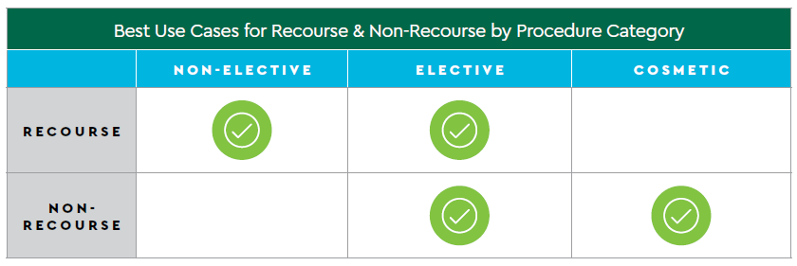
Comparing Recourse and Non-Recourse

Slide 36


SINCE FEBRUARY 2021
302
ENROLLED
1,603
TRANSACTIONS
1,393,125
FUNDED

Slide 37
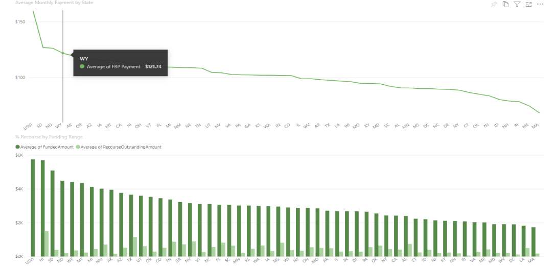
Avg. Payment Amount by State

Slide 38
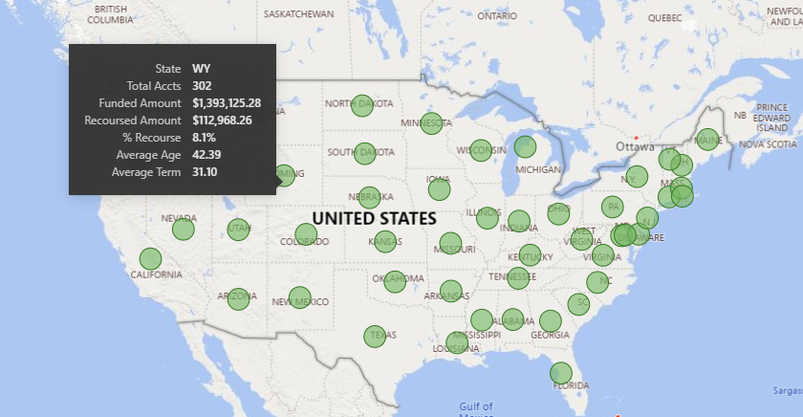

Slide 39
Improved Revenue Cycle

Slide 40
Focus on maximizing staff
Back to the mission at hand.
Reduce Expense
Eliminate, reduce cost of collections
Cut quantity of monthly statements
Reduce time tracking in system
Time value of money – collect cash up front!
What to look for:
Patient likelihood to pay
Simple enrollment; no credit checks to patients
Refunded fee if patient defaults
Automatic 835 posting

Slide 41
Let’s be honest.
Implementing new processes isn’t easy...
to get the team to buy in.
to automate enrollment
Dedicate training
to the team on the value of payment options to patient financial experience and ease of enrollment through automation.
It’s challenging…
So…

Slide 42
Provide options, after charity pre-screen
4
Alternative payment plan
What can work:
Giving patients the dignity of options
Reallocate staff to implement program
3
1
2
Patient pays cash
Enroll in external offering
Shorten Internal payment plans

Slide 43
Measuring Costs/Calculating Value

Slide 44
In-House Payment Plans: Measuring Costs/Calculating Value
Weighted Average Cost of Capital
Servicing Cost
Bad Debt Rate

Slide 45
Q&A

Slide 46
Thank you!
Contact Info:
Taylor St. Eve
Taylor.St.Eve@Commercebank.com
314-746-7440

