Slide 1
Coding compliance
WyHFMA Spring Meeting
March 10, 2022
Casper, WY

Slide 2
Today’s objectives
Define Coding Compliance
Coding is More than Coders
Compliance as the Culture
Monitoring Compliance
Where to Focus
Resources
Q&A

Slide 3
Defining coding compliance

Slide 4

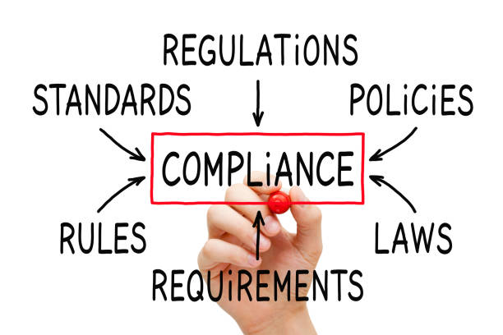
compliance
The process of following rules, regulations and laws that relate to healthcare practices.
Continuous process
Proactive tasks to prevent fraud, waste or abuse

Slide 5

Regulatory Compliance
Corporate Compliance
Rules, regulations and practices an organization puts into place for compliance according to external regulations.
Rules, regulations and practices an organization puts into place for compliance according to both external regulations and internal policies.

Slide 6
WHAT IS CODING COMPLIANCE?
WHO IS RESPONSIBLE FOR CODING COMPLIANCE?
IS CODING COMPLIANCE REGULATORY OR CORPORATE?
Audience Participation Required…

Slide 7

WHAT IS THE CODER’S ROLE?
“A professional medical coder reviews and analyzes clinical documentation to connect services with billing codes related to a diagnosis, procedure, charge and professional and/or facility code.”
https://revcycleintelligence.com/features/exploring-the-fundamentals-of-medical-billing-and-coding

Slide 8
Stakeholder groups
C-Suite
Metrics related to revenue
Missed revenue
New revenue
Coders
Accuracy
Productivity
Providers
RVUs/compensation
Documentation
Guidelines
Billers
Denial management

Slide 9




Coding compliance is more than coders

Slide 10
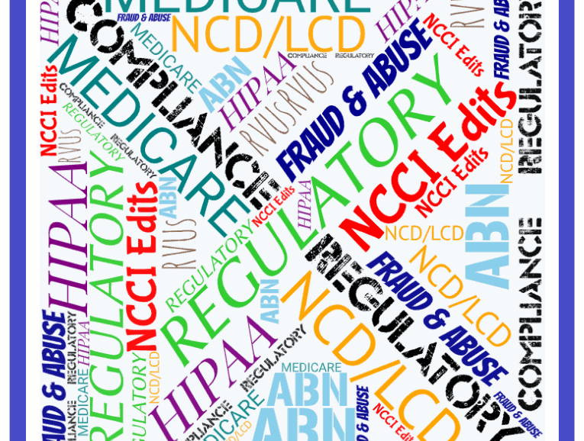
Coding compliance
Review of medical records
Assign appropriate codes
  ICD-10 CM & PCS
  DRG
  CPT
  HCPCS
  Modifiers
Proper queries
NCCI edits
  Medical Necessity
  Bundling

Slide 11
Coding compliance is so much more than just coding
Documentation
Regulatory changes
Coding changes
Payer policies
Healthcare Information Technology
Internal policies
Denial management

Slide 12
your coding compliance
How does your organization manage incomplete or delinquent documentation?
Does your organization have a compliant query process?
Do you share denial statistics with your coding team?
How do you monitor the above?
Does your Compliance Department send out regulatory updates?
Are internal coding policies reviewed, updated, and communicated?
Does your billing department communicate payer rules to the coding team?
Do your coders have the tools/ resources necessary to perform their tasks?

Slide 13

Credentials are part of compliance too
To review new guidelines
To complete my CEUs
Listen to that webinar
To go to the meeting

Slide 14
Compliance as the culture

Slide 15
Compliance culture
An organization with strong compliance culture has an awareness of compliance best practices and the risks associated with non-compliance.
Infusing ethics into an organization’s operations and embracing the opportunities to learn and improve together.
No fear of retaliation or being a target.
Education and training before discipline.

Slide 16
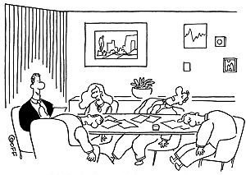
When was your last compliance meeting/training?
  Coding compliance?
  Billing compliance?
  Department compliance?
  General compliance?
  Patient safety compliance?

Slide 17


Compliance communication

Slide 18
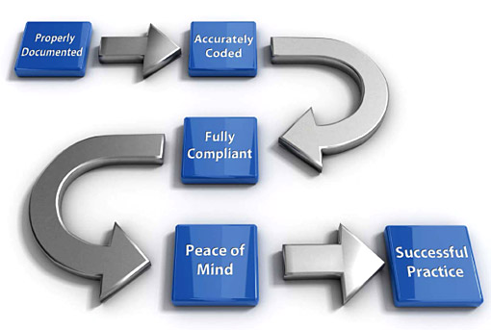
AUDIT
Is this a bad word in your organization?

Slide 19
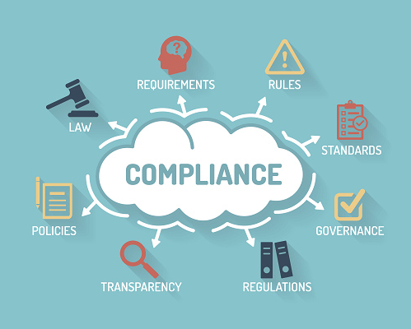
Monitoring compliance

Slide 20
auditing

Slide 21
What to audit?
Documentation
Coding accuracy
Missed services
Orders for ancillary services
Query compliance
Productivity
RAC, CERT, UPIC, ZPIC
OIG work plan
LCD/NCD
Denials
Prior authorization/pre-certification
High-risk audits (DRGs with excessive denial rates)

Slide 22

monitoring

Slide 23
What and how to monitor
DNFB
  Documentation
  Coding delay
  Staffing issue
Productivity
  Meeting standards
  Below standards
  Volumes
  Accuracy
Denials
  Medical necessity
  Bundling
Revenue
  Department
  Overall
  Peaks/valleys
Days in A/R

Slide 24
POLICIES

Slide 25
CODING REGULATIONS & POLICIES
Regulatory
Operational
Ethics
CMS
OIG
MEDICAID
COMMERCIAL INSURANCES
RAC
CERT
CHANGING CODES
MISSING/INCOMPLETE DOCUMENTATION
QUERIES
DENIALS
ACCURACY
PRODUCTIVITY
CHARGE MASTER
AHIMA/AAPC CODE OF ETHICS
ORGANIZATIONAL ETHICS
PROFESSIONAL ETHICS
COMPLIANCE ETHICS

Slide 26
Where to focus

Slide 27
SO MANY CHOICES…
POLICIES
RAC
ACCURACY
CMS
AMA
ICD-10
DOCUMENTATION
MEDICAID
AUDIT
CERT
OIG
PAYERS
CPT
DENIALS

Slide 28
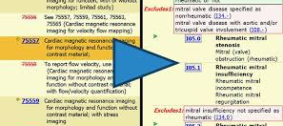

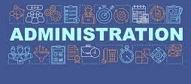
CODING COMPLIANCE
CODING
PROVIDERS
ADMINISTRATIVE
Auditing for correct code assignment
Auditing for missed services
Auditing for TAT/Productivity
OIG target areas
Auditing for documentation completeness
Auditing for timely documentation
Auditing medical necessity
Auditing denials related to coding
Auditing missed services
Auditing DNFB or Days in A/R

Slide 29
Steps to get started
What part of coding compliance do you want to review?
Internal compliance policies
Identify what
Identify who
Identify policies
Identify regulations
Identify data sources
What data is needed to evaluate compliance based on policy and regulation
Who is involved in this portion of coding compliance?
External rules related to the what

Slide 30
WHAT
Coding Accuracy Compliance
Appropriate assignment of U07.1 ICD-10 code in specific date range
WHO
Coders – X, Y, Z
IP Status Patients
POLICIES/REGULATIONS
Internal policy – coding accuracy
Regulations – ICD-10 CM guidelines, Public Health Emergency Rules, ICD-10 CM Coding Clinic, CMS
DATA SOURCES
Claims based report where U07.1 is listed as principal diagnosis within specific date range

Slide 31
NEXT STEPS
Review
Full review or random sample
Audit
Audit for accuracy
ICD-10 CM guidelines, PHE rules, CMS regulations
Evaluate
Evaluate results
Internal accuracy rate policy
Share
Share results
Satisfactory results – set follow up/next review date
Unsatisfactory results
Educate
Set expected improvement
Set new review date (30-45 days)

Slide 32
25 IP Stays with U07.1 as primary diagnosis
Audit criteria
Internal coding accuracy policy (95% or higher)
ICD-10 CM guidelines for assigning code
PHE and CMS rules for U07.1
Results
18 of 25 IP stays accurately coded based on criteria
72% accuracy rate
Share
Unsatisfactory results
Below internal policy threshold
Improper assignment based on ICD-10 CM guidelines
Educate
Provide specific education related to U07.1
Set expectations for improvement
Set new review date

Slide 33
recap
Compliance as a culture encourages positive and ethical intentions/actions
Internal policies and external regulations highly impact coding compliance
Coding compliance can be evaluated from many different aspects
Coding compliance is more than just the coder
Coding compliance may have a different meaning to different people in the organization
Coding compliance is a piece in the full revenue cycle
Coding compliance is highly dependent on documentation

Slide 34
OIG
  https://oig.hhs.gov/
Social Security Administration
  https://www.ssa.gov/OP_Home/ssact/ssact-toc.htm
HIPAA
  https://www.hhs.gov/hipaa/for-professionals/security/laws-regulations/index.html
HITECH
  https://www.hhs.gov/hipaa/for-professionals/special-topics/hitech-act-enforcement-interim-final-rule/index.html
False Claims Act
  https://uscode.house.gov/view.xhtml?path=/prelim@title31/subtitle3/chapter37/subchapter3&edition=prelim
Centers for Medicare and Medicaid Services (CMS)
  https://www.cms.gov/
Noridian Healthcare Solutions (Jurisdiction F)
  https://med.noridianmedicare.com/web/jfb
Wyoming Medicaid Provider Manual and Bulletins
  https://www.wyomingmedicaid.com/portal/Provider-Manuals-and-Bulletins
American Health Information Management Association
  https://www.ahima.org/
American Academy of Professional Coders
  https://www.aapc.com/

Slide 35
Amy Hayes, MBA, CCS, CCS-P, CHA
813 East Lincolnway
Cheyenne, WY 82001
307-638-0300

