Slide 1
Revenue Cycle Employee Experience
Hire, Train, Inspire and Retain the Best Revenue Cycle Team in a Post-COVID world
Karie Bostwick, VP of People and Compliance

Slide 2
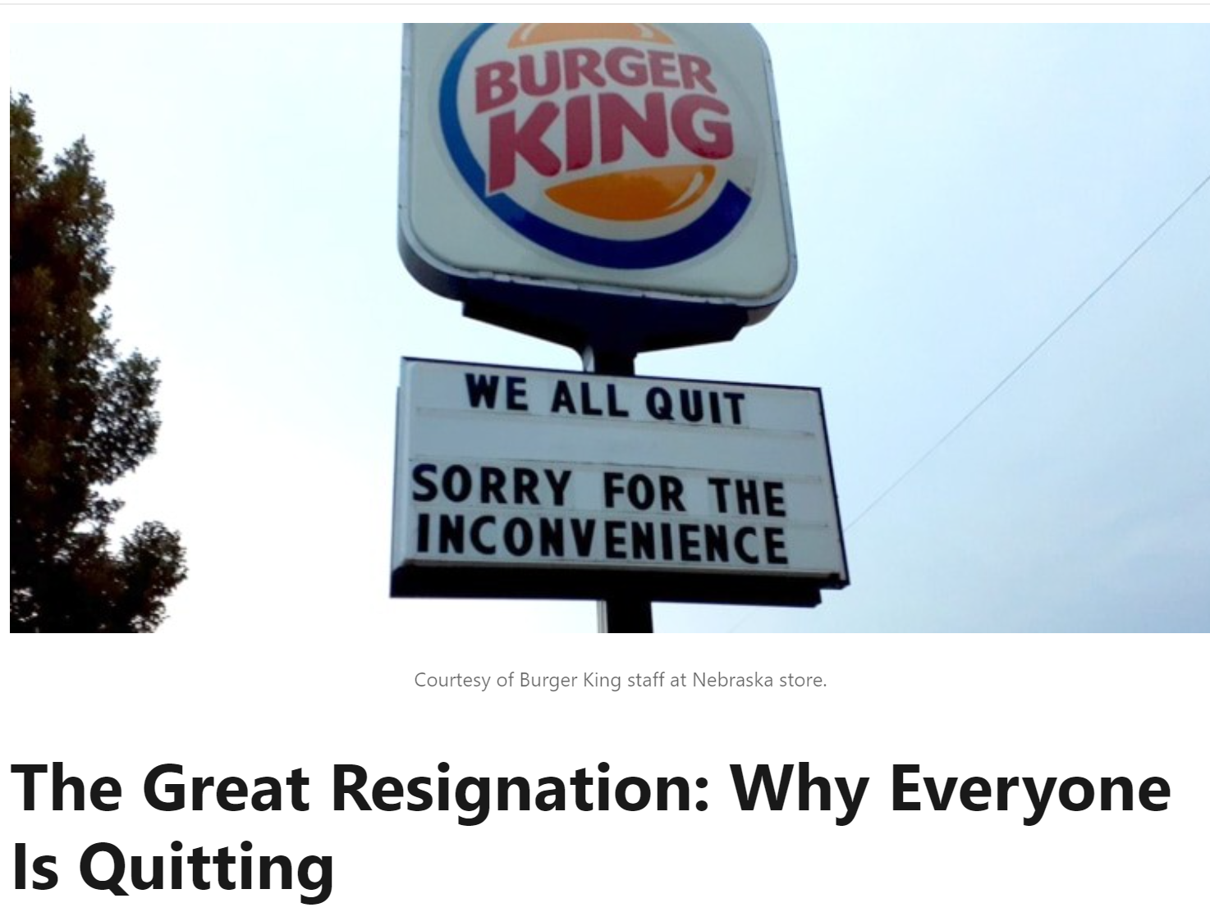
*(99+) The Great Resignation: Why Everyone Is Quitting | LinkedIn

Slide 3
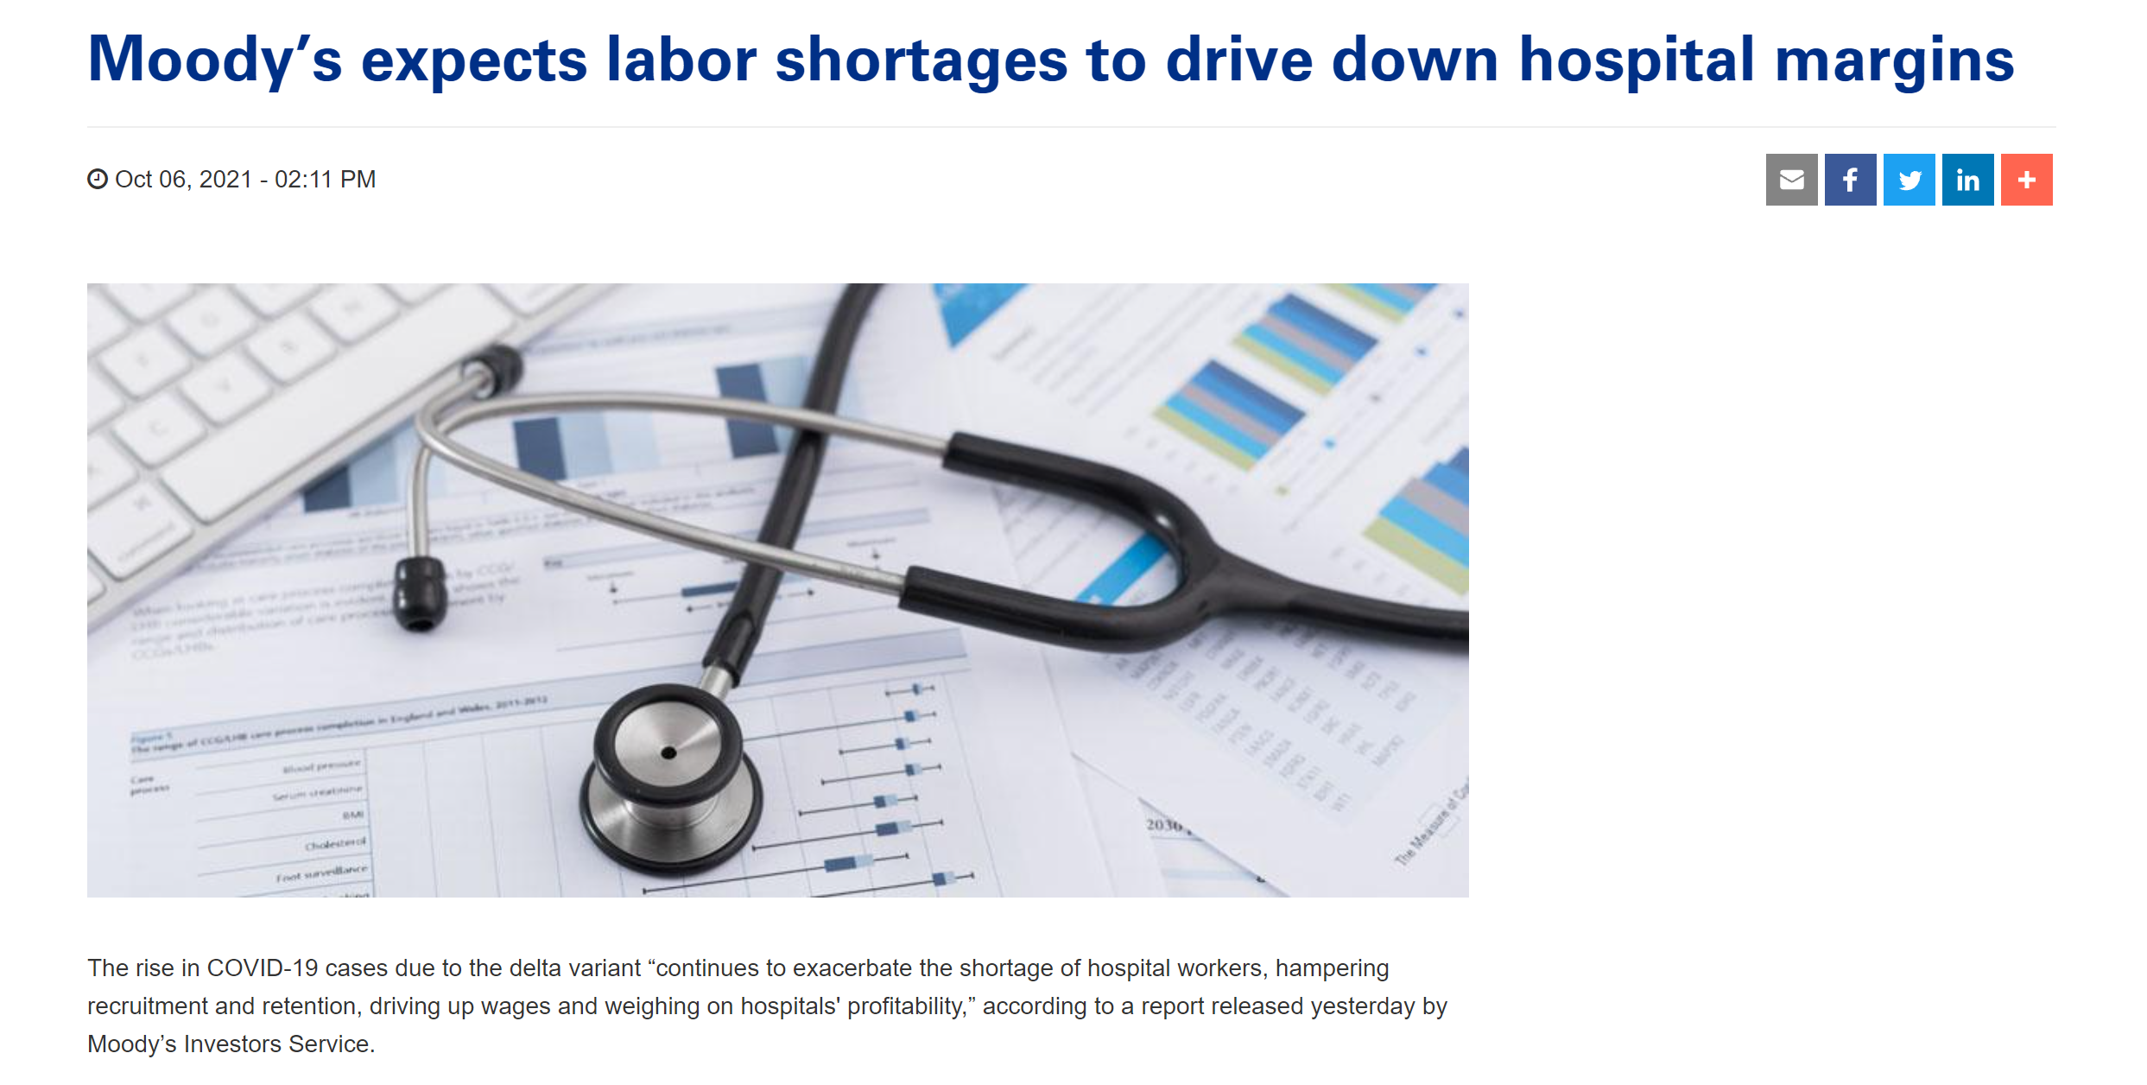

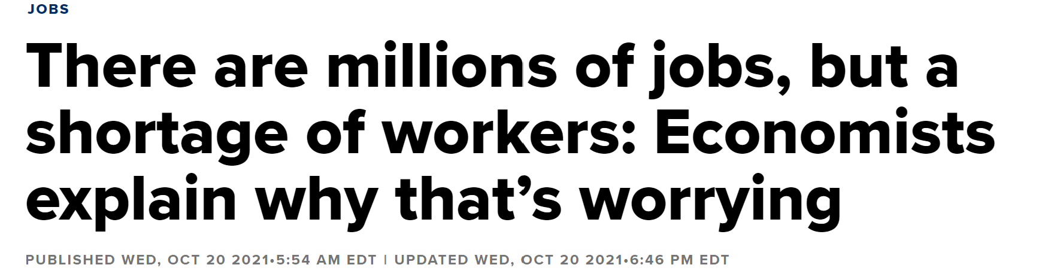
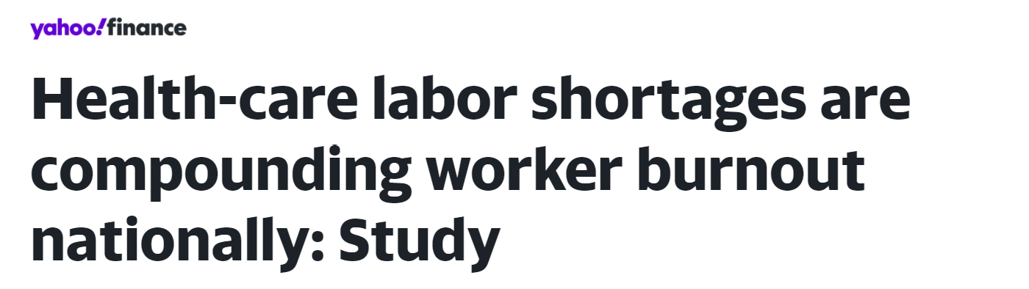
Today’s Headlines
Notes:
We’ve all seen the headlines and experienced the pain of labor shortages this year. Either in our own facilities/businesses or in our communities.

Slide 4

Healthcare unemployment rate hit 4.3% in August 2021 –
The Healthcare industry lost 534,000 employees in August alone.*
The workforce was restless in 2018 and is now even more difficult to find and retain.
Total hospital turnover rates across the nation are 19.5%
The turnover rate in the healthcare industry has risen nearly 5% — across all jobs in the industry — over the last decade.
Millennials are now the largest part of the workforce comprising 41% of our healthcare workers.
42% of Millennials say that growth and learning is the most important thing to them.
44% of Millennials want a flexible work environment and want their work to “make a difference”.*
Healthcare Staffing Stats
*Statista 2021 https://www.statista.com; *2021 NSI National Health Care Retention & RN Staffing Report
*www.advisory.com/daily-briefing/2021/10/18/employees-quitting
*wwwamnhealthcare.com/amn-insights/news/healthcare-workforce-millennials
Notes:
Unemployment is high. The reason is still a mystery to me. Before the pandemic we were easily able to find and hire employees who wanted to work in our office for $16 an hour. Now we are hiring those who want to work remote, while watching their children, and they want $20 an hour+. And we’re on the business end. I can’t imagine what it’s like to recruit and find clinical and nursing staff?
So the stats speak for themselves.
We have a workforce that is tired, burned out and seeking flexibility. We are suffering from COVID-19 fatigue in every way. The workforce is restless and seeking a way to support themselves and their families in a way that keeps them safe while feeding the need to do a job that is rewarding and impacts the greater good. Oh and please don’t forget that many of our workers are willing to start at the bottom but want a quick path to grow in both income and responsibility.
That leaves employers in a place to act and ensure they have appropriate strategies in place to both attract and retain qualified staff.

Slide 5

Employee Turnover
Causes and costs
Turnover Reasons Historically
Employee is offered a better job by another employer (solicited or unsolicited)
Employee no longer wants to work for current company – due to conflicts with co-workers/policies/procedures lack of engagement with manager
Employee is disengaged and actively looking for a new more exciting position
Employee is seeking higher pay/better benefits or an opportunity to advance his/her career
Employee is terminated due to
  Attendance
  Behavior
  Failure to adhere to policy
  Failure to meet minimum work guidelines
Cost of Turnover:
$12,000 to replace one employee making $36,000/year
$20,000 to replace one manager making $50,000/year
$50,000 to replace one executive making $150,000/year
*Employee Benefit News
Turnover has a ripple effect on the department and productivity of existing employees as well as productivity
Notes:
Let’s look at employee turnover and the reasons staff leave.
First, we’ll look at historical information and then at current data as to reasons why employees leave.
Employees leave for other/better opportunities – could be they are always looking or a recruiter reached out to them.
Employees become unhappy with their current employer/position – could be due to lack of engagement or lack of growth opportunities. Flexibility in time off is another key factor causing turn over
Employees are disengaged from their position (don’t see the big picture – don’t feel as if they are a part of something or have any power over how they do their job.)
Overall the cost of turnover is expensive depending upon how much you are paying each employee.

Slide 6
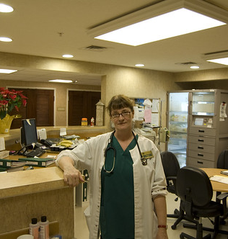
Low Wage Jobs – Wages have increased in the past year and employers are slower to respond.
Opportunity for growth
Cost of Child Care
Increasing responsibility
Burn-Out and Fatigue due to COVID pandemic
Desire for flexibility in working environments and hours
2021 Turnover drivers
*www.advisory.com/daily-briefing/2021/10/18/employees-quitting
This Photo by Unknown Author is licensed under CC BY
Notes:
2021 COVID pandemic world has changed how we view turn over. We have witnessed double digit percentages in wage growth (at least in COLO) for our entry level positions. We have more open positions now and find it tougher to get qualified employees. Demands have changed from employees who have had at least 9 months to a year of working from home and found a new level of work/life balance.
Day care is hard to find as day-care providers cannot find qualified care givers, working parents are now unable to afford to go back to work full time and/or find care for their children so they are forced to look for flexibility in their work allowing them to be at home with their children.
The staffing shortage is having another effect in causing burn out for employees who are able to work and face a larger load of the work as leaders scramble to find employees to do the job and then train them.
Mental health issues have risen in employees forcing some to leave the workforce to focus on their health. Even employers with remote workers are needing to reach out to help provide support for employees who are lonely and facing depression/anxiety.
In healthcare the burn out is palpable from overworked and tired clinical staff and trying to keep people there to support and help those in the community who need care. The pandemic seems overwhelming to some getting better and then developing a new strain and causing more heartache and illness.
Add to it that Baby Boomers are retiring (some earlier than expected due to COVID) and the millennial growth as a % of the overall workforce is impacting the culture and how the work is done.

Slide 7
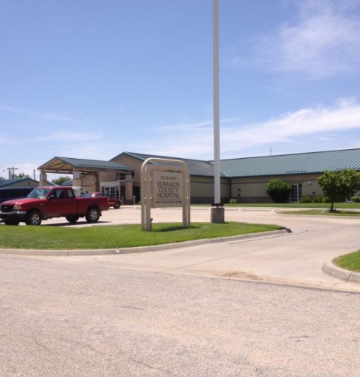
Staffing Challenges for Rural Providers
Limited Pool of skilled candidates
Lack of resources (pay) to compete with other area industries
Environmental challenges (roads/weather issues)
Notes:
Rural providers are still facing a limited candidate pool for their job openings. Salary adjustments in healthcare are not easy to come by and often require approval through several levels at the hospital. Those who must report to work at the hospital or provider office still face challenges during inclement weather (depending upon location).
Although my prediction is that with growth in remote work opportunities and a desire for a better quality of life rural locations may see a growth in their area of new families moving into the area.. Just my prediction.

Slide 8

What can you do?
Highlight “meaning” in the work.
Provide flexibility around where and when employees work
Provide a culturally diverse workforce focused on community
Invest in employee growth through education and advancement opportunities
*www.forbes.com/sites/forbeshumanresourcescouncil/2021/11/01/how-to-position-your-company-to-avoid-the great-resignation/?sh=3944e0d55be
Notes:
As an employer you have a couple of key areas to focus on to help attract and retain the best employees:
Highlight the value in their role. - Paint a bigger picture as people want to know that they contribute to the greater good. So for example instead of saying “ I’m a biller” they can share – “they ensure that their healthcare provider is able to serve the community by submitting accurate claims to payers.
Provide flexibility around where and when employees can work. Can you provide flex-time options for revenue cycle employees? There are those who need to work 9-5 but could you perhaps set up a shift from 5-9 p.m. and another from 6-10 a.m.? We are considering using part-time employees to help us with full time positions. What do your employees desire as far as flexibility goes? Can they work remotely?
The younger generation is more culturally aware. They value diversity in many areas and want a position that enhances the greater good.
Additionally most millennials are out of school at this time or graduating and are seeking positions that allow them to grow in responsibility and income more quickly. What does the growth path look like at your facility?

Slide 9
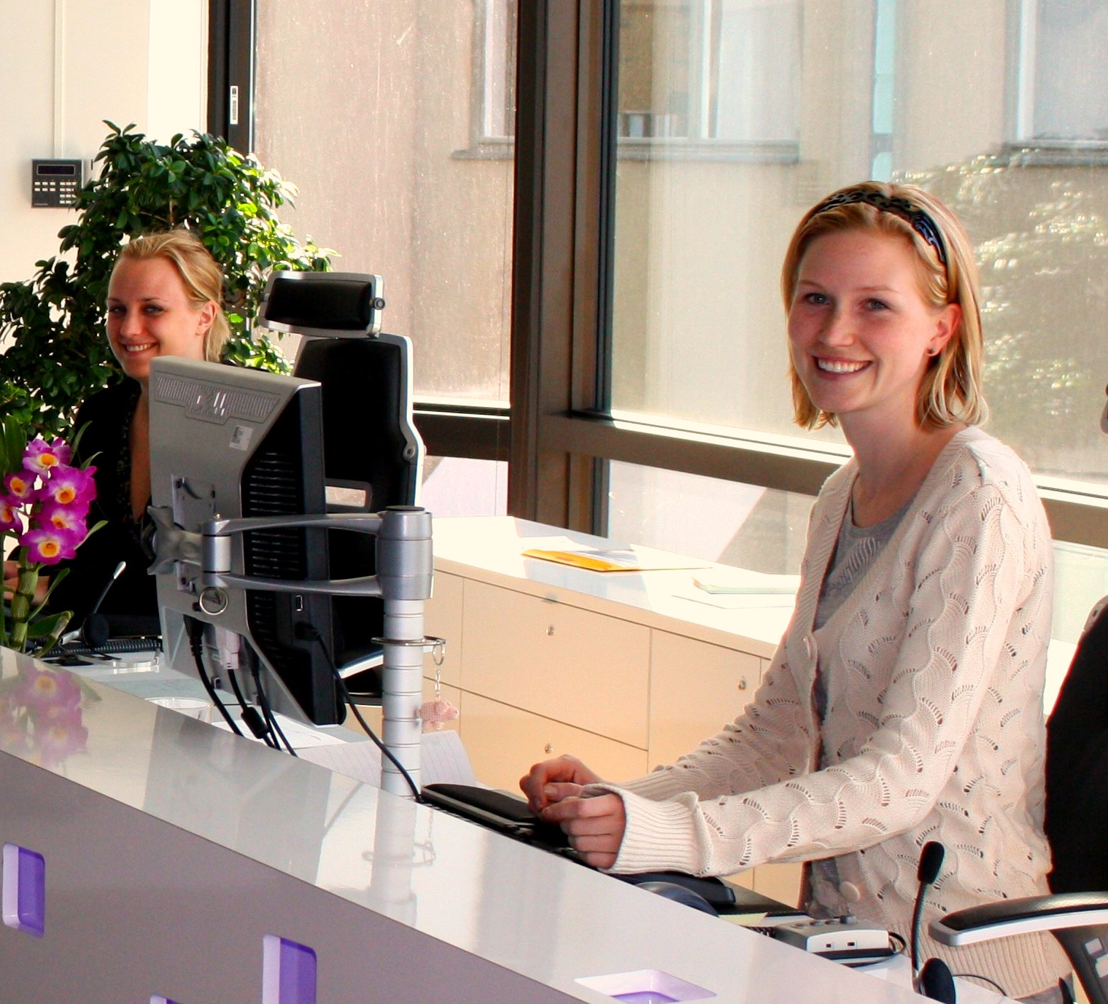
Finding the Right People
Attracting Talent
Identification of “Winning” Characteristics
Interview Process
Hiring
Onboarding and Training
Employee Engagement
Building Employee Trust and Gathering Data
Motivation and Inspiration
Building your Culture
Notes:
When you are seeking qualified talent it is best to work directly with your Leadership and your HR team. Identify the characteristics and traits of your top employees? What do they demonstrate that allows them to be top players? Are they willing to learn new things? Are they self-starters? Are they dependable? Solidify these characteristics and hire for them.
Set up an interview process that allows for at least 2 steps if not more. There are many times that an initial interview with a candidate (remote) will turn into a no at the next level when that candidate is challenged by a simulation of some of the tasks they will be asked to do at the next level.
Assess the skills and basic knowledge skills of your applicants. We have signed on with Hire Select and use a basic skills test for the type of position we are hiring for to ensure they meet a minimum level.
Those who interact with applicants should be able to effectively market your facility and workplace to new hires. They should be welcoming and warm throughout the application process.
Have a solid and well-defined onboarding process. Introduce the new hires to their new managers, assign them an on-boarding buddy or a mentor (a senior member of their team they will be working with). This individual will help the new hire with questions and tips and tricks once they are on the job.
Engage with the new hire regularly and provide feedback frequently. Be sure to train your leaders that feedback (even negative feedback) can be stated in such a way as to motivate the employee to improve. Employees WANT to know what they are and are not doing correctly.
Building employee trust is huge – it really starts at the top. Employees want to know that they are safe in their jobs and will be provided training and support to be successful.
Motivating your team really is something that requires you the leader to have passion to accomplish goals. Set out a goal and measure and report on this so employees can see their progress. Help them to feel like they are a part of something important and to recognize the vision of success. The leader’s dialogue when working with their team is hugely important. If the leader is deflated the employees will not be inspired.
Ensure that leaders focus on building and acknowledging employees who uphold the facility’s culture through their actions. Do public recognitions and rewards as frequently as you can to reward desired behaviors and actions.

Slide 10
Attracting Talent
Review Job Description
Identify Key Skills, Aptitudes, desired characteristics, and behaviors
Talk to employees in those jobs – Identify how their work impacts the organization and the community
Identify top 3-5 things that make working at your facility or in your department awesome
Create your ad as if you are marketing your organization and your team – you are!
Grab the attention of your readers by appealing to a way they want to feel working for you
Identify the key things that make working at your organization fulfilling – appeal to your reader
Highlight what employees can expect from you and what you expect from them
Notes:
When it comes to attracting talent – it starts with the job description – make sure you have identified the key traits, skills and behaviors that your A players are exhibiting. Write the job description that emphasizes the importance of each role.
Create your ad with marketing. You are indeed marketing your facility as “The” place to work. Not just because you are the biggest employer in the community but because you are the Best employer.
Add in the great culture and team/family feel your organization may have. Employees really want to feel connected to their employer. Is their work fun? Do you help to ensure that the work they do not only is important it can be enjoyable.
Emphasize the way th employee will “feel” in their job. Does their job make them feel like they are helping others or helping the community? Add that into your ad.
Be sure to highlight any awards your facility or team may have received – this matters to applicants and research the type of employee ratings you have received in on-line recruiting sites. Both Glassdoor and Indeed offer current employee and former employees to “rate” the employer. The higher the rating the more savvy applicants who do their research will want to work for you.

Slide 11

Where to Look?
RECRUITING SOURCES
Look internally
  Develop current employees
      Outline demonstrated skills/behaviors for new position
      Offer assistance to employees to help them grow
      Create a Mentoring program
      Outline a leadership development course for employees to take to help them prepare
  Employee Referrals (Incentive for referrals?)
      Employee Recruitment Cards (when they meet someone who would be a great teammate give em a card!) Use a QR code!
      Offer automatic initial interview to all Employee Referrals
      Offer financial or other incentives for successful referrals.
Look externally
On-Line
Recent Graduates at Local Schools
Semi-Retired Individuals – Retired from one industry not ready to quit working
Post ads in local businesses
Social Media
Notes:
There are several areas to review when recruiting for applicants. The best I have found for our office are internal. If you have a chance to develop and grow an entry level employee for greater responsibility do-so. This not only allows that employee an opportunity to take on a different and greater role (which infuses all kinds of positivity in the work area) but it lets him/her know they have opportunity and creates loyalty.
We are in the process of developing internal training programs for employees to help them learn and demonstrate the skills and behaviors that will prepare for a promotion and be ready when the opportunity arises.
We also have hired several employees in our team that are referred by former co-workers or friends who current work at the organization. Incentivize employee referrals. Given them at least an initial interview because they know and named someone at your office who referred them.
If hired, offer a monetary or other type of award for the employee referring someone who is now contributing to the success of your facility/organization. We have chosen a monetary incentive/bonus after a period of time. This rewards employees for referring great candidates.
Create employee recruitment cards with a QR code or provide them with an application request email they can send to a friend/former co-worker that will send the applicant right to the application.
Externally look to community boards, schools (perhaps a job fair for high school seniors who are graduating or community college)? Look at those who have retired from one career and are perhaps looking to get into another career.
Post ads in local businesses, and don’t forget Social Media. Your need for applicants and your key positions should be listed on your Linked In and FaceBook frequently. Again provide a quick link so applicants can go directly to the application section.

Slide 12


“A picture is worth 1,000 words”
Help your future employees visualize themselves working for you!
Notes:
Use your local FB page or show pictures of happy employees (with their permission) for your ads. Don’t forget to market how great it is to work at your organization. Do you do a community fundraiser every year? Post pictures of employees both at work and outside of work with co=workers doing fun things, or giving back to the community. Applicants pay attention.

Slide 13

Create your Ad
The Hook
The Hook! Who are You? Expectations
Would you like to help patients and their families to better understand their medical bills and provide them with options to resolve them? Are you looking for a career with a solid company with stable hours (Monday-Friday, 8am-5pm) and great benefits, where the customer service you provide, and your contribution is valued?
We would like to talk to you! We are looking for full-time, caring, and talented Healthcare Customer Service Representatives to make a long-term home in our organization. In this important role, you will work with patients and their families to explain their medical bills and negotiate affordable payment terms.
We provide customized, innovative, cost-effective and flexible solutions for hospitals and healthcare providers on their self-pay account balances. We value compassion, clarity (understanding bills and helping patients to understand their bills), and results. If you value these things too, you will be highly appreciated.
What you can expect from us:
Opportunity to be an integral part of an established and well-respected organization, where your voice matters
A commitment to your professional development
Business hours Monday-Friday remote or in-office
Part-time or Full-time opportunities
You
Expectations
Notes:
When creating an ad – start with a Hook. Appeal to what an applicant wants to feel/do and let them know you are looking for this type of person.
Have a brief section on what your organization does and your team within the organization. Again emphasize the importance and feel-good part of the job. People want to help intrinsically this is in our nature to connect with others.
Outline the benefits of working for your team.

Slide 14
Sample Ad Continued..
Benefits and Your Expectations
Excellent benefits including: Health, dental, life insurance and disability; 401K with employer matching; generous PTO accrual from day 1; discounts with various retailers and services via LifeMart.
What we’ll expect from you and what you’ll be doing:
Using your passion for helping others to provide outstanding customer service and to collaborate with patients over the phone on affordable payment plans and settlements, and taking payments by phone
Using empathy and fantastic listening, verbal, and written communication skills to help patients and their families to understand their bill, answer questions about their debt and medical billing process
Using your computer proficiency, organization, and attention to detail to accurately document all calls and follow ups in our software systems throughout each day
Supporting your fellow team members with consistent attendance, excellent work ethic, and caring team focus
Benefits
Your expectations
Notes:
Outline benefits of working for you and your team. Applicants really value these so make sure to point out if you provide not only health insurance but vision and EAP programs. Do you help with vision and what about child care?? Is there a Health Savings Account option? Does your facility contribute to a pension or provide a retirement savings plan for employees?
Outline what the employee will be doing in simple and yet appealing terms. Really appeal to the skills that the employee has that makes a difference.

Slide 15
Hire to Your Office Culture
Mission Statement – Core Values?
Who are you?
What drives you?
Team Dynamics?
Notes:
Hire to your culture. This is one way to find a candidate that will thrive in your organization. Looking for employees whose values and words match your culture help to ensure a better fit in the long run.
Ensure that applicants share similar vision as the facility this will help drive that vision into other areas of the organization.
Also hire to your team dynamics. If you have outgoing bubbly people on one team placing an introvert on that team may not be the best fit. Look for fit in the team personalities as well.

Slide 16
The Interview Process
Selecting the right fit
Identify your steps – Review Resume – Interview – Hire? Or….
Is it worth it to extend the process to include a couple of steps?
  Phone Interview
  Role-Play
  Skills Testing
  Aptitude Testing
  Personal Interview
  Second Interview
  Team Introductions
Determine the best selection path for each position
Use standardized scoring on each interview to objectively select the best candidate
Hiring for culture and ability to develop wins
Notes:
When interviewing potential applicants I prefer a multi-step process. This not only helps us to identify employees who would do the best job for us but helps to weed out those who have mastered the initial interview and yet struggle in the job. This will eliminate unnessasary turn over at a later time when it’s more expensive.
I interview by using the same questions and comparing answers from candidates. For specialty positions I will put together a spreadsheet and weighting system for each answer and advance the best candidate(s) for a final interview.
I have found creating a simulation of the job or type of work is a great way to really test the aptitude of a new hire to learn the role. There has often been a great initial interview candidate who bombed the simulation showing a complete lack of preparation and forethought. Is this really the person you want working for your team? While somewhat time consuming it does help.

Slide 17
OnBoarding
First Impressions
Ensure candidates have a positive first impression of your organization when they arrive for their first day.
  Welcome them to the team.
  Let them know and demonstrate through your first day actions you are happy they are here.
Follow the 4 C’s of Onboarding
  Compliance – Make sure new hires understand what they should and should not do
  Clarification – Outline responsibilities and expectations as well as a clear understanding of how they fit into the overall organization
  Culture – Clearly explain the culture, mission and values of the organization
  Connection – Assist new employees to make new friends at work. Partner them with an existing senior representative who can show the ropes. Provide a mentor. Building relationships is the most important way to ensure that new hires opt to stay and ensure a better chance at longevity. *
Notes:
When onboarding employees ensure there is an organized, warm team feel to your onboarding process. You are giving your new hires a first impression of what it will be like working for you! Be welcoming and enthusiastic. Let them know you are happy and excited they are here.
Follow the 4 C’s of Onboarding – Compliance, Clarification, Culture (who are you), and Connection.
Staying connected with the new hires and allowing them to be connected with each other during this initial phase creates a sense of community and comraderie. Bring in coworkers from the teams and ensure there are both initial and more in-depth introductions.
Match new hires with a buddy or Senior rep (who is both welcoming and knowledgeable) to help the new hire not only learn their job but answer questions and provide guidance and support.
Finally, provide feedback to the new hires. If there is something that they are doing that does not adhere let them know early and help them to stay on track with training. If there is something they are doing great! Let them know that as well. Also prepare them for their training – a well thought out schedule of training activities (who, where, when and how) really helps.

Slide 18
Training
STARTING OFF RIGHT
Provide comprehensive training on:
  Skills
  Expectations
  Culture – Who are we? How do we behave? How do we think? How do we do things? How he/she fits and contributes?
  The Why behind their role
  Potential Career Paths
  How to demonstrate readiness for the next level?
  What support will they receive to help them develop skills?
Notes:
There are so many ways to train a new employee but make sure that as you train you are engaging him/her. Ask questions, ensure that you check their knowledge of the subjects trained by adding in frequent smaller assessments that help to ensure the employee is paying attention and retaining the knowledge.

Slide 19

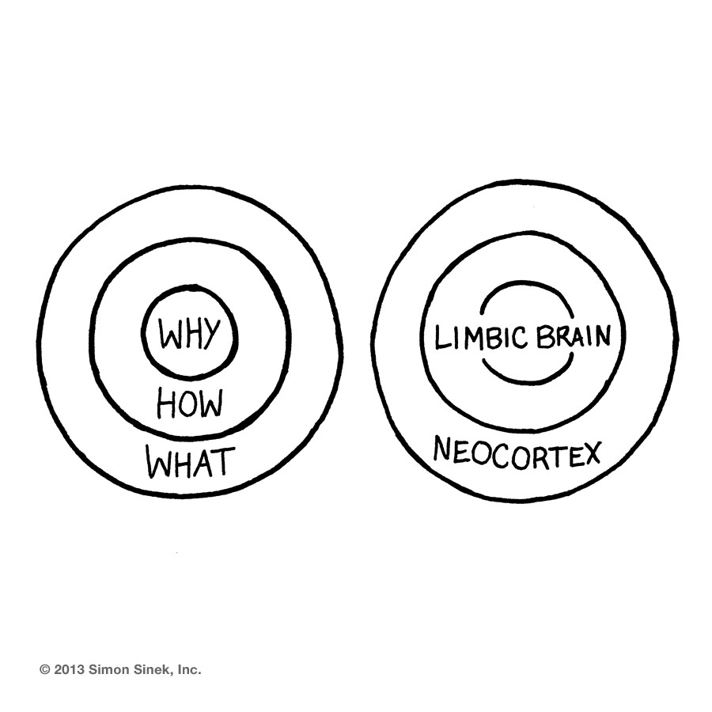
INSPIRING AND MOTIVATING
The ‘Why’ is integral to a company’s being.. it is biological fact. Why we do something as opposed to how or what we do, is emotional. Successful companies understand why they do what they do. Because it is emotional it is powerful driver for collective motivation.
It is ‘from inspiration to implementation’ and it inspires fresh possibilities along with longer term support. Discovering the ‘Why’ is quite simple but somehow more difficult to implement.”
https://www.industrialprintblog.com/blog/2016/6/10/leadership-the-importance-of-whyTS;
Notes:
When you are inspiring and motivating employees remember to go to the basics. If an employee feels a part of the process, empowered and understands the goals an vision the motivation is easy. For a Leader to share the “Why” behind a process or change it helps to get the team on track. Simon Sinek does a great talk called the Why where he explains why they do what they do. Use that same logic when inspiring employees to great performance. Again remember to link the Why to the greater good and value of the action you are trying to inspire. If employees believe and put their energies together anything is achievable.

Slide 20
“leadership is about creating simplicity and belief.”
https://www.industrialprintblog.com/blog/2016/6/10/leadership-the-importance-of-why

Slide 21
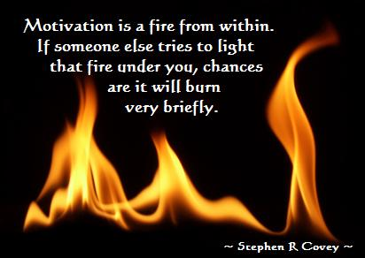
Motivating Employees
Getting in touch with your team
Share your vision and goal – set clear and measurable goals
Communicate with your staff – Keep a constant flow of communication with your staff.
Encourage teamwork
A healthy work environment – pleasant and inviting ..fun?
Give positive feedback and reward your team
Provide opportunities for development
https://www.impraise.com/blog/how-to-motivate-and-inspire-your-team-to-achieve-better-results
Notes:
Again it’s important to do what you can to light the fire of motivation in your team. To do this share your vision – ensure that you speak to the long term impact of the work and the greater good it brings. Have clear plans and keep the communication at the forefront. Measure your goals and communicate often. Encourage the team to work together and contribute ideas and engagement in the process. If the team is a part of the plan the better the chances of success.
Ensure that you have a healthy and positive work environment. Make sure the focus is on the prize, ensure you acknowledge and reward those who achieve and make strides towards reaching the goals and provide opportunities for learning and achievement. The team will gain the pride that comes with accomplishment. This will burn like a fire within and burn.

Slide 22




Key ways to engage and connect with your team
True connection makes a difference
Brainstorming on new ideas to improve processes
One on One Meetings
Acknowledgment and Recognition
Incentives for reaching goals – Monetary and Non-Monetary
Notes:
Here are some ways to engage and connect with your team. Employees want to feel connected to both their employer and their work. Engage with them by brainstorming. Appeal to their expertise in their jobs and ask for their feedback and ideas.
Be diligent about holding one on one meetings. Remember with these it’s about the employee’s time with their manager to discuss what the employee wants to do. These are key times for Managers to get to know their employees on a more personal level and understand what makes them tick.
Be sure to acknowledge and provide recognition where it’s deserved and provide incentives for reaching goals.

Slide 23
Gaining Employee Trust
Building Trust through Action
Conduct an Annual Employee Satisfaction Survey
Analyze Results
Share with Leadership
Discuss how you CAN meet employee wishes or improve Management shortfalls
Share survey results with employees – talk to what can and cannot occur and WHY
Show progress toward meeting requests/expectations
Conduct Employee “Pulse” Surveys
Share with Leadership
Discuss how you CAN meet employee wishes or improve Management shortfalls
Share survey results with employees – talk to what CAN and Cannot occur and WHY
Show progress toward meeting requests/expectations
Trend Results
Annual Survey
Patient Satisfaction Scores
Employee Retention
Share with team
Notes:
When employees feel that their employer is on their side and true to their word it’s an amazing thing. Gaining employee trust is about “being your word”. Do what you say you will do and listen to your team. Truly try to understand their point of view and ping them for their ideas and opinions.
Ask for feedback from your team and ask the tough questions. Be willing to analyze your results and share openly how you CAN meet their recommendations and wishes. IF you are unable tos do so talk about a path to get close and let them know you are working along side them to help get as close as your can. Explain why the recommendation is not feasible but what is feasible.
Be willing to track your own progress towards meeting employee wishes so you can share your willingness to create a work environment that makes employees feel good about being a part of..
Conduct pulse surveys on specific areas and definitely conduct an annual survey. It’s also helpful to have an independent 3rd party help with this to ensure employees feel confident in their confidentiality and can be more open. The comments can be very eye opening and highlight opportunities for leadership improvement. It’s a partnership!

Slide 24
Trends in Employee Satisfaction

Slide 25
Employee Retention
Recognize and Acknowledge Employee milestones
“Retention Bonus” for new hires who stay past 6 months – 1 year (Monetary or Non- Monetary)
Embrace diversity in your workforce – promote culture
Stay Interviews with “A” Players
Celebrate wins together as a team
Promote Teamwork with other activities (bowling, happy hour, other team gathering?)
Provide education and promotion opportunities
Provide flexibility to support employee’s lives (hours/work location)
Notes:
Here’s a quick run down on some ways to retain your key staff:
Recognition and Acknowledgement (be sincere)
Retention or Stay bonuses are a great way to ensure your team stays for a certain period of time.
Embrace diversity in your workforce. Often different people bring different and new ideas that can have a positive impact on the team.
Conduct regular “Stay Interviews” with your key players. Make sure you ask them “why” they like working for the organization and the team. Ask them how you can improve. Be sincere and be vulnerable.
Celebrate wins together – it doesn’t have to be much but a small celebration as a team creates a bond and reinforces the need to continue.
Promote Team with get-togethers and activities that promote the team getting together (even remotely) to celebrate together
Provide Education and growth opportunities for your team – development creates loyalty.
Be flexible with your team and ensure you support and care about your employee as a whole! They have a personal life – be sure to pay attention and ask about him/her on a personal level – not just the work but the person.
Be open and curious as to how you can do better to help your team to be successful..

Slide 26

Other Options
Support and Mentoring
Mental Health Support
Employee “Stay” Interviews
Analyze Turn-Over Reasons (Exit Interviews)

Slide 27

Building Culture
Understanding humans:
HUMAN BEINGS DESIRE TO:
Connect to build relationships
Belong to something larger than ourselves*
Provide employees a place to BELONG.
Who are WE?
How do WE behave?
What do we VALUE?
How do we show up for and to our team?
What do we say to help promote our culture?
How do we act to demonstrate the culture?
How do we treat one another and our patients?
Match employees to Culture to Build a Winning Team!
Look at culture before looking at people, and processes when things go wrong*
It takes 18 months to change an organization’s culture. If you need to change…start now!
*Gustavo Grodinsky – Culture Trumps Everything
Notes:
As human beings we learned in this past 2 years how much our connections and relationships mean. As leaders if we remember that humans desire to build a connection and feel a part of something greater than themselves
Understanding and building a culture of success and energy is contagious. If people feel good about their work and believe in the values it’s an amazing result. Your entire workforce will surge forward to help achieve goals together. Employees who feel safe will take chances and think-outside-the-box and will contribute. Employees will analyze their failures and be open to ways to avoid this in the future and look for lessons.
The workforce will be more thoughtful and forward thinking and less reactive.

Slide 28

“Culture has the ability to change the way that we live”
*Gustavo Grodnitzky
change the way you see the world
This Photo by Unknown Author is licensed under CC BY-SA-NC
Notes:
There is a book from Gustavo Grodinsky called “Culture Trumps Everything”. This is an amazing book and true. Building culture takes time, energy and work and starts at the top. But is’s worthwhile endeavor.

Slide 29

SUMMARY
Assisting patients with their bills in a positive caring environment.”
“Every day is different. The variety of my duties.
Building the Right team can have immeasurable impact on your organization.
Building your Policies and processes can positively impact how you can engage and retain your team.
Culture drives everything you do
  Define your Culture
  Hire for your Culture
  Train for your Culture
Engage your employees
Review your policies and redefine how you work – emphasize flexibility, diversity, inclusion and the greater value.
Measure your impact and success
Reduce Turnover
Save money – improve retention
Make work rewarding and fun!
Create vision and Inspire performance
Company cares for employees, clients, and patient. Everyone cares and that goes a long way.”
“The culture and work atmosphere. The company keeps us engaged with work as well as with other events to keep an equal balance.”
“I love the teamwork and the open line of
communication with my manager.”
Notes:
In summary we are in a unique time in our history. Not only are we struggling to find qualified employees we also are struggling to retain them. There are so many factors out there and it’s time for us as leaders to “give up a story” in order to be successful. Time for us to truly concentrate on retaining and engaging our current team and ensuring we are taking care of them as people. Be open to the new generation of employees coming in and to their ideas.
The reward is a more stable workforce and a happier one.

Slide 30
References
Health-care sector labor shortages compound worker burnout nationally: Study (yahoo.com)
US Labor Shortages of 2021: Challenges and Solutions – Deputy
Global shortage of workers: What's going on? Experts explain (cnbc.com)
Employment News: Pay Bumps, Flexibility Offered More as Staff Shortages Bite – Bloomberg
(99+) The Great Resignation: Why Everyone Is Quitting | LinkedIn

