Slide 1

Price Transparency & Pricing strategy
Pricing of Services….
What it Means to You
and Your Patients
Jackie Coult, CHBC – jcoult@eidebailly.com

Slide 2
Agenda
Factors Driving Pricing Transparency
Hospital Price Transparency
Payor Price Transparency
State Actions Towards Price Transparency
Patient Movement
Clinics & Medical Professional Pricing Strategy
Pricing Strategies
How you know your strategy is not working
Market Reimbursement Maximization Approach
How to Implement & Benefits with Sample Published Rates
How Quality Plays a Role
Care Maps
How to Maximize Care & Revenue
How Approach works for RHC and Provider based billing

Slide 3
Factors Driving Pricing Transparency
Unsustainable healthcare cost growth
High Patient deductibles
Relative effectiveness of treatment and overall outcomes
Increased price sensitivity on “public relations” prices; emergency room departments, imaging services, etc.
Government and interest groups pressing pricing decisions
Pressure to maintain bottom line

Slide 4
Hospital Price Transparency
Effective January 1, 2021
Hospitals’ standard charges, including the rates they negotiate with insurance companies and the discount price a hospital is willing to accept directly from a patient if paid in cash, must be publicly available, free of charge, and presented in a consumer-friendly display:
        300 shoppable items and services
        Machine-readable
        CPT, HCPCS, DRG, NDS or another common identifier
Designed to deliver better value and results for patients through competition and innovation
        Shop around for routine tests/procedures
Biden Administration proposing $300/day (>30 beds) or $10/bed/day (<30 beds), not to exceed $5,500 per occurrence, minimum $109,500 per hospital, max total penalty $2,007,500 per hospital
https://www.cms.gov/hospital-price-transparency
Notes:
In the Final Rule, CMS detailed the strong opposition to the requirement, objecting to the burden it would place on hospitals, the impact to market competition, and the usefulness of the data generally. Further, commenters noted they did not believe the policy would inform Medicare beneficiaries with cost and quality information that would promote choice or encourage cost-conscious decisions to lower overall health care costs.

Slide 5
PayOr Price Transparency
Effective January 1, 2022
  Insurers must post 3 online machine-readable files
  Negotiated rates for all covered items and services between the plan or issuer and in-network providers
  Historical payments to, and billed charges from, out of network providers
  Detail in network negotiated rates and historical net prices for all covered prescriptions drugs by plan or issuer at the pharmacy location level
2023
  Insurers must offer online shopping tool for an out-of-pocket costs estimate and negotiated prices for 500 most shoppable services
2024
  Online Shopping tool for ALL services
https://www.cms.gov/newsroom/fact-sheets/transparency-coverage-final-rule-fact-sheet-cms-9915-f

Slide 6

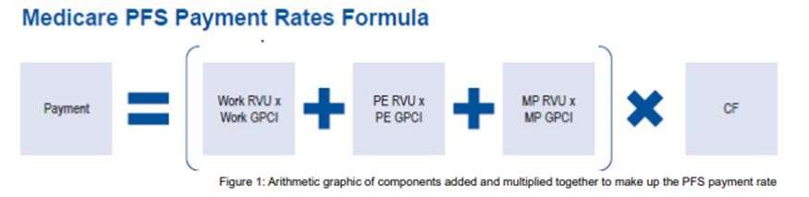
Currently How we secure contracted reimbursement
Medicare (As of 2021, Medicare limits 500 codes per download) & Tricare
    Physician Fee Schedule/CMAC
    CLIA
    HCPCS/NDC Crosswalks
    Medicare part B drug average sales price
    Durable Medical Equipment, Prosthetics/Orthotics, and Supplies Fee Schedule
Access to rates via Availity, Payor website or Provider Representative
  Hand enter each code, if loaded
Limitations on the quantity of codes they will give you
Sophisticated calculation (RBRVS x GIPC x Conversion Factor)

Slide 7
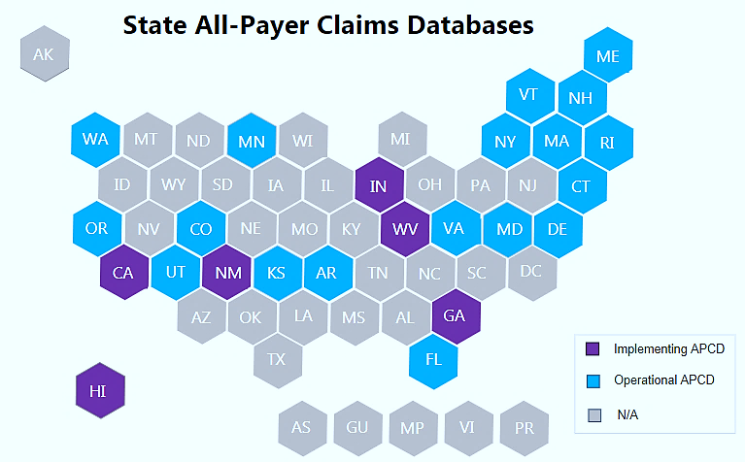
States Actions on Price Transparency
Common state strategies for improving price transparency include:
Leveraging all-payer claims databases (All-Payer Claims Databases (APCDs)
  18 states have operational APCDs
  6 states enacted legislation to implement an APCD system
2. Establishing consumer-facing tools for patients to compare prices,
3. Enacting right to shop laws.
https://www.ncsl.org/research/health/transparency-and-disclosure-health-costs.aspx

Slide 8
Clinic & Medical Professionals
Price Transparency
More is coming!

Slide 9
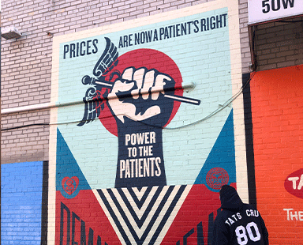
Power to the patient movement
“Prices are now a right”

Slide 10

Renowned artist and activist,
Shepard Fairey, explains why real healthcare prices are needed now
https://www.powertothepatients.org/

Slide 11
Price Transparency Drives Informed Decisions
Patients will be looking for prices via health plan website, mobile apps, email and alerts
Patients want to make smarter healthcare decisions with more control over care and costs
Build patient trust and loyalty with accurate healthcare cost transparency tools
It’s our Health
It’s our Money to Save

Slide 12
Clinics & Medical Professionals Pricing Strategy

Slide 13

developing Gross Charge master or Master Fee Schedules
Percentage of Medicare Rates
Fee Analyzer Books (Ingenix)
Market databases
Best Practices
Market Reimbursement Maximization Approach
  Proactively Customized Charge Master/Master Fee Schedule

Slide 14
Utilizing % of Medicare
Why do providers use a percentage of Medicare?
It is the Easiest to Implement and Update
Family Practice set Gross Charges at 200% for Procedures & 150% for E & M’s with no updates.
Notes:
This practice lost a total of $89,000 per year just on gross charges.
Billing deleted codes total $6,700
Billing improper units total $36,098 (J1050-Depo Provera 150 units per treatment, cost $95.00, rev $3.68)

Slide 15
Fee Analyzer Books
Practice utilized 75 percentile from Fee Analyzer Book
Utilized 200 codes, 126 were below max payor
Highest payors consisted 28% of payor mix
Total annual loss of $188, 000

Slide 16

How you know your current strategy is not working?
You receive 100% of billed charges
Can’t provide clear financial expectations at the time of service to your patients
Not maximizing reimbursement for each provided service
Losing money on supplies or labs
Self-pay rate does not cover the cost to provide each service
Patients are frequently frustrated with billing
Not sure what the contracted rate is for services provided
Can’t verify accuracy of payment for all services from all payors
Not sure how payor rate changes effected your bottom line

Slide 17
How to Implement
Market Reimbursement Maximization Approach
Notes:
Acquire all contracts and any amendments issued.
Know if/when your reimbursement rates update: quarterly, annually or stagnant until you request an increase.
Acquire all contracted fee schedules
Provide a list of active used codes in excel (if they will not provide a full fee schedule)
Calculate or assemble fees
Inventory all Gross Charges, CPT & HCPCS codes, modifiers and units billed/utilized in the last 2 Years
Create your Master Fee Schedule with highlighted cells with default rates
Calculate your Max, Min & Avg Payor
Dial in Gross Charges as a % of Max Payor with customization on defaults
Inventory the costs of all supplies purchased?
IUD
Vaccines
Immunizations
Injectables

Slide 18
Revenue Recovered – You’ve earned it
Total Annual Revenue Recovered
Critical Access Hospital $ 89,609
Oral Maxillofacial $155,612
Cardiology Grp $424,000
Internal Medicine $112,308
Family Practice (9 providers) $ 89,302
Podiatry $ 32,000
Neurology $238,605

Slide 19

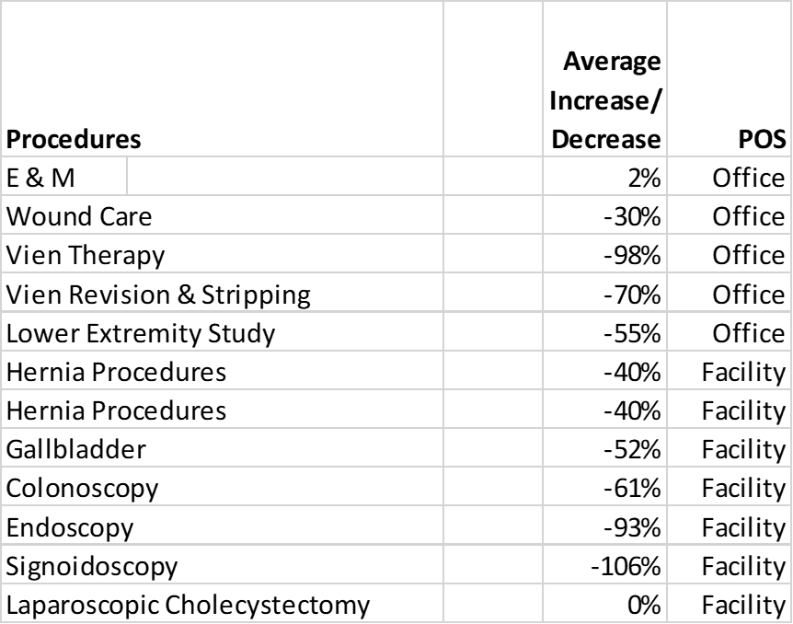
Ability to Track Payor rate changes & how it affects your bottom line?
See where Payors are cutting reimbursement

Slide 20
Financial Impact Payor Rates Changes
Annual loss of $26,000

Slide 21
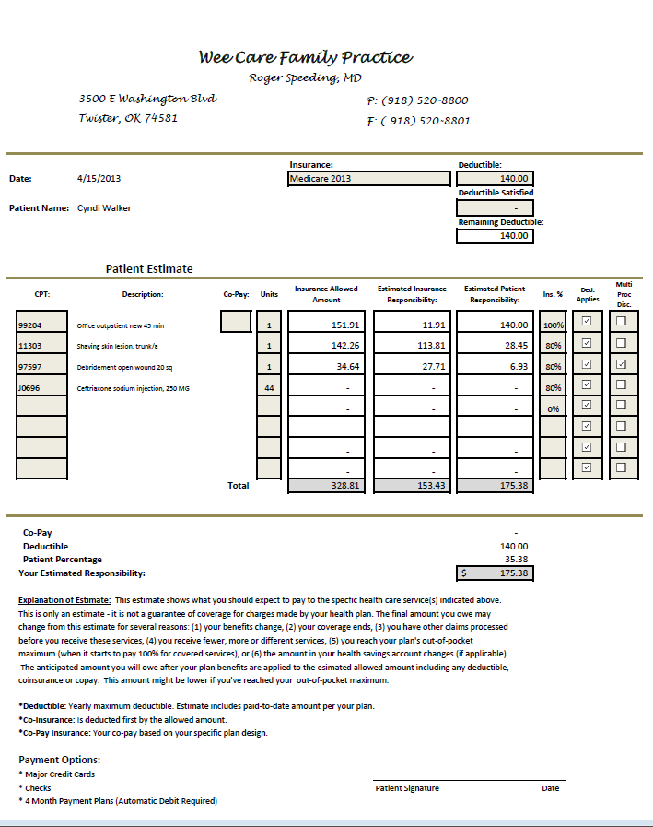
Patient Estimator
Tell them what it cost at the time of service
Accounts Receivable can be reduced by 8%
Increase patient
satisfaction

Slide 22

Proactively Customizing your Charge Master or Master Fee Schedule “will”
Maximize revenue
Reduce AR’s
Give patients clear financial expectations
Set self-pay rates to ensure viability
Identify poor payors
Identify contract provisions which reduce profitability
Ensure accuracy of payor payments
Identify Medical supplies that exceed reimbursement
Identify coding anomalies
Identify services billed incorrectly
Ability to measure financial impact of Payor rate changes
Ability to track RVU changes
Remain compliant
This Photo by Unknown Author is licensed under CC BY-NC

Slide 23
Examples on How Rates Can Be Published
 | Amount Displayed as the “Price”
Example Test / Order (CPT code) | List Price | Reimbursed Amount (e.g., private insurer) | Medicare Fee
Complete Blood Count with Automated Differential (85025) | $142 | $23 | $11
Urine Culture (87088) | $163 | $40 | $11
Chest X-ray Two Views (71020) | $385 | $56 | $29
MRI Brain With and Without Contrast (70553) | $4704 | $1,183 | $538
https://www.ncbi.nlm.nih.gov/pmc/articles/PMC4465135/

Slide 24

How does Quality Plays a role?
Simplify Healthcare Complexity while enhancing CARE
Securing the Payment, You Deserve
Maximizing Quality Reimbursement

Slide 25
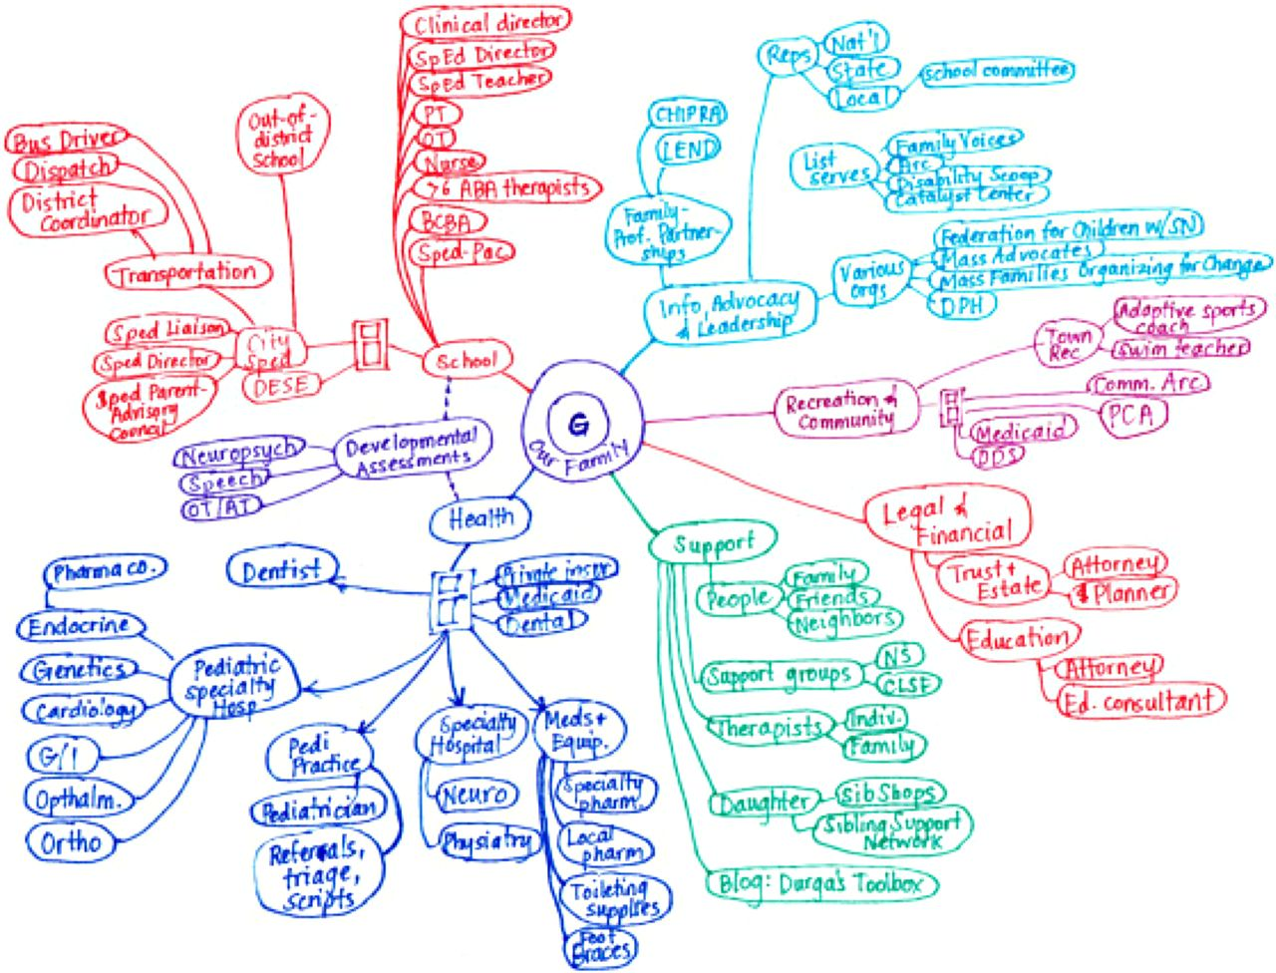
\
Care map –created by the mother of a child with medical complexity to pictorially represent aspects of her child’s life.
Care Map
Created by the mother of a child with medical complexity to pictorially represent aspects of her child’s life.
Dennis Z. Kuo et al. Pediatrics 2016;138:e20163021

Slide 26
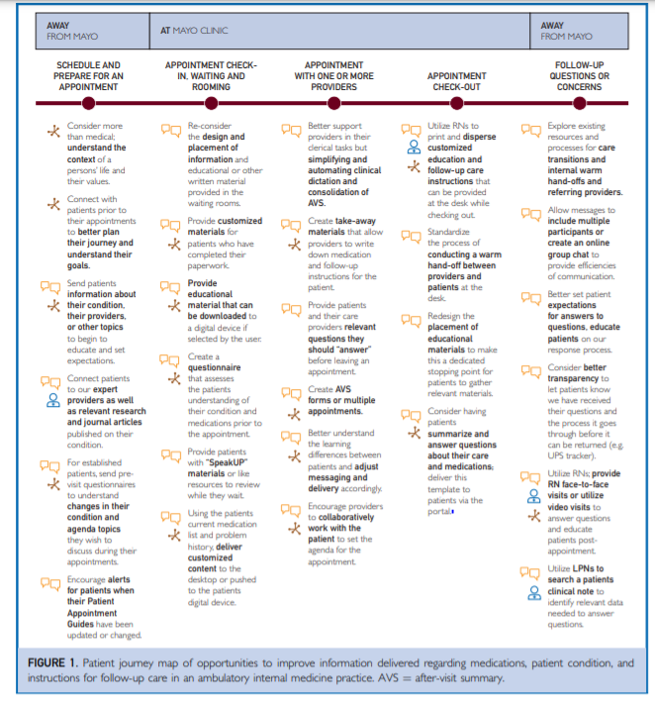

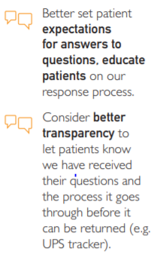
Patient-Centered Journey map
Creation of a Patient-Centered Journey Map to Improve the Patient Experience: A Mixed Methods Approach - MAYO

Slide 27

TIPs To Get paying what you deserve
Commercial payers don’t automatically reward physicians for being loyal members of their networks.
Commercial payers don’t automatically reward physicians for being loyal members of their networks. Physicians need to ask for higher payment rates, said Marcia Brauchler, MPH, CPC, president and founder of Physicians’ Ally Inc., a healthcare consulting company in Littleton, Colo. who spoke during AAPC’s HEALTHCON, April 8-11 in Orlando, Fla.
HEALTHCON offers educational sessions and networking opportunities for medical coders, billers, payer representatives, practice managers, attorneys, physicians, and other healthcare business professionals.
Brauchler provided these five tips to help practices negotiate more favorable commercial payer contracts:
1. Focus on payers that consistently pay below the Medicare fee schedule amount. Have some commercial payment rates remained the same over time even despite increases in the Medicare fee schedule? If so, this could be leverage for negotiating higher payment rates, said Brauchler, who posed this question to attendees: If a payer paid 100 percent of Medicare five years ago, why wouldn’t it pay 100 percent today when that rate is higher?
“If you were worth it then, why aren’t you worth it today?” she said. “Letting contracts live in perpetuity without negotiating year over year ends up costing your practice.”
2. Create a value proposition. Has your practice opened an additional office location, and are seeing more patients because of it? If so, ask for more money, said Brauchler. Are you reporting favorable quality data for HEDIS measures? If so, ask for money because this data ultimately reflects well on the payer and helps it gain customers, she said. If your practice has implemented an EHR, consider reminding the payer that it benefits from this technology even though it didn’t pay any financial incentives for adoption. Other items for consideration include the volume of patients seen annually (especially if volumes have increased over time), your practice location (especially if the practice is located near a large insured group such as a school), or extended hours or weekend clinics that help avoid costly emergency room visits, she said.
3. At a minimum, ask for a cost-of-living increase. If you can show that your medical malpractice premium went up, for example, you may be able to negotiate a higher rate, said Brauchler. “It’s hard for payers to argue against a rate increase if you can tell them that your malpractice premium just went up 12 percent,” she said.
Don’t stop there, though, said Brauchler. Look at your rent, staff health insurance, and staff salaries. Over time, have they gone up as well? “It should be an immediate win if your own health plan that you provide for employees hasn’t given you a payment rate increase-especially if you’ve seen premiums increase for the last three years,” she said. “Where is the annual premium increase going when you’re still being paid on a previous year’s fee schedule?”
4. Don’t forget ancillary services. This includes labs, x-rays, and HCPCS codes (e.g., durable medical equipment, supplies, and injectables). “If a contract pays 120 percent of Medicare, that’s awesome, but it doesn’t affect any of these services,” said Brauchler. “If you haven’t negotiated the value of your labs, you’re probably paid at the default 42 percent of Medicare by most of your payers. It’s pretty easy to get payers to agree that having a lab done at the time of service is worth at least 100 percent of Medicare.”
5. Involve your coders. Coders possess code-level expertise and can easily identify common payer-specific barriers to getting paid so you can solve these problems proactively through your contract. For example, does the payer refuse to pay an unlisted code? If so, advocate for payment when negotiating your contract-and ask the payer to put it in writing, said Brauchler.
Focus
Focus on payers that consistently pay below the Medicare fee schedule amount.
Create
Create a value proposition.
Ask
At a minimum, ask for a cost-of-living increase.
Don’t Forget
Don’t forget ancillary services.
Involve
Involve your coders.
Commercial payers don’t automatically reward physicians for being loyal members of their networks.
This Photo by Unknown Author is licensed under CC BY-NC
Notes:
1. Focus on payers that consistently pay below the Medicare fee schedule amount. Have some commercial payment rates remained the same over time even despite increases in the Medicare fee schedule? If so, this could be leverage for negotiating higher payment rates, said Brauchler, who posed this question to attendees: If a payer paid 100 percent of Medicare five years ago, why wouldn’t it pay 100 percent today when that rate is higher “If you were worth it then, why aren’t you worth it today?” she said. “Letting contracts live in perpetuity without negotiating year over year ends up costing your practice.”
2. Create a value proposition. Has your practice opened an additional office location, and are seeing more patients because of it? If so, ask for more money, said Brauchler. Are you reporting favorable quality data for HEDIS measures? If so, ask for money because this data ultimately reflects well on the payer and helps it gain customers, she said. If your practice has implemented an EHR, consider reminding the payer that it benefits from this technology even though it didn’t pay any financial incentives for adoption. Other items for consideration include the volume of patients seen annually (especially if volumes have increased over time), your practice location (especially if the practice is located near a large insured group such as a school), or extended hours or weekend clinics that help avoid costly emergency room visits, she said.
3. At a minimum, ask for a cost-of-living increase. If you can show that your medical malpractice premium went up, for example, you may be able to negotiate a higher rate, said Brauchler. “It’s hard for payers to argue against a rate increase if you can tell them that your malpractice premium just went up 12 percent,” she said.
Don’t stop there, though, said Brauchler. Look at your rent, staff health insurance, and staff salaries. Over time, have they gone up as well? “It should be an immediate win if your own health plan that you provide for employees hasn’t given you a payment rate increase-especially if you’ve seen premiums increase for the last three years,” she said. “Where is the annual premium increase going when you’re still being paid on a previous year’s fee schedule?”
4. Don’t forget ancillary services. This includes labs, x-rays, and HCPCS codes (e.g., durable medical equipment, supplies, and injectables). “If a contract pays 120 percent of Medicare, that’s awesome, but it doesn’t affect any of these services,” said Brauchler. “If you haven’t negotiated the value of your labs, you’re probably paid at the default 42 percent of Medicare by most of your payers. It’s pretty easy to get payers to agree that having a lab done at the time of service is worth at least 100 percent of Medicare.”
5. Involve your coders. Coders possess code-level expertise and can easily identify common payer-specific barriers to getting paid so you can solve these problems proactively through your contract. For example, does the payer refuse to pay an unlisted code? If so, advocate for payment when negotiating your contract-and ask the payer to put it in writing, said Brauchler.
Physicians need to ask for higher payment rates, said Marcia Brauchler, MPH, CPC, president and founder of Physicians’ Ally Inc., a healthcare consulting company in Littleton, Colo. who spoke during AAPC’s HEALTHCON, April 8-11 in Orlando, Fla.
HEALTHCON offers educational sessions and networking opportunities for medical coders, billers, payer representatives, practice managers, attorneys, physicians, and other healthcare business professionals. Brauchler provided these five tips to help practices negotiate more favorable commercial payer contracts:

Slide 28
Maximizing QUALITY PAYMENTS
Scenario - 500 Patients 99213 & G0439 Payment - 4.76+ Star Rating | HP1 MA | MSSP w/ACO | HP2 MA | Comments
99213 | $ 86 | $ 88 | $ 88
G0439 | $ 125 | $ 128 | $ 128 | Medicare - allows AWV coverage every 12 months; MA; allows AWV coverage anytime in calendar year. We are front loading MA patients, so we have more time to close gaps, AWV's, etc. that are not closed.
HCC's Addressed (Meet/Exceed Qtr. Goal - $10 per qtr.) | $ 40 | $ -
HEDIS/Stars Improvement (5 Stars) | $ 36
New Members ($200) | Y | G0438 | N | G0438 – Initial Annual Wellness Visit (AWV); including a personalized prevention plan of services; face-to-face visit. BUT: can only be used once in a lifetime; Y - New member to the HP but may not be a new member to us.
Submission of HCC'S | Separate Portal* | Separate Portal ** | EMR Integration*** | * - upload HCC form to portal; switched from faxing - no communication that they have received; ** - a pain, have weird form and need to fax HCC's ***Can submit HCC's in EMR - very easy, great longitudinal data, but need executive quality dashboard, had initial latency issues, data issues to work through before we could use. ****Very clunky to submit on yet another portal,
Attestation/HCC's $'s for completion | $ 200 |  | $ 200
More than one attestation/HCC $'s per patient | Y* | N | N | Y* - can receive up to 4 a year = $800; benefit in front loading AWV for HP1; takes priority for scheduling
ACO Incentive (based on quality ratings & ACO performance) - not guaranteed |  | $ 200 |  | Comment: Review your ACO contracts; if you move from one ACO to another some will not pay you for the past year's performance
Medicare Incentive (MIPS) - 5 Star - 9% |  | $ 19
AWV, TCM, Screenings, etc. Call Support From HP | $ 250 | $ 25 | $ 200 | Comment: $250 - HP has nurse calling patients (working to get AWV, screenings, etc. captured on one call, $50 limited calling. Success: with HP2 MA have completed 84% of AWV's by May, 2% scheduled in future
Screening Bus - 4 X's a Yr. (Mammo, RetinaVue, etc.) | Y | N | N
ABI Screening (given by HP - can be used w/all insurances) | Y | Can Use | Can Use | Hold - will not use until ABI Screening loads up our patient demographics - they want lots of demographic and insurance information
Pooling - Paying for the sins of others or possibly our sins | Y | Y | N* | N* - Pooling of all HP product lines for risk mitigation; whereas payments for other based on MA or MSSP population
Huddles to review Quality Initiatives | 3X a week | Once a week | 3X a week
Total | $ 738 | $ 460 | $ 616
500 Patients | $ 368,808 | $230,180 | $307,965

Slide 29
QUESTIONS?

Slide 30
THANK YOU
Jackie Coult, CHBC
Certified Healthcare Consultant
jcoult@eidebailly.com
801-456-5207

