Slide 2
AGENDA
Membership Card Information
Medicare Advantage
TriCare
BlueCard
Sample Cards
Problems

Slide 3
I. Membership Card
  Front Typically
    Insurance Company / PPO Network Name
    Payor ID: #####
    Group Name and/or Number
      Employer
      MSCAN / CHIP / Medicaid
    Product Name
    Product Type
      PFFS (Medicare Advantage)
      PPO
      HMO
      Limited Benefit Plans
      Pharmacy Benefit

Slide 4
I. Membership Card
    Member Name
    Member ID
    PCP Name
    Effective date of coverage
    Patient Responsibility Information: Deductible, Co-Pay, Co-Ins, etc.
    Pre-cert/Authorization/referral requirements
    HRA, HSA, FSA – will have a credit card logo, 16-digit credit card number, chip on the front or magnetic strip on the back to process as a credit card

Slide 5
I. Membership Card
  Back Typically
    Contact Information
    Billing Address
    Carve Out Benefit information including contact information
      Behavioral Health
      Outpatient Lab
      Outpatient Imaging
    Microprint with information that may be of value. Always read as it sometimes has valuable information such as might state a “Limited Benefit Plan” if not stated on the front.

Slide 6
II. Medicare Advantage
  Medicare Contract ID and Summary of Benefits
    Contract ID should be on the card.
    Format is A####-###.
    Example: R0110-001, H5216-160.
    Summary of Benefits - use the code to search the internet or payor website to pull down the detailed benefits in the “Summary of Benefits”.

Slide 7
II. Medicare Advantage
  Products
    Regular Medicare Advantage (PFFS, PPO, HMO): If you don’t see a D-SNP, I-SNP, or C-SNP reference then assume regular Medicare Advantage
    D-SNP – Dual Eligibles (PPO, HMO): Members that are both Medicare and Medicaid eligible
    I-SNP – Institutionalized (PPO, HMO): Members that are institutionalized such as in a nursing home
    C-SNP – Chronic Conditions (PPO, HMO): Examples: CHF, Dementia, Diabetes, Cancer.

Slide 8
III. TriCare / TriCare East / Humana Military
  Must be “Certified/Authorized” to be paid any amount that is covered
  These are insurance products, not benefits. The VA is a benefits program and separate and apart from TriCare.
  Regions
    Eastern US: This is called TriCare East
    Western US: This is call TriCare West
  Products
    TriCare for Life – Medicare Supplement
    Select – PPO
    Prime – HMO

Slide 9
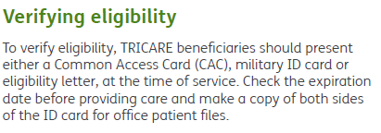
III. TriCare / TriCare East / Humana Military
  Obtain copies of the following information
    Insurance card such as Prime, Select or TriCare for Life – copy both sides of the insurance card and place it in the patient’s record.
    Military IDs –used to verify the patient’s identity to check eligibility. Having one of these forms of IDs does NOT confirm the patient’s eligible or benefits.
    Refusal to provide/ allow copies of Military ID – Refer to Tricare East Provider Manual (page 18, 2020 Manual):

Slide 10
IV. BlueCard
  What is BlueCard?
  How to identify – If there is a suitcase on the card, then the plan participates in BlueCard
  Who to call for Eligibility and Benefits
    Local Plan – When the provider has an agreement with the patient’s specific BlueCross plan.
    BlueCard – When the provider does NOT have an agreement with the patient’s specific BlueCross plan, and the plan participates in BlueCard, call 1.800.676.BLUE (2583) to check benefits and eligibility.
    Home Plan: When the provider does NOT have an agreement with the patient’s specific BlueCross plan and there is NOT a suitcase on the card

Slide 11
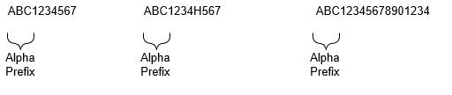
IV. BlueCard
  Mississippi does not currently have an HMO product. So, any HMO products are out-of-area.
  Suitcase – call BlueCard
  No Suitcase – call Home plan and identify yourself as an OON provider and request benefits as and OON provider
  Not sure – call BlueCard. If not a BlueCard account, they will direct you to call the Home plan.
  Group ID - up to 17 characters with an alpha prefix for positions 1-3 and the remaining characters will be numeric.

Slide 12
IV. BlueCard
  What is BlueCard?
  How to identify – If there is a suitcase on the card, then the plan participates in BlueCard
  Who to call for Eligibility and Benefits
    Local Plan – When the provider has an agreement with the patient’s specific BlueCross plan.
    BlueCard – When the provider does NOT have an agreement with the patient’s specific BlueCross plan, and the plan participates in BlueCard, call 1.800.676.BLUE (2583) to check benefits and eligibility.
    Home Plan: When the provider does NOT have an agreement with the patient’s specific BlueCross plan and there is NOT a suitcase on the card

Slide 13
IV. BlueCard
    BCBS of Mississippi Card - Call BCBS of Mississippi
    Suitcase – call BlueCard
    No Suitcase – call the Home plan and identify yourself as an OON provider and request benefits as and OON provider.
    Not sure – call BlueCard. If not a BlueCard account, they will direct you to call the Home plan.
    HMO Products – BCBS of Mississippi doesn’t have an HMO product. So, any HMO product, the member is out-of-area.

Slide 14
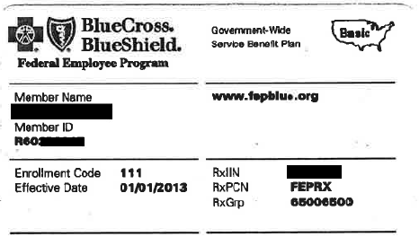





V. Card Samples - BCBS
  Federal – no suitcase. Has an “R” for the group #. Notice there is NO suitcase. Instead, there is a map of the US. The “Basic” tells you which benefit plan they purchased.

Slide 15
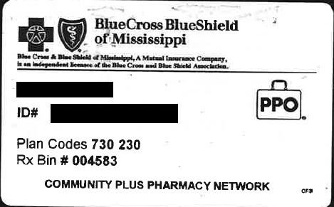


V. Card Samples - BCBS
  Mississippi – Cards actually say “Mississippi” on the front. Suitcase indicates BlueCard if member travels outside Mississippi.

Slide 16
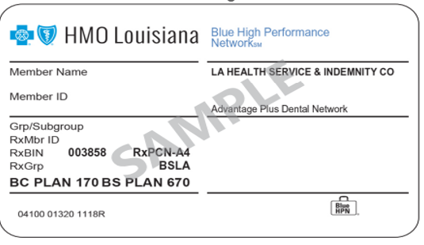


V. Card Samples - BCBS
      Louisiana – Suitcase so participates in BlueCard. However, given this is an HMO it is likely that benefits are very limited outside of Louisiana other than mandated benefits such as emergency services and out-of-area dialysis, etc.

Slide 17
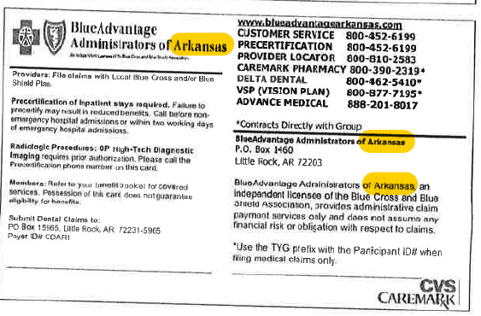
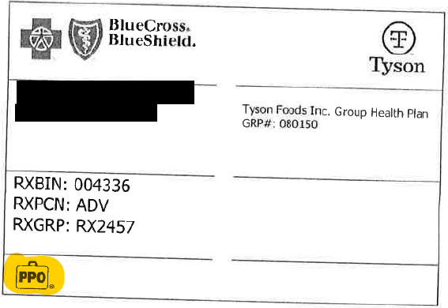
V. Card Samples - BCBS
  Arkansas – Notice Arkansas is NOT prominent. Have to look for clues on the back. Suitcase indicates BlueCard.

Slide 18
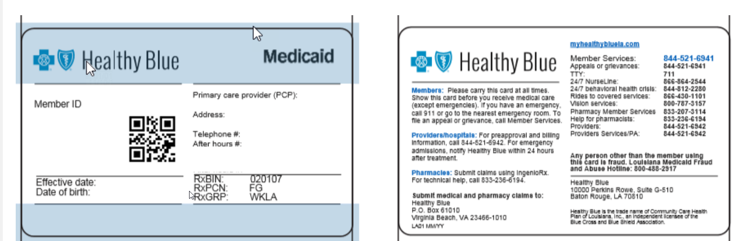







V. Card Samples - BCBS
    Non-BlueCard Sample
    1. Louisiana – Medicaid (AKA Healthy Blue): Notice NO Suitcase. So, NOT BlueCard.

Slide 19
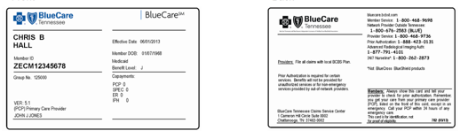


V. Card Samples - BCBS
      2. Tennessee – Medicaid (AKA Healthy Blue): Notice NO Suitcase. So, NOT BlueCard.

Slide 20
V. Card Samples - BCBS
      Louisiana – Suitcase so participates in BlueCard. However, given this is an HMO it is likely that benefits are very limited outside of Louisiana other than mandated benefits such as emergency services and out-of-area dialysis, etc.

Slide 21
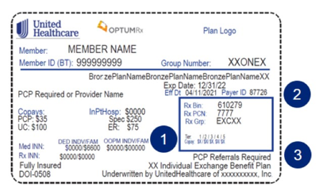


V. Card Samples - United
      Health Insurance Exchange (HIE)

Slide 22
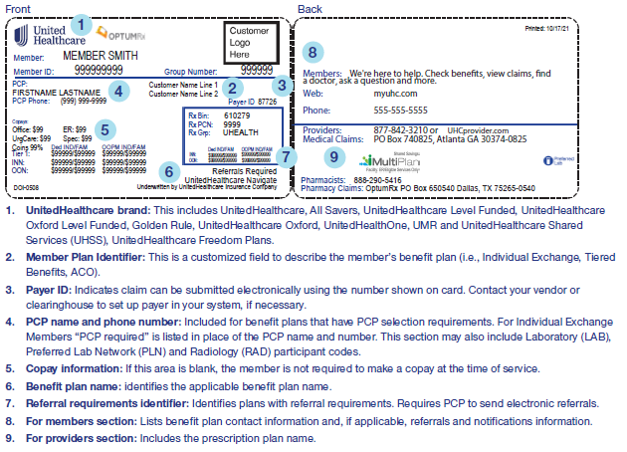
V. Card Samples - United
      Commercial

Slide 23
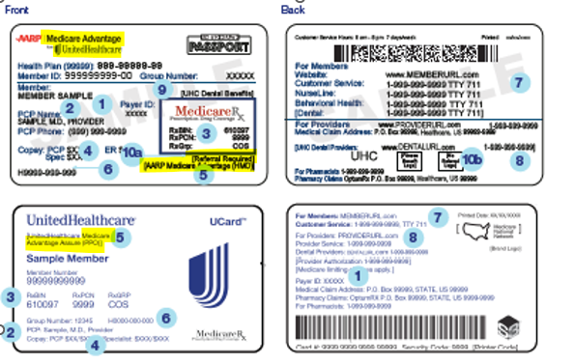
V. Card Samples - United
      Medicare Advantage

Slide 24
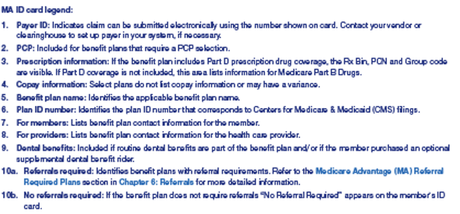
V. Card Samples - United
      Medicare Advantage

Slide 25
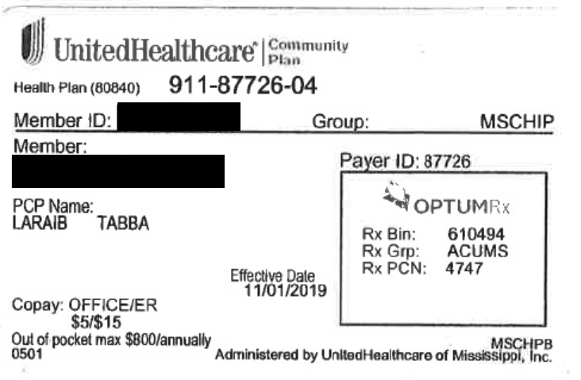



V. Card Samples - United
    Community Plan – Plan name for United’s Medicaid and CHIPs products.
      MSCHIP
  2. MSCAN – Will look like the MSCHIP but will have “MSCAN” on the card instead of “MSCHIP”.

Slide 26


V. Card Samples – Magnolia (Centene)
      Health Insurance Exchange (HIE) - Look for the “ambetter” logo. Also notice the “IN NETWORK COVERAGE ONLY”.

Slide 27
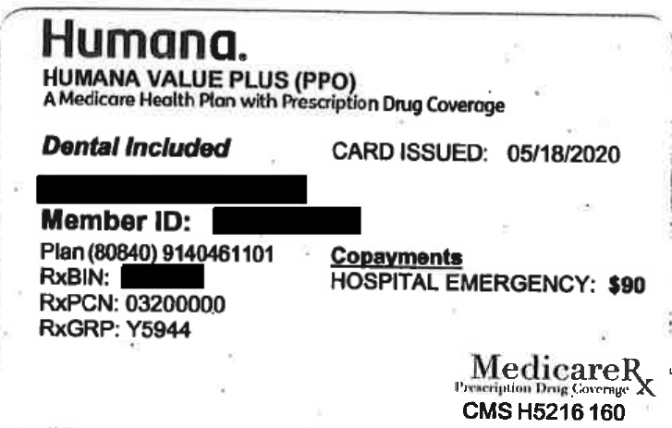



V. Card Samples - Humana
      Medicare Advantage - The newer cards say PFFS, PPO or HMO.

Slide 28
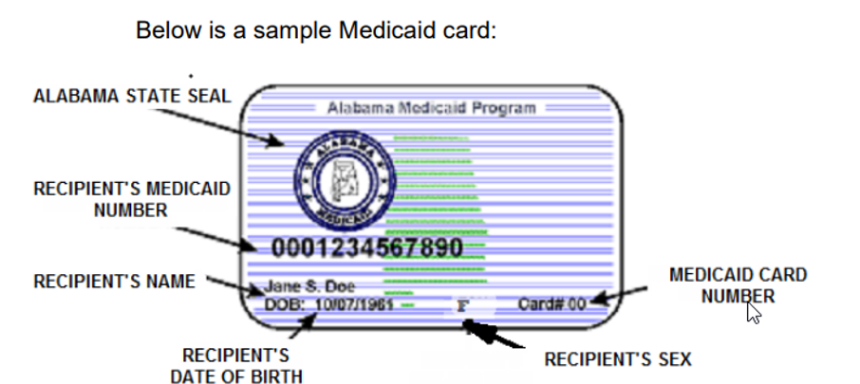
V. Card Samples - Medicaid
      Alabama

Slide 29
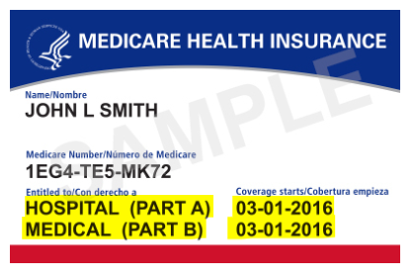
V. Card Samples - Medicare
      Part A only – Only covers inpatient. So, if the card does not say Part B then the member does not have outpatient hospital or physician benefits.
      Part A and B – This member has inpatient hospital benefits (Part A) and outpatient hospital and physician benefits (Part B).

Slide 30
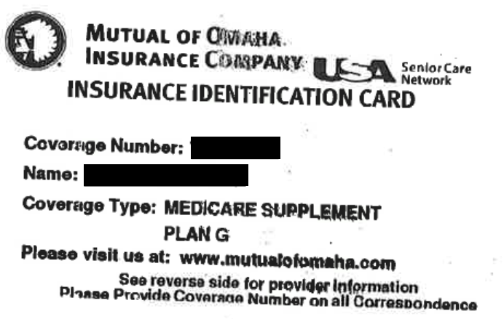

V. Card Samples – Medicare Supplements
    Pay after primary Medicare insurance pays
    Look for “Medicare Supplement” on the card

Slide 31
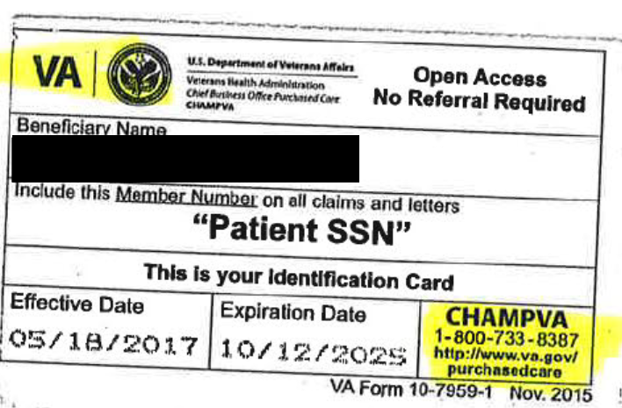
V. Card Samples – CHAMPVA (VA)
    Pays secondary except pays before Medicaid
    Patient should have another insurance card
    Instructions on the back states this

Slide 32





VI. Problems – Pharmacy Cards
    Card will reference Rx or Pharmacy. No mention of medical benefits.
    CVS/Walgreens
    Medicare Advantage Part D such as Humana Medicare Part D
    Cigna Sample – Notice all the text references Rx. The Medicare Rx logo says underneath “Prescription Drug Coverage.” There is nothing on this card mentioning medical benefits.

Slide 33
VI. Problems – Limited Benefits
  Limited Benefits
    How to identify – Look for somewhere on the card the words “Limited Benefits” or “Limited Benefit Plan.”
    These are NOT insurance. They only pay a specified amount. And, may pay little to none for many services. They often only pay a token amount for IP stays and result in the patient owing most of the bill.
    Cards may print what they pay, not what patient owes.
    They are supposed to print “Limited Benefits” on the card. Sometimes it is in the small print on the back of the card.
    Card examples

Slide 34
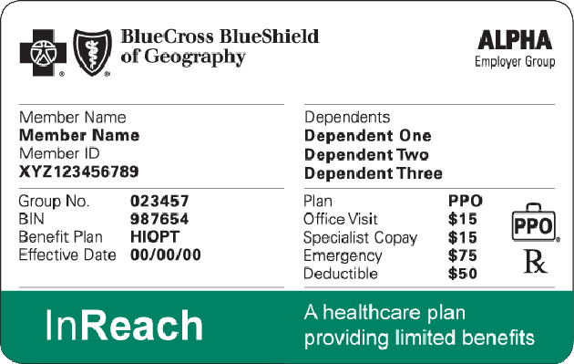

VI. Problems – Limited Benefits
    Card examples

Slide 35
VI. Problems – Reference Based Pricing
    Plan pays a fee schedule and patient is responsible for the difference between the fee schedule and the allowed/charge amount
    Popular now to base fee schedule off Medicare

Slide 36
VI. Problems – Commercial Secondary
    Pared with another Medical Insurance. The secondary plan covers some or all of the patient responsibility that is patient balance from the Primary Plan. These are typically used in conjunction with a Major Medical Plan that has high deductibles or other large balances rolled to the patient.

Slide 37
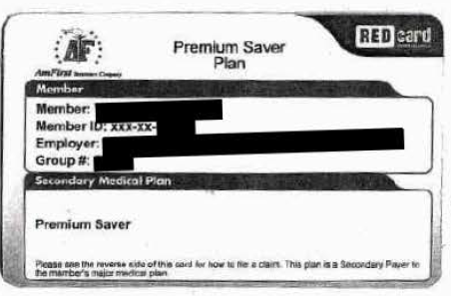



VI. Problems – Commercial Secondary
    Sample – Two sections of this card help identify it as a commercial secondary
Plan. First, the section of the card that says “Secondary Medical Plan.” Second, the small print at the bottom states “This plan is a Secondary Payer to the member’s Major Medical plan.”

Slide 38
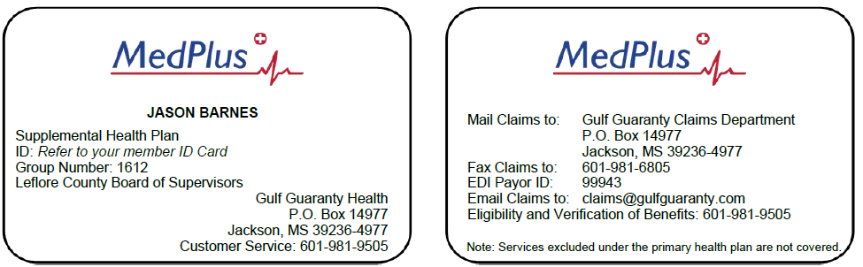


VI. Problems – Commercial Secondary
  Commercial Secondary Plans
    Sample – Notice on the back it alludes to another insurance existing that is primary. Since Medicare is NOT mentioned anywhere on the card it can be assumed this is NOT a Medicare Supplement.

Slide 39
VI. Problems - Discounter
    Not insurance – trying to get discounts off
      OON commercial insurance claims
      Worker’s Compensation state fee schedule
      Billed charges for Third Party Liability (TPL) claims such as automobile medical services coverage
    Logo on card along with other logos. Not the predominate logo.
    Companies
      Multiplan
      Three Rivers Provider Network
      Mitchell

Slide 40
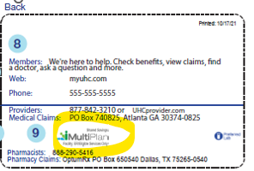
VI. Problems - Discounter
    Care Example - MultiPlan

Slide 41
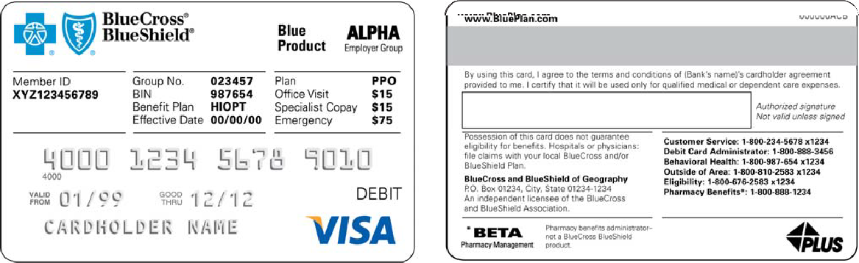
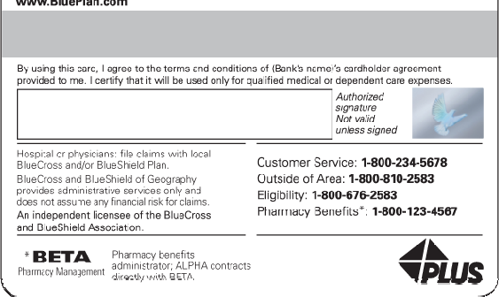







VI. Problems – Debit Cards
  Used to access funds in a Healthcare Spending Account, Healthcare Reimbursement Account or a Flexible Spending Account
    Combined with Medical Insurance – Has insurance information (circled in red) and information that looks like a credit card (highlighted in yellow)

Slide 42
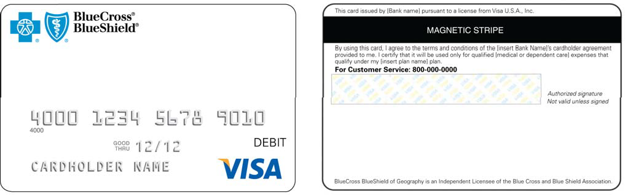




VI. Problems – Debit Cards
  Stand alone Debit Card – notice there is only information that looks like a credit card. There is no information about insurance such as member number, group / plan number, or information about copays, deductibles, etc.

Slide 43
VI. Problems – Carve Outs
    Lab
      Cigna – Often carves out outpatient and/or reference lab to a national laboratory such as LabCorp or Quest Diagnostic. There is no reliable logo on a card to know this. Check with your Managed Care department and ask if contractually Cigna can carve out the lab. If they can you will have to get clarification when checking benefits if the patient can use your lab or if they have to be referred to a lab vendor.

Slide 44

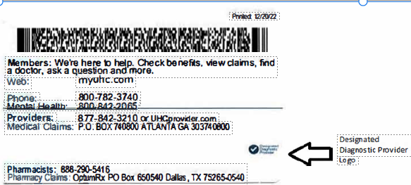

VI. Problems – Carve Outs
    Radiology
    United Designated Diagnostic Provider “DDP”. If you see this logo, the member is required to have outpatient lab done at a provider designated as a DDP to maximize their benefits. The logo looks like and can be on the front or the back of the card. The logo is typically very small.

Slide 45
VI. Problems – Carve Outs
    Behavioral Health – Make sure your follow the specific behavioral health instructions on the card.
      Magellan
      Value Options
      Optum (United company)
      Cigna Behavioral Health

Slide 46

Questions?
Ed Casteel, CPA
Partner
ed@trilogy-health.com
(601) 427-5988 (office)
(601) 405-4641 (direct)

