Slide 1

DIRECT PRIMARY CARE
MELINDA J. CAIL, MD, FAAFP

Slide 2
A New (ish) Model of Healthcare Delivery, Benefitting Patients, Employers, and YOU!

Slide 3



FIRST OF ALL, WHAT IS DIRECT PRIMARY CARE?

Slide 4
DPC BASICS
Membership based practice
No insurance billing
Smaller patient panels (600-800)
Price transparency
Relationship based medicine
No third party involvement

Slide 5


Slide 6

So what is the problem?
Primary Care is broken!
72,472 primary care shortage by 2025 (AAMC).
Autonomy is evaporating. 87% of primary care are employed
TIME has been stolen! The average 15 minute visit is 9 minutes of computer time and 6 minutes of face to face

Slide 7


Slide 8

Behind the Numbers
Cost is out
of control! Healthcare in the US is up to 19% of GDP
($11,582pp)
In 1960 it was 5% and $1,100pp
Millennials will spend
50% of lifetime earnings on healthcare
Insurance cost is up ($19K family of 4) and coverage is down
Patients are the real losers in this unsustainable pattern.

Slide 9
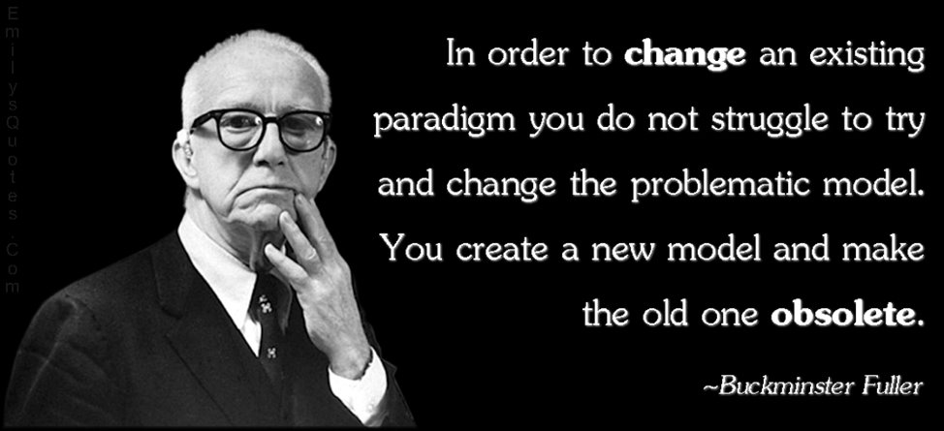

Slide 10

Direct Primary Care: Key Elements
Limited patient panel:
400-800
Average monthly fee in US $82
Available to patients
Usually access to low cost medications, lab, imaging
NO third-party involvement

Slide 11
Direct Primary Care: Benefits
01
Time, time,
time –
that which has been stolen is returned
02
Relationship based medicine…
with patient not other payors
03
Accessibility, convenience… removal of hassles!
04
COST containment
05
COST advocates

Slide 12

DOCTOR
LOWER WORK STRESS
NO INCENTIVE TO SEE MORE, MORE, MORE
FLEXIBILITY
TIME!
ABILITY TO MANAGE MORE CHRONIC CONDITIONS

Slide 13
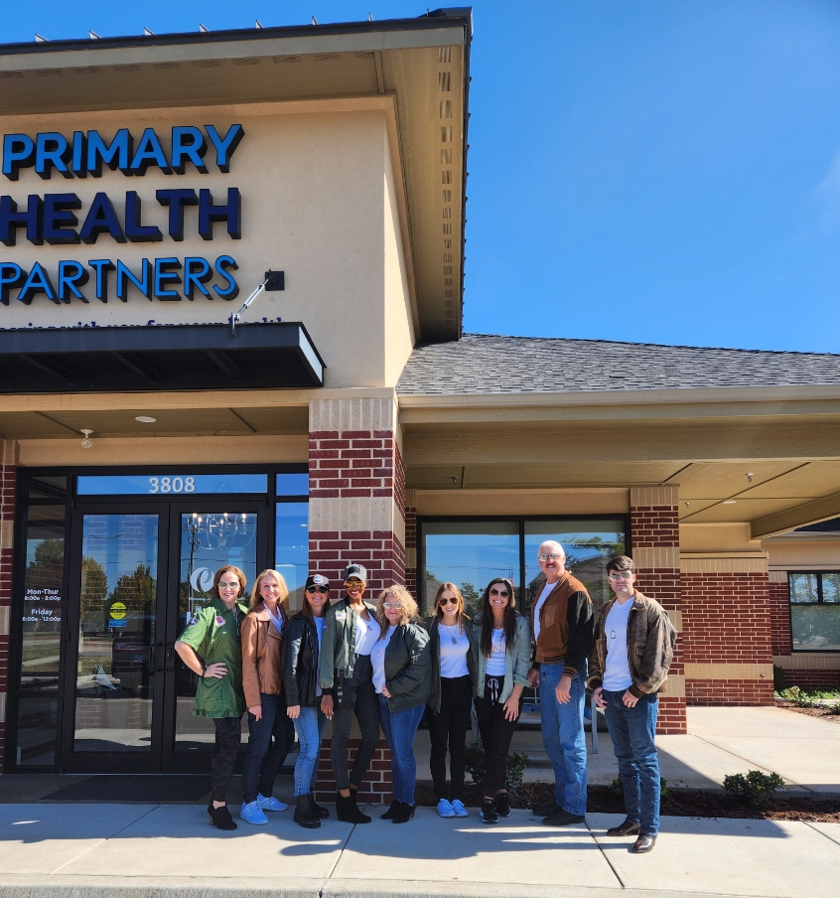

Slide 14

Patients
LESS TIME OFF WORK
ACCESS TO PHYSICIAN (DURING AND OUTSIDE OFFICE HOURS)
EARLY INTERVENTION
Transparent pricing
APPOINTMENTS ARE NOT RUSHED

Slide 15
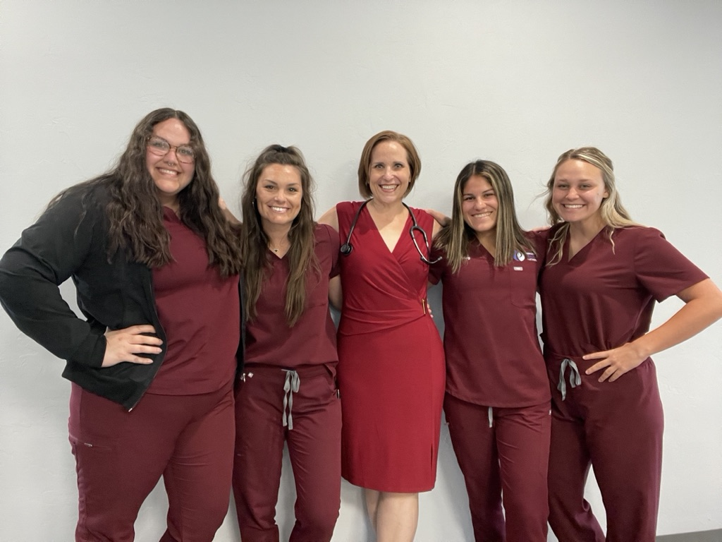

Slide 16

EMPLOYERS
EMPLOYEES TAKE LESS TIME OFF WORK
FEWER SPECIALIST REFERRALS
FAR LOWER HEALTHCARE COSTS

Slide 17






Direct Primary Care: Business Benefits
Major savings to self funded health plans!

Slide 18
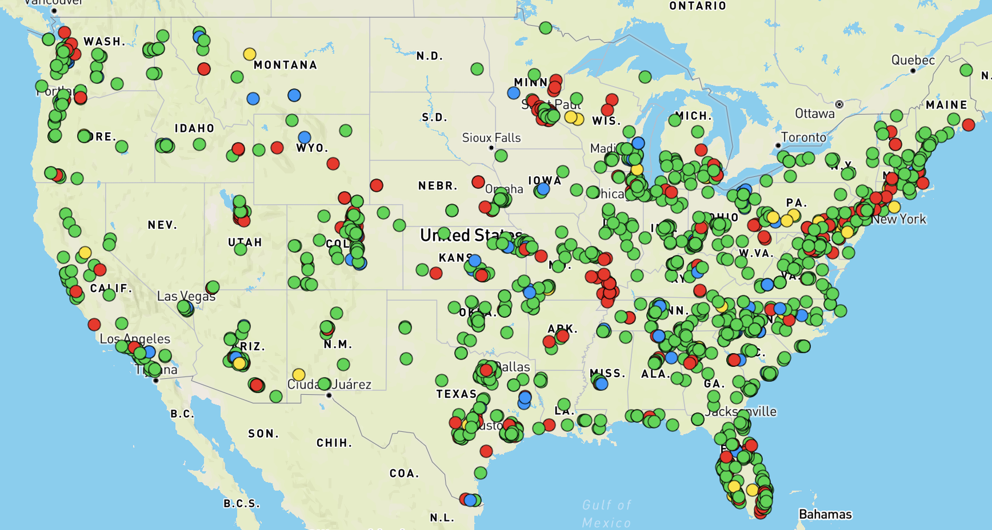
Direct Primary Care: Now
Major savings to self funded health plans!
Scaling with networking practices to meet larger demands

Slide 19


