Slide 1
Presentation For:
Presented By: Daniel Posada, SPHR | 813.616.2254
Dan.Posada@AssuredPartners.com

Slide 2
Vicarious Representation
Interviewing/Hiring
Coaching/Counseling
Documentation
Terminations
Employment Practices Overview

Slide 3
Our Workplace Values and Culture: Something bigger than ourselves
Community
Commitment
Compassion
Growth & Opportunity
Integrity

Slide 4
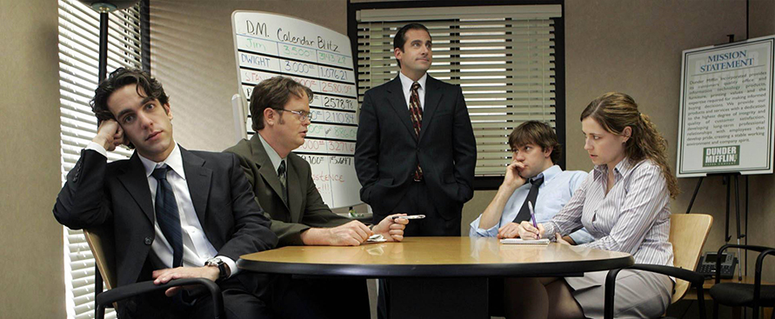
“Vicarious Representation”
Liability assigned to an employer or other principal for his agent’s or employee’s acts performed in the course of employment or other duty.
Team leads
Supervisors
Managers
Department Heads
Senior management
Directors
Executives

Slide 5
Interviewing/Hiring
Interviewing
Hiring
Pre-Screening/telephone
Face to face
Interview questions
First impressions go both ways
Distractions
Avoid verbal contracts
Discrimination exposures
Due-Diligence/Background check
Drug screening $$$
Onboarding makes a difference
First 90 days
Performance feedback
Welcoming
Celebrate

Slide 6
Coaching & Counseling
Coaching
Counseling
Ongoing
Continuous feedback
Constructive
Collaborative
Positive reinforcements
Follow-up
Consistency
Progressive discipline
Multi-step process
Verbal/Written/Final Written/PIP
Escalation
Witnesses
Constructive/Collaborative
Win-Win
At-Will Employment

Slide 7
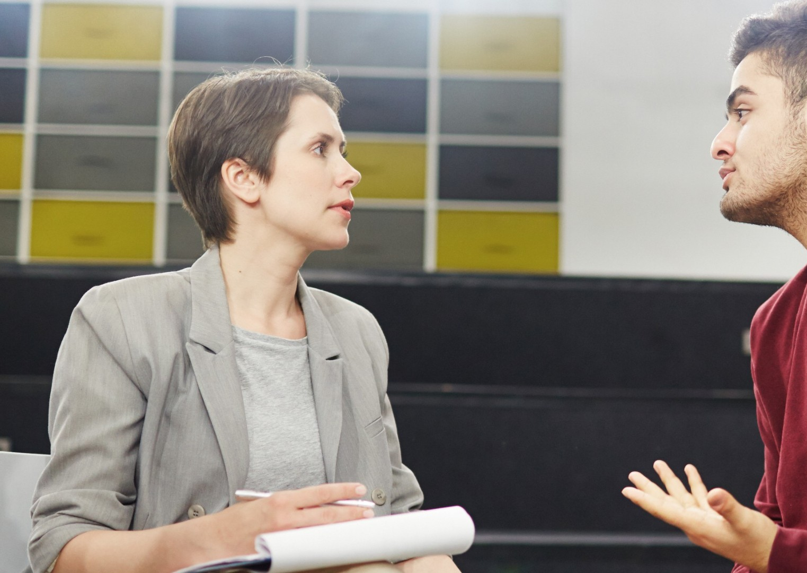
Documentation
“If it’s not in writing, it never happened”
Ignorance Defense
Building your case
Subjective/Objective language
Employee should draft solution with your guidance
Continuous feedback
No surprises
Personnel files will be subpoenaed
Using your documentation or lack thereof against you in court

Slide 8
Termination of Employment
Never take a termination lightly
Ensure your scenario has been reviewed with senior management/human resources
Review documentation
Never terminate in an emotional charged situation
PAC (Termination classifications)
Always prepare for retaliation
Workplace violence
EAP
Supportive information

Slide 9
Keys to Success!
Strive to be your best everyday at work
Lead by example
Managers are always on stage perform accordingly
Work closely with HR
Communicate often with all team members
Get to know your people
Zero-Tolerance for discrimination
Document accordingly
Utilize technology and data
Continuous education/Sharpen the saw
Treat one another as your most valued customer

Slide 11
4600 W. Cypress Street Suite 550 Tampa, FL 33607 (813) 616-2254

