Slide 1
Battlefield to Boardroom
PRESENTED TO:
Kentucky HFMA
February 16, 2023

Slide 2
Joshua White
Regional Vice President, Sales
Med-Metrix
United States Marine Corps
Disabled combat veteran
Served 2001 to 2008
Author, Amazon best seller
Owner, CALL OF DOODEE

Slide 3
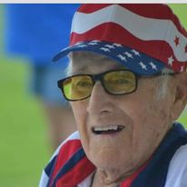
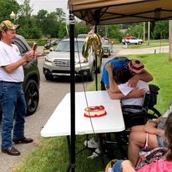
“LET’S GET TO WORK!”
James K. Burrell (Jim)
Tail gunner WW2

Slide 4
CHAOS WHISPERS January 1, 2018

Slide 5
PURPOSE
Help myself
Therapy, PTSD
Built for this
Help others
Book
Post Traumatic Growth
Mentor
Raise Awareness

Slide 6
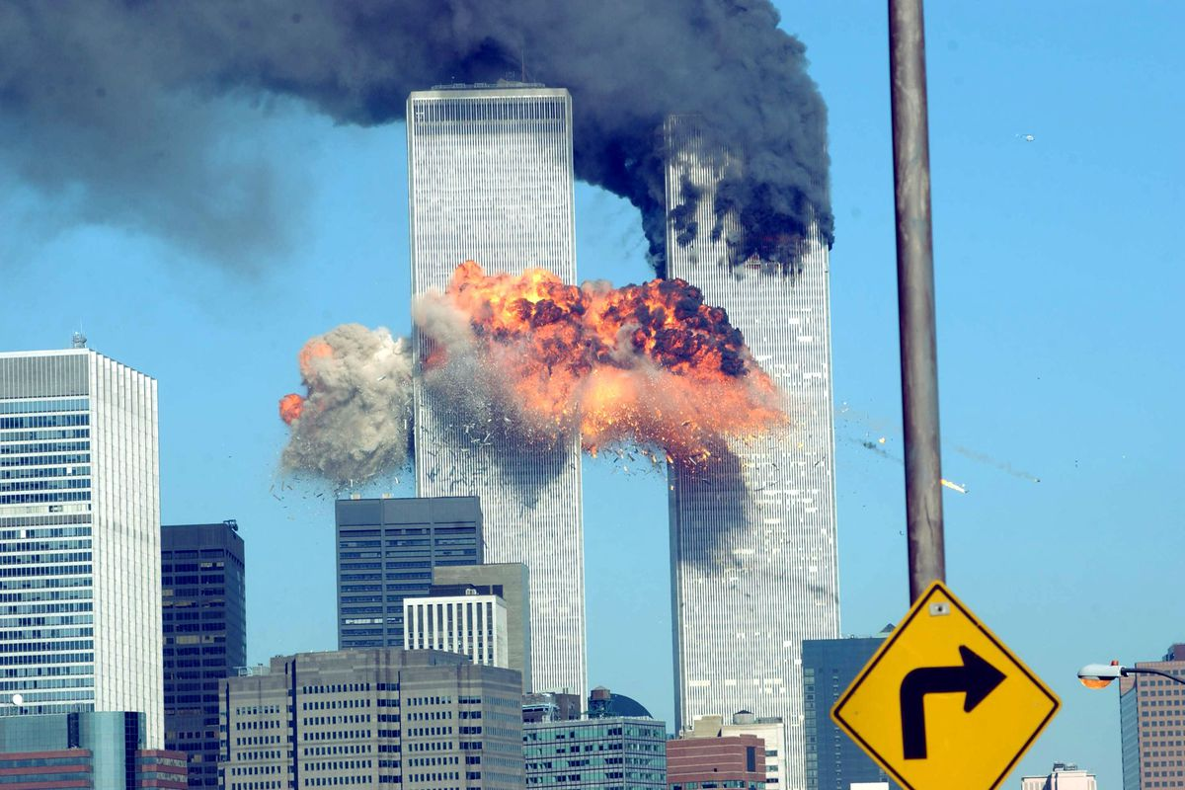
UNITED STATES MARINE CORPS
the why

Slide 7
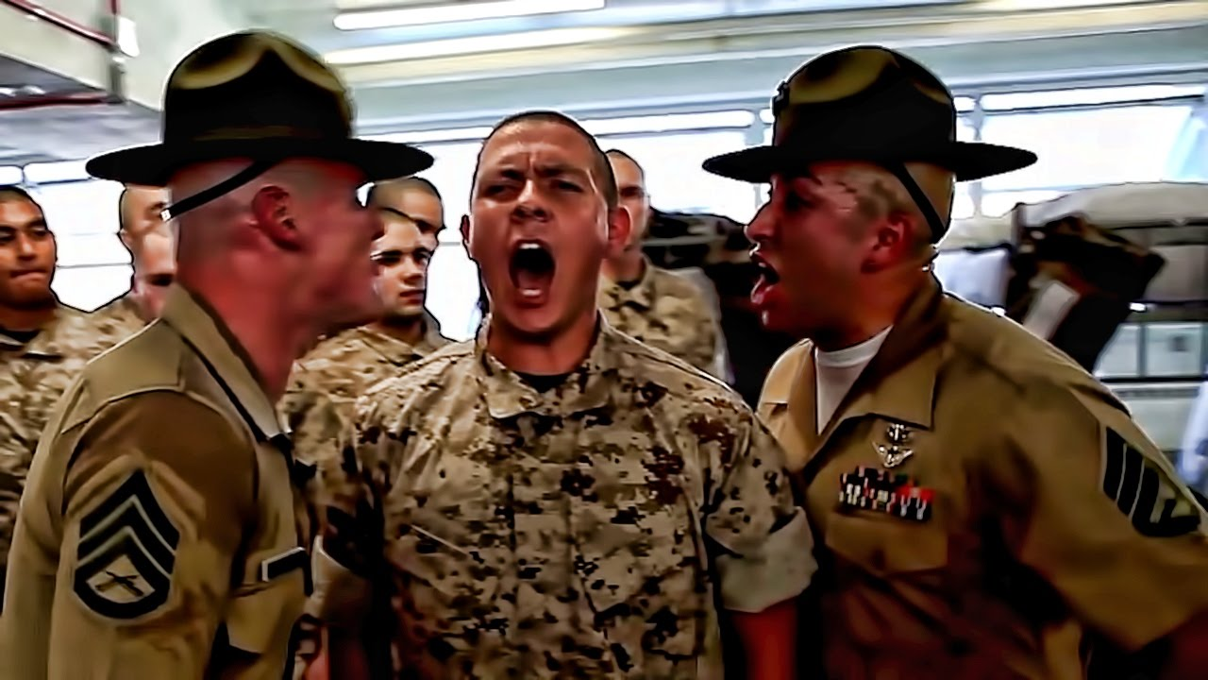
MILITARY TRAINING – PREPARE FOR WAR
Learn a skill
Competent
Add complexity
Distractions
Sleep Deprivation
Limit Resources (food/water)
Physical Fatigue
Execute at the highest level for mission success

Slide 8
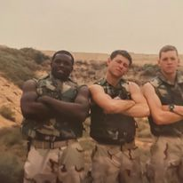
OPERATION ENDURING FREEDOM (IRAQI FREEDOM)
Military Occupation Status (MOS)
0621 Field Radio Operation, communicator
January 2003
Kuwait
Outsourced to different companies
1st Marine Division

Slide 9
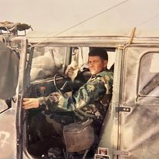
CATASTROPIC VIOLENCE
Hidden Enemies
Excessive Heat
Camouflage
No Armor
Chemical suits
Sandstorms
Poop
Death

Slide 10
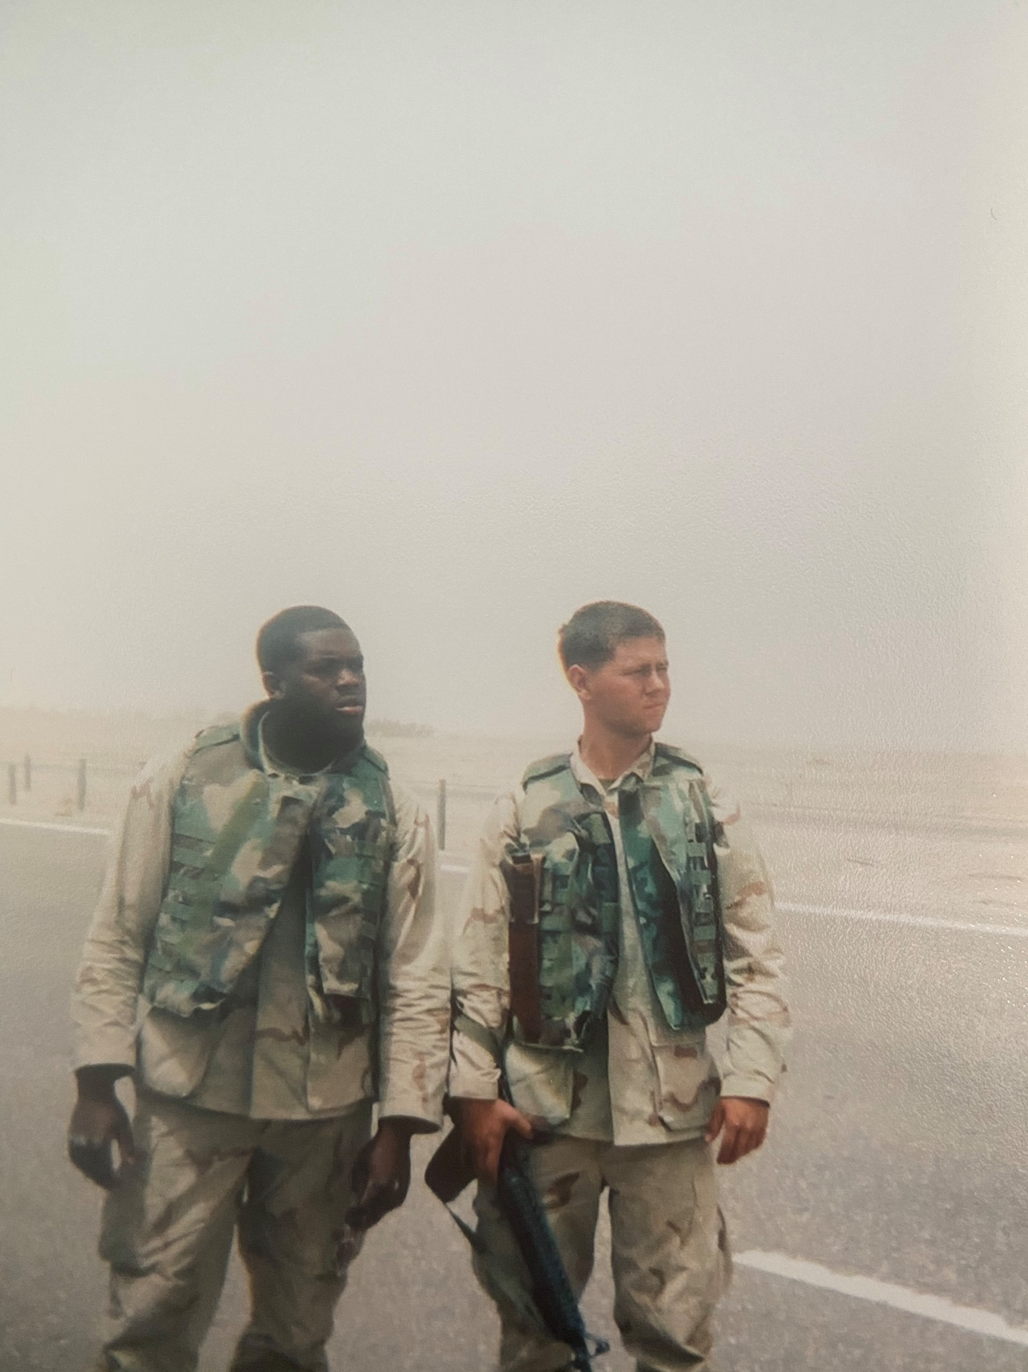
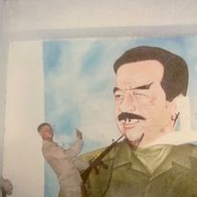

Slide 11
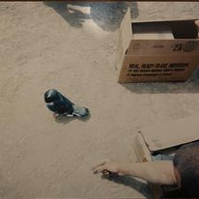

Slide 12
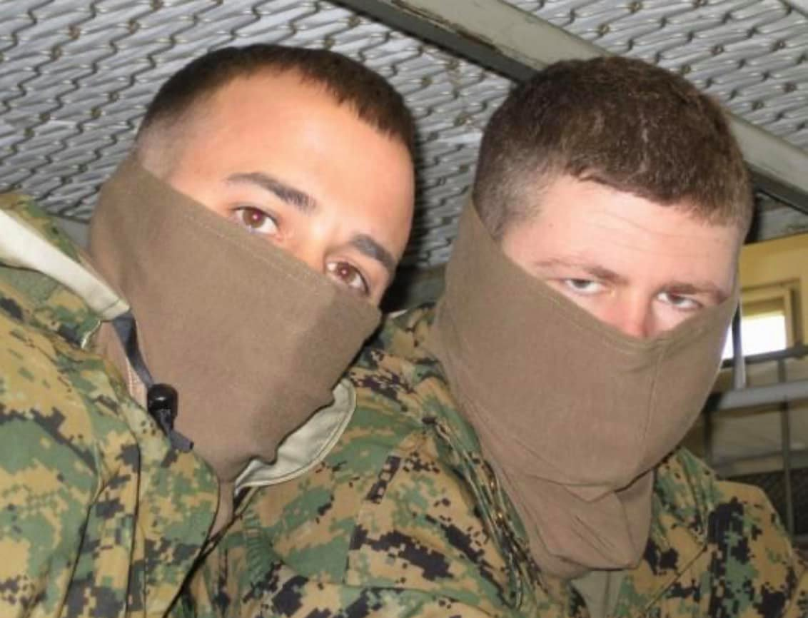
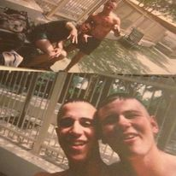
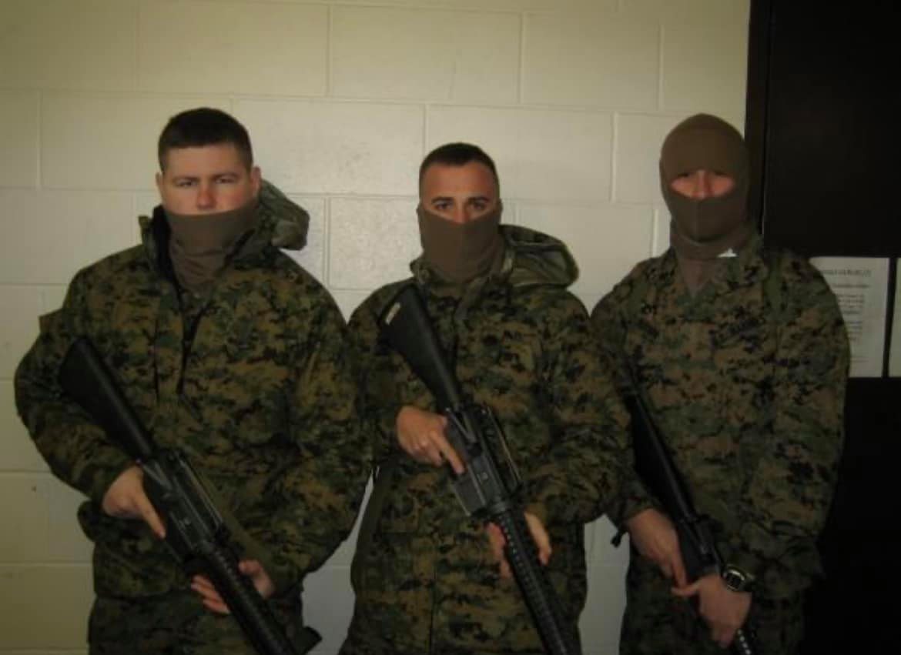

Slide 13
BATTLEFIELD TO BOARDROOM

Slide 14
FEARLESS
FORWARD
Set Objectives then SMASH
Start Simple
Making your bed
complacency kills – move or die

Slide 15
FEARLESS
Effort
Anyone can, but will you
How to lead when there is a generational gap:
What does this next generation need?
What is important to them?
Completely different mindset

Slide 16
FEARLESS
Accountability
Uniform of the day
Extreme ownership
Wins and Losses
are you there when it matters most

Slide 17
FEARLESS
Retreat
Lack of decision making
Lack of discipline
Too many distractions
Wasted time, what are some of your time sucks?
Marines do not retreat, we tactfully reposition

Slide 18
FEARLESS
Leadership (the actual kind)
TRUST > Performance
if serving is beneath you, leadership is beyond you

Slide 19
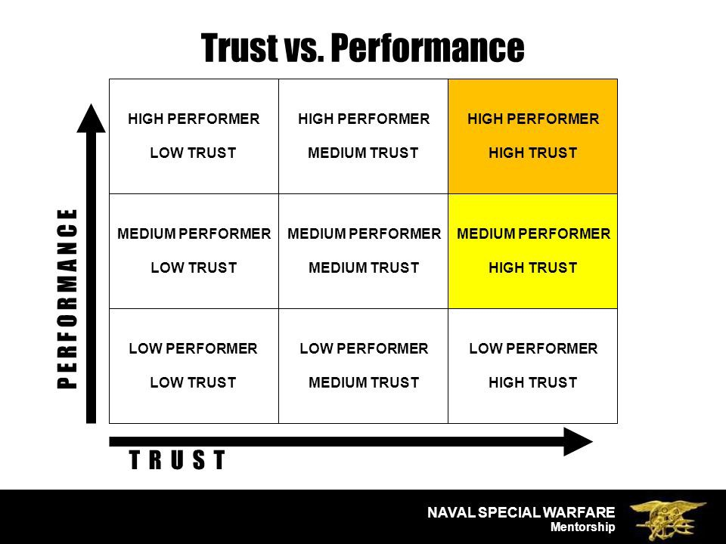

Slide 20
UNDESIRABLE BECOMES UNDENIABLE
Age
Experience
Modelnetics
They didn’t know…
2/22/2022 - present
$100,000+

Slide 21
FEARLESS
Effective
Listen
Communication dictates tempo on the battlefield
Keep it simple, by the numbers
Least sophisticated person can understand
communication wins wars

Slide 22
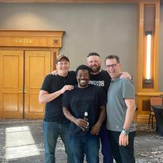
FEARLESS
Support
Marines share a unique bond
General Mattis’ made a promise
Battle-buddies
Higher Standard
we do not leave Marines behind

Slide 23
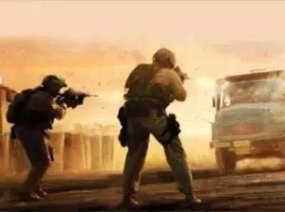
FEARLESS
Sacrifice
six seconds in Ramadi

Slide 24
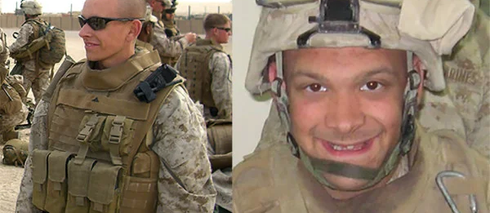
Corporal Jonathan Yale and Lance Corporal Jordan Haerter

Slide 25
joshuaonfire.com

