Slide 1

Leadership and Team Accountability
Think big and act small
For Kentucky HFMA
2023 Annual Conference
Presented by:
David Baumgartner, PCC, SHRM-SCP

Slide 2
Today
Look at two mental concepts
How teams can impact the “B” word
Close look at the use of teams
The role of the leader/manager
The guarantee

Slide 3
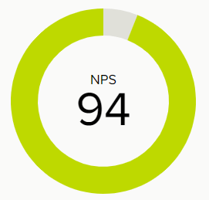
Housekeeping
Be Open!
I’m not married to words or phrases
Our focus is concept awareness
Notes:
Our data shows 65% of the people we coach want additional support

Slide 4
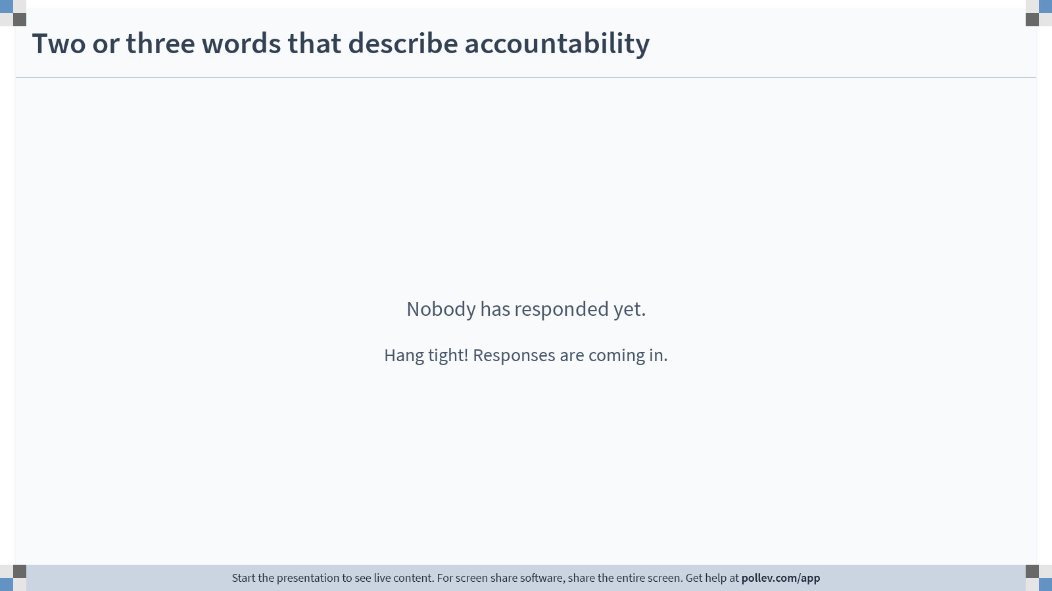
Notes:
Poll Title: Do not modify the notes in this section to avoid tampering with the Poll Everywhere activity.
More info at polleverywhere.com/support
Two words that describe accountability
https://www.polleverywhere.com/free_text_polls/IlDfBFBEuKWlh8kPdnqWo

Slide 5
Start with context
What is Accountability?
What does successful accountability look like?
Accountability for self?
Accountability for others?
What makes accountability hard?
For self?
For my team?
What are some tips for successful accountability?

Slide 6

Notes:
Poll Title: Do not modify the notes in this section to avoid tampering with the Poll Everywhere activity.
More info at polleverywhere.com/support
Now two or three words that describe accountability
https://www.polleverywhere.com/free_text_polls/ELURtzZ4U7x1w1SMh0yfY

Slide 7
The world around us
Resilience
No Staff
Inflation
COVID
Teamwork
Inclusion
Why Start Here
Financial Constraints
In-Equity
Burnout
Compassion
Caring
Divisiveness
Competing Demands
HOPE

Slide 8
The Team Environment
Payors
The world around us
Organization
Team
Self
Patients
Peers
Personal Life
Regulators

Slide 9
The Reality
Payors
The world around us
Organization
Team
Self
Patients
Peers
Personal Life
Regulators

Slide 10
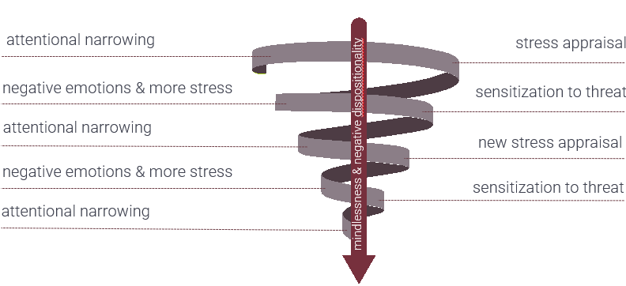
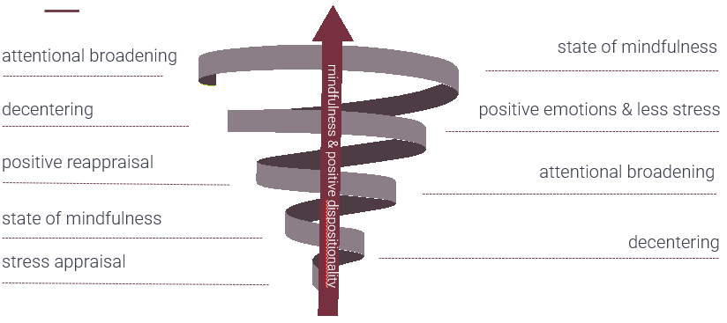
The way we look at life is important
The first point:
Pressure from competing demands is real!
Be curious, chin up, and eyes open
Remember to Broaden and Build
Broaden & Build
By Barbara L. Fredrickson

Slide 11
Long before COVID!
In recent years, the degree of change in healthcare and the magnitude of attracting talent has magnified exponentially
At the same time, financial resources to address the challenge have become strained across all healthcare sectors
Burnout in healthcare was a challenge before COVID
Controlled interventions to reduce physician burnout – Dec 2015
Burnout in healthcare; the case for organizational approach – July 2019
A cross-section study of burnout among healthcare professionals during COVID – April 2021
.25

Slide 12
Balancing Competing Demands
Six areas of “Fit” or “Match” between the workplace and the worker (WL6)
Workload
Control
Reward
Community
Fairness
Values
Burnout, by contrast to exhaustion, is when the workload is combined with a mismatch in one of the other five areas of work life
Burnout in Healthcare
By A Montgomery and colleagues

Slide 13
Burnout is a Shared Problem
Common responses are individualized
Take better care of yourself
Do yoga
Become more resilient
Learn to cope with stressors
The individual approach can ignore workplace stressors
Constant Change
Incivility
Staff Shortages
Austerity Measures
Burnout in Healthcare
By A Montgomery and colleagues

Slide 14

Team – A collective solution
The second point:
It’s ok to recognize the world around us
Learning to work together is key!
A small group of people with complementary skills who are committed to a common purpose, set of performance goals, and a shared approach for which they hold themselves mutually accountable
Notes:
Talk about a recent conversation with Mark; he has less support staff, i.e., HR. The goal is to get the team to take control of and make a difference in something, starting small. Then you say a great job, now what.
We do the same thing all day in leadership development and coaching; create awareness, encourage a change, then take advantage of movement.

Slide 15
Teams need to be adaptable because they are a part of a complex system
Purpose and motivation
External processes and system
Relationships
Internal processes and systems
Learning process
Leadership
Coaching the team at work
By David Clutterbuck

Slide 16
Team Models – From simple to complex
Information Sharing
Consultative
Coordinating
Decision Making
All team types are legitimate and have a purpose
PL – Not knowing which one we are right now
PL – When a larger group of 24 information sharing doesn’t know about a smaller group of 4 or 5 decision making
Four kinds of leadership teams
By Dr. Ruth Wageman

Slide 17
Defining Team
A small group of people with complementary skills who are committed to a common purpose, set of performance goals, and a shared approach for which they hold themselves mutually accountable
.50

Slide 18
Where most researchers agree
The team needs to know their purpose
The right people need to be on the team
They need to focus on structure – what we do together (tasks, processes)
They need to focus on dynamics – how we work together (safe space)
Take time to learn and improve
The leader manages the framework
The third point:
Different team models
What does the organization need; be intentional and clear

Slide 19
Work Group vs. Team
What is important that we work on together?
Department or Individual Contributor
Department or Individual Contributor
Department or Individual Contributor
Department or Individual Contributor

Slide 20
Today
Why Teams
Next Year
Next Quarter
Patients
Peers
Personal Life
Payors
Regulators
The world around us
Organization
Team
Self
Personal Life
Regulators
Peers
Patients
Payors
Payors
Patients
Personal Life
Regulators
Peers

Slide 21
What is the role of a leader in team accountability?
Organization
Team
Self

Slide 22
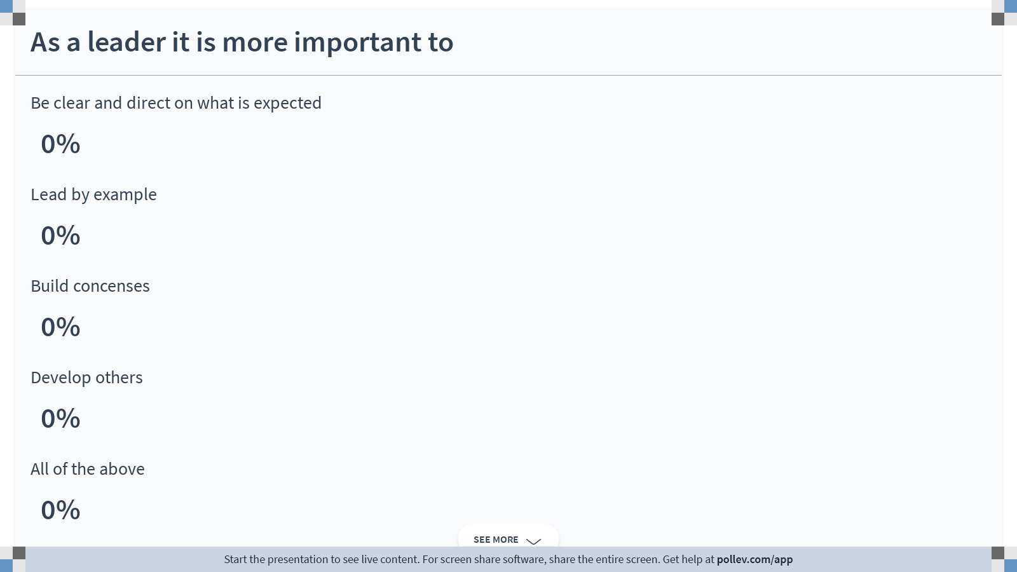
Notes:
Poll Title: Do not modify the notes in this section to avoid tampering with the Poll Everywhere activity.
More info at polleverywhere.com/support
As a leader it is more important to
https://www.polleverywhere.com/multiple_choice_polls/vkNqnCwZz6J0A4tLqlkAN?state=opened&flow=Default&onscreen=persist

Slide 23
Think Big and Act Small
What’s going on in the organization
  Growth or retraction
  Special project or initiative
  Major changes in capital
  External originated challenges
What functions need to be filled
  Information sharing to align effort
  Consultation to support strategic and complex decisions
  Coordination of interdependent change initiatives, improvement projects
  Decision-making about important initiatives

Slide 24
The Role of a Leader
Get
Get the right people on the team – be intentional
Clarify
Clarify the team purpose
Create
Create the conditions for team effectiveness
Support
Support a sound structure – internal and external
Provide
Provide team coaching/learning
The fourth point:
Leaders are the conductor
What does the organization need; be intentional and clear
.75

Slide 25
Let’s tie a bow on the day
1 – Leadership is hard
Accountable for what?
Individual performance, team performance
2 – Work as a team to support calm focus
Having purpose clarity enables role clarity
The clarity in the role supports calm focus to control what can be controlled
Remember the 6 areas that create “fit” or “match”.
The greater the alignment the greater the resilience
Pressure from competing demands – Broaden & Build

Slide 26
Let’s continue to tie a bow on the day
3 – Different Team Models
Teams can support running the business and transforming at the same time
4 – Leader is the conductor
Demonstrate leadership
Relaunch if necessary
What is needed and why
6 conditions predict 80% of team effectiveness
Go slow to go fast: 60% is in the team design
Provide the purpose, people, structure, and context for success

Slide 27

Becker’s 2/2/23
The “hard truth” about staffing shortages: They aren’t going away
Notes:
Irma Sept 2017
Dorian Sept 2019

Slide 28
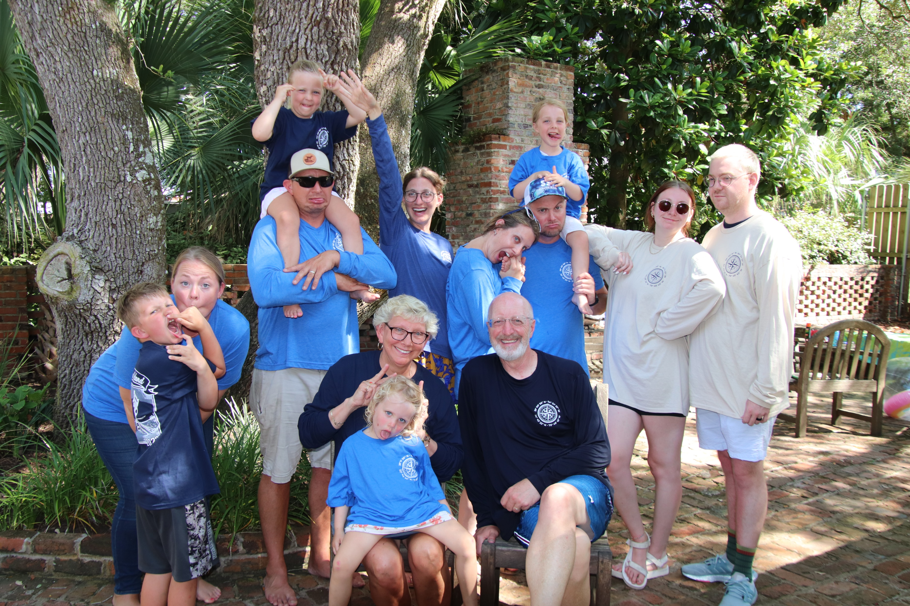
The Guarantee

Slide 29
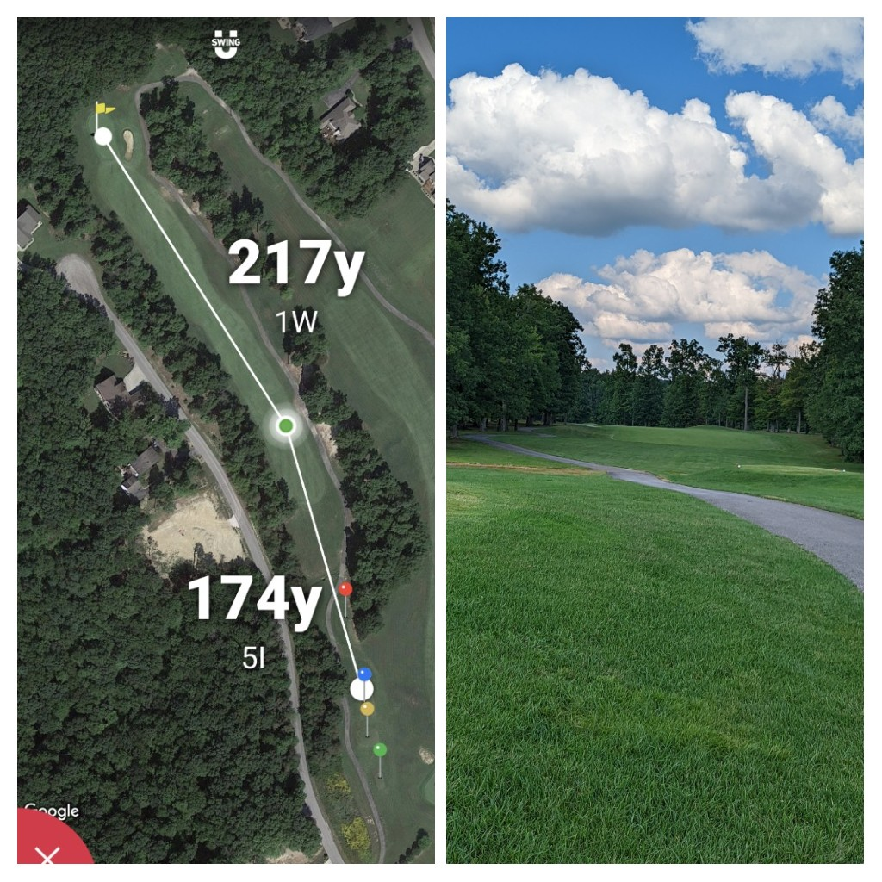
Golf & Leadership
704 out of 1,174 = 59.97%
Scottie Scheffler 100th
4 wins in 22; 16 mil
Have a plan
Have an idea of the hazards
Take action
Reflect and learn
Repeat
Does Anyone know Ryan Armour

Slide 30
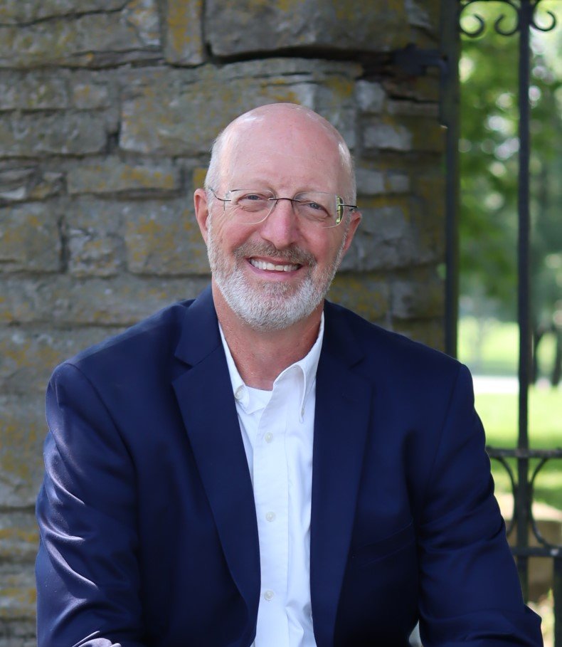
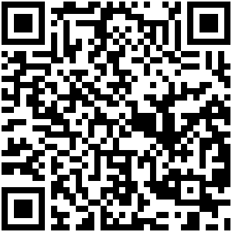
Bringing Workplaces Together
Join our 3-part series to learn more about our approach to leadership and team accountability and alignment
Leadership and Team Development
David Baumgartner, PCC, SHRM-SCP
Toll-free (866) 9-VALUES
(866) 982-5837
dbaumgartner@tresane.com
linkedin.com/in/drbaumgartnerky/

