Slide 1
Understanding data for revenue cycle improvement
Nebraska HFMA Annual Meeting – The Economics of Healthcare

Slide 2
Rochelle Dahmen, CSBI
Rochelle is the Healthcare Consulting Senior Manager for Eide Bailly. She has more than 20 years of health care experience, including more than three years at Blue Cross Blue Shield of Minnesota and more than 17 years working in multiple health care organizations across the country. Specializing in revenue cycle and technology implementations, she has assisted health systems throughout the country with denials management, chargemaster assessments, compliance reviews, charge capture improvements, as well as electronic health record implementations, conversions and optimizations. Rochelle brings strong analytical skills and a thorough understanding of the revenue cycle that allow her to quickly identify issues and create solutions to improve revenue cycle performance.

Slide 3
Learning Objectives
Define ‘Big Data’
Data Analytics Pipeline
Analytics in the Revenue Cycle
Case Study
What is Data Analytics
Questions

Slide 4
Defining ‘Big Data’

Slide 5
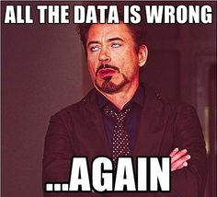
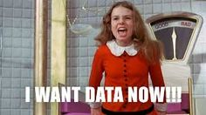
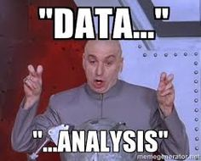
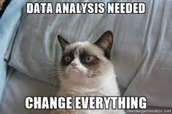

Slide 6
‘Big Data’ Definitions
Noun: extremely large data sets that may be analyzed computationally to reveal patterns, trends, and associations, especially relating to human behavior and interactions
- Definition from Oxford Languages
Big data is a term that describes the large volume of data – both structured and unstructured – that inundates a business on a day-to-day basis. But its not the amount of data that’s important. It’s what organizations do with the data matters. Big data can be analyzed for insights that lead to better decisions and strategic business moves.”
- According to SAS
Big Data in health encompasses high volume, high diversity biological, clinical, environmental, and lifestyle information collected from single individuals to large cohorts, in relation to their health and wellness status, at one or several time points.
- Health Directorate of the Directorate-General and Innovation of the European Commission

Slide 7
BIG DATA IN HEALTHCARE
5 Dimensions of Big Data in Healthcare:
Volume – High amount of total data to be processed
Variety – Different formats from heterogeneous sources:
Structured – database, delimited files, markup files
Unstructured – pdf, image, video, audio, text
Value – Enablement of decision tress, statistical models, etc.
Velocity – Real-time event data, streaming delivery
Variability– Authenticity, trustworthiness must be verified and tracked
Notes:
Volume – Clinical data associated with lab tests and physician visits, admin data around payers and payments
Variety - the huge diversity of data types that healthcare organizations see every day. Again, think about electronic health records and those medical devices: Each one might collect a different kind of data, which in turn might be interpreted differently by different physicians—or made available to a specialist but not a primary care provider. The challenge for healthcare systems when it comes to data variety? Standardizing and distributing all of that information so that everyone involved is on the same page. With increasing adoption of population health and big data analytics, we are seeing greater variety of data by combining traditional clinical and administrative data with unstructured notes, socioeconomic data, and even social media data.
Value - big data must have value. That is, if you’re going to invest in the infrastructure required to collect and interpret data on a system-wide scale, it’s important to ensure that the insights that are generated are based on accurate data and lead to measurable improvements at the end of the day
Velocity - Velocity in the context of big data refers to two related concepts familiar to anyone in healthcare: the rapidly increasing speed at which new data is being created by technological advances, and the corresponding need for that data to be digested and analyzed in near real-time. For example, as more and more medical devices are designed to monitor patients and collect data, there is great demand to be able to analyze that data and then to transmit it back to clinicians and others. This “internet of things” of healthcare will only lead to increasing velocity of big data in healthcare.
Variability- The way care is provided to any given patient depends on all kinds of factors—and the way the care is delivered and more importantly the way the data is captured may vary from time to time or place to place. For example, what a clinician reads in the medical literature, where they trained, or the professional opinion of a colleague down the hall, or how a patient expresses herself during her initial exam all may play a role in what happens next. Such variability means data can only be meaningfully interpreted when care setting and delivery process is taken into context. For example a diagnosis of “CP” may mean chest pain when entered by a cardiologist or primary care physician but may mean “cerebral palsy” when entered by a neurologist or pediatrician. Because true interoperability is still somewhat elusive in health care data, variability remains a constant challenge.

Slide 8
Sources of Big data in healthcare
Patient Portals
Government Agencies
EHR
BIG DATA
Payer Records
Public Records
Search Engines
Smart Phones
Wearable Devices

Slide 9
What is data Analytics?

Slide 10
Data Analytics
The science of analyzing raw data to make conclusions about that information.
This Photo by Unknown Author is licensed under CC BY-SA-NC
Notes:
Data analytics is a growing industry with evolved tools coming up with each passing day. Make sure you include the data management procedures in your upcoming workflow digitization journey to get the best returns on investment.
Superior data management tools help validate the collected data during the revenue cycle billing process. The devices run the data through their system, scrub them for any minor errors, and cross-check the collected information with the current data from the insurance company.
They are capable of combining loads of data from the Scheduling Database and Master Patient Index (MPI) so that you do not face any trouble with duplication of claims. Their agility and smooth functionality reduce the time consumed by the teams and increase efficiency.
The charge capture process includes several procedures and needs close attention to detail to get it correct. That could become difficult for the billing team in a hospital catering to hundreds of patients in a single day. Data analytics tools help to keep your charge integrity intact by running them for any errors and intimidating you with the same.
The data analytics performs the most during the claim processing period. They run the claims by comparing them with the historical data to give you accurate trends for collection management, days in Accounts Receivables, denials management, and payer analysis.

Slide 11
FOUR TYPES OF DATA ANALYTICS
Descriptive – What happened?
Diagnostic – Why did this happen?
Predictive – What will happen?
Prescriptive – How can we make it happen?
Notes:
Descriptive – what happened?
Descriptive analytics will tell you what is happening in your practice. For example, there has been an increase in the number of denied claims over the past several months. Further research identifying a trend revealed that the increase in denials is specific to a particular denial code. In this example, the denial code is for a referring provider who is not being enrolled in the Medicare Provider Enrollment, Chain, and Ownership System (PECOS).
Diagnostic – why did it happen?
In our example, descriptive analytics has identified an increase in denials specific to a referring provider. The next step utilizes diagnostic analytics to understand why this change occurred. Identify why the referring provider is not enrolled in PECOS. In addition, looking for changes in referring provider patterns at the time the increase in PECOS denials began would help to identify new referring providers. It will also identify whether these new referring providers are enrolled in PECOS. For the purpose of this example, assume you identify one referring provider who is new to referring to your practice that is not enrolled in PECOS.
Predictive – what will happen?
Predictive Analytics allows you to learn from historical trends to predict what will happen in the future. Utilizing descriptive and diagnostic analytics, you can determine the historical referral pattern of the new referring provider not enrolled in PECOS. Assuming this provider remains not enrolled in PECOS and refers a steady volume of patients to your organization, predictive analytics will tell you the expected denials associated with these claims. The resulting impact of this situation is identified.
Prescriptive – what should I do?
Prescriptive Analytics assists in determining the best course of action from the information gathered from descriptive, diagnostic and predictive analytics. In this scenario, the best course of action would be to contact the new referring provider, express appreciation for the new referrals, but also evidence that the provider’s referrals are resulting in denied claims due to PECOS enrollment. By working with this provider to become enrolled in PECOS, denied claims can now be rebilled. In addition, future claims are less likely to be denied due to the provider not being certified/eligible to be paid for the procedure/service on the claim date of service.
The key to prescriptive analytics is implementing a preventive solution that will prevent the same breakdown from occurring again in the future. By reducing the likelihood of claim denials, the overall financial health of the physician practice benefits. This is all thanks to the wisdom imparted by the use of the four types of analytics.

Slide 12
“Analytics maturity can be described as the evolution of an organization to integrate, manage, and leverage all relevant internal and external data sources into key decision points.”
(“Analytics Maturity Models: An Overview”, Król & Zdonek, ResearchGate)

Slide 13
Gartner’s maturity model for data and analytics
Notes:
Stage 1: Manual chaos
At this stage data in a company is siloed, used on an ad-hoc basis, and really creates more confusion than a benefit for a company. All data operations are relying on manual effort of employees from different departments, taking too much time and causing too many errors.
Stage 2: We need more dashboards
As the company moves forward, there’s a concerted effort on collecting and visualizing data. But, without a parallel flow of organizational improvements throughout the company, this results in only a slightly better overview than in stage 1.
Stage 3: Single source of truth
Reaching stage 3 means that the organization is much more systematic in its data collection and analysis. More time is spent on understanding and analyzing information coming from the data than on collecting and organizing data itself.
Stage 4: Predictive capabilities
Once a company has reached stage 4, the data-driven culture is much more widespread throughout the organization. Decision-makers have started relying on data for both strategic and daily decisions, bringing a synergistic effect and impulse for growth.
Stage 5: Strategic revenue driver
Ultimately, data analytics becomes an integral part of strategic planning and decision making, because it provides insights not only on past events but also a projection of future developments that is significantly more powerful than the educated guesses found in stage 1.

Slide 14
Data Analytics Pipeline

Slide 15
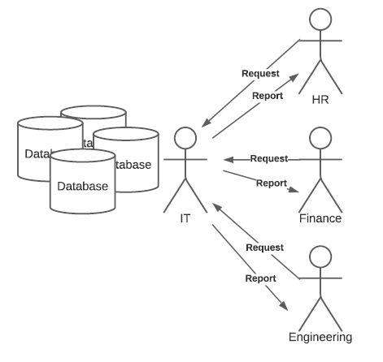
Traditional Healthcare Business Intelligence
Pros:
Security
Cons:
Bottlenecks
IT doesn’t know data as well as business users
What is the truth?

Slide 16
Democratized data – more matured business intelligence
Pros:
Bottleneck removed
Business analysts can get timely access and make decisions from their data
Cons:
Security risk increased
Scalability is difficult
Performance of source systems are not optimized for analytics
Availability of source systems could crash with too much traffic
Access to raw dirty data permeates
Communicating between databases is difficult
What is the truth?

Slide 17
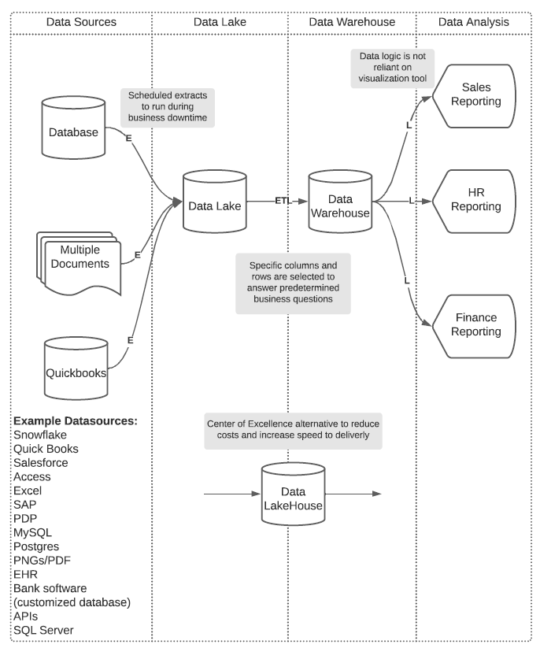
Governed and Trusted Data Management – Optimal BI
Pros:
Truth is established
Security measures in place
Scalability is easy
Performance of systems is preserved
Availability of data is limited to only needed data
Accessibility is easy because the data is structured for the business analyst
Cons:
Expensive to implement data enterprise solutions
Notes:
Cons – the cost can be mitigated by focusing on a few key business questions and combining the data lake and data warehouse into one step.

Slide 18
The data lake
Information is housed in a repository called a data “lake”, quickly becoming data oceans.
Allows all types of analytics to be run – from dashboards and visualizations to big data processing and real-time analytics.
Aws.amazon.com/big-data/datalakes-and-analytics/what-is-a-data-lake/
Notes:
In Data Lakes – data is stored as is. There is no need to structure the data.
This means you can store all of your data without careful design or the need-to-know what questions you might need answers for in the future.
Different types of analytics on your data like SQL queries, big data analytics, full text search, real-time analytics, and machine learning can be used to uncover insights.

Slide 19
Data aggregation and visualization
All this information is great, but we need to make it useful.
Data aggregation is the process where data is collected and presented in a summarized format for analysis:
Allows you to look beyond the two dimensionality of a row and a column tool like Excel
Starts the process of looking at data to begin to use the data
Data visualization is taking that summarized data and creating graphical representations – like charts, graphs and maps:
Helps to tell stories
Removes the noise
Highlights trends and outliers
Allows for decision making at greater speed, precision, consistency and agility
Notes:
This is a crucial step, since the accuracy of insights from data analysis depends heavily on the amount and quality of data used.
It is important to gather high-quality accurate data and a large enough amount to create relevant results.
Data aggregation is useful for everything from finance or business strategy decisions to product, pricing, operations, and marketing strategies.

Slide 20
Analytics in The Revenue Cycle

Slide 21
“As we move into this new digital normal, there is an opportunity to think differently. Organizations are saying let’s not build our recovery on what existed before, but let’s reimagine.”
- Srinivas Kosaraju
senior director of public sector solutions engineering at Tableau

Slide 22
Major Trend
Gartner Identifies 10 Trends CFOs Must Understand to Prepare for the Future of Finance.
1 — Digital is creating a skills disconnect
2 — Demand for decision-ready data
3 — (Re)centralization of finance analytics
4 — The AI revolution has begun
5 — An emerging fourth era for ERP
6 — Growing use of global business services
7 — Reporting goes on-demand
8 — RPA is putting internal controls at risk
9 — Cost scope is harming efficient growth
10 — Unlocking growth through supplier innovation

Slide 23
Notes:
According to MarketStudyReport, North America healthcare analytics market is slated to reach USD 50.3 billion in valuation by the end of 2028.
Regional Overview:
Experts have suggested that the U.S. industry is poised to grow at 19.4% CAGR during the stipulated time and yield revenues worth USD 44 billion by the end of 2028, ascribed to the widespread adoption of innovative analytics tools to manage healthcare facilities most effectively.
Massive investments employed in healthcare sector, technological advancement to aid the management of massive volume of medical records, and the use of Big Data in healthcare to efficiently predict the at-risk patients and create effective treatment plans are boosting the growth of industry.

Slide 24
By the numbers
47.5 % of health systems currently use artificial intelligence (AI) solutions to address workforce challenges (HealthITAnalytics)
78% of executives claim that their health systems are either using or considering AI for revenue cycle management (HealthITAnalytics)
52% of medical practices use built-in reports for revenue cycle analytics (MGMA)
90% of healthcare organizations strongly agreed to the growing influence of data analytics in their organizations over the next few years (Folio3)
Statistics suggest that by 2025 the market for health-related analytics will increase to $28 billion

Slide 25
Case Study

Slide 26
Challenges with Data
Inaccurate or inconsistent data
Random sampling
Manual data processes
Rearview mirror vs. Looking forward
A lack of timely access
Time-to-value, slow backend development
Unscalable visualizations, ignoring the backend

Slide 27
Solutions with data
Decrease risk with accurate data
Widen scope
Weed out inefficiencies
Prevent future problems
Continuous monitoring/auditing
Real-time & Predictive analysis
Proactive approach

Slide 28
Final thoughts
1.
Analytics have the potential to drive improved value by pinpointing areas where proactive steps can better support optimal revenue cycle performance—as well as the organization’s mission.
2.
The trend toward analytics to improve value in health care is on the rise, driven by advancements in technology, healthcare reform, regulatory mandates and the emergence of value-based payment models.
3.
Creating a data-driven culture in which the use of analytics becomes the norm requires a commitment from leadership.
Notes:
notes_title
add_note_to_this_slide

Slide 29
QUESTIONS?

Slide 30
Thank You!
Rochelle Dahmen
Senior Manager
rdahmen@eidebailly.com
612.253.6638

