Slide 1
ASSET MANAGEMENT & PLANNING
Life Cycle Risk Mitigation Strategy
February, 2023
Baptist Health
Cindy Gueltzow, System Vice President, Supply Chain Services
Todd Hill, System Deputy Chief Information Security Officer
Chris Graff, System Vice President, Financial Operations

Slide 2
Asset Management Planning and
Retirement Capital Committee
System committee was sanctioned by SEC in 2019 and development of data collection required to identify risk began immediately.
  Purpose
  The purpose of the Asset Management Planning & Retirement (AMPR) Committee is to provide guidance and support to the organization’s efforts regarding the management of its capital assets. This includes providing planning, growth and retirement recommendations throughout the lifecycle of all assets. Additionally, AMPR will remediate risks associated with equipment at or near end of life.
  Co-Chairs: Michael Erickson, System Chief Cyber Security Officer, Cindy Gueltzow, System Vice President of Supply Chain Services
Primary Focus since inception: Develop strategy and tool(s) to track key capital modalities that pose a risk to the network, our ability to provide care for our patients and/or our operations/revenue.
Membership includes: Cyber Security, IT, Biomed, Supply Chain, Facilities, Business Continuity and Finance

Slide 3
Cybersecurity Implications
Legacy/end-of-life operating systems and software
Use available data elements to develop cyber risk profile of assets and use as part of capital replacement prioritization and risk mitigation approach
Vendor controlled deployment & management
Evaluate vendor partner approaches to security, establish strong relationships and contractual expectations
Limited security visibility & control
Invest in enhanced network monitoring and mitigation capabilities, prioritize response to medical device events
Lack of resilience
Seek opportunities to ensure continuity of services by eliminating single points of failure
Non-standard configurates and access controls
Establish configuration and access standards, evaluate new and existing assets for compliance, and develop exception handling process
Proliferation of network & internet connected components
Review new functionality during evaluation & procurement phase and determine security approach prior to deployment, incorporate in asset management processes

Slide 4
Factors for Determining Asset Cyber Risk
Operating system and software remaining useful life
Network/internet connectivity, system integration requirements
Access controls (including remote access)
System vulnerability/threat profile
Known attempts to exploit device
Ability to support cyber security requirements and tools
Criticality of device to operation
Vendor reputation and relationship
Cost and feasibility to replace or otherwise mitigate risk

Slide 5
Data System & Reporting
Key requirements for asset lifecycle management function to assist with gaining better visibility across different type of assets (e.g. IT, facilities, clinical engineering, supply chain & cyber security)
  Biomed and capital budgeting software databases will be used jointly to report key data for risk evaluation as well as 3-5 year plan development (replacement and growth)
    Physical Facility & Network location of all equipment
    Make and model of all modalities including serial numbers and asset tag #
    Operating software version – Supply Chain risk level
    Inspection and Service dates – Biomed risk level
    Age of equipment to define remaining useful life
    Business continuity risk level
    Standardized vendor to guide bulk purchases
    Capital ID and Purchase order number
    Cyber security risk level (scaled & based on numerous factors)
    IT risk level (scaled & based on numerous factors)
    Utilization by modality by site
    Peak Schedule – utilization
    Open appointments
  Preliminary go live of our software tools is scheduled for March 2023 for subset of overall equipment data

Slide 6






Strategic Asset Management
Lifecycle Planning Team
Procurement
Finance
Information Systems
Cyber Security
Bio-Medical
Business Continuity
Executive Management
Supply Chain and Contract Management Database
Scale economies achieved within defined safety and quality expectations
Capital Planning and Financial Management
Database
Processes that include Patient Safety and Technology Risks in purchasing decisions
Configuration Management Database
Vulnerability & Configuration Management
Legacy System Archival
Hardware Access Controls and Vulnerability Database
Third party risk management
Medical Device Security
Facilities Management
Database
Treatment of Physical plant as an I.T. Asset
Common Procedures and risk based controls
Continuity of Operations Plans
Resilience as a core competency
Front line champions
Learn dependencies
Disciplined decision making based on the economic value of an asset
Calculated risk-taking
Accountability for lifecycle management
Asset Lifecycle Management improves with collaboration, data integration and data analysis
Proactive
Risk Mitigation Strategies
Integration of IT and information security reviews during the procurement cycle to ensure Baptist standards are met for new equipment and exceptions are noted and tracked.
Monthly scanning/prioritization of cyber risk for capital replacement process
Continuous scanning and monitoring for network connected assets to detect changes and component level risk.
Implementation of new comprehensive IT asset database and service management processes and new governance process for IT asset management program.
Monthly reporting and triage of asset security compliance across network connected devices.
Additional capabilities for network isolation of high risk assets and systems.

Slide 7
Risk Mitigation – Sample Projects
Lifecycle Assessments were completed without a software system. A number of resources assisted in the identification of these high risk assets requiring replacement. Funding was spread across multiple years to alleviate the identified risks. Without data visualization the timeframe for replaced was elongated.
  Replaced CR X-ray rooms with safer DR X-ray rooms that were identified as a tier 1 cyber security risk in 2020 across the health system.
  Patient monitoring, nurse call, patient beds, & stretchers identified as a tier 1 cyber security or patient safety/operations risk were replaced over a period of three years starting in 2021. This project improved nursing satisfaction.

Slide 8
Asset Management Capital
Reserve Strategy
Positioning Baptist Health as the healthcare technology leader by focusing on
7 key asset categories: Imaging, Cardiac, Surgical Services, Nursing,
Pharmacy, Radiation Oncology and Infrastructure
  Significantly reduce our cyber security and business continuity risks by replacing equipment at or before end of useful life
  Up-to-date technology attracts new physician & nurses while retaining existing staff
  Focused on reducing revenue disruptions due to equipment failures
  Replace existing equipment with additional capabilities to increase capacity
  Improve physician satisfaction with faster throughput allowing for quick diagnosis
  Improve patient satisfaction with quicker procedure scheduling and shorter procedure times with newer equipment
  Forecasting capital needs with confidence improves budget planning dramatically

Slide 9
Strategic Asset Management -
Benefits of lifecycle management
with capital reserves
Forecast key asset replacements & implement like modalities simultaneously
  Reduces risk of equipment failures/lowers breakage rates
  Reduces architectural and construction costs with standardized implementations
  Creates predictive capital budgeting
Standardize capital equipment by modality within the health system
  Provides the highest technology across the health system
  Streamlines operational workflow
  Decreases the number of interfaces to EMR
  Reduces the infrastructure servers required to maintain the fleet
  Reduces purchase & service contract cost with system standards approach
Maximize patient throughput
  Increase replacement modality capabilities to improve patient volume by site
  Improved patient satisfaction with improved scheduling
  Improve speed to treatment for patients
  Optimize peak hours and increase schedule if possible taking into consideration staffing

Slide 10
Strategy
Volume
  Existing Volume
  New Volume - Provider Recruitment
  New Volume - Strategic Pricing
Growth Strategy
Long-Term Strategy
Operations
  Hours of Operations
  Staffing
  Scheduling
  PAO Improvements
Capacity
Capital
  Routine Equipment Replacement
  Equipment Upgrades
  New Equipment
  New Locations
Capacity

Slide 11
Key Assessment Priorities
Replacing risk based equipment to reduce our exposure to network risk, long term outages due to repair issues, operating system failures
Maintaining adequate and up-to-date technology is critical to delivery quality care, maintain positive patient experience and increase operational efficiencies
Upgrading our technology to minimize operational disruptions due to failing aged equipment. Delays in parts and service delivery hinder operations.
Upgrading to new technology provides improvement in protocol speed thereby improving workflow for staff while increasing patient throughput
Evaluation of current schedule and staffing to determine if throughput could be increased with increased hours of operation
Using data to define growth strategies to better meet our patient needs
Standardize our workflow and scheduling processes to increase patient throughput

Slide 12

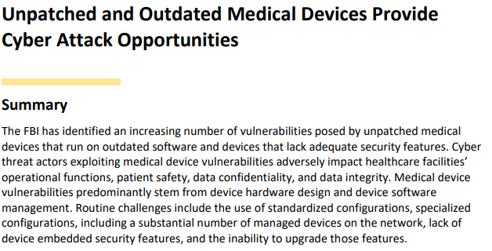
Source: https://www.aha.org/cybersecurity-government-intelligence-reports/2022-09-12-fbi-pin-tlp-white-unpatched-and-outdated

Slide 13
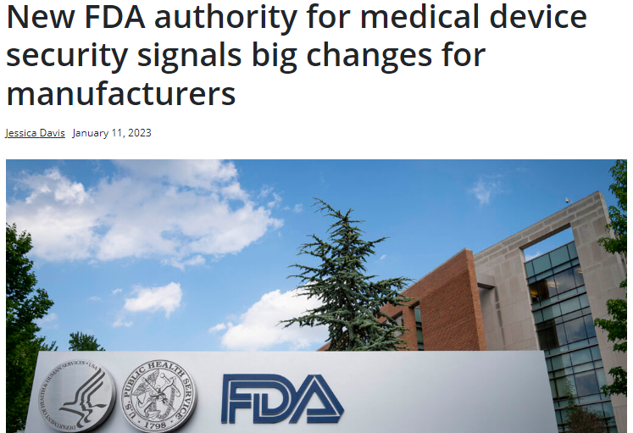
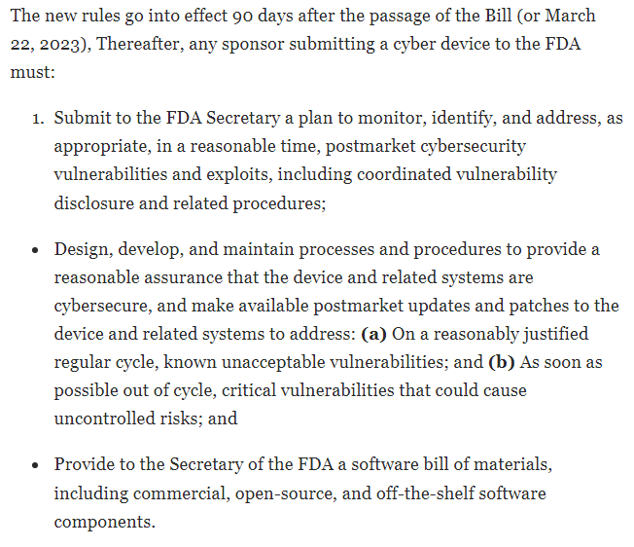
Sources:
https://www.scmagazine.com/feature/device-security/new-fda-authority-for-medical-device-security-signals-big-changes-for-manufacturers
https://www.jdsupra.com/legalnews/heightened-cybersecurity-requirements-5386637/

Slide 14

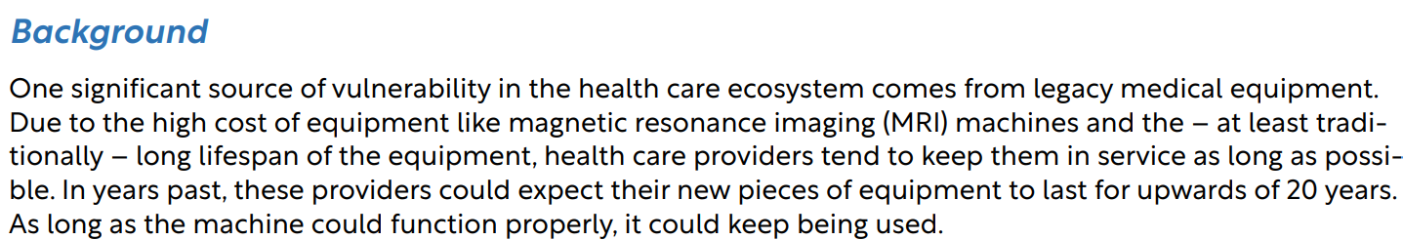
Source: https://www.warner.senate.gov/public/_cache/files/f/5/f5020e27-d20f-49d1-b8f0-bac298f5da0b/0320658680B8F1D29C9A94895044DA31.cips-report.pdf

Slide 15
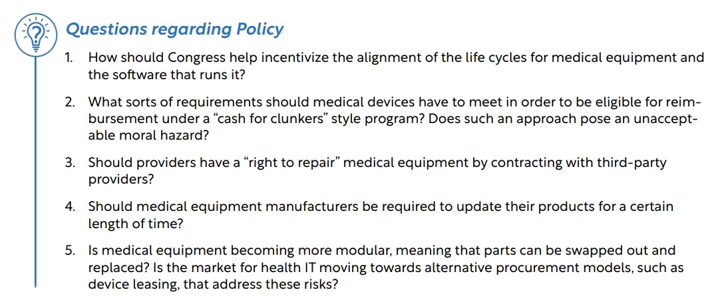
Source: https://www.warner.senate.gov/public/_cache/files/f/5/f5020e27-d20f-49d1-b8f0-bac298f5da0b/0320658680B8F1D29C9A94895044DA31.cips-report.pdf

Slide 16
Questions?
Thank you for your time!

