Slide 1
Full Disclosure: Surprise Billing and Price Transparency Update
Wisconsin HFMA
Spring Conference & Annual Meeting
May 18, 2023

Slide 2
Presenter
Benjamin Fee
Attorney, Hall Render
BFee@hallrender.com
(720) 282-2030

Slide 3
Price Transparency
Surprise Billing
GFE

Slide 4
Price Transparency
Laws that increase public disclosure of healthcare pricing
Both Federal and State Laws
Surprise Billing
Laws that protect patients against unexpected or unavoidable out-of-network bills
Both Federal and State Laws
Federal Laws
Federal Hospital Price Transparency Rule (Hospitals)
Additional Federal Laws
No Surprises Act - Good Faith Estimate Requirement
Transparency in Coverage - Health Plans
State Laws
No Surprises Act - Balance Billing Protections
State Laws
Usually only apply to state-regulated plans

Slide 5
Enforcement is Increasing Rapidly

Slide 6
Hospital Price Transparency

Slide 7
Price Transparency | Only Applies to Hospitals
Requirement to post fees (including payor-specific rates) beginning January 1, 2021 in two ways:
Machine readable file for all items and services (not just a chargemaster)
Display in a consumer-friendly format for 300 shoppable services (most hospitals rely on an existing or new price estimator tool
Applies to nearly every hospital
No minimum threshold for third-party payers
Updated on an annual basis
Include disclaimers

Slide 8
Price Transparency | Enforcement
Patient advocacy reports continue to report low compliance rates across industry
Growing pressure for CMS to increase enforcement
Four hospitals penalized for non-compliance
$883,180
$214,320
$102,660
$117,260
Enforcement
Warning letters
Corrective action plan
Penalties use a sliding scale based on bed count effective January 1, 2022
Full year of non-compliance total penalty between $109,500 and $2,007,500
CMS likely to compress process soon. I.e., fewer opportunities to correct before penalties

Slide 9
PRICE TRANSPARENCY –
NSA GOOD FAITH ESTIMATES

Slide 10
Think of NSA as Two Separate Laws
Protections Against Surprise Medical Bills
Balance billing law
Patients with commercial health coverage
Limited to certain locations
Notice and posting requirements
Good Faith Estimates
Uninsured and self-pay patients (for now)
Price Transparency law
Applies in more locations
Notice and posting requirements

Slide 11
GFE | What is it?
As of January 1, 2022, providers must provide a written “good faith estimate” of expected charges for items and services to uninsured and self-pay patients when scheduling or upon request

Slide 12
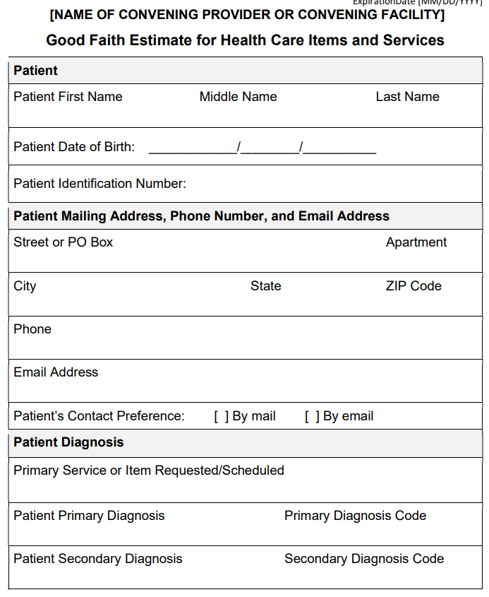
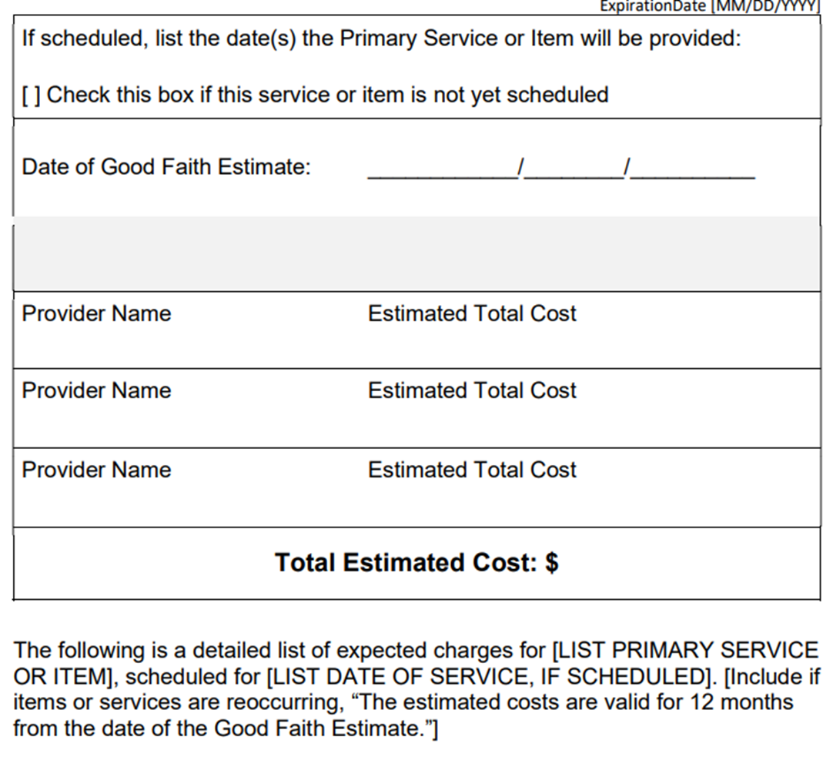

Slide 13
GFE | Who Must Provide?
All state-licensed or certified health care providers and facilities (everyone)
Including private practice locations
Convening provider or facility
the provider or facility that is responsible for scheduling the primary items or services or that receives an initial request for a GFE

Slide 14
GFE | Co-Providers
Law requires GFE to include expected charges for any item or service that is reasonably expected to be provided in conjunction with the scheduled or requested item or service, including those provided by co-providers or co-facilities
Enforcement delay originally until December 31, 2022
CMS announced indefinite extension

Slide 15
GFE | To Whom?
For now, only required for uninsured or self-pay patients
HHS defines an “uninsured or self-pay” patient as an individual who does not have benefits for an item or service under a group health plan, group or individual health insurance coverage offered by a health insurance issuer, federal health care program, or a health benefits plan OR an individual who is choosing to not use their coverage benefit

Slide 16
GFE | When?
Convening provider or facility must inform uninsured and self-pay patients of availability of GFE
Must provide a “good faith estimate” of expected charges to patients (again, for now only uninsured or self-pay) when scheduling or upon request
Within 3 business days of scheduling if service at least 10 days later
The next business day after scheduling if service at least 3 days later but less than 10 days later
Within 3 business days of receiving a request for a GFE by an uninsured or self‐pay individual

Slide 17
GFE | How?
Must be provided in writing or electronically as requested by the patient

Slide 18
GFE | What If We Get This Wrong?
Patients can challenge bills substantially in excess of GFE via a government dispute resolution process
“Substantially in excess” means in excess of $400 or more of GFE
Could also be subject to civil penalties ($10,000 per violation)

Slide 19
GFE | Other Details
Must post notice of availability of GFE on website (if have one) and on-site where scheduling or questions about cost of care occur
There is an HHS model posting
Must update GFE if anticipate changes in scope or estimate
Recurring services can use a single GFE for up to 12 months
GFE is considered part of the patient’s medical record
Must provide copies of prior GFEs to patients furnished within last 6 years
Still waiting on rules for providing GFE to insured patients (via the patient’s plan)

Slide 20
GFE FAQs

Slide 21
Is a provider or facility required to provide a GFE to uninsured (or self-pay) individuals upon scheduling same-day (or walk-in) items or services?
No. The requirement to provide a GFE to an uninsured (or self-pay) individual . . . is not triggered upon scheduling an item or service if the item or service is being scheduled fewer than 3 business days before the date the item or service is expected to be furnished.
For example, if an uninsured (or self-pay) individual arrives to schedule same-day laboratory
testing services, the laboratory testing provider or facility is not required to provide the
individual with a GFE [from HHS FAQs for GFEs Part 2]

Slide 22
Do providers or facilities need to provide GFEs to all individuals, for instance, patients with Medicare or Medicaid?
Effective January 1, 2022, providers and facilities are required to provide GFEs to uninsured (or self-pay) individuals who schedule items or services or request an estimate. An uninsured individual is one who is not enrolled in a group health plan, or group or individual health insurance coverage, or a Federal health care program, or a Federal Employees Health Benefits (FEHB) program health benefits plan. A self-pay individual is one who is enrolled in but is not seeking to have a claim submitted to their group health plan, health insurance coverage, or FEHB program health benefits plan for the item or service being scheduled or for which a GFE is requested. Under the No Surprises Act statute, providers and facilities are generally not required to provide GFEs to individuals insured under Medicare, Medicaid, or other federal health care programs.
[from HHS FAQs for GFEs Part 1]

Slide 23
How can providers or facilities provide a GFE to an uninsured (or self-pay) individual when the underlying complexity of an individual’s condition is not yet known?
GFE must include items or services reasonably expected to be furnished for the primary item or service, and items or services reasonably expected to be furnished in conjunction with the primary item or service [ . . . ]. “ . . . the interim final rules do not require the good faith estimate to include charges for unanticipated items or services that are not reasonably expected and that could occur due to unforeseen events.
[from HHS FAQs for GFEs Part 1]

Slide 24
Do providers or facilities need to factor in financial assistance an uninsured (or self-pay) individual may receive when calculating the expected charges for items or services included in the GFE?
Yes. The GFE must reflect the expected charges, including any expected discounts or other
relevant adjustments that the provider or facility expects to apply to an uninsured (or self-pay)
individual’s actual billed charges. For example, certain tax-exempt hospital organizations are
required to meet certain Financial Assistance Policy (FAP) requirements; for purposes of this
example, any adjustments expected to be applied under the FAP would be factored in and
reflected in the amount reported in the GFE. [from HHS FAQs for GFEs Part 1]

Slide 25
GFE | Enforcement
Patient complaints
Patient dispute resolution requests
CMS and states investigating patient complaints and non-compliance
GFE does not include required information
No disclosures on GFE
GFE not provided

Slide 26
Surprise Billing
NSA Surprise Billing Protections

Slide 27
Surprise Billing | No Surprises Act
Effective date of most requirements was January 1, 2022
Prohibits balance billing in the following circumstances:
All out-of-network emergency services
Certain non-emergency services performed by out-of-network providers at in-network facilities
All out-of-network air ambulance services
Protections DO NOT apply if non-emergency services and both facility and provider are out-of-network
Providers can balance bill if they provide notice and obtain consent in limited circumstances

Slide 28
Surprise Billing | Payments and Disputes
Two payments: (1) patient to provider and (2) payer to provider
No Surprises Act DOES NOT mean no payment
Patient cost sharing limited to in-network cost sharing (unless notice and consent allowed and obtained)
Patient cost-sharing usually based on “qualified payment amount” (QPA)
QPA is median of contracted rates in January 2019 for similar item or service, provider, region and adjusted annually
Payer is supposed to include QPA on notice of non-payment or payment
Plan obligated to pay provider

Slide 29
Surprise Billing | IDR Process
If provider disagrees with payment from payer, can dispute via Federal Independent Dispute Resolution (IDR)
IDR is arbitration-lite
There are several stages in IDR driven by hard deadlines, including:
Open negotiation notice and period
Notice of IDR initiation
Selection of Certified IDR entity
Submission of offer and other credible information
IDR entity payment decision (baseball style)
Cooling off period (neither party may initiate IDR for same of similar item or service with the same opposing party
Can “batch” certain claims if meet specific criteria
Factors IDR entity considers is still being litigated
There is a lot of technical guidance availablele on HHS website

Slide 30
Surprise Billing | IDR Data
Departments must publish IDR data quarterly
Latest data:
More than 330,000 disputes between April 15, 2022, and March 31, 2023
That likely represents nearly a million claims
Only a few thousand payment decisions due to backlog (was speeding up)
Nearly half of IDR initiations are challenged as ineligible
reasons: federal/state jurisdiction, incorrect batching, missed deadlines, failure to complete open negotiation
Initiating parties are prevailing in approximately 71% of disputes
***This is still a new process that all parties are learning to navigate***

Slide 31
Notices and Postings

Slide 32
Surprise Billing | Notice and Consent
Providers can balance bill if they provide notice and obtain consent in limited circumstances
Very few organizations likely to take this approach
Provider is not permitted to request consent:
for certain services (emergency medicine, anesthesiology, pathology, radiology, laboratory, neonatology, assistant surgeons, hospitalists and intensivists)
or if no participating provider is available
Use standard HHS form
Also, the patient does not have to agree (and HHS doesn’t think many patients will)

Slide 33
Surprise Billing | Model Disclosure
Model Disclosure Notice of Surprise Billing Protections
Provide to patients covered by commercial plans and only for services in a hospital, CAH, or ASC
Facility can provide on behalf of providers but requires written agreement
Provide no later than time bill is sent to patient
Post on website (if have one)
Post prominently in areas where patients check in or pay bills
Do not post in non-hospital (freestanding) office setting
HHS model notice of surprise billing protections

Slide 34
FAQs

Slide 35
For the one-page notice facilities and provider must issue describing the patient balance billing protections, is that notice required to be given to every single patient walking into the hospital or only out-of-network patients?
The law and regulation requires that hospitals give the notice describing patient balance billing protections to all patients covered by insurance. Therefore, the conveyance of the notice is not limited to those that are out-of-network. The final rule stipulates that, at a minimum, providers and facilities should give the notice to the patient at the time of billing. However, the rule does offer providers and facilities some flexibility on the timing of the notice and gives an example that the notice could be conveyed to the patient at the time a procedure is scheduled.
[From American Hospital Association]

Slide 36
Does the patient need to sign an acknowledgement that the patient has received the disclosure notice regarding patient protections against surprise billing disclosure?
No. Patients don’t need to sign to acknowledge that they have received the disclosure notice regarding patient protections against surprise billing. Review and download the model disclosure notice for patient protections against surprise billing, which providers and facilities may use. [CMS FAQ April 6, 2022]

Slide 37
What are the penalties for non-compliance?
CMP up to $10,000 per
violation

Slide 38
Hall Render Experience | Takeaways
None of this is going away
Fines will increase
Enforcement increasing
HHS and CMS patience decreasing
Review Price Transparency machine-readable file and price estimator tool
Audit NSA compliance, including GFE
Monitor federal and state law changes

Slide 39
Lori Wink
LWink@hallrender.com
Ben Fee
BFee@hallrender.com

