Slide 1
The 340B Program: (More) Updates for Current and Future Planning
James Junger
Attorney, Hall Render
Thursday, May 18, 2023

Slide 2
Today’s Speaker
James Junger is a shareholder in Hall Render’s Milwaukee office focusing his practice on pharmacy and health care compliance issues. James assists clients, which include hospitals, health systems, federally qualified health centers and safety net providers, as they navigate the complex 340B program, drug distribution laws, fraud and abuse rules that regulate the health care industry.
James works with clients to establish compliance programs and to analyze their effectiveness and if they are aligned with the seven elements of an effective compliance program as defined by OIG. He also assists in navigating internal investigations, government investigations and e-discovery reviews and damages calculations, including the reviews of claims data and other financial data. Additionally, James has experience working with large amounts of data, including assisting with transactions by coordinating multiple due diligence review processes.
James was named on the 2022 edition of The Best Lawyers in America: Ones to Watch and was recently elected as a Fellow of the American Bar Foundation.
James Junger, Esq., CHC
jjunger@hallrender.com
(414) 721-0922

Slide 3
Agenda
What Are the Issues Today?
340B Program Overview
Contract Pharmacy Restrictions
Alternative Sourcing Models
Risk Factors & Other Issues
Reminder: Considerations in Data Sharing
Reminder: Restoration of OPPS Payments
Takeaways

Slide 4
What Are the Issues Today?

Slide 5
What Are the Issues Today?
Who is a covered entity?
What are manufacturers required to do?
What are covered entities allowed to do?
Who are covered entities’ patients?
What is HRSA OPA doing?

Slide 6
What Are the Issues Today?
Who is a covered entity?
What are manufacturers required to do?
What are covered entities allowed to do?
Who are covered entities’ patients?
Provider-based departments and child sites
What is HRSA OPA doing?
Provider-based departments and child sites
Contract pharmacies
Contract pharmacies
Pharmacist-led clinics and MTM
Alternative sourcing models
Contract pharmacies
Guidance vs regulations; audits; alternative dispute resolution

Slide 7
340B Program Overview

Slide 8
340B Program – History and Purpose
In 1990, Congress created a problem: Medicaid Drug Rebate Program caused manufacturers to eliminate discounts for safety-net providers
In 1992, Congress addressed the problem by creating the 340B program and a related program for the Department of Veterans’ Affairs (DVA)
“The Committee is persuaded that, without intervention, the DVA and Federally-funded clinics may continue to experience substantial drug price increases as manufacturers try to limit their rebates to Medicaid. In the view of the Committee, the Federal government simply cannot continue to allow the DVA, Federally-funded clinics, and their patients to remain unprotected against manufacturer price increases.”
“In giving these ‘covered entities’ access to price reductions the Committee intends these entities to stretch scarce Federal resources as far as possible, reaching more eligible patients and providing more comprehensive services.”

Slide 9
Basic 340B Framework
Eligible Patient Determination
Covered Outpatient Drug Transaction

Slide 10
Eligible Patient Deterination
Patient
Qualifying Outpatient Service; and
Administration or Prescription of Covered Outpatient Drug
Prescriber
Maintains Record of Health Care
Employment or Other Agreement
Covered Entity

Slide 11
Covered Outpatient Drug Transaction
Covered Entity pays Wholesaler 340B price
Covered Entity dispenses/ administers drug to patient
Wholesaler
Patient
Wholesaler pays Manufacturer
Wholesaler ships drugs to Covered Entity
Covered Entity
Manufacturer ships drugs to wholesaler
Manufacturer
Insurer pays Covered Entity standard rate
Insurer

Slide 12
Eligible Patients and Prescribers
340B Drugs can only be Administered/Dispensed to Eligible Patients
Individual is an “Eligible Patient” of a Covered Entity Only if:
Covered entity has established a relationship with the individual, such that covered entity maintains records of the individual’s health care; and
Individual receives health care services from health care professional who is either employed by the covered entity; or provides health care under contractual or other arrangements (e.g., referral for consultation) such that responsibility for care provided remains with covered entity

Slide 13
340B Program – Patient Eligibility
Apexus 2022:
“If the covered entity can demonstrate that the patient is their patient and it is retaining responsibility of care, then 340B could potentially be used.”

Slide 14
Impacts and Incentives
Estimated Savings: 25-50% of a drug’s Average Wholesale Price (GPO is typically 15-20% savings)
Manufacturers that want to receive Medicaid payment for drugs required to enter into Pharmaceutical Pricing Agreement (“PPA”)
340B Program savings – used in support of hospital’s non-profit mission
Pass-through NOT required, except by Medicaid and certain Medicaid Managed Care plans

Slide 15
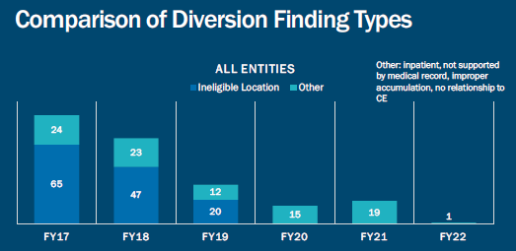
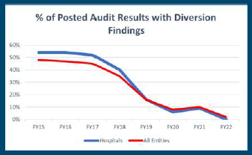
340B Program Overview
340B Health Guidance
*SOURCE: S. Miller, 340B Health presentation, August 2, 2022.

Slide 16
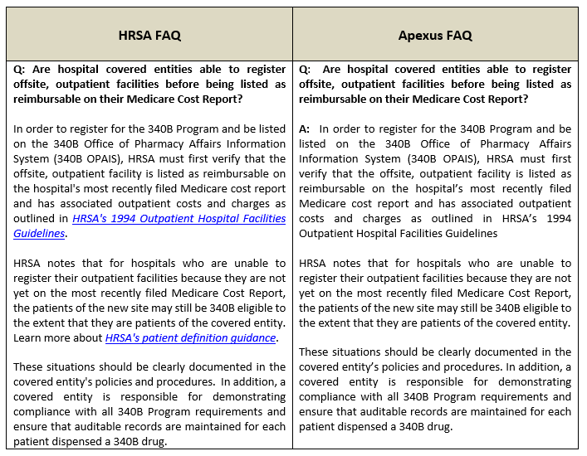
340B Program Overview

Slide 17
340B Program Overview
Removed from HRSA and Apexus websites as of May 12, 2023

Slide 18
Contract Pharmacy Restrictions

Slide 19
Contract Pharmacy Restrictions
Background
In 2020, drug manufacturers began restricting 340B contract pharmacy shipments
So-Called Duplicate Discounts
Manufacturer paying a rebate to an insurer/PBM for a drug it already sold at the 340B price
Some are prohibited by statute (Medicaid)
Occur rarely; processes in place to prevent them
Some are prohibited by manufacturers’ contracts with commercial payors
Most manufacturers have some exceptions (wholly owned pharmacies; single contract pharmacies)
Manufacturers are using data to deny payor rebates
Manufacturers’ Central Complaint
Exceptions and Conditions
Began with Eli Lilly
Now, 24 total manufacturers
Some manufacturers permitting shipments if covered entity provides claims-level patient data directly to manufacturer or Second Sight Solutions
Second Sight is owned by Berkeley Research Group, a Pharma-aligned consultancy

Slide 20
Contract Pharmacy Restrictions
AbbVie
Amgen
AstraZeneca
Bausch Health
Bayer
Biogen
Boehringer Ingelheim
Bristol Myers Squibb
Eli Lilly
EMD Serono
Exelixis
Gilead
GlaxoSmithKline
Johnson & Johnson
Merck
Novartis
Novo Nordisk
Pfizer
Sanofi
Takeda
UCB
United Therapeutics
Woodward Pharma

Slide 21
Contract Pharmacy Restrictions
Not Demanding Data
Demanding Data 340B ESP
AbbVie
Amgen
Bausch
Boehringer Ingelheim
Eli Lilly
Exelixis
Gilead
GlaxoSmithKline
Johnson & Johnson
Merck
Novartis
Pfizer
Sanofi
United Therapeutics
AstraZeneca
UCB
Novo Nordisk
Demanding Data Direct Submission
Bristol Myers Squibb
EMD Serono
Biogen
Bayer
Other Restrictions
Woodward Pharma
Takeda (kind of)

Slide 22
Contract Pharmacy Restrictions
Government Response
Congress, HRSA, and HHS Office of General Counsel have been highly critical of manufacturers’ actions
Manufacturer Litigation
At least eight manufacturers plus PhRMA (trade group) have sued HHS
HRSA has sent enforcement letters to nine manufacturers informing them that their restrictions are unlawful
HRSA has referred seven of these manufacturers to OIG for Civil Monetary Penalties
Cases have been mixed; two appeals are pending; one appeal decided in manufacturers’ favor
OIG has taken no public action so far

Slide 23
Contract Pharmacy Restrictions
January 30, 2023 - Third Circuit Court of Appeals decision upheld contract pharmacy restrictions imposed by Novo Nordisk, AstraZeneca, and Sanofi.
Very shortly after, Johnson & Johnson announced a more restrictive 340B CP policy that we believe is directly related to this decision.
While disappointing, it is not unexpected.
Additional manufacturers have unilaterally implemented more restrictive contract pharmacy policies.
We are evaluating response options.

Slide 24
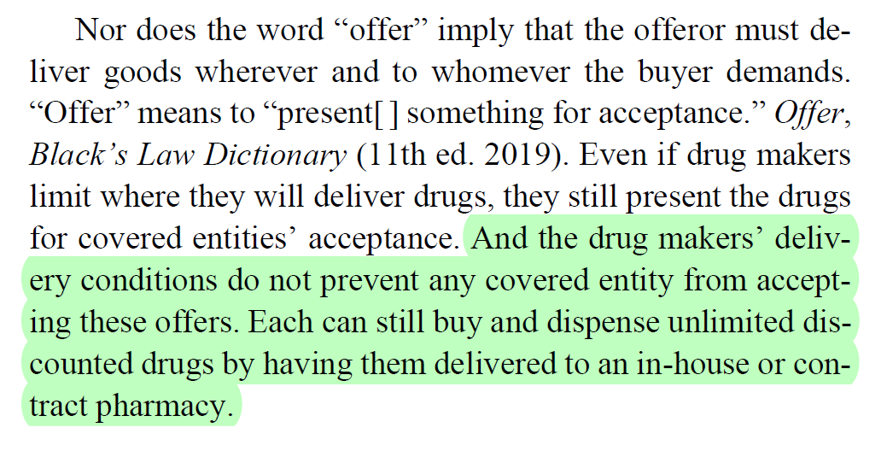
Contract Pharmacy Restrictions
What does the Third Circuit decision mean?
If adopted by other courts/not overturned, 340B Statute as written does not require manufacturers to ship drugs to covered entities’ contract pharmacies…but

Slide 25
Contract Pharmacy Restrictions
Options Without Sharing Data
Wholly owned pharmacy exceptions
Single contract pharmacy exceptions
Alternative sourcing models
Novo Nordisk: Two pharmacies (one retail, one specialty)
Manufacturers with limited distribution drugs typically allow a second contract pharmacy designation specific to those drugs

Slide 26
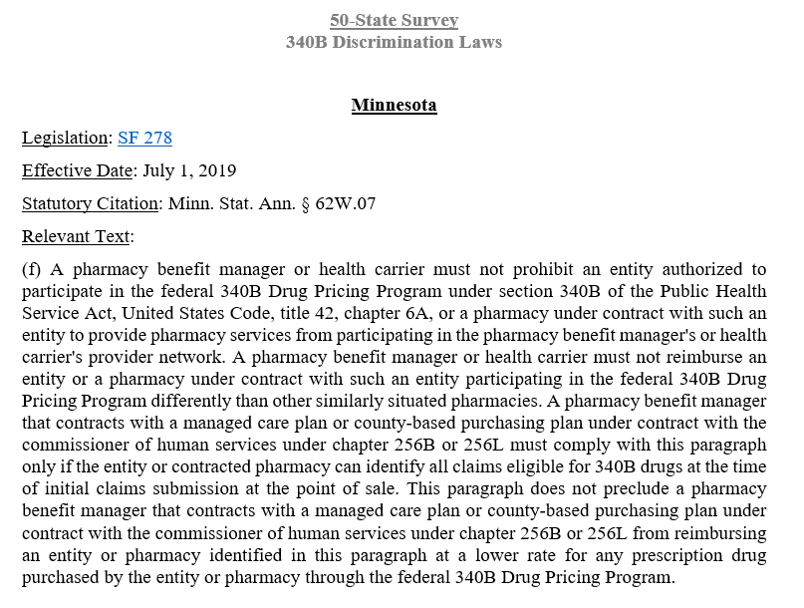
Contract Pharmacy Restrictions
Downstream Impacts
Coordinate with contracting team – monitor 340B-based discriminatory pricing
Consider state laws addressing 340B pricing discrimination in the pharmacy setting
Consider PBM and pharmacy data sharing restrictions (contractual)

Slide 27
Alternative Sourcing Models

Slide 28
Alternative Sourcing Models
Models to facilitate contract pharmacy shipments without direct shipment by manufacturers / wholesalers
Leverages the covered entity’s operational capacity and legal authority to move its own drugs from one place to another

Slide 29
DSCSA - Requirements
Key DSCSA provisions only apply when:
Product ownership is transferred; and
A transfer does not meet an exemption to the definition of a “Transaction”
DSCSA broadly defines “Transaction” as a transfer of a Product between person when a change of ownership occurs
21 U.S.C. § 360eee(24)(A)

Slide 30
DSCSA - Requirements
18 EXEMPTIONS from the definition of “Transaction” including:
Distribution of a Product among hospitals or other health care entities under COMMON CONTROL;
INTRACOMPANY DISTRIBUTION of any Product between members of an Affiliate
System-owned licensed wholesale distributors would be able to transfer drugs. Consider:
T3 compliance;
3PL requirements;
Pricing/contract compliance
DSCSA requirements do not apply when a “Transfer” is exempted from the definition of a “Transaction”

Slide 31
State Law Considerations
In addition to federal regulatory standards, need to consider state law:
Includes Pharmacy Practice Acts
Wholesale distributor licensure required?
Legal requirement vs. more restrictive (even in incorrect) BoP interpretations
Even if intracompany exceptions

Slide 32
Other Options
MTM Models
Shared Service Centers
Consolidate Ship-to Accounts
Central Fill Pharmacy Models
Intracompany Transfers
Central Warehouses:
Intrasystem
Establish Wholesale Distributor
System-owned Specialty Pharmacy

Slide 33
340B MTM
Overview
Not unreasonable for 340B CE to consider patients who only receive pharmacist (non-prescriber) MTM services to establish 340B eligibility.
Must establish a relationship with the CE such that it is responsible for and maintains a record of their care
Consider: Infusion Department
Recommend: Document Eligible Patient definition in a written policy and notify HRSA OPA anonymously to give them the opportunity to adopt an alternative position
Consider: Fact-specific implementation

Slide 34
Risk Factors &
Other Issues

Slide 35
Other Options – Risk Factors
What about Child Sites?
HRSA OPA historically required a provider-based department to be included on an as-filed cost report before registering it as a “child site”
Flexibility announced during COVID-19 pandemic
After the pandemic, have things changed?
If things have changed, what would it affect?

Slide 36
Other Options – Risk Factors
Drug Distributor Agreements:
“Own Use” requirements?
Contract Pharmacy Agreements:
Address data sharing to ensure compliance with carve-outs (e.g., MCO and FFS)
Legal Risk:
State and federal distribution laws
Lower risk: Intrasystem
Higher Risk: Third Party (Agency Status)

Slide 37
Other Options – Risk Factors

Slide 38
Other Issues
DSH percentages trending downward, potentially implicating continued 340B eligibility
Variety of factors implicated, directly and indirectly related to PHE, Medicaid expansion, demographic changes and more
Consider: Custodial care days, service line/department optimization, remote locations, specialty hospitals
To Do:
Evaluate current DSH percentage metrics and estimate whether any near-term action is necessary to ensure DSH thresholds are met
SCH/RRC ≥ 8$;
DSH/PED/CAN > 11.75%

Slide 39
Reminder: Restoration of OPPS Payments

Slide 40
Restoration of OPPS Payments
Effective January 1, 2023, CMS eliminated ASP – 22.5% payment rate for 340B-purchased drugs
Separately payable OPPS drugs now reimbursed at ASP + 6% for all hospital providers
Background
Since 2018, CMS has paid 340B hospitals less than other hospitals for drugs under the Outpatient Prospective Payment System
Standard rate: Average Sales Price + 6%
340B rate: ASP – 22.5%
340B hospitals directed to identify 340B-priced drugs using a “JG” modifier
Policy Update
Supreme Court found this policy to be unlawful in American Hospital Ass’n. v. Becerra

Slide 41
Restoration of OPPS Payments
What about 2018-2022 payments?
Not entirely clear
What about claims for the rest of 2022-23?
JG/TB modifiers requirement still included in applicable regulations/guidance
AHA challenged payments for 2018 & 2019. Supreme Court did not require any particular remedy
Proposed OPPS rule indicates that CMS will adopt a remedy for 2018 through 2022
Budget neutrality a big issue
JG/TB modifiers may be required for Medicare Rebate purposes under the Inflation Reduction Act

Slide 42
Restoration of OPPS Payments
2023 OPPS Final Rule (2022.11.23)
CMS implemented a –3.09% reduction to payment rates for non-drug services to achieve budget neutrality for the 340B drug payment rate change for CY 2023.
CMS will address remedy for 340B drug payments from 2018-2022 in future rulemaking prior to the CY 2024 OPPS/ASC proposed rule.
Claims for 340B-acquired drugs paid after the district court’s September 28, 2022 ruling are paid at the default rate (generally ASP plus 6%).
For CY 2023, CMS maintained requirement for 340B hospitals to report ‘‘JG’’ and ‘‘TB’’ modifiers for informational purposes - no effect on payment rates

Slide 43
Restoration of OPPS Payments
Hospital Type (determined by CMS) | Pass-through Drug (SI “G”) | Separately Payable Drug (SI “K”) | Vaccine (SI “F” “L” or “M”) | Packaged Drug (SI “N”)
Not Paid under OPPS
CAH | TB, Optional | TB, Optional | N/A | TB or JG, Optional
Non-Excepted Off-Campus PBD | TB | TB | N/A | TB or JG, Optional
Paid under the OPPS, Excepted from the 340B Payment Adjustment for 2018
Children’s Hospital | TB | TB | N/A | TB or JG, Optional
PPS-Exempt Cancer Hospital | TB | TB | N/A | TB or JG, Optional
Rural Sole Community Hospital | TB | TB | N/A | TB or JG, Optional
Paid under the OPPS, Subject to the 340B Payment Adjustment
DSH Hospital | TB | JG | N/A | TB or JG, Optional
Medicare Dependent Hospital | TB | JG | N/A | TB or JG, Optional
Rural Referral Center | TB | JG | N/A | TB or JG, Optional
Non-Rural Sole Community Hospital | TB | JG | N/A | TB or JG, Optional

Slide 44
Reminder: Considerations in Data Sharing

Slide 45
Risk Factors – Data Sharing
Federal
HIPAA
SAMHSA / 42 C.F.R. Part 2
FTC
State
Privacy laws
Attorneys General Investigations:
Business
Civil Liabilities: Notice of Privacy Practices
Contractual liabilities: Wholesale Distributor Agreements, 340B CP confidentiality, Payor agreements (340B claims identification)
Deceptive trade practices
Compliance with laws
Etc.
Other Issues: Monetization of health system and patient data, third party indemnification related to above federal and state laws, public perception, competitive considerations

Slide 46
Data Sharing – 340B ESP
Covered Entity Provides
Rx Number*
Rx Number*
Fill Date*
Manufacturer Receives
Random Linking ID
BUT, 340B ESP T&Cs appear to permit 340B ESP to provide all data to Manufacturer
Covered Entity Receives
Fill Date*
Prescribed Date*
Pharmacy NPI
Prescriber NPI
NDC
Quantity
Wholesaler Invoice Number
Covered Entity ID
Manufacturer Provides
Pharmacy NPI
NDC
Quantity
Random Linking ID
340B ESP Retains
Rx Number*
Fill Date*
Prescribed Date*
Pharmacy NPI
Prescriber NPI
NDC
Quantity
Wholesaler Invoice Number
Covered Entity ID
Random Linking ID
* Values are salted and hashed

Slide 47
340B ESP – T&Cs
CEs agree to be bound by 340B ESP T&Cs and Privacy Policy if they create an account
Using the 340B ESP “single contract pharmacy” and “wholly owned pharmacy” designation forms likely does not constitute agreement to the T&Cs
340B ESP T&Cs indicate they are not receiving PHI due to encryption/deidentification
HOWEVER, 340B ESP requests BAA and will treat information as if it’s PHI.
Manufacturers WILL reidentify data. Internal inconsistency in 340B ESP T&C
Fundamental Question:
Manufacturers receiving PHI – permissible? No payor engaging manufacturer
Consider risk within HHS – Agency and Secretary Becerra that has said 340B CP restrictions NOT appropriate

Slide 48
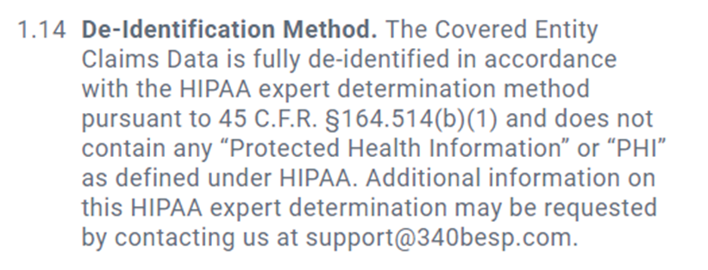
340B ESP – 1.14: Deidentification Method

Slide 49
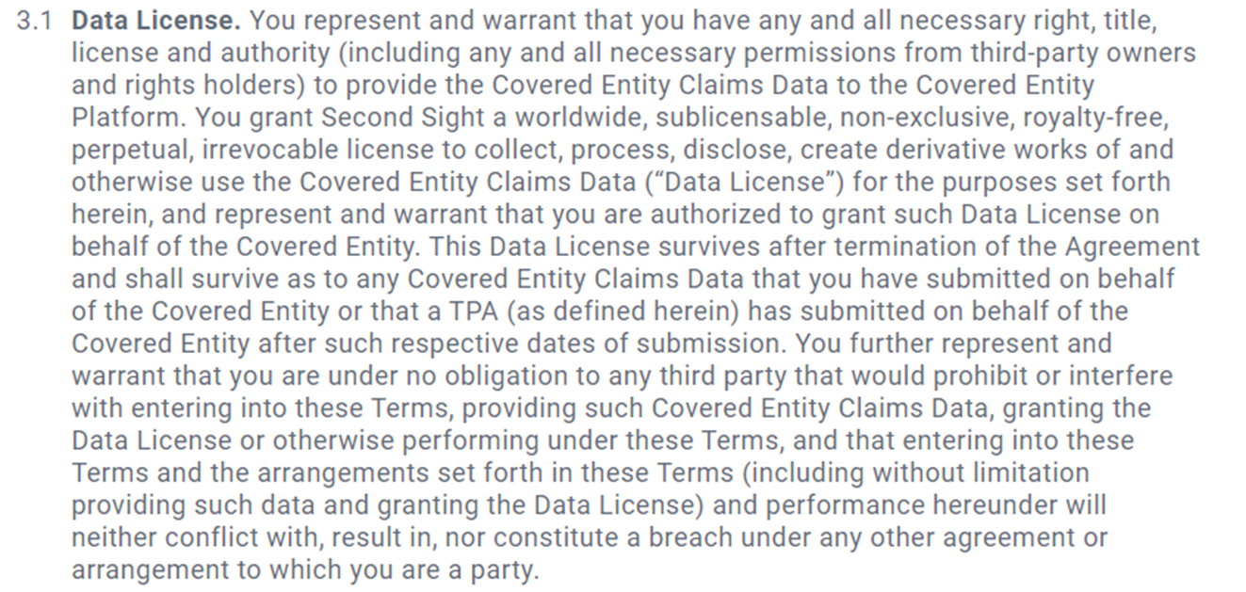
340B ESP – 3.1: Data License

Slide 50
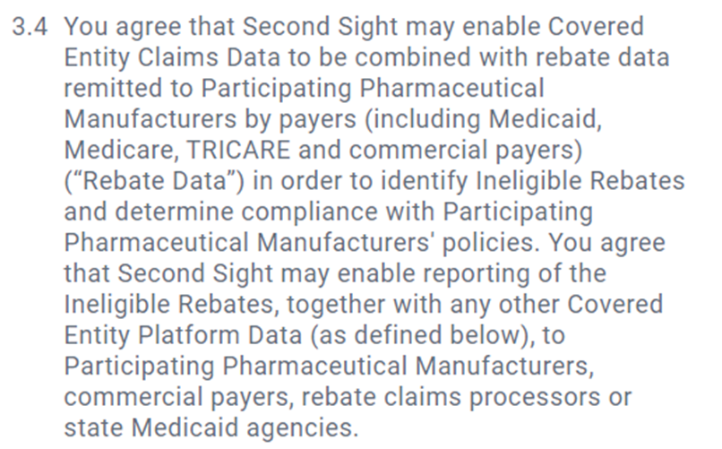
340B ESP – 3.4: Use of Data

Slide 51
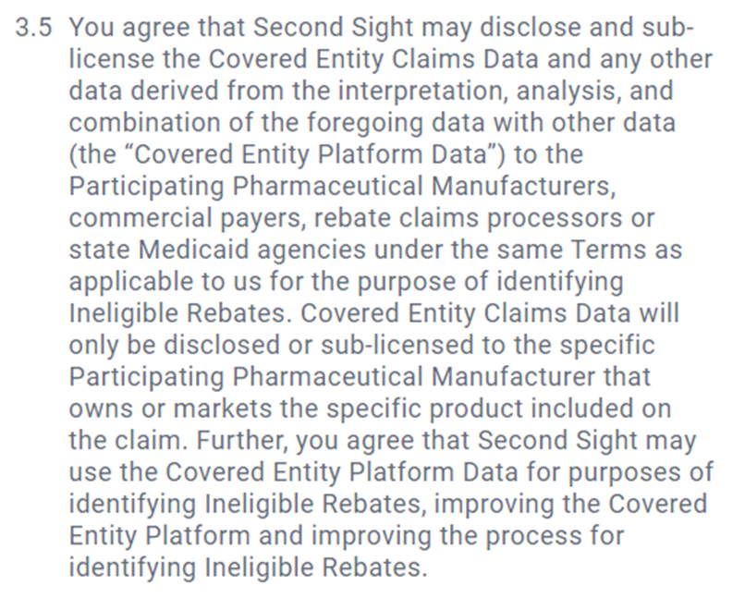
340B ESP – 3.5: Disclosure and Sublicensing

Slide 52
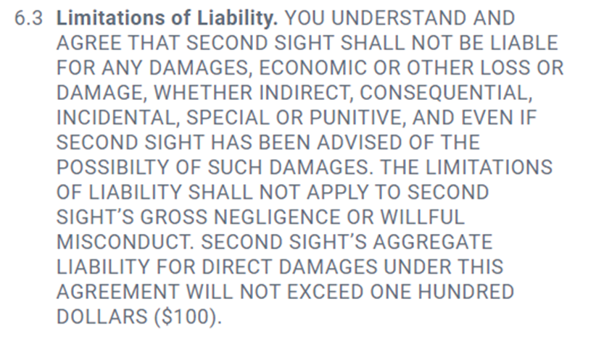
340B ESP – 6.3: Limitations of Liability

Slide 53
What Can Second Sight or a 3rd Party Discern From Your Data?
“Dr. Smith at Community Memorial Hospital prescribed 70 capsules of AbbVie’s drug Creon. The Patient filled the prescription at CVS Location # 1234 the same day.”
“Most CMH patients who get their drugs from a retail pharmacy go to CVS # 12345. Next is Location # 23456, then Location # 34567.”
“Most patients prescribed Creon pick up their prescriptions the same day.”
“CMH physicians prescribed more of Product X, made by AbbVie, than Product Y, made by Johnson & Johnson.”
“CMH purchased at least $___ from Cardinal based on NADAC value.”
“CVS #12345 filled prescription #8989 with 340B drug, which was paid by ESI.”

Slide 54
Other Limited Distribution/Data Submission Programs
Direct Data Submissions
REMS
Hub Transfers

Slide 55
Takeaways
Consider expanded 340B Patient Definition opportunities (MTM)
Assess and optimize pharmacy operations (Specialty Pharmacy, Intracompany Transfers, Distributor, Repackager, 503B)
Conduct a reimbursement/340B opportunity assessment
Track DSH%
Consider community benefit comms plan
Assess OPPS Reimbursement Impact and resubmit claims
Consider 340B ESP data sharing risks/benefits

Slide 56
QUESTIONS?
James Junger
jjunger@hallrender.com

