Slide 1


CONSUMER INNOVATIONS WITHIN THE PATIENT FINANCIAL EXPERIENCE
SPEAKERS: WESLEY GRYNA & JENNIFER TAYLOR

Slide 2



PATIENT SATISFACTION
OVERALL EXPERIENCE
Billing Process
Communication Engagement
Anielka
PFE
Technology
Building Loyalty
Cost Transparency

Slide 3








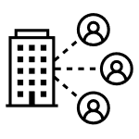







BRIDGING THE GAP
REDETERMINATION
Support
patients by providing a good overall experience
Collaborate
with providers on the front lines with patients
Engage
with patients using a variety of communication platforms
Meeting the patient where they are at
Analyze
patient data to identify those at risk
Focus
on state guidelines and stay connected to regulations

Slide 4


DEFINITIONS
CAMPAIGN TYPES
Proactive
Data driven to influence behavior in a positive way
Reactive
If this, then that
Defined
Data driven with a very defined purpose Automating patient follow-ups from work queues

Slide 5

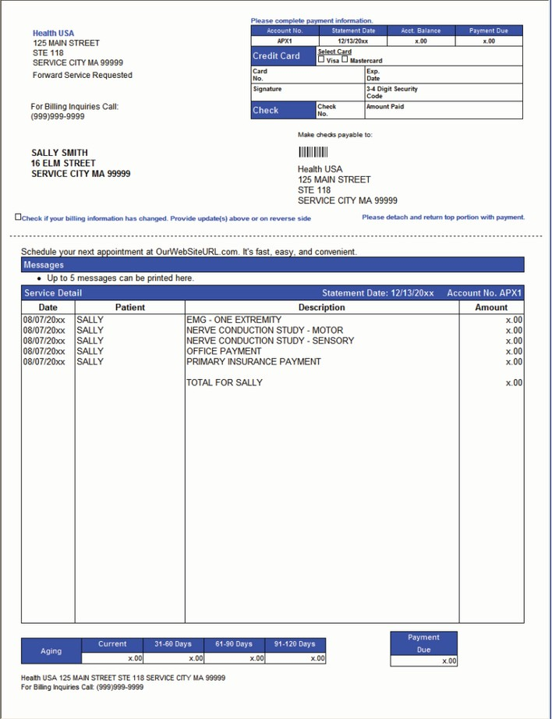



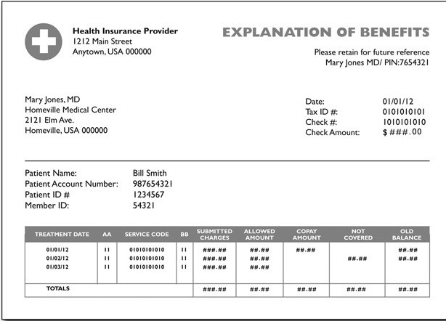

DRIVING CONFIDENCE
BILLING BARRIERS AND CONFUSION
Sources of Doubt
NPR Bill of the Month
Reddit - Personal Finance
Previous Billing Experiences

Slide 6




IDENTIFYING PATIENT NEEDS
CAMPAIGN STRATEGIES
Personalization
Attitudes & preferences with a cross- generational approach
Messages that align with needs
Derive action and inaction to build the most relevant message

Slide 7









CAMPAIGN STRATEGIES
ENGAGEMENT CHANNELS
Print & Mail
Digital Voice
SMS/Text
Voicemail Drop
Email

Slide 8



PATIENT PORTAL ADOPTION
CAMPAIGNS WITH PURPOSE
Portal User
Non-user

Slide 9




PAYMENT PLANS
CAMPAIGNS WITH PURPOSE
Patients continue to look for flexibility in terms for in-house payment plans
Establish basic criteria using your patient's payment history to begin immediately establishing plans

Slide 10
METRICS
CAMPAIGNS AND ENGAGEMENT
Reach Rate
Quantifying who you can communicate with and cannot communicate with by channel
Payment Velocity
Understanding how quickly patients pay from campaign activity
Bad Debt Behavior
3 in 10 patients are going to collections but have made a payment

Slide 11




CAMPAIGNS AND ENGAGEMENT
DIMENSIONS
New Patients
Established Patients
Emergent Visits
Non-emergent Visits
Engaged
Un-engaged

