Slide 1
Poverty vs a Living Wage: How Understanding Helps Us

Slide 2


Introduction
Jake Rouse
healthcare can and should
be better
Principal Consultant
Jacob.rouse@amitechsolutions.com
763-227-0651
Proud Husband, Father of 4, Coach, and Avid DIYer.
Values the drive me: health, improvement, family, community, and faith
Background: Health system leadership and consulting (executive, revenue cycle, finance, automation)
Chair / Board: Local United Way, Church Finance Committee, Community Garden organization, HFMA WI (officer rotation)
Data, analytics and automation strategies and solutions
to make healthcare more proactive, higher quality and less expensive for everyone
Here’s why it matters: Lower Cost, Enduring, Value-Driven Results, Unrivaled Speed & Efficiency

Slide 3

What is a Living Wage?
The minimum income necessary for a worker to meet their basic needs and expenses, without falling into poverty.
The living wage varies depending on the cost of living in a particular area.
Sources: UNC (image)
Notes:
https://ncimpact.sog.unc.edu/2022/07/working-for-a-living-wage/

Slide 4
Learning objectives
Understand difference between poverty and living wage
Understand the health impact of poverty
Understand the true financial needs and strains of those we serve
Review strategies to understand the needs of your population

Slide 5
Poverty

Slide 6
Poverty: What is?
Poverty is about not having enough money to meet basic needs including food, clothing and shelter. It is also about much more than not having enough money.
The World Bank Organization describes poverty in this way:
“Poverty is hunger. Poverty is lack of shelter. Poverty is being sick and not being able to see a doctor. Poverty is not having access to school and not knowing how to read. Poverty is not having a job, is fear for the future, living one day at a time.
Poverty has many faces, changing from place to place and across time, and has been described in many ways. Most often, poverty is a situation people want to escape. So poverty is a call to action -- for the poor and the wealthy alike -- a call to change the world so that many more may have enough to eat, adequate shelter, access to education and health, protection from violence, and a voice in what happens in their communities.”
Sources: World Bank Organization, GNB
Notes:
https://www2.gnb.ca/content/gnb/en/departments/esic/overview/content/what_is_poverty.html

Slide 7
How is Poverty Calculated?
Calculated by the U.S. Census Bureau using the official poverty measure
Calculation:
Poverty = Family income - Poverty threshold
Anything less than 0 is considered poverty
*$30,000 = poverty threshold for a family of four in 2023
Sources: HHS, United States Census Bureau, Healthcare.Gov
Notes:
https://www.census.gov/topics/income-poverty/poverty/guidance/poverty-measures.html
https://aspe.hhs.gov/topics/poverty-economic-mobility/poverty-guidelines/frequently-asked-questions-related-poverty-guidelines-poverty
https://www.healthcare.gov/glossary/federal-poverty-level-fpl/

Slide 8
How is Poverty Calculated?
Family Income
Based on a family's pretax cash income
Excludes
Non-cash benefits from housing subsidies
Supplemental Nutrition Assistance Program (SNAP)
Other forms of government relief
Family income scale is based on family size
Assuming Family of 4 keeping 100% of $30,000: $2,500 / month
Sources: HHS, United States Census Bureau
Notes:
https://www.census.gov/topics/income-poverty/poverty/guidance/poverty-measures.html
https://aspe.hhs.gov/topics/poverty-economic-mobility/poverty-guidelines/frequently-asked-questions-related-poverty-guidelines-poverty

Slide 9
How is Poverty Calculated?
Poverty Threshold
Calculation:
(3 times the cost of food) + (additional allowances for shelter, clothing, transportation, and other necessities)
The cost of food is determined by the U.S. Department of Agriculture, and the additional allowances are based on family size and composition.
Criticism: does not take into account the cost of housing or cost of childcare
Sources: HHS, United States Census Bureau
Notes:
https://www.fns.usda.gov/snap/thriftyfoodplan
https://www.census.gov/topics/income-poverty/poverty/guidance/poverty-measures.html

Slide 10
How is Poverty Calculated?
Poverty Threshold Breakdown Family of 4*
Measure | Annual Amount | Monthly Amount
Total | $30,000 | $2,500
Food (Thrifty Food Plan x3) | $11,556 | $963
Housing | $10,262 | $855
Clothing | $1,262 | $105
Transportation | $3,000 | $250
Other | $5,182 | $432
Other = savings, retirement, childcare, entertainment, kids activities, cell phone, etc.
*estimating certain category breakdown
Sources: HHS, United States Census Bureau, USDA
Notes:
https://www.fns.usda.gov/snap/thriftyfoodplan
https://www.census.gov/topics/income-poverty/poverty/guidance/poverty-measures.html

Slide 11

Social Detriments of Health
Healthy People 2030 (HHS lead initiative to be roadmap for improving the health of all Americans)
5 Areas
Economic Stability
Education Access and Quality
Health Care Access and Quality
Neighborhood and Built Environment
Social and Community Context

Slide 12
Causes of Poverty
Causes of poverty are complex
Personal Factors
Cultural and Social Factors
Political and Economic Factors
Poverty
Most poverty research finds poverty is cyclical
Frequent Cited Reasons for Poverty
Access to Resources
Unemployment
Education
Healthcare
Discrimination
Corruption
Infrastructure
Family structure
Health problems
Food
Political Unrest
Opportunity
Awareness
Inclusion
Affordable housing
Transportation
Poor Living Conditions
Lack Education
Lack Opportunity
Low Income
Sources: United Way, NCCP, Research Gate, Sisters of Charity, YMCA, APA
Notes:
https://unitedwaynca.org/blog/child-poverty-in-america/
https://www.nccp.org/publication/childhood-and-intergenerational-poverty/
https://www.researchgate.net/figure/Factors-influencing-information-poverty-In-this-model-information-poverty-is-shaped_fig2_334908139
https://sistersofcharitysc.com/poverty-study/
https://www.tandfonline.com/doi/full/10.1080/1331677X.2020.1780144
https://ywcaspokane.org/race-poverty-and-access-to-wellbeing-in-america/
https://www.huffpost.com/entry/better-understanding-pare_b_3000089

Slide 13
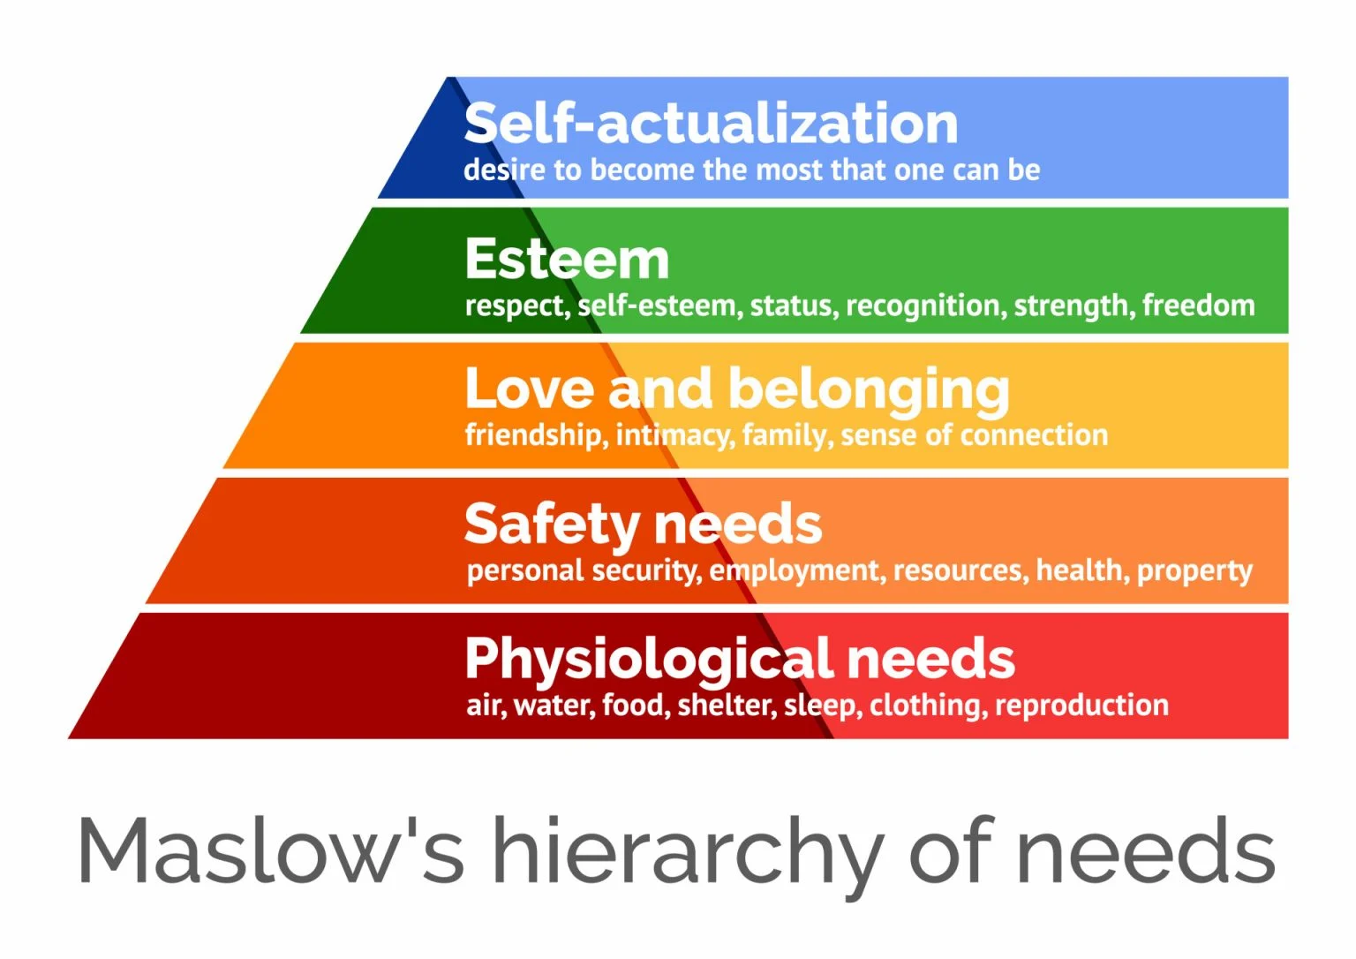
Results of Poverty
“Poverty is not only a lack of money, it's a lack of sense of meaning” - David Bornstein
Sources: ThoughtCo (image)
Notes:
https://www.thoughtco.com/maslows-hierarchy-of-needs-4582571

Slide 14
Results of Poverty
People in Poverty (Overall) Experience a Lower Quality of Life in the United States
Measure | In Poverty | Non-Poverty | Increased Rate in Poverty
Birth rates per 1000 Women | 72 | 56 | 29%
Chronic Diseases % of Population | 52% | 38% | 37%
Injuries % of Population | 20% | 15% | 33%
Mental Illness % of Population | 25% | 18% | 39%
Premature Death % of Population | 12% | 8% | 50%
Sources: The U.S. Census Bureau, The Centers for Disease Control and Prevention, The National Institutes of Health, The American Public Health Association
Notes:
https://health.gov/healthypeople/priority-areas/social-determinants-health/literature-summaries/poverty#:~:text=Across%20the%20lifespan%2C%20residents%20of,mortality%2C%20and%20lower%20life%20expectancy.&text=Children%20make%20up%20the%20largest%20age%20group%20of%20those%20experiencing%20poverty.
https://www.census.gov/newsroom/stories/poverty-awareness-month.html
https://www.kff.org/other/state-indicator/poverty-rate-by-raceethnicity/?currentTimeframe=0&sortModel=%7B%22colId%22:%22Location%22,%22sort%22:%22asc%22%7D
hronic diseases
U.S. Census Bureau, "Income, Poverty, and Health Insurance Coverage in the United States: 2021"
Centers for Disease Control and Prevention, "Chronic Disease Overview"
National Institutes of Health, "Chronic Disease"
American Public Health Association, "Chronic Disease Prevention and Control"
Mental illness
U.S. Census Bureau, "Income, Poverty, and Health Insurance Coverage in the United States: 2021"
Centers for Disease Control and Prevention, "Mental Illness"
National Institutes of Health, "Mental Illness"
American Public Health Association, "Mental Health"
Injuries
U.S. Census Bureau, "Income, Poverty, and Health Insurance Coverage in the United States: 2021"
Centers for Disease Control and Prevention, "Injury Prevention"
National Institutes of Health, "Injury Prevention"
American Public Health Association, "Injury Prevention"
Premature death
U.S. Census Bureau, "Income, Poverty, and Health Insurance Coverage in the United States: 2021"
Centers for Disease Control and Prevention, "Premature Death"
National Institutes of Health, "Premature Death"
American Public Health Association, "Premature Death"
Birth rates
U.S. Census Bureau, "Income, Poverty, and Health Insurance Coverage in the United States: 2021"
Centers for Disease Control and Prevention, "Birth Rates"
National Institutes of Health, "Birth Rates"
American Public Health Association, "Birth Rates"

Slide 15
Poverty and Children
Poverty and Children is especially Important
Adverse Childhood Experiences (ACEs) = CDC study that found certain events as child result in health problems, mental health problems, and risky behaviors as adults.
Summary of findings: 3 or more ACEs result in significantly higher rates of poor health and poverty (more recent findings)
ACEs study identified 10 types of ACEs
Physical abuse
Sexual abuse
Emotional abuse
Neglect
Household substance abuse
Household mental illness
Parental separation or divorce
Household imprisonment
Witnessing domestic violence
Living with a chronically ill or disabled parent
Sources: APA, North Carolina Medical Journal, National Institute of Health
Notes:
https://www.apa.org/pi/families/poverty#:~:text=Poverty%20is%20linked%20with%20negative,adversely%20impact%20our%20nation's%20children.
https://ncmedicaljournal.com/api/v1/articles/55046-poverty-as-an-adverse-childhood-experience.pdf
https://pubmed.ncbi.nlm.nih.gov/29563312/

Slide 16
Poverty and Abortion
49%
of abortions in the United States are obtained by women living below the poverty line (estimated 75% form “low income”)
This means half of abortions come from 13% of the population.
Children in poverty is a national crisis
This is not a PRO or ANTI abortion recommendation. This is the reality that we need to discuss and understand in women’s rights
Sources: Guttmacher Institute, National Center for Health Statistics, U.S. Census Bureau
Notes:
https://www.guttmacher.org/united-states/abortion/demographics
National Center for Health Statistics, "Births, Deaths, Marriages, and Divorces: Provisional Data for 2021"
U.S. Census Bureau, "Income, Poverty, and Health Insurance Coverage in the United States: 2021

Slide 17
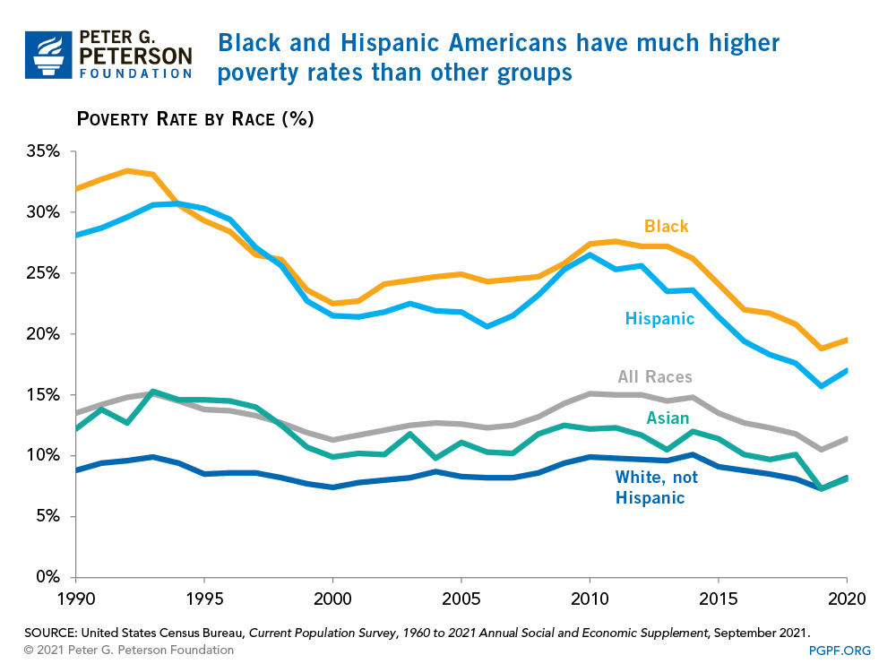
Poverty Statistics
Overall
12.8%
White
9.5%
21.7%
Black
Hispanic
17.6%
Asian
10.2%
American Indian
25.0%
Multiple Races
14.1%
Sources: KFF, PPF, GBN
Notes:
https://www.kff.org/other/state-indicator/poverty-rate-by-raceethnicity/?currentTimeframe=0&sortModel=%7B%22colId%22:%22Location%22,%22sort%22:%22asc%22%7D
https://www2.gnb.ca/content/gnb/en/departments/esic/overview/content/what_is_poverty.html

Slide 18
Living Wage

Slide 19
What is a Living Wage?
Recap
The minimum income necessary for a worker to meet their basic needs and expenses, without falling into poverty.
The living wage varies depending on the cost of living in a particular area.
Sources: UNC (image)
Notes:
https://ncimpact.sog.unc.edu/2022/07/working-for-a-living-wage/

Slide 20
Long Term Inflation Trends
Per capita increases since 1989 to 2019 (30 years)
318% = Income increase
460% = Healthcare consumption expense increase
814% = Prescription drugs consumption
474% = 4-year university expense increase (498% public, 428% private)
Sources: PNREAP, CMS, NCES
Notes:
Sources:
Income:
Pacific Northwest Regional Economic Analysis Project (PNREAP. (2020). United States: Per Capita Personal Income Trends over 1958-2020. United States Regional Economic Analysis Project. Retrieved December 15, 2021, from https://united-states.reaproject.org/analysis/comparative-trends-analysis/per_capita_personal_income/tools/0/0/
Healthcare
U.S. Centers for Medicare and Medicaid Services. (2020). NHE Summary, including share of GDP, CY 1960-2019. U.S. Centers for Medicare and Medicaid Services. Retrieved December 13, 2021, from https://www.cms.gov/Research-Statistics-Data-and-Systems/Statistics-Trends-and-Reports/NationalHealthExpendData/NationalHealthAccountsHistorical.
Education
National Center for Education Statistics (NCES). (2021). The NCES Fast Facts Tool provides quick answers to many education questions (National Center for Education Statistics). Tuition costs of colleges and universities. Retrieved December 15, 2021, from https://nces.ed.gov/fastfacts/display.asp?id=76

Slide 21

United Way: ALICE
AL
Asset Limited
IC
Income Constrained
E
Employed
Income above the Federal Poverty Level (FPL)
ALICE households earn too much to qualify as “poor” but are still unable to cover basic household expenses.
The project began in New Jersey in 2013
Individual research in United Ways in 41 states
Sources: United Way
Notes:
https://www.unitedforalice.org/wage-tool
https://www.unitedforalice.org/national-overview

Slide 22
United Way: ALICE Statistics
23%
29%
2018
2021
Percent U.S. households are ALICE households but NOT Poverty
ALICE households has increased in all 50 states and the District of Columbia.
ALICE households are more likely to be headed by women, people of color, and people with disabilities. They are also more likely to live in rural areas and to have lower levels of education
Sources: United Way, U.S. Census Bureau, the Bureau of Labor Statistics, and the American Community Survey
Notes:
https://www.unitedforalice.org/wage-tool
https://www.unitedforalice.org/national-overview

Slide 23
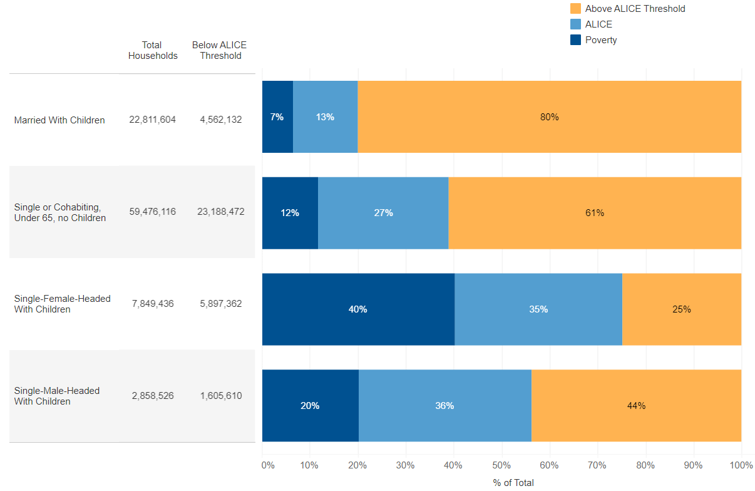
United Way: ALICE Statistics
Knowledge at your fingers: www.unitedforalice.org/national-overview
Takeaway: slide and dice ability to understand financial needs out our population
Sources: United Way, U.S. Census Bureau, the Bureau of Labor Statistics, and the American Community Survey
Notes:
https://www.unitedforalice.org/wage-tool
https://www.unitedforalice.org/national-overview

Slide 24
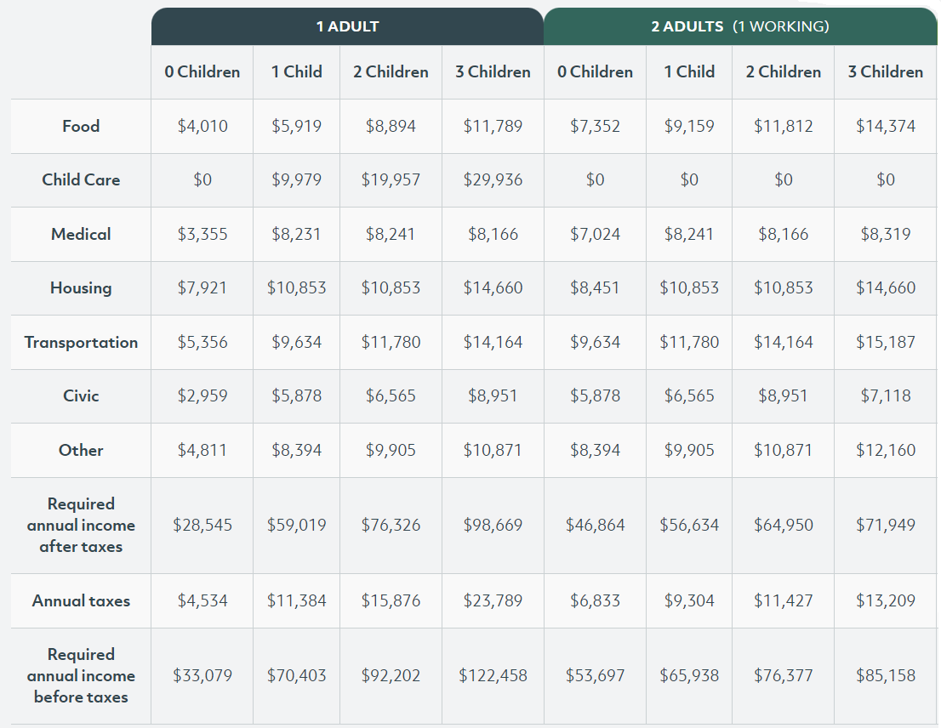
MIT Living Wage
Knowledge at your fingers: livingwage.mit.edu
Table to right is for Calumet County
Family of 4 Monthly Budget
$985 = Food
$904 = Housing
2 Kids = $1,663 / month child care
Sources: MIT
Notes:
https://livingwage.mit.edu/counties/55015

Slide 25
Recap and Grounding

Slide 26
Why Is This Topic Important?
Population Health
Know patient’s needs and influences
Offer support to address barriers to thriving
Why
Affects the overall health and well-being of a community
Physical, mental, financial, and social well-being of a population.
How
Impact economic productivity, quality of life, and social cohesion
Notes:
Sources
Gagnier, S. (2017, October 27). The past, present, and future of Population Health Research. intermountainhealthcare.org. Retrieved December 3, 2021, from https://intermountainhealthcare.org/blogs/topics/research/2016/05/past-present-and-future-of-population-health-research/.
Oregon Primary Care Association. (2021). Health Equity & Social Care. Oregon Primary Care Association. Retrieved December 3, 2021, from https://www.orpca.org/initiatives/social-determinants-of-health.

Slide 27
Recap of Needs
13%
29%
42%
Of Americans are in Poverty
Of Americans ALICE but not Poverty
Of Americans are Financially Struggling

Slide 28
Comparison
Measure | Poverty Monthly Amount | MIT Living Wage Monthly Amount | % Difference
Total | $ 2,500 | $ 6,365 | 255%
Food | $ 963 | $ 984 | 102%
Housing | $ 855 | $ 904 | 106%
Transportation | $ 250 | $ 1,180 | 472%
Other | $ 432 | $ 3,296 | 763%

Slide 29
How Can We Use this Knowledge to Address issues and Improve Population Health

Slide 30

How to Address
Create Macro and Micro Economic and Social Incentive Structure to:
Expand access to health care
Provide healthy food options
Promote physical activity
Reduce stress
Address environmental hazards
Increase access to education
Create jobs
Create affordable house
Notes:
https://health.gov/healthypeople/priority-areas/social-determinants-health/literature-summaries/poverty#:~:text=Across%20the%20lifespan%2C%20residents%20of,mortality%2C%20and%20lower%20life%20expectancy.&text=Children%20make%20up%20the%20largest%20age%20group%20of%20those%20experiencing%20poverty.

Slide 31
Factor to Consider While Approaching Work
CORE COMPETENCIES
Skills, knowledge, and abilities that an organization does best and that give it a competitive advantage
Why Important?
Allows your organization to focus on what they do best and partner with others to fill in the gaps.
Faster and more impactful results
YOUR ORGANIZAITON IS NOT AN EXPERT ON EVERYTHING

Slide 32
Success Story
Previous Employer
Utilized referenced research
Revamped Financial Assistance Policy
Updated patient statements
Increased online capabilities
30% decrease in non-collected patient balances

Slide 33
FOR YOU: Immediate Action Recomendations
Familiarize Yourself with United Way ALICE reporting
Bookmark
www.unitedforalice.org/national-overview
www.livingwage.mit.edu
Be able to speak to Poverty statistics and trends in your community

Slide 34
FOR YOU: Within 1 Month Recommendations
Contact local United Way to host workshop
Needs of community
Community research
Community organization assets (list or organizations focused on specific community needs)
Evaluate the demographic questions you are asking patients and have a clear and concise WHY you are asking / what you will do with the information
ROLE PLAY FOR TRAINING

Slide 35
FOR YOU: Roadmap Items Recommendations
Use Data
PDSA 1 segment of population with a community partner
Objectively Evaluate Living Wage of Staff
NOTE: ANSWER CANNOT BE INCREASE WAGES AND STAFFING
Advocate
Policy changes do not happen without people driving change
Volunteer
Go face to face with struggles in your community
Create a patient navigator program
How can you guide patients towards assets in your community

Slide 36
Final Takeaways
PARTNER
In community
With research
DON’T
Recreate wheel
Do nothing

Slide 37

Thank You
Jake Rouse
Principal Consultant
Jacob.rouse@amitechsolutions.com
763-227-0651
Healthcare data, analytics and automation strategies and solutions

