Slide 1
HFMA’s Regulatory Sound Bites
An Overview of the Final 2014 Inpatient Prospective Payment Rule

Slide 2
Dear Member,
This presentation provides a summary of recent regulatory acts and highlights the features that most affect acute care hospitals. It also offers a guide to HFMA resources you can use to navigate your organization through the complicated economic and regulatory environment.
Please feel free to use this presentation to educate your staff and other hospital stakeholders. If HFMA can be of additional assistance in any way, please do not hesitate to contact us.
Warmest Regards,
HFMA

Slide 3
Presentation Objectives
Review the 2014 Final Medicare Inpatient Prospective Payment Rule
Identify HFMA Resources for Addressing These Changes
1

Slide 4
Mixed Impact
The Final Rule Increases Payments to All Facilities, except rural and non-teaching hospitals
Reimbursement Impact of the 2014
Final IPPS Rule
Geographic Area
Teaching Status
Urban
All Hospitals
Non-Teaching
Other Urban Areas
> 100 Residents
Large Urban Areas
<= 100 Residents
Rural Areas
Source: http://www.gpo.gov/fdsys/pkg/FR-2013-08-19/pdf/2013-18956.pdf pgs. 51021-51022
2
Notes:
4

Slide 5
Operating Base Rates
CMS Is Adjusting the Market-Basket Update
IPPS Provisions
IPPS Provisions
The FY14 market basket rate of increase is 2.5%..
The FY14 IPPS payment rate update is:
0.7% for hospitals submitting quality data
-1.3 % for hospitals not submitting quality data
The market basket rate-of-increase of 2.5% will be reduced further by:
0.8% ACA adjustments
0.2% admission and medical review criteria adjustment (2-midnight rule)
0.8 ATRA recoupment adjustment
Resulting in an overall payment increase of 0.7 percent.
Update does not include the impact of the 2% reduction to Medicare payments from the sequestration.
IPPS rate increase required by statute, along with other payment changes, will increase hospital operating payments by an estimated $498 million in FY14, or 0.5 percent.
CMS will continue with the recoupment adjustments of -0.8 percent ATRA documentation and coding adjustment through FY17 to recoup the $11 billion required by the legislation.
Notes:
1. See Appendix 1 for final operating rates
3
Notes:
5

Slide 6
Capital Base Rates and Payments
Capital Payments Are Increased by an Estimated 1.6 Percent in FY14
IPPS Provisions
Implications for Hospitals
CMS established an FY14 update of 0.9% in determining the FY13 capital federal rate for all hospitals.
Combined effect of all the changes will increase the FY14 national capital federal rate by 1.90 percent compared to the FY13 national capital federal rate.
Capital rate established at $429.31 for FY14.
Estimated $134 million increase in FY14 capital payments (or 1.6 percent change)
Additional negative adjustments for documentation and coding should be anticipated.
Notes:
1. See Appendix 2 for FY14 standard federal capital rates
4

Slide 7
Outlier Payments
CMS calculated a final outlier fixed-loss cost threshold for FY14 equal to the prospective payment rate for the MS–DRG, plus any IME, empirically justified Medicare DSH payments, estimated uncompensated care payment, and any add-on payments for new technology, plus $21,748. The current amount is $21,821.
FY14 threshold is lower than the FY14 proposed outlier threshold of $24,140.
CMS believes that taking into consideration uncompensated care payments in the calculation of the outlier threshold contributed to a lower final fixed loss outlier threshold for FY14.
CMS projects that the thresholds for FY14 will result in outlier payments that will equal 5.1 percent of operating DRG payments and 6.07 percent of capital payments based on the federal rate.
5

Slide 8
Quality Data for Payment Update
For FY14, CMS suspended data collection for four measures (beginning with January 1, 2012, discharges), affecting the FY14 payment determination and subsequent years.
These measures include:
Acute Myocardial Infarction (AMI)
AMI-1 Aspirin at arrival
AMI-3 ACEI/ARB for left ventricular systolic dysfunction
AMI-5 Beta-blocker prescribed at discharge
Surgical Care Improvement Project (SCIP)
SCIP INF-6 Appropriate Hair Removal
CMS says the suspension of data collection for these four measures will be continued unless it has evidence that performance on the measures is in danger of declining
6

Slide 9
Quality Data for Payment Update
The rule finalizes a total of 59 measures for FY15 and subsequent years
IPPS Provisions
Implications for Hospitals
For FY15 CMS adopted all Hospital IQR Program measures adopted in previous payment determinations, with the exception of 17 measures.
Measures that CMS is removing include:
1 chart-abstracted measure
16 claims-based measures
For FY15, and subsequent years, the 59 measures that CMS is finalizing include:
New survey-based measure items for inclusion in the HCAHPS survey measure
3 claims-based measures
1 chart-abstracted measure
Total of 59 measures for the FY15 payment determination and subsequent years.
Providers should make sure they can collect and submit the additional quality measures.
Processes should be in place to improve performance for each measure.
See Appendix 3 for FY15 Hospital IQR quality measures
7
Notes:
9

Slide 10
Quality Data for Payment Update
Additional IQR Program Measures for FY15
IQR Program Measures for the FY16
HCAHPS survey measure: NQF-endorsed 3-Item Care Transition Measure (CTM-3) (NQF #0228)
Three claims-based measures:
Hip/Knee Complication: Hospital-level risk-standardized complication rate (RSCR) following elective primary total hip arthroplasty (THA) and total knee arthroplasty (TKA) (NQF#1550)
Hip/Knee Readmission: Hospital-Level 30-Day All-Cause Risk-Standardized Readmission Rate (RSRR) Following Elective Total Hip Arthroplasty (THA) and Total Knee Arthroplasty (TKA) (NQF #1551)
Hospital-Wide Readmission (tentative NQF #1789)
New Chart-Abstracted Measure:
Elective Delivery Prior to 39 Completed Weeks Gestation: Percentage of babies electively delivered prior to 39 completed weeks gestation (NQF #0469)
CMS adopted the Safe Surgery Checklist Use measure for FY16
Not NQF-endorsed
Structural measure assesses whether a hospital outpatient department utilizes a Safe Surgery checklist that assesses whether effective communication and safe practices are performed during three distinct perioperative periods:
prior to the administration of anesthesia
prior to skin incision
period of closure of incision and prior to the patient leaving operating room
CMS adopted all program measures adopted in previously, with the exception of seven that it removed and one that it suspended. CMS finalizes five new claims-based measures for a total of 57
measures for FY16.
8
Notes:
10

Slide 11
Quality Data for Payment Update
Adopted IQR Program Measures for FY16
Electronic Clinical Quality Reporting
CMS adopting all of the Hospital IQR Program Measures adopted in previous payment determinations, with the
exception of seven measures (six chart abstracted
measures and 1 structural measure) that it is removing
and one measure being suspended (one chart abstracted
measure).
Acute Myocardial Infarction
AMI-2 Aspirin prescribed at discharge
AMI-10 Statin prescribed at discharge
Pneumonia
PN-3b Blood culture performed in the
emergency department prior to first
antibiotic received in hospital
Heart Failure
HF-1 Discharge instructions
HF-3 ACEI or ARB for LVSD
Surgical Care Improvement Project
SCIP-Inf-10 Surgery patients with
perioperative temperature management
Immunization (suspended)
IMM-1 Immunization for pneumonia
Structural Measure
Participation in a systematic clinical
database registry for stroke care
CMS believes that collection and reporting of data through health information technology will greatly simplify and
streamline reporting for many CMS quality reporting programs.
As health information technology evolves and infrastructure
is expanded, CMS will have capacity to accept electronic
reporting of many of the chart abstracted measures that are
currently part of the Hospital IQR Program.
CMS will allow optional electronic submission of the STK, VTE, ED, and PC measure sets for the FY16 payment
Determination.
CMS intends to add 5 new measures to be collected via
EHRs in the future:
Severe Sepsis and Septic Shock Management Bundle NQF #0500
PC–02 Cesarean Section NQF #0471
PC–05 Exclusive Breast Milk Feeding NQF #0480
Healthy Term Newborn NQF #0716
Hearing Screening Prior to Hospital Discharge
NQF #1354
See Appendix 4 for FY16 Hospital IQR quality measures
9

Slide 12
Wage Index
IPPS Provisions
Implications for Hospitals
For FY14, the wage index will continue to be calculated and assigned to hospitals on the basis of the labor market area in which the hospital is located.
CMS defines hospital labor market areas based on the Core-Based Statistical Areas (CBSAs)
Providers should complete the occupational mix index survey.
In the FY11 IPPS/LTCH PPS proposed rule and final rule, beginning with the new 2010 occupational mix survey, CMS required hospitals that do not submit occupational mix data to provide an explanation for not complying.
CMS instructed fiscal intermediaries/MACs to continue gathering this information as part of the FY14 wage index desk review process. CMS will review these data for future analysis and consideration of potential penalties for noncompliant hospitals.
The FY14 wage index values are based on the data collected from the Medicare cost reports submitted by hospitals for cost reporting periods beginning in FY10 (the FY13 wage indices were based on data from cost reporting periods beginning during FY09).
The FY14 national average hourly wage (unadjusted for occupational mix) is $38.3998.
10
Notes:
12

Slide 13
Hospital Readmissions Reduction
IPPS Provisions
Implications for Hospitals
The Hospital Readmissions Reduction Program requires a reduction to a hospital’s base operating DRG payment amount to account for excess readmissions of selected applicable conditions:
Acute Myocardial Infarction (AMI)
Heart Failure (HF)
Pneumonia (PN)
Minimum number of discharges for each applicable conditions is 25.
Will result in a 0.2 percent decrease, approximately -$227 million, in payments to hospitals overall for FY14.
Data collected from July 1, 2009, to June 30, 2012, will be used to calculate the excess readmission ratio and readmission payment adjustment factors for FY14.
Maximum reduction to hospitals with excess readmissions will increase from 1% of base operating payments in FY13 to 2% in FY14.
Hospitals should work to understand the readmission drivers within their patient population and put programs in place to mitigate these issues.
11

Slide 14
Hospital Readmissions Reduction
CMS identified planned readmissions for procedures and treatments for exclusion
from the readmission Measures.
Developed an expanded “planned readmission algorithm” in the CMS Planned Readmission Algorithm Version 2.1 Report
Will apply the algorithm to the AMI, HF, and PN measures for FY14
For FY15, CMS has expanded applicable conditions to include:
Total Hip Arthroplasty (THA) and TKA (Total
Knee Arthroplasty)
Chronic obstructive pulmonary disease
(COPD)
HHS Secretary can exempt Maryland hospitals from the Hospital Readmissions Reduction Program.
In order for state to receive the waiver of participation, final report must be submitted
by June each year.
12

Slide 15
Value-Based Purchasing
Under Hospital Value-based Purchasing Program (VBP), value-based incentive payments are made in a fiscal year to hospitals that meet performance standards established for a performance period for such fiscal year.
ACA directs the Secretary to begin making value-based incentive payments under the Hospital Inpatient VBP Program for discharges occurring on or after October 1, 2012.
The applicable percentage for FY14 is 1.25%
The applicable percentage for FY15 is 1.5%
The applicable percentage for FY16 is 1.75%
The applicable percentage for FY17 and subsequent years is 2%
13

Slide 16
Value-Based Purchasing
FY14
CMS estimates that the total amount available for performance-based incentive
payments for FY14 will be approximately $1.1 billion.
All hospitals will have a 1.25% reduction in their payments and those qualifying for the incentives will share in the $1.1 billion pool.
FY14 Baseline and Performance Periods:
Measure Domain | Baseline Period | Performance Period
Clinical Process of Care | April 1, 2010 – December 31, 2010 | April 1, 2012 – December 31, 2012
Patient Experience of Care | April 1, 2010 – December 31, 2010 | April 1, 2012 – December 31, 2012
Outcome Mortality | July 1, 2009 – June 30, 2010 | July 1, 2011 – June 30, 2012
14

Slide 17
Value-Based Purchasing
For FY14, CMS has adopted 17 measures for the Hospital VBP Program, including:
12 clinical process of care measures from FY13 Hospital VBP Program
HCAHPS measure adopted for the FY13 Hospital VBP Program
1 new clinical process of care measure (SCIP-Inf-9: Postoperative Urinary Catheter Removal on Postoperative Day 1 or 2)
3 mortality outcome measures (Acute Myocardial Infarction (AMI) 30-Day Mortality Rate, Heart Failure (HF) 30-Day Mortality Rate, Pneumonia (PN) 30-Day Mortality Rate)
Although CMS previously adopted 8 HAC measures, 2 AHRQ composite measures, and a Medicare Spending Per Beneficiary Measure for the FY14 Hospital VBP Program, it has suspended the effective date of these measures, with the result that they will not be included.
MSPB measure and AHRQ composite measure delayed until FY15
See Appendix 5 for FY14 Hospital VBP Program Measures
15

Slide 18
Value-Based Purchasing
FY15
For the FY15 VBP Program, CMS adopted 12 Clinical Process of Care measures, one Patient Experience of Care measure in the form of the HCAHPS survey, 5 Outcome measures (including three 30-day mortality measures, the AHRQ PSI composite measure, and the CLABSI measure), and one Efficiency measure.
CMS removed the following measures for FY15:
SCIP-Inf-10
AMI-10
SCIP-VTE-1
Note: two of the three measures (SCIP-Inf-10 and AMI-10 ) that CMS says it removed from the Value-Based Purchasing Measure Set for FY15, are also not included in the measure set published for FY14 (Appendix 5).
See Appendix 6 for FY15 VBP Program Measures
16

Slide 19
Value-Based Purchasing
FY15 Baseline and Performance Periods:
Measure Domain | Baseline Period | Performance Period
Clinical Process of Care | January 1, 2011 – December 31, 2011 | January 1, 2013 – December 31, 2013
Patient Experience of Care | January 1, 2011 – December 31, 2011 | January 1, 2013 – December 31, 2013
Outcome Mortality AHRQ | October 1, 2010 – June 30, 2011 October 15, 2010 – June 30, 2011 | October 1, 2012 – June 30, 2013 October 15, 2012 – June 30, 2013
CLABSI | January 1, 2011–December 31, 2011 | February 1, 2013–December 31, 2013
Efficiency Medicare Spending Per Beneficiary -1 | May 1, 2011 – December 31, 2011 | May 1, 2013 – December 31, 2013
17

Slide 20
Value-Based Purchasing
FY16
CMS is adopting the following new measures for FY16
One new clinical process measure
IMM-2 influenza immunization
Two new healthcare-associated infection measures
Catheter-Associated Urinary Tract Infection (CAUTI)
Surgical Site Infection (SSI), which is stratified into two separate surgery sites
CMS will remove the following measures from the Hospital VBP Program for FY16:
AMI-8a: Primary PCI Received within 90 Minutes of Hospital Arrival
PN-3b, Blood Cultures Performed in the Emergency Department Prior to Initial Antibiotic Received in Hospital
HF-1, Discharge Instructions
SCIP-Inf-1
SCIP-Inf-4
CMS is considering the inclusion of additional measures in the efficiency domain for Hospital IQR Program and the Hospital VBP Program.
See Appendix 7 for FY16 VBP Program Measures
18

Slide 21
Value-Based Purchasing
FY16 Baseline and Performance Periods:
Measure Domain | Baseline Period | Performance Period
Clinical Process of Care | January 1, 2012 – December 31, 2012 | January 1, 2014 – December 31, 2014
Patient Experience of Care | January 1, 2012 – December 31, 2012 | January 1, 2014 – December 31, 2014
Efficiency | January 1, 2012 – December 31, 2012 | January 1, 2014 – December 31, 2014
Mortality | October 1, 2010–June 30, 2011 | October 1, 2012–June 30, 2014
AHRQ PSI | October 15, 2010–June 30, 2011 | October 15, 2012–June 30, 2014
FY16 Baseline and Performance Period for CLABSI, CAUTI, and SSI
The final FY16 baseline and performance periods for Central-Line Associated Blood Stream Infection (CLABSI), Surgical Site Infection (SSI), and Catheter-Associated Urinary Tract Infection (CAUTI) were inadvertently omitted from the FY14 IPPS final rule. The proposed periods appear in the FY14 OPPS proposed rule, published in the July 19, 2013, Federal Register. The final periods may appear in the FY14 OPPS final rule.
19

Slide 22
Value-Based Purchasing
Finalized Domain Weights
Finalized Domain Weights for the FY14 Hospital VBP Program for Hospitals Receiving a Score on All Proposed Domains
Domain | Weight
Clinical Process of Care | 45%
Patient Experience of Care | 30%
Outcome | 25%
Final Domain Weights for the FY15 Hospital VBP Program for Hospitals Receiving a Score on All Proposed Domains
Domain | Weight
Clinical Process of Care | 20%
Patient Experience of Care | 30%
Outcome | 30%
Efficiency | 20%
Finalized Domain Weights for the FY16 Hospital VBP Program for Hospitals Receiving a Score on All Proposal Domains
Domain | Weight
Clinical Process of Care | 10 Percent
Patient Experience of Care | 25 Percent
Outcome | 40 Percent
Efficiency | 25 Percent
20

Slide 23
Disproportionate Share
Beginning in FY14, DSHs will receive 25 percent of amount they previously would have received under the current statutory formula for Medicare DSH payments.
75 percent of what otherwise would have been paid as Medicare DSH payments, reduced for changes in the percentage of individuals under age 65 who are uninsured, will become available to make additional payments to each hospital that qualifies for Medicare DSH payments and that has uncompensated care.
Each Medicare DSH hospital will receive its additional amount based on its share of the total amount of uncompensated care for all Medicare DSH hospitals for given time period.
For FY14 and each subsequent fiscal year, HHS Secretary shall pay an additional amount equal to the product of three factors to subsection (d) hospitals.
Factor 1: Difference between CMS’s estimates of: the amount that would have been paid in Medicare DSH payments for FY14 and subsequent years, in the absence of new payment provision; and the amount of empirically justified Medicare DSH payments that are made for FY14 and subsequent years, which takes into account the requirement to reduce Medicare DSH payments by 75 percent.
21

Slide 24
Disproportionate Share
Hospitals that are not eligible to receive empirically justified Medicare DSH payments in FY14 and subsequent years will not receive uncompensated care payments for those respective years.
CMS will make a determination concerning eligibility for interim uncompensated care payments based on each hospital’s estimated DSH status for FY14 or applicable year.
Payments will be made on a per claim basis instead of pass-through basis.
Interim payments are made for each claim based on the best available data concerning each hospital’s eligibility for DSH payments and the appropriate level of such payments.
Final determination of eligibility for Medicare DSH payments and the final empirically justified payment adjustments for eligible hospitals settled on cost report.
Factor 2: For FY14 through FY17, 1 minus percent change in percent of individuals under the age of 65 who are uninsured, determined by comparing the percent of those individuals who are uninsured in 2013, the last year before coverage expansion under the ACA, minus 0.1 percent for FY14, and minus 0.2 percent for FY15 through FY17.
Factor 3: Represents a hospital’s uncompensated care amount for a given time period relative to the uncompensated care amount for that same time period for all hospitals that receive Medicare DSH payments in that fiscal year, expressed as a percent.
22

Slide 25
Disproportionate Share
CMS interim final rule published in the October 3, 2013, Federal Register:
Revised certain operational considerations for hospitals with Medicare cost reports spanning more than one fiscal year
Made changes to the data that will be used in the uncompensated care calculation to ensure that data from Indian Health Services are included in factors 1 and 3
Policy adopted in the FY14 IPPS/LTCH PPS final rule inconsistent with longstanding cost reporting
requirements.
For hospitals with cost reporting periods not concurrent with the federal fiscal year, the policy adopted in the final rule departs from cost reporting requirements by reconciling interim uncompensated care payments made for discharges occurring during the hospital’s 2013 cost reporting period on its 2014 cost report.
Finalized policy of reconciling uncompensated care payments for hospitals with cost reporting periods
that begin after October 1, 2013, would not work as intended for majority of IPPS hospitals with cost reporting periods not concurrent with the federal fiscal year.
23

Slide 26
Disproportionate Share
As a solution, CMS will:
Align final payments for the uncompensated care payment with each hospital’s cost reporting periods
Reconcile interim uncompensated care payment amounts on the hospital’s cost report for the proportion of the cost reporting period that overlaps a federal fiscal year and in which the interim payments were made or should have been made
Final uncompensated care payment amounts included on cost report spanning two federal fiscal years would be the pro rata share of the uncompensated care payment associated with each federal fiscal year.
Pro rata share is determined based on the proportion of the applicable federal fiscal year included in cost reporting period.
Hospitals with cost reporting periods spanning more than one federal fiscal year eligible for the respective pro rata shares of uncompensated care payment if eligible for DSH in that cost reporting period.
If ineligible for DSH in that cost reporting period, the hospital is ineligible to receive the respective pro rata share of uncompensated care payment from the respective federal fiscal year (or years).
Note: CMS has updated the DSH file, which can be found at: http://www.cms.gov/Medicare/Medicare-Fee-for-Service Payment/AcuteInpatientPPS/Downloads/FY2014-FR-DSH-Supplemental-File.zip
24

Slide 27
GME Payments
CMS revised the GME policy addressing inpatient labor and delivery days in the inpatient Medicare utilization calculation.
Because labor and delivery days are considered inpatient days for DSH purposes, they should be considered inpatient days for purposes of determining the Medicare share for direct GME payments.
CMS finalized proposal to include patient days associated with maternity patients who have been admitted as inpatients and are receiving ancillary labor and delivery services at time the inpatient routine census is taken, regardless of whether the patient:
Actually occupied a routine bed prior to occupying an ancillary labor and delivery bed
Occupies a ‘‘maternity suite’’ in which labor, delivery, recovery, and postpartum care all take place in the same room, in the Medicare utilization calculation for cost reporting periods beginning on or after October 1, 2013
CMS notes that final policy does not impact Medicare payments calculated on a reasonable cost basis for routine inpatient services.
25
Notes:
27

Slide 28
HAC Reduction Program
CMS has undertaken a number of initiatives to reduce the number of hospital-acquired conditions (HACs) among Medicare beneficiaries.
In the FY11 IPPS/LTCH PPS final rule, CMS adopted 8 HAC measures into the Hospital Inpatient Quality Reporting (IQR) Program for FY12 payment determination.
ACA establishes adjustment to hospital payments for HACs, or a HAC Reduction program, under which payments to applicable hospitals adjusted to provide incentive to reduce HACs, effective for discharges beginning on October 1, 2014, and subsequent program years.
In the first year of the program, FY15, CMS will use measures that are part of the IQR program.
Measures will be grouped into two separate domains (Domain 1 and Domain 2) to calculate a total HAC score in order to determine the payment adjustment.
CMS adopting the PSI-90 composite for Domain 1, and the CDC measures for Domain 2
PSI-90 both NQF-endorsed and fully supported by the Measures Application Partnership (MAP) for the HAC Reduction Program
Appropriately encourages robust hospital attention to patient safety events
26

Slide 29
HAC Reduction Program
Domain 1
PSI-90 One Composite of 8 component indicators
PSI-3 (Pressure ulcer rate)
PSI-6 (Iatrogenic pneumathorax rate)
PSI-7 (Central venous catheter-related blood stream infections rate)
PSI-8 (Postoperative hip fracture rate)
PSI-12 (Postoperative PE/DVT rate)
PSI-13 (Postoperative sepsis rate)
PSI-14 (Wound dehiscence rate)
PS-15 (accidental puncture & laceration rate)
Domain 2
CMS will use the following CDC NHSN measures:
For FY15 (onward)
Catheter-associated urinary tract infection (CAUTI)
Central line-associated blood stream infection (CLABSI)
For FY16 (onward)
Surgical Site Infection (SSI)
For FY17 (onward)
Methicillin-resistant staphylococcus aureus (MRSA) Bactermia
Clostridium difficile (C-difficile)
27

Slide 30
HAC Reduction Program
Scoring Methodology
CMS will use a scoring methodology similar to achievement scoring methodology currently used under the Hospital VBP Program.
Scoring will begin at minimum value for each measure rather than 75th percentile, as proposed.
The finalized methodology will assess top quartile of applicable hospitals for HACs based on Total HAC Score.
CMS will calculate a Total HAC Score for each hospital by using the hospital’s performance score on each measure within a domain to determine a score for each domain, then multiplying each domain score by the following weights:
Domain 1 - (AHRQ PSI-90) = 35 percent
Domain 2 - (CDC NHSN Measures) = 65 percent
Weighted domain scores will be combined to determine the Total HAC Score.
CMS will use hospital’s Total HAC Score to determine top quartile of subsection (d) hospitals (applicable hospitals) that will be subject to payment adjustment beginning with discharges on or after October 1, 2014.
Maryland Exemption
Secretary may exempt hospitals if the state submits an annual report to HHS Secretary describing how a similar program in the state achieves or surpasses the measured results in terms of patient health outcomes and cost savings.
CMS will establish criteria for evaluation of Maryland’s annual report to the HHS Secretary to determine whether Maryland will be exempted from the application of payment adjustments under this program.
28

Slide 31
HAC Reduction Program
HAC Measure Data Collection Period
Measures | Collection Period
AHRQ (Domain 1) | July 1, 2011, through June 30, 2013
CDC HAI Measures (Domain 2) | CYs 2012 and 2013
HAC Weights
Domain 1 Measures: 35%
Domain 2 Measures: 65%
29

Slide 32
2-Midnight Rule
CMS clarifies the rules governing physician orders of hospital inpatient admissions for payment under Medicare Part A.
CMS clarifies that an individual becomes an inpatient of a hospital, including a critical access hospital (CAH), when formally admitted as such pursuant to an order for inpatient admission by a physician or other qualified practitioner.
Order required for payment of hospital inpatient services under Medicare Part A
Regulation needed in response to concern about recent increases in the length of time that Medicare beneficiaries spend as hospital outpatients receiving observation services.
If a physician expects a beneficiary’s surgical procedure, diagnostic test, or other treatment to require a stay in the hospital lasting at least two midnights, and admits the beneficiary to the hospital based on that expectation, it is generally appropriate that the hospital receive Medicare Part A payment.
A formal order of inpatient admission is required to begin inpatient status, but physician permitted to consider all time a patient has already spent in the hospital as an outpatient receiving observation services, or receiving care in the emergency department, operating room, or other treatment area in guiding their two-midnight expectation.
30

Slide 33
2-Midnight Rule
CMS will continue applying the timely filing restriction to the billing of all Part B inpatient services, under which claims for Part B services must be filed within 1 year from the date of service.
Hospitals will be permitted to follow the Part B billing timeframes established in CMS Ruling-1455-R after the effective date of the final rule (October 1, 2013), provided that:
The Part A claim denial was one to which the ruling originally applied; or
The Part A inpatient claims has a date of admission before October 1, 2013, and is denied after September 30, 2013, on the grounds that although hospital outpatient services would have been reasonable and necessary, the inpatient admission was not.
31

Slide 34
Other Updates
Additional Policy Changes
The final rule finalizes new quality reporting measures for LTCHs, PPS-Exempt Cancer Hospitals, and Inpatient Psychiatric Facilities in 2015 and beyond.
The Medicare-Dependent, Small Rural Hospital (MDH) program will no longer be in effect in. Beginning in FY14, all hospitals that previously qualified for MDH status will no longer have MDH status and will be paid based solely on the Federal rate.
Revising Medicare’s policy for payment of Part B hospital inpatient services following the denial of a Part A hospital inpatient claim on the basis that the inpatient admission was not reasonable and necessary, but hospital outpatient services would have been reasonable and necessary in treating the beneficiary.
Final policy estimated to result in an approximately $4.6 billion decrease in Medicare program expenditures over 5 years
32

Slide 35
HFMA Resources
Links to HFMA Resources Addressing IPPS-Related Challenges
HFMA provides additional information on the following:
IIPS Final Rule:
HFMA’s Medicare’s Final Inpatient Payment Rule for FY14 September Webinar
Larry Goldberg provides commentary on the 2014 final Medicare rule.
Value-Based Purchasing:
Hospital Inpatient Value-Based Purchasing Program Fact Sheet
Discusses the value-based purchasing program, including scoring methodologies, thresholds, benchmark targets, and measures.
Hospital Value-Based Reimbursement Resource
Information on CMS’s quality improvement initiatives related to, value-based purchasing, readmissions, and hospital acquired conditions.
Hospital Readmissions:
Hospital Readmissions Reduction Program Overview
Provides a summary of the various aspects of the Hospital Readmissions Reduction Program.
Two-Midnight Rule:
CMS’s Two-Midnight Rule: How will it Impact Short Stay Cases?
Joe Becht, Hugh Aaron, and Joe McMenamin explains the two midnight rule and explains the implications for hospitals.
CMS’s Open Door Forum
Summary of CMS’s September 26, 2013, two-midnight rule open door forum call.
33

Slide 36
QUESTIONS
For questions regarding this presentation or the final IPPS Rule, please contact:
Chad Mulvany
Technical Director
HFMA
1825 K Street, NW
Suite 900
Washington, D.C. 20006
Office: 202.238-3453
Email: dmulvany@hfma.org
34
Notes:
36
The full text of the bill is available at http://www.rules.house.gov/

Slide 37
Appendices
Appendix I: Final IPPS Base Rates/Standard Operating Amounts
Appendix II: Standard Federal Capital Rates
Appendix III: FY15 Hospital IQR Quality Measures
Appendix IV: FY16 Hospital IQR Quality Measures
Appendix V: FY14 Hospital VBP Program Measures
Appendix VI: FY15 Hospital VBP Program Measures
35

Slide 38
Appendices
Appendix VII: FY16 Hospital VBP Program Measures
36

Slide 39
Appendix I: Final IPPS Base Rates/Standard Operating Amounts
National Adjusted Operating Standardized Amounts
(69.6 Percent Labor Share/30.4 Percent Non-labor if Wage Index Is Greater Than 1.0000)
National Adjusted Operating Standardized Amounts
(62 Percent Labor Share/38 Percent Non-labor Share if Wage Index Is Less Than or Equal To 1.0000)
Adjusted Operating Standardized Amounts for Puerto Rico, Labor/Nonlabor
 | Rates if Wage Index is Greater than 1 |  | Rates if Wage Index is Less than or Equal to 1
 | Labor | Nonlabor | Labor | Nonlabor
National | Not Applicable | Not Applicable | $3,329.57 | $2,040.71
Puerto Rico | $1,608.90 | $936.82 | $1,578.35 | $967.37
37

Slide 40
Appendix 2: Final IPPS Base Rate Standard Federal Capital Rate
38

Slide 41
Appendix 3: FY15 Hospital IQR Quality Measures
Topic | Hospital IQR Program Measures for FY15 Payment Determination and Subsequent Years
Acute Myocardial Infarction (AMI) Measures
 | AMI-2 Aspirin prescribed at discharge
 | AMI-7a Fibrinolytic (thrombolytic) agent received within 30 minutes of hospital arrival
 | AMI-8a Timing of Receipt of Primary Percutaneous Coronary Intervention (PCI)
 | AMI-10 Statin Prescribed at Discharge
Heart Failure (HF) Measures
 | HF-1 Discharge instructions
 | HF-2 Evaluation of left ventricular systolic function
 | HF-3 Angiotensin Converting Enzyme Inhibitor (ACE-I) or Angiotensin II Receptor Blocker (ARB) for left ventricular systolic dysfunction
Stroke (STK) Measure Set
 | STK-1VTE prophylaxis
 | STK-2 Antithrombotic therapy for ischemic stroke
 | STK-3 Anticoagulation therapy for Afib/flutter
 | STK-4 Thrombolytic therapy for acute ischemic stroke
 | STK-5 Antithrombotic therapy by the end of hospital day 2
 | STK-6 Discharged on Statin
 | STK-8 Stroke education
 | STK-10 Assessed for rehab
39

Slide 42
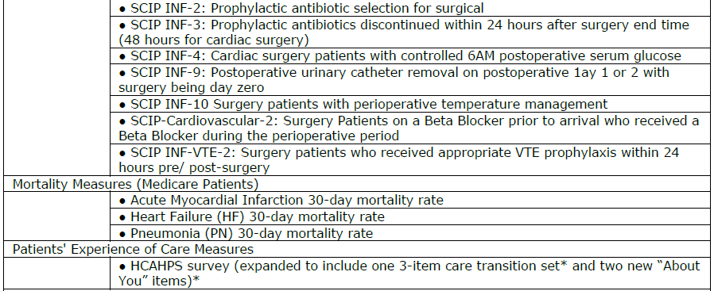
Appendix 3: FY15 Hospital IQR Quality Measures (Continued)
40

Slide 43
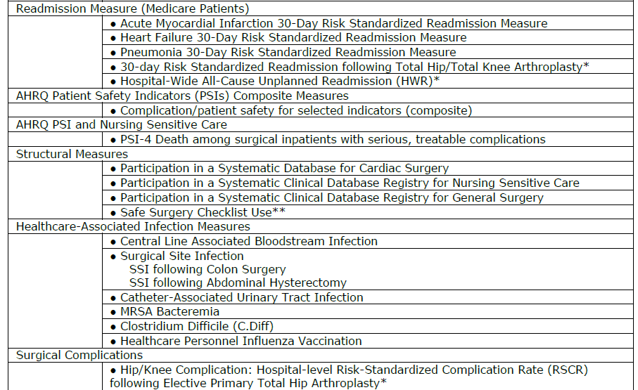
Appendix 3: FY15 Hospital IQR Quality Measures (Continued)
41

Slide 44
Appendix 3: FY15 Hospital IQR Quality Measures (Continued)
42

Slide 45
Appendix 4: FY16 Hospital IQR Quality Measures
43

Slide 46
Appendix 4: FY16 Hospital IQR Quality Measures (Continued)
44

Slide 47
Appendix 4: FY16 Hospital IQR Quality Measures (Continued)
45

Slide 48
Appendix 4: FY16 Hospital IQR Quality Measures (Continued)
46

Slide 49
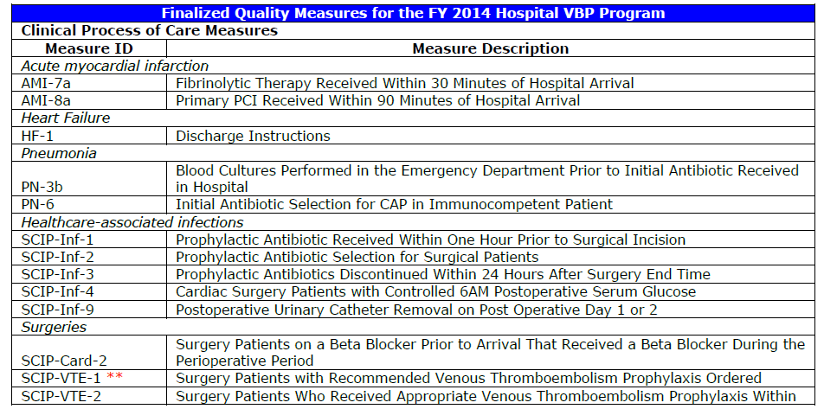
Appendix 5: FY14 VBP Measures
47

Slide 50
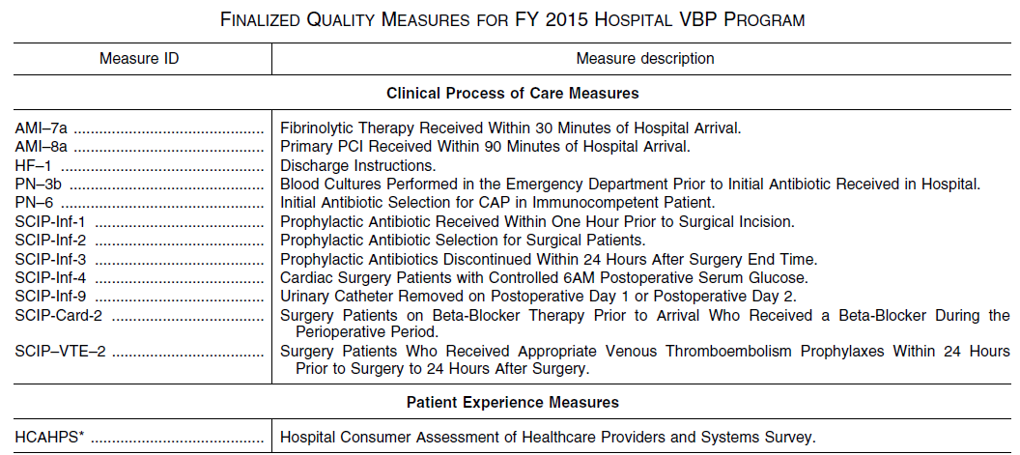
Appendix 6: FY15 VBP Measures
48

Slide 51
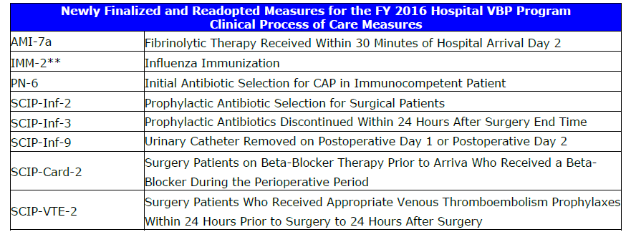
Appendix 7: FY16 VBP Measures
49

Slide 52
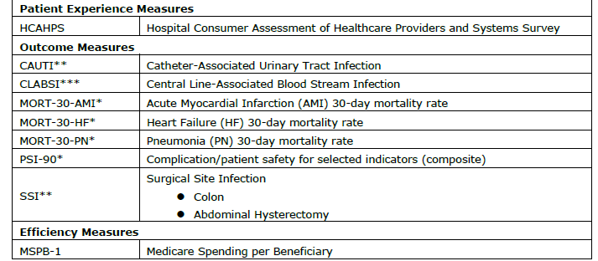
Appendix 7: FY16 VBP Measures (Continued)
50

Slide 53
Other Resources
FY14 IPPS Changes to Cost Reporting Related to Disproportionate Share Hospital Uncompensated Care Payments. October 3, 2013, Federal Register. http://www.gpo.gov/fdsys/pkg/FR-2013-10-03/pdf/2013-24209.pdf
FY14 IPPS Final Rule. August 19, 2013, Federal Register.
http://www.gpo.gov/fdsys/pkg/FR-2013-08-19/pdf/2013-18956.pdf
51

