Slide 1
Affordable Care Act - What Is It?

Slide 2
Introduction
Jake Rouse
healthcare can and should
be better
Principal Consultant
Jacob.rouse@amitechsolutions.com
763-227-0651
Proud Husband, Father of 4, Coach, and Avid DIYer.
Values the drive me: health, improvement, family, community, and faith
Background: Health system leadership and consulting (executive, revenue cycle, finance, automation)
Chair / Board: Local United Way, Church Finance Committee, Community Garden organization, HFMA WI (officer rotation)
Data, analytics and automation strategies and solutions
to make healthcare more proactive, higher quality and less expensive for everyone
Here’s why it matters: Lower Cost, Enduring, Value-Driven Results, Unrivaled Speed & Efficiency

Slide 3
Presentation Description
Learning objectives
Understand the most key elements of this enormous bill
What were some positives of the ACA
What were some negatives of the ACA
Whats does “get rid of Obama Care” really mean?

Slide 4
Healthcare is Complicated
“Nobody knew healthcare could be so complicated”

Slide 5
Affordable Healthcare Act Summary

Slide 6
Summary
Know as Obamacare
Patient Protection and Affordable Care Act, ACA
Associated: Health Care and Education Reconciliation Act of 2010, Comprehensive 1099 Taxpayer Protection and Repayment of Exchange Subsidy Overpayments Act of 2011, Tax Cuts and Jobs Act of 2017
Signed: March 2010 by President Barack Obama
13 years of legislation what has altered or added element
906 pages (original law)
13,000 pages of regulations that impact ACA
Notes:
KFF. (2018, December 17). Summary of the affordable care act. KFF. Retrieved September 10, 2022, from https://www.kff.org/health-reform/fact-sheet/summary-of-the-affordable-care-act/

Slide 7
Goals (As Stated by HHS)
Make affordable health insurance available to more people. The law provides consumers with subsidies (“premium tax credits”) that lower costs for households with incomes between 100% and 400% of the federal poverty level (FPL).
Expand the Medicaid Program
Support Innovative and Lower Cost
Health Insurance More Affordable for More People
Cover all adults with income below 138% of the FPL. Not all states have expanded their Medicaid programs.
Promote innovative medical care delivery methods designed to lower the costs of health care generally.
Notes:
U.S. Department of Health & Human Services. (2023). About the Affordable Care Act. Retrieved from https://www.hhs.gov/healthcare/about-the-aca/index.html

Slide 8
ACA: Key Elements
Individual Mandate
Health Insurance Exchanges
Medicaid Expansion
Pre-Existing Conditions
Essential Health Benefits
Online marketplaces where individuals and small businesses can shop and purchase health insurance.
Expanded Medicaid for low-income Americans.
Prohibited insurers from denying coverage or charging higher premiums to people with pre-existing conditions.
Requires all health plans to cover a set of essential health benefits (doctor visits, hospital stays, prescription).
Requires most Americans to have health insurance or pay a penalty.
Health Information Technology
Provisions designed to improve the use of HIT in healthcare

Slide 9
Individual Mandate

Slide 10
Individual Mandate: Summary
Goal: encourage people to get health insurance
Requiring (most) Americans to have health insurance or pay a penalty
Penalty eliminated in 2019 but mandate itself remains in effect
Tax Cuts and Jobs Act 2017

Slide 11
Individual Mandate: Positives and Negatives
Positives
Negatives
Spread the risk of healthcare costs across a larger pool of people.
Diffucult to know the impact on national coverage
Difficult to enforce
Perceptions of fairness and government overreach

Slide 12
Health Insurance Exchange

Slide 13
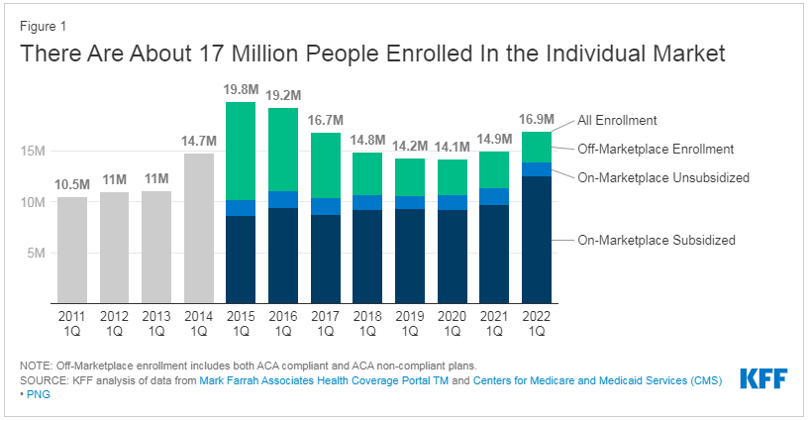
Health Insurance Exchange: Summary
Goal: offer a marketplace where individuals and small businesses can shop for and compare health insurance
Temporary insurers incentives to offer products on exchange
Risk corridor payments: cover losses in early years
Reinsurance payments: cover cost of higher risk individuals
Creation of nonprofit health insurance entity, the "Consumer Operated and Oriented Plan" (“CO-OP“)
American Rescue Plan Act (ARPA)
Increased subsidy funding
Notes:
https://www.kff.org/health-reform/issue-brief/explaining-health-care-reform-risk-adjustment-reinsurance-and-risk-corridors/
https://www.kff.org/policy-watch/as-aca-marketplace-enrollment-reaches-record-high-fewer-are-buying-individual-market-coverage-elsewhere/
https://www.kff.org/private-insurance/issue-brief/insurer-participation-on-the-aca-marketplaces-2014-2021/

Slide 14
Health Insurance Exchange: Positives and Negatives
Positives
Negatives
Insurance platform promoting
Competition
Comparison
Choice
Affordable option for more Americans
High Premiums: health insurance is expensive even in this model
Lower enrollment than expected (specifically CO-OPs)
4 of 23 CO-OPs remained by 2017
What happened: low prices put on marketplace to grow members, losses not sustainable, CO-OPs failed
Enrollees steady decrease until 2020 (COVID funding)

Slide 15
Medicaid Expansion

Slide 16
Medicaid Expansion: Summary
What is Medicaid?
ACA Impact
Health coverage
Focused on: Low-income adults, Children (32M+), Pregnant women, Elderly adults (8M+), People with disabilities (10M+).
Administered by states, governed federally
Funding Basics: $1 of state funding = $1 federal (minimum)
$1.00 to $1.90 average pre-ACA
3rd largest program in federal budget
Increased individual eligibility 138% Federal Poverty Level
Increased federal funding
Initial: fund 100% (dropping to 90%) of all new members
National Funding Ratio (State to Federal): $1.90 to $2.23 (2022)
Notes:
Snyder and Robin Rudowitz Published: May 20, 2015 L. (2016, December 21). Medicaid financing: How does it work and what are the implications? KFF. Retrieved September 10, 2022, from https://www.kff.org/medicaid/issue-brief/medicaid-financing-how-does-it-work-and-what-are-the-implications/
Center on Budget and Policy Priorities. (2022). Policy basics: Introduction to Medicaid. Center on Budget and Policy Priorities. Retrieved September 10, 2022, from https://www.cbpp.org/research/health/introduction-to-medicaid
https://www.kff.org/medicaid/state-indicator/federalstate-share-of-spending/?currentTimeframe=0&sortModel=%7B%22colId%22:%22Location%22,%22sort%22:%22asc%22%7D
https://www.kff.org/medicaid/issue-brief/status-of-state-medicaid-expansion-decisions-interactive-map/
https://www.ncbi.nlm.nih.gov/books/NBK500098/
https://www.kff.org/medicaid/issue-brief/trends-in-state-medicaid-programs-looking-back-and-looking-ahead/view/print/
https://www.kff.org/medicaid/state-indicator/federal-matching-rate-and-multiplier/?currentTimeframe=15&sortModel=%7B%22colId%22:%22Location%22,%22sort%22:%22asc%22%7D
https://www.macpac.gov/subtopic/medicaids-share-of-state-budgets/

Slide 17
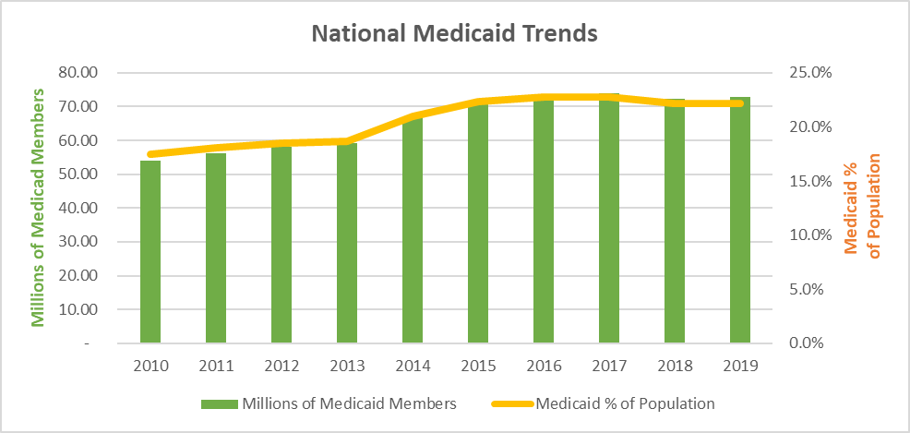
Medicaid Expansion: Positives and Negatives
Positives
Negatives
Increased Coverage Options for Americans
EVERY STATE has increased Medicaid coverage
Including 12 states that did not accept increased federal funding
Expantion funding: Uncertainty
Current Snapshot: 69% vs 65% (pre-ACA) of Medicaid is federally funded
Program financial sustainability
Health system reimbursement for care

Slide 18
Pre-Existing Conditions

Slide 19
Pre-Existing Conditions: Summary
Protection for Individuals
Prohibits health insurance companies from denying coverage or charging more for coverage based on pre-existing conditions.
Goal: decrease uninsured population

Slide 20
Individual Mandate: Positives and Negatives
Positives
Negatives
Affordability for people with pre-existing conditions
Access for people with pre-existing conditions.
Increased the cost of health insurance for some
Insurance profitability is an actuary equation that requires cost shifting
Reason insurers leaving the health exchnage market
Legal battles

Slide 21
Essential Health Benefits

Slide 22
Essential Health Benefits: Summary
Protection for Individuals
Requires health insurance plans (individual and small group markets) essential health benefits (EHBs).
Goal: ensure that all Americans have access to appropriate care when covered by health insurance
List of EHBs
Ambulatory patient services: This includes doctor's visits, outpatient surgery, and diagnostic tests.
Emergency services: This includes care you receive at an emergency room, even if you don't have health insurance.
Hospitalization: This includes inpatient care, such as stays in a hospital bed.
Maternity and newborn care: This includes care for pregnant women and their newborns.
Mental health and substance abuse services: This includes counseling and therapy for mental health conditions and addiction.
Prescription drugs: This includes coverage for prescription medications.
Rehabilitative and habilitative services and devices: This includes care for people who have disabilities, such as physical therapy and wheelchairs.
Laboratory services: This includes blood tests, urinalysis, and other tests that are used to diagnose and treat medical conditions.
Preventive and wellness services: This includes services that help you stay healthy, such as annual physicals and vaccinations.
Pediatric services, including oral and vision care: This includes care for children, such as well-child visits and dental care.

Slide 23
Essential Health Benefits: Positives and Negatives
Positives
Negatives
Standardization and affordability for basic services
Increased the cost of health insurance for some
Insurance profitability is an actuary equation that requires cost shifting

Slide 24
Health Information Technology (HIT)

Slide 25
HIT: Summary
Funding for the development, adoption, and regulating of HIT
Meaningful use
Funds to assist EHR adoption.
$34.7B federal funds
Health Information Technology for Economic and Clinical Health (HITECH) Act
Interoperable EHR systems and for the protection of patient privacy and security.
Created the Office of the National Coordinator for Health Information Technology (ONC),
Outcomes
Requires health plans to provide patients with electronic copies of their health records
Requires health information exchanges (HIEs) to be established in all states
Sources: HealthIT.gov, CMS

Slide 26
HIT: Positives and Negatives
Positives
Negatives
Healthcare needs data and technology standardization and governance
As of 2021, 90%+ of physician practices and hospitals using certified electronic health records
We have lot of data
Healthcare is NOT less expensive or producing better outcomes
Notes:
https://www.healthit.gov/data/quickstats#:~:text=As%20of%202021%2C%20nearly%209,a%20consistent%20trend%20since%202015.

Slide 27
Less Discussed Elements

Slide 28
ACA: Less Discussed Elements
Food Transparancy
Restaurants are now required to post calorie counts on their menus
Grocery stores are now required to post nutrition information on the front of food packages
Food manufacturers are now required to list all ingredients on food labels
Food companies are now prohibited from using certain misleading terms on food labels, such as "natural" or "healthy.“
Mental Health Parity
Requires health insurance plans to cover mental health services at the same level as they cover physical health services.
Women’s Health
Requires health insurance plans to cover contraception and maternity care.

Slide 29
Final Takeaways

Slide 30
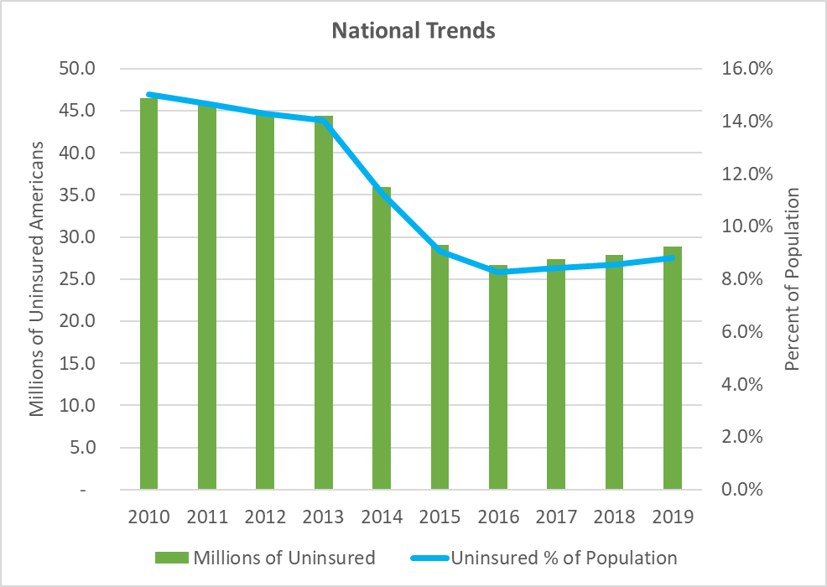
More Americans Have Coverage
Result 1 of 2

Slide 31
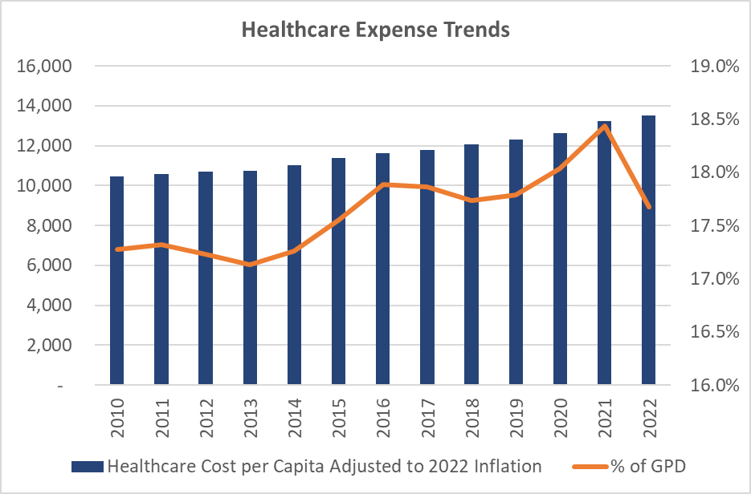
Result 2 of 2
$4.5 Trillion
Estimated 2022 United States projected healthcare spend
$13,500
Estimated 2022 United States projected healthcare spend / person
29%
Increase in Per Capita Healthcare Spend (Adjusted for Inflation) from 2010 to 2022
Notes:
Graph:
Research Excel Document “Healthcare Affordability” authored by Jacob Rouse
Sources:
U.S. Centers for Medicare and Medicaid Services. (2020). NHE Summary, including share of GDP, CY 1960-2019. U.S. Centers for Medicare and Medicaid Services. Retrieved December 13, 2021, from https://www.cms.gov/Research-Statistics-Data-and-Systems/Statistics-Trends-and-Reports/NationalHealthExpendData/NationalHealthAccountsHistorical.
U.S. Centers for Medicare and Medicaid Services. (2020). NATIONAL HEALTH EXPENDITURES BY TYPE OF SERVICE AND SOURCE OF FUNDS: CALENDAR YEARS 1960 to 2019. Retrieved December 13, 2021, from https://www.cms.gov/Research-Statistics-Data-and-Systems/Statistics-Trends-and-Reports/NationalHealthExpendData/NationalHealthAccountsHistorical.
U.S. Centers for Medicare and Medicaid Services. (2020). National Health Expenditure Data: Historical. U.S. Centers for Medicare and Medicaid Services. Retrieved December 13, 2021, from https://www.cms.gov/Research-Statistics-Data-and-Systems/Statistics-Trends-and-Reports/NationalHealthExpendData/NationalHealthAccountsHistorical. Table 2 National Health Expenditure Amounts and Annual Percent Change by Type of Expenditure: Calendar Years 2012-2028
U.S. Centers for Medicare and Medicaid Services. (2020). National Health Expenditure Data: Historical. U.S. Centers for Medicare and Medicaid Services. Retrieved December 13, 2021, from https://www.cms.gov/Research-Statistics-Data-and-Systems/Statistics-Trends-and-Reports/NationalHealthExpendData/NationalHealthAccountsHistorical. Table 1: National Health Expenditures and Selected Economic Indicators, Levels and Annual Percent Change: Calendar Years 2012-2028
United States Congressional Budget Office. (2021). Budget and Economic Data. Congressional Budget Office. Retrieved December 13, 2021, from https://www.cbo.gov/data/budget-economic-data#4.
Other Sources:
Bureau of Economic Analysis. (2021). Health care. Health Care | U.S. Bureau of Economic Analysis (BEA). Retrieved December 3, 2021, from https://www.bea.gov/data/special-topics/health-care.
Published by Jenny Yang, & 8, S. (2021, September 8). U.S. health spending as share of GDP 1960-2020. Statista. Retrieved December 3, 2021, from https://www.statista.com/statistics/184968/us-health-expenditure-as-percent-of-gdp-since-1960/.
Centers for Medicare & Medicaid Services. (2020). National Health Expenditure Data (Historical). Centers for Medicare & Medicaid Services. Retrieved December 3, 2021, from https://www.cms.gov/Research-Statistics-Data-and-Systems/Statistics-Trends-and-Reports/NationalHealthExpendData/NationalHealthAccountsHistorical#:~:text=U.S.%20health%20care%20spending%20grew,spending%20accounted%20for%2017.7%20percent.

Slide 32
Final Question
Whats does “get rid of Obama Care” really mean?
13,000 pages of legislation to remove, update, replace
Individual Mandate
Health Insurance Exchanges
Medicaid Expansion
Pre-Existing Conditions
Essential Health Benefits
Health Information Technology

Slide 33
Thank you!
Jake Rouse
Principal Consultant
Jacob.rouse@amitechsolutions.com
763-227-0651
Healthcare data, analytics and automation strategies and solutions

