Slide 1
Home Recovery Care/ Hospital at Home
Swetha Gudibanda MD, Medical Director HRC, Hospitalist
Adam Gingery, Director of Finance/Chief Financial Officer
Mary Newman, Core Line Administrator Hospital Medicine
Marshfield Clinic Health System

Slide 2
Modernized Approach to Care Delivery Drives Better Outcomes & Well-Being
HRC Performance Results
SAFE
QUALITY METRICS
SEAMLESS
90%+
PATIENT SATISFACTION
44%
REDUCTION IN READMISSIONS
35%
REDUCTION IN MEAN LOS
Administered with existing ancillary providers
Coordinates with clinical initiatives
No incremental administrative burden
Well-defined clinical model
Evidence based protocols
Coordinated care delivery
OPERATIONAL METRICS
~2 hrs
AVG TIME TO ADMIT A PATIENT
93%
ACCEPTANCE RATE
100%
HEALTH ASSESSMENTS COMPLETED
Contessa & Marshfield Clinic’s Home Recovery Care program was recently featured in a New England Journal of Medicine article detailing the success and outcomes of the first 300+ patients seen in Marshfield, Wisconsin.

Slide 3
Home Recovery Program- Care Model
The program launched in 2016 at the Marshfield Medical Center in Marshfield and has since expanded to our Medical Centers in Minocqua and Weston
The foundation of our model is a multi-disciplinary care team including:
Hospitalist MD’s and APC’s
Recovery Care Coordinators
Virtual Care Unit Coordinators
Acute home care RNs
Pharmacists
Social workers/Case Managers
Rehab therapists: Speech, Physical and Occupational
Care coordination is also empowered through the use of a telehealth platform, allowing providers to virtually round on patients and track vital signs from Bluetooth devices

Slide 4
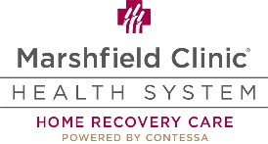
Home Recovery Care Addresses Approximately 40% of Hospitalizations
Home Recovery Care clinical model delivers all the essential elements of inpatient care in the safety and comfort of a patient’s home
CLINICAL MODEL
Hospital
Completing Hospital at Home Model
Completion of hospitalization in the home utilizing hospital replacement services
Physician Clinic
Patient
Hospital ED
Patient evaluated by Provider and Contessa RCC (meets inpatient / enrollment criteria)
Observation & Acute Model
Hospital Replacement Services (Up to 30-day episode / ~150 DRGs)
Urgent Care
Multiple Admitting Sites / Portals of Entry into HRC
Hospital
Post-Acute Model
SNF Replacement Services (60-day episode / ~720 DRGs)

Slide 5
Extensive Focus on Clinical Protocol Development
Marshfield & Contessa’s evidence-based protocols can address ~40% of hospital discharges
ACUTE Medical
Post-Acute
Top DRGs treated in HRC
COPD
CHF
Pneumonia
UTI
Cellulitis
DVT / PE
Asthma
Dehydration
General Medicine Protocol for any patient that could be safely treated at home
All conditions where patients are able to be treated safely at home
Limited exclusionary criteria
Pneumonia | 16%
Cellulitis | 14%
CHF | 13%
COPD | 10%
UTI | 10%
DVT/PE | 5%
Asthma | 5%
Gastro | 4%
Renal Failure | 2%
Other | 21%
Includes 44 episodes & 151 DRGs

Slide 6
Clinical Eligibility Guidelines & Admission Health & Home Assessment
Clinical Eligibility Guidelines
Admission Health & Home Assessment Key Topics
HRC will determine eligibility to make the referral process easier for inpatient teams
The following conditions will not be eligible:
Pregnancy​
Need for IV narcotics ​
Nursing home residents​
Patients residing outside of 30-mile radius or 30 mins from tertiary facility
Certain insurance plans – detailed list to be provided
Unsafe home environment or inadequate support
Home Arrangements and Patient Safety
Cellular connectivity
Home safety (firearms, drug use, smoking & oxygen use)
Proper utilities to support home care (telephone, electricity, running water, access to refrigeration)
Special Home Considerations
Existing home health/caregiver services & support
Activities of daily living
Use of DME
Prior Hospitalizations, ED Visits, and Comorbidities
Code Status
Advanced directives
Height, weight, allergies
Falls Assessment
*PROMIS: Functional Status Assessment
Quality of life
Mental health
Physical health
Caregiver Psychosocial Assessment
Note: List of topics presented above is not exhaustive and is provided for discussion purposes only. *For Completing Hospitalization at Home (cHaH) model, No PROMIS, but BIMS will apply

Slide 7
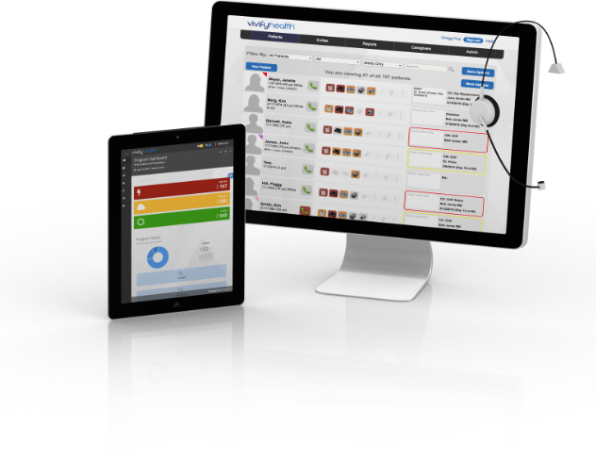
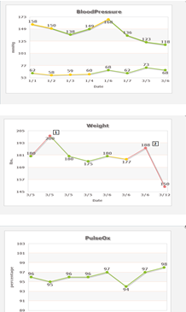
Telehealth System Allows Patient and Care Team to Easily Connect
Patients are equipped with a telehealth system allowing them to connect seamlessly with their provider, Registered Nurse and Recovery Care Coordinator
Telehealth Platform
Virtual Assessments
High resolution audio/visual capabilities
Biometric data monitoring (data is pushed into native EMR)
Blood pressure
Pulse
Pulse oximetry
Glucose
Weight
Virtual stethoscope
Contessa specific assessments
Patient health summary
Virtual rounding with Admitting Provider
Acute Care RN in home during rounding
RCC coordinates scheduling for patients / providers
24/7 on-call coverage:
Admitting Provider
Acute Care RN
RCC
All providers document in native EMR systems
Telehealth platform data pushed to other provider EMRs (as system capability allows)

Slide 8
Major benefits of Hospital-at-Home /home recovery care programs are improved outcomes for patients while also reducing costs
Home Recovery Care allows patients to receive hospital level care in their home at prospective bundled rate, which comes at a cost savings to the health plan
Program saves 15 -30% per each episode to the health plan and our health system.
Reducing:
Readmission rates
Length of stay
Hospital acquired infections
Fall risks
Adds more capacity to our health system
.

Slide 9
Benefits for patients
Patient receives all the necessary:
Medical visits; Provider virtual visits and acute RN visits
Lab testing
Social services
Physical/occupational/speech therapy
Medications
Medical transportation
Medical equipment
Medications courier services
Rates:
Prospective bundled rate
Reduced copay for their full 30 day episode in acute model and 60 days in SNF level model

Slide 10
Patient Testimonial
We admitted an immunocompromised patient with COVID pneumonia
Patient was initially admitted to hospital with COVID pneumonia requiring 6-10L O2. Patient wanted to go home to his family, saturations improved slightly so he transferred home to complete his hospitalization
Within 3 days of being home, he had O2 sats of 98% on 2L
Patient comments: “I thought I would die in the hospital without seeing my family; you made me come home and helped me get better. Home recovery care also took care of my wife and my daughter. Thank you all. This program is the best. I would recommend this to everyone.”

Slide 11
Pandemic response
COVID-19 pandemic accelerated the need and demand for hospital care at home
CMS approved Marshfield Clinic’s Home Recovery Care program as a Public Health Emergency Waiver for Medicare Fee-For-Service patients in December 2020
This expansion has proven to be a vital resource in the wake of the COVID-19 pandemic. CMS offered a much need expansion and Marshfield Clinic was able to serve more patients at home while reserving inpatient beds for the more acute patients.
During this time, we introduced a new model called Completing Hospitalization at Home
We can now transfer stable patients from hospital to home helping our system to add more capacity with out adding any over head costs
SNF level patients can also be served with this program

Slide 12
Future of Hospital at Home Program
After widespread and rapid adoption of virtual care during the PHE, CMS fee-for-service waivers have undoubtedly helped boost awareness and adoption of hospital-at-home services throughout the pandemic. We are hoping to see more health plans offering this value based, low cost care to their members.
Security Health Plan is one of the first health plans in the nation to offer this program to their members. At the American Tele-Association meeting, MCHS participated in a panelist discussion. We are proud to see where MCHS is standing with our integrated technology and Hospital at Home program.

Slide 13
Questions
Thank you for your attention- and
we welcome your questions

