Slide 1
Wisconsin’s Political & Public Policy Environment for Healthcare
HFMA Spring Conference & Annual Meeting
May 19, 2023
Kyle O’Brien
Senior Vice President Government Relations

Slide 2
Biggest Issues We Work on For Our Members
Reimbursement & Coverage
Over 60% of hospital care is delivered to patients on a government program, Medicare or Medicaid.
1 in every 2 births in Wisconsin are covered by Medicaid.
Workforce
Hospital and health system workforce is impacted by all facets of government, from education/training, licensure and reimbursement policies.
According to our most recent workforce report, Wisconsin hospitals have a vacancy rate that has doubled between 2020 to 2021 – the most recent statewide data available.
Regulatory Policy
Hospitals are heavily regulated at both the federal and state level. WHA has worked hard to reduce regulatory burden (and cost) on our members.

Slide 3
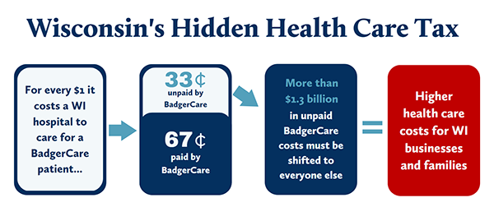
Medicaid Reimbursement Remains a Challenge
WHA has successfully lobbied the legislature to include over $800 million during the last decade to improve hospital reimbursement in Wisconsin.

Slide 4
But our challenges are mounting…
Increased pressure by the employer/payer community to reduce health care costs, while expecting hospitals to maintain their commitment to community benefits and access to care.
Between 2019 and 2021, the costs for both labor and supplies increased by $2.2 billion on an annual basis. Double-digit increases in the two largest expense categories for hospitals.
Local governments continue to pull back from commitments to services like behavioral health, substance abuse and public health.
Aggressive insurance company practices that are creating friction between provider, patient and payer.

Slide 5
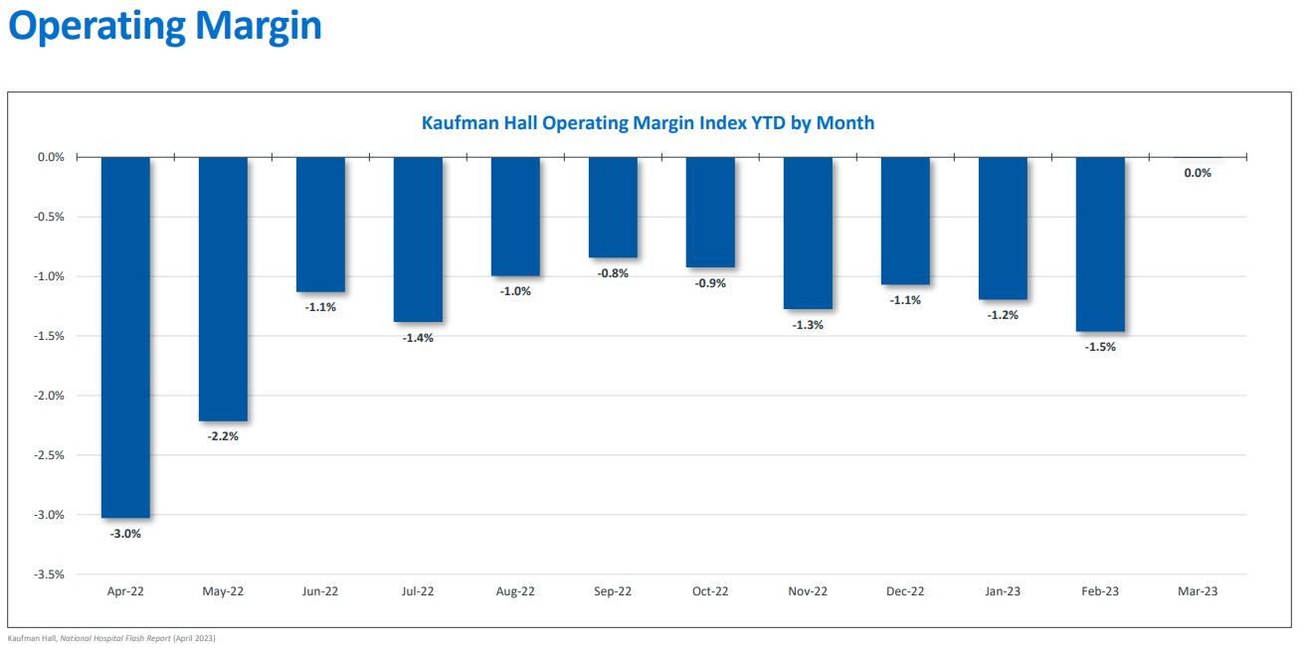
Hospital Operating Margins Nationally Remain Underwater

Slide 6
Post-Acute Care Challenges Back-Up Hospitals
Patient presents in hospital ED
Patient admitted into hospital
Patient discharged to home or post-acute care setting
Hospital typically paid one “bundled” rate for inpatient stay.
Longer patients wait to be discharged the more staff time is consumed
Reform the nursing home bed cap to promote innovation.
Create a delayed discharged supplemental payment to hospitals.
Reform laws that delay discharge, including the creation of a next-of-kin process for incapacitated patients.

Slide 7
EBD on Medicaid (+15,645), Licensed NH beds (-2,380)
NH beds occupied by Medicaid enrollee (-3,932) (1/2020-2/2023)

Slide 8
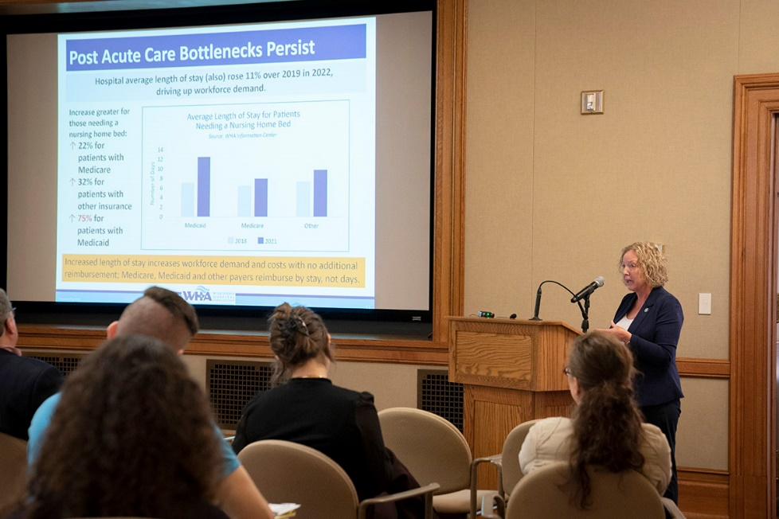
WHA’s Workforce Agenda
“WHA’s 2023 Health Care Workforce Report creates recommendations for health care employers, educators and public policymakers on how they can best support a health care workforce that meets the needs of patients in Wisconsin.”
- Sen. Cabral-Guevara, Rep. Moses, Sen. Hesselbein and Rep. Subeck

Slide 9
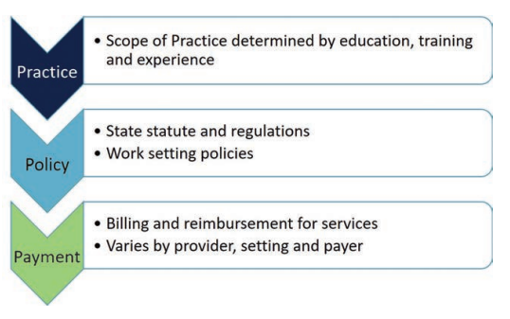
Principles of Workforce Policy Development

Slide 10
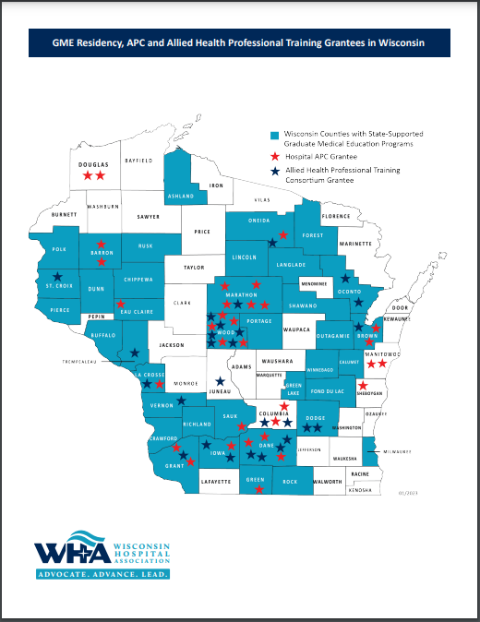
Priority Areas in Workforce
Encouraging more people to enter health care careers.
Promoting the use of state and federal support to expand clinical experiences, utilizing the “Grow Our Own” equation.
Removing regulatory barriers that limit the ability for hospitals to efficiently use our workforce.
“DHS has awarded 89 total grants, spurring a greater than $56 million investment in new and expanded clinical training programs in Wisconsin.”

Slide 11
Regulatory Burden Impedes Access to Care
According to the American Hospital Association, an average-size hospital requires 59 full-time-equivalent staff just to comply with federal regulations.
WHA has worked for years to pass legislation to streamline regulatory processes for our providers and staff.
But there are constantly efforts to add regulations on how hospitals provide care to patients.
WHA’s Regulatory Foundation
Legislation and rules should be the minimum necessary to protect patients and must accommodate for flexibility and innovation in care delivery.

Slide 12
Current Issues in front of the Legislature
State Budget – Medicaid funding & reimbursement
Professional licensure
Post-Acute Care & Hospital Discharge Challenges
Abortion policy following the Dobbs Supreme Court decision
Hospital Price Transparency

Slide 13
What types of reimbursement increases?
Hospital Rate Increase
Disproportionate Share Hospital program
Rural Critical Care supplement
Hospital base rates
Provider/Professional Fee Increases
Primary Care
Delayed Discharge Reimbursement
Inpatient Behavioral Health Reimbursement
$1.3 Billion
“We don’t expect to create a margin serving Medicaid patients, but we also shouldn’t be expected to shoulder it’s costs like we are doing today.”
Gundersen Moundview Administrator Frank Perez-Guerra
Testimony to the Joint Finance Committee on April 12, 2023

Slide 14
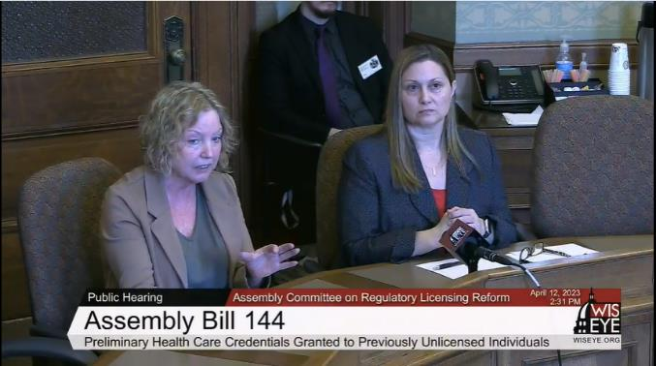
Licensure Public Policy
Several proposals from the Leg Council Study Committee on Occupation Licensure move forward.
Lengthen license renewals from two years to four years.
Eliminate legal review process for certain offenses.
Create expedited licensure pathway for new grads.
WHA’s SVP Workforce & Clinical Practice joined by UW Health Leigh Larson, GME and Medical Staff Administration to testify in support of Assembly Bill 144.
New grad legislation (Assembly Bill 144) receives hearing on April 12 in Assembly Committee.
Other bills receiving hearings next week in Senate and Assembly committees.

Slide 15
Post-Acute Care & Delayed Discharges
WHA continues to discuss challenges with avoidable days, delayed discharges in both the Assembly and Senate.
On April 6, GOP leadership calls meeting with WHA and various nursing home associations. Joining us:
Brian Stephens, President/CEO - Door County Medical Center
Sarah Becker, Social Services Director – Advocate Aurora Health
Takeaways:
Group asked to come back with three proposals:
“Crack open” the nursing home bed cap
Provide supplemental payments to hospitals for patients we cannot discharge
Develop “all encompassing rate” for patients with complex care needs

Slide 16
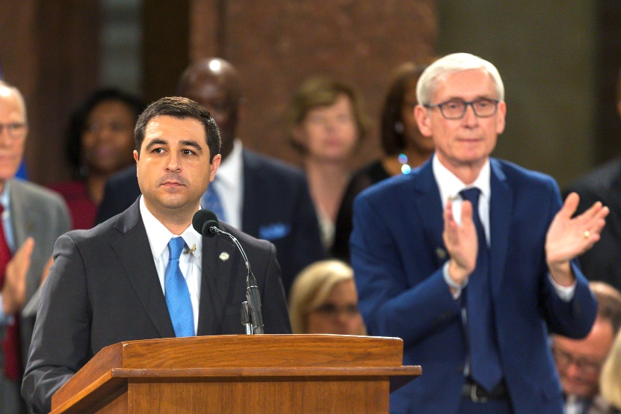
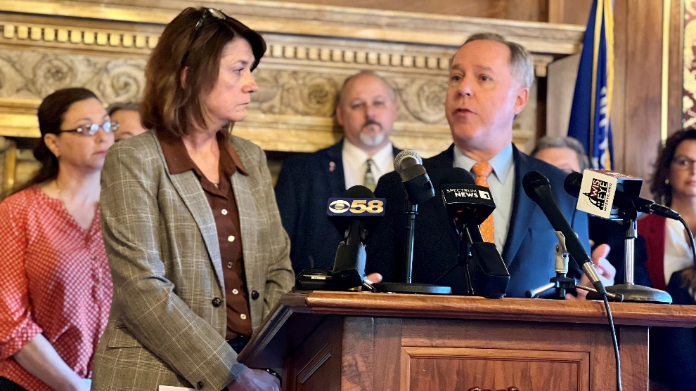
Dobbs Supreme Court Decision Results in Legal, Legislative Action to Clarify Wisconsin Law
Following the overturning of years of federal caselaw, Wisconsin statutes passed years ago needed to be contemplated.
Attorney General Josh Kaul and Governor Tony Evers filed suit, stated that a statehood-era law is no longer valid.
Meanwhile, GOP members of the legislature circulated “exceptions” legislation.

Slide 17
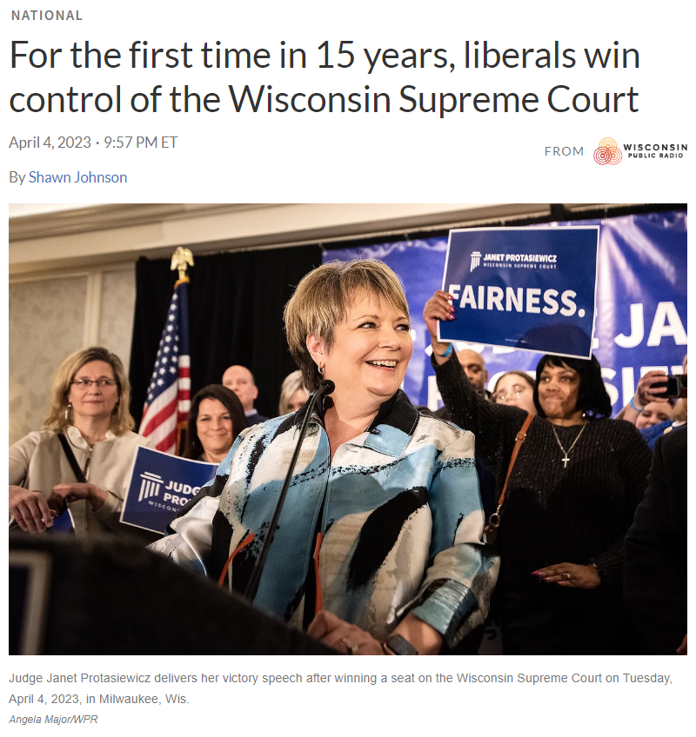
Court Changes Could Impact Healthcare Policy
Wisconsin’s Supreme Court has shifted from a 4-3 (mostly) conservative majority to a liberal majority.
Known issues could come back into play, along with unknown issues.

Slide 18
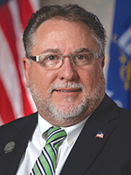
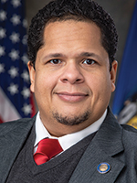
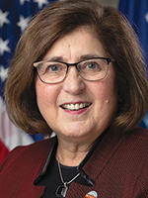
Lawmakers Release Transparency Legislation
May 3, four Republican State lawmakers held a press conference to unveil their “Know Your Healthcare Costs Act”.
“Wisconsin hospitals are national leaders in complying with federal transparency law and that is why WHA believes this legislation is unwarranted.”
WHA President/CEO Eric Borgerding
May 3, 2023
Sen. Mary Felzkowski
Rep. Rob Brooks
Sen. Juliann Bradley
Rep. Donna Rozar

Slide 19
Background on LRB 2922/2
Fifteen-page legislation that creates completely separate and additional state-level submission requirements and penalties for non-compliance with federal price transparency rule.
Requires fines to be paid in ten days, requires appeals to be made in ten days and requires hospitals to submit information, in a format determined by DHS, every time files are updated – at least once annually.

Slide 20
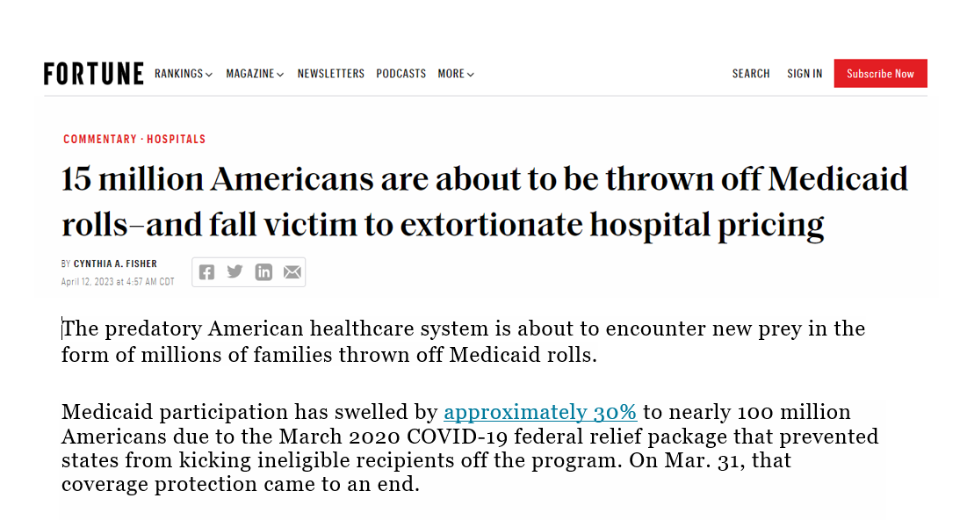

Slide 21
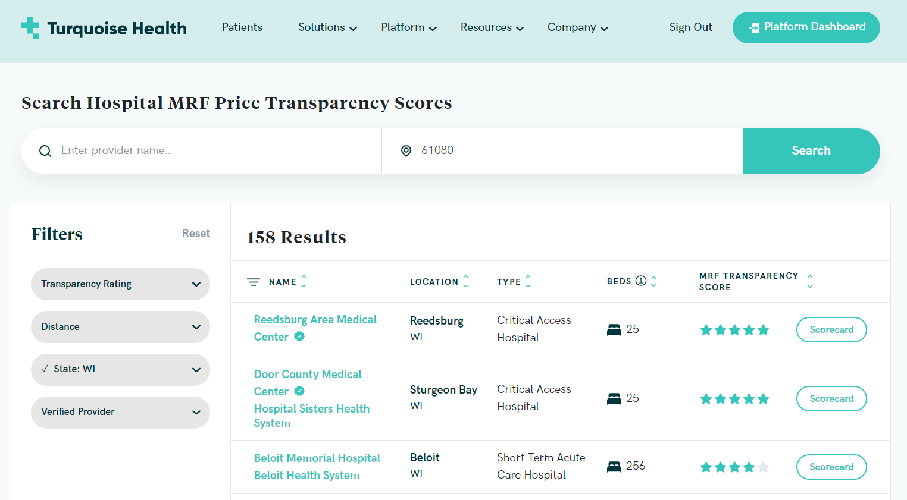
Turquoise Health Rates WI Hospitals 4.5 out of 5

Slide 22
How can you best support our work?
Advocacy
Lobbying
Political Engagement
Grassroots

Slide 23
Questions/Comments
Thank you!
Please contact me directly at kobrien@wha.org.
Stay informed by subscribing to WHA’s Valued Voice newsletter. Contact Tammy Hribar at thribar@wha.org to sign up.

