Slide 1
Recent Cybersecurity Trends In Healthcare
Keynote address
Linn F. Freedman, Esq.
HFMA MA-RI & NEHIA Joint Compliance Conference
November 30, 2022

Slide 2
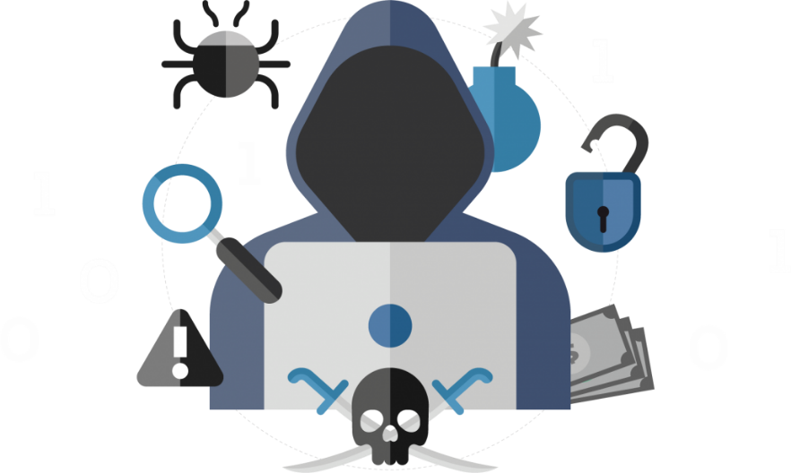
Recent Cyber Threats
Malware
Ransomware
Employee Error/Insider Threat
Technology Intrusions
Phishing/Spear-Phishing/ Smishing
Vishing/QR-ishing Schemes
Man-in-the-Middle Attacks
Wire Transfer Fraud
Internet of Medical Things
Vendors/Subcontractors – Poor Security Protocols/Standards

Slide 3
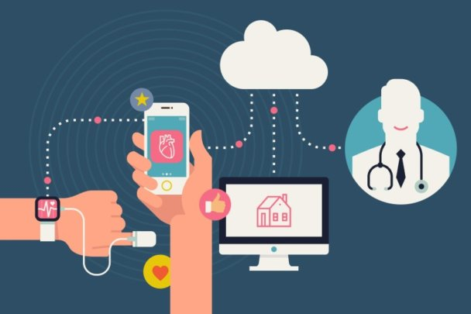
Top Three Risks to Healthcare Organizations
According to HealthTech (Nov. 1, 2022) top 3 cyberthreats facing healthcare organizations
Phishing Attacks
Ransomware Attacks
More Attack Vectors in Medical Internet of Things devices

Slide 4
Current Trends in Cyber Threats
The average time to identify and contain a breach is 277 days
The top 4 most common attack vectors are:
Compromised credentials
Phishing
Cloud misconfigurations
Third-party software vulnerabilities
IBM Cost of a Data Breach Report 2022
Notes:
UPDATED

Slide 5
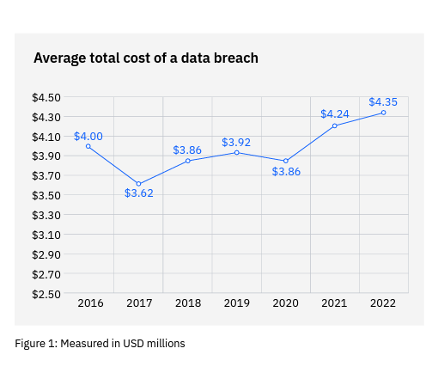
Average Data Breach Cost Hit Record High in 2022
**
IBM Cost of a Data Breach Report 2022
Notes:
UPDATED

Slide 6
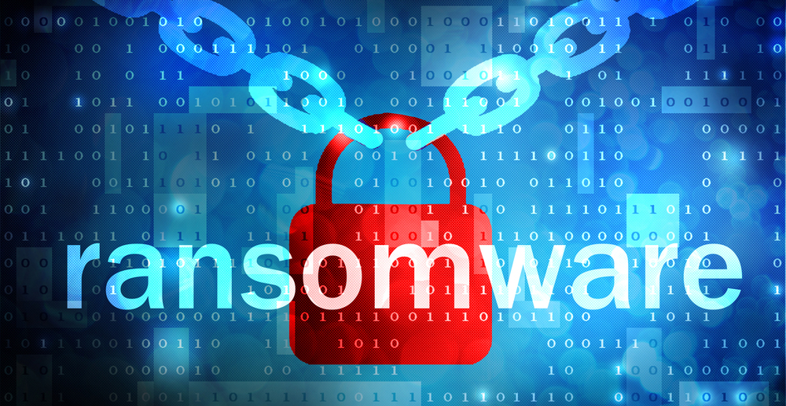
What is the biggest risk right now?

Slide 7
War Between Russia & Ukraine
Believe it or not, the current war between Russia & Ukraine is a significant risk to all U.S. organizations
Russian-based hackers “APTs” pose a significant risk to U.S. organizations
CISA & FBI have issued multiple warnings over the last few months for organizations to be extra vigilant
As tensions grow, and sanctions get harsher, Putin will use cyber war to fight back
Attacking U.S. businesses is certain
Reports on Russian based ransomware groups are particularly active

Slide 8
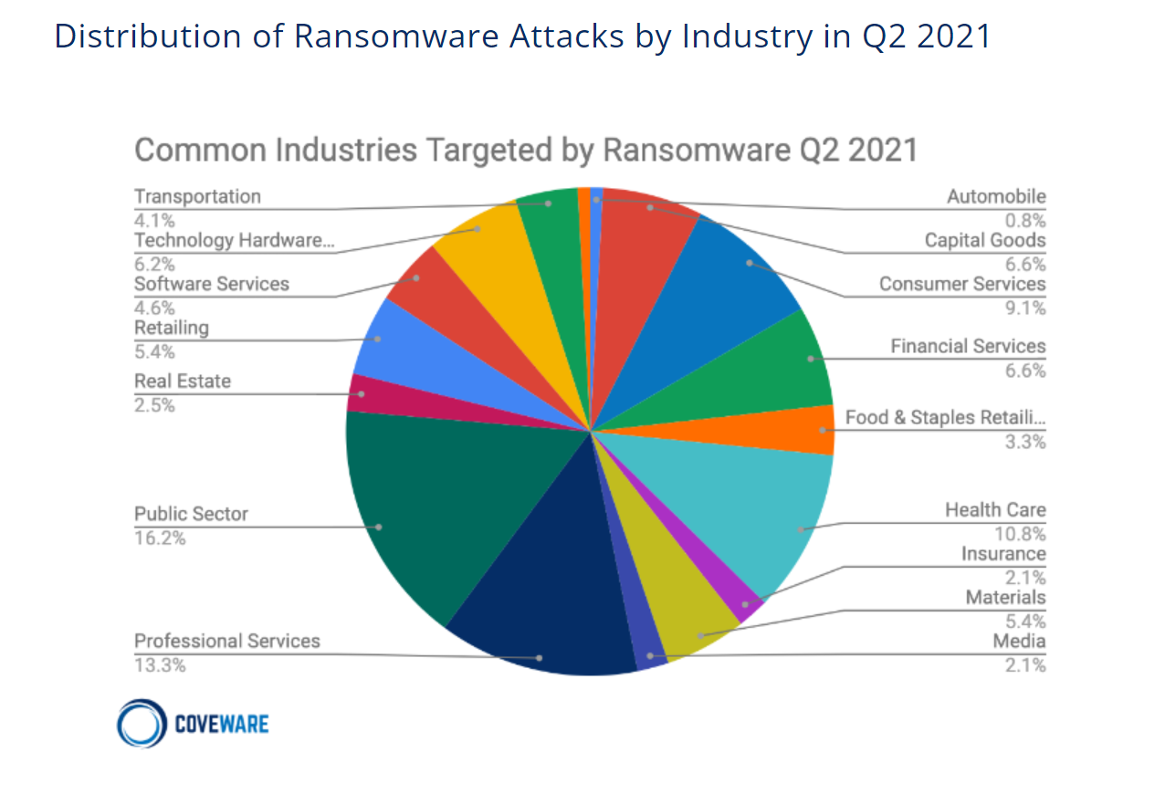
There is not a single industry which is immune to hacking.
Notes:
Linn
Here in this chart, in the 2nd quarter of 2021, professional services businesses (like law firms) accounted for about 13.3% of the types of industries targeted by ransomware attacks.
We’ll talk more about what exactly a ransomware attack is and what happens when a business suffers a ransomware attack, but for now, the takeaway here is simply that we are not immune.

Slide 9
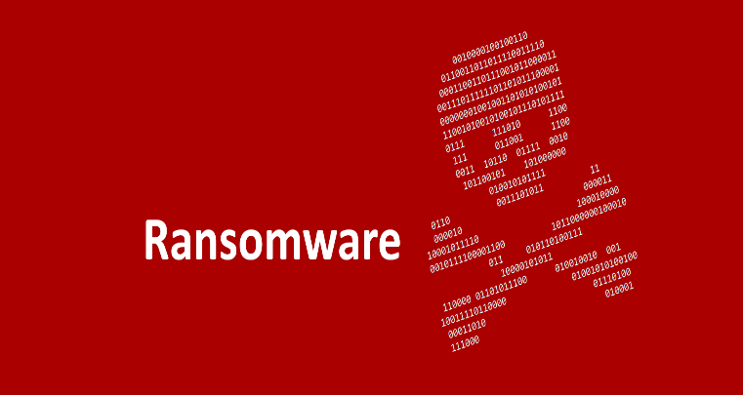
Recent CISA + FBI Warnings to Healthcare Organizations
CISA and FBI Warn of Zeppelin Ransomware Threat to Healthcare Organizations
Health IT leaders should take steps to strengthen their security posture and mitigate the impacts of Zeppelin ransomware attacks.
November 17, 2022 CISA, FBI and DHS Warning of Hive Ransomware
#StopRansomware: Hive
Victimized over 1,300 organizations
$100 million in ransom payment

Slide 10
Recent Trends In Healthcare Attacks
Shift away from large targets towards small, midsized, and specialty facilities with weaker defenses
Third-party Electronic Medical Record (EMR) systems have emerged as a common target for attackers
Consolidation of major hospital systems with common IT systems has led to larger impacts from data breaches
Critical Insight Jan-June 2022 Healthcare Breach Report

Slide 11
Recent Healthcare Cyberattacks
In October 2022, CommonSpirit Health, the second largest US Hospital chain, suffered a ransomware attack that affected its Electronic Medical Record (EMR) system
Several providers had to reschedule patient appointments
At least one hospital delayed critical procedures
At least one hospital diverted ambulances

Slide 12
Recent Healthcare Cyberattacks – Cont.
Ascension St. Vincent’s Coastal Cardiology in Georgia is currently remediating a ransomware attack that affected its EMR systems
As a result
An unknown number of patients had their PHI stolen, including medical records, Social Security numbers, insurance, and billing information

Slide 13
Recent Healthcare Cyberattacks—Cont.
Shields Health Care Group
June, 2022
Affected 2,000,000 patients
Health information exfiltrated
Name, SSN, DOB, address, provider information, diagnosis, billing information, insurance information, medical and treatment information
Faces class action lawsuit

Slide 14
Ransomware
Ransomware is a type of malicious software that threatens to publish the victim's data or perpetually block access to it unless a ransom is paid (usually in bitcoin).
Victims are at risk of losing their files, but may also experience financial loss due to paying the ransom, lost productivity, IT costs, legal fees, network modifications, and/or the purchase of credit monitoring services for employees/patients.

Slide 15
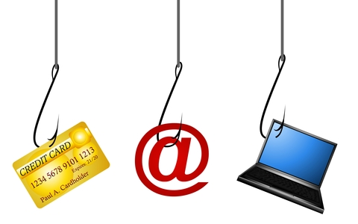
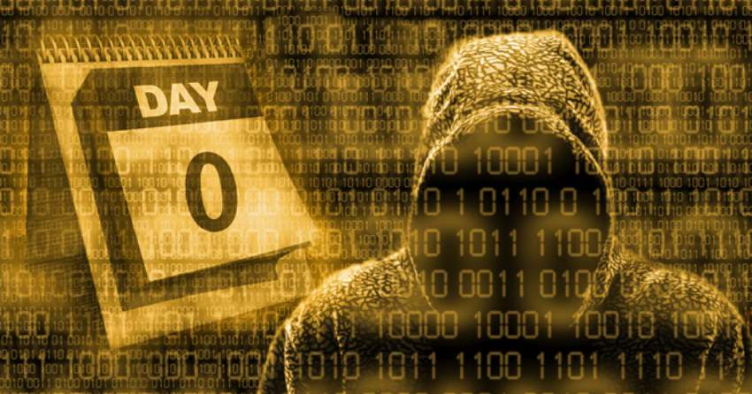
How do Ransomware Attacks Occur?
Phishing
A malicious “spam-like” message sent in large batches to broad audience
Spear-Phishing
Highly targeted email. May appear to be from coworkers.
Zero-Day Vulnerabilities
Threats related to a newly discovered software vulnerability. Because the developer has just learned of the flaw, it means an official patch or update to fix the issue hasn't been released, making the vulnerability easy for hackers to exploit.
Notes:
Linn

Slide 16
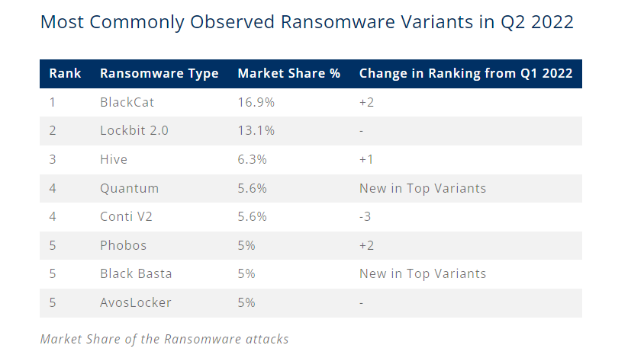
Recent Ransomware Attacks
Notes:
Kathryn

Slide 17
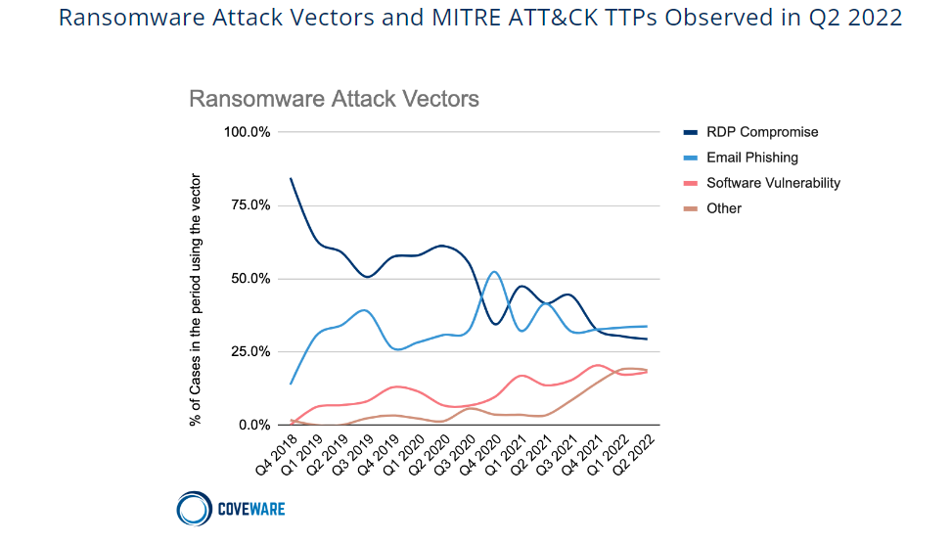
Ransomware Statistics (cont’d)

Slide 18
Ransomware Statistics (cont’d)
86% of ransomware cases involve a threat of leaking exfiltrated data.
During Q2, continued evidence that threat actors do not honor their word as it relates to destroying exfiltrated data.
In Q2, the average days of downtime was measured at 24 days, a decrease of 8% from Q1 2022.
*2022 Q2 Coveware Report
Notes:
Kathryn

Slide 19
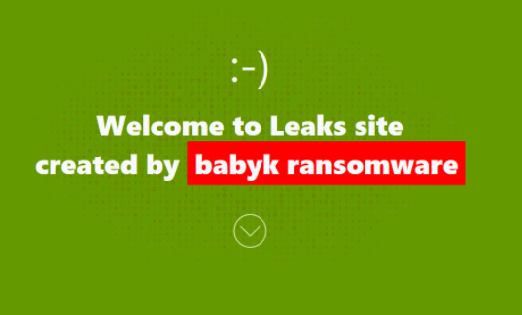
Public Shaming Websites
Many ransomware operators have created data leak sites to publicly shame their victims and publish the files they stole. Called “Double-extortion” attack.

Slide 20
Impact of Cyber Attacks on Healthcare Entities
Ponemon Institute Report with Proofpoint
Issued September, 2022
89% of organizations had at least one cyberattack in last 12 months
Average total cost for the most expensive cyberattack experienced in last 12 months was $4.4M
Lost productivity on average was “the most significant financial consequence averaging $1.1M
50% of the attacks were against supply chain which disrupted patient care
Delay of procedures
Longer lengths of stay

Slide 21
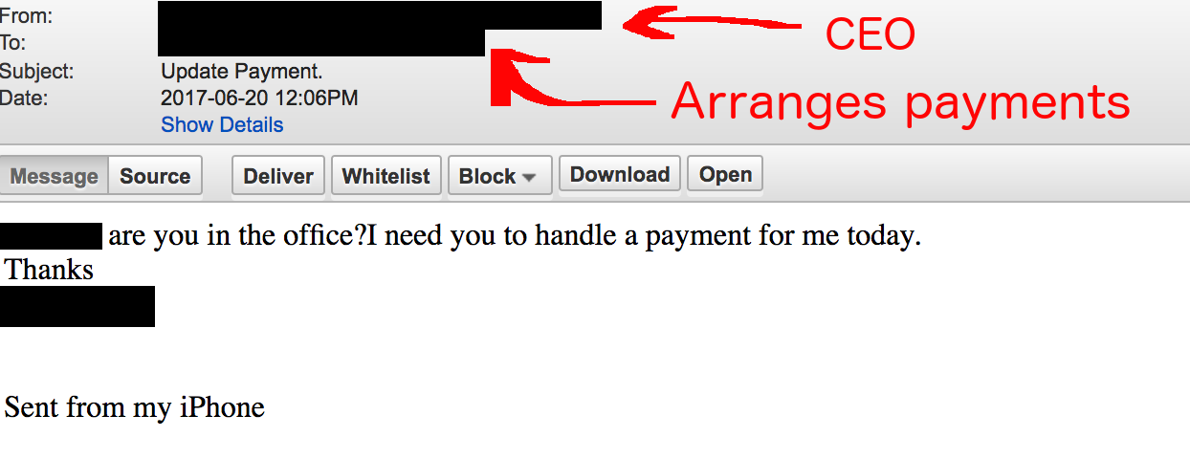
Impact of Cyber Attacks on Healthcare Entities
Cloud compromises and attacks in supply chain were most frequent attacks
Supplier impersonation

Slide 22
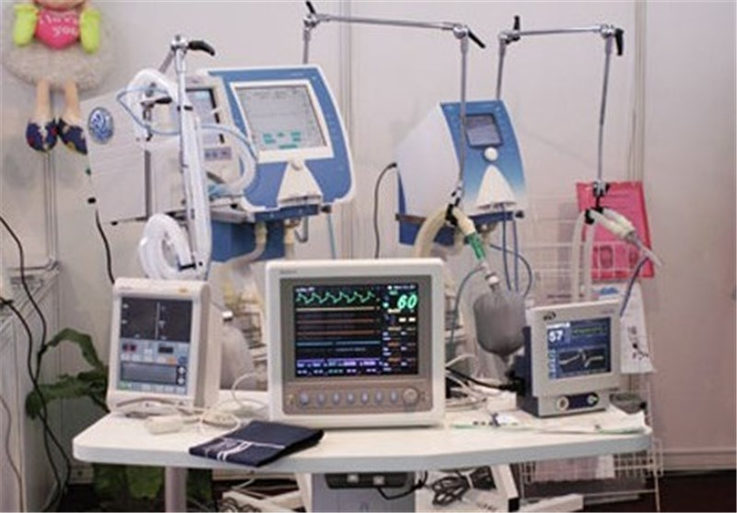
Insecure Medical Devices and Mobile Apps
On average, health care organizations have more than 26,000 network-connected devices
Insecurity of these devices and connection to the Internet is significant risk to organization
Pacemakers
Infusion Pumps

Slide 23
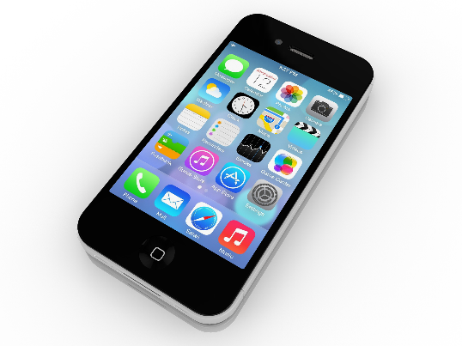
New Methods: Vishing, Smishing & QRishing
Exploits via SMS, telephone calls, or text messages
Vishing:
Often the caller will pretend to be calling from the government, tax department, police, or a bank, requesting personal information.
Smishing:
Text messages with malicious links to webpages, email addresses, or phone numbers that when clicked may automatically open a browser window or email message or dial a number.
QRishing:
Form of phishing initiated using malicious QR codes embedded in emails, texts, posters, magazines, brochures, or menu-less restaurants.
Cyber criminals want this integration of email, voice, text message, and web/mobile browser functionality to increase the likelihood that users will fall victim to social engineering and other malicious activities.

Slide 24
Cyber Attacks Disrupt Care to Patients
Top three attacks that disrupt care
Supply Chain
Business email compromise
Ransomware
Disruptions
Delays in procedures and tests that have resulted in poor outcomes
Longer length of stay
Increase in diversions
Increase in complications from medical procedures
Increase in mortality rate

Slide 25
Cyber Attacks Disrupt Care to Patients
Investigation in September of 2020 of patient death in Germany from ransomware attack
Following ransomware attack, patient in need of urgent medical care died after being diverted to a different hospital 20 miles away
Alabama hospital being sued by patient whose baby was born with severe brain injury and died during ransomware attack
Patient alleges hospital never told her that it was suffering a ransomware attack
Alleges tests weren’t available that would have shown that the umbilical cord was wrapped around baby’s neck

Slide 26
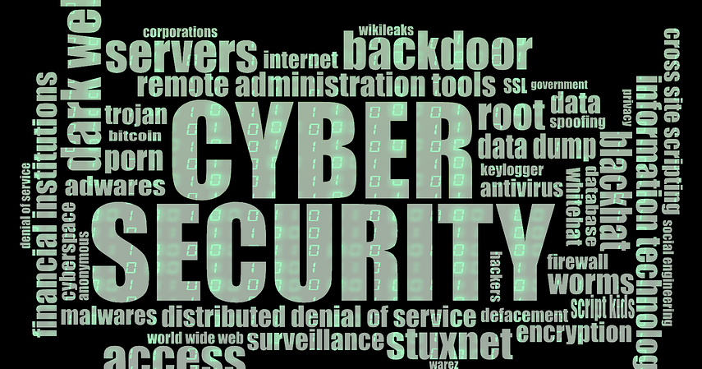
Mitigations
Robust Cybersecurity Program
Threat intelligence
Employee Education
Staying abreast of Vulnerabilities through CISA, DHS and FBI

Slide 27
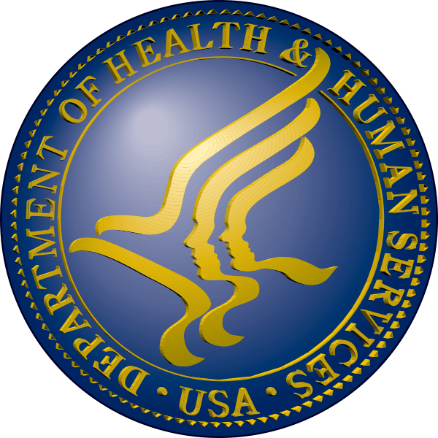
OCR ENFORCEMENT ACTIONS

Slide 28
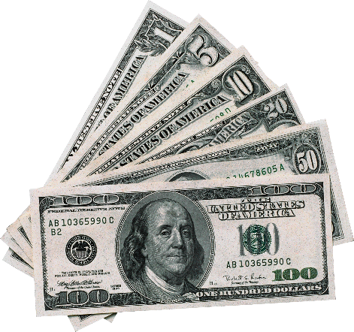
HIPAA Enforcement Actions (cont’d)
2021
Banner Health - $200,000
Lifetime Healthcare Companies - $5.1 Million
Renown Health, P.C. - $75,000
Sharp HealthCare - $70,000
The Arbour, Inc. - $65,000
Village Plastic Surgery - $30,000
Peachstate Health Management, LLC - $25,000
The Diabetes, Endocrinology & Lipidology Center, Inc. - $5,000
Children’s Hospital & Medical Center - $80,000
Advanced Spine & Pain Management - $32,150
Denver Retina Center, P.C. - $30,000
Office of Dr. Robert Glaser - $100,000
Rainrock Treatment Center, LLC dba Monte Nido Rainrock - $160,000
Wake Health Medical Group - $10,000

Slide 29
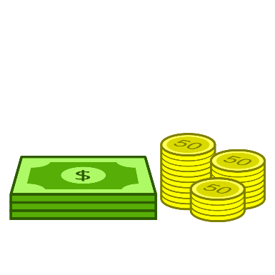
HIPAA Enforcement Actions (cont’d)
2022
Dr. Donald Brockley, D.D.M - $30,000
Dr. U. Phillip Igbinadolor, D.M.D. & Associates, P.A. - $50,000
Jacob and Associates - $28,000
Northcutt Dental-Fairhope, LLC (Northcutt Dental) - $62,500
Oklahoma State University –Center for Health Services -$875,000
New England Dermatology P.C. d/b/a a New England Dermatology and Laser Center -$300,640

Slide 30
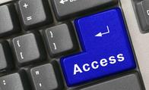
OCR ‘Right to Access’ Enforcement Actions
OCR continues to investigate under its HIPAA Right of Access Initiative
OCR has previously announced that it will vigorously enforce the rights of patients to get access to medical records promptly, without being overcharged and in the readily producible format of their choice
As of September 20, 2022, there have been 41 investigations and enforcement actions for right of access complaints

Slide 31
OCR ‘Right to Access’ Enforcement Actions (cont’d)
Bayfront Health St. Petersburg
Korunda Medical, LLC
Housing Works, Inc.
All Inclusive Medical Services, Inc.
Beth Israel Lahey Health Behavioral Services
King MD
Wise Psychiatry, PC
St. Joseph’s Hospital and Medical Center
NY Spine Medicine
Riverside Psychiatric Medical Group
Dr. Rajendra Bhayani
University of Cincinnati Medical Center
Elite Primary Care
Banner Health ACE
Renown Health, P.C.
Sharp Rees-Stealy Medical Centers
Arbour Hospital
Village Plastic Surgery
The Diabetes, Endocrinology & Lipidology Center, Inc.
Children’s Hospital & Medical Center
Wake Health Medical Group
Denver Retina Center
Advanced Spine & Pain Management (ASPM)
Rainrock Treatment Center, LLC dba Monte Nido Rainrock
Dr. Robert Glaser
Dr. Donald Brockley, D.D.M.
Jacob and Associates
ACPM Podiatry
Associated Retina Specialists
Lawrence Bell, Jr. D.D.S.
Coastal Ear, Nose and Throat
Danbury Psychiatric Consultants
Erie County Medical Center Corporation
Fallbrook Family Health Center
Hillcrest Nursing and Rehabilitation
MelroseWakefield Healthcare
Memorial Hermann Health System
Southwest Surgical Associates
Family Dental Care, P.C.
Great Expressions Dental Center of Georgia, P.C.
B. Steven L. Hardy, D.D.S., LTD

Slide 32
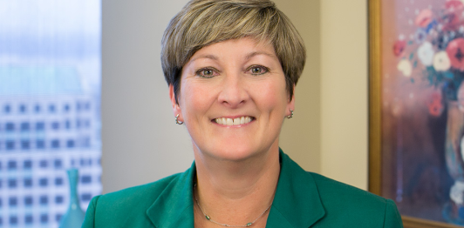
Linn Foster Freedman
lfreedman@rc.com
Robinson + Cole One Financial Plaza
14th Floor
Providence, RI 02903
401-709-3353
Thank you QUESTIONS?

