Slide 1



INDIAN HEALTH SYSTEM
PURCHASED/REFERRED CARE
OUTREACH
July 26, 2023
Taveah George, PRC Director
Bobbie Moran, Health System Specialist
Oklahoma City Area PRC Team
Oklahoma City Area Indian Health Service
701 Market Drive, Suite 143, Oklahoma City, OK 73114

Slide 2
Indian Health Service Mission Statement
The Mission of the Indian Health Service is
to raise the physical, mental, social, and spiritual health of American Indians and Alaska natives to the highest level.

Slide 3
PRC Program History
Treaties exchanged lands for Federal trust responsibilities and benefits for the Federal government to provide health care to Indians under the Department of Interior, Bureau of Indian Affairs which established the Indian Health Service (IHS).
On November 2, 1921, Congress passed the Snyder Act which provided continuing authority for Federal Indian programs.
The term Contract Health Services (CHS) originated under BIA when authority to enter into health services contracts for American Indian and Alaska Natives (AI/AN) was provided under the Johnson O’Malley Act of 1934.
In 1955, the IHS was transferred to the Department of Health, Education, and Welfare, Public Health Service under P.L. 83-568.

Slide 4
Contract Health Services/Purchased Referred Care – Name Change
Effective in 2014, Contract Health Services (CHS) was renamed to Purchased/Referred Care (PRC).
This name change was authorized under the Consolidated Appropriation Act of 2014 that was signed by President Obama in January.
The name change did not change the function or funding of the Program. All current policies, practices, and improvements continued.
Tribal programs may or may not change program name.
Thanks for your patience and understanding as we continue education for community transition to the new name.

Slide 5
Area Office Presentation
Presentation Provides details on how the Federal PRC programs operate.
Tribal PRC Programs are not Required to Implement Regulations the Same as the Indian Health Service.
Tribal Program in the Oklahoma City Area process payments independently.
The Federal PRC Programs all use the Fiscal Intermediary (FI) for payments. Currently none of the Tribes in our Area utilize the FI.

Slide 6
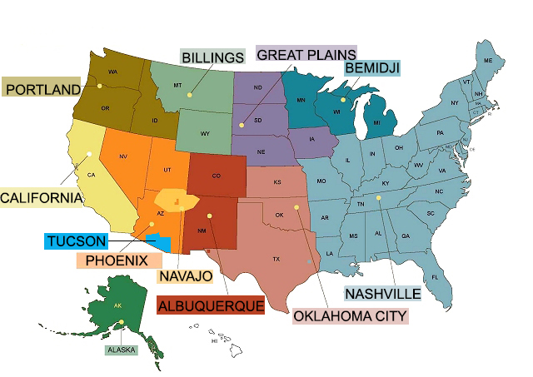
IHS National Areas

Slide 7
PURCHASED/REFERRED CARE
Purchased/Referred Care is:
Healthcare purchased by the Indian Health System (IHS) for eligible Indians from non IHS providers and facilities when direct services of appropriate types are not available or accessible.
Required to operate within appropriated funds. There is no authority to provide payment/approve services through the Purchased/Referred Care (PRC) program unless funds are, in fact, available.

Slide 8
PURCHASED/REFERRED CARE FUNDS
PRC resources are a finite congressional appropriation.
Purchased/Referred Care is not:
An Entitlement Program
An Insurance
PRC is limited to services that are medically indicated within the established medical priorities.
If services are not authorized for payment they will be denied or deferred.

Slide 9
USE OF PRC FUNDS – PRC Policy
PRC funds are used to supplement and compliment other health care resources available to eligible Indian people.
The funds are utilized in situations where:
1. No IHS direct care facility exists.
2. The direct care facility is incapable of providing required emergency specialty care.
3. The direct care facility has an overflow of medical care workload.
4. Supplementation of alternate resources (i.e. Medicare, Medicaid, private insurance, Veterans Health Administration) is required to provide comprehensive health care to eligible American Indian/Alaska Native (AI/AN).

Slide 10
PRC REVIEW COMMITTEE
PRC review committee may meet as often as daily or once a week to review all referrals and self referrals (previously referred to as ER call-ins)
Requests are reviewed, categorized and ranked in accordance with established medical priorities
PRC staff obligate funds only to the extent of the resources available by issuing purchase delivery orders (PDO).
The exception to these procedures are urgent referrals that require immediate review and, if approved, are quickly processed. The funding for these referrals are deducted from the allocated spending allowance.
Notes:
Some call it managed care committee

Slide 11
FUNDING
After ranking of requests, PRC staff obligates funds (issue purchase delivery orders) in sequence of the highest to the lowest ranking and only to the extent of funding available for that review period.
Available funding level for the review period is determined by prorating the PRC program’s quarterly funding level into a weekly/daily allocated spending plan.

Slide 12
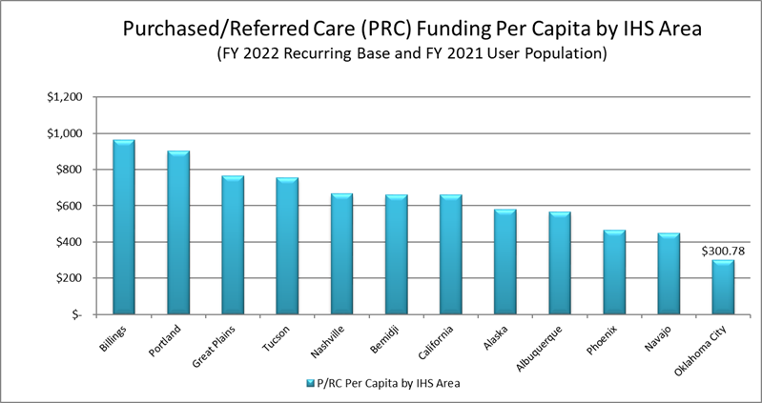

Slide 13
Accessing PRC
Referral by Federal, Tribal or Urban Providers within the Indian Health System or Self Referral (previously referred to as ER call-ins)
Referral
The patient presents to Indian Health System (IHS) Facility and a referral is written by an IHS provider for medically indicated care which cannot be provided directly through IHS.
A referral does not authorize payment for medical care delivered, and some PRC medically indicated referrals are not within established or funded medical priorities and cannot be paid by PRC.
If services are approved, patient will be contacted by PRC with appointment information or they may contact their servicing PRC Office to find out the status of their referral.
All non-emergency care must be pre-authorized by PRC before receiving medical treatment in order for PRC to pay.

Slide 14
PRC Specialty Referrals Path
1. Referral is initiated from the patient’s IHS medical facility which may or may not be their Medical Home. We encourage our patients to establish a medical home within our Indian Health System to optimize healthcare outcomes.
2. Referral is submitted to Patient’s PRC program.
3. Patient is evaluated for eligibility and/or applicable alternate resources.
4. Referral is presented to review committee for medical priority and ranking.
5. If referral is approved, appointment/requested service is scheduled with a contracted/private sector provider, and patient is notified of appointment.
6. Patient receives medical care.
7. IHS receives clinical documentation.
8. If private sector provider requests additional referrals, a new referral must be written by the patient’s medical home or other IHS provider. Referral must be approved by the PRC program prior to patient’s visit or funds can not be authorized for the service. PRC is unable to retroactively authorize referred services.

Slide 15
Self Referrals (previously referred to as Call-ins or Emergency Notifications)
Patient, beneficiary/applicant, or medical provider shall, within 72 hours after beginning treatment, notify PRC and provide information to determine the relative medical need for the services.
For an elderly or disabled person, this time may be extended to 30 days. The IHS defines elderly as an individual who is 65 years of age or older.
The following supporting documentation is required (as applicable) and must be submitted prior to review in order to establish relative medical priority. This includes the following documentation:
Emergency Room Report, History & Physical, Lab/X-ray results, Operative report & Discharge Summary.

Slide 16
Successful Self Referral Notifications
Please provide all insurance, demographic information and alternate resource details with the notification, as applicable.
Supporting medical information is required and must be submitted prior to review in order to establish relative medical priority.
Emergency notifications and appeals can be submitted by patient, family, or health care institution for medically indicated care which cannot be provided directly through IHS.
Information required during notification is patient’s permanent residence, their Registered Tribe, services received during emergency visit, and date(s) the service(s) occurred.
Timely notification of emergency service is calculated upon onset of services provided, not the discharge date.

Slide 17
Federal Appeal Process
If services are denied, the patient may file an appeal. The IHS appeals process applies to IHS administered PRC programs, and is a 3 level process:
1. A request for reconsideration of the appeal by the Service Unit CEO.
2. A request for appeal to the Area Director (Oklahoma City Area Office).
3. A final appeal to the Director, IHS (Rockville, Maryland).
To check on the status of a Federal Appeal, please call Casie
Lester at (405) 951-3737.

Slide 18
Tribal Appeal Process
Tribes that have assumed their PRC program provides their own administrative appeal procedures and IHS/PRC is not involved.
If a Tribal appeal is submitted to our Area office, it is forwarded to the appropriate Tribal PRC program for processing.
Our office will provide consultation to Tribal PRC programs, as requested.

Slide 19


Slide 20
Eligibility
1) Reside on or near a reservation or Purchased/Referred Care Delivery Area (PRCDA)
2) Member of tribe or tribes located on that reservation or PRCDA,
3) Maintain close economic and social ties with that tribe or tribes,
4) Student or transient who would otherwise be eligible at their permanent residence but who are temporarily absent from their residence,
a) students – full time attendance at programs of vocational, technical or academic institutions, including normal school breaks and for a period not to exceed 180 days after the completion of the course of study,
b) transients, persons who are in travel or are temporarily employed such as seasonal or migratory workers during their absence, and
5) Other persons who leave the PRCDA in which they are eligible and who are neither students or transients shall be eligible for PRC not to exceed 180 days from such departure unless an acute medical condition is still being treated. In this instance the patient would receive care until acute condition is resolved.

Slide 21
Kansas
Purchased/Referred Care Delivery Areas
Kansas Service Units
Haskell
Holton
Tribal and Federal Programs

Slide 22
Texas
Purchased/Referred Care Delivery Area
Texas Service Unit – Eagle Pass
Tribal CHS Program
Kickapoo Traditional Tribe Of Texas
Nick Gonzales, Director
Eagle Pass, TX 78852
(830) 757-0322 Direct
(830) 757-9228 Fax

Slide 23
Oklahoma
Purchased/Referred Care Delivery Area

Slide 24
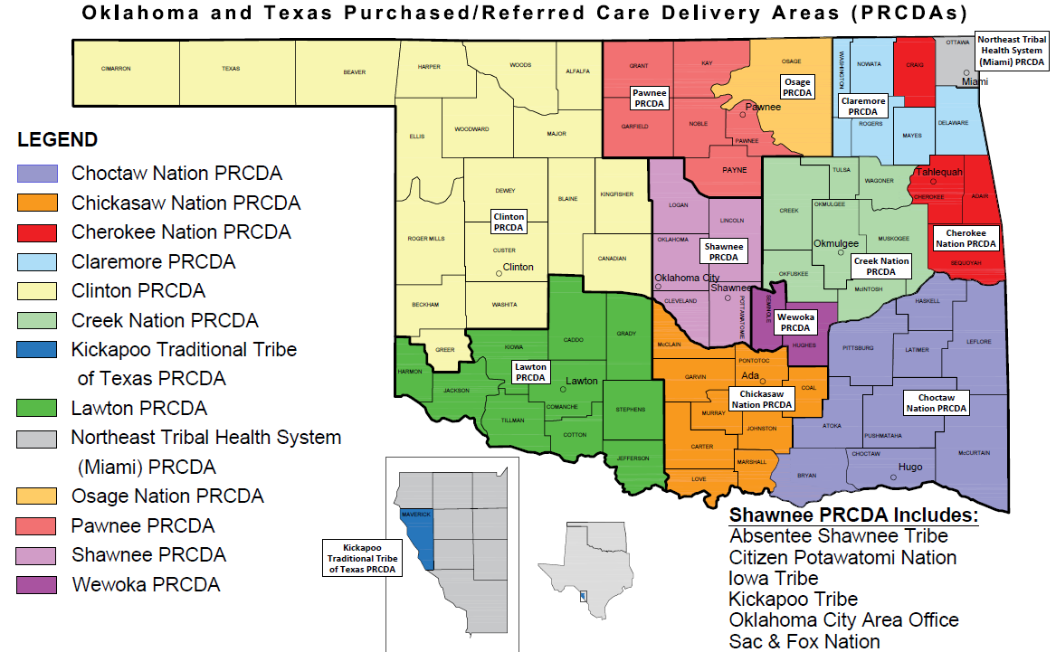
-Federal
-Federal
-Federal
-Federal
-Federal
-Federal
-Tribal
-Tribal
-Tribal
-Tribal
-Tribal
-Tribal

Slide 25
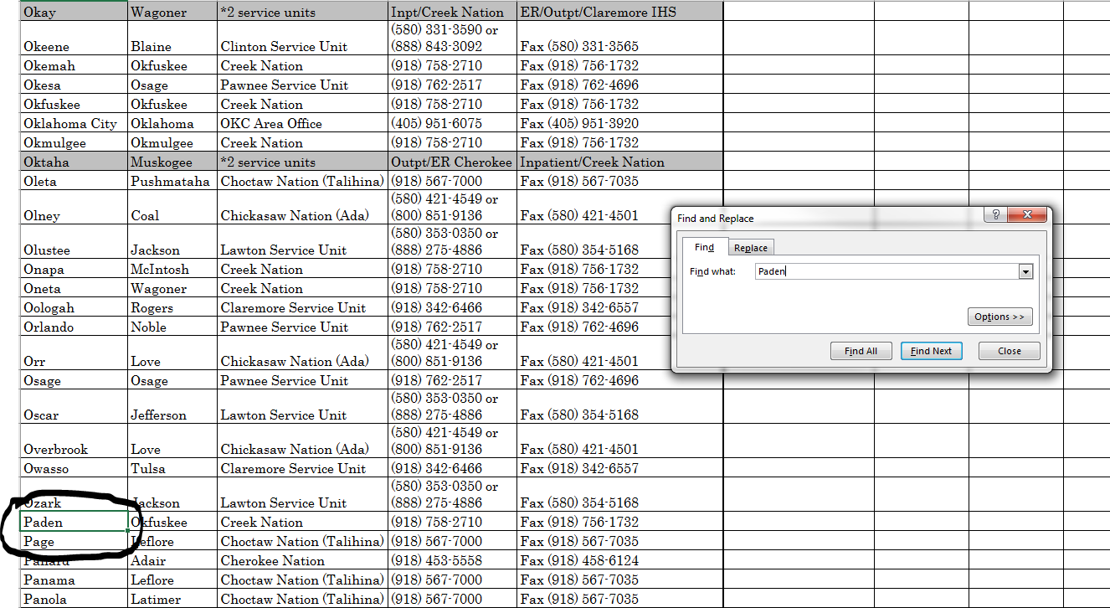
Quick find in PRC Delivery Area Directory (Ctrl + F)

Slide 26
Shawnee
Purchased/Referred Care Delivery Area

Slide 28
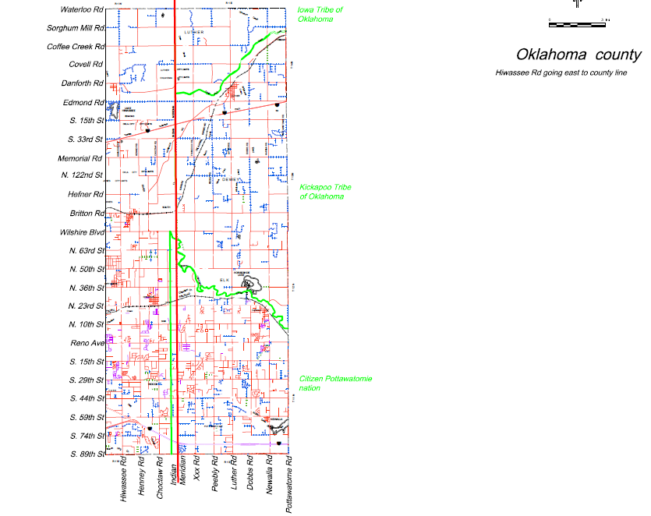

Slide 29
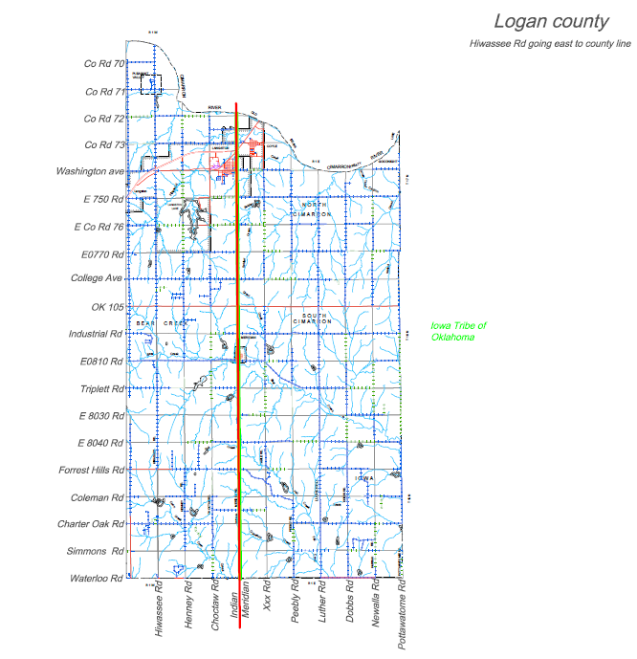

Slide 30
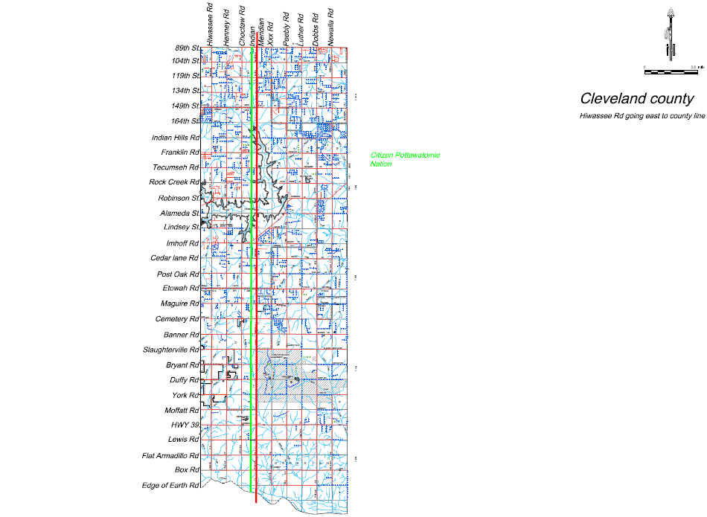

Slide 31
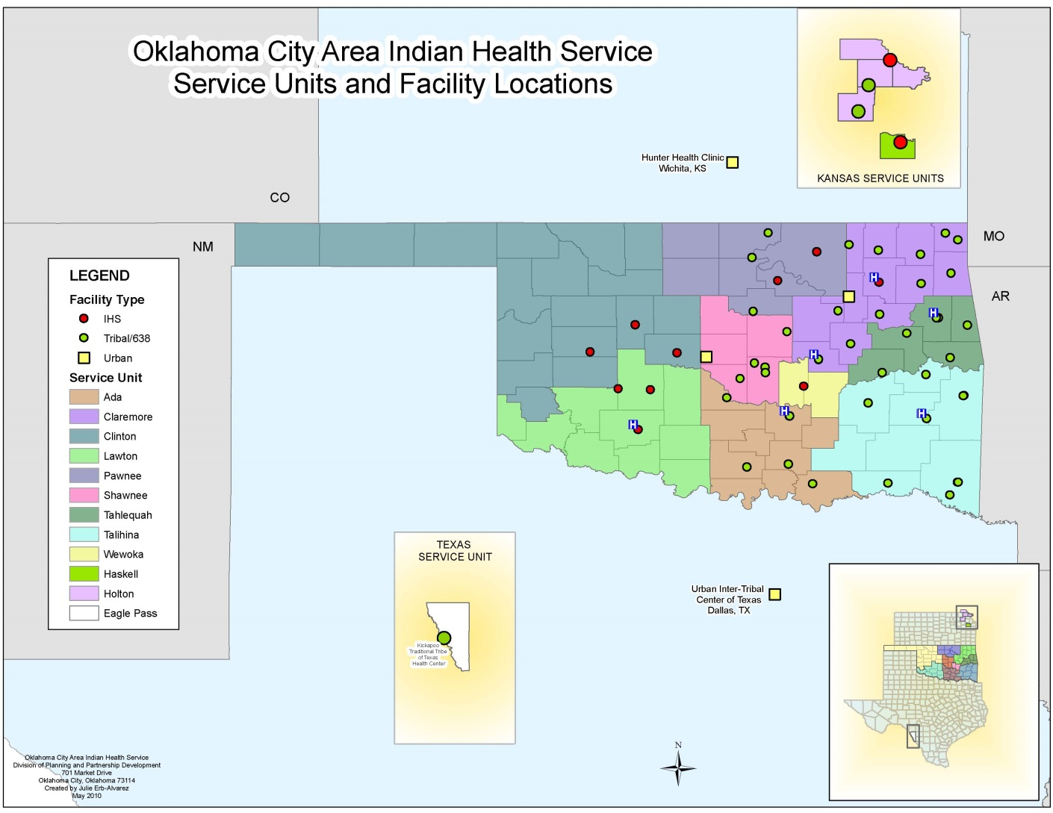

Slide 33
Alternate Resource Coordination
Use of alternate resources is mandated by the IHS Payor of Last resort regulation, 42 CFR 136.61
Individual is required to apply for alternate resources
Refusal to apply, requires the denial of eligibility for PRC
Alternate Resource (AR) coordination begins upon initial encounter of care and/or admission.
Case Managers can not easily plan for a patient’s care unless you/the patient is aware of how the required care is to be funded.
Recommend primary goal of coordinating patient benefits by exploring all AR programs to assist in funding for services when none are otherwise available.
Encourage collaboration with IHS Benefit Coordinators to assist patients in applying for AR to ensure services are funded appropriately.

Slide 34
Alternate Resources
The IHS expects the non-IHS provider of services to assist IHS patients in applying for alternate resources as it would for its uninsured non-AI/AN patients.
The non-IHS provider must investigate with each patient, his or her eligibility for alternate resources, and should assist the patient in completing the necessary application forms for AR.
The IHS encourages strong partnerships with Benefit Coordinators within the Indian Health System.

Slide 35
Better Outcomes for Alternate Resource Coordination
Verify
Screen
Information is acquired from a website.
Search for information that may or may not be up-to-date.
Increase chance for missed opportunities for patient assistance through Alternate Resource(s).
Information is acquired from a personal interview with patient.
Validates if the verified information from website is accurate or not.
Further actions may be needed based upon the results of the screening and/or investigational tool.

Slide 36
Coordination of Health Reimbursement: Assisting patients through the application process NODOS AND PS-1
NODOS
PS-1
Notification of Date of Service form (NODOS) needs to be submitted if eligible for services through Oklahoma Health Care Authority (OHCA)
NODOS must be received timely and prior to the patient’s application for services.
The application date (not NODOS date) for services will be the beginning date for the case.
Eligible for services through the Department of Human Services, such as the Aged/Blind/Disabled (ABD) program.
If patient expires: This classifies them as a disabling condition; therefore, they maybe eligible for the ABD – Medicaid. Please ensure a PS-1 has been filed on behalf of our patients.

Slide 37
Alternate Resources
Medicaid – SCHIP, Aged/Blind/Disabled Program and Medicare Supplemental Program
Medicare – Part A, B, C & D; End Stage Renal Disease (ESRD)
Veteran Affairs (VA)
Disability – Supplemental Security Income (SSI) and Social Security Disability Insurance (SSDI).
Please also apply for Medicaid/Title 19. Applications can be certified back to the date that Social Security Administration establishes the patient to be disabled as long as a Title 19 application was accepted at the same time.
Please ensure that billers timely file account(s) with Medicaid so they will retro reimburse
Insurance – Health, Sports, Liability & Worker’s Compensation
Victims of Crime Compensation Board
IHS is the payor after Victims of Crime Compensation Board
Oklahoma Cares - Breast Cervical Cancer Treatment Program

Slide 38
Centers for Medicare & Medicaid (CMS) Medicaid
2023 SoonerCare
Children and Soon-To- Be Sooners
Expansion Adults
Adult Caretaker/Relative w/Child
Pregnant Women: Full Scope Benefits and SoonerPlan
Oklahoma ESI Income Guidelines
Eligibility Guidelines (oklahoma.gov)
Aged/Blind/Disabled Program
Oklahoma Department of Human Services - Aid to the Aged, Blind and Disabled (State Supplemental Payment) | OK DRS
Medicare Supplemental Program Qualified Medicare Beneficiary (QMB) or Specified Low-Income Medicare Beneficiary (SLMB)
Specified Low-Income Medicare Beneficiary (SLMB) Program | Benefits.gov
Breast & Cervical Cancer Programs may be available, or other state benefit variation

Slide 39
Breast & Cervical Cancer Program
Eligibility:
http://www.ok.gov/health/http://www.ok.gov.health/
Be screened under the Breast and Cervical Cancer Detection Program and have an abnormal screen, which requires further diagnosis and/or treatment/services.
Meet low income screening standards and not otherwise be eligible for Medicaid.
Have no other insurance which covers Breast and Cervical Cancer diagnosis and/or treatment.
Be under the age of 65.
Program Contact Information
Oklahoma State Department of Health: (866) 550-5585

Slide 40
Disability Programs
Supplemental Security Income (SSI)
Social Security Disability Insurance (SSDI)
Please immediately apply for Medicaid/Title 19 designed to potentially retro certify case
Please ensure vendors timely file with Medicaid

Slide 41
Disability
Social Security Program Options
Presumptive Disability, Compassionate Allowances, and Quick Disability Determinations
TERI – terminal illness cases;
Terminally ill or expired patients may be categorically eligible for Medicaid coverage if they meet income and resource guidelines.
Defined as an untreatable condition and expected to result in death; expedited case processing and decision
As a potential payor this must be coordinated prior to PRC consideration of payment.
Social Security Contact Information
Online enrollment at ssa.gov
Telephone (800) 772-1213 (7am – 7pm)

Slide 42
Other Alternate Resources
Sports Insurance
Statement from school declining payment for the acquired injury.
Office of Workers’ Compensation Programs (OWCP)
Private Insurance / Medicare Supplement (Medigap)
Liability and Auto Insurance
Include insurance information in alternate resource determination (i.e., responsible party for accident, verify types of insurance coverage of all parties).

Slide 43
Oklahoma Crime Victims Compensation Program (OCVCP)
Eligibility
The crime must have occurred in Oklahoma.
The crime must have been reported to law enforcement within 72 hours of the incident.
Exceptions are always made for child victims
Claimant must fully cooperate with law enforcement
If victim contributed to result, the claim be denied.
Claims may take up to six (6) months for determination.
Patients cannot be turned to collections while awaiting a decision.
Claimant can appeal the decision within thirty (30) days, if denied.
Applications can be completed by: the victim, dependent of a deceased victim, or person authorized to act on behalf of the victim
Phone number for OCVCP (405) 264-5006

Slide 44
How IHS and OCVCP Partner to Optimize Patient Outcomes
PRC program may authorize ongoing referrals for care as “pending cooperation with alternate resources” while awaiting OCVCP decision from application.
Patients failure to apply and/or cooperate with OCVCP application, if there is reasonable assumption they would be eligible for program, requires services to be denied by PRC program.
PRC program remains the payor of last resort to OCVCP.
If patient fully cooperates with process and services are denied by OCVCP, PRC program may pay for services, if the patient would otherwise be eligible for PRC program.

Slide 45
More Alternate Resources
Affordable Care Act (ACA)
Indian Health Service is encouraging patients to apply when the patient has no out of pocket expenses: www.healthcare.gov
US Department of Veterans Affairs (VA)
AIDS Coordination and Information Services (ACIS)
Tribal Programs
I/T/U Communities

Slide 47
Medicare Like Rates (MLR)
Section 506 of the Medicare Modernization Act:
Requires Medicare participating providers to participate in the PRC program and charge no more than the Medicare-based rates to individuals eligible for PRC since July 5, 2007.
IHS claims are also subject to timely filing period for Medicare claims. If the timely filing period is exceeded the patient nor IHS can be pursued for the outstanding charges.
The payment methodology for coordination of benefits with other payors under section 506 is similar to the Medicare Secondary Payor Program.

Slide 48
MLR Requirements
Requires Medicare-participating hospitals to accept MLR as payment in full from Indian Health Service, Tribal and Urban PRC programs for authorized PRC services
PRC remains “payor of last resort”
Does not affect lower contracted rates nor negate such contracts
Does not “limit” existing rates less than MLR

Slide 49
Purchased/Referred Care Rates
42 CFR Part 136
For medical services not previously covered by MLR
Described as payment for physicians and other health care professional services, associated with hospital and non-hospital-based care.
Reimbursement will be at Medicare Rates
Regulation named PRC Rates.
IHS encourages best value contracts below these standard national rates.
Implementation date for Oklahoma City Area Federal programs, October 1, 2016.
Tribal programs effective date for implementation may vary by program.

Slide 50
Best Value Contracts with IHS/PRC
Given the limited amount of funds the PRC program receives per person the PRC program strives to establish best value contracts below the MLR and/or PRC rates.
This allows the PRC program to divert referred care to these specific contractors which ensures optimization of care and expenditure of limited funds.
The Oklahoma City Area PRC program has successfully demonstrated the benefits of these best value contract for many specialty services in our Medical Community.

Slide 51
Payment Process
Purchase Delivery Order (PDO) is issued
Medicare Like Rates (MLR)
Purchased/Referred Care Rates (PRC)
Federal Acquisition Regulation (FAR)
Requires *UEI and registration in *SAM
*UEI Unique Entity Identifier- number issued by SAM to identify businesses and other entities that do business with the federal government.
*SAM (System for Award Management)

Slide 52
Payment Process
Purchase Delivery Order (PDO) is issued
Established Eligibility with PRC
Self Referrals (call-ins/ER Notification) must occur timely (within 72 hours/30 days)
Approved Pre-Authorization (referral)
Exhaust Alternate Resources

Slide 53
Paperless PDO process
For services recently obligated, weekly PDO reports are submitted to Providers.
Six reports are sent to Providers annually of every issued PDO that remains pending for payment.
When filing paper claims for payment, please write legible PDO number on claim and submit with applicable EOBs, to our Fiscal Intermediary (FI) at Blue Cross/Blue Shield of New Mexico. Mailing Address: PO Box 13509, Albuquerque, NM 87192-3509.

Slide 54
FI Electronic Filing Option
Strongly encourage electronic filing, payment timeline decreases from 30 to approximately 7-10 days. To start electronic filing, or address payment questions, please call the FI at (800) 225-0241.
When calling the FI to set up electronic file management, please have your Clearing House Information available.
Once connectivity is established, the FI will send a welcome email to you and walk you through their electronic claim filing process.

Slide 55
Billing Reminders
The Health Record Number (HRN) is provided in the PDO report. When filing the claim to the FI electronically please include a zero at the front of the number because the HRN must be six digits long. Example: 012345
The PDO number must by 10 digits long when filing electronically. Number 1 is the first digit and the letter after the Fiscal Year is an O and not a zero. Example: 19O9101234.
Suggestion for PDO placement (electronic and paper claim filing): Box 23 of the 1500 and/or in Box 63 of the UB. Thank you for also writing the PDO number on each submitted EOB.
Suggestion for the HRN placement: Box 1a or Box 19 of the 1500 and/or in Box 80/60B of the UB. Only required for electronic filing.

Slide 56
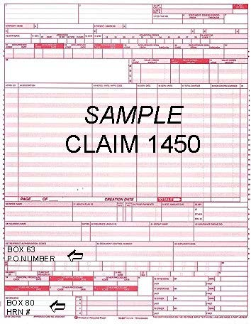
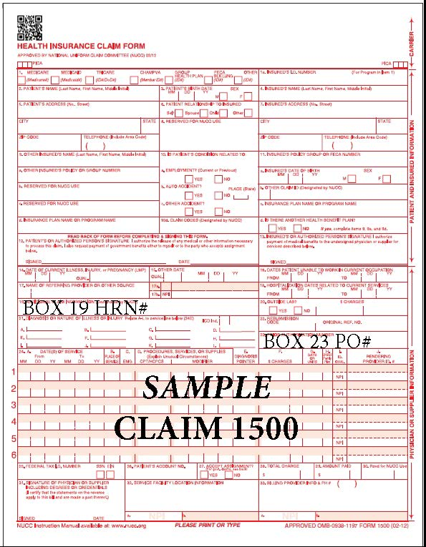
Example of Claim Forms

Slide 57
Paradigm Payment Shift
The purchase orders are estimated pricing and any excess funds will be recycled once the purchase orders have paid. Purchase orders are valid for 365 days from the date the document was issued.
Please return the PDO report and advise when documents can be cancelled or if a reissue is required for a change in date of service or if you are unable to identify patient.
How can we work together better to process the purchase orders for payment faster?

Slide 58
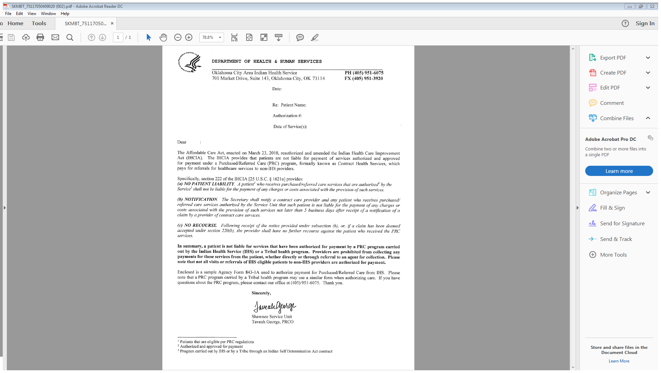
Indian Health Care Improvement Act

Slide 59
Indian Health Care Improvement Act
Provisions within this act ensure that a patient who receives Purchased/Referred Care (PRC) shall not be liable for the payment of any charges or costs associated with the provision of such service.
Therefore, a patient is not liable for services that have been authorized for payment by PRC and/or a Tribal Health program. Providers are prohibited from collecting any payments for these services from the patient, whether directly or through referral to an agent for collection.
Please note that not all visits or referrals of IHS eligible patients to non-IHS providers are authorized for payment.

Slide 61
Affordable Care Act
Qualified Health Plans (QHPs)
An insurance plan certified by the Marketplace will cover 10 Essential Health Benefits (EHB)
Must follow established limits on cost-sharing
Deductibles, copayments, and out-of pocket maximum amounts
10 Essential Health Benefits
Ambulatory Patient Services
Emergency Services
Hospitalization
Maternity and Newborn Care
Mental Health and Substance Use Disorder Services, including Behavioral Health Treatment
Prescription Drugs
Rehabilitation and Habilitative Services
Laboratory Services
Preventative and Wellness Services and Chronic Disease Management
Pediatric Services, Including Oral and Vision Care. QHPs may omit the pediatric dental benefit if a stand-alone dental plan offered through the Marketplace covers the pediatric dental benefit.

Slide 62
Zero Cost Sharing Plans and PRC
Plan is limited to members of Federally Recognized Tribes and Alaska Natives
Household income between 100% and 300% of the Federal Poverty Level
Must be eligible for Premium Tax Credits
Enrolled in coverage through a Marketplace
In Network Provider
PRC referral is not needed to receive zero cost-sharing for EHBs, but encouraged
Out of Network Provider
PRC approved referral is required to cover the cost of out of network charges, or patient will be responsible for charges.

Slide 63
Limited Cost Sharing Plans and PRC
Only available to members of Federally Recognized Tribes and Alaska Natives
Household income of any level
Enrolled in coverage through a Marketplace as Native American
In Network Provider
PRC referral is required to avoid cost-sharing for EHBs for the Patient and PRC
Verify in Network Provider and QHP EHBs (Plans vary)
Verify if the patient’s QHP primary care provider must provide a referral to avoid denial by the QHP
Out of Network Provider
PRC authorized referral is required.
If services are approved in PRC review committee, PRC must cover the cost of the out of network charges.

Slide 64
PRC Self Referrals and ACA
Patient, beneficiary/applicant, or medical provider shall, within 72 hours (30 days for elders) notify PRC and provide information to determine the relative medical need for the services.
Please provide all insurance information with the notification, if applicable.
Patients with Zero Cost Sharing Plans will have no co-pays or deductibles.
Patients with Limited Cost Sharing Plans can use self referrals to waive co-pays and deductibles, if coordinated within network and services received are an EHB.

Slide 65
Affordable Care Act Resources
IHS encourages patients to apply through the Marketplace website
www.healthcare.gov
Resources
www.tribalhealthcare.org
www.marketplace.cms.gov
http://www.cms.gov/Outreach-and-Education/American-Indian-Alaska-Native/AIAN/Outreach-and-Education-Resources.html

Slide 66
Oklahoma City Area Office PRC Staff
Taveah George, PRC Director
(405) 951-3723 or taveah.george@ihs.gov
Bobbie Moran PRC Health System Specialist
(405) 951-3933 or bobbie.moran@ihs.gov
Randi Schoeppel, PRC Nurse Case Manager
(405) 951-3828 or randi.schoeppel@ihs.gov
Sommer Crossley, PRC Health System Specialist
(405) 951-3910 or sommer.crossley@ihs.gov
General PRC Information (405) 951-6075 or www.ihs.gov

