Slide 1
No Surprises Act
Amy Trogdon
Director of Revenue Cycle
INTEGRIS Health​​
07/26/2023

Slide 2
Agenda
Meet the Presenter​
History
Good Faith Estimates
Disclosures
Scheduled Services
Post-Stabilization
Continuity of Care
Provider Directories
Enforcement
IDR
Delays

Slide 3
Meet the presenter
Amy Trogdon​​
Amy Trogdon is the Director of Revenue Cycle Patient Access Services at INTEGRIS Health. She is a Certified Healthcare Access Manager through the National Association of Healthcare Access Management and currently attending University of Oklahoma’s School of Law obtaining a Masters of Legal Studies for Healthcare Law.

Slide 4
My Team
INTEGRIS Health Patient Access
Access Center (92 FTEs)
Pre-Services
Central Scheduling
Financial Assistance
EZ Auth
Denial Prevention
Specialty Services
Order Transcription
Patient Registration (227 FTEs)
Inpatient
Outpatient
Emergency
Financial Advocates

Slide 5
Quick Poll
Who fully understands the No Surprises Act?
Who has robust workflows to tackle what is required?

Slide 6
History
How We Got Here
Created to Address Price Transparency Gaps & Complaints
Bi Partisan Passage, Rushed Legislation with the Intent to “Agree” later and defer to CMS & HHS
Consolidated Appropriations Act, 2021
Title I (No Surprises Act) of Division BB amended title XXVII of the Public Health Service Act (PHS Act)
​
​
Notes:
About 1 in 5 emergency room visits and 16% of in-network hospitalizations for non-emergency care included surprise bills from out-of-network providers.

Slide 7
Components
Good Faith Estimate
Disclosures
Scheduled Services
Post-Stabilization Services
Continuity of Care
Provider Directories
Independent Dispute Resolution (IDR)
​
​

Slide 8
Good Faith Estimate Requirements
Uninsured/Self-Pay Patients
Expanded definition of Uninsured includes patients who are not enrolled in a federally funded program or group health plan
Examples: Workman’s Comp, Christian Sharing, Third Party Liability, Reference Based Pricing
Impacts all care settings: facility, clinic, therapy, etc..
Good Faith Estimate must list all EXPECTED charges and include the distinct language provided by CMS
Timeframe required to provide the Good Faith Estimate is based on dated scheduled
Not required if scheduled less than 3 days
1 business day if scheduled 3 to 9 days out
3 business days if scheduled 10 days or greater out

Slide 9
Discloser Requirements
Applies to:
All insured patients except Medicare and Medicaid, regardless of network status
Disclosure must be furnished for each episode of care
Defines balance billing
Defines patient protections
Defines patient rights
Provides contact information for patients if they believe they have been wrongly billed
Facility or provider should follow the same procedure it employs for other required notices to demonstrate compliance

Slide 10
Discloser Requirements (Cont.)
Facility or provider must furnish the Disclosure in person or through mail or email (as selected by the patient) no later than:
The date on which the provider or facility requests payment
If the provider does not request payment from the patient, the date on which the facility or provider submits a claim to the plan or issuer.
Disclosure must be posted prominently at the physical location and on the public facing website
Must not be embedded within other documents
Disclosure must be translated in the top 15 languages
CMS link: https://meetings.ringcentral.com/j/1490775542

Slide 11
Scheduled Services
Scheduled services by an Out-of-Network Provider at an In-Network Facility
Provider must furnish the following documents within the required timeframe in order to balance bill
Disclosure of Balance Billing Protection, Notice of Surprise Billing Protections & Consent and Good Faith Estimate
Timeline based on the date the service was scheduled
Same day service: 3 hours prior
1 day to 3 days: 24 hours
Greater than 3 days: 72 hours
Patient has the right to refuse signing the consent. This needs to be in writing and under no duress. No cancellation fee
Physicians have the right to refuse treatment if the patient does not consent
​
​

Slide 12
Knowledge Check
A surgeon is not contracted with “True Health”, but the facility is. Can the surgeon balance the patient for his services provided at the facility?
​
​
Notes:
Scalable

Slide 13
Knowledge Check
Yes, but only if the surgeon’s office provided the patient with the Disclosure of Balance Billing Protection, Notice of Surprise Billing Protection & Consent and Good Faith Estimate within the specified timeframe.
​
​
Notes:
Scalable

Slide 14
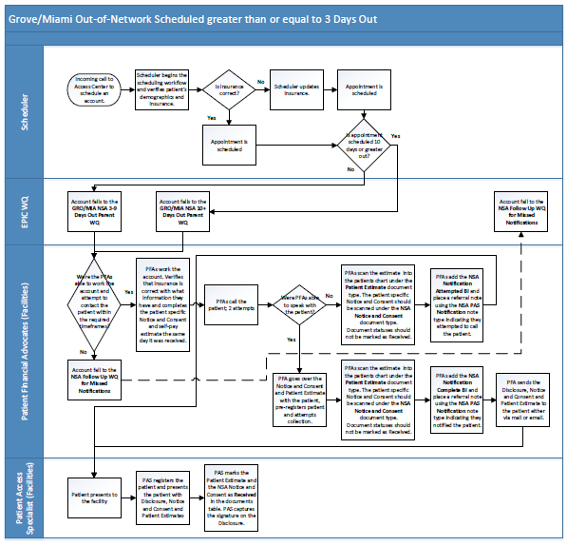
Scheduled Services Workflow
Notes:
We have 3 workflows divided out by timeframe.

Slide 15
Post-Stabilization
Post-Stabilization Care—Out-of-Network Providers and Out-of-Network Facilities
Requirements to meet Post-Stabilization status—all four must be met
the patient is able to travel using non-medical transportation or non-emergency medical transportation to an available in-network provider or facility located within a reasonable travel distance (protecting patients receiving emergency care far from their plan’s provider network);
the provider or facility furnishing the post-stabilization services satisfies the notice and consent criteria set forth in the Interim Final Rule;
the patient is in a condition to understand the notice and provide informed consent; and
the provider or facility satisfies any additional requirements or prohibitions under applicable state law (for example, some state laws do not permit patients to waive protections in any circumstance).
Oklahoma does not have any balance billing laws
​
​

Slide 16
Post-Stabilization
Post-Stabilization Care—Out-of-Network Providers and Out-of-Network Facilities (Cont.)
Balance billing protections apply even in observation and inpatient settings until post-stabilization status has been deemed
Patient may refuse to sign the consent
Facility is bound to the provider’s decision regarding post-stabilization status
​
​
Notes:
When giving notice and seeking consent from individuals to waive their balance billing protections under the No Surprises Act, providers and facilities must use standard notice and consent documents developed by HHS.
The standard notice and consent documents were published as part of CMS Form Number 10780 and are available for download on CMS.gov.
Providers and facilities must tailor the standard notice with individual- and provider-specific information.
Provider/Facility supplied information in notice document: •
Patient Name •
Out-of-network provider(s) or facility name •
Statement that the health care provider is an out-of-network provider, with respect to the health plan or coverage •
Good faith estimates of the amount the individual may be charged for items or services delivered by the out-of-network provider(s) or facility •
Statement that prior authorization or other care management limitations may be required •
For post-stabilization services furnished by an out-of-network provider in an in-network emergency facility: A list of in-network providers at the facility able to deliver needed items or services

Slide 17
Knowledge Check
Patient, from Maine, is travelling cross county and needs emergent care. Patient presents to the Emergency Room in Oklahoma City and requires surgery and an inpatient stay. The patient is stabilized after surgery and can be transported by ambulance.
Patient is out-of-network for physicians and facility
The patient signs the Notice of Surprise Billing Protections & Consent and receives a good faith estimate.
Can the provider and facility balance bill?
​
​
Notes:
Scalable

Slide 18
Knowledge Check
No, in this scenario, the patient does not meet the first requirement to qualify for post-stabilization status because he needs to travel via ambulance.
Until all post-stabilization criteria are met, the balance billing protections apply and the provider and facility are prohibited from balance billing
​
​
Notes:
Scalable

Slide 19
Knowledge Check
Out-of-Network patient presents for emergency care, requires surgery and a 7-day inpatient post-operative stay
Patient meets the post-stabilization criteria on day 3 of inpatient stay
Facility presents the patient with the 4 required documents
Can the provider and facility balance bill?
​
​
Notes:
Scalable

Slide 20
Knowledge Check
Trick Question…Surprise!!
2 Outcomes
No, patient refuses to sign the consent—balance billing protections still apply
Yes, patient signs the consent—provider(s) and facility may balance bill for services after the date the consent was signed
​
​
Notes:
Scalable

Slide 21
Post-Stabilization Workflow
Notes:
Parties Involved
Patient
Physician
Case Management
Transfer Center
Patient Registration
Access Center

Slide 22
Continuity of Care
A health care provider or facility that ends a contractual relationship with a plan or issuer and has a continuing care patient:
Must, generally, in cases where the contractual relationship between a plan or issuer and a provider or facility ends, resulting in a change in the provider or facility’s network status with the plan:
Accept payment from the plan or issuer (and cost-sharing payments) for a continuing care patient at the previously agreed to payment amount for up to 90 days after the date on which the patient was notified of the change in the provider’s network status.
Continue to adhere to all policies, procedures and quality standards imposed by the plan or issuer for such items or services as if the contract were still in place.
​
​
Notes:
When giving notice and seeking consent from individuals to waive their balance billing protections under the No Surprises Act, providers and facilities must use standard notice and consent documents developed by HHS.
The standard notice and consent documents were published as part of CMS Form Number 10780 and are available for download on CMS.gov.
Providers and facilities must tailor the standard notice with individual- and provider-specific information.
Provider/Facility supplied information in notice document: •
Patient Name •
Out-of-network provider(s) or facility name •
Statement that the health care provider is an out-of-network provider, with respect to the health plan or coverage •
Good faith estimates of the amount the individual may be charged for items or services delivered by the out-of-network provider(s) or facility •
Statement that prior authorization or other care management limitations may be required •
For post-stabilization services furnished by an out-of-network provider in an in-network emergency facility: A list of in-network providers at the facility able to deliver needed items or services

Slide 23
Provider Directories
Any health care provider or health care facility that has or has had a contractual relationship with a plan or issuer to provide items or services under such plan or insurance coverage:
Must submit provider directory information to a plan or issuer, at a minimum:
At the beginning of the network agreement with a plan or issuer,
At the time of termination of a network agreement with a plan or issuer,
When there are material changes to the content of the provider directory information of the provider or facility, Upon request by the plan or issuer, and
At any other time determined appropriate by the provider, facility, or HHS.
​
​
Notes:
Scalable

Slide 24
Enforcement & Monetary Penalties
Enforcement has been minimal.
Under the statute, CMS will only enforce a provision with respect to the applicable regulated parties if CMS determines that a state is not substantially enforcing that provision. This can occur, for example, when a state lacks authority to enforce, or requests that CMS enforce, one or more provisions.
Insurers can be fined up to $100 per patient per day for “balance billing” in violation of the act.
Providers can face monetary penalties of up to $10,000 per violation.
​
​
Notes:
Scalable

Slide 25
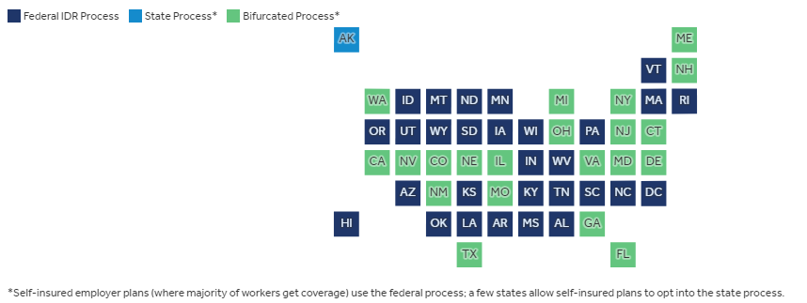
Independent Dispute Resolution (IDR)
Takes the patient out of the dispute process for out-of-network bills
Federal and State IDR processes
Oklahoma follows the Federal IDR process
Notes:
The protections cover people with private insurance (including employer-based coverage, non-group plans, and grandfathered plans). The patient’s cost sharing amount for out-of-network services and items covered under the law is required to be no more than the in-network cost sharing.
To determine the plan payment to the out-of-network provider or facility, the No Surprises Act established an independent dispute resolution (IDR) process. The IDR process takes patients out of the disputes between the out-of-network provider’s asked price and plan payment for surprise bills. Instead, a third-party baseball-style arbitration process determines the plan payment amount.

Slide 26
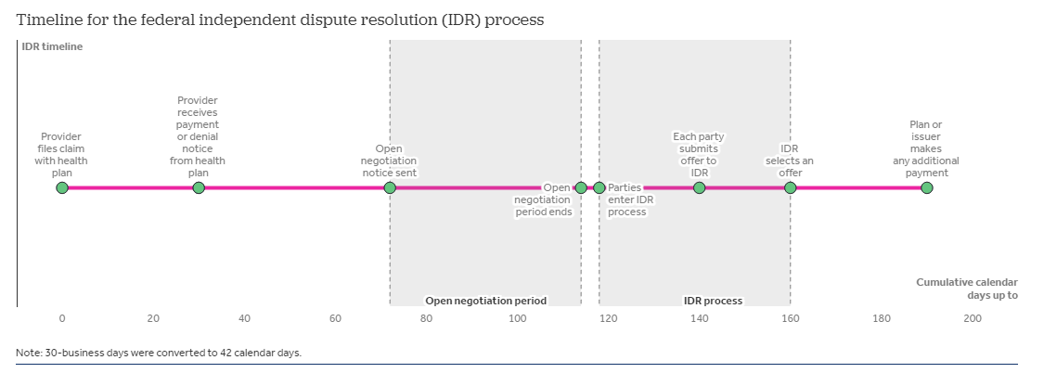
IDR Timeline
Notes:
After the provider files a claim, the plan generally has 30 days to make an initial determination on whether and how to cover a claim. Once a claim is filed, by day 30, the health plan must decide whether it will pay, deny, or adjust the claim. There are rules permitting extensions in certain circumstances, for example, if the plan determines the claim is incomplete, the plan could ask for additional information. On the date the health plan processes the surprise bill claim, it calculates the applicable in-network cost sharing amount based on the qualified payment amount (QPA)—which is the median in-network contracted rate by the health plan issuer in the same insurance market and region for the item or service. The plan informs the out-of-network provider of the patient’s responsibility and issues an explanation of benefits (EOB) to the patient showing the applicable in-network cost sharing that the patient owes the provider.
Open negotiation period must be exhausted before initiating a federal IDR process. After the plan determination, the plan or provider initiate open negotiation on the payment. Parties must exhaust 30 business days (or about 42 calendar days) of open negotiations before entering the federal IDR process. If the parties do not reach an agreement after open negotiation, either party can initiate the federal IDR process within 4 business days following the end of open negotiations.
Federal independent dispute resolution entities select one of the offers submitted. Parties have 10 business days to select a certified IDR entity and submit offers of payment. IDR entities are third-party organizations that are certified by the federal government to arbitrate the payment amount between plans and providers. The selected IDR entity picks one of the two offers within 30 business days of offer submissions. In selecting the offer, the IDR entity considers the QPA and additional supporting materials. Additional supporting materials can include provider’s or facility’s quality, market share, and complexity of population served. The IDR entity is not allowed to consider typical provider charges or public payers’ payment rates. From IDR entity selection to the IDR entity selecting an offer can take up to about 62 calendar days. Once the IDR selects one of the offers submitted by the plan or the provider, the health plan has 30 calendar days to make any additional payments. From the claim determination to any additional payment being made can take over 6 months.
Providers not participating in any plan networks could face longer timelines for reimbursement. The time from plan initial claim determination to IDR decision and plan payment could take over 6 months. Providers with many out-of-network claims could face cashflow issues while waiting to resolve payment disputes.

Slide 27
IDR Disputes
Notes:
According to the Centers for Medicare and Medicaid Services (CMS), which is responsible for implementing the law, 90,000 disputes were initiated through the federal IDR process from April to September of 2022. Disputes initiated in this period exceeded CMS’ initial estimate of less than 20,000 for the entire year. Similar disputes between the same provider and plan are required to be batched and so we do not know how many out-of-network items or services were disputed through the federal IDR process.
Half of disputes submitted (46%) were challenged by the other party and 18% were found ineligible for the federal IDR process. The non-initiating party can challenge the dispute’s eligibility for the federal IDR process. The dispute can be found ineligible if state jurisdiction applies, incomplete or incorrect information is submitted, submission does not comply with requirements, or the open negotiation period has not been exhausted.
Of the disputes initiated in the April to September 2022 period, less than 4% were issued payment determinations. Most of the disputes initiated were awaiting eligibility or payment determination.

Slide 28
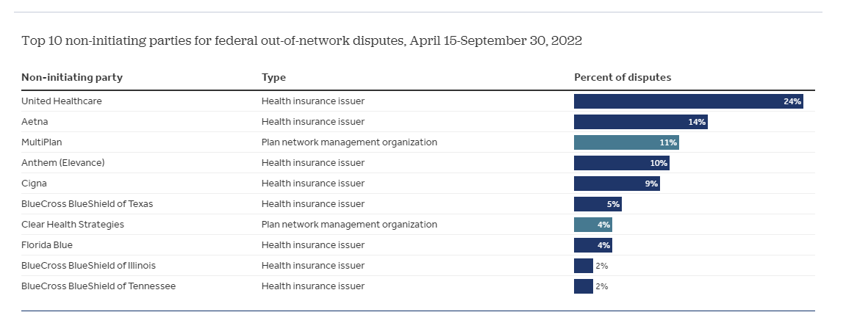
IDR Non-Initiating Parties
Notes:
Over 8 in 10 disputes (85%) were initiated against 10 entities. Of these, 8 are health insurers with 70% of the disputes and the others (Clear Health Strategies and Multiplan) are entities that help insurers with their provider networks.

Slide 29
IDR Costs
Losing party is responsible for the IDR fees
2023 IDR Fee
$350 to $700 for a single determination
$475 to $938 for batched determinations
The IDR incentivizes good faith plan and provider offers during the process.
​
​
Notes:
When giving notice and seeking consent from individuals to waive their balance billing protections under the No Surprises Act, providers and facilities must use standard notice and consent documents developed by HHS.
The standard notice and consent documents were published as part of CMS Form Number 10780 and are available for download on CMS.gov.
Providers and facilities must tailor the standard notice with individual- and provider-specific information.
Provider/Facility supplied information in notice document: •
Patient Name •
Out-of-network provider(s) or facility name •
Statement that the health care provider is an out-of-network provider, with respect to the health plan or coverage •
Good faith estimates of the amount the individual may be charged for items or services delivered by the out-of-network provider(s) or facility •
Statement that prior authorization or other care management limitations may be required •
For post-stabilization services furnished by an out-of-network provider in an in-network emergency facility: A list of in-network providers at the facility able to deliver needed items or services

Slide 30
Ongoing Litigation with the IDR
TMA has previously sued HHS twice resulting in new rules
TMA sues again 9/22/22
TMA successful in TMA I, now we are in TMA II
Battle is for appropriate standard to determine rate of out of network health care provider services in NSA
Lawsuit challenges 4 aspects of Regulations:
1) Rules wrongly require arbitrators to prioritize QPA in violation of NSA plain language
2) Rules exempt QPA from credibility requirements since there is no oversight from payors of how QPA is calculated
3) Rules now require arbitrators to evaluate all info except QPA
4) Rules allow arbitrators to double count QPA
→AHA has filed amicus brief in support of TMA
Notes:
Provider groups have challenged the No Surprises Act and the implementation of the law in multiple lawsuits. A lawsuit brought by the Texas Medical Association resulted in the United States District Court for the Eastern District of Texas setting aside parts of the initial No Surprises Act implementing regulations, including the requirement that IDR entities presume that the QPA amount is the appropriate rate for the claim, absent additional information. Another requirement, that the certified IDR entity select the offer closest to the QPA unless additional credible information indicates otherwise, was also vacated. In response to this court ruling, the Biden Administration issued a final rule in August 2022 requiring the IDR entities to consider the QPA first and then consider other submitted justifications in addition to the QPA in selecting an offer. On February 6, 2023, the U.S. District Court for the Eastern District of Texas again ruled in favor of the Texas Medical Association in another challenge to the IDR regulations and ruled the August 2022 final rule unlawfully favors the QPA. In response to this ruling, federal regulators initially asked IDR entities to hold payment determinations. On February 24, 2023, federal regulators asked IDR entities to resume payment determinations for disputes involving items or services furnished before October 25, 2022, and to continue holding payment determinations for those furnished on or after October 25, 2022, until further guidance. On March 17, 2023, federal regulators posted updated guidance in response to the February 6, 2023 decision, and resumed IDR payment determinations for all disputes. Other challenges are pending and will determine the future of the No Surprises Act implementation.

Slide 31
Delayed Components of the No Surprises Act
CMS announced that for the period January 1, 2022, to December 31, 2023, it will exercise its enforcement discretion in cases in which the Good Faith Estimate provided to a self-pay patient does not include expected charges from co-providers.
Notes:
The challenges cited are as follows:
The No Surprises Act requires providers and facilities to exchange billing information and codes with all co-providers and co-facilities. There is currently no system that allows unaffiliated providers to share information with affiliated providers. In other words, a doctor who treats patients in an in-network hospital cannot provide the hospital with an estimate for treatment; they can only bill after.
Case management systems do not send bills and invoices to other providers but only to the insurance companies. Compliance with No Surprises Act regulations would require manual input for all estimates, which would likely take more time than the three-day limit set by No Surprises Act.
There is no standardized system for sharing patient information, treatment codes, and other medical information in the manner required to create the estimate. AHA raised concerns that some of this data-sharing is restricted by HIPAA, hence the need to bill insurers directly.
Without a standardized, automated system, provider variance and incompatibility between systems will likely lead to errors, additional delay, and increased administrative costs.

Slide 32
Delayed Components of the No Surprises Act
CMS announced that it will exercise its enforcement discretion regarding the requirement for providers to provide a Good Faith Estimates to Insurers who then provide Advance Explanation of Benefits to patients.
Notes:
The AHA and AMA specifically mentioned concerns in three areas:
Differences in information to be collected. The letter noted vast differences between providers, forms, and types of information currently gathered in creating an estimate.
The standard should follow the existing system as closely as possible to utilize existing infrastructure, processes, and training. The AMA and AHA were concerned about the need for extensive retraining and retooling for new processes under discussion.
AEOB requirements would apply to more than 61% of Americans with commercial health insurance. The one-day requirement for an AEOB would either require an influx of new staff or place unsustainable burdens on the healthcare system to handle the administrative work and continue providing care.

Slide 33
Why the Delay?
HHS has received comments and feedback indicating that compliance with this provision is likely not possible by January 1, 2023, given the complexities involved with developing the technical infrastructure and business practices necessary for convening providers and facilities to exchange GFE data with co-providers and co-facilities.
Stakeholders have requested that HHS further delay the enforcement of this provision until HHS has established a standard technology or transaction to automate the creation of comprehensive GFEs and given providers and facilities sufficient time to implement such standards.
Notes:
The AHA and AMA specifically mentioned concerns in three areas:
Differences in information to be collected. The letter noted vast differences between providers, forms, and types of information currently gathered in creating an estimate.
The standard should follow the existing system as closely as possible to utilize existing infrastructure, processes, and training. The AMA and AHA were concerned about the need for extensive retraining and retooling for new processes under discussion.
AEOB requirements would apply to more than 61% of Americans with commercial health insurance. The one-day requirement for an AEOB would either require an influx of new staff or place unsustainable burdens on the healthcare system to handle the administrative work and continue providing care.

Slide 34
Thank you
Amy Trogdon
405-713-6006​
Amy.Trogdon@integrisok.com
www.integrisok.com

