Slide 1
and Protect Revenue with Supply Chain Logistics Data
Chad Pfaff, VP of Product
Amber Bielak, Product Manager
Notes:
CHAD
Good morning, everyone and thank you for joining us today.
Before we dive into our presentation, I'd like to take a moment to introduce ourselves and provide a little background on our company.
I’m Chad Pfaff, and I’ve had the privilege of working with VPL for almost 9 years.
Here with me today is Amber Bielak, who is the driving force behind our data and analytics solutions and has been with us for a little over 3 years now.
Together, we'll be walking you through how you can maximize cost savings using supply chain logistics data.
[NEXT SLIDE]

Slide 2
About VPL
20
Years of experience in
healthcare supply chain
A freight, visibility analytics and compliance solution designed to modernize and continuously improve your supply chains from vendor to patient.
700+
Hospitals, Pharmacies, and
Ambulatory Surgery Centers
97%
Customer retention rate
Notes:
CHAD
Let's start with a bit about VPL and who we are.
We’ve been supporting healthcare supply chains for more than 20 years. In fact, our founders brought the original legacy freight management to the market back then, which is still used by some companies today.
And then about 10 years ago, they went back to the drawing board to launch VPL, but this time driven by technology, transparency, and ongoing cost savings.
Our cost-focused visibility and compliance platform leverages freight data to enable critical, clinical supply chains to save money and maximize operational performance.
We take pride in fostering collaboration and continuous optimization among supply chain partners, and we're excited to share our insights with you today.
So, enough about us! It’s time to shift the focus to you.
[NEXT SLIDE]

Slide 3
Agenda
Industry trends
Four key areas to focus on
Live demo
Q&A
Notes:
CHAD
Here’s a look at our agenda for today:
Industry trends – what does the market look like now, and where is it headed?
Four key areas to focus on – what are the four critical data points that demand your attention?
Live demo – we’ll show you our supply chain analytics & data visualization platform so you can see it in action.
And lastly, we’ll wrap up the presentation with a Q&A session.
[NEXT SLIDE]

Slide 4
Industry trends
Notes:
CHAD
Before diving into the details of leveraging data, let's briefly discuss why it's important to focus on your health system's supply chain data now more than ever.
[NEXT SLIDE]

Slide 5
U.S. Inflation Hit 40-Year High in 2022
The impact of inflation has driven up healthcare input costs significantly:
National healthcare spending to increase by $370 billion within next five years¹
Supply chain issues will cause non-labor costs to increase by up to $110 billion in the next five years²
Between 2019-2022, labor costs per adjusted hospital discharge grew 25%, closely followed by pharmaceuticals at 21%, supplies at 18%, and services at 16%¹
1 Fleron, A., Krishna, A., & Singhal, S. (2022, September 19). The gathering storm: The transformative impact of inflation on the healthcare sector [web log]. Retrieved January 24, 2023, from https://www.mckinsey.com/industries/healthcare/our-insights/the-gathering-storm-the-transformative-impact-of-inflation-on-the-healthcare-sector.
2 Bailey, V. (2022, September 26). Inflation, Labor Costs Will Increase Healthcare Spending by $370B [web log]. Retrieved January 24, 2023, from https://revcycleintelligence.com/news/inflation-labor-costs-will-increase-healthcare-spending-by-370b
Notes:
CHAD
Last year we saw U.S. inflation hit a 40-year high, and it caused healthcare input costs to surge across the board.
Looking ahead, within the next five years, national healthcare spending is projected to increase by a whopping $370 billion, and supply chain challenges could contribute to a potential $110 billion hike in non-labor costs.
Additionally, the cost of supplies grew by 18% between 2019 and 2022.
[NEXT SLIDE]

Slide 6
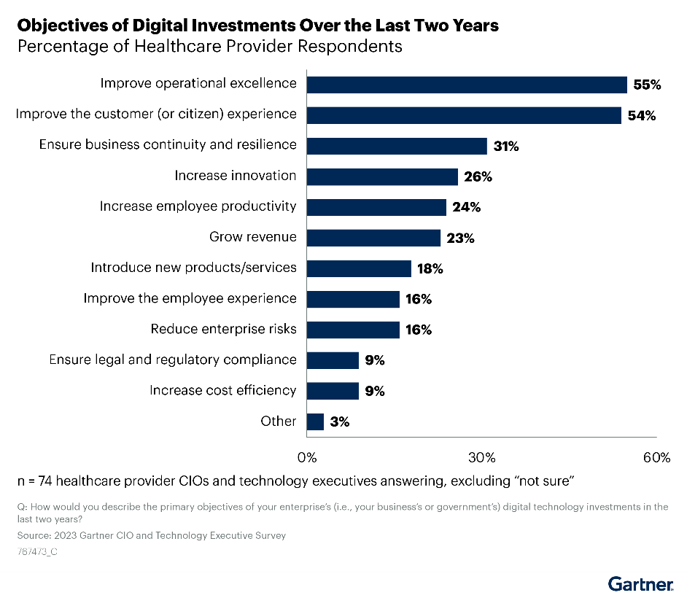
Investment Priorities Are Shifting
Notes:
CHAD
With these mounting costs in mind, providers are actively exploring innovative approaches to manage expenses, allocate resources effectively, and enhance the delivery of patient care – and they are turning to technology as a strategic tool to navigate these initiatives.
Gartner recently asked healthcare providers how they would describe the primary objectives of their digital investments in the last 2 years.
As you can see, operational excellence, resilience, revenue growth, and cost-efficiency have been top-of-mind.
In our journey to address these challenges, one fundamental principle stands out…..
[NEXT SLIDE]

Slide 7
If you can't see it, you can't fix it.
Notes:
CHAD
If you can't see the problem, you can't fix it.
[NEXT SLIDE]

Slide 8
Data Transparency Is Everything
Healthcare providers struggle to gain a comprehensive view of all data associated with how products move into and throughout the healthcare system.
Most health systems are overspending by at least:
VPL increases the average customer’s managed freight volume by:
20% for inbound freight
10 – 15%
30% for outbound freight
While unmanaged freight costs as much as 1.5x more per shipment
Notes:
CHAD
So, here's the thing: a big part of the issue is that most healthcare-specific supply chain solutions don't really focus on data transparency.
As a result, healthcare providers often find themselves in a bit of a pickle, lacking a complete picture of what's going on with the movement of products in their own systems.
But let's zoom out for a moment and get a better sense of the problem.
On average, most health systems are overspending by at least 20% on inbound freight and 30% on outbound freight.
Additionally, some are even shelling out 1.5 times more than they should on unmanaged shipments.
These numbers don't just tell us there's an issue; they scream out loud that we've got a real problem here.
It's crystal clear that we need to step up our game when it comes to data transparency in healthcare supply chains.
[NEXT SLIDE]

Slide 9
Barriers to Transparency
What’s really blocking transparency in logistics?
Lack of carrier flexibility
Single carrier solutions limits your range of service and pricing options
Hidden margin models
Obscured cost breakdown (carrier fee + undisclosed profit margin)
Percentage mark-up on express shipments
Notes:
CHAD
Now let's pivot to barriers to transparency.
There’s two primary factors that contribute to the problem:
1) Many providers struggle to offer the flexibility needed to meet your specific needs, limiting your options in terms of services and pricing.
2) Unfortunately, providers often utilize hidden margin models that make it difficult to see the true cost breakdown such as carrier fees and undisclosed profit margins. Additionally, you might encounter situations where there’s a percentage mark-up on express shipments, which can add unnecessary costs.
These challenges highlight the need for a more transparent and flexible approach in the healthcare supply chain industry.
[NEXT SLIDE]

Slide 10
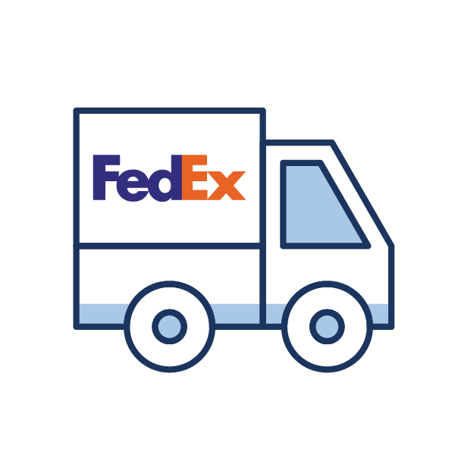
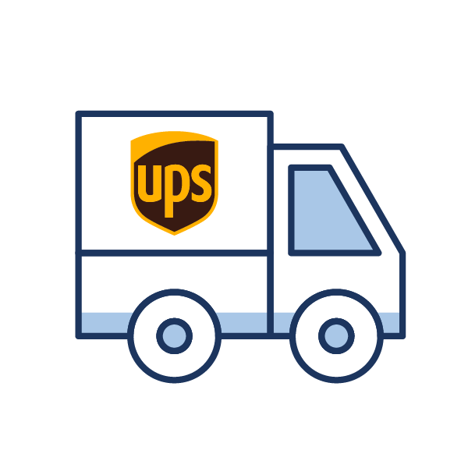
Key Considerations for Logistics Partnerships
Choice
Transparency
Legacy programs
FedEx
Guaranteed Incremental Savings!
$$$
Hidden Margin Model
UPS
$
Flat Shipment Fee
USPS
Other
Notes:
CHAD
Whether you’re choosing between logistics providers or evaluating your current partner, there are some important things you should keep in mind:
Multi-carrier shipping options
It's essential to have access to multiple carriers because not all suppliers prefer working with a single carrier.
A good logistics provider should offer shipping options through FedEx, UPS, and USPS for shipments from suppliers.
This approach allows you to bring a broader range of suppliers into your program, increasing opportunities for cost savings in your supply chain.
Varied discounts
Look for a provider that provides access to a range of discounted rates. This means your ideal provider should help you tap into contracted carrier discounts.
Whether it's utilizing your GPO FedEx rates, State Government rates, or negotiated rates, your provider should align each supplier with the best rates for every carrier.
There should be no hidden fees or unexpected mark-ups, just complete transparency in your cost structure.
Flexibility for change
Change is inevitable, and your logistics provider should be adaptable.
If your health system or GPO secures better rates with one carrier or the other, the transition should be seamless for your suppliers.
Flexibility isn't just about rates; your provider should also have the ability to switch carriers swiftly in response to service issues or labor strikes.
This ensures a dependable and smooth supply chain, even in challenging situations.
Transparency
While not the standard practice, transparency should be a hallmark of your ideal provider.
You'll have the core carrier charge and the program management fee to consider.
These fees should be crystal clear, ideally specified per shipment, ensuring you're always well-informed about your costs.
This approach is fairer and aligns better with your cost-saving objectives compared to percentage mark-ups on carrier costs, which can lead to higher expenses, particularly for express shipments.
[NEXT SLIDE]

Slide 11
Four key areas to focus on
Notes:
CHAD
With this understanding as our foundation, let's explore the four ways your health system can leverage our supply chain logistics data to slash costs and protect revenue!
[NEXT SLIDE]

Slide 12
Inbound Freight Analytics
#1
Evaluate total spend within each health systems’ locations
Track volume, spend, and avg. cost per shipment by each carrier
Monitor carrier mix % over time
Categorize actionable carrier surcharges
Identify service level optimization opportunities
Confidential | VPL | 2023
Notes:
CHAD
The first area of focus would be through our inbound freight analytics. Shipments being received within your health system.
Our data makes it easy to Identify service level optimization opportunities to increase cost savings. For example, there are instances when FedEx First Overnight or UPS Early AM shipments could have been shipped Priority Overnight with only a different of 2 hours in arrival times. Often these shipments arrive on the same truck but there is a significant difference in cost per shipment.
Additional areas you can focus on include:
Evaluate total spend within each health systems’ locations to monitor budgeting and purchasing behaviors
Track volume, spend, and average cost per shipment through each carrier
Monitor carrier mix % over time (What is the total volume between UPS and FedEx)
Categorize and distinguish between actionable and non-actionable carrier surcharges
[NEXT SLIDE]

Slide 13
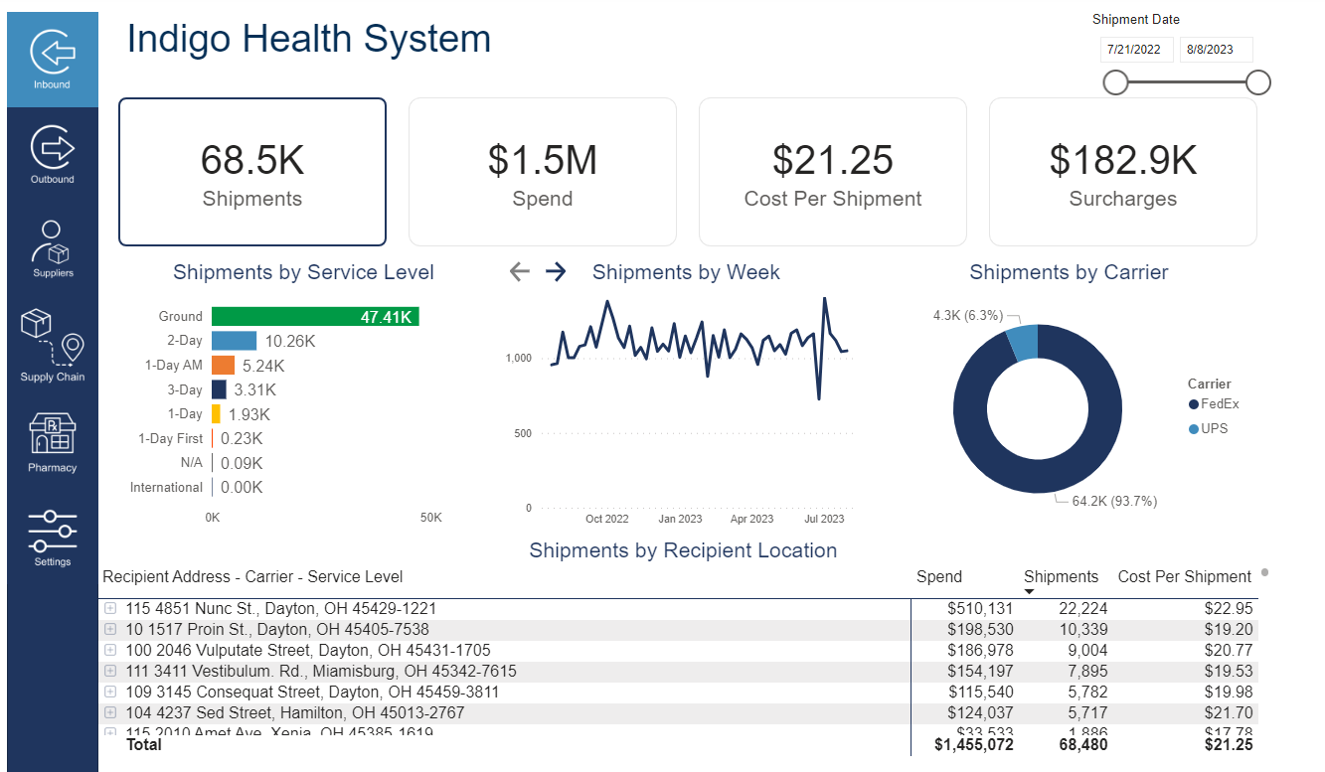
Use Case
Inbound Freight Analytics
Problem
“I want to be ability to identify service level optimization opportunities in order to increase cost savings.”
Notes:
AMBER
Here is an example use case we often hear from customers.
Problem
“I want to be ability to identify service level optimization opportunities in order to increase cost savings.” Service level opportunities again refer to those really expensive overnight deliveries that can possibly be converted to less costly service levels in the future through identifying who the supplier is and which departments are shipping these types of service levels. Our data can provide these answers!
Solution:
VPL provides visuals to trend service level mix by % of volume and spend over time to identify cost savings opportunities.
Customers can drill down into express service levels and increase cost savings by changing supplier shipping behaviors or ordering behaviors through their buyers.
[NEXT SLIDE]

Slide 14
Customer Story
Inbound Freight Analytics
Cause
A supplier opted for express-level shipping due to back orders.
Result
The customer received a $30,000 credit from the supplier.
Notes:
AMBER
We have a customer that was experiencing several expensive overnighted shipments shipped through a particular supplier. When looking deeper and driving conversations with the supplier, the supplier shared its because they are experiencing back orders and needed to ship express to get the customer their products on time. However, express shipments were not apart of the customers request. The result was the supplier issuing over $30k worth of credits to the customer. Without our easy to read data, this would have been a missed opportunity.
[NEXT SLIDE]

Slide 15
Outbound Shipping Analytics
#2
Evaluate total spend, volume, and average cost per shipment by shipper and shipper location
Drill down to carrier and service levels to trend shipping behaviors
Review correlated shipment details to drive internal conversation
Example: Labs will ship express levels due to sensitive blood tissue samples
Address costly shipping behaviors by identifying shippers using suboptimal carrier service levels against recommended options
Notes:
CHAD
The next area of focus would be through our outbound shipping analytics. Shipments being shipped outside of your health system
Through our data you can target costly shipping behaviors by identifying shippers using suboptimal carrier service levels against recommended options that could have arrived within the same timeframe based upon desired delivery date.
In addition, our data product allows our customers to also focus on:
Evaluating total spend, volume, and avg. cost per shipment by shipper and shipper location
Drill down to carrier and service levels to trend shipping behaviors
Review correlated shipment details to drive internal conversation
Example: Labs will ship express levels due to sensitive blood tissue samples
[NEXT SLIDE]

Slide 16
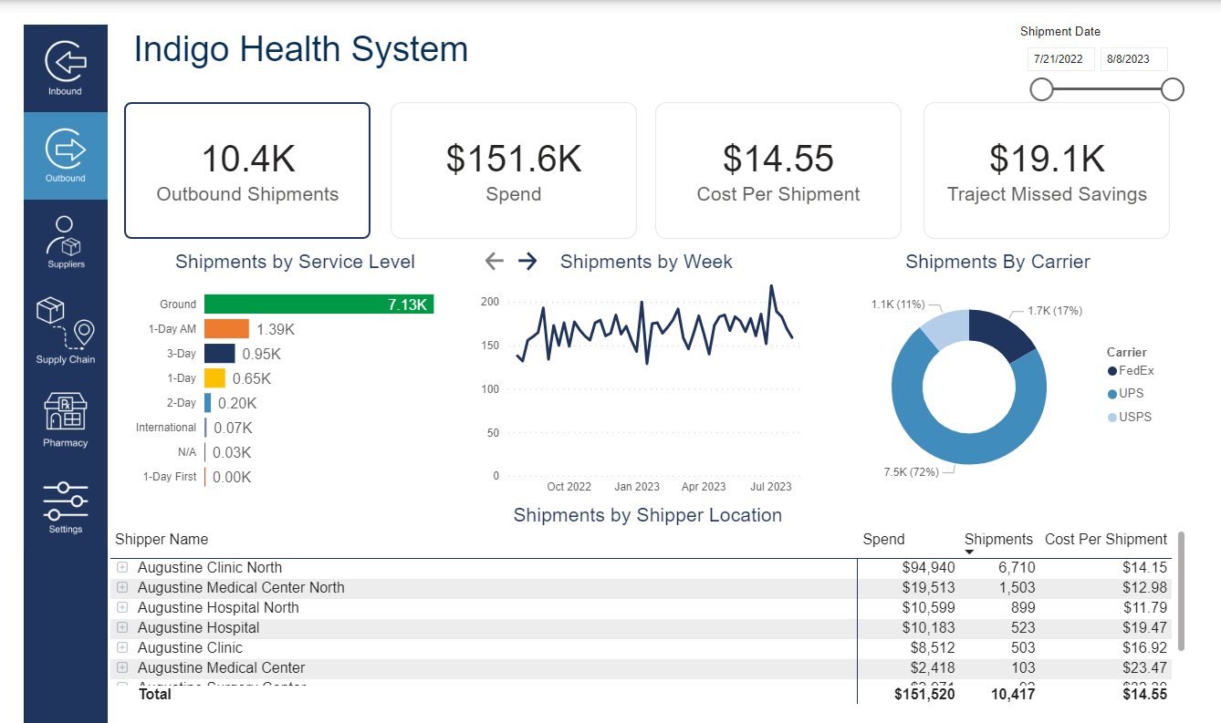
Use Case
Outbound Shipping Analytics
Problem
“I need to review which shippers are shipping express levels in order to conduct internal conversations to learn why and potentially change shipping behaviors.”
Notes:
AMBER
Problem
“I need to review which shippers are shipping express levels in order to conduct internal conversations to learn why and potentially change shipping behaviors.”
Again outbound shipments her referring to internal shippers within a health system shipping packages outside of their health system.
Solution:
VPL provides an aggregated table to show total spend, volume and average cost per shipment by shipper and shipper location. In addition to service level mix trending visuals.
Customers can drill down to carrier and service levels to trend shipping behaviors.
Customers can also review correlated shipment details to drive internal conversations. Ex. Labs will ship express levels due to sensitive blood tissue samples. Another perk of our program is that we offer our own outbound shipping platform that captures more details versus shipping through carrier sites.
[NEXT SLIDE]

Slide 17
Customer Story
Inbound Freight Analytics
Cause
Customers were not maximizing the efficiency of their shipments.
Result
Our Customer Success Team identified and corrected shipping behaviors, resulting in $2 million in savings over 12 months.
Notes:
AMBER
Another great example of how our data breaks down missed savings opportunities through outbound shipping. Our outbound shipping platform presents the most cost effective service level based upon desired delivery date. When a customer chooses a more expensive carrier service level, that data is captured and easy to understand within our data analytics platform. Within the past year, we have identified $2M dollars in savings for our outbound customer base. Our customers are able to understand who the shipper was, what type of products they were shipping and what was the best service level presented to them. This data helps drive internal conversations to understand why and change operational shipping practices.
[NEXT SLIDE]

Slide 18
Supplier Analytics
#3
Evaluate total shipment volume, spend, and avg. cost per shipment by supplier
Monitor and trend supplier shipping behaviors over time
Identify suppliers who are not compliant with your freight program
Determine which suppliers are assessing fees, fee types and fee trends
Drive changes in buyer behaviors
Control prepaid and add spend
Notes:
CHAD
The third area of focus would be through our supplier analytics.
Our supplier analytics equips customers to control prepaid and add spend. Shipments that are invoiced directly from a supplier versus through their VPL program which are significantly more costly.
Supplier data allows empowers customers to:
Evaluate total shipment volume, spend, and avg. cost per shipment by supplier
Monitor and trend supplier shipping behaviors over time
Identify suppliers who are not compliant with your freight program
Determine which suppliers are assessing fees, fee types and fee trends
Drive changes in buyer behaviors to minimize minimum order fees
[NEXT SLIDE]

Slide 19
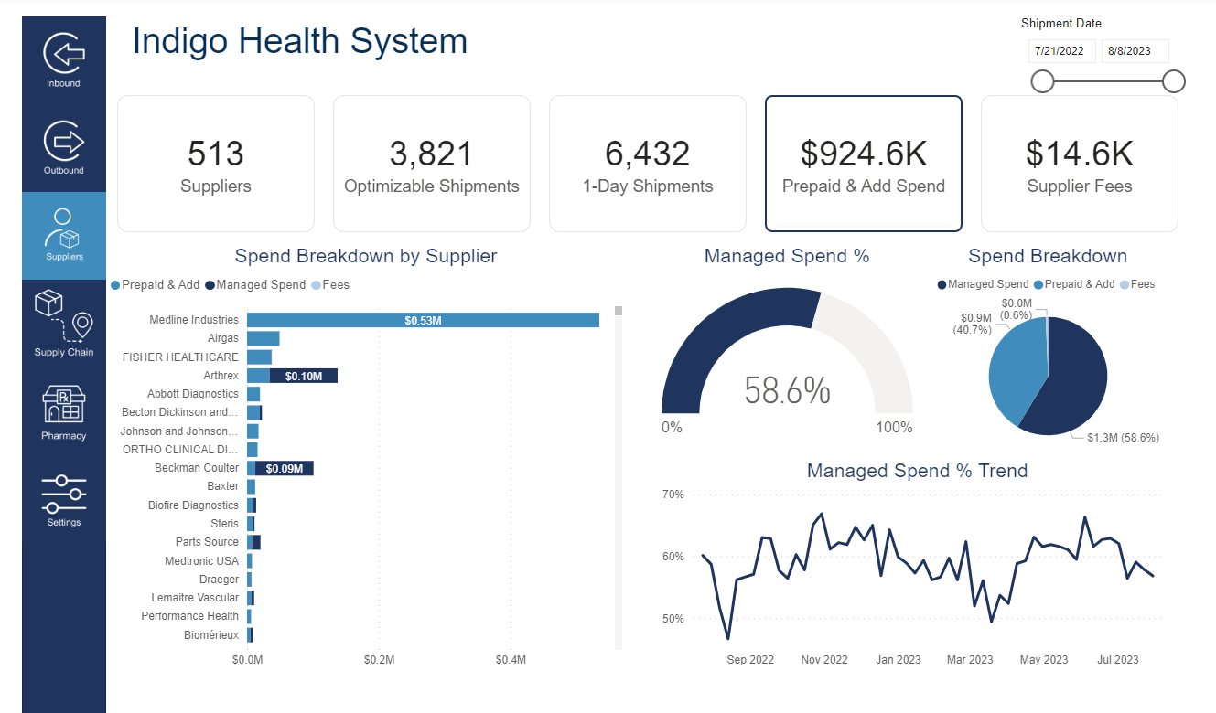
Use Case
Supplier Analytics
Problem
“I want to understand which suppliers not shipping through the VPL program so that I can increase my managed freight spend.”
Notes:
AMBER
Problem
“I want to understand which suppliers not shipping through the VPL program so that I can increase my managed freight spend.” This is really important because when supplier do not ship through VPL the typical invoice price is 1.5X more which really adds up!
Solution:
VPL's data product provides spend break down by suppliers to visually show managed spend and unmanaged spend.
Customers can identify suppliers who are not compliant with their VPL program and use this information to drive conversations with suppliers.
Customers can trend overtime if their managed spend is increasing or decreasing.
[NEXT SLIDE]

Slide 20
Customer Story
Inbound Freight Analytics
Cause
The discovery of an uncontracted PO% fee.
Result
We promptly identified and rectified this issue, saving the customer $50,000 in fees.
Notes:
AMBER
Here is an example of our data identifies supplier fees for our customers to understand what suppliers are charging them. One particular supplier was charging a purchase order % fee. When the customer reviewed their contracts with the supplier they quickly realized they should have never been charged this fee. Thus resulting in $50,000 worth of credits back to the customer.
[NEXT SLIDE]

Slide 21
Supplier & Carrier Performance Metrics
#4
Drill down to the supplier-level to review total late/on time shipments
Evaluate carrier performance metrics based upon service level agreements
Track carrier performance trends over time
Examine supplier lead times
Notes:
CHAD
The 4th area of focus would be through supplier & carrier performance metrics
Focus on late/on time shipments based upon service agreements to avoid disruptions. One of the many greats things about VPL is our customers have multiple carriers to choose from and can be nimble if needed.
Examine supplier lead times based upon purchase order request dates. How long is it taking your suppliers to fulfill orders? This information can help with inventory planning or driving supplier conversations.
[NEXT SLIDE]

Slide 22
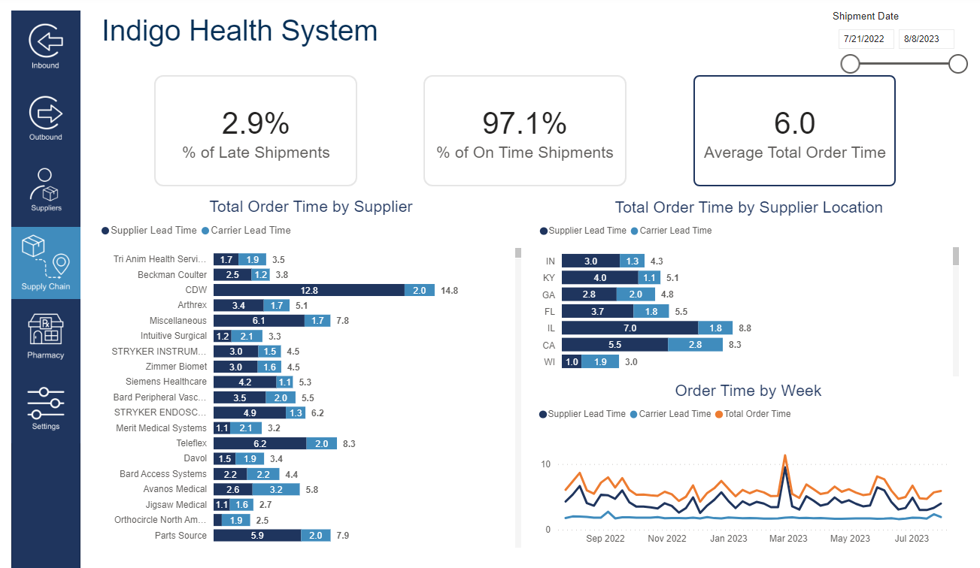
Use Case
Supplier Performance Metrics
Problem
“With consistent supply chain disruptions, I need to understand how long it’s taking suppliers to fulfill my orders so that I can drive supplier conversations to improve lead times or order from a different supplier.”
Notes:
AMBER
Problem
“With consistent supply chain disruptions, I need to understand how long it’s taking suppliers to fulfill my orders so that I can drive supplier conversations to improve lead times or order from a different supplier.”
Solution:
VPL breaks down supplier lead times by suppliers based upon purchase order request dates in addition to how it’s taking carriers to deliver their orders (carrier lead times) giving customers a full view of total order time.
Customers can drill down by supplier and supplier location to review supplier lead times. This information will equip customers to drive supplier conversations to improve lead times or order from an alternate supplier if necessary.
[NEXT SLIDE]

Slide 23
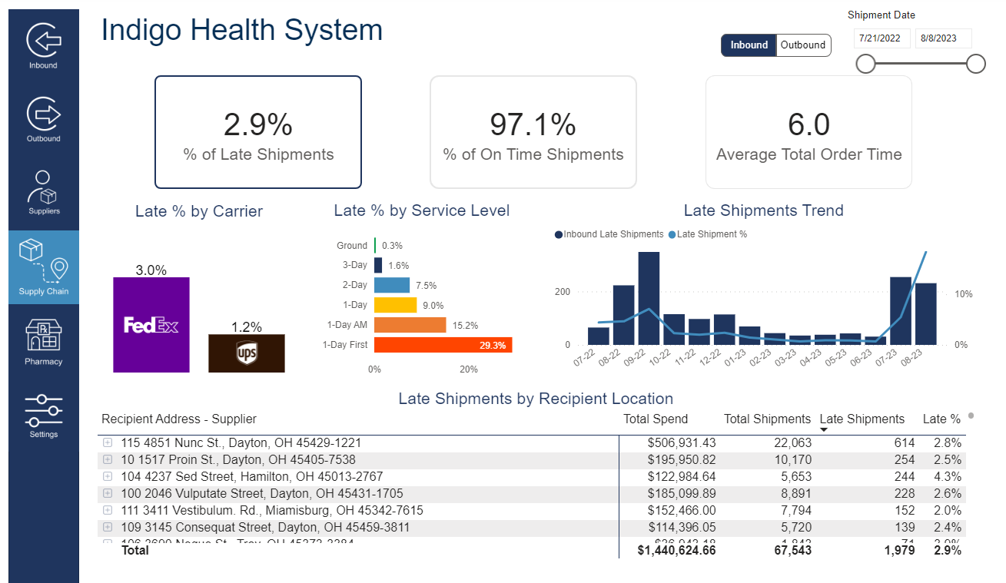
Use Case
Carrier Performance Metrics
Problem
“We have noticed shipments arriving late by FedEx at one of our main hospital locations but need more information to fully understand the problem before switching to UPS.”
Notes:
AMBER
Problem
“We have noticed shipments arriving late by FedEx at one of our main hospital locations but need more information to fully articulate the problem before switching to UPS.”
Solution:
VPL provides carrier performance metrics based upon each carrier's service level agreements.
We assess late shipments and on time shipments by recipient locations. Customers can drill down to the supplier displaying total spend, total volume, total late/on time shipments received at their hospital locations.
Customers can also trend carrier performance metrics overtime.
[NEXT SLIDE]

Slide 24
Customer Story
Inbound Freight Analytics
Cause
Delays at FedEx's Perrysburg, Ohio hub led to multiple late deliveries at the main hospital.
Result
The customer temporarily switched to UPS for shipping.
Notes:
AMBER
Customer proof point
In the past a customer identified that there was a slow down at FedEx’s hub in Perrysburg, Ohio after feeling the pain of several late deliveries to their main hospitals location. For a temporary period of time, the customer switched their distributors shipping via UPS. This data helps empower customers to make those shipping method decisions based upon carrier performance. It also showcases the power to choose between multiple carriers.
Another customer plans to use supplier lead time data to understand if some of their products are on back order and if they need to order a substitute product from a different supplier.
In addition, one of our customers plans to share supplier lead times with their Project Managers who are overseeing expansions/renovations within their health system so they can develop accurate timelines based on how long suppliers are taking to fulfill orders.
[NEXT SLIDE]

Slide 25
Live demo
Notes:
AMBER
Let's move into a live demo of our analytics solution where I can visually show you the various ways our data provides visibility and identifies ways to increase cost savings
[OPEN DEMO]

Slide 26
Q&A
Notes:
CHAD
Thank you for the great demo, Amber!
Before we wrap up, I'd like to open the floor to any questions you might have.
Whether it's about the topics we've covered or anything else related to our presentation, please feel free to ask.
[Pause to answer questions]
If that's all the questions we have today, then that concludes our presentation!
[NEXT SLIDE]

Slide 27
Thank you! To learn more, visit www.getvpl.com
Notes:
CHAD
Amber and I would like to thank you for your time and attention today.
We hope the insights and information we shared here today will prove valuable to you and your organization.
Should you have any questions or if you'd just like to chat, please don't hesitate to reach out to us!
Thanks again, and have a wonderful day!
[END PRESENTATION]

