Slide 1
Chapters and Regions
Notes:
1:15 – 2:00pm
Cindy

Slide 2
Chapters – The Heart and Soul of HFMA
Education programs - national as well as local issues/topics
Networking/social activities
Guidance and support
Leadership opportunities
All 59 chapters are within one of 11 Regions across the country

Slide 3
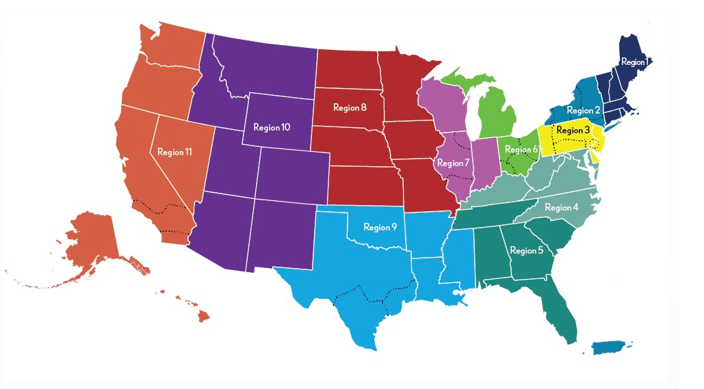
Chapters/Regions
Notes:
Highlight the chapters within your region - explore your chapter and region websites to become familiar with the content.
If you would like to get communications from other chapters, update your profile under My Chapter – can select up to 10 alternate chapters

Slide 4
Regional Executives
Serve as the primary volunteer leader between volunteers at the local level and the Association
Promote and lead change efforts to drive HFMA’s strategies
Foster dialogue and communication at all levels of HFMA
Represent the needs and interests of chapter leaders to the Regional Executive Council and to the HFMA National Board and staff
Work to create a seamless system of service
Encourage chapters to collaborate and help other chapters.
Oversight for DCMS (Davis Chapter Management System), Dashboard and Chapter Success Plan

Slide 5
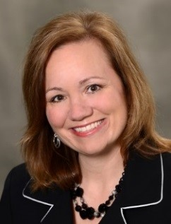
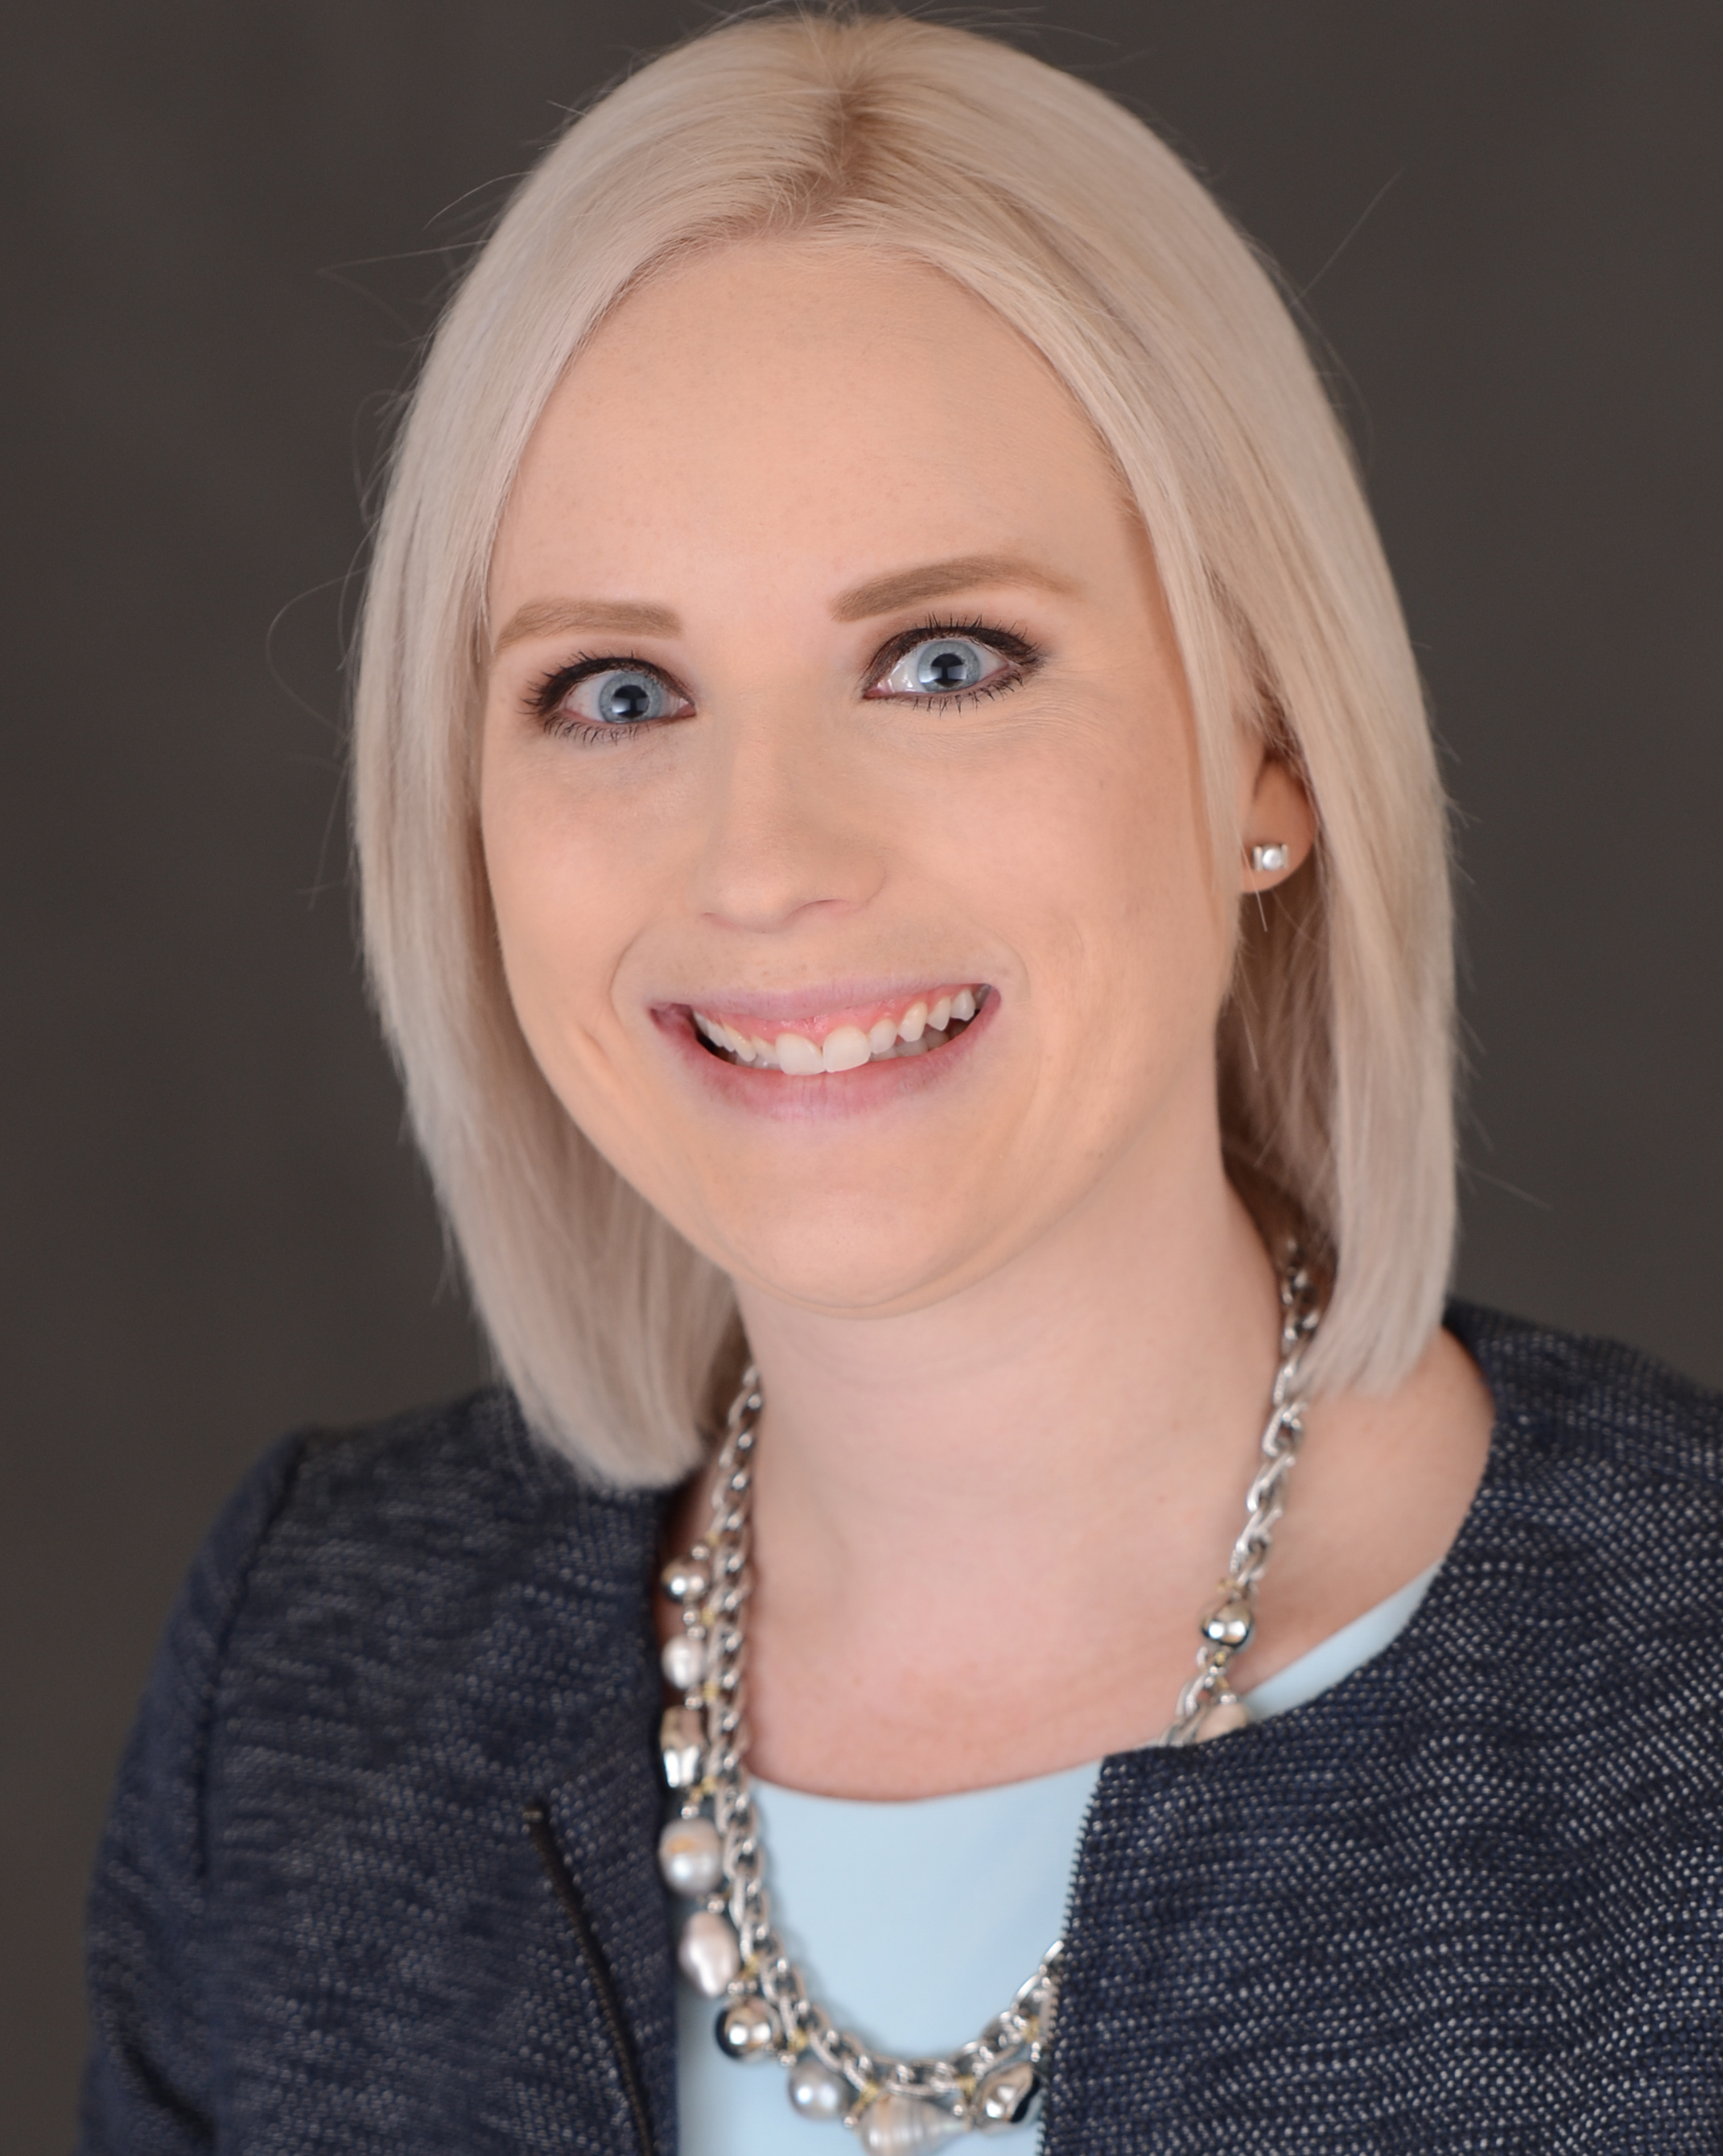
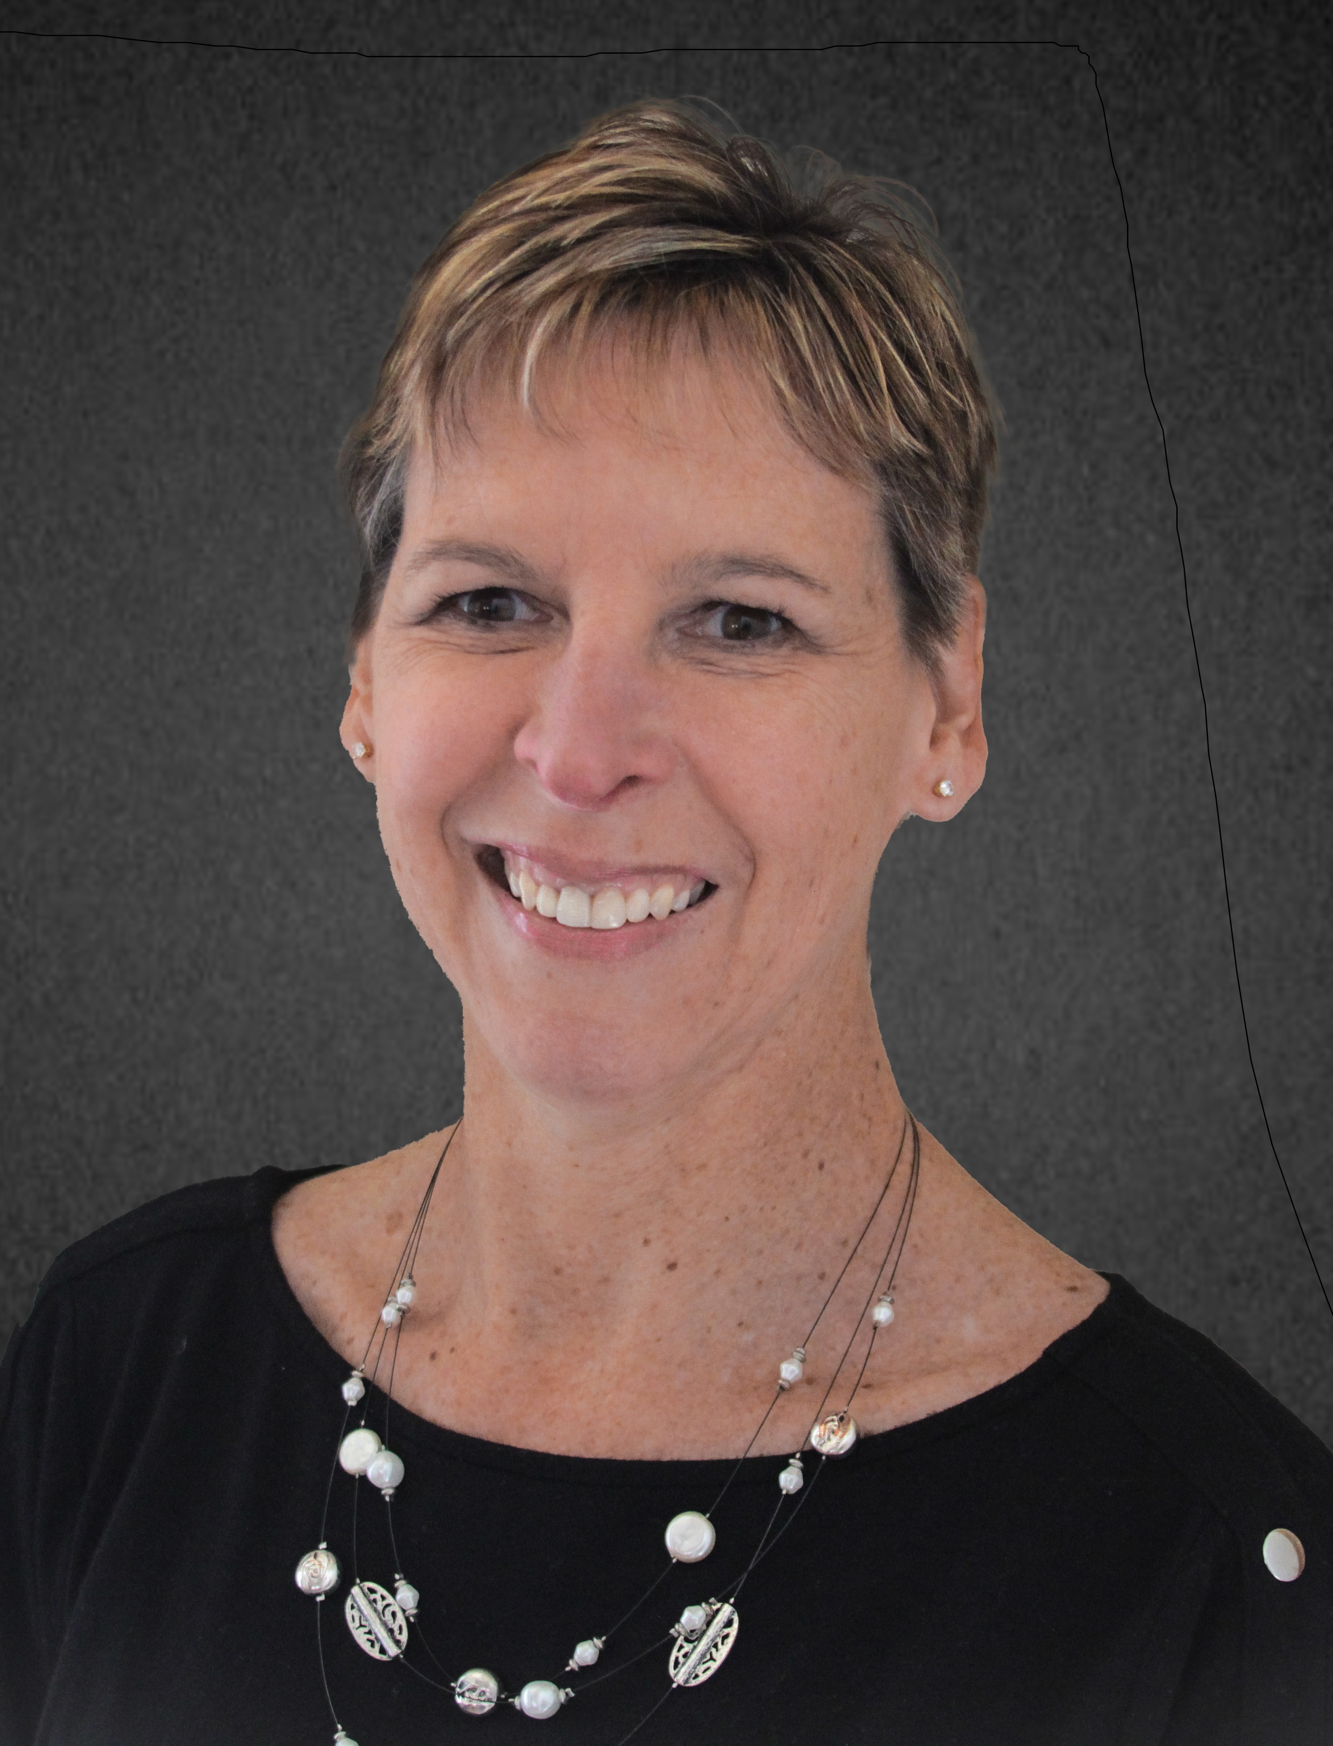
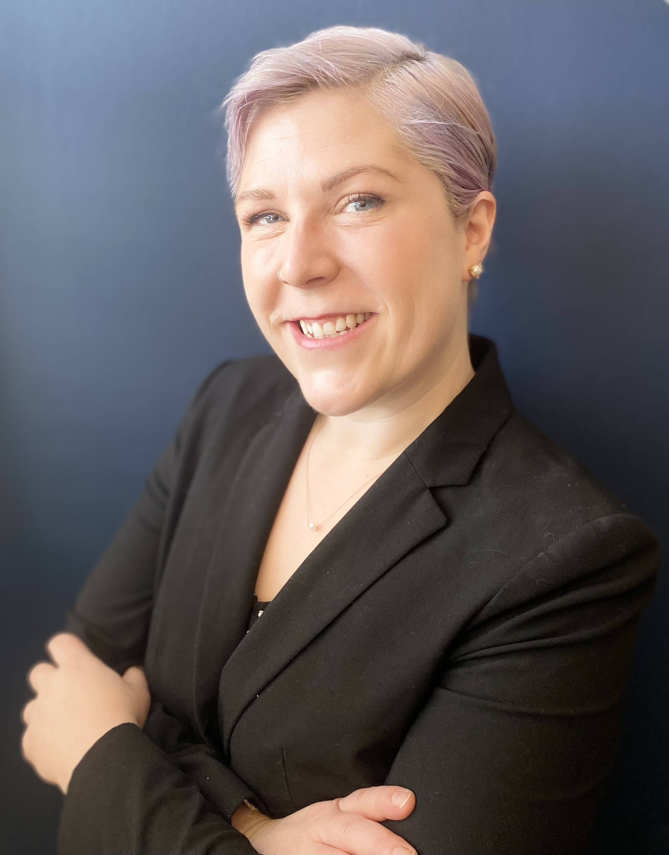
Volunteer Experience Team
Contact: Chapter@hfma.org
Tracy Packingham
Director
Member/Volunteer Experience
Brianna Slominski
Manager
Member/Volunteer Experience
Cindy Fischer
Volunteer Experience Administrator
Regions 1 thru 6
Samantha Anderson
Volunteer Experience Administrator
Regions 7 thru 11
Notes:
Each region is supported primarily by one member of the Volunteer Experience Team, however the best way to reach them is the Volunteer Experience email chapter@hfma.org. This allows better coverage if a team member is out.
Team will join Regional or Chapter calls to help assist with any questions during the call – support only. Team is also available to attend large chapter/multi-chapter and/or regional conferences.
Available to provide training with your leadership and/or board on navigating the website/resources etc.

Slide 6

What questions do you have?

