Slide 1
Team Cohesion
Building Teams that Get Results
TriState HFMA Conference
9/21/2023
a Rise Company

Slide 2
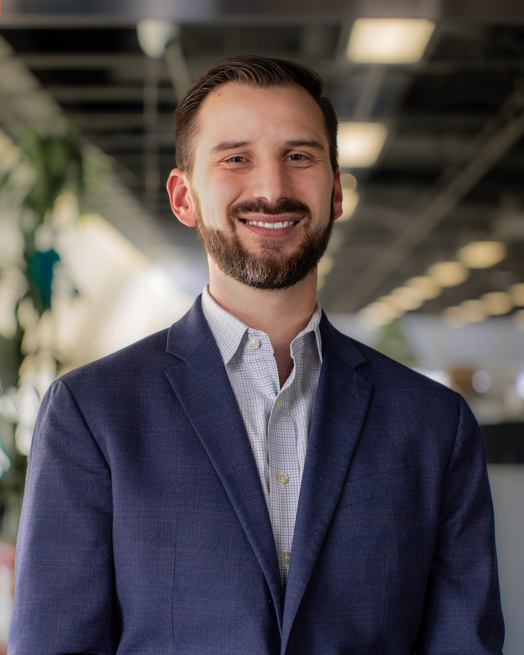
Peter Joseph
Co-founder & Partner
15+ years of revenue cycle management experience
Operational, technology, and strategic leadership
Passionate about building and contributing to high performing teams
… for example, the Michigan Wolverines, Go Blue!

Slide 3
Teamwork Matters

Slide 4
Importance of Teamwork
Problem Solving
Innovation
Happiness
Personal Growth
Efficiency
Productivity
Sustained Performance
Career Mobility

Slide 5
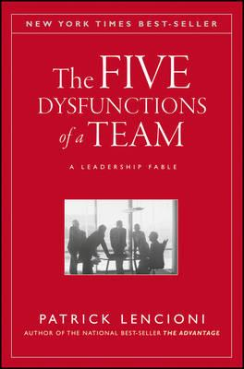
Find the right teammates …
Organized into their strengths and ideal roles …
Working together as one to maximize performance
Mission: Build High Functioning Teams

Slide 6
Our Plan for Today
Setting the Stage
Building the Foundation
Stepping into Discomfort
Moving Forward Together

Slide 7
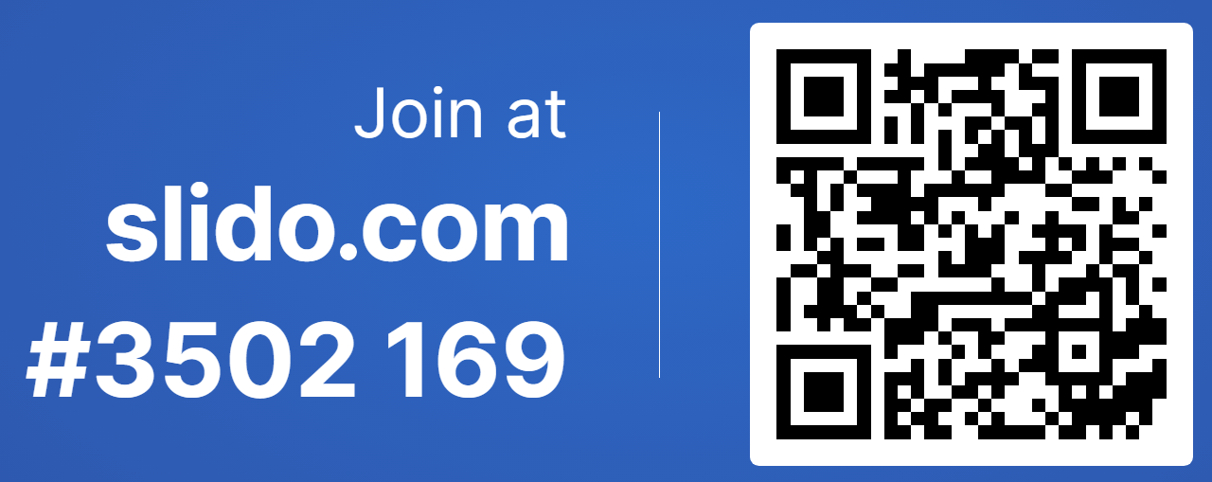
https://app.sli.do/event/vxRmtS4u6vCeitqVdN5fbY
The Five Dysfunctions of a Team

Slide 8
What do you think YOUR team needs MORE of to improve outcomes?
ⓘ Start presenting to display the poll results on this slide.

Slide 9
5
Inattention to Results
Five Dysfunctions
4
Avoiding Accountability
3
Lack of Commitment
2
Fear of Conflict
1
Absence of Trust
Five Dysfunctions of a Team

Slide 10
Absence of Trust
Five Dysfunctions
1
What is it?
This occurs when team members are reluctant to be vulnerable with one another, and are thus unwilling to admit their mistakes, acknowledge their weakness, or ask for help
2
What are the symptoms?
Conceal your challenges or weaknesses | Don’t offer to step in
Don’t seek out assistance | Strengths are under-utilized
3
Why does it matter?
If you can’t “go there”, then you’ll never “get there”

Slide 11
Fear of Conflict
Five Dysfunctions
1
What is it?
Stifling productive conflict increases likelihood of destructive back-channel sniping and leads to sub-optimal decision-making without hearing true ideas and perspectives
2
What are the symptoms?
Boring meetings | Controversy is avoided | Time is wasted
Back-channels and hidden grievances | Lack of input & debate
3
Why does it matter?
Without hearing the honest truth, a team will not truly move forward together

Slide 12
Lack of Commitment
Five Dysfunctions
1
What is it?
When a team does not truly commit to decisions after healthy debate, it often creates an environment of ambiguity, indecision, and confusion – leading to frustration among team members
2
What are the symptoms
Ambiguity | Over-analysis | Fear of failure | Second-guessing
3
Why does it matter?
Without a clear and agreed-upon plan of action, individuals will hesitate to hold each other to the plan

Slide 13
Avoiding Accountability
Five Dysfunctions
1
What is it?
Even the most focused and driven individuals will not engage in peer-to-peer accountability on counter-productive actions or behaviors if there were never agreed-upon terms to begin with
2
What are the symptoms?
Resentment | Mediocrity | Missed deadlines | Lagging Standards
Too much onus on the leader
3
Why does it matter?
Shared results will only come from shared accountability

Slide 14
Inattention to Results
Five Dysfunctions
1
What is it?
When team members are not holding one another accountable, they will default to individual achievements and recognition to measure success – at the expense of collective team results.
2
What are the symptoms?
Stagnated performance | Lose out on ambitious goals
Unwanted attrition | Self and Ego Focused | Distracted priorities
3
Why does it matter?
It’s the ONLY thing that matters!

Slide 15
“
Is it worth the effort?
Five Dysfunctions
”
Excellent results can only be achieved and sustained by high functioning teams
Identify and overcome any dysfunction before it compromises team cohesion
Get more done in less time … avoid wasted time, spin cycle, and energy drain

Slide 16
Building a Foundation of Trust

Slide 17
What behavior or characteristic could a teammate exhibit that would help you increase your trust in them?
ⓘ Start presenting to display the poll results on this slide.

Slide 18
“
”
I’m getting the real you.
Unique Ability
Authenticity
Authenticity
Vulnerability
Empathy
Framework for Building Trust
Notes:
Authenticity = I’m getting the real you
Empathy = I believe you care about me and my success
Vulnerability = I am willing to be known
Unique Ability = I know you and your capabilities

Slide 19
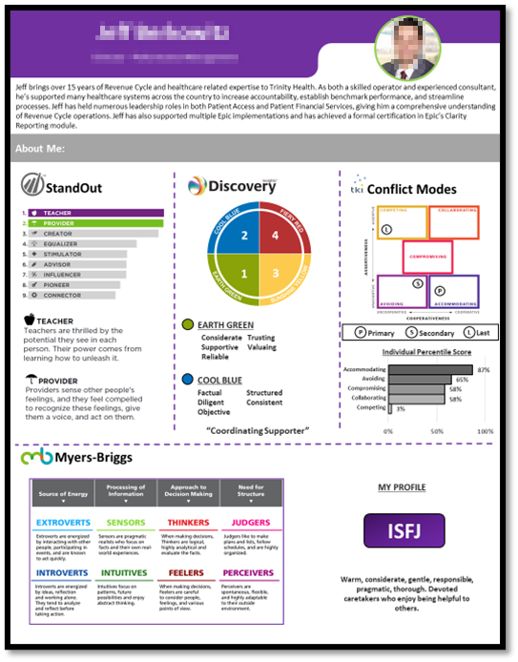
“
”
I know you and your capabilities.
General overview of colleague experience
Unique Ability
Professional Development Models & Tools
Experiences, Expertise, Strengths, & Preferences
Unique Ability
Aggregation of personal assessment results
Share Openly & Revisit Frequently
Free-text to describe preferences, stressors, vulnerabilities and interests
Awareness of Unique Abilities

Slide 20
“
”
I am willing to be known.
Vulnerability
Ice Breakers
Reflections
Casual Convos
Joint Issue Solving
Project Post-mortems
“This I Believe”
Vulnerability
1
2
3
Make time to make it personal
Talk about your professional challenges & weaknesses
Share your story and professional ethos
Leaning into Vulnerability

Slide 21
“
”
I believe you care about my well-being.
Have the tools already …
Empathy
Be proactive, be vocal, be intentional
Lead by example and make it contagious
Empathy
Would benefit from tools or structure …
Emotional Intelligence (EIQ) training can help
Create a self-learning module … plenty of books & podcasts!
Needs more formal coaching or development …
Be humble and curious in your approach as you get started
Seek out mentorship and be open to real-time coaching
Practicing Empathy

Slide 22
Building Block Opportunities
Unique Ability
Get to know each other!
Be willing to be wrong, in need of help, and genuinely curious
Don’t make it weird! But lean into discomfort and trust the process
Start small and fiercely protect the trust foundation you build together
Building Trust
Authenticity
Empathy
Vulnerability
Cumulative Growth Over Time

Slide 23
Stepping into Healthy Conflict

Slide 24
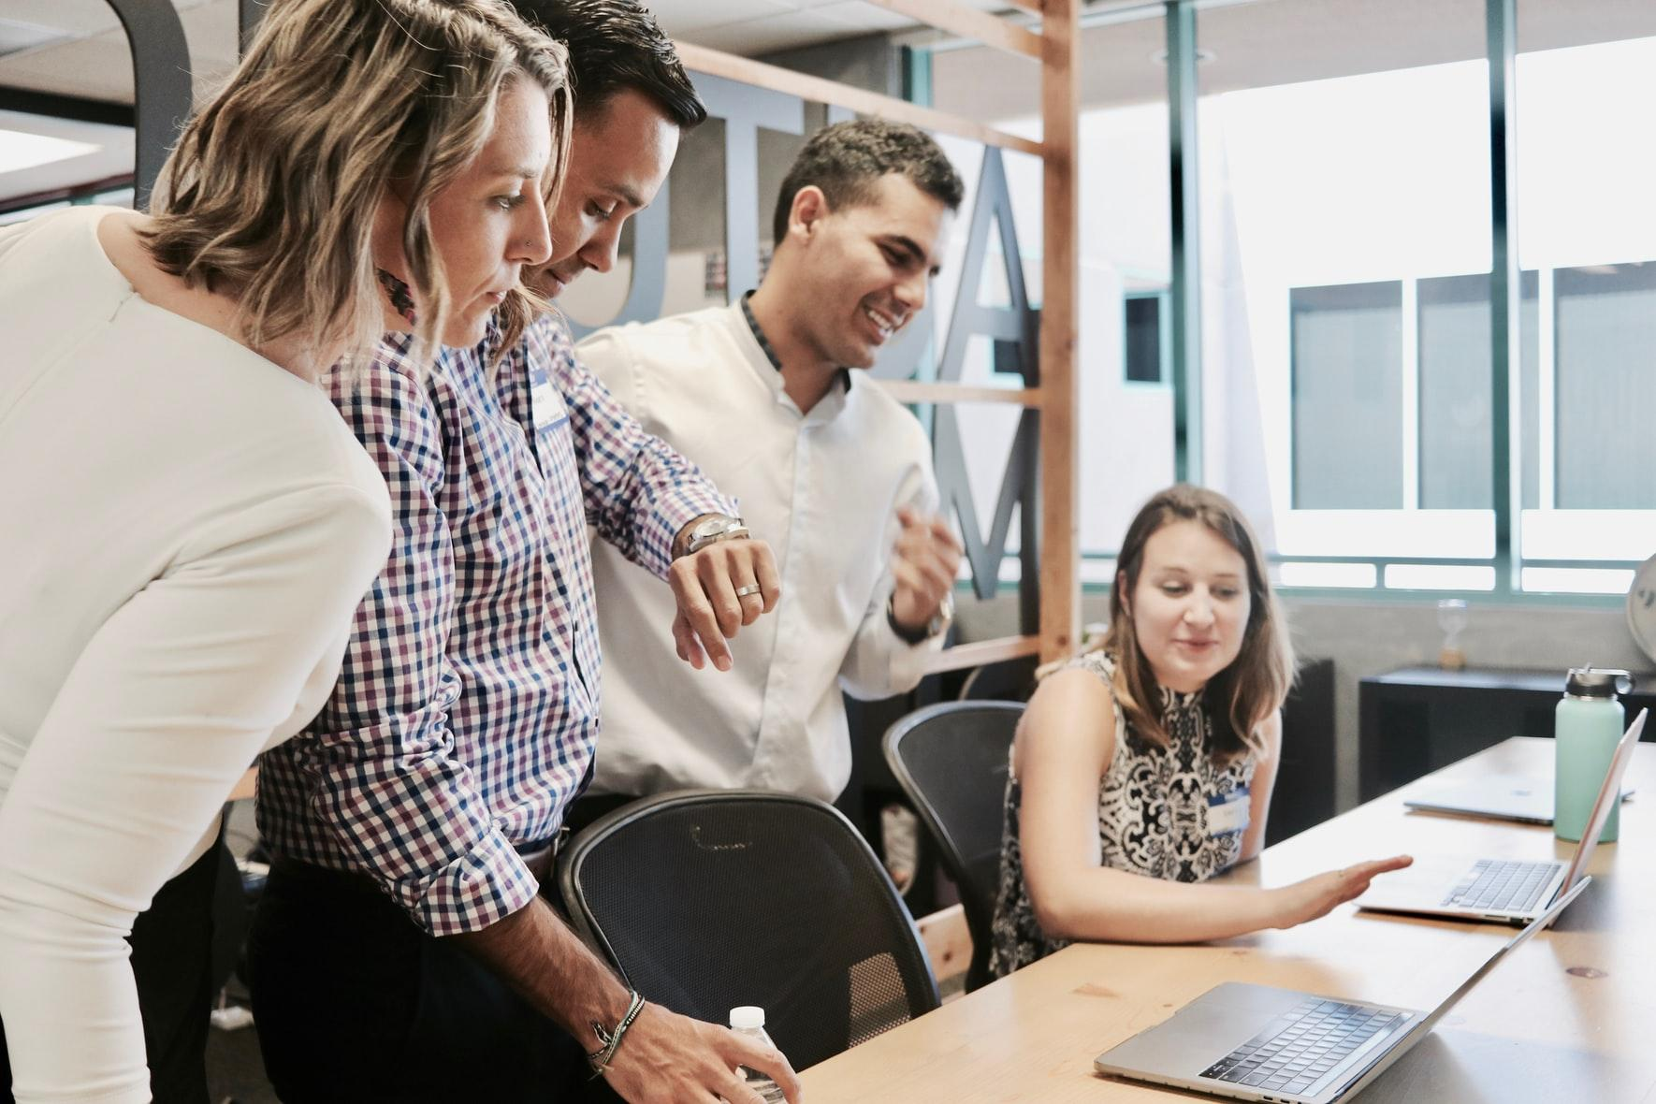
“
What do we mean by healthy conflict?
”
Healthy Conflict
Artificial Harmony
Destructive Conflict
Conflict Continuum

Slide 25
Rank the following 'norms' or behaviors from MOST acceptable (#1) to LEAST acceptable (#5), for your personally, when engaging in professional debate or conflict.
ⓘ Start presenting to display the poll results on this slide.

Slide 26
1
2
Dedicated Forum
Vs
Anytime, Anywhere
Time Box
Vs
Until We’re Done
Time & Place
Healthy Conflict
3
4
Affected parties only
Vs
Full team engaged
Appropriate emotions, language, and civility
Behaviors & Norms
5
“Is it alright if I challenge you there?”
Or
“Can we spend time peeling that back together?”
6
Planning to Discuss
Vs
Attempting to Solve
Readiness
Set Your Ground Rules

Slide 27
Each team member may have a different primary or secondary preference in approaching conflict:
High
COMPETING
COLLABORATING
Healthy Conflict
Be mindful to adjust approach when necessary
Be careful not to assign negative connotations to conflict preferences
Individuals with low Assertiveness may need prompting to ‘go there’, and sometimes appreciate a different forum for embracing conflict
Assertiveness
COMPROMISING
AVOIDING
ACCOMMODATING
Low
Low
High
Cooperativeness
Thomas-Kilmann Conflict Mode Instrument
Conflict Modes & Preferences

Slide 28
“
Sounds painful … is it worth it?
”
Embracing Conflict Together
Maintain an “issues list” and carve out time to dig in together
Learn about individual preferences and team-specific norms
Practice it with authentic motives
Healthy Conflict
Best ideas can come to light
True buy-in can occur, even after disagreements
When trust is in place – even intense debates can be safe, productive, and effective
Start Practicing!

Slide 29
Results through Shared Accountability

Slide 30
Shift in communication:
From “You decided …” to “We decided …”
Commitment
Shift in priorities and values:
Follow-through is emphasized and discussed
Shift in goal-setting:
Personal and team goals become more aligned
… Leads to Clear Commitments

Slide 31
Shift in communication:
From “It’s not my problem …” to “This is our problem …”
Accountability
Shift in priorities and values:
Peer-to-peer feedback is expected and readily given
Shift in goal-setting:
Goals and deadlines are publicly and frequently shared
… Leads to Shared Accountability

Slide 32
Shift in communication:
From “We’ll see …” to “We must move …”
Results
Shift in priorities and values:
Urgency towards outcomes is escalated
Shift in goal-setting:
Team Goals > Individual Achievements or Status
… Leads to Focus on Results

Slide 33
What Does Your Team Need More Of?

Slide 34
5
Focus on Results
Team Cohesion
4
Shared Accountability
3
Clear Commitments
2
Healthy Conflict
1
Foundation of Trust
Five Attributes of a High-Performing Team

Slide 35
If you’re a team leader …
If you’re a team member …
If you’re a service provider …
Make a plan and own it
Talk openly with your team
Learn about your teammates
Lead by example
Be open to feedback
Be authentic & build trust
Journey begins with first step

Slide 36
Thank you !!!

