Slide 1
Digital engagement strategies that transform self-pay performance
Speaker: Casey Williams,
Senior Vice President, Patient Engagement

Slide 2
Healthcare leaders are under more pressure than ever to do more with less— and to do it fast.
Bad debt
Deferred care
expectations
Out-of-pocket
Labor & supply costs
Cost-to-collect
Turnover
Patient volumes & revenues
Yield
Loyalty
Competing business challenges and patient concerns have accelerated the need for digital transformation among providers.

Slide 3
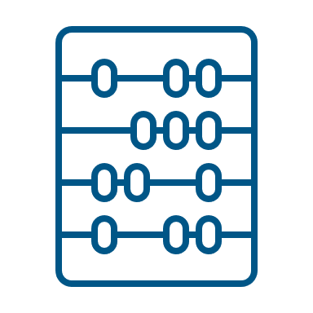
Current technology limitations & roadblocks.
The traditional approach is no longer sustainable.
Stacked, disparate technologies
Slow, tiered deployments
Capital & resource intensive
Technology deployment poses roadblocks for healthcare leaders trying to meet the demands of today’s market and healthcare consumers.
Disjointed patient experience
Low/no touchpoint personalization
Inefficient labor utilization
Vendor misalignment
Siloed ownership and metrics
Low/no scalability
Notes:
What specific blockers are you seeing in your current patient engagement and digital transformation initiatives?

Slide 4
Would a poor medical billing experience cause you to look for a different healthcare provider?
30%
Neutral
33%
Somewhat Likely
Notes:
The Implications of a Poor Billing Experience

Slide 5
A remarkable experience can differentiate your brand.
Care quality
Workforce engagement
Healthcare process
+
+
=
LOYALTY
Good teamwork
Provider courtesy & respect
Good patient-provider communication
Happy staff
Collaboration
Patient access
Appointment scheduling & availability
Patient financial experience
Source: Press Gainey
Notes:
2019 Press Ganey Report. (sited in this article: https://patientengagementhit.com/features/what-is-patient-loyalty-does-it-affect-healthcare-consumerism) After clinical quality has been established, those consumerism bells and whistles can make a difference. The patient experience part of the loyalty equation can be split into two areas:
Healthcare processes: patient access, appointment scheduling and availability, patient financial experience
People: good patient-provider communication, friendly staff, shared decision-making, patient education

Slide 6
Poll
How many vendors do you use to complete a patient’s journey similar to the one shown in the previous slide?
1-3
4-6
7+

Slide 7
Understand Your Patient Portfolio
Put patient understanding at the center of one connected experience

Slide 8
Understand Your Patient Portfolio
Engage & activate the modern healthcare consumer.
92%
LESS THAN
15% of patients will stay with a provider after a poor pre-care or billing experience
A BETTER PATIENT EXPERIENCE is the
TOP DESIRED OUTCOME among healthcare leaders
Sources: RevSpring Voice of the Patient Survey; Deloitte Center for Health Solutions Survey

Slide 9
Using Demographic and Behavioral Data
Demographic Data
Behavioral
Data
Public Record Data collected from thousands of sources and organized into a centralized database
Information collected from patients’ behavior
KNOW
Payment behavior: amount & channel
Bad debt history
Patient’s non-payment interactions
Payment plan behavior
ME
Number of statements sent & outstanding balance
Insurance
Occupation
Net worth
Income
How we use this information to drive engagement
Investments
Purchase history
Properly preparing for their appointment
Communication preferences
Understanding their financial obligations
Asset ownership
Inspiring them to pay
Qualifying for financial assistance
Household characteristics
9
Notes:
RevSpring’s patient insights:
Do not use credit data
Do not use patient behavior from another client

Slide 10
How to Understand Your Patient Portfolio
Predictive Analytics
What To Know
Consumer Behaviors
Ability to Pay
Your Own Data
KNOW
Precise Engagement
How To
Engage
ME
Print
Text
Email
Automated Calls
CSR Enablement
Payment in Full
Prescribed Payment Plans
Financial Assistance
Smarter, Faster Payments at a Higher Yield
Individualized
Outcomes

Slide 11
Knowing Your Patients Pays
More than 3/4
of all respondents agreed they would pay their full balance by the due date if they received a discount
64%
agreed they were more likely to pay on time when their provider gave them an estimate first
Copyright © RevSpring, Inc.
11

Slide 12
I pay sooner when presented with the best payment option that fit my ability to pay (i.e. payment plan, financial assistance)
35%
Completely agree
36%
Somewhat agree
24%
Neutral
Notes:
Q68
Billing sentiment
Over-three-quarters agreed that they would pay their full balance by the due date if they received a discount
64% agreed that they were more likely to pay on time when their provider gave them an estimate first

Slide 13
Patient Sentiment: Billing Experience
Mostly positive findings—but with only 77% feeling at least somewhat satisfied, that leaves room for growth
Recommendation: Don’t get complacent —patient preferences and comfort levels with new technology is always changing, so expectations could continue to rise
40%
Somewhat satisfied
37%
Very satisfied
Notes:
Mostly positive findings – but with only 77% feeling at least somewhat satisfied, that leaves room for growth.
Recommendation: Don’t get complacent – patient preferences and comfort levels with new technology is always changing, so expectations could continue to rise

Slide 14
Engineering Outcomes: Drive Self-Service Adoption

Slide 15
How would patients prefer to receive bills & statements?
Printed & Mailed
Email
Text
Mobile App
Phone Call
All Ages
54%
48%
16%
13%
2%
Ages 18–26
38%
46%
43%
18%
5%
Ages 65+
75%
32%
3%
3%
1%
Sources: RevSpring Voice of the Patient Survey; Deloitte Center for Health Solutions Survey
Notes:
Combined email and text together surpass print except in the oldest populations and widely surpass in the youngest populations – those that are up and coming in your patient base – time to plan for their preferences now.

Slide 16
“I am more likely to trust my provider if they communicate with me using my preferred communication choices.”
Strongly agree 46%
Somewhat agree 35%
Sources: RevSpring Voice of the Patient Survey; Deloitte Center for Health Solutions Survey

Slide 17
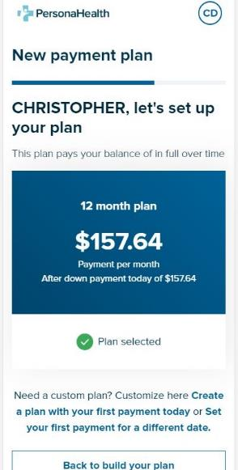
Scoring & Segmentation
Streamline and optimize self-pay outcomes.
Personalized messaging and omnichannel engagement
Optimize yield
Augment staff
Eliminate waste and cost
Delight patients
Payment outcomes that fit each patient
Staffing optimization

Slide 18
Poll
What Percent of Your Patients Opt-in for Paperless Billing Today?
A. 0-20%
B. 21-30%
C. 31-40%
D. More than 40%
E. I’m not sure (and that’s ok!)

Slide 19
Adopt a Digital First™️ Approach
Using the Best Channels
Making Them Work Together
With Best Practices Driven by Data
Individualize for Each Patient
Improve the Patient Experience
Increase Engagement
Eliminate Waste
Enable Speed and Precision
Eliminate Guesswork

Slide 20
Digital First Results
Reach your Patients
90% DIGITAL REACH
Faster Engagement
6.5 Days Faster PAYMENT FROM DIGITAL COMMUNICATIONS
Low Opt-Out Rates
1% PER TOUCH
20–30% Opportunity to REDUCE POSTAGE COST

Slide 21
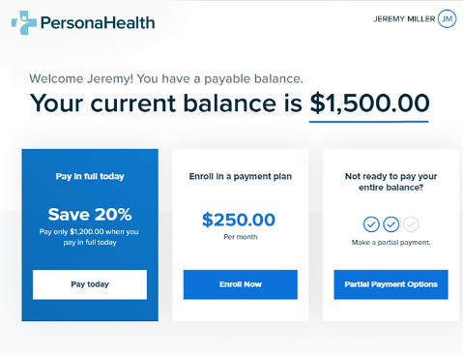
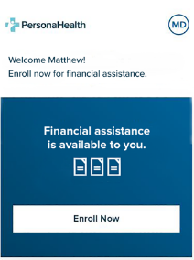
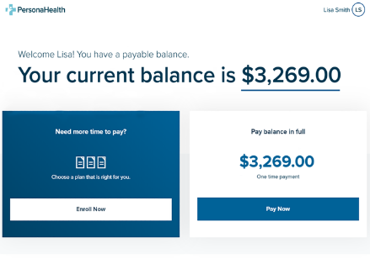
Use Intelligence
To Engineer The Right Payment Outcome
…to deliver the most efficient and complete patient-centric way to increase payments

Slide 22
I pay sooner when presented with the best payment option that fit my ability to pay (i.e., payment plan, financial assistance)
35%
Completely agree
36%
Somewhat agree
24%
Neutral
Sources: RevSpring Voice of the Patient Survey; Deloitte Center for Health Solutions Survey
Notes:
Q68
Billing sentiment
Over-three-quarters agreed that they would pay their full balance by the due date if they received a discount
64% agreed that they were more likely to pay on time when their provider gave them an estimate first

Slide 23
Up to a
35% SELF-SERVICE RATE
Patient Self-Serve Payment Portal Results
1.24%–1.55% Increase in PAYMENT RATE
2.5x Increase in E-BILL ADOPTION

Slide 24
Our Recommendations
Apply Intelligence to better understand each individual patient’s ability to pay
Explore alternative payment methods especially for younger patients
Use an OmniChannel approach for communicating and collecting payments
Understand patient preferences

