Slide 1





LEADING YOURSELF
AND OTHERS THROUGH
CHANGE

Slide 2


01
Why Change?
02
Leading Yourself
03
Leading Others

Slide 3
How do you feeling
about change?
Excited
Depends
Indifferent
Worried
Nervous

Slide 4
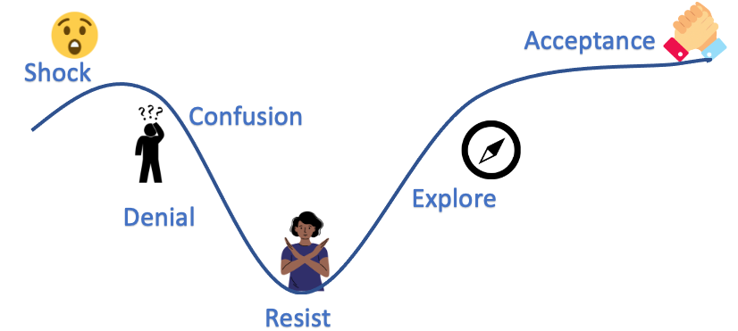

Slide 5
ANXIETY

Slide 6

QUOTES ABOUT CHANGE
If we don't change, we don't grow. If we don't grow, we aren't really living. —Gail Sheehy
Nothing is forever except change.—Buddha
True life is lived when tiny changes occur. -Leo Tolstoy
Be like the flower—survive the rain but use it to grow. —Unknown
The measure of intelligence in the ability to change. - Albert Einstein

Slide 7

PLANNED OR UNPLANNED
CHANGE IS HARD!

Slide 8
Why Change?
"79.7% of people need to adapt their business every two to five years."
  Market continues to change
  Competition
  Advances in technology
  Crisis
  Meet the needs of your business better
Change management statistics you need to know in 2023. The Change Management Blog. (2022, October 31). Retrieved February 18, 2023, from https://change.walkme.com/change-management-statistics/
Notes:
Blockbuster
Circuit City
Kodak
Polaroid
AOL

Slide 9

Why is Change so Hard?
Too many changes happening at the same time!
We have doubts about the change.
Change management
We're comfortable!

Slide 10

2020 Everything
CHANGED!
  Working remote
  Working hybrid
  Recruiting/Turnover
  Illness
  Workload Builds
  Masks
  Homeschooling

Slide 11



Is it easier to lead yourself or others?

Slide 12

Let's start with YOU!

Slide 13


Slide 14
Leading Yourself
CHANGE
OCCURS
RESPONSE
HAPPENS

Slide 15

Leading Yourself
CHANGE
OCCURS
RESPONSE
HAPPENS

Slide 16
Leading Yourself
CHANGE
OCCURS
RESPONSE
HAPPENS
P.A.U.S.E.

Slide 17

How to P.A.U.S.E.
P
A
U
S
E
resent
ttitude
nderstand the Benefits
tay Curious
nergy

Slide 18

Present
  Focus less on how things used to be.
    It was so much easier when____."
    Remember when ____________."
  Allows you to focus all of your energy on the task at hand.
  Being mindful of your thoughts can reduce stress.
  Recognize when you're not in the present moment.
    Is my stress coming from the past or the future?
    Bring it back to present.

Slide 19

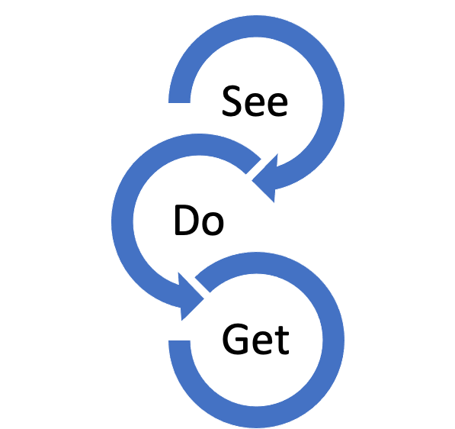
Attitude
What you see. The lens in which you see change.
Determines what you do.
Then determines the results that you get.

Slide 20

EXAMPLES
Co-worker that annoys you
Our in-laws
Stuck in traffic

Slide 21

ATTITUDE
What lens will you choose to look through when change occurs?

Slide 22

UNDERSTAND THE CHANGE
External
Factors
Internal
Factors
Accept and modify internal processes or items based on change.
Educate
Communicate
Training
Support

Slide 23

STAY CURIOUS
  What new opportunities await with this change?
  How can you fill your needs a new way?
  What are the facts?

Slide 24

Energy
Energy is like a currency. How will you spend it?
You only have a certain
amount of energy each day.
How you spend it is what you'll get in return.
Be aware of how you spend your energy.

Slide 25

Avoid setting conditions around change:
  I'll be happier once we get through this
  I'll be less stressed when things get back to "normal".
  I'll be better once I get through this project.
Notes:
When's the last time you didn't have anything to worry about?
That's why learning how to manage change is so important. After this change, there's another change and you're always waiting on some condition to make it easier or better for you.

Slide 26
What if this is as good
as it gets?

Slide 27

Leading
Others

Slide 28

01
Honesty
02
Communication
03
Availability
04
Empathy

Slide 29

LEADING OTHERS

Slide 30

Honesty
It's okay if you don't have all the answers.
It's okay to tell them you're unsure of
the answer.
You're there to lead when no answers
are available.
Level set expectations:
— "Here's what I know…"
— "I'll tell you what I know when I find out."

Slide 31

Communication
Communication is key when experiencing or preparing for change.
Don't presume they've been told information you have.
They want to know what you know, when appropriate.
Have scheduled time to provide updates regarding change.

Slide 32

Availability
"Let me know if you need anything" and mean it.
Encourage them to block 15 minutes on your calendar.
Are you available and approachable?
Let them be seen and heard.
I see you.
I hear you.

Slide 33

Empathy
Listen
"Seek first to understand" -- Stephen Covey
"It sounds like___________."
Have a genuine interest in your team.
  How are they really doing?
  Be a sounding board
  Let them know you're here to listen even if you don't have all the answers.
  Check in with them. A personalized check-in makes them feel seen and heard.

Slide 34

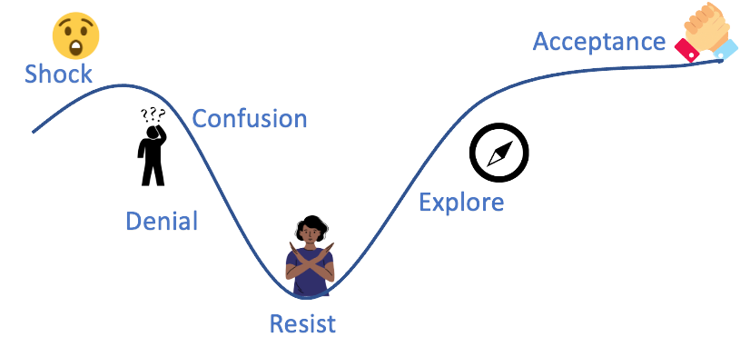
LEADING OTHERS
Everyone on your team may be at different points on the change curve.
Who can help bring along the ones who are struggling?
Who on your team can be a "change agent"?

Slide 35
Everything is
FIGUREOUTABLE
-MARIE FORLEO

Slide 36
Worry
PRETENDS
to be necessary, but
SERVES NO USEFUL PURPOSE
-ECKHART TOLLE

Slide 37

Thank
You.

