Slide 1


The Three Rs to Reduce Contingent Labor
August 2023

Slide 2

The Challenge
Notes:
Healthcare hiring has never been more challenging. The financial impacts of the pandemic on our healthcare facilities are far-reaching, leaving budgets strained. As hospital and health systems navigate these challenges, leaders need to re-imagine their recruitment and retention strategies, assess premium labor utilization, and get innovative to have the workforce needed within budget constraints.

Slide 3
  Fewer people are participating In the labor workforce
  An additional 2.5 million workers would need to be in the labor force for the participation rate to reach its pre-pandemic level.
Source: Bureau of Labor Statistics
Notes:
High level metric - labor force participation rate. (Percentage of the civilian noninstitutional population 16 years and older that is working or actively looking for work. It is an important labor market measure because it represents the relative amount of labor resources available.)

Slide 4
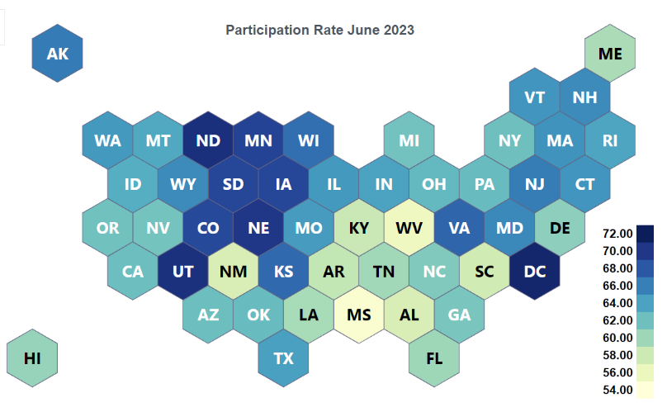
  How does your state compare to the national average?
Kentucky: 57.7%
Ohio: 62.1%
Indiana: 63.6%
National: 62.8%
Source: Bureau of Labor Statistics

Slide 5



That drought has been felt in the healthcare industry
Source: Liquid Compass
Notes:
Compare pre-pandemic to current. Nearly double the openings.

Slide 6
AVERAGE LENGTH OF TIME SPENT IN A ROLE, BY GENERATION.
  Length of time people are staying in a role is decreasing
BABY BOOMERS
8 YEARS, 3 MONTHS
57-75 years old
GEN X
5 YEARS, 2 MONTHS
41-56 years old
MILLENNIALS
2 YEARS, 9 MONTHS
25-40 years old
GEN Z
2 YEARS, 3 MONTHS
6-24 years old
Notes:
We are experiencing more churn / turnover.

Slide 7

Impact of clinical workforce shortages
+ $1,485
+ 9%
200,000
Increase in labor expense per adjusted discharge
Increase in total labor expenses made up by contingent labor
RN openings projected each year through 2031 due to retirements & workforce exits
Notes:
from 2019 to March 2022 – Source Beckers

Slide 8



Do you truly have as many people as you think?
Notes:
FTE erosion analysis

Slide 9


Proficiency in recruiting and retaining talent is more critical than ever.
Notes:
Companies are always losing employees, so to maintain our workforce, we have to recruit an equal number of new employees to keep the bucket full, so to speak. To grow our workforce, we have to be especially good at new employee acquisition, or we have to slow the leak.

Slide 10

Is your value proposition valued?
Notes:
We are going to talk about recruitment and retention but before we even get there….

Slide 11
What candidates’ value differs by generation
57% of job candidates report benefits and perks are among
Their top considerations before accepting a job
Baby Boomers
Gen Xers
Millennials
Salary level
Health insurance
Retirement plan
Salary level
401K plan with matching benefits
Job security
Advancement within the company
Opportunities for work-life balance
Benefits choices
Paid time off
Ability to work remotely
Control over their schedules
A great deal of flexibility
Notes:
Studies show that we have 5 generations in the workforce right now. One size all will not work

Slide 12





Scheduling
Hours
Set own hours, shifts or opt for compressed workweek
Ability to switch to part-time or cut hours when needed
The definition of “flexibility” is… flexible
Location
Flexible PTO
Work from home, office or other locations
Staff can take time off when needed
Job Sharing
Job Rotation
Two part-time employees share a single full-time role
Temporary assignment to a different department / role for new experience
Source: Great Place To Work

Slide 13


Polish your value proposition
To meet the diverse values of a multi-generational workforce, offer menu-style options to supplement core benefits.
Student loan assistance
Sabbaticals for long-term employees
Phone / internet expense assistance
Mindfulness app subscriptions
Virtual hangouts for remote employees
Home office improvement stipends
Childcare reimbursement
Pet care insurance
Healthy lifestyles programs
Tax-efficient compensation
Offer more in the form of non-taxable supplemental benefits while investing less than a comparable pay increase
Notes:
One of the ways we can provide value to a very diverse workforce is to offer a cafeteria style benefit package instead of offering everything to everyone. Point system, select benefits best for their personal situation. Less expensive than offering everything to everyone. Stipends.
By participating in the Health Lifestyles program, employees can earn a $1,000 credit on their health plan. Employees participate through annual biometric evaluations that can identify health concerns early to support intervention.
“Benefit Alternative” – Melody’s experience

Slide 14

Recruit better & faster

Slide 15
Career Website Visitors
Candidate Applications
Offers
Interviews
Filling your recruitment funnel
Widen your candidate pool
  Friends & family referrals
  Veterans
  People with mental or physical health challenges
  Convert travelers
Advertise in different, non-traditional venues
Emphasize career pathways and opportunities for advancement
Notes:
Re-engage early retirees, Reach out to passive candidates or those who abandoned applications, Friends & family referrals, Veterans, People with mental or physical health challenges, Employee networks (LinkedIn), Convert travelers, Don’t reject! Redirect!
Social media, hospital lobbies, waiting rooms and cafeterias, time clock notifications. Put “We’re hiring” messages in email signatures, newsletters, and social media profiles CORE HIRE
Why this job is a great opportunity for them. How it will improve their lives and careers. No laundry list of duties and responsibilities. Help them picture themselves in the role. Talk to your candidates. Use an authentic tone of voice. Use the word “you” to directly address candidates.
Candidates should be able to apply to our jobs on their cell phones. Limit questions to only what is necessary.

Slide 16

MAKE APPLYING TO YOUR JOBS EASY
Decrease complexity & length of applications - 5 minutes to complete or less!
No no’s
  Re-entering work histories
  Multiple logins
  References up front
Best Practice – focus on people, not paperwork
80 to 92% of candidates who click apply never complete the application!
Notes:
A CareerBuilder survey shows that about 50 percent of responding employers said the length of application processes is a positive because it "weeds out" applicants.
But, in reality, the opposite is true. Good candidates know their time is important and they have plenty of opportunities in the job market. Their tolerance for jumping through hoops is much lower than many employers think.

Slide 17

How does your state rank in terms of employed RNs per population? (in 1000s)
WA 8.34
AK 9.17
MT 8.92
ND 14.5
ME 10.55
OR 8.82
VT 10.71
ID 7.06
MN 11.16
NH 9.68
SD 15.78
WI 10.37
NY 9.68
MA 13.48
WY 8.72
MI 10.11
RI 10.23
PA 10.64
CT 9.46
NV 7.54
NE 10.1
IA 10.64
NJ 8.46
UT 6.75
IL 10.28
IN 9.86
OH 11.09
MD 8.08
DE 11.28
CA 8.34
CO 8.97
KS 10.39
WV 11.89
MO 11.4
KY 9.97
VA 8
DC 17.59
TN 8.63
NC 9.75
AZ 7.61
NM 7.53
OK 7.54
AR 9.35
SC 8.33
HI 8.19
MS 9.99
AL 9.73
GA 7.6
TX 7.69
LA 9.54
FL 8.88
Upper Quartile
Upper Median Quartile
Lower Median Quartile
Data Sources: US Census Bureau & Bureau of Labor Statistics
Bottom Quartile

Slide 18
Where Americans moved in 2022
WA
MT
ND
ME
OR
MN
VT
ID
WI
NH
SD
NY
MA
WY
MI
RI
PA
CT
NV
NE
IA
NJ
UT 0%
IL
IN
OH
MD
DE
CA
CO
WV
KS
MO
KY
VA
DC
TN
NC
AZ 1%
NM
OK
High Inbound
AR
SC
AL
Medium Inbound
MS
GA
TX
LA
Balanced
FL
Medium Outbound
High Outbound
Data Source: United Van Lines 2022 Movers Study
Notes:
Americans are moving from expensive cities to lower-density, more affordable regions.”

Slide 19
Matching your recruitment strategy and value proposition to moving job seekers
WHAT THEY SEEK
STRATEGIC RECRUITMENT
Affordability
Tout your cost-of-living advantages & offer relocation packages
Ability to work from home
Offer remote / hybrid work opportunities
Proximity to family & friends
Solicit referrals from current employees
More living space
Flaunt it if you’ve got it! Highlight less dense communities in your service area while recruiting
Notes:
Source United Van Lines study

Slide 20
Q
Retention
“Train people well enough so they can leave, treat them well enough so they don't want to.”
Richard Branson

Slide 21
Don’t | Do
Why have you decided to leave this company? | What caused you to start looking for a new job?
 | What does your new company offer that encouraged you to accept the offer?
How was your relationship with your manager? | How would you describe your manager’s leadership style in 3 words?
 | What 2 or 3 things could your supervisor do to improve his/her management skills?
  If we can’t measure it, we can’t fix it
Employee engagement is higher when leadership shows they are committed to understanding and improving turnover
Talent exit surveys are vital – get help doing them well!
Notes:
Assess your surveys, identify your top issues and build a plan around it

Slide 22
Why people left their previous job
Top reasons for quitting previous job
Source: Subset of respondents from McKinsey’s 2022 Great Attrition, Great Attraction 2.0 global survey (n = 13,382)

Slide 23


Provide career development & advancement
If you have limited opportunities for growth, get creative about lifelong learning opportunities
Offer variety in day-to-day activities where possible (new locations, etc.)
Provide opportunities to volunteer, mentor and give back to community
Upskill your staff (phlebotomy, additional certifications, etc.)
Notes:
41%!!!!

Slide 24
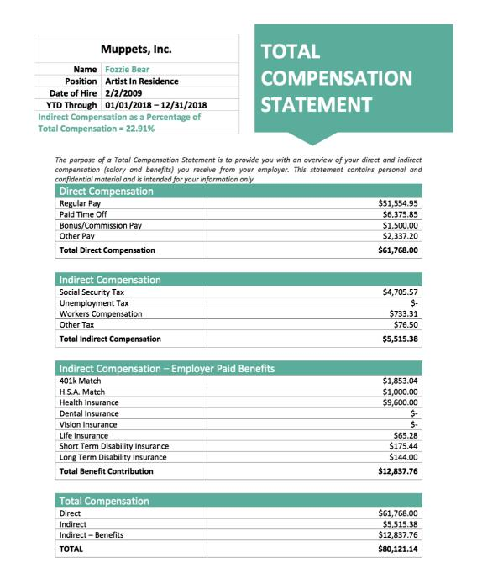
Compensation Strategies
Keep up with the market to the extent possible.
Move new staff quickly to the salary midpoint to retain them.
Issue an annual total compensation statement & quantify the full picture of compensation to employees who may not realize the true measure of what they’re being compensated.
Sample compensation statement from Genesis HR Solutions

Slide 25
Reward & Recognition
Rewards
Recognition
Tangible
Consumed
Have economic value
Expected
Intangible
Experienced
Holds emotional value
Surprise
The present-day workforce is more concerned about how their workplace treats them rather than how much it pays.
Notes:
Most cost-effective way to boost employee morale.
Bridge communication gaps and build trust
Improves productivity, employee engagement & retention

Slide 26

Money isn’t the only motivator
Baby Boomers
Generation X
Millennials
Generation Z
Mutual respect
Hands-on education
Predictable schedule
Independent decision-making
Flexible schedule
Career advancement training
Recognition & praise
Clear goals & structure
Direct supervision & mentorship
Practical experience with orientation
Internal competition
Work-life balance
Gossipy environment
Entitlement
Technology
Lack of feedback
Feeling “dumped on”
Micromanagement
Hearing “how we do things here”
Expectation working all the time is good
Disparaging comments re them & generation
No straightforward, consistent feedback
Lack of opportunity for internal growth
Unfair or unethical manager
Notes:
Clark KR. Managing Multiple Generations in the Workplace.

Slide 27

Best practices in recognition
Timely & creative
A verbal or handwritten thank you
Peer-to-peer as well as managerial
“Social” recognition
Welcome suggestions
Give them chances to “try it their way”
Be aware of birthdays & work anniversaries
Prime parking
Recognize punctuality

Slide 28

Staff shortages
Manage the workload
  Bring in temp help to cover vacancies.
Embrace technology and streamline
  Technology-driven solutions like digital check-in and self-scheduling offer more staffing flexibility and improve the patient experience.
  Given the changes in workflow, have we reviewed & updated job descriptions?
Is remote work a possibility for any job functions?
Lots of demand for flexibility – opportunities for job sharing? Shorter work weeks? Etc.
Burnout
Notes:
don’t pile it on if shorthanded (bring in temps, close office for one day a week, etc.)

Slide 29
Retaining vulnerable age groups
Highly experienced (aka older) staff
  Offer flexible / shorter shifts / job sharing / seasonal work
  Focus on ergonomics
  Provide career paths that capitalize on experience and are less physically rigorous
  Keep their specific needs in mind (i.e., retaining social security benefits)
Maternity age staff
  Identify work-at-home opportunities
  Offer per-diem status / job sharing
  Implement parent-friendly scheduling policies (consistent schedules, shifts around school breaks, etc.)
  Don’t add to their stress by calling them in on days off
Notes:
Source: Bureau of Labor Statistics

Slide 30


“Non - Sticky”
Benefit Offerings
“Sticky”
Benefit Offerings
Free Food / Snacks
Transportation Subsidies
Sign-on Bonuses
Housing Assistance
On-Site Amenities
(gym, shower, nap-pods, etc.)
Childcare
Mandatory “Fun” Activities
Apprenticeship & Career Paths

Slide 31



Use the “right” resource

Slide 32
TYPICAL CENSUS DEMAND
75 – 80%
  Internal core perm staff on regular pay
  Staff
  resourcing
Spikes in Daily Demand / Sick Call Offs
10 - 20%
  Internal float pool on regular pay
  Internal part-time / per diem on regular pay
  Internal core perm staff on overtime
Seasonal Census / Leave Coverage
5 – 10% as needed
  External ad hoc daily registry
  External travelers

Slide 33
How do we staff to cover vacancies?
Source: Advisory Board / National Healthcare Retention Report
Notes:
Depends on how high your vacancy rate is…. Turnover and vacancy rates remain significant problems despite recent gains
• Increased burnout, reduced loyalty, and evolving employee expectations
contribute to elevated turnover rates
• Shortage of talent to fill roles means it’s not possible to hire out of the problem

Slide 34
Selecting the most cost-effective resource
Average RN with 5-9 years of experience
31%
average benefit & regulatory load
(per 2023 Bureau of Labor Statistics)
Sources: Indeed.& Aya Healthcare Analytics

Slide 35
Impact of traveler demand on rates
Increase in Travel Rates
Decrease in Travel Rates
Notes:
We’ve reduced traveler demand – rates have gone down – but open perm needs have soared
Are we burning out our staff? Will we boomerang back? How can we avoid that?

Slide 36
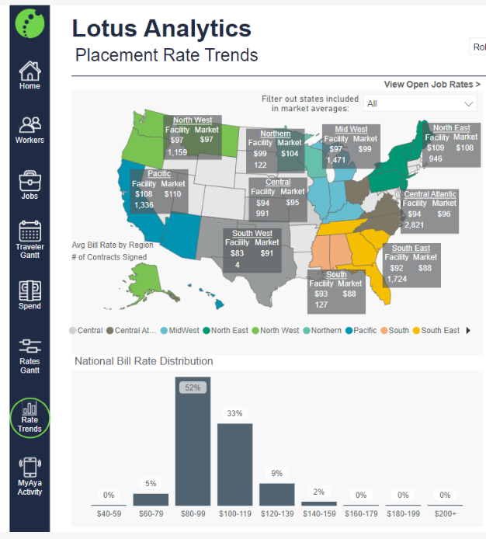
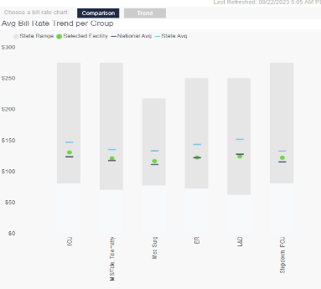
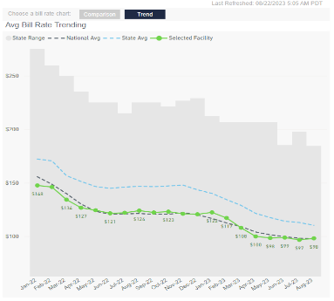
Lotus Analytics provides market & bill rate transparency

Slide 37
When comparing rates, take terms into consideration
Overtime bill rates and when applied
Call off penalties
Conversion fees
Ask if you can post your perm jobs on their website
Tips on negotiating with your contingent labor suppliers

Slide 38




What is your call to action?

Slide 39
Q
Let's re-imagine recruitment and retention together.
Cristal Mackay
cristal.mackay@qualivis.com

