Slide 1
Meeting Value Based
Reimbursement Challenges in 2023
Linda Corley, MBA, ACPAR, CRCR, CPC
Chief Compliance Officer
706 577-2256
lcorley@xtendhealthcare.net

Slide 2
Agenda
After the close of the Public Health Emergency, what value-based payment methodologies are being utilized in Hawaii by traditional Medicare, Medicare Advantage Plans and/or Medicaid Care Management Organizations?
Are commercial payors following CMS adoption of Hierarchical Condition Categories (HCCs) for reimbursement?
And, what is the current requirement for reporting HEDIS patient care measurements to Medicaid plans?
This session brings together updates for ensuring payment optimization under 2023 state and federal Quality Review programs, as well as preparation for 2024.

Slide 3
Value Based Reimbursement Challenges
Since 2013, Hawaii Med-Quest (Medicaid) has required its five contracted MCOs to incorporate value-based purchasing requirements into their provider contracts.
These reimbursement calculations are also affecting commercial payors.
The state MCO contracts increase the percentage of providers that must be covered by value-based payment contracts each year (now surpassing 80%) subject to only value-based payment.
The plans are required to use the same quality measures.
Fee-for-service Medicaid covers disability only.
Finally, Hawaii is one of the 18 states/regions participating in the CPC+ program, a two-track primary care medical home model that seeks to reform care delivery and multi-payer payment.

Slide 4
Value Based Reimbursement Challenges
All Provider Quality Metrics – Addressing National Standards for Healthcare Services, Compliance and Optimum Reimbursement . . .
Payor Percentages of Patient Plan Coverage for Hawaii
        Employer (non-Medicare) 52.6%
        Employer (Medicare) 7.0%
        Military (Active) 6.8%
        Military (Retired) 0.1%
        Direct Purchase 3.2%
        Medicare 5.6%
        Medicaid 14.2%
        Dual 2.9%

Slide 5
2023 Hierarchical Condition Categories
  Hawaii’s Utilization of HCC Payments
    CMS and the Hawaii Dept. of Health Services have agreed on payments for each federal / state covered enrollee: payments from
      CMS reflecting coverage of Medicare Parts A/B services, and Medicare Part D services, and
      CMS reflecting coverage of Medicare Part C – Advantage Plans, and
      Hawaii reflecting coverage of Medicaid service rate component will be:
      risk adjusted using the prevailing CMS HCC models.
    The Medicare Part D (Prescription Drug plans) payment will be risk adjusted using the Part D Rx HCC model.

Slide 6

Value Based Reimbursement Challenges
  2023 Metrics – Hierarchical Condition Categories
Hawaii’s Utilization of HCC Payments – Medicare, Medicaid, Commercial Plans
Why are these CMS HCC methodologies so important?
        Categorization of Patient medical needs based on severity of illness
        Determination of Medicare Advantage Plan reimbursement
        Medicaid Care Managed Plan reimbursement
Risk Adjustment Factor (RAF) – is the mechanism by which government programs adjust the revenue to health plans based on the health status of the covered population(s).
MEAT definition and principles important to documentation.
Utilize HCC tips for accurate categorization of patient’s medical condition and “optimum” reimbursement.

Slide 7
2023 Hierarchical Condition Categories
  What is CMS’s Hierarchical Condition Categories?
Medicare HCC model introduced by the Centers for Medicare and Medicaid (CMS) in 2004.
The goal is to pay Medicare Advantage (MA) and Prescription Drug Plans (PDPs) accurately and fairly by adjusting payment for enrollees based on their demographics and their health status.
This Risk Adjustment payment model measures the disease burden that includes 19 HCC categories, which are correlated to diagnosis codes.
Accurate diagnosis code documentation (ICD-10 CM) and reporting now determines reimbursement.
ICD-10 codes map to 1 of 86 HCCs (mostly chronic but some are acute)

Slide 8

^
2023 HCC Model Complexities
CMS requires an encounter each calendar year and diagnosis by an APRN, PA or physician.
Documentation must be accurate and support the diagnosis . . . But not all diagnosis codes risk adjust.
SITE NEUTRAL – Does not distinguish payment based on a site of care.
Specific evaluation and testing are required for quality reporting of services provided on an annual basis.
HCC codes are additive.
Patient specific Risk Adjustment Factor enables identification and stratification for patient management.

Slide 9
Value Based Reimbursement Challenges
  2023 Metrics – Hierarchical Condition Categories
  Risk Adjustment Factor
  Risk Adjustment is the mechanism by which government programs adjust the revenue to health plans based on the health status of the covered population(s).
The HCC model assigns a RAF to each patient as measurement of probable costs, which is then used to adjust capitation payments for patients enrolled in Medicare and Medicaid plans.
All five of the Hawaii Medicaid plans utilize this methodology!
  RAF responsible for largest increase or decrease in individual patient payment for services!

Slide 10

Risk Adjustment Overview
^
What is Risk Adjustment?
Payments reflect the specific characteristics of each enrolled beneficiary, including demographics, Medicaid eligibility, and health status.
Method used by CMS to account for the overall health and expected medical costs of each individual enrolled.
MA plans are paid on a capitated basis for medical care and separately for prescription drug benefits for each beneficiary.

Slide 11
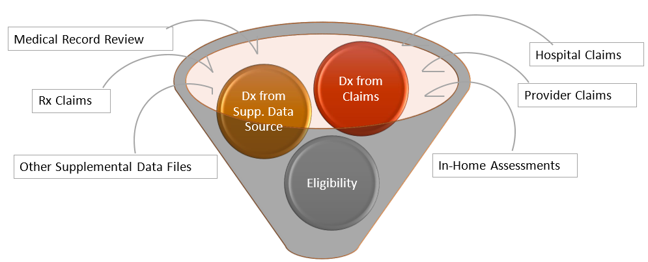
2023 Hierarchical Condition Categories
  Risk Score Calculation:

Slide 12

Risk Adjustment Overview
^
How is Risk Adjustment Used?
CMS uses a disease model to determine a risk “score” for each member.
The model combines individual diagnosis codes into broader diagnosis groups refined into HCCs.
HCCs, together with demographic factors are used to predict beneficiaries’ total care costs.

Slide 13
2023 Hierarchical Condition Categories
  Examples of Chronic Conditions
The following HCCs reflect a few common chronic conditions found in the Medicare population, that MA Plans look for to be documented in a patient’s chart:
      Diabetes without complications – HCC 19
      Chronic Obstructive Pulmonary Disease – HCC 108
      Congestive Heart Failure – HCC 80
      Breast Cancer – HCC 10
      Ischemic Heart Disease – HCC 92
      Angina – HCC 83D
Diagnoses from the previous year are used to establish capitation payments to the MA plan.
HCCs must be captured every 12 months for CMS to reimburse.
Health Status is re-determined every year.
If the HCC codes are captured outside the 12 months (e.g. 12 months and 4 days), it will generate a 6-month revenue gap for that MA plan.

Slide 14
2023 Hierarchical Condition Categories
  HCC Importance – Impact to Reimbursement
Risk Adjustment Factor (RAF) scores are utilized to predict future healthcare costs for plan enrollees.
      Chronic conditions
      Age
      Gender
      Institutionalization status
      Medicaid status
      Current reason for Medicare eligibility
Each HCC has an associated risk weight.
HCCs allow for payment for only the most severe or complicated illness within a category.
CMS pays participating health plans a monthly capitation payment based on the assigned HCC.

Slide 15

2023 Hierarchical Condition Categories
  Examples of Chronic Conditions – Acuity and Specificity
Because ICD-10-CM codes are used in risk adjustment, the documentation of acuity and specificity can be significant.
These are some examples of the increased specificity needs that are important to include in the documentation for risk adjustment.
ICD-10 Guidelines:
“Code all documented conditions that coexist at the time of the encounter/visit, and require or affect patient care, treatment or management.
Do not code conditions that were previously treated and no longer exist.”

Slide 16
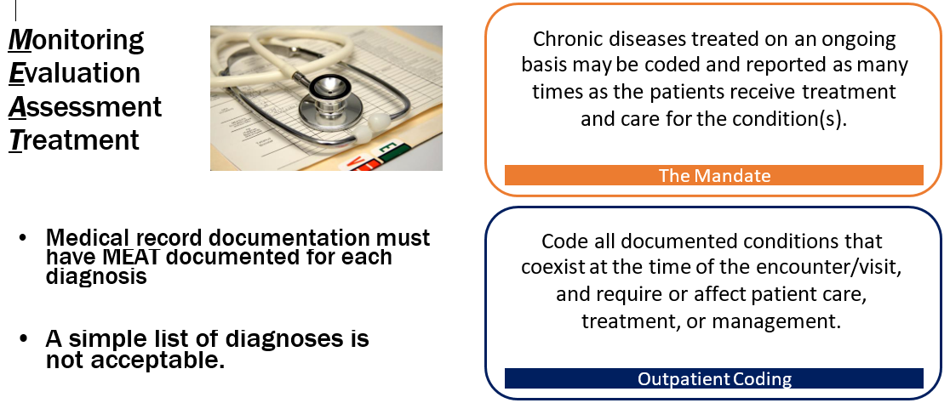
2023 Hierarchical Condition Categories
The MEAT of HCCs

Slide 17
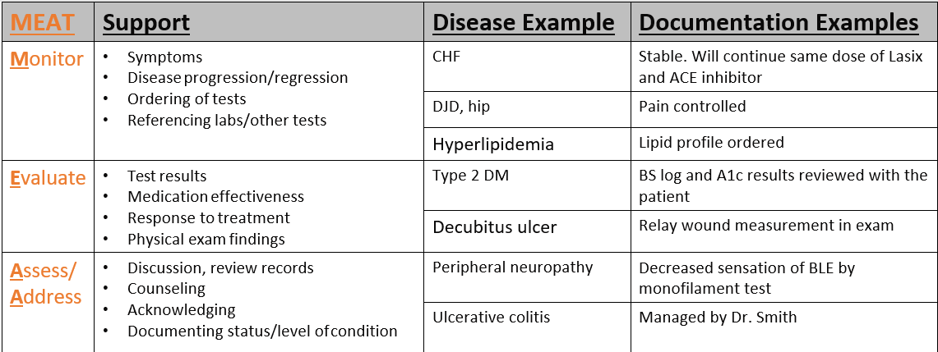
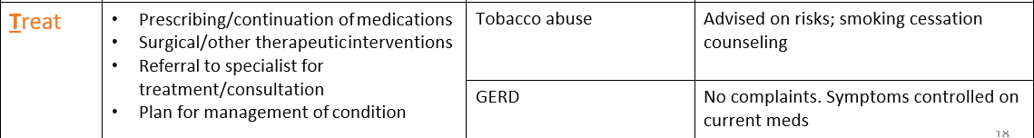
2023 Hierarchical Condition Categories – The MEAT of HCCs

Slide 18
2023 Hierarchical Condition Categories
> 70,000+ ICD-10 Diagnosis Codes
805 Disease Groups
189 Condition Categories
86 HCCs

Slide 19

Factors That Affect RAF Scores
^
Low RAF Score May Indicate
Healthier population
OR
Inadequate documentation
Inaccurate ICD-10 coding
Patients not being seen
High RAF Score May Indicate
Population with increased
health risks
OR
Undocumented diagnoses
Overcoding via copy/paste in
EMRs
LOW RISK
MEDIUM RISK
HIGH RISK

Slide 20
Risk Adjustment Example
^
Few Chronic Conditions Coded
76 year old female | .437
Medicaid Eligible | .151
PVD (I73.9, HCC 108) | .298
DM not coded (no HCC) | 0
CHF not coded (no HCC) | 0
No disease interaction | 0
Raw RAF Score | .886
Some Chronic Conditions Coded
76 year old female | .437
Medicaid Eligible | .151
PVD (I73.9, HCC 108) | .298
DM (E11.9, HCC 19) | .118
CHF not coded (no HCC) | 0
No disease interaction | 0
Raw RAF Score | 1.004
All Chronic Conditions Coded
76 year old female | .437
Medicaid Eligible | .151
PVD (I73.9, HCC 108) | .298
DM (E11.9, HCC 19) | .118
CHF (I50.9, HCC 85) | 0.323
Interaction (DM + CHF) | 0.182
Raw RAF Score | 1.759
Little Reimbursement
More Reimbursement
Maximum Reimbursement

Slide 21















Why Your Codes Matter!
^
2023 Hierarchical Condition Categories
Basic
Medicare Advantage PMPM
Risk Adj.
Conditions
Documented treatment of complex needs = equitable funding to support high risk utilization
vs.
Incomplete documentation unable to be coded to highest specificity = reduced funding

Slide 22
Performance Improvement Suggested by HMSA
^
2023 Hierarchical Condition Categories
Annual Wellness Visit
Utilize Telehealth
Code new HCCs
Risk stratify your panel
≥3 chronic
conditions
Schedule visits

Slide 23
2023 Social Determinants of Health
The Social Determinants of Health (SDOH) topic area was designed to identify ways to create social and physical environments that promote good health for all.
In order to accomplish this, a “place-based” approach was utilized for Social Determinants of Health, categorizing all determinants into five key areas:
        Economic Stability
        Education Access and Quality
        Healthcare Access and Quality
        Neighborhood and Built Environment
        Social and Community context
SDOH conditions can now be coded in ICD-10
Now affect reimbursement!

Slide 24
2024 Inpatient Final Payment Rule
Health Equity
Three health equity-focused measures were added by CMS in 2023 under the Hospital Inpatient Quality Reporting (IQR) Program
    First measure: assesses a hospital’s commitment to establish a culture of equity by reviewing five areas including:
        Data collection
        Data analysis
        Quality improvement
        Strategic Planning
        Leadership engagement
    Second and third measures: focus on screening and identifying of patient-level, health-related social needs such as:
        Housing instability
        Food insecurity
Notes:
https://www.hhs.gov/about/news/2022/04/18/cms-proposes-policies-advance-health-equity-maternal-health-support-hospitals.html

Slide 25



2024 Inpatient Final Payment Rule
SDOH
Social Determinants of Health (SDOH) are the conditions within environments where individuals are born, live, learn, work, play, worship and age that affect a wide range of health, functioning, and quality-of-life outcomes and risks
IPPS payment is made based on the use of hospital resources in the treatment of a patient’s severity of illness, complexity of service, and/or consumption of resources
      Generally:
        Higher severity level designation of a diagnosis code results in a higher payment to reflect the high resource use.

Slide 26
2024 Inpatient Final Payment Rule
SDOH
After review, CMS finalized a change to the severity designation of the three ICD-10-CM diagnosis codes to describe homelessness (unspecified, sheltered and unsheltered) from non-complication or comorbidity (NonCC) to complication or comorbidity (CC)
The change was based on the higher average resource costs of cases with the diagnosis codes compared to similar cases without the codes.
Z59.00
Homelessness unspecified
Z59.01
Sheltered unspecified
Z59.02
Unsheltered unspecified
Notes:
This action is also consistent with the Administration’s goal of advancing health equity for all, including members of historically underserved and under-resourced communities
CMS plans to continue to analyze the effects of SDOH on severity of illness, complexity of services, and consumption of resources.

Slide 27
2024 Who, What, When, Why and How? HEDIS
Healthcare Effectiveness Data and Information Set (HEDIS)
National Committee for Quality Assurance (NCQA)
Quality measures are updated and must be reported annually.
It is a standardized set of performance measurements developed to evaluate consumer health care.
Providers must . . .
    Understand the HEDIS guidelines / required testing / reporting (by payor).
    Next, follow clinical “best practice” using evidence-based clinical practice guidelines.
    Establish an individual patient review process to establish best clinical practice per guidelines based on medical condition and plan of care.
    And finally, continue identifying and repeating best practice guidelines so that everyone in the office can begin to follow along.

Slide 28
Who, What, When, Why and How? HEDIS
Healthcare Effectiveness Data and Information Set (HEDIS)
Federal and State moving toward a quality-driven healthcare reimbursement policy based on quality performance measures.
HEDIS more important in 2024 for both providers and health coverage plans.
Physician-specific scores are also used to measure a practice’s preventive care efforts.
    Practice HEDIS score determines rates for physician incentive programs that may pay an increased – for example, Pay For Performance or Quality Bonus Funds.
    Accurate and timely claims / encounter data reduces the need for medical record review.
        If services are not billed or not accurately billed, they are not included in the score for the practice.

Slide 29

What? Retrospective Review
HEDIS is a look backwards at the year or years prior.
It is a review of the services and clinical care provided to patients.
Some measures have only a one-year look-back period, while other measures the look-back period can extend up to ten years, like for colorectal cancer screening.
It is a review of the services and clinical care provided to insurance plan members.
Future
Past
Goal is to be better than 75% of other Medicaid health plans in the nation.

Slide 30
HEDIS Reporting Data
HEDIS hybrid data is a combination of:
Administrative data: Data captured from Claims, Encounters, Pharmacy, and Labs
Administrative data is captured from claims that have been submitted,
encounter data, prescription and lab information.
This type of data can be electronically captured by the payor.
Medical Record review: A validation audit
For the second method, the payor conducts medical record reviews to verify that a
service, test or screening was done and appropriately documented.
HEDIS data may also be collected through a combination of surveys and patient rating requests. The data collected provides information regarding customer satisfaction, specific health care measures, and structural components that ensure quality of care.

Slide 31
Physician’s General Role in HEDIS?
Ensure preventive healthcare screening is done, at least annually, for each patient.
Ensure screening is completed within the right time frame per payor’s coverage policy.
Ensure results for all screenings are documented in the Medical Record, and any follow-up tests or services are completed to evaluate individual patient (plan member) medical status (condition).
Consider EHR template for a payor specific checklist of required measures.
Ensure the date of service, date of birth, and member name are legible and correct on the claim per the Medical Record.
If records are requested, ensure prompt and complete response.

Slide 32

Provider’s Role in HEDIS?
Improving health outcomes
Identify and close care gaps for preventive screenings, annual exams and vaccinations.
Complete timely submission of claims or encounter data.
Share health education to influence patient behavior.
Provide care coordination and timely access to care and services.
Meet the cultural and linguistic needs of each person.
Follow recommended clinical, preventive health guidelines, and best practices.

Slide 33
Provider’s Role in HEDIS?
Managed Care Accountability Set –
Department of Health Services (DHS) oversees the HEDIS Program.
    along with NCQA, and
    the Centers for Medicare and Medicaid Services (CMS)
DHS sets the annual measures, known as the Managed Care Accountability Set (MCAs).
Providers must meet Minimum Performance Levels (MPLs) established by DHS.
Plan may conduct Performance Improvement Projects (PIPs) to address performance areas below benchmarks.

Slide 34
Value Based Reimbursement Challenges
Recommendations for improved payment under Value Based reimbursement:
Know your individual payors! Plan and reporting requirements.
Train clinical (UR, CM and DCP) and revenue cycle (PAS, PFS, MRC) reps to evaluate monthly stats in required areas for success throughout the year.
Include physicians (providers) and office mgrs. in requirements.
Check quarterly for updates to quality indicators and the documentation to support the plan requirements have been met.
Review EMR templates to support quality reporting and services required to meet fulfilling annual and patient equity goals.
Remember patient education as a component of quality.

Slide 35
Linda Corley
Chief Compliance Officer
(706) 577-2256
LCorley@xtendhealthcare.net

Slide 36
APPENDIX
Slides follow with further documentation and coding requirements for HCCs –

Slide 37
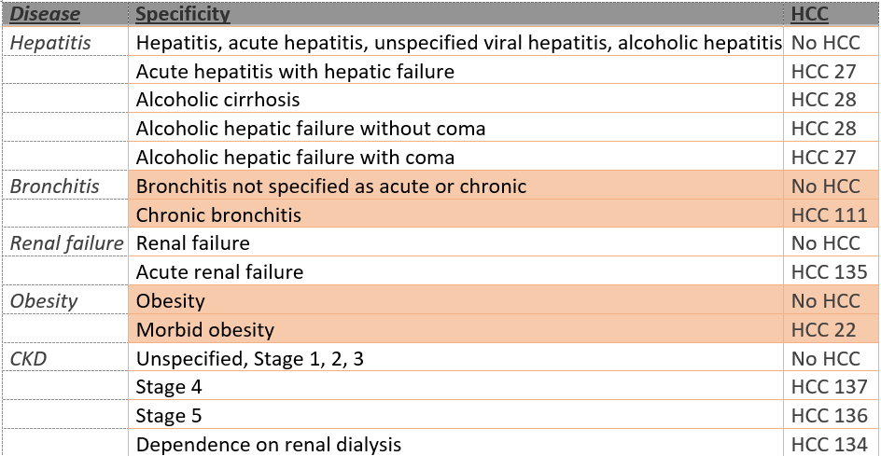
2023 Hierarchical Condition Categories
  Examples of Chronic Conditions

Slide 38
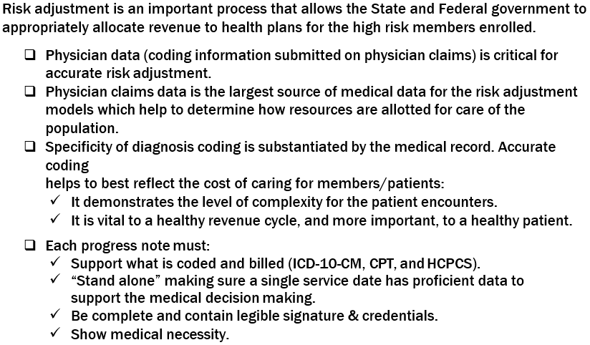
2023 Hierarchical Condition Categories
Physician Determination of RAF

Slide 39
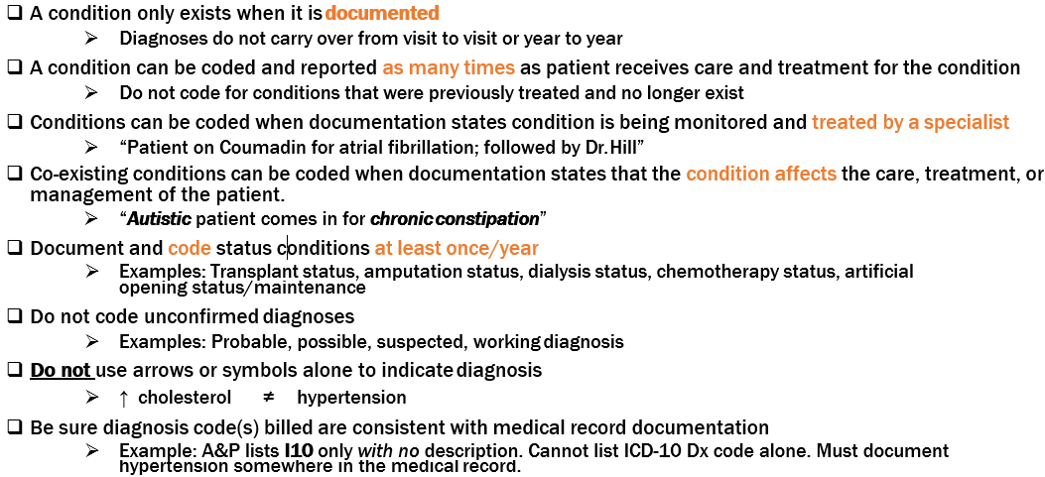
2023 Hierarchical Condition Categories
  Medical Record Documentation Tips

Slide 40
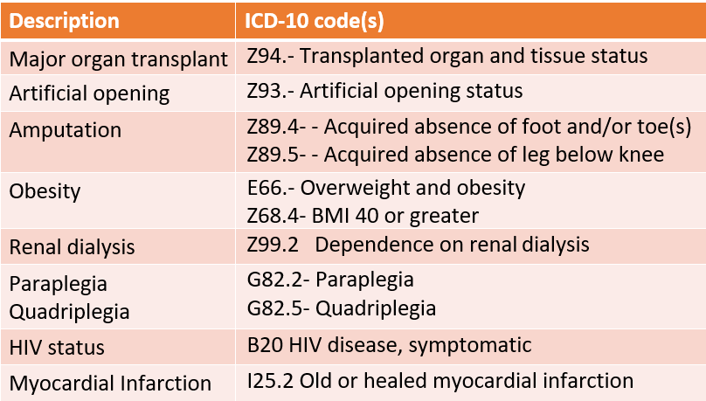
2023 Hierarchical Condition Categories
  Commonly Overlooked Diagnoses

Slide 41
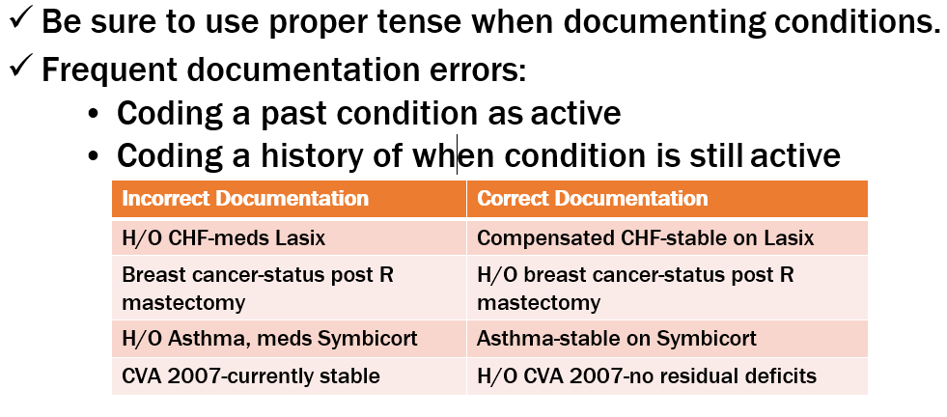
2023 Hierarchical Condition Categories
Current vs. “History of”

Slide 42
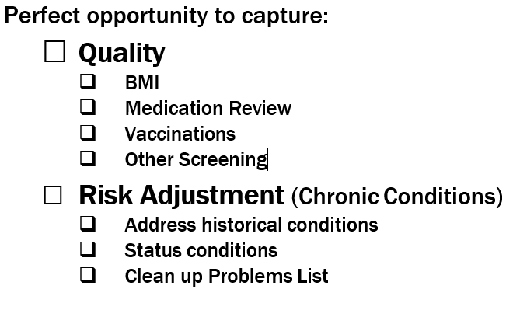
2023 Hierarchical Condition Categories
Annual Wellness Visit – Required

Slide 43
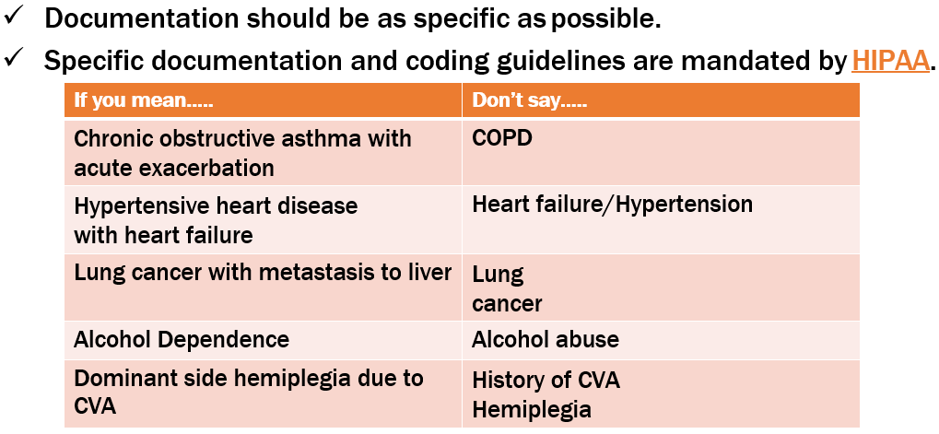
2023 Hierarchical Condition Categories
Specificity

Slide 44
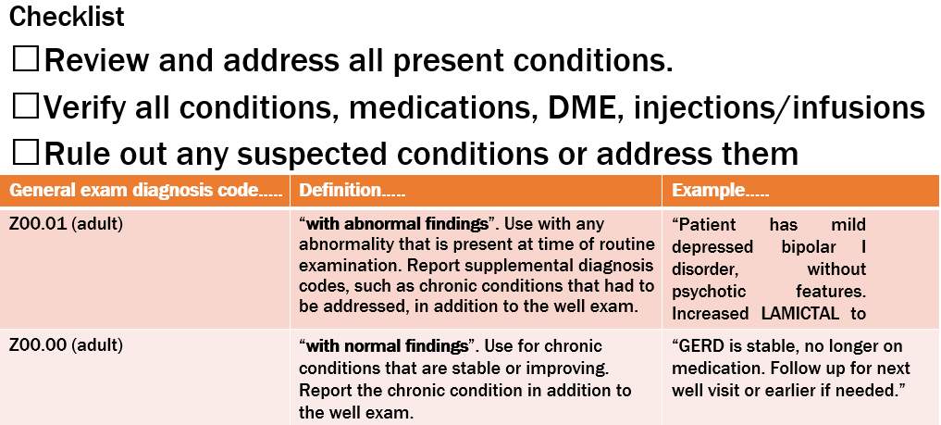
2023 Hierarchical Condition Categories
Annual Wellness Visit

Slide 45
2023 Hierarchical Condition Categories
  Past Medical History
Some conditions do not go away; however, coding from past medical history without current documented support for the condition is not acceptable.
Some EMR software “auto-populates” all conditions previously coded for that patient.
Beware of “copy and paste” without specific time documented medical condition updates:
        Why is this condition (still) a problem?
        Was it coded correctly?
        Is the condition still active?
        When did the condition last occur?

Slide 46
Linda Corley
Chief Compliance Officer
(706) 577-2256
LCorley@xtendhealthcare.net

