Slide 1
Iowa Healthcare Financial Management Association
February 22, 2024

Slide 2
Disclaimer
We prepared this education as a tool to assist the provider community. Medicare rules change often. They are in the relevant laws, regulations and rulings on the Centers for Medicare & Medicaid Services (CMS) website.
We will provide responses to questions based on the facts given, but the Medicare rules will determine final coverage.
CMS prohibits recording of the presentation for profit-making purposes.

Slide 3
Add-On Complexity Procedure Code G2211
An add-on procedure code to an office or other outpatient evaluation and management (E/M) service
The code recognizes the practitioner relationship with the patient
Longitudinal care
Primary source of health services for the patient
Payment under the Medicare Physician Fee Schedule
For payment under another method, include in cost report

Slide 4
Telehealth Services
Through the end of 2024
Continue waivers enabled during the public health emergency
For services in 2024, use the telehealth place of service codes – 02 and 10
Will not append Modifier 95
Medicare payment for 02 and 10 changed to non-facility pricing

Slide 5
New Services
Medicare has multiple new patient care services
Caregiver Training Services (CTS)
Principal Illness Navigation (PIN)
Community Health Integration (CHI)
Social Determinants of Health (SDOH) Assessment

Slide 6
Revalidations
Revalidations required
Respond to revalidation requests
Providers can also access Provider Enrollment, Chain, and Ownership System (PECOS) to determine revalidation schedule for their office

Slide 7
New Specialties for 2024
Marriage and Family Therapy (MFT)
Mental Health Counselor (MHC)
Multiple dental specialties
Epileptologist (Effective July 1, 2024)

Slide 8
Common Rejections and Denials
Medical necessity
Incorrect modifiers
Modifier GZ
Service within hospital or Skilled Nursing Facility (SNF) stay
Medicare secondary payer (MSP)

Slide 9
Resources
Add-on Complexity services (G2211)
Edits to Prevent Payment of G2211 with Office/Outpatient Evaluation and Management Visit and Modifier 25
CMS Internet-Only Manual (IOM) Publication 100-04, Chapter 12, Section 30.6.19
Telehealth services MLN 901705
New services - Calendar Year (CY) 2024 Medicare Physician Fee Schedule Final Rule

Slide 10
Additional Resources
Revalidation of Medicare Enrollment
New Specialties - Calendar Year (CY) 2024 Medicare Physician Fee Schedule Final Rule

Slide 11
Questions

Slide 12
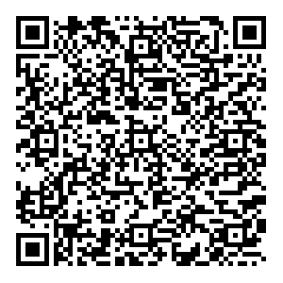
Survey
Let us know what you think!
Take time to complete the survey now.

Slide 13
Thank You

