Slide 1
Healthcare Financial Management Association: An Introduction
Helping Health Care Professionals
& Their Organizations Succeed

Slide 2
Today’s Presentation
Industry overview
HFMA initiatives
Organizational overview
Benefits and resources
Get involved

Slide 3
Industry Overview

Slide 4
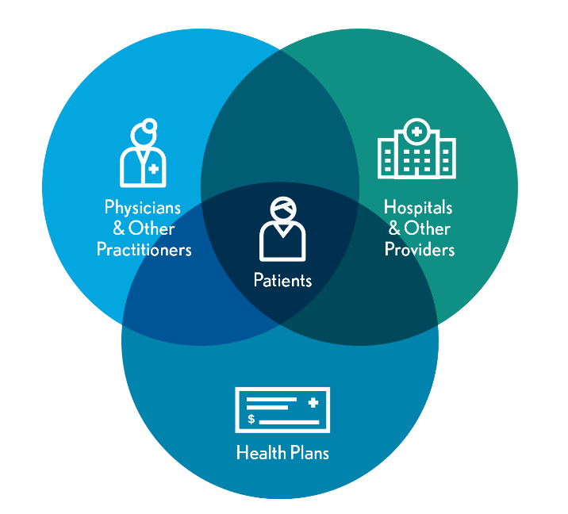
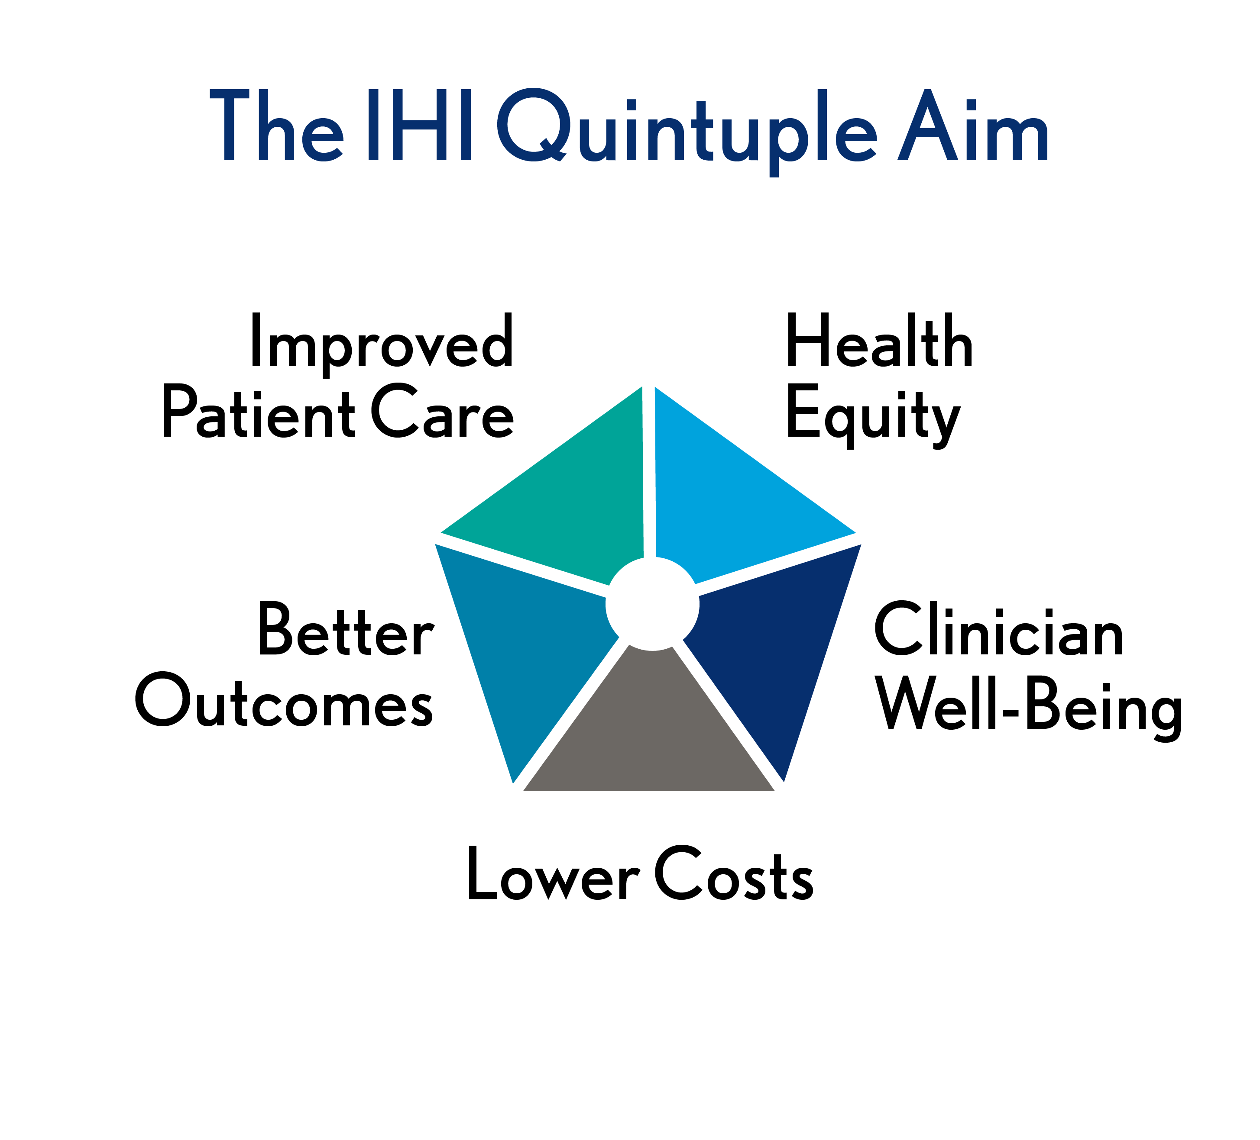
Realignment Is Erasing Traditional Healthcare Boundaries
Driven by demands for care transformation, the healthcare industry
is realigning at an unprecedented pace.

Slide 5
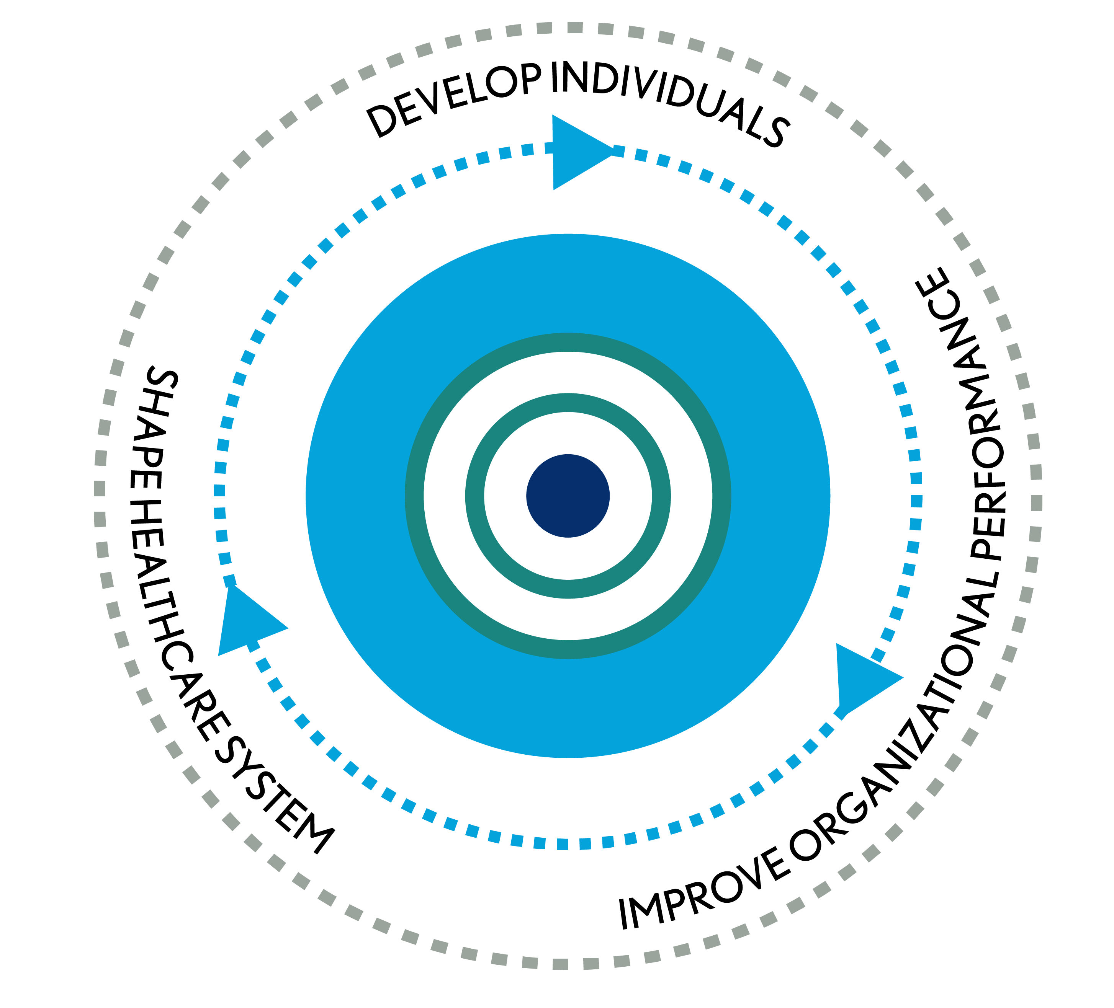
We Help Stakeholders Achieve Optimal Results
OUR MISSION
Leading the financial
management of health care
OUR VISION
HFMA will bring value
to the industry as the leading organization
for healthcare finance

Slide 6




Thought Leadership Shapes the Future of Health Care
WHAT WE DO
Share finance perspectives to drive improvement
Convene healthcare groups to build consensus
Develop strategic frameworks
to guide action
Establish principles
and guidance
to advance capabilities
Foster
measurement and
accountability
for outcomes
CHANNELS
Official Comments
and Testimony
Media
Other Associations and Industry Groups
Chapters
Notes:
In notes please address following: showing people that we "don't lobby" but we are the "technical experts"?

Slide 7
HFMA Helps Turn Knowledge into Action
Continuing education and training
Career development and certification
Small group-focused interactions
Information analysis and perspective
Guidelines and best practices
Organizational performance management
Problem-solving community: online and face-to-face networking
Your Challenge. Our Mission.
Notes:
Verify "standard setting"

Slide 8
HFMA Initiatives

Slide 9

Regulatory Resources: Perspective on the Policymaking Process
hfma.org/policy

Slide 10

Cost Effectiveness of Health (CEoH)
Minimize costs associated with delivering optimal health outcomes.
Identify appropriate spending
to realize the best possible outcomes.
This is not a reduction of costs
or bending the cost curve.
CEoH is a global issue.
COSTS
COST EFFECTIVENESS
OF HEALTH
HEALTH
OUTCOMES
Achieving cost-effectiveness of health
will transform the healthcare industry
to the direct benefit of patients, employers and providers.
Notes:
We’ve been talking about cost-effective healthCARE for a long time. But healthcare is only one element of health, as we’ll talk about more later.
Cost effectiveness of health, or CEoH for short, means minimizing the costs associated with delivering optimal health outcomes. That entails identifying what spending is appropriate to realize the best possible outcomes. And that’s different from just reducing costs or bending the cost curve.
CEoH isn’t a uniquely American issue; it’s actually a global issue.
And achieving it will transform the entire healthcare industry, to the benefit of healthcare purchasers, including patients and employers, and providers as well.

Slide 11


Join us in the Just Cause
of working toward CEoH.
Join us in the Just Cause
of working toward CEoH.
A just cause defines a vision for the future
that your work helps bring about.

Slide 12


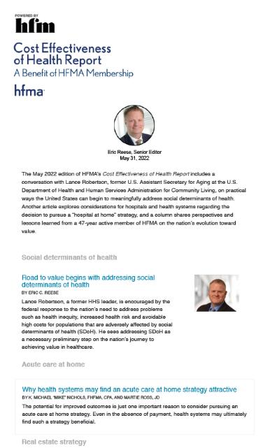
HFMA’s CEoH resources
Publications
eNewsletter
Notes:
If you make the choice to deal with it, or if you’re considering making that choice, check out these HFMA resources to get started.

Slide 13




HFMA’s Environmental Assessment Series, Healthcare 2030
Volume 2 builds on Volume 1, which covers the CFO’s expanding role in the C-suite, the workforce, consumers and technology, and strategic investment.
hfma.org/hc2030

Slide 14

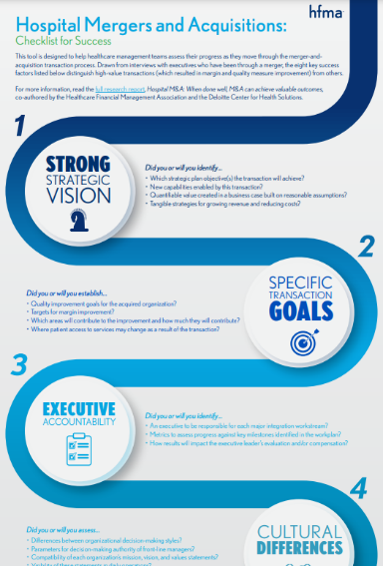
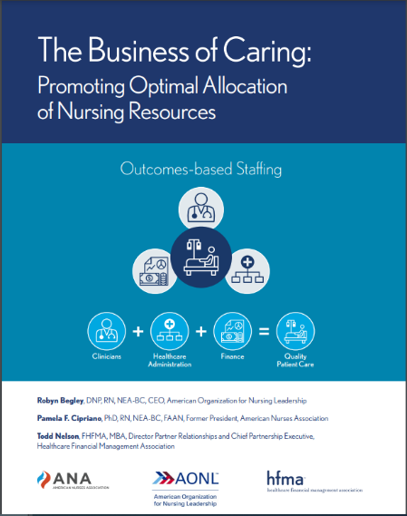
HFMA Research: Strategies for Success
HIGH-VALUE HEALTHCARE
hfma.org/valueproject
MERGERS
NURSE STAFFING
hfma.org/guidance/research-trends
Notes:
Total cost of care report:
Growth of population-based payments is not associated with a decrease in market-level cost growth, yet.
Market factors associated with Medicare costs and cost growth.
What is driving total cost of care? Analysis of factors influencing total cost of care in U.S. healthcare markets.

Slide 15




Our Consumerism Best Practices and Resources
PATIENT FINANCIAL COMMUNICATIONS
PRICE TRANSPARENCY
MEDICAL ACCOUNT RESOLUTION
CONSUMER EDUCATION
hfma.org/dollars
Notes:
Update your business processes to align with HFMA’s best practices for patient financial communications.
Ensure that your organization’s policies reflect consumer needs in the high-deductible health plan era.
Provide consumer education resources online.
Adopt best practices for consumerism.
HFMA has developed a whole suite of industry-consensus best practices in this area. They address price transparency, financial communications with patients and medical debt resolution. We call this initiative Healthcare Dollars & Sense. Hundreds of providers have adopted these best practices but others may still be unaware.
These best practices, together with the self assessment tool in our consumerism maturity model, provide a solid foundation for building a consumer-centric revenue cycle.

Slide 16

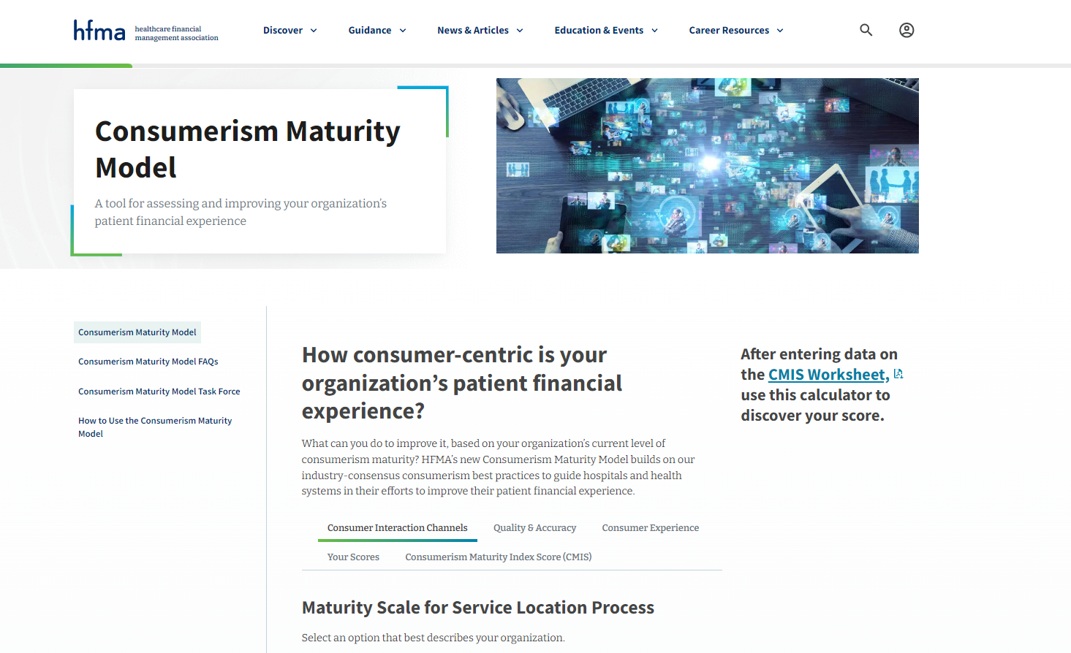
HFMA’s Consumerism Maturity Model
Online self-assessment tool
Appropriate for all providers: hospitals, systems and physician groups
Takes a consumers-first viewpoint
Identify gaps and areas for improvement
Build your roadmap for success
Designed by industry-wide task force
hfma.org/consumermodel

Slide 17

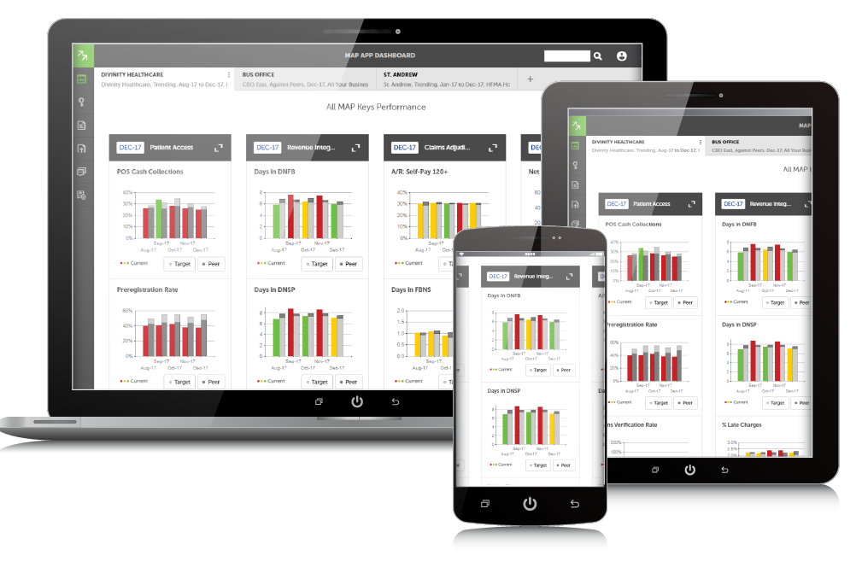
MAP: Hit Your Revenue Cycle Performance Targets
MAP Keys – Industry standard KPIs
MAP Award – Recognizes revenue cycle excellence
MAP App – Online benchmarking tool
MAP Key Connect – Benchmarking reports for business partners
hfma.org/map

Slide 18
Organizational Overview

Slide 19
Professional Membership Association – serving both individuals and organizations
95
88
%
%
110,000+
MEMBER COUNT AS OF JANUARY 2024
ENTERPRISE MEMBERSHIP RETENTION RATE AS OF FEBRUARY 2023
MEMBERSHIP GROWTH FROM JUNE 2020 TO FEBRUARY 2023
Notes:
HFMA provides two ways to join: individual memberships and our group or organizational memberships, known as Enterprise.

Slide 20

Organizational Membership
Organizations can offer HFMA benefits and resources to all employees - administrative
and clinical.
Cost effective means for providing teams with relevant healthcare finance training and tools.
Build staff competencies, knowledge and engagement.
Drive organizational performance.
Options for all sizes of provider
and business partner organizations.
hfma.org/enterprise
Notes:
What Enterprise Means for Current HFMA Members
- Individual membership and benefits will not change. These members simply roll over into the Enterprise account.
- Common ground and shared experiences with a wider range of people.
Ability for providers to leverage performance benchmarking with preferred MAP App access pricing.

Slide 21
Member Career Stage
6%
60%
10%
24%
EXECUTIVE LEVEL
PROFESSIONAL LEVEL
DIRECTOR/MID LEVEL
OTHER
As of February 2023

Slide 22
Primary Member Job Functions
REVENUE CYCLE
FINANCE
PATIENT ACCESS
PATIENT FINANCIAL SERVICES
ACCOUNTING
ADMINISTRATION & OPERATIONS
HEALTH INFORMATION/MEDICAL RECORDS
DECISION SUPPORT/BI/ANALYTICS
As of February 2023

Slide 23
Member Profiles Vary by Membership Category
2%
14%
14%
58%
7%
INDIVIDUAL
MEMBERS
55%
ENTERPRISE
MEMBERS
29%
21%
EXECUTIVE LEVEL
PROFESSIONAL LEVEL
DIRECTOR/MID LEVEL
OTHER
As of February 2023

Slide 24
Provider Organizations (Hospitals/Systems) Make Up Majority of Membership Base
15%
8%
20%
3%
6%
56%
27%
80%
85%
Individual Members
Enterprise Members
Total Members
HOSPITALS/HEALTH SYSTEMS
HEALTH PLANS
INDIVIDUAL
BUSINESS PARTNERS
OTHER
ENTERPRISE
PHYSICIAN GROUPS
As of February 2023

Slide 25

Our Members Belong to 59 Local Chapters
Chapters and Regions
REGION 1
Connecticut
Massachusetts-Rhode Island
Northern New England
REGION 2
Empire New York
Metropolitan New York
Puerto Rico
Rochester Regional
REGION 3
Central Pennsylvania
Metropolitan Philadelphia
New Jersey
Northeastern Pennsylvania
Western Pennsylvania
REGION 4
Kentucky
Maryland
North Carolina
Virginia DC
West Virginia
REGION 5
Alabama
Florida
Georgia
South Carolina
Tennessee
REGION 6
Central Ohio
Michigan Great Lakes
Northeast Ohio
Northwest Ohio
Southwestern Ohio
REGION 7
Greater Illinois
First Illinois
Indiana Pressler Memorial
Wisconsin
REGION 8
Greater Heartland
Iowa
Kansas (Sunflower)
Minnesota
Nebraska
North Dakota
South Dakota
REGION 9
Arkansas
Lone Star
Louisiana
Mississippi
Oklahoma
South Texas
Texas Gulf Coast
REGION 10
Arizona
Colorado
Idaho
Montana
New Mexico
Utah
Wyoming
REGION 11
Hawaii
Nevada
Northern California
Oregon
San Diego – Imperial
Southern California
Washington - Alaska
Notes:
Every member is provided free membership in one local chapter. In addition, they can get communications from additional chapters, if interested.

Slide 26



Physician & Physician Practice Engagement
For clinical leaders—The opportunity to learn the business side of healthcare.
For physician practice groups—Strategies to lead the transition to value-based case.
hfma.org/education-events
hfma.org/physician
hfma.org/webinars
Notes:
Invite physician colleagues to attend HFMA’s Annual Conference for a deep dive educational experience in the most pressing challenges facing physicians and practice executives.
Business of Health Care course is certified for 13.5 AMA PRA Category 1 Credits TM for physicians as well as continuing education credit for dentists, pharmacists, nurses, and health care executives offering hours toward Fellows of the American College of Healthcare Executives (FACHE) designation
Sign up for Physician Business Adviser, a free e-newsletter, & forward it to your physician colleagues so they can subscribe, too.
Suggest that physicians and physician practice executives check out HFMA’s webinars on topics of interest to them, such as the Quality Payment Program.

Slide 27

Heath Plan Engagement
Health plan executives stay up-to-date on the financial management of healthcare organizations.
hfma.org/education-events
hfma.org/healthplan
Share HFMA reports focused on industry collaboration to deliver greater value to the patient while ensuring financial sustainability.
Notes:
Invite health plan colleagues to attend HFMA’s Annual Conference to network and hear first-hand about how physicians, providers, and health plans are collaborating in novel ways to improve quality while reducing costs.
Price Transparency report: Clarifies basic definitions that are often misused, Sets forth guiding principles, Establishes roles for health plans, providers, others, Reflects consensus of key stakeholders
Consumer Guide to Understanding Healthcare Prices: Describes how to request price estimates, step by step, the guide can be downloaded for free at hfma.org/consumerguide and posted on your organization’s website as a resource for consumers. No permission needed.

Slide 28
Belonging to HFMA

Slide 29


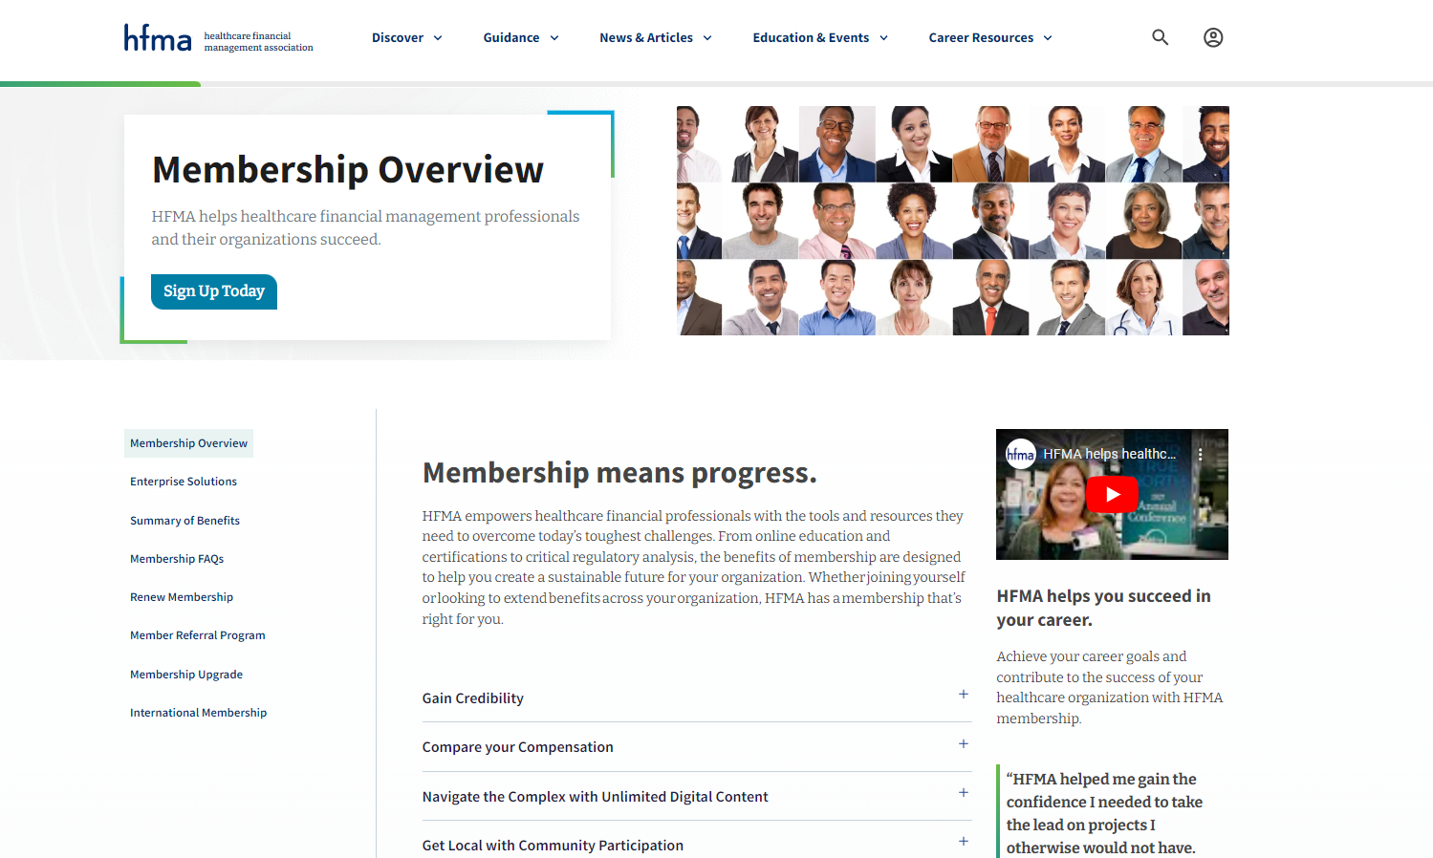



When you belong to HFMA
Easily find
& discover
relevant information
Access
what you need when you need it
Navigate
the complex healthcare environment
Belong & engage
Collaborative opportunities
& communities to actively
hfma.org/membership

Slide 30

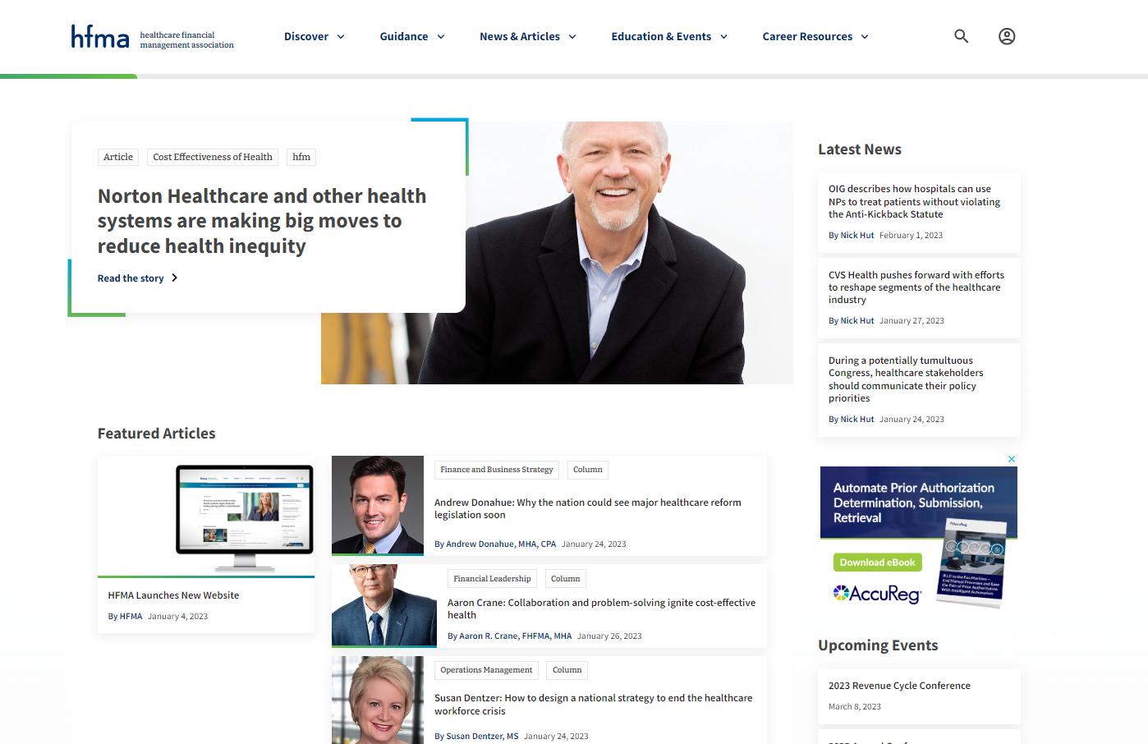
Online Member Home
New website launched January 2023
Bold new layout and design
Updated navigation
Enhanced search
Personalized experiences when logged in
hfma.org/newsite
Notes:
Managing your HFMA account is now centralized. From tracking CPE to paying your dues, from setting communication preferences to referring friends and associates to join, all activities are easily managed online.
- Most online content is now member-only access. (Registered Guests only get up to 5 pieces of content per month)

Slide 31





Included with HFMA Membership
Professional Certifications
E-Learning Courses + Webinars
Community
E-Newsletters
Member-Only Content

Slide 32
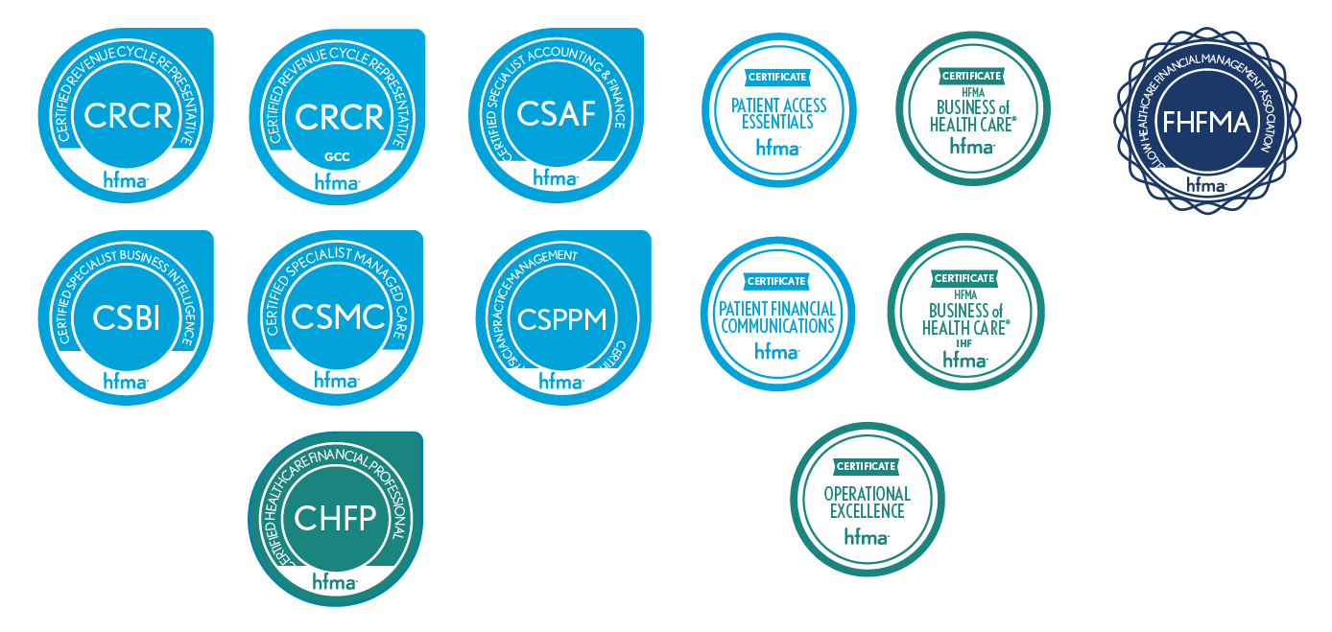
Distinguish Yourself with Certification
hfma.org/certifications
Notes:
NOTE: For your clinical colleagues, the HFMA Business of Health Care ® course is certified for 13.5 AMA PRA Category 1 Credits TM for physicians as well as continuing education credit for dentists, pharmacists, nurses, and health care executives offering hours toward Fellows of the American College of Healthcare Executives (FACHE) designation

Slide 33



News, Strategies, Insights
hfm magazine
E-Newsletters
HFMA Daily
Revenue Cycle Insights
Cost Effectiveness of Health Report
Leadership
Healthcare Finance Strategies
Notes:
- HFM available to read with an online reader, as well as mobile app for all mobile devices, including iPhones, tablets and all Android devices.
E-Newsletters contain newsworthy content, industry stories, and strategies – log into My Profile on hfma.org and revbiew My Communication Preferences to ensure you are opted in

Slide 34
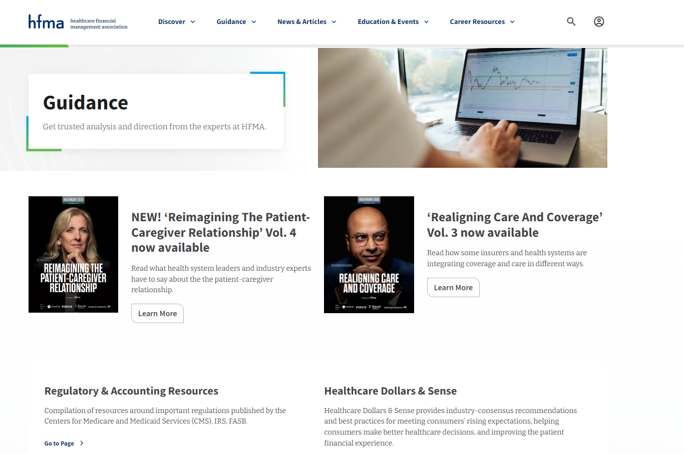
Guidance: Reports + More
Regulatory and Accounting Resources
Healthcare Dollars & Sense
Value Project
Patient Friendly Billing
Healthcare 2030
Consumerism Maturity
Research & Trends
Claim Integrity
Special Reports from HFMA's Thought Leadership Retreat

Slide 35
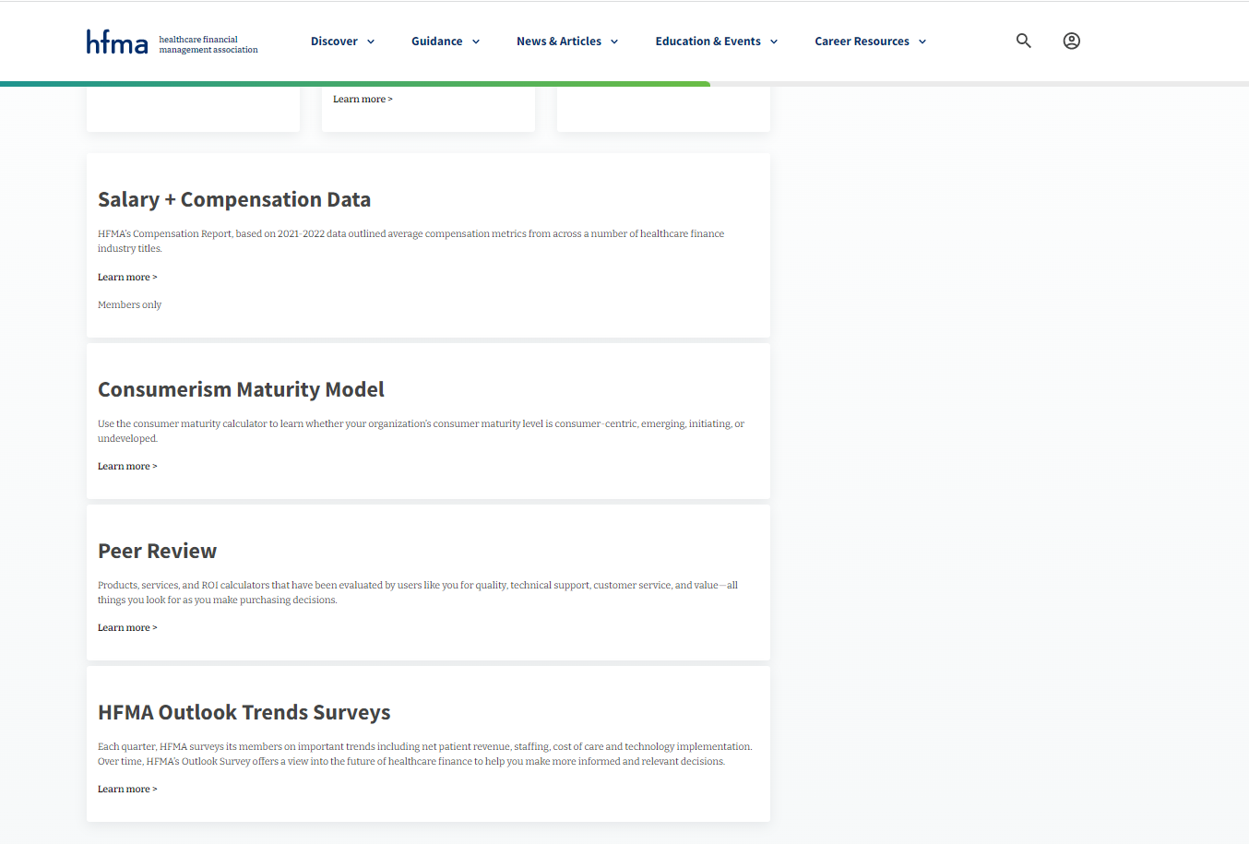
Data + Insights
Salary + Compensation Data
Consumerism Maturity Model
MAP Award Score Calculator
HFMA's Peer Review
Outlook Trend Surveys
+ more
Notes:
HFMA’s Compensation Report, based on 2021-2022 data outlined average compensation metrics from across a number of healthcare finance industry titles.
Use the consumer maturity calculator to learn whether your organization’s consumer maturity level is consumer-centric, emerging, initiating, or undeveloped.
benchmark your performance against previous MAP Award winners.
Products, services, and ROI calculators that have been evaluated by users like you for quality, technical support, customer service, and value—all things you look for as you make purchasing decisions.
Each quarter, HFMA surveys its members on important trends including net patient revenue, staffing, cost of care and technology implementation. Over time, HFMA’s Outlook Survey offers a view into the future of healthcare finance to help you make more informed and relevant decisions.

Slide 36

HFMA’s Podcast Series
Insights from leading experts on a range of topics in healthcare finance
hfma.org/podcast

Slide 37


Connect: Stay in Touch
Community
hfma.org
HFMA Daily
Social Media
Notes:
HFMA Daily: uses Artificial Intelligence to learn preferences over time and deliver targeted healthcare finance content.
hfma.org: updated regularly with the most news, feature articles and industry blogs.
HFMA Community: your place to network, crowdsource ideas, share expertise and solutions, ask questions of your colleagues and more.
HFMA social help channels keep you connected.

Slide 38
Get Involved

Slide 39
Get Involved!
Attend local and national educational events
Take advantage of networking opportunities
Write an article
Speak at an HFMA local or national event
Participate in national workgroups
Volunteer for your local HFMA chapter and pursue leadership opportunities
Contribute to the HFMA online community
Get certified
Refer your colleagues

Slide 40

Why Volunteer?
Volunteering for your professional association is a great way
to enhance your career, expand your connections and have fun!
Other reasons to volunteer include:

Slide 41
THANK YOU!

