Slide 1
Introduction to RCM Services
February 15,2024

Slide 2
Altera RCM Services
100% U.S.-based executive management
Concierge client management and support for RCM services & technology
Average team leader has 10+ years of professional billing and coding experience
Assigned functional area team members are experts in your specialty
Technology and financial support
Partnership includes a tailored scope of work
KPI reporting and industry comparisons
Software agnostic expertise
We align our incentives with results.
Providing technology-driven solutions that transform financial performance and patient experience
Notes:
RA = 400+ clients, 61 specialties, 600+ people
RH = ?
RPM = ?

Slide 3
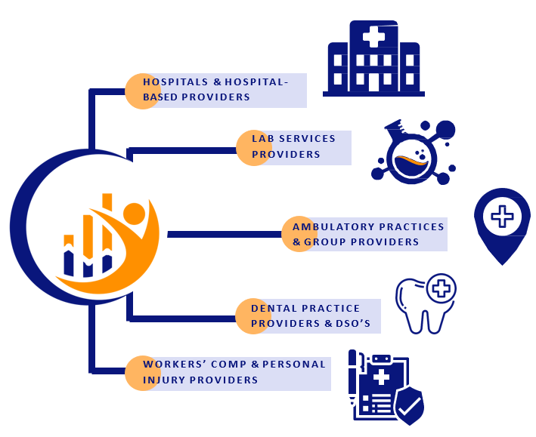
Altera RCM Services
Notes:
RA = 400+ clients, 61 specialties, 600+ people
RH = ?
RPM = ?

Slide 4
Opportunities
The quickest way to positively impact your revenue
Aging AR – AR Rundowns
Focused team that specializes in resolving aging claims
Tech-enabled service, patented process to resolve aging claims through payer appeals
Ambulatory RCM Services
Performance-based contracting – 3-7% collection improvement
Start with a portion of the portfolio and grow into more
Staff Augmentation
Staffing is a wide-spread, industry issue and RCM isn’t immune
Staff members can be deployed quickly to help clients fill gaps
Can be a short-term tactic & part of a longer-term RCM strategy
Hospital / Health System RCM Services
Performance-based contracting – 3-7% collection improvement
45-60 day payroll holiday
Inpatient RCM or Inpatient & Ambulatory RCM Services
Rebadging

Slide 5
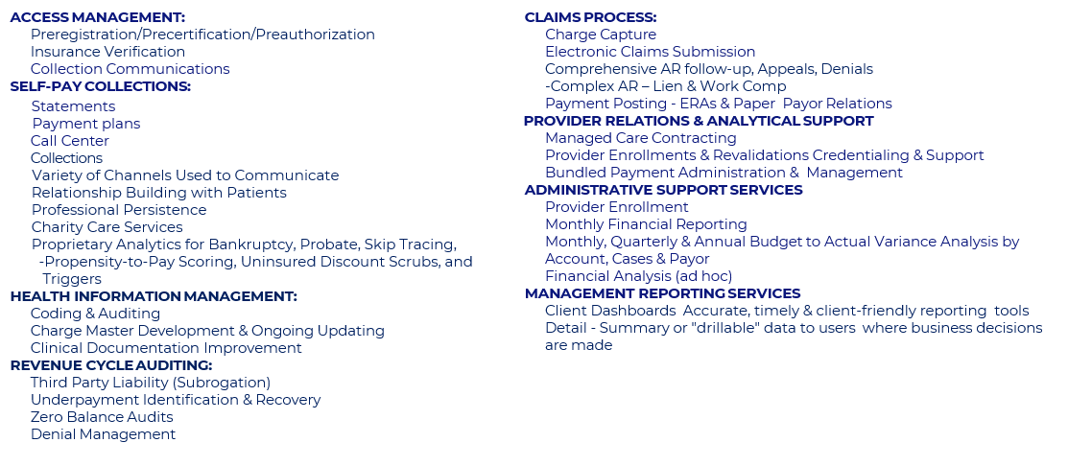
Altera RCM Services
End-to-End Services Tailored to the Practice’s Needs

Slide 6
Angie Coldiron
Director, RCM Services
Mcoldiron@harriscomputer.com
Mobile Phone: 469.744.8583

