Slide 1
HAF and HIP Redesign
HFMA February 2024

Slide 2
What are HAF and HIP?
Hospital Assessment Fee (HAF)
Healthy Indiana Plan 2.0 (HIP)
Program increases base Medicaid payments to all hospitals through add-on/supplement payments
Supplemental payment is calculated on every claim and paid directly on remit from Gainwell (FFS) and MCOs
HAF Fees are paid to State in two ways:
Direct withholds from FFS remits
Monthly payments to Gainwell (formerly DXC) in amounts from Myers & Stauffer letters
Medicaid Expansion plan approved in 2016
Covers over 750,000 Hoosiers
Hospital Payments are at same rate as Medicaid
Increases Medicaid Primary Care fee schedule to % of Medicare
HIP fees are paid to FSSA through monthly invoices

Slide 3
Historical HAF/HIP Fees

Slide 4
HAF vs HIP Fees: What They Pay For
HAF Fees Fund…
Hospital Reimbursement Enhancement (difference between base Medicaid fee schedule and “Medicare” for traditional & managed care population)
HIP Fees Fund…
Capitation Payments for All Medical Costs of Expansion Population at Medicare Rates (this includes hospitals but also physician, drugs, etc.)
State Administrative Costs for HIP (with limits)
Increases in Physician and Other Provider Rates to 75% of “Medicare” for Non-Expansion Medicaid
Leveraging Indiana’s Medicaid DSH Allotment
28.5% Share of the Total Goes to FSSA for the General Medicaid Budget
Hospital Presumptive Eligibility
Increases in Physician and Other Provider rates to 100% of “Medicare” for HIP Expansion Medicaid
Base Medicaid fee schedule has not been updated since 1991

Slide 5
Enhanced Payment Factors
2. *Combined factor from CMS mandated rate change mid-year
**Factor change runs 8/1 – 7/30, one month behind State Fiscal Year
Factors to remain largely the same for SFY 2024 with the exception of Rehab, which will increase to 3.2
3, OP 2.5 for state fiscal year
**Beginning in 2018 rate is effective through 7/31

Slide 6
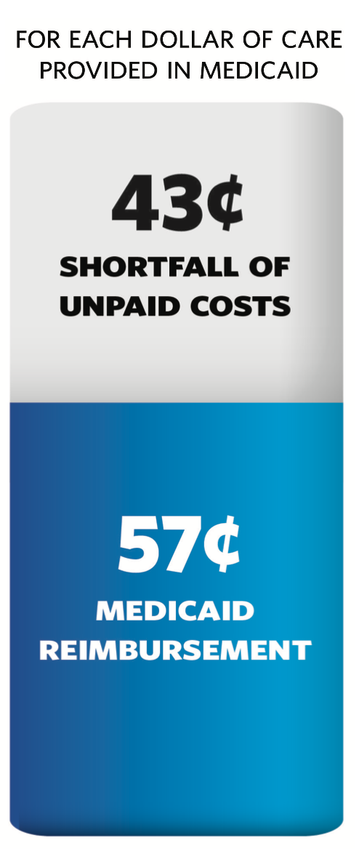
Indiana’s Medicaid Underpayment
Even with these additional payments, and because Indiana’s hospitals fund them, they still have tremendous Medicaid shortfalls
Indiana Medicaid covers only 57 cents for every dollar of hospitals’ cost to provide care under the program
Indiana’s low Medicaid reimbursement results in as much as $2.7 billion in unpaid statewide health care costs each year

Slide 7
National Environment – Maximum Payment Limits
Unlike FFS upper payment limit (UPL) which caps hospital payments at Medicare, recently approved directed payment programs can effectively increase payments up to the average commercial rate (ACR)
CMS has approved using average commercial rates as the basis in other states
ACR is defined separately for IP and OP
Little guidance from CMS exists on calculation of ACR
ACR definition will likely evolve quickly over the next few years

Slide 8
National Environment – Directed Payments
A recent analysis by the Medicaid & CHIP Payment and Access Commission found that:
Between July 2021 - February 2023, CMS approved 249 distinct directed payment arrangements in 40 states.
Most of these directed payments were uniform rate increases.
The stated goal of most directed payment arrangements (60 percent) was improving access to care.
Directed payment arrangements approved as of February 1, 2023, are projected to spend a total of $69.3 billion a year
This is nearly three times the $25.7 billion in projected spending identified in arrangements approved as of December 2020.
Directed Payments in Medicaid Managed Care. (June 2023). MACPAC Issue Brief. Retrieved from: https://www.macpac.gov/wp-content/uploads/2023/06/Directed-Payments-in-Medicaid-Managed-Care.pdf

Slide 9
Current Opportunity for Indiana: HAF Redesign
Updating the Hospital Assessment Fee (HAF) would allow hospitals to be assessed up to the federally allowable maximum, thereby increasing Medicaid reimbursement without an impact to the State’s General Fund
Federal regulations allow provider assessments up to 6% of net patient revenues of taxed providers; currently, Indiana is at 6% of net inpatient revenue and approximately 4% of net outpatient revenue
Kentucky, Ohio, and Illinois already have State Directed Payment Programs, and Michigan is moving ahead with a plan; Without a redesign, Indiana is leaving its federal tax dollars on the table

Slide 10
Current Opportunity for Indiana: HAF Redesign
Potential additional fee $335 Million (Limited to 6% of statewide NPR)
Potential additional net benefit $580 Million
Assumes no change in State’s 28.5% admin fee
Potential net benefit $1 Billion if admin fee is reduced by $100 Million
For every dollar reduction in the State’s admin fee, hospital reimbursement could be increased by three dollars
The increase in fees could provide a statewide increase in hospital reimbursement of between 20% and 40%, depending upon State’s admin fee

Slide 11
Goals for Indiana HAF Redesign
Make program sustainable over long-term
Increase transparency
Increase reimbursement
Reduce uncertainty (e.g., DSH eligibility)
Safeguard against Federal changes
CMS scrutiny of hospital assistance programs (HAP)
Reduction of DSH (e.g., cuts and Section 203 impact)
Establish our own quality goals
Infuse quality into the HAF program
Allow for accurate, timely reconciliation of hospital fees under the HAF program
Minimize net contributors/lift all boats while ensuring the HAF program meets CMS’ statistical tests

Slide 12
Timeline
Initial activities
Finalize legislative language
Determine quality metrics
Secondary activities
Submit Waiver, SPA and Preprint to CMS
Later activities
Respond to CMS inquiries on submitted documents
Develop administrative process to guide/oversee program

Slide 13
NASHP Hospital Financial Profile
National Academy of State Health (NASHP) is an organization heavily funded by Arnold Ventures, an entity with a history of funding misleading, one-sided reports on hospital costs
The NASHP financial profile uses hospital cost reports, which systematically underrepresent true hospital costs and do not include certain costs altogether, such as Medicare bad debts and medical education costs.
IHA has reviewed several hospitals and found the NASHP data to significantly misrepresent hospital profit margins.
This data will likely be used by various groups to attempt to establish hospital reimbursement caps
The link to the NASHP Hospital Cost Tool is: https://tool.nashp.org/ you can search by state and hospital to find your facility.
Very important to review the NASHP “analysis” for your hospital and notify IHA of incorrect margins

Slide 14
CMS Medicare Advantage and Two-Midnight FAQ
CMS released FAQ’s on February 6th
https://www.aha.org/system/files/media/file/2024/02/faqs-related-to-coverage-criteria-and-utilization-management-requirements-in-cms-final-rule-cms-4201-f.pdf
Covers multiple topics including utilization review and management, use of AI and others
Look for information on what your insurers are saying about the FAQ and any policies/statements already released or sent out

Slide 15
Other FSSA Items
MTLSS implementation 7/1/2024
HIP Equalization 1/1/2024
Physician Services
Laboratory Services
School Corporation Services
DME (Durable Medical Equipment)
Dental (Under Development)
Non-Emergency Medical Transportation (Under Development)

Slide 16
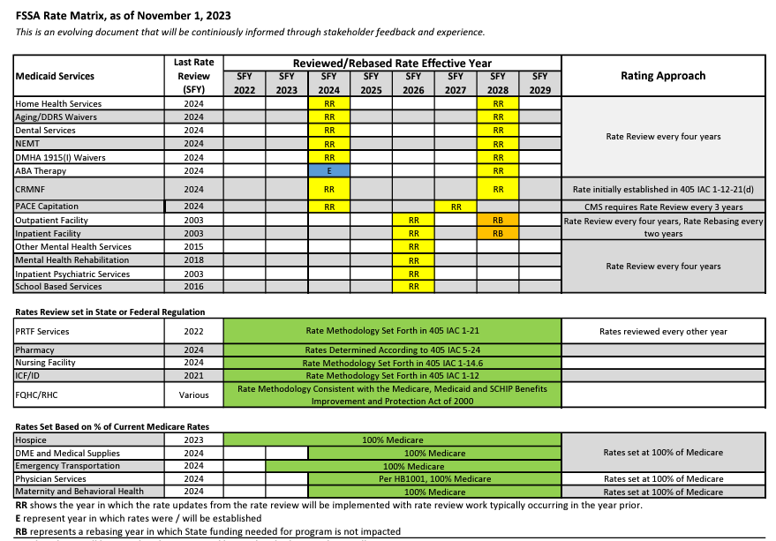
Other FSSA Items
Rate Matrix Project
Last Hospital Update 8/1/20 for rebase only
SFY 2026 is next Hospital Rate Review since 2003
https://www.in.gov/fssa/rate-matrix-for-medicaid-services/

Slide 17
DSH/HAF Timeline
SFY 2022 Agreed Upon Procedures – in process now
Payment estimated May/June 2024
SFY 2021 DSH Audit – Mail to providers in May/June 2024
Due to CMS December 2024
SFY 2024/2025 DSH Eligibility Surveys – Distribute in April/May 2024
Results in February 2025
SFY 2024 Municipal DSH Payment – Paid July 2024
SFY 2023 Agreed Upon Procedures – begin September/October 2024
Payment estimated in March/April 2025
SFY 2025 HAF Fees/Letters/Factors – Implementation 8/1/24

